Slide 1
Module 02 : Configure and Manage OneDrive

Slide 2
Module agenda
Overview of OneDrive in Microsoft 365
Deploy OneDrive
Manage OneDrive

Slide 3
Lesson 1: Overview of OneDrive in Microsoft 365

Slide 4
Lesson Introduction
Overview of OneDrive in Microsoft 365
OneDrive service description
OneDrive deployment and management options
OneDrive Admin Center

Slide 5
Overview of OneDrive in Microsoft 365
Access files from all your devices
Share inside or outside your organization
Collaborate with deep Microsoft Office integration
Quickly find files that matter most
Protect your files with enterprise-grade security

Slide 6
OneDrive service description
Recycle bin
eDiscovery
Government cloud
Known Folder Move
Modern attachments
OneDrive Files Restore
Auditing and reporting
Data loss prevention (DLP)
OneDrive Files On-Demand
Office 365 Customer Lockbox
Customer-controlled encryption keys
OneDrive Multi-Geo storage locations
Encryption of data in transit and at rest
Hybrid integration with SharePoint Server
Seamlessly connecting files to conversations
Intelligent discover with OneDrive Discover view
OneDrive is available in Office 365 U.S. Government plans.
Real-time team collaboration: Coauthoring in full versions of Microsoft Word, Excel, and PowerPoint

Slide 7
OneDrive deployment and management options
Size of organization | Deployment tools used | Management
Small business | Local installation | OneDrive admin center
Medium-sized business | Scripted installation or Microsoft Intune mobile device management (MDM) | Office 365 with MDM, OneDrive admin center, Intune mobile application management (MAM) or MDM
Enterprise | System Center Configuration Manager with Intune or Windows Autopilot | System Center Configuration Manger, Group Policy objects (GPOs), etc.

Slide 8
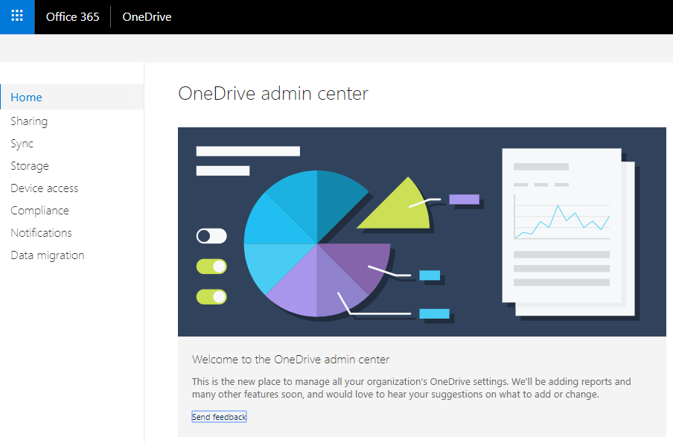
OneDrive Admin Center
Sharing
Sync
Storage
Device Access
Compliance
Notifications

Slide 9
Lesson 2: Deploy OneDrive

Slide 10
Lesson Introduction
Prepare OneDrive deployment
Deployment OneDrive
Use silent account configuration
Transition from the previous sync app (Groove.exe)

Slide 11
Prepare OneDrive deployment
Client and app requirements
Network utilization
Estimate the network bandwidth
Control sync throughput
Multi-Geo
Hybrid

Slide 12

Deploy OneDrive
Install OneDrive apps and sync apps manually
Install OneDrive on Windows devices by using scripting methods
Deploy and configure OneDrive through Windows AutoPilot
Deploy OneDrive by using Intune
Deploy OneDrive by using Microsoft Endpoint Configuration Manager

Slide 13
Use silent account configuration
Organizations can silently configure user accounts when deploying the new OneDrive sync app (OneDrive.exe) to managed Windows computers in their enterprise.
Prerequisites
Enable silent configuration
Domain group policy
Intune and a Microsoft PowerShell script
Using Group Policy
Enable silent account configuration
Maximum OneDrive size for downloading all files automatically (optional)
Set the default location for the OneDrive folder (optional)
Using a script

Slide 14
Transition from the previous sync app (Groove.exe)
If you already have the OneDrive client installed on Windows devices, start by determining the version or versions of OneDrive in your environment. Depending on your findings, you may need to change your deployment process to accommodate the current version.
Find out version
Check the taskbar
Check File Explorer
Transition from the previous OneDrive for Business sync app
Prerequisites
Configure takeover
Block the previous sync app from syncing

Slide 15
Lesson 3: Manage OneDrive

Slide 16
Lesson Introduction
Manage OneDrive
Use Group Policy to control OneDrive sync settings
Set the default storage space
Change user storage
Configure data retention
Manage Sync client updates

Slide 17
Manage OneDrive (1/2)
Category | Tasks | Technology or method
OneDrive organization-wide settings | Manage settings such as storage limits and sharing capabilities. | OneDrive admin center Microsoft PowerShell
App updates | Update the OneDrive sync client or mobile apps | MDM (for example, Intune) System Center Configuration Manager Group Policy OneDrive admin center Manually
Sync client settings | Configure the sync client update ring, DLP policies, and other device or app restrictions. | MDM (for example, Intune) System Center Configuration Manager Group Policy Manually

Slide 18
Manage OneDrive (2/2)
OneDrive admin center
Mobile device management (MDM)
Microsoft Endpoint Configuration Manager

Slide 19
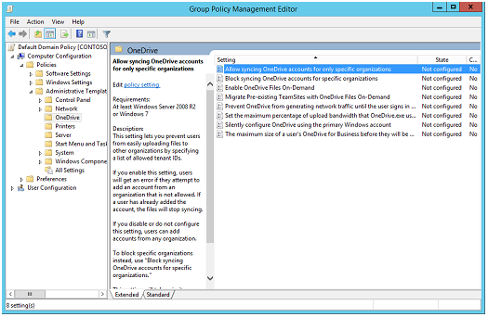
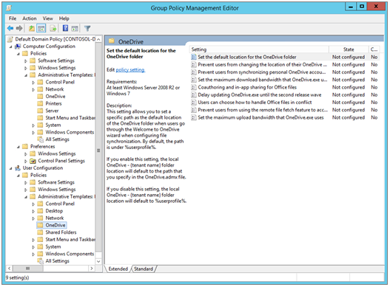
Use Group Policy to control OneDrive sync settings
Computer Configuration policies
Computer Configuration\Policies\Administrative Templates\OneDrive.
User Configuration policies
User Configuration\Policies\Administrative Templates\OneDrive.
Use Group Policy to manage OneDrive settings for domain-joined machines

Slide 20
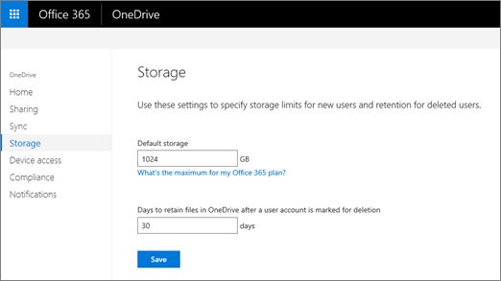
Set the default storage space
The default storage space for each user's OneDrive user is 1 TB. Depending on your Microsoft 365 plan, you can increase the storage up to 5 TB.

Slide 21
Change user storage
Change the storage space for a specific user's OneDrive
Set-SPOSite -Identity <user's OneDrive URL> -StorageQuota <quota>
Check the storage space for a specific user's OneDrive
$r=Get-SPOSite -Identity <user's OneDrive URL> -Detailed
$r.StorageQuotaType

Slide 22
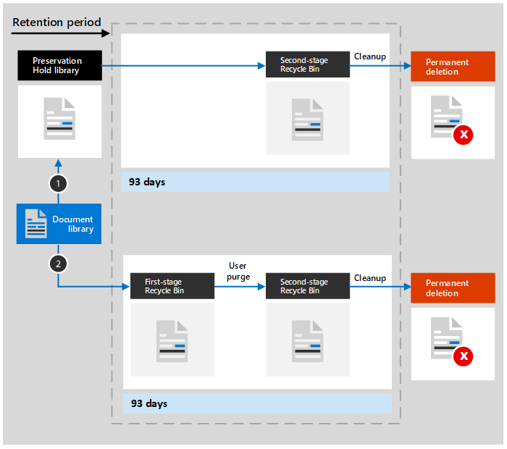
Configure data retention (1/2)
Retention policies in Microsoft 365
A retention policy is applied at the level of a site (previously called “site collection”) . When you include a SharePoint site or OneDrive account in a retention policy, a Preservation Hold library is created, if one doesn't already exist. Most users can't view the Preservation Hold library because it's visible only to site administrators.
If the content is modified or deleted
If the content is not modified or deleted

Slide 23
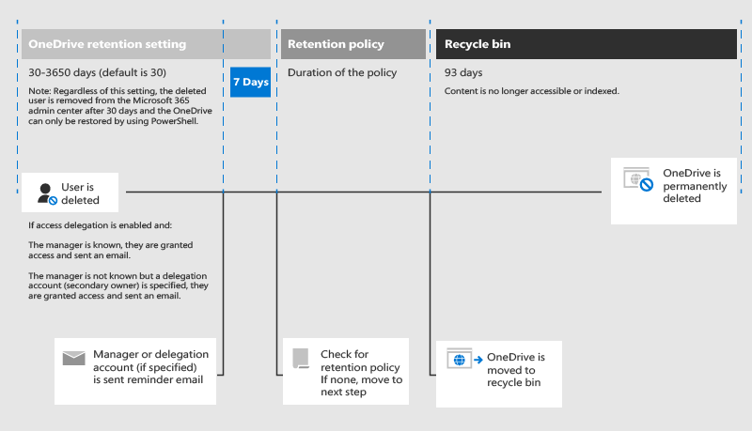
Configure data retention (2/2)
OneDrive retention days in OneDrive admin center

Slide 24
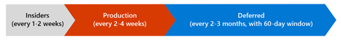
Manage Sync client updates
Update process
After Microsoft validate updates through rings within Microsoft, Microsoft releases them through multiple rings.
Insiders ring
Production ring
Deferred ring
How the sync app checks for and applies updates
Checks for available updates every 24 hours when it's running.
Deploying updates in the Deferred ring
Execute <pathToExecutable>\OneDriveSetup.exe /update /restart

Slide 25
Lab: Manage OneDrive

Slide 26
Lab Exercises
Exercise 1: Manage OneDrive settings

