Slide 1
Module 03 : Sharing and Security in SharePoint and OneDrive

Slide 2
Module agenda
Manage SharePoint site permissions
Manage sharing in SharePoint and OneDrive
Manage security in SharePoint and OneDrive

Slide 3
Lesson 1: Manage SharePoint site permissions

Slide 4
Lesson Introduction
Overview of SharePoint permissions
SharePoint permission levels
SharePoint groups
Create a permission level
Create a SharePoint group
Manage SharePoint site permissions

Slide 5
Overview of SharePoint permissions (1/2)
SharePoint permissions have been managed through a set of permissions groups within a site.
The default SharePoint groups are created automatically when you create a site.
The default groups use SharePoint's default permission levels to grant users rights and access.
SharePoint Group | Permission level
Owners | Full Control Contains all available SharePoint permissions.
Members | Edit Add, edit, and delete lists; view, add, update, and delete list items and documents.
Visitors | Read View pages and items in existing lists and document libraries and download documents.

Slide 6
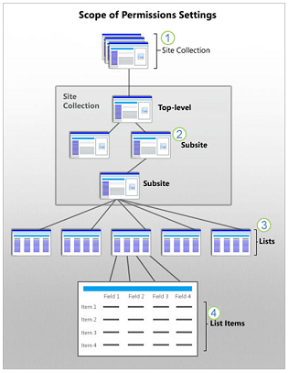
Overview of SharePoint permissions (2/2)
Permissions inheritance
Permissions inheritance means that the permission settings of an element are passed on to the children of that element. By default, SharePoint sites inherit permissions from a parent site. This means that when you assign a user to the Members group, the user's permissions automatically cascade down through all the sites, lists, libraries, folders and items that inherit the permission level.

Slide 7
SharePoint permission levels (1/3)
Permission Level | Description
Full Control | Contains all available SharePoint permissions. By default, this permission level is assigned to the Owners group. It can't be customized or deleted.
Design | Create lists and document libraries, edit pages and apply themes, borders, and style sheets on the site. There is no SharePoint group that is assigned this permission level automatically.
Edit | Add, edit, and delete lists; view, add, update, and delete list items and documents. By default, this permission level is assigned to the Members group.
Contribute | View, add, update, and delete list items and documents.
Read | View pages and items in existing lists and document libraries and download documents.

Slide 8
SharePoint permission levels (2/3)
Permission Level | Description
Limited Access | Enables a user or group to browse to a site page or library to access a specific content item when they do not have permissions to open or edit any other items in the site or library. This level is automatically assigned by SharePoint when you provide access to one specific item. You cannot assign Limited Access permissions directly to a user or group yourself. Instead, when you assign edit or open permissions to the single item, SharePoint automatically assigns Limited Access to other required locations, such as the site or library in which the single item is located.
Approve | Edit and approve pages, list items, and documents. By default, the Approvers group has this permission.
Manage Hierarchy | Create sites and edit pages, list items, and documents. By default, this permission level is assigned to the Hierarchy Managers group.

Slide 9
SharePoint permission levels (3/3)
Permission Level | Description
Restricted Read | View pages and documents, but not historical versions or user permissions.
View Only | View pages, items, and documents. Any document that has a server-side file handler can be viewed in the browser but not downloaded. File types that do not have a server-side file handler (cannot be opened in the browser), such as video files, .pdf files, and .png files, can still be downloaded.
Best practices for permission levels
Don't edit default permission levels
Don't delete default permission levels
Assign permission levels to SharePoint groups

Slide 10
SharePoint groups
SharePoint groups enable you to control access for sets of users instead of individual users. They can also hold Azure Active Directory security groups (created in Microsoft 365 or Azure AD) or can be a combination of individual users and security groups.
Special SharePoint Groups
Everyone except external users is a special group that doesn't appear in the Microsoft 365 admin center. All users added to your organization automatically become members of “Everyone except external users”.
Company Administrator acts like a group but is a role in Azure AD. This group contains all users who are assigned the global admin role. The root site for your organization is created with “Company Administrator” as the primary admin.

Slide 11
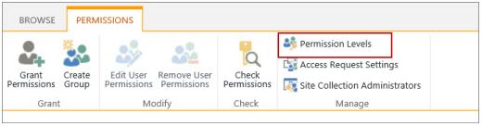
Create a permission level
The easiest way to work with permissions is to use the default groups and permissions levels provided, which cover most common scenarios. But, if you need to, you can set more fine-grained permissions beyond the default levels.
You create and make changes to permission levels on the Permissions Levels page.

Slide 12
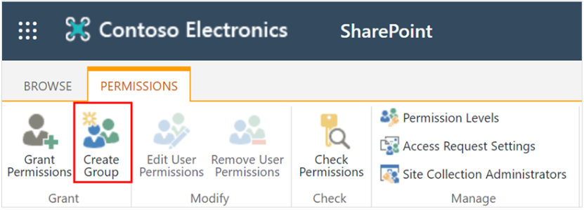
Create a SharePoint group
While SharePoint allows considerable customization of site permissions, we highly recommend using the built-in SharePoint groups for communication site permissions and managing team site permissions through the associated Microsoft 365 group. But, if you need to, rather than assign permissions one person at a time, you can use groups to conveniently assign the same permission level to many people at once.

Slide 13
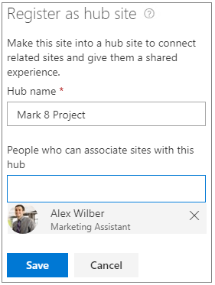
Manage SharePoint site permissions
An effective permissions strategy will enhance the manageability and performance of your site, ensure compliance with your organization's data governance policies, and minimize the cost of maintenance for you and your organization.
Team site permissions (group-connected)
Communication site permissions
Hub site permissions

Slide 14
Lesson 2: Manage sharing in SharePoint and OneDrive

Slide 15
Lesson Introduction
Overview of sharing
Overview of external sharing
Manage external sharing
Manage sharing links

Slide 16
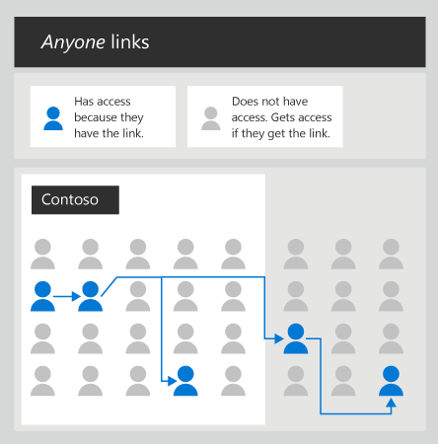
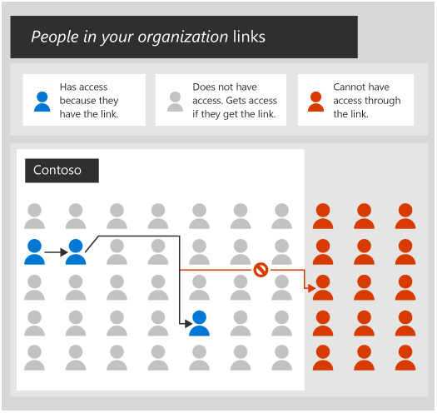
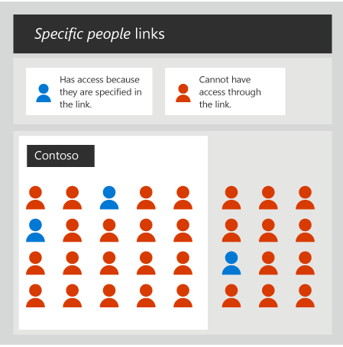
Overview of sharing
The sharing settings for file collaboration environment :
Disallow sharing with people outside your organization.
Require people outside your organization to authenticate.
Restrict sharing to specified domains.

Slide 17
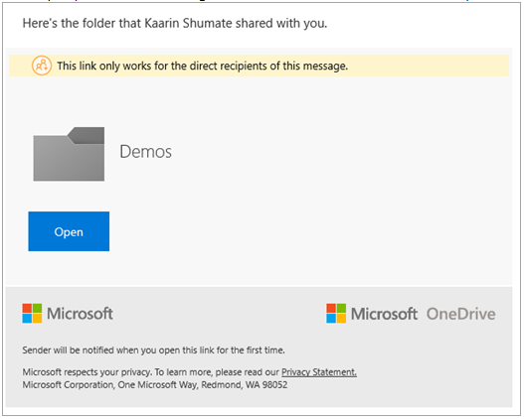
Overview of external sharing (1/4)
The external sharing features of Microsoft SharePoint let users in your organization share content with people outside the organization (such as partners, vendors, clients, or customers).
When users share with people outside the organization, an invitation is sent to the person in email, which contains a link to the shared item.

Slide 18
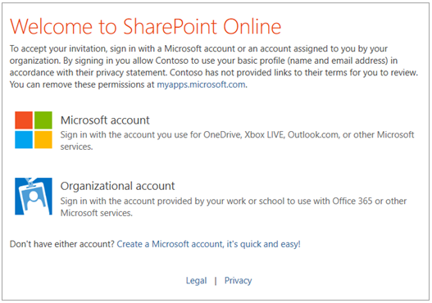
Overview of external sharing (2/4)
Recipients who sign in
When users share sites, recipients will be prompted to sign in with:
A Microsoft account
A work or school account in Azure AD from another organization
When users share files and folders, recipients will also be prompted to sign in if they have:
A Microsoft account

Slide 19
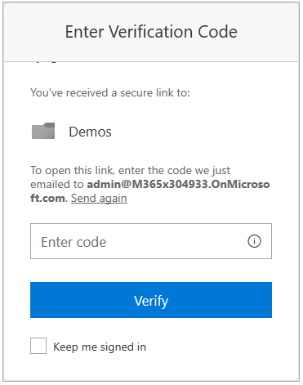
Overview of external sharing (3/4)
Recipients who provide a verification code
When users share files or folders, recipients will be asked to enter a verification code if they have:
A work or school account in Azure AD from another organization
An email address that isn't a Microsoft account or a work or school account in Azure AD

Slide 20
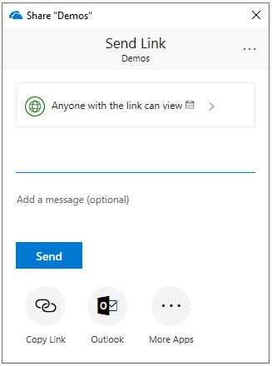
Overview of external sharing (4/4)
Recipients who don’t need to authenticate
Anyone with the link (inside or outside your organization) can access files and folders without having to sign in or provide a code.
These links can be freely passed around and are valid until the link is deleted or expires (if you've set an expiration date).
You cannot verify the identity of the people using these links, but their IP address is recorded in audit logs when they access or edit shared content.

Slide 21
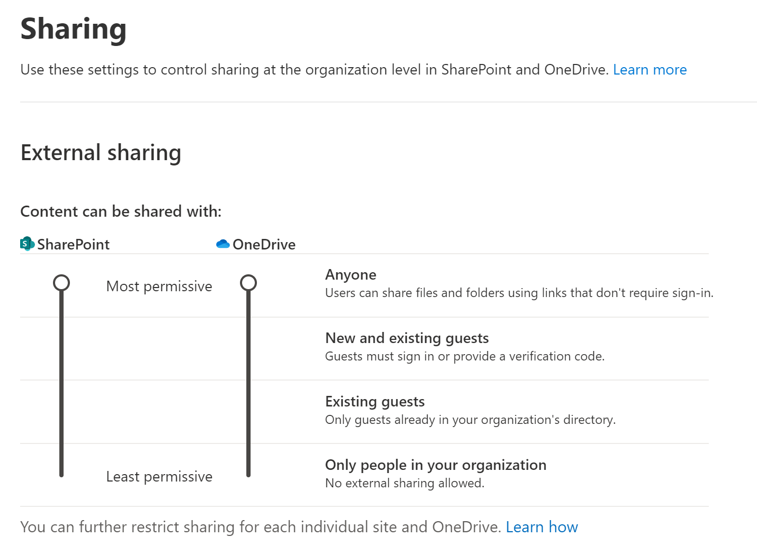
Manage external sharing
Manage external sharing at the organization level
Azure organizational relationships settings
SharePoint organization level sharing settings
Manage external sharing at the site level
If you're sharing files and folders that are in a SharePoint site, you also need to check the site-level sharing settings for that site.
Users can stop the sharing by their own.

Slide 22
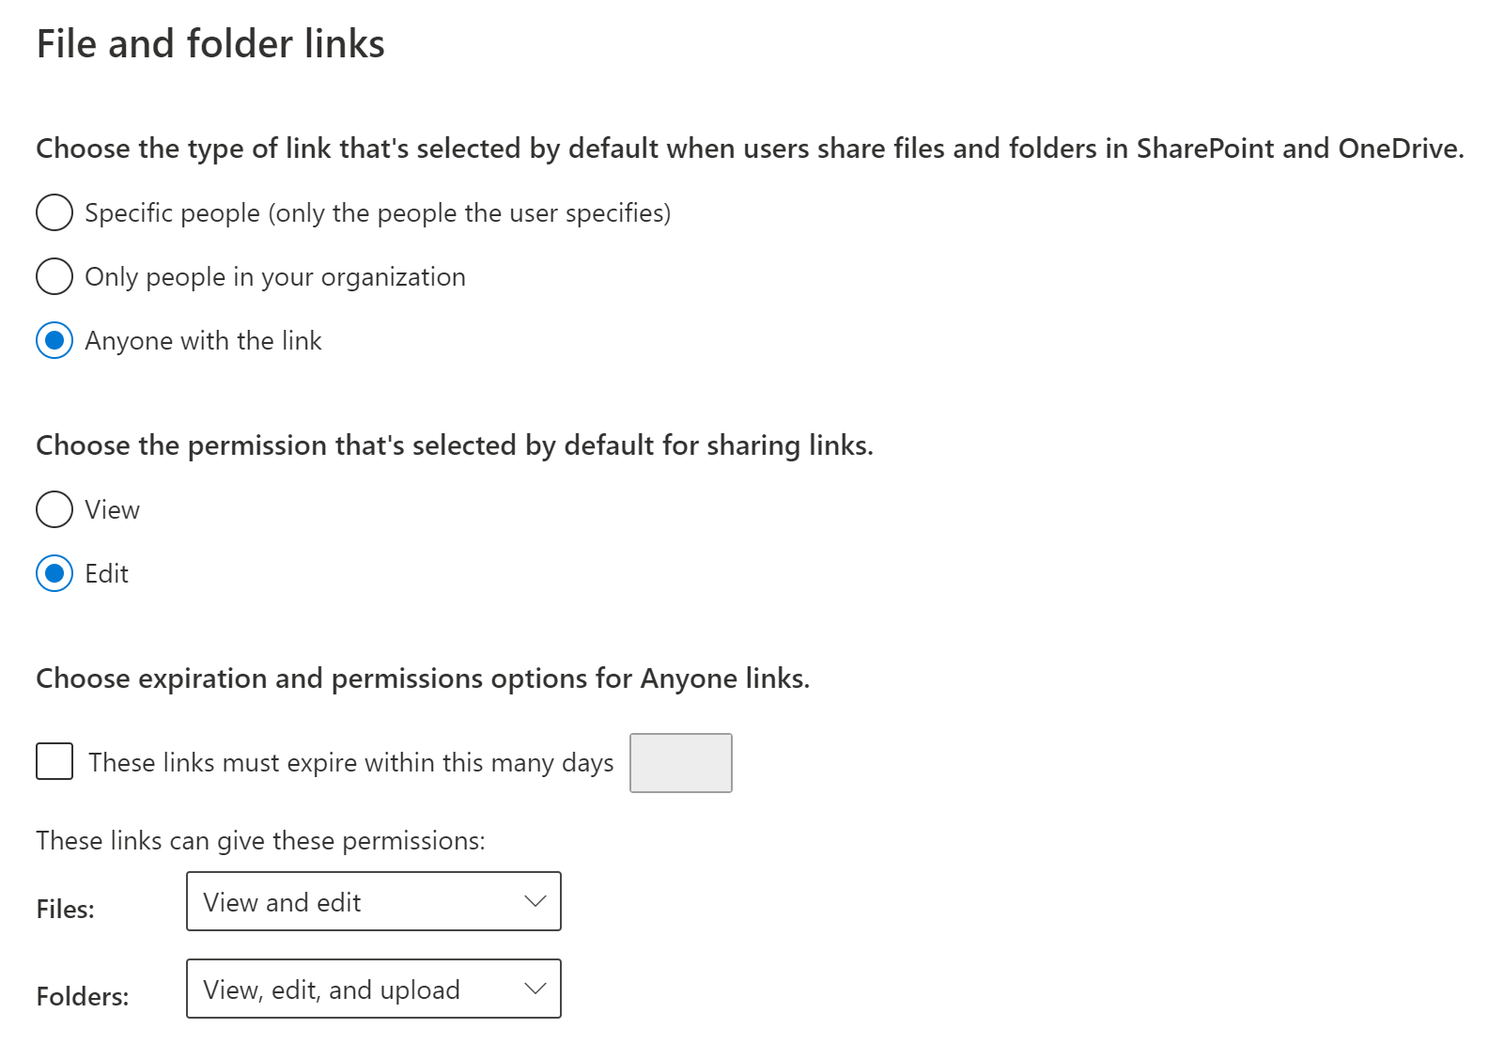
Manage sharing links
The default file and folder link
Specific people
Only people in your organization
Anyone with the link
Manage sharing links at the organization level
Manage sharing links at the site level

Slide 23
Lesson 3: Manage security in SharePoint and OneDrive

Slide 24
Lesson Introduction
Overview of data security
Multi-Geo Capabilities
Control access from unmanaged devices
Control access with idle session sign-out
Control access based on network location
Control access to mobile app features
Manage sync security
Monitor usage and activity reports

Slide 25
Overview of data security
A big part of a successful collaboration solution is making sure your organization's data remains secure. Microsoft 365 provides a variety of features to help you keep your data secure while enabling a seamless collaboration experience for your users.
Control sharing
Classify and protect information
DLP policies
Sensitivity labels
Manage access
Protect against threats
Monitor activity

Slide 26
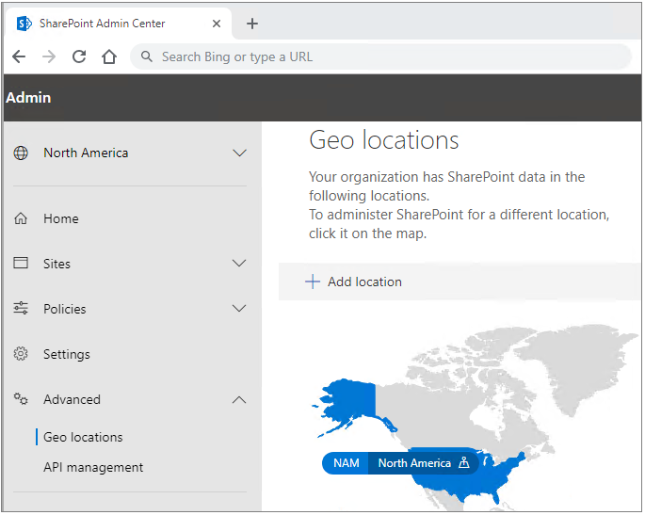
Multi-Geo Capabilities
Multi-Geo capabilities in OneDrive and SharePoint in Microsoft 365 enables control of the country or region where shared resources like SharePoint team sites and Microsoft 365 Group mailboxes are stored at rest.
Setting up and managing your multi-geo environment is done through the SharePoint admin center. Some actions, such as moving a SharePoint site, or a OneDrive site require Microsoft PowerShell.

Slide 27
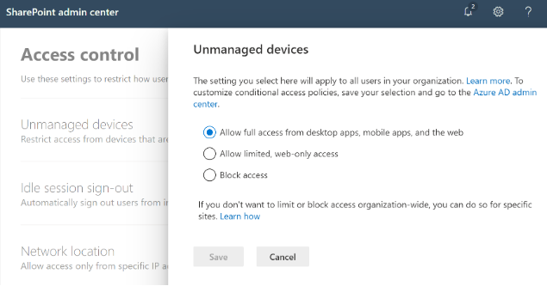
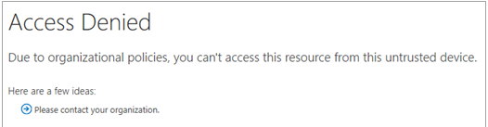

Control access from unmanaged devices
As a SharePoint or global admin in Microsoft 365, you can block or limit access to SharePoint and OneDrive content from unmanaged devices (those not hybrid AD joined or compliant in Intune).
Block access
Limiting access

Slide 28
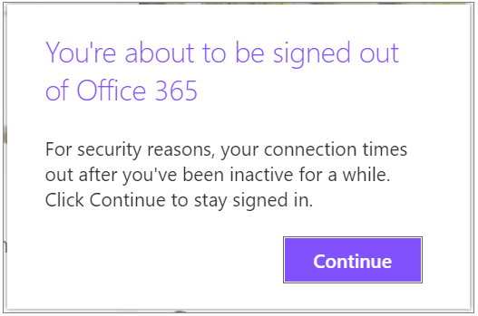
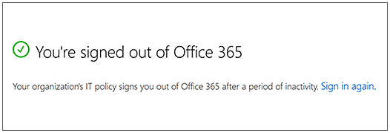
Control access with idle session sign-out (1/2)
When a user is inactive in SharePoint and OneDrive for a period of time you specify, the following message appears:
If users don't select Continue, they are automatically signed out, and the following message appears.

Slide 29
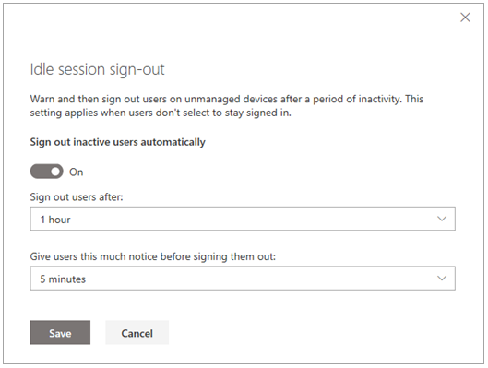
Control access with idle session sign-out (2/2)
Specify idle session sign-out settings
From the SharePoint admin center
From PowerShell
Set-SPOBrowserIdleSignOut
-Enabled $true
-WarnAfter (New-TimeSpan -Seconds 2700)
-SignOutAfter (New-TimeSpan -Seconds 3600)

Slide 30
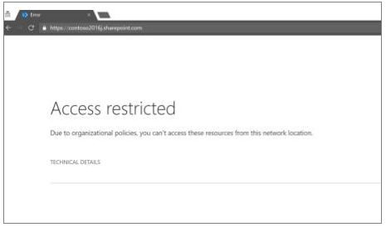
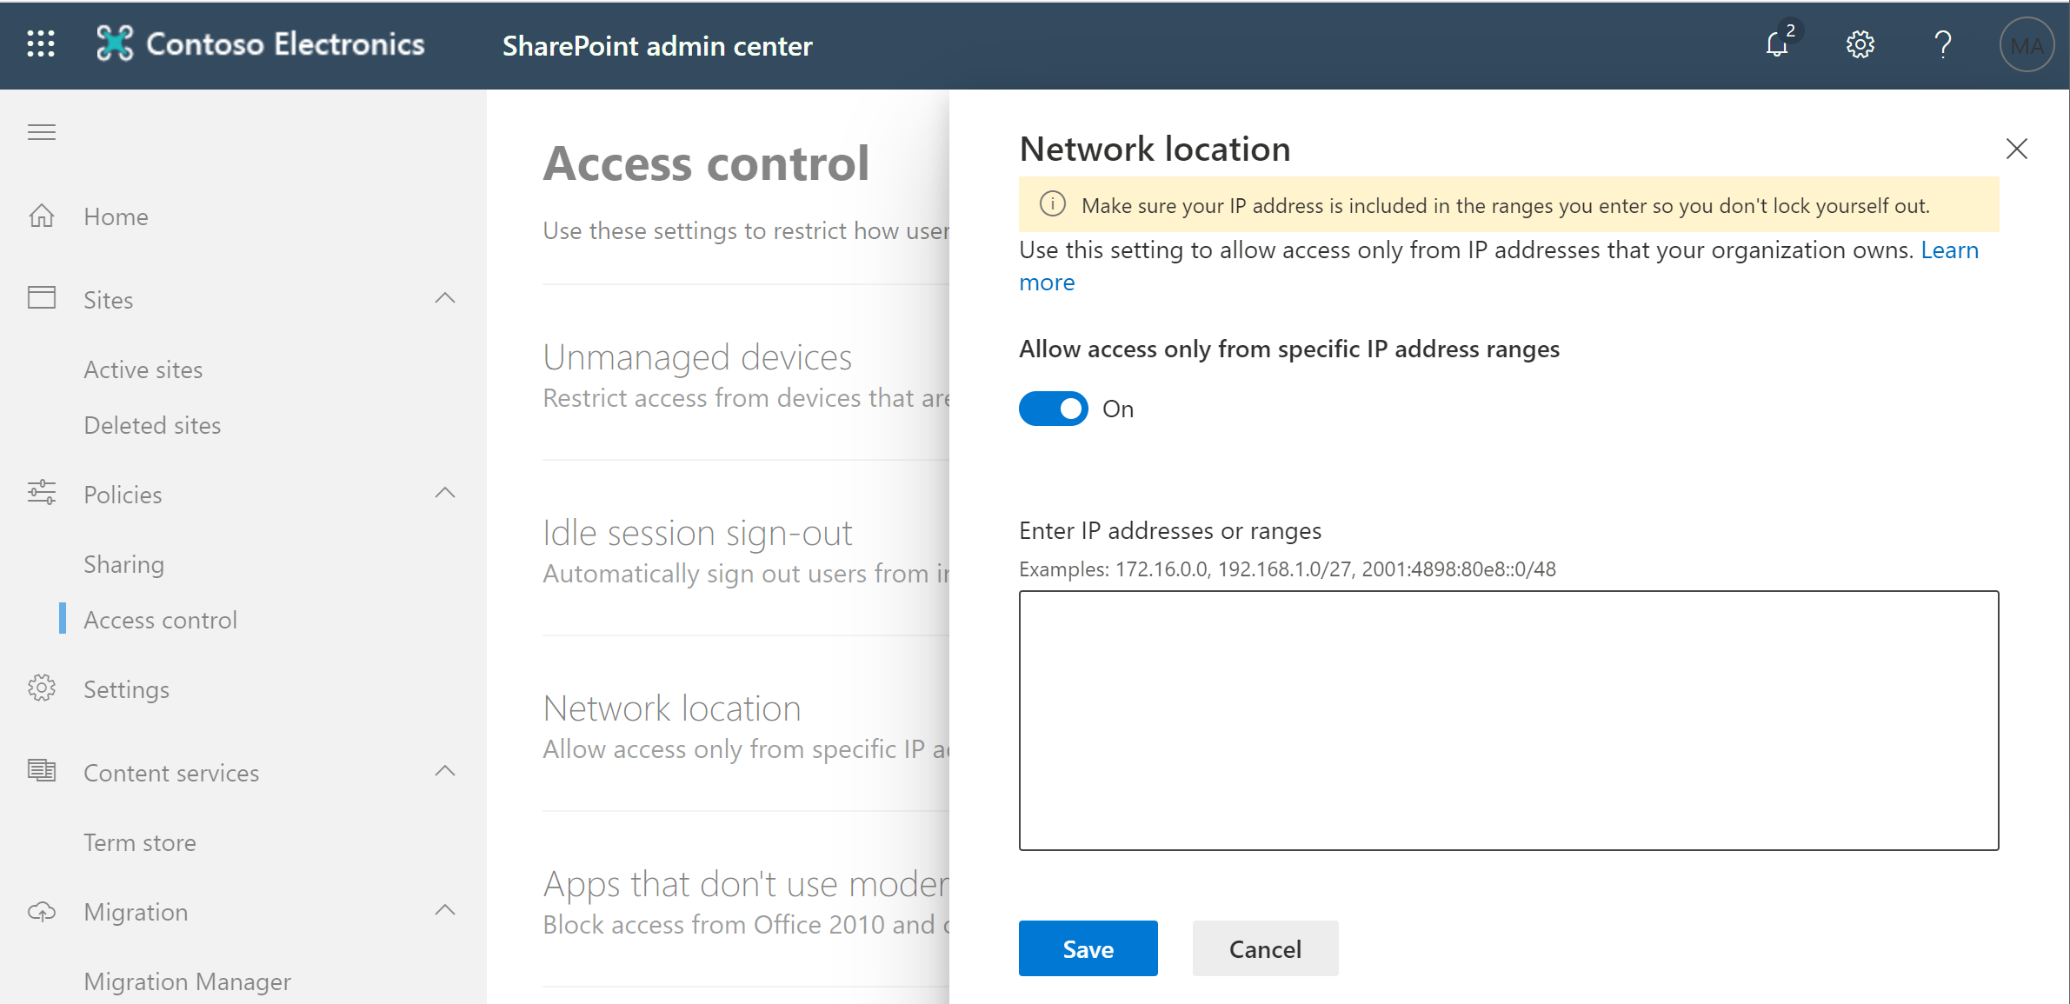
Control access based on network location
As an IT admin, you can control access to SharePoint and OneDrive resources in Microsoft 365 based on defined network locations that you trust.

Slide 31
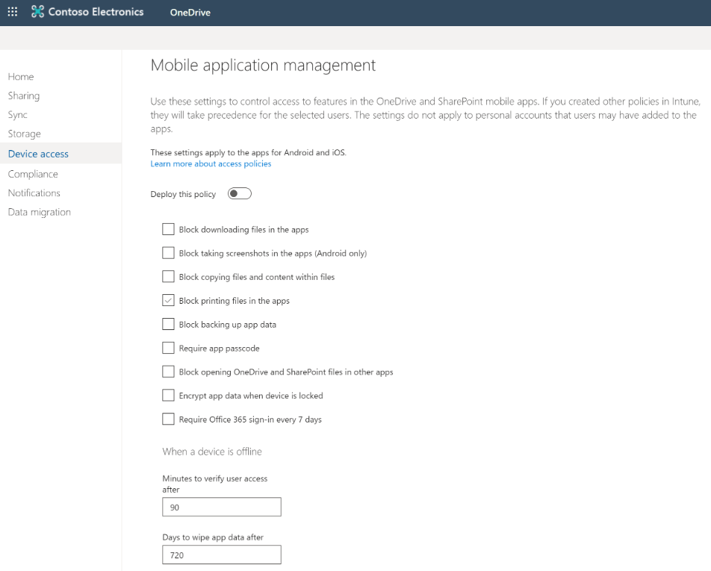
Control access to mobile app features
If your organization has Microsoft Intune or Enterprise Mobility + Security, you can use the OneDrive admin center to create a global policy that manages the OneDrive and SharePoint mobile apps for Android and iOS.

Slide 32
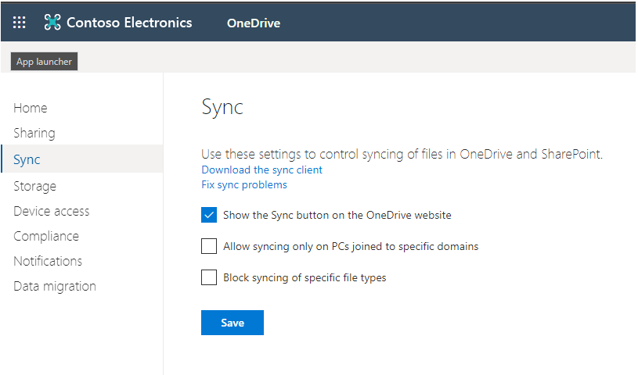
Manage sync security
Prevent installation
Allow syncing only on specific domains
Block file types

Slide 33
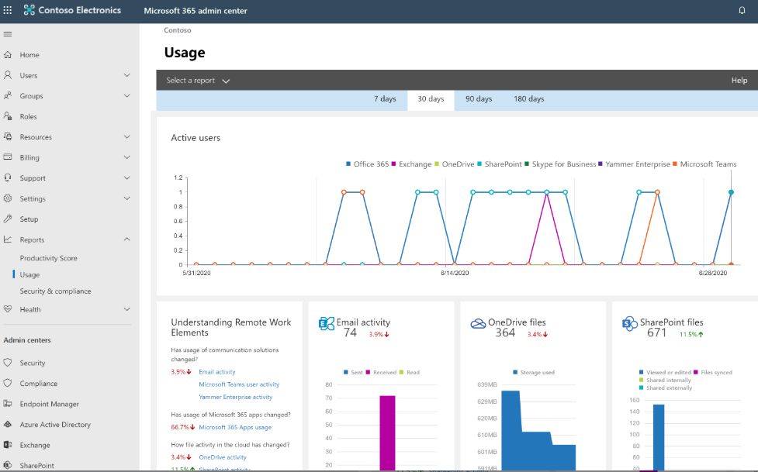
Monitor usage and activity reports (1/2)
Microsoft 365 usage analytics provide you with a better view of how your organization is adopting the various services within Microsoft 365.
As a SharePoint admin, you can drill in to get more granular insight about the activities specific to each product.

Slide 34
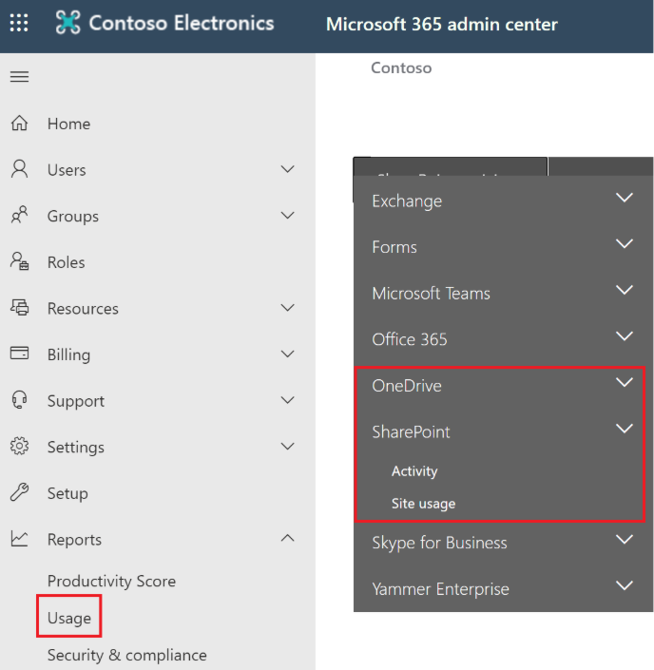
Monitor usage and activity reports (2/2)
View reports
Microsoft 365 usage analytics is a template app that gives you access to a pre-built dashboard that provides a cross-product view of the last 7 days, 30 days, 90 days, and 180 days and contains several pre-built reports.

Slide 35
Lab: Manage sharing

Slide 36
Lab Exercises
Exercise 1: Enable external sharing
Exercise 2: Manage sharing for a site

