Slide 1
Module 04 : Manage User Profiles and Apps

Slide 2
Module agenda
Manage User Profiles
Manage apps

Slide 3
Lesson 1: Manage User Profiles

Slide 4
Lesson Introduction
Overview of user profiles
Add and edit user profile properties
Add and remove admins for a user´s OneDrive
Manage Audiences

Slide 5
Overview of user profiles
A User Profile is the collection of user properties that describe a single user. Each property includes policies and settings associated with the user. Most organizations don't need to change any user profile settings in the SharePoint admin center.
For the organizations that do need to work with user profile settings, here are the most common tasks:
Add and edit user profile properties
Add and remove admins for a user's OneDrive
Manage audiences

Slide 6
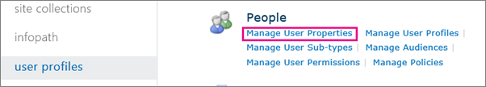
Add and edit user profile properties
Add a property for a user profile
Edit or delete a property you added
Synchronize custom properties

Slide 7
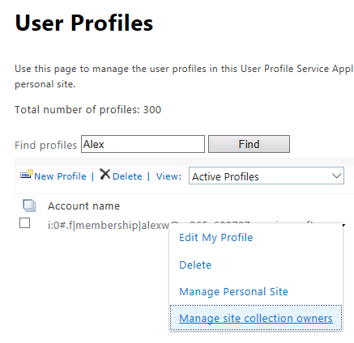
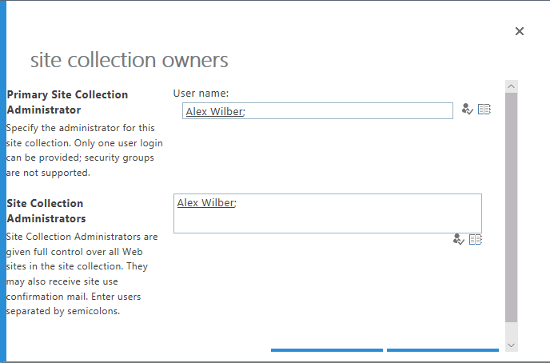
Add and remove admins for a user´s OneDrive
Transfer ownership of a OneDrive to a different user

Slide 8
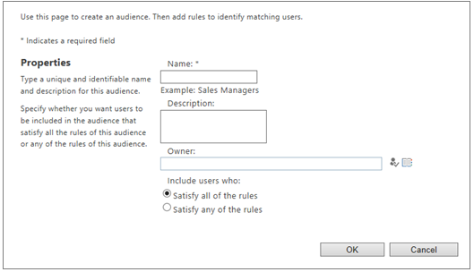
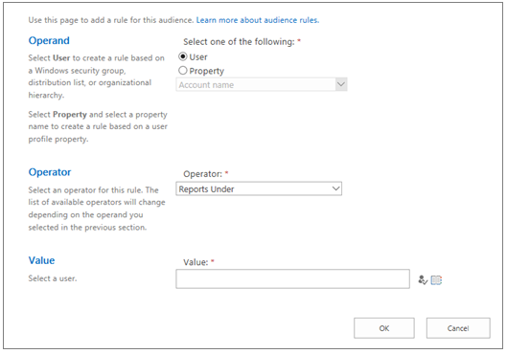
Manage Audiences
In Microsoft SharePoint, an audience is a group of users that share a common goal, feature, or other attribute.
Only sites that use classic templates can be customized based on audience.

Slide 9
Lesson 2: Manage apps

Slide 10
Lesson Introduction
Overview of customizing SharePoint
Create an App Catalog site
Add custom apps to the App Catalog site
Configure SharePoint Store settings
Manage app licenses
Add an app to a site
Monitor apps
Remove apps

Slide 11
Overview of customizing SharePoint
Category | Legacy | Modern
Branding | Master pages, page layouts, and themes | Apply a look(logo, header, footer and colors)
Navigation | Structured navigation Managed metadata navigation | Manually specify navigational links
Page content | A wiki page (text layout) | A modern page (section layouts)
Workflows | SharePoint Designer | Power Automate
Forms | InfoPath | Power Apps
Custom code | Sandbox solutions | SharePoint App Catalog to deploy a client-side web part to a site. Third-party apps Custom apps

Slide 12
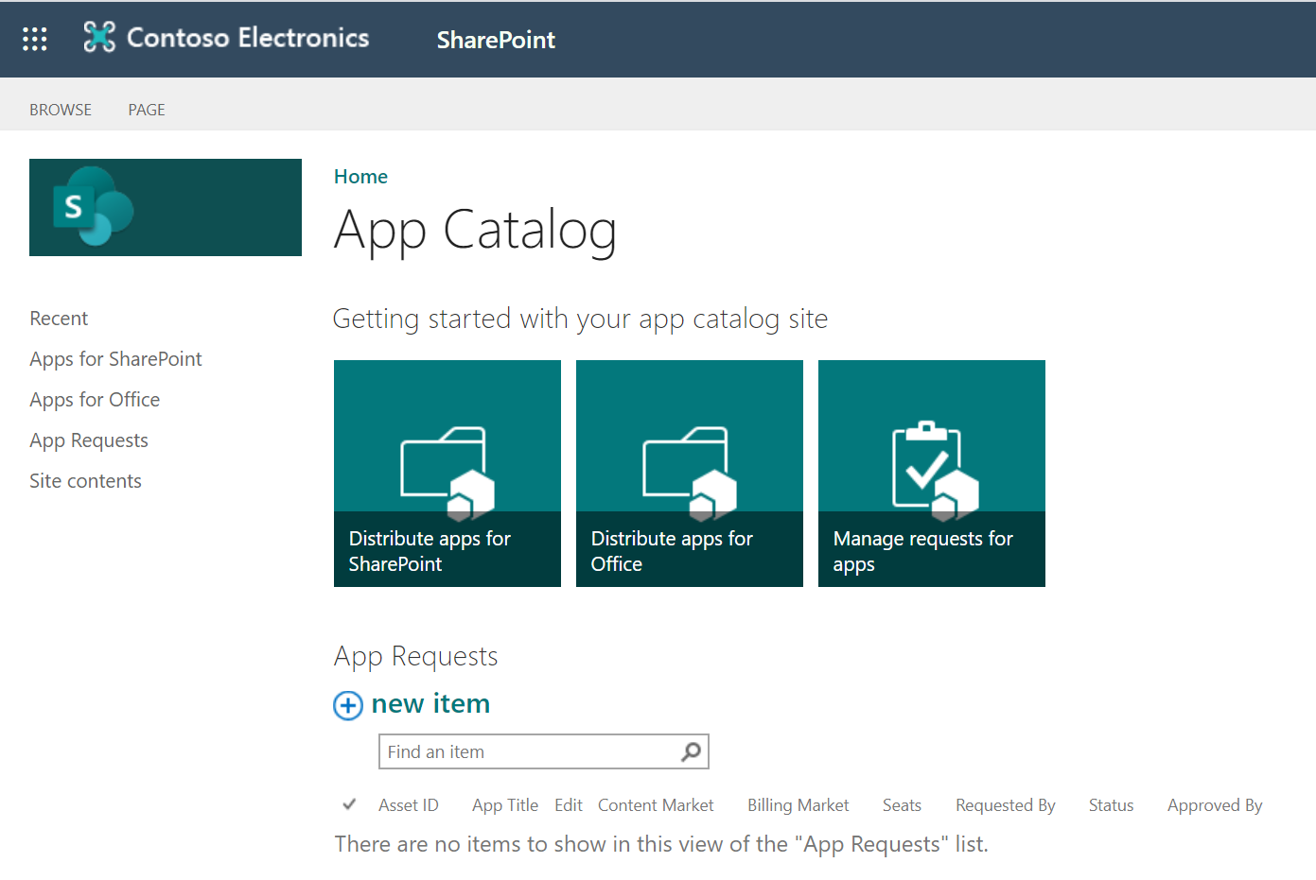
Create an App Catalog Site Collection
You can use App Catalog site to :
Upload any custom apps that your organization has developed.
Install custom or third-party apps on sites for users
Manage app requests from users

Slide 13
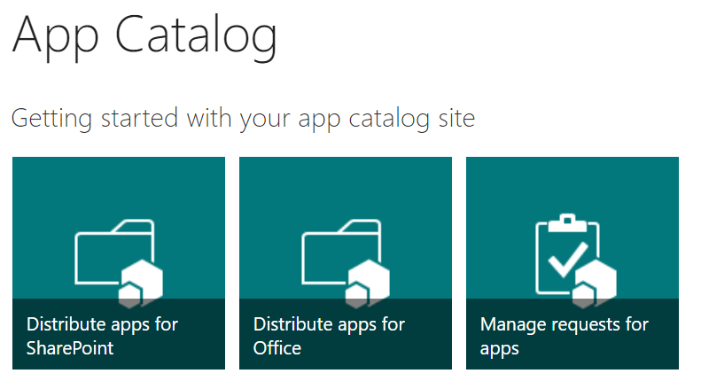
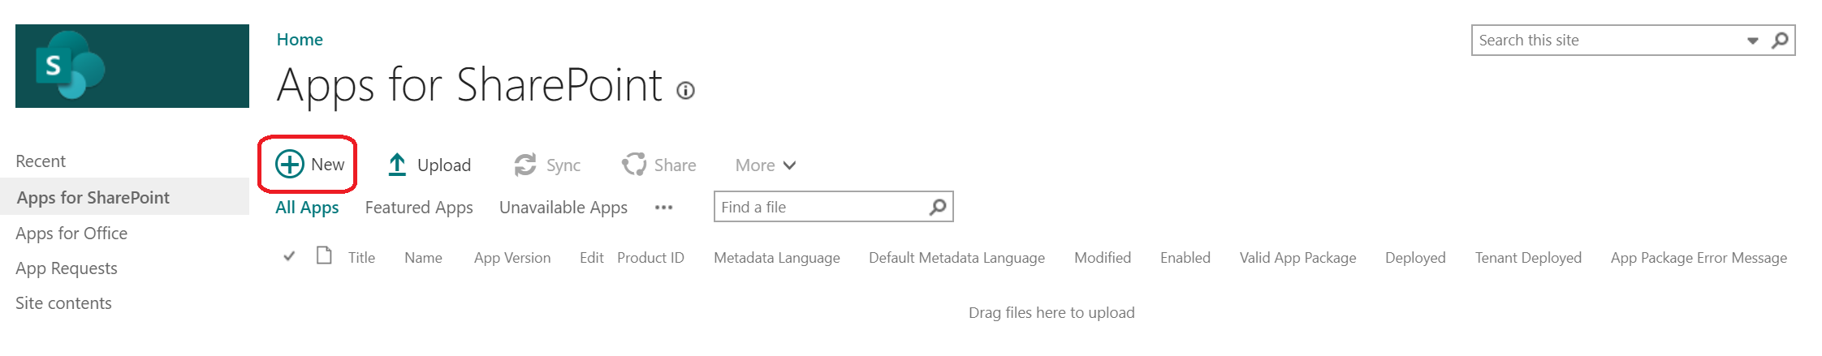
Add Custom Apps to an App Catalog site
After an App Catalog site has been created, you can use it to upload any custom apps that your organization has developed.
Distribute apps for SharePoint
Distribute apps for Office

Slide 14
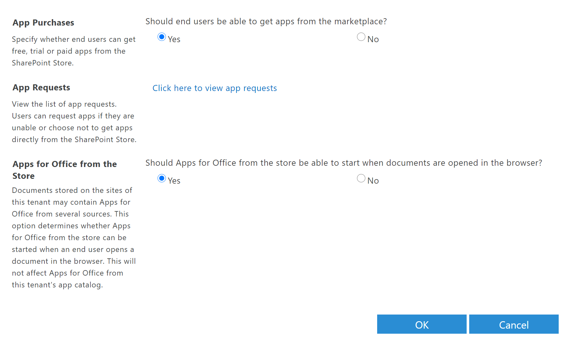
Configure SharePoint Store settings
Specify whether users can get apps from the SharePoint Store
Specify whether to allow apps for Office to start in documents
View or manage app requests

Slide 15
Manage app licenses
Assign licenses to specific users
Buy more licenses
Remove app licenses
Recover app licenses
Add a License Manager

Slide 16
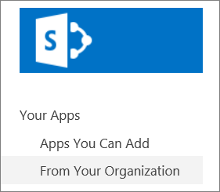
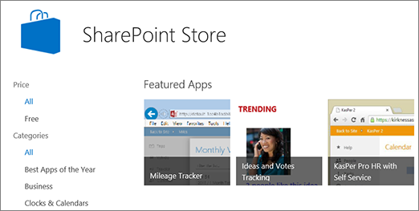
Add an app to a site
Add a built-in SharePoint app, such as a document library
Add an app from your organization
Download an app from the SharePoint store

Slide 17
Monitor apps
Select apps to monitor
View app details or errors
View the details about the app, such as:
the number of licenses purchases or used
the number of errors and installations
usage information
View error information for an app

Slide 18

Remove apps
Remove an app from the App Catalog
Remove an App from a Site

Slide 19
Lab: Manage User Profiles and Apps

Slide 20
Lab Exercises
Exercise 1: Manage user profiles
Exercise 2: Manage apps

