Slide 1
Module 05 : Plan and Configure Managed Metadata and Business Connectivity Services

Slide 2
Module agenda
Plan and configure Managed Metadata
Plan and configure Business Connectivity Services

Slide 3
Lesson 1: Plan and configure Managed Metadata

Slide 4
Lesson Introduction
Overview of managed metadata
Assign roles and permissions
Set up term groups
Set up term sets
Create and manage terms

Slide 5
Overview of managed metadata
Taxonomy
A taxonomy is a formal classification system. A taxonomy groups the words, labels, and terms that describe something, and then arranges the groups into a hierarchy.
Folksonomy
A folksonomy is an informal classification system. It evolves gradually as web site users collaborate on words, labels, and terms on a site.
Terms
Term Set
Term Group

Slide 6
Assign roles and permissions
Roles | Permissions
Term Store Administrator | Create or delete term set groups Add or remove Group Managers or Contributors Change the working languages for the term store Any task that a Group Manager or Contributor can do
Group Manager | Add or remove Contributors Any task that a Contributor can do
Contributor | Create or change a term set

Slide 7
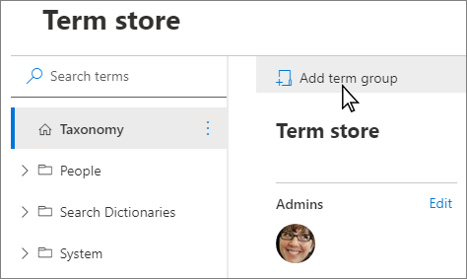
Set up term groups
A term group is a set of term sets that all share common security requirements. To create a new term group, you must be a term store admin. Only users who are designated as contributors to a specific group can manage term sets that belong to the group or create new term sets within it.

Slide 8
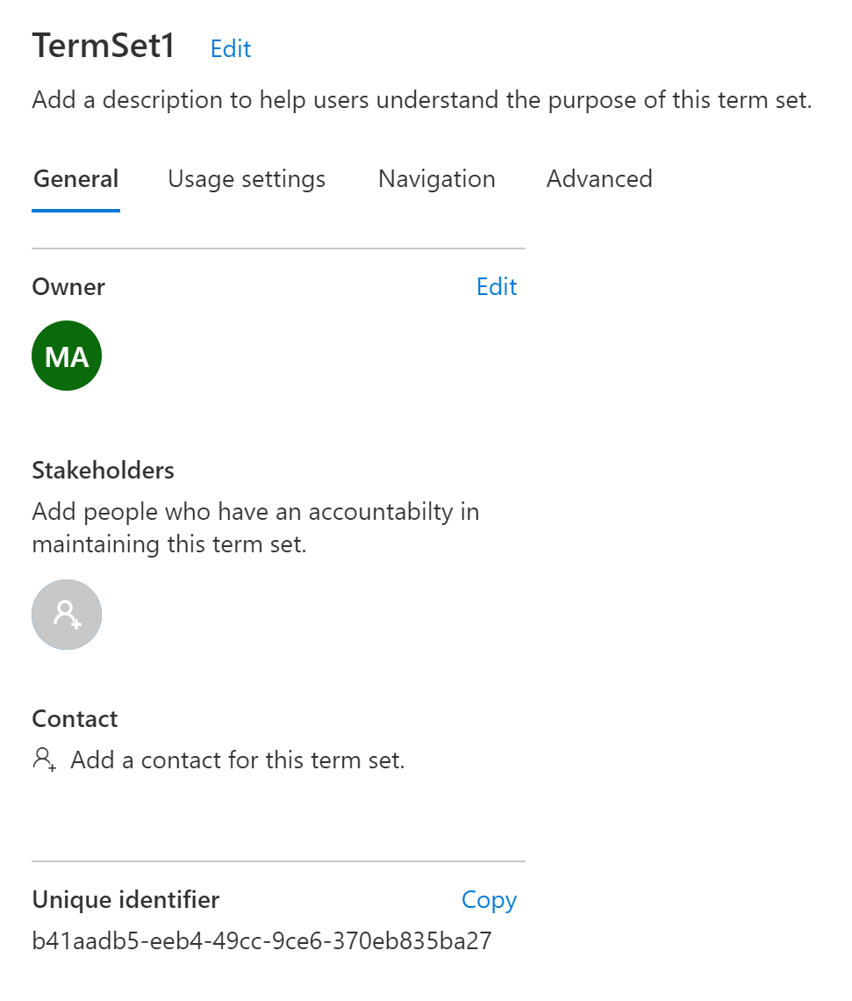
Set up term sets
Create a term set
Import a term set
Configure term sets
General tab
Usage settings tab
Usage navigation tab
Advanced tab

Slide 9
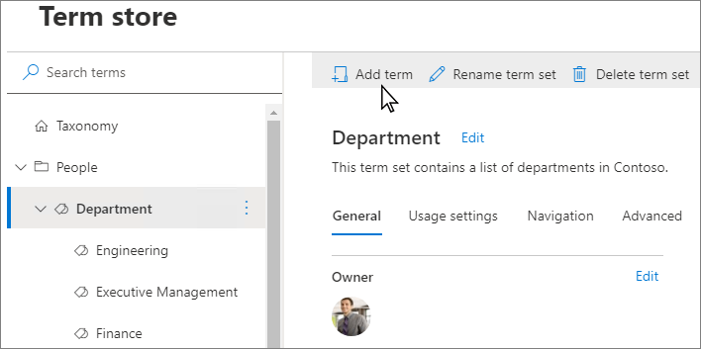
Create and manage terms
Create a term in a term set
Manage terms
Rename term
Copy term
Move term
Delete term
Pin term
Reuse term
Merge term
Deprecate term

Slide 10
Lesson 2: Plan and configure Business Connectivity Services

Slide 11
Lesson Introduction
Overview of Business Connectivity Services
Manage BCS permissions
Configure Secure Store Target Application
Import or export a BDC model
Create an External List

Slide 12
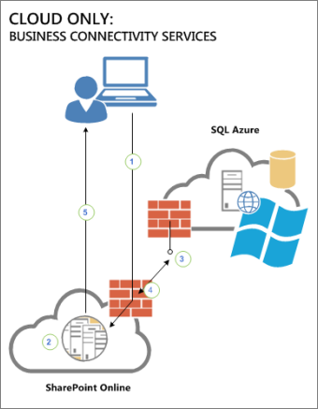
Overview of Business Connectivity Services
Two kinds of data resources
A SQL Azure database
A WCF web service that acts as an end-point for some other kind of data store
Examples
Create a SharePoint external list of employee personnel data.
Connect up-to-date customer data in Enterprise Resource Planning (ERP).
Create an event planning solution that links to a controlled Line-of-Business application.

Slide 13
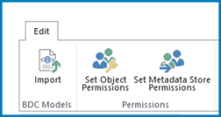
Manage BCS permissions
Object permissions
Object permissions apply only to a specific External System, BDC Model, or External Content Type (ECT). Each ECT is a securable object.
Metadata Store permissions
Metadata Store permissions apply globally to the whole BCS store. That is, they apply to all BDC Models, external systems, ECTs, methods, and methods instances that are defined for that external data system.

Slide 14
Configure Secure Store Target Application
Secure Store keeps encrypted copies of credentials. Take SQL Azure as an example, it enables a SharePoint Online admin to associate a SharePoint group that uses a single SQL Azure account that can access the target database.
Create a Target Application
Set credentials for a Target Application

Slide 15
Import or export a BDC model
The BDC Model view allows a user to import and export the underlying framework for the business data connection. This is very useful if you have to re-create the connection in a new environment. A BDC Model file can be imported to create an ECT connection to an external system.
You can import or export two types of model files:
Model. Exports the XML metadata for a selected system.
Resource. Exports the localized names, properties and permissions for a selected system.

Slide 16
Create an External List
What to do: | Where to do it:
Step 1: Set permissions on the BCS Metadata Store | SharePoint admin center
Step 2: Create a Secure Store Mapping | SharePoint admin center
Step 3: Create an External Content Type (ECT) | SharePoint Designer OR Visual Studio
Step 4: Create an External List | SharePoint admin center
Step 5: Grant permissions to manage your ECT | SharePoint admin center

Slide 17
Lab: Manage term set

Slide 18
Lab Exercises
Exercise 1: Import a term set
Exercise 2: Apply the term set to a library column

