Slide 1
Module 06 : Plan and Configure Search

Slide 2
Module agenda
Plan search
Configure search

Slide 3
Lesson 1: Plan search

Slide 4
Lesson Introduction
Overview of search in SharePoint
Overview of Microsoft search
Overview of search management
Differences between classic and modern search

Slide 5
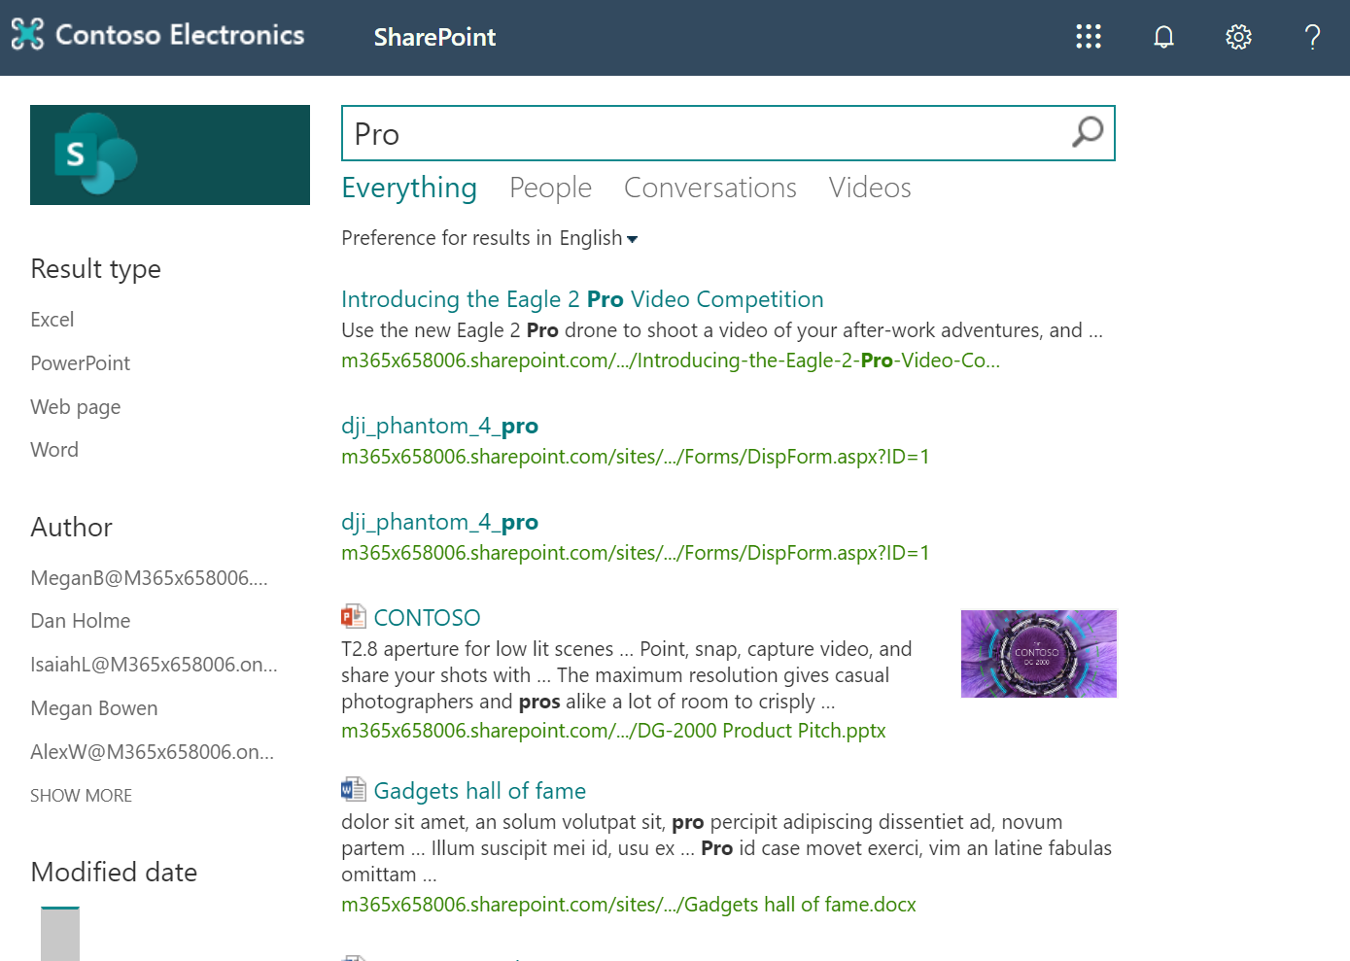
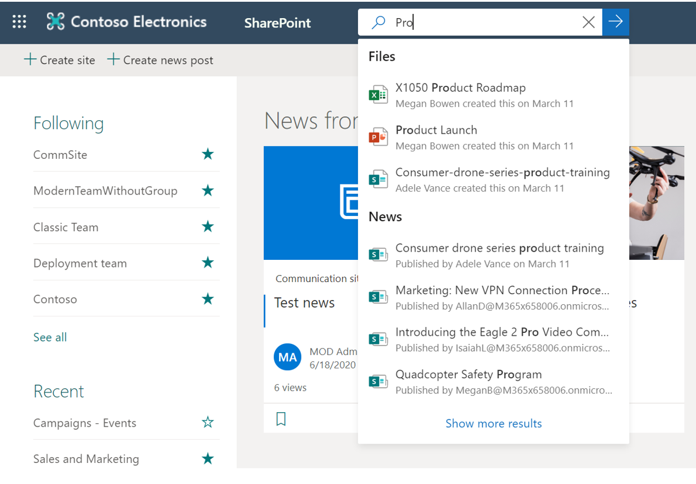
Overview of search in SharePoint
Classic Search Experience | Modern Search Experience
Users get the classic search experience on publishing sites, classic team sites, and in the Search Center. | Users get the Microsoft Search experience on the SharePoint start page, hub sites, communication sites, and modern team sites.

Slide 6

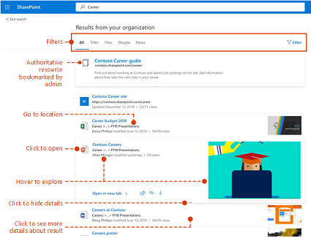
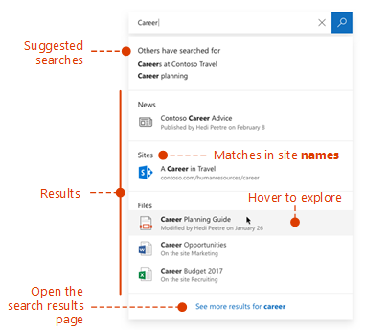
Overview of Microsoft search
Consistent search box across apps in Microsoft 365
Show relevant content

Slide 7
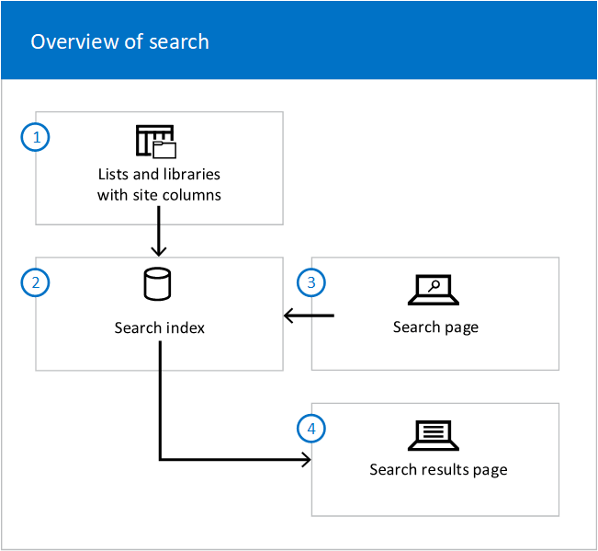
Overview of search management
Make sure the content can be found
Make the search results look great
Show relevant search results
Check logs, limits and reports

Slide 8
Differences between classic and modern search
 | Classic Search | Modern Search
Search locations | Search Center Publishing sites Classic team sites | Hub sites Modern team sites Communication sites SharePoint home page
Search result | Same search result | Personal search result
Search experience | Submit query to see search results | Search results show up before typing and update as you type
Search result page | Customizable | Non-Customizable

Slide 9
Lesson 2: Configure search

Slide 10
Lesson Introduction
Manage search
Manage search schema
Configure managed properties
Manage result sources
Manage query suggestions
View search usage reports

Slide 11
Manage search (1/3)
Search Administration | Search settings
Make sure the content can be found | Make content searchable. Crawl content Configure hybrid search
Make the search results look great | Manage the Search Center Specify the default Search Center URL Specify the Search Center URL for a site or subsite The Search Box Web Part The Search Results Web Part The Search Navigation Web Part The Refinement Web Part The Content Search Web Part Use result types and display types to change how search results look

Slide 12
Manage search (2/3)
Search Administration | Search settings
Show relevant search results | Manage the search schema Manage query rules Manage query suggestions Using query transforms Manage result sources Manage result types Manage search dictionaries Manage authoritative pages Export and import search settings
Check logs, limits and reports | View search usage reports Query throttling Set crawl log permissions Search limits

Slide 13
Manage search (3/3)
Most of the customizations apply only to classic search. The modern search experience use Microsoft search. Customization options for modern search are limited, but are expected to expand.
Classic Search | Modern Search
Crawl site content Search schema Result source Remove a search results Promoted result Site level search settings Custom search results (display template, search web parts, query rules) | Crawl site content Search schema (except sortable, refinable, company name extraction) Result source(Tenant level) Remove search results Promoted result (only when search across all of SharePoint)

Slide 14
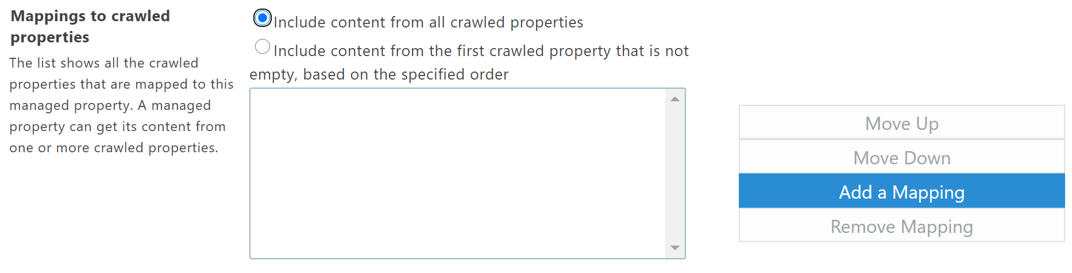
Manage search schema
Terms and concepts
Search index
Search schema
Crawled properties
Manage properties
Managed property settings
Searchable
Queryable
Retrievable
Refinable
Safe for Anonymous
Map crawled properties
Auto-generated managed properties
Change the search schema on tenant level or on site collection level

Slide 15
Configure managed properties
Create a new managed property
Edit a built-in managed property
Crawling and re-indexing

Slide 16
Manage result sources
The modern search experience gets results from the default result source. If you change the default result source, this impacts both the classic and modern search experiences.
For the classic search experience, you can create your own result sources, or use the predefined result sources. After you create a result source, you configure Search Web Parts and query-rule actions to use it.

Slide 17
Manage query suggestions
Automatic query suggestions
SharePoint automatically creates a query suggestion when you've clicked a search result for a query at least six times.
Manual query suggestions
You can manually create your own lists of query suggestions and import them to SharePoint. Manual query suggestions apply to all result sources, all site collections, and to both search experiences.

Slide 18
View search usage reports
Number of Queries
Top Queries by Day
Top Queries by Month
Abandoned Queries by Day
Abandoned Queries by Month
No Result Queries by Day
No Result Queries by Month
Query Rule Usage by Day
Query Rule Usage by Month

Slide 19
Lab: Configure Search

Slide 20
Lab Exercises
Exercise 1: Configure result source
Exercise 2: Monitor Search

