Slide 1
Domain Identification
Vivek Anad and Yash Agrawal

Slide 2
Attention Model for classification and Keyword Extraction
The idea is to classify the given news article into a domain and extract domain specific keywords.
We use attention mechanism for classification task and the idea is the more attention will be given to the words that are very important for that domain.
So Top k words are taken to be the domain specific keywords.

Slide 3
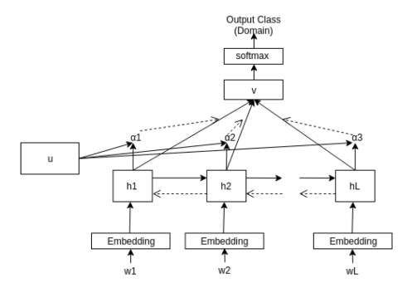
Model

Slide 4
Other methods
We also use other ML techniques for classification task.
However we used the attention model for keyword extraction other methods were used only for classification task.

Slide 5
Adapting for Hindi
The model was trained on english dataset.
We also wanted the model to work on Hindi.
We first translate the hindi article into english, word by word, and then use the same model.
We then re-map the keywords into their root hindi word to get hindi keywords.

Slide 6
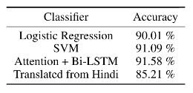
Results

