Slide 1
systems analysis
Developing Software Requirements

Slide 2
Topics
Software engineering activities (review)
Types of requirements
Requirements activities
Eliciting requirements
Analyzing requirements
Expressing requirements
Prioritizing requirements
Validating requirements
Managing requirements
Business requirements

Slide 3
SOFTWARE ENGINEERING ACTIVITIES
Design and Implementation
Create Process
Set Standards
Manage Risks
Perform Estimations
Make Measurements
Improve Process
Specification
Identify Ideas or Needs
Elicit Requirements
Express Requirements
Prioritize Requirements
Validate Requirements
Manage Requirements
Design Architecture
Design Databases
Design Interfaces
Document
Write Code
Integrate Functionality
Develop Test Procedures
Create Tests
Execute Tests
Report Test Results
Conduct Client Demos
Conduct Project Retrospective
Project Management
Allocate Resources
Verification and Validation
Analyze Requirements

Slide 4
Types of Software Requirements
Requirement Type | Definition
Business | A high-level business objective, a reason why the software is being developed
User | A task that a specific class of users must be able to perform with the software, or a desired product attribute for a class of users; helps specify who the product is being developed for
Functional | A description of a behavior that a system will exhibit under specific conditions, what the software will do
Non-Functional | A description of a property or characteristic that a system must exhibit, how well the software will perform

Slide 5
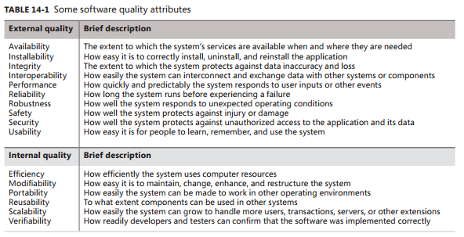
“Non-functional” Requirements
How well the software will perform
Quality attributes (See Chapter 14 for more info)

Slide 6
Additional Requirements
Requirement | Definition
Business Rule | A policy, guideline, standard, or regulation that defines or constrains some aspect of the business. Not a software requirement in itself, but sometimes the origin of software requirements.
Constraint | A restriction that is imposed on the choices available to the developer for the design and construction of a product.
External Interface | A description of a connection between a software system and a user, another software system, or a hardware device.
Physical Setting | How the product needs to be designed in order to function in its physical environment. For example, if a product is being developed for underwater exploration, it needs to be waterproof.

Slide 7
Eliciting Requirements
Interactive, investigative process to:
Figure out what clients really need
Learn about the environment in which the new product will be used
Identify user classes and other stakeholders
Work with individuals who represent each user class to understand their functionality needs and quality expectations
Understand user tasks and goals and the business objectives with which these tasks align

Slide 8

Collect Information Before the First Meeting
Before meeting with the client, whether internal or external, collect some basic business-related information
Products produced/services supplied
Financial viability
Customers, suppliers, competitors
Competitive advantage

Slide 9
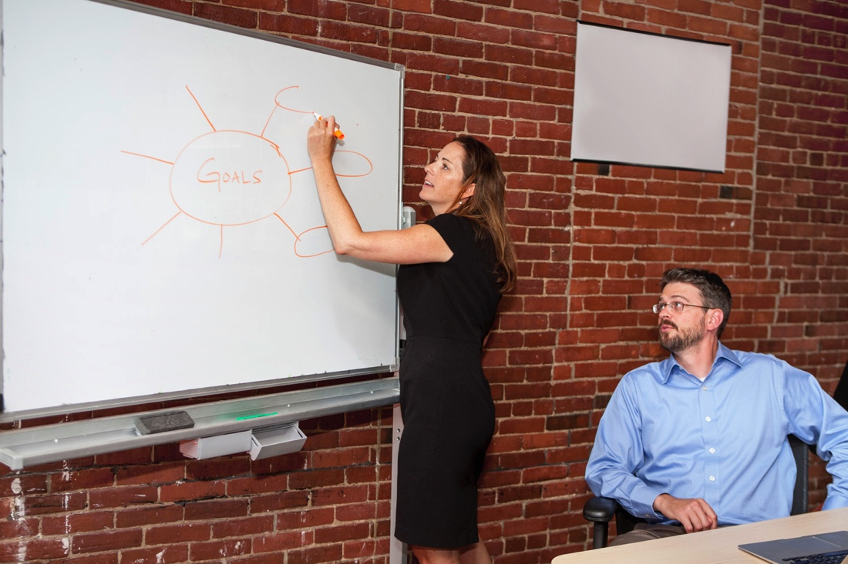
Meet with the Customer
Try to get
A concise statement of the goals of the project
What problem are they trying to solve?
How will new technology help them be more successful in their business?
What must happen for the project to succeed?

Slide 10
Meet with the Customer
Discover any biases
For example
Will they only use certain company’s products?
Do they avoid certain technologies?
Do the software engineers look down on the QA people or vice versa?
Talk to the technical and management staff
Get a copy of the org chart, contact info for your stakeholders
Get a copy of the security policy

Slide 11
Requirements Elicitation Techniques
Refer to Chapter 7 of Wiegers and Beatty for more info (the textbook for our class)
Requirements elicitation could make a good term paper topic!
Interviews
Workshops
Focus groups
Observations
Questionnaires
System interface analysis
User interface analysis
Document analysis

Slide 12
Analyze Requirements
Reach a richer and more precise understanding of each requirement
Analyze information received from users to distinguish tasks, functional requirements, quality expectations, business rules, suggested solutions
Decompress high-level requirements into detailed requirements
Resolve conflicting requirements
Examine requirements to ensure they are clear, complete, consistent, and unambiguous

Slide 13
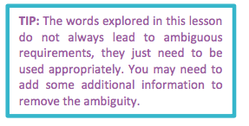
Ambiguous Requirements
Refer to University of Alberta Course Notes for more details (on our Moodle site)
Indirect words (should, could, sometimes, often, may)
Vague words (process, handle, operate, item)
Persuasion words (clearly, obviously, as can be seen)
Completion words (and so on, and so forth, etc.)
Qualifiers (all, every, only)
Comparatives (is the same as, is bigger than, smaller)
Quantities (a, an, some, few)
Pronouns (he, she, it, they)
Positional words (after, before, following, last)
Temporal words (when, until, since)
Joining words (and, or, both)

Slide 14
Express Requirements
Translate collected user needs into written requirements and diagrams suitable for comprehension, review, and use by their intended audience
Represent and store collected requirements knowledge in a persistent and well-organized fashion
Frame the requirements in a way that allows a product to be built
Develop use cases, user stories, storyboards, wireframes, diagrams, Vision and Scope Document, Software Requirements Specification (SRS)

Slide 15
Prioritize Requirements
Figure out what to do first, next, and last
What could you not do?
Questions to help establish priorities include:
What requirements must be completed for the project and product to be successful?
What requirements should be done? In other words, what is important but is not as time-critical or could be satisfied another way or at a later time?
What could be done to improve the project or product but is not necessary? These priorities are usually included only if both time and resources allow for it.

Slide 16
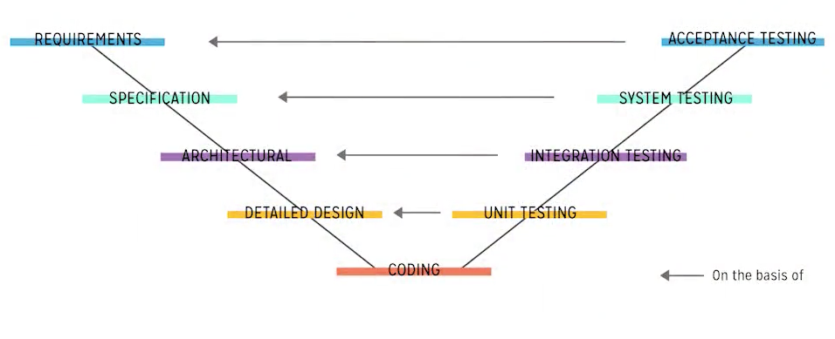
Validate Requirements
Is this really going to be the right software product for the clients?
Meets their needs, solves their problem; they are happy with the plan
Correct any problems before development starts
Develop acceptance tests and criteria to confirm that a product based on the requirements meets customers needs and achieves business objectives

Slide 17
Manage Requirements
Continuously organize and reorganize requirements
Keep track of priorities and changes in requirements
Negotiate new commitments based on estimated impact
Watch out for feature creep!

Slide 18
Business requirements
Systems Analysis
Developing Software Requirements

Slide 19
Business Requirements
The reasons why a product is being developed
The value this new product brings to the organization
Must be defined before functional and non-functional requirements
A statement of the vision and scope helps greatly in figuring out proposed features and product releases
Business requirements need to be defined for all software projects, regardless of their development methodology

Slide 20
Business Goals Examples
Increase revenue
Reduce operating costs
Improve communications
Shorten product development cycle
Expand into worldwide markets
Build partnerships with other companies
Offer better customer support or new customer services

Slide 21

Business Constraints
Budget
Staffing
Schedule
Politics and policies

Slide 22
Business Rules
Policies, guidelines, standards, or regulations that define or constrain some aspect of the business
Examples of business rules include:
Government or legal regulations
Privacy policies
Brand uniformity requirements

Slide 23
Product Vision
Succinctly describes the product that will achieve the business objectives
Defines what the product is and what it ultimately could become
Written using Moore keywords:
For [target customer] who [statement of the need or opportunity], the [product name] is a [product category] that [major capabilities, key benefit, compelling reason to buy or use]. Unlike [primary competitive alternative], our product [statement of primary differentiation].

Slide 24
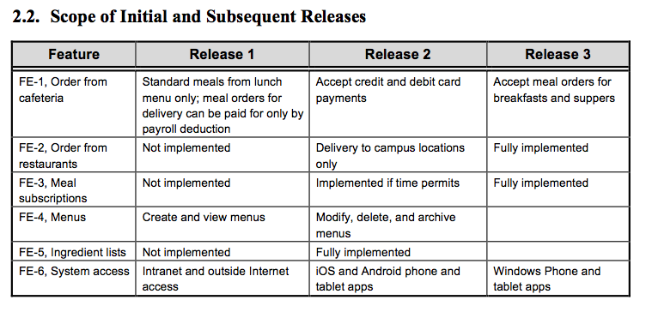
Product Scope
Identifies what portion of the vision the current project or development iteration addresses
Identifies any features that are not included
Lists the products’ major features
Summarizes the major features that will be included in the initial and subsequent releases; a table works well here

Slide 25
Product Scope
Various diagrams can help explain the scope:
Context diagram
Ecosystem map
Feature tree

Slide 26
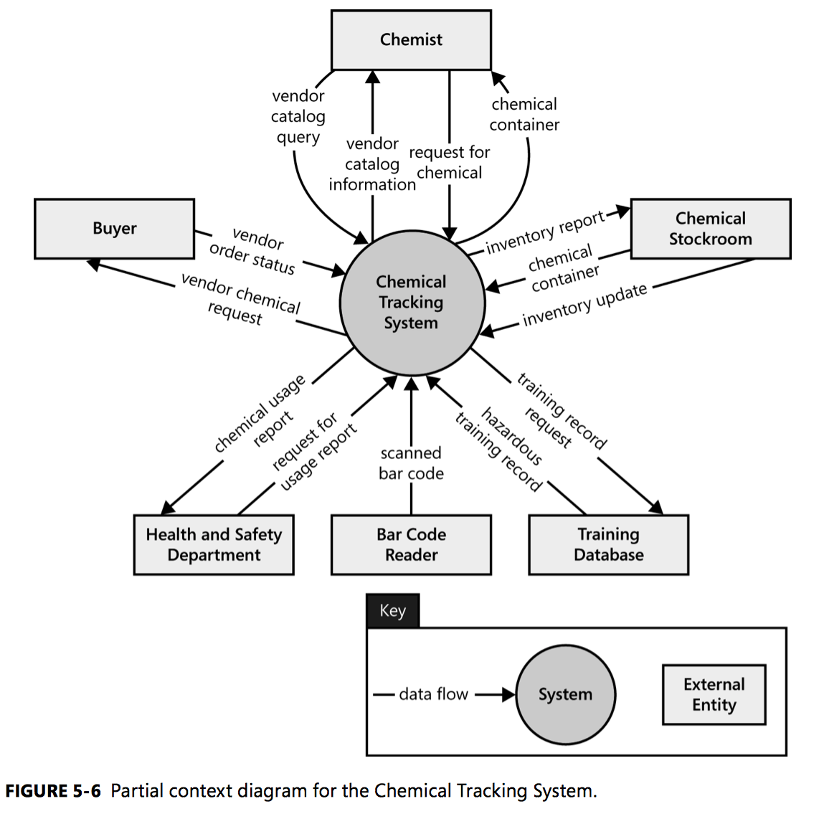
Context Diagram
Depicts a high level of abstraction of a system
Identifies objects outside the system that exchange data with the system
Probably one of the most useful diagrams that we will discuss

Slide 27
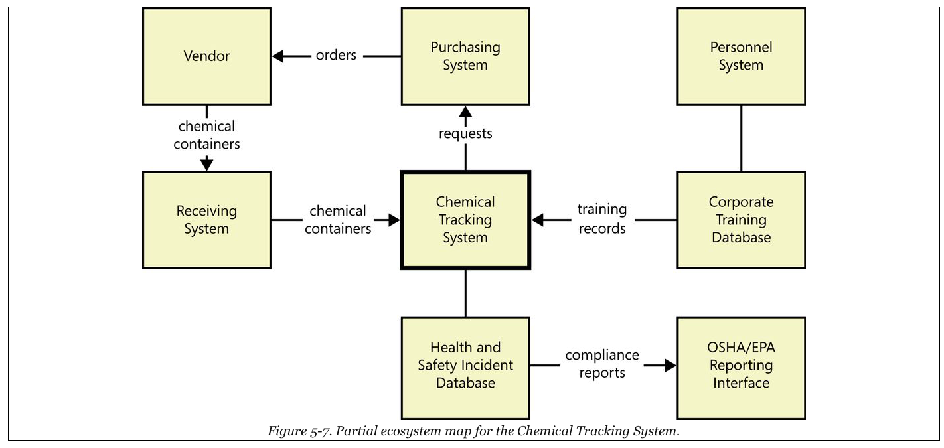
Ecosystem Map
Shows a set of systems that interact with each other and the nature of their relationships
Unlike a context diagram, shows systems that have a relationship even if there is no direct interface between them

Slide 28
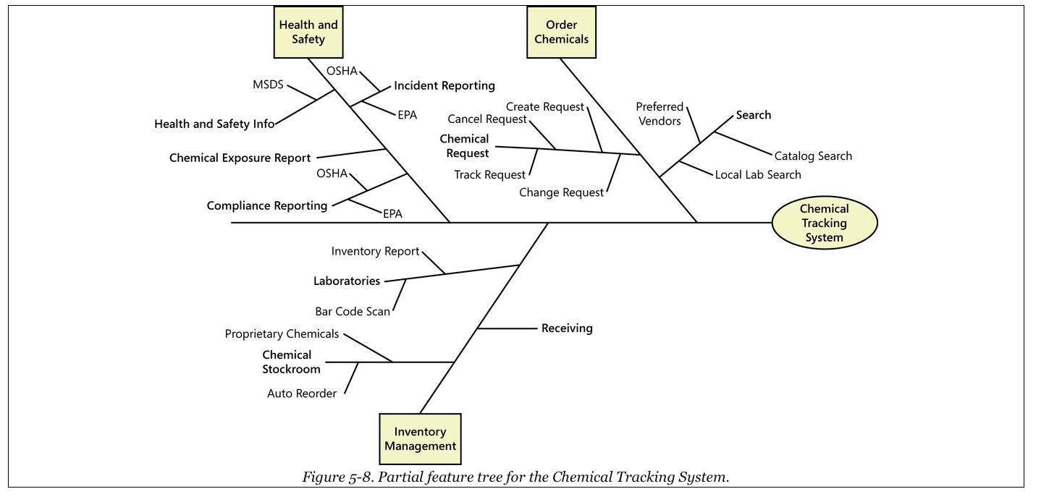
Feature Tree
Shows features planned for a system in a hierarchical tree, with sub-features beneath each main feature

Slide 29
One More Word on Scope
Remember, the business objectives are the most important factor to consider when making scope decisions
Determine which proposed features or user requirements add the most value with respect to the business objectives; schedule those for the early releases
When a stakeholder wants to add functionality, consider how the suggested changes will contribute to achieving the business objectives

Slide 30
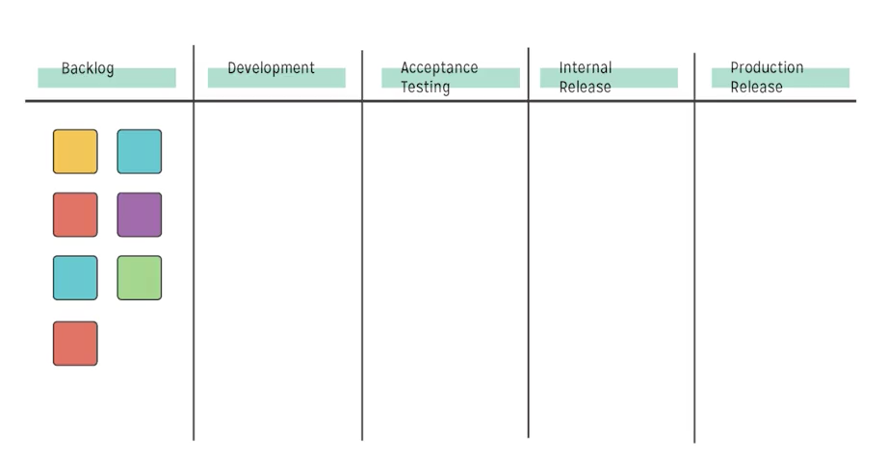
Vision and Scope on Agile Projects
Development is performed in a series of fixed timed iterations
Scope of each iteration consists of user stories selected from a dynamic product backlog, based on relative priority and estimated delivery capacity of the team for each time period

Slide 31
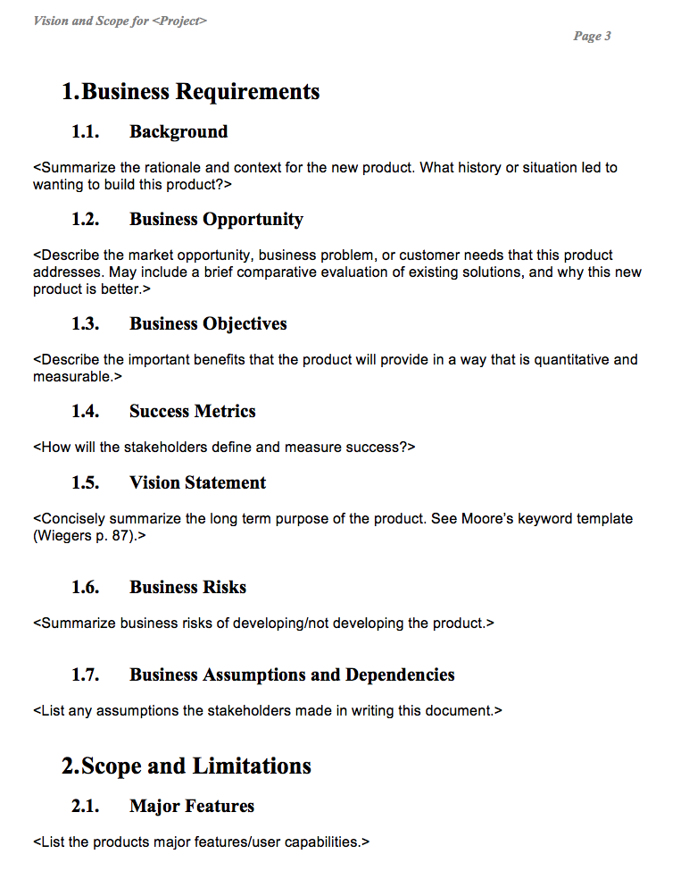
Vision and Scope Document
Used most often in Waterfall methodology, but concepts apply to all methodologies
See Wiegers and Beatty, Chapter 5, for more info
See our class Moodle site for example and template

Slide 32
Summary
In this module, we talked about:
Types of requirements
Requirements activities
Eliciting requirements
Analyzing requirements
Expressing requirements
Prioritizing requirements
Validating requirements
Managing requirements
Business requirements
Goals, rules, constraints
Vision
Scope
Vision and Scope Document

