Slide 1
systems analysis
Developing Analysis Models and Diagrams

Slide 2
Topics
Models and diagrams
When and how should you model or diagram system components?
Which types of diagrams work best in various circumstances?
Specific types of diagrams
Use case (review)
Context
Data flow
Swim lane
State transition
Activity (review)
Storyboard

Slide 3
Models and Diagrams
Models and diagrams depict the logical aspects of the problem domain’s
Data components
Transactions
Transformations
Real-world objects
Changes in system state

Slide 4
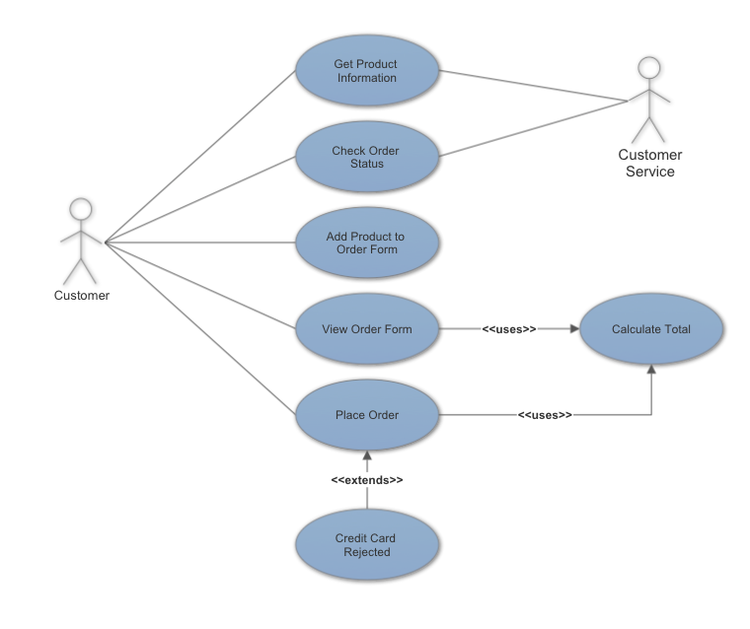
A Picture Is Worth a 1024 Words
Some clients and developers don’t like to read long documents (imagine that!)
A lot of people understand things better with pictures.
Documenting software requirements with models and diagrams can be extremely helpful for users, developers, product owners, managers, etc.
You need a combination of textual and visual requirements representations at different levels of abstraction to paint a full picture of the intended system.

Slide 5
Visual Requirements Models
UML is a general-purpose modeling language used to visualize many different aspects of software and software development
There are many types of UML diagrams:
Use case
Activity
Class (see Chapter 13)
State
Other models include:
Data flow diagrams
Process flow diagrams such as swim lane diagrams
Dialog maps
Decision tables
Story boards
Etc.

Slide 6
When to Model
Focus your modeling on:
The most complex and riskiest portions of the system
Those portions most subject to ambiguity or uncertainty
Safety-critical, security-critical, mission-critical elements
Listen to your customer to determine when modeling is needed and which models will work best

Slide 7
Types of Diagrams
Diagram | Description
Use case | Identifies the actors who interact with the system and their use cases
Context | Identifies objects outside the system that exchange data with the system
Data flow | Identifies processes, data stores, external entities, and flows among them
Swim lane | Shows sequential steps of a business process flow, divided into lanes
Activity | Depicts a process flow proceeding from one activity to another
State transition | Shows the sequence of states that an object in a system goes through in response to events
State table | Shows in matrix form the states of a system and which transitions between states are allowed
Decision tree | Depicts the actions a system takes in response to specific conditions
Decision table | Shows in matrix form all combinations of values of a set of conditions and the expected system action
Dialog map | Shows the dialog elements with which the user can interact and the navigations permitted between them
Storyboard | Tells a story of how the user will use the software

Slide 8
Which Diagram to Use
Information Depicted | Diagram
External interfaces | Use case
 | Context
 | Data flow
 | Swim lane
Business process flow | Data flow
 | Swim lane
 | Activity
System and object states | State transition
 | State table
Complex logic | Decision tree
 | Decision table
User interfaces | Dialog map
 | Storyboard

Slide 9
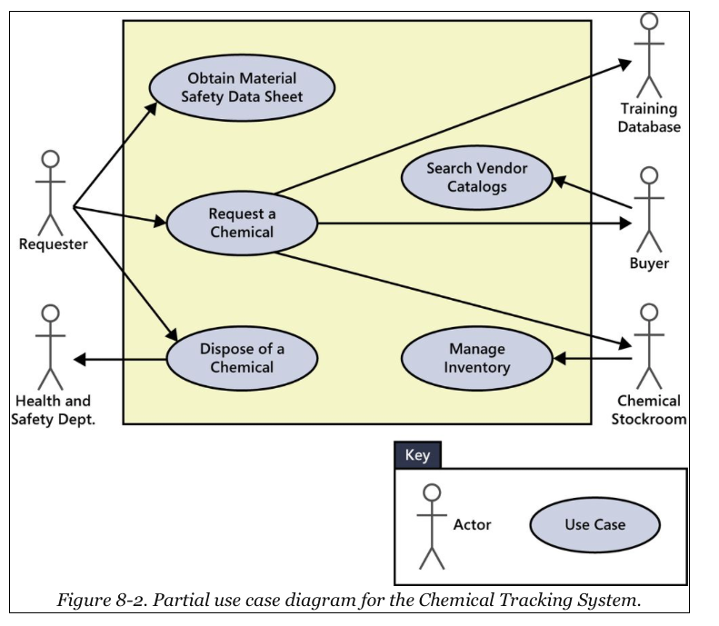
Use Case Diagram (Review)
Identifies the actors who interact with the system and their use cases

Slide 10
Context Diagram
Shows external entities that connect to the system, and the data or material flows between the system and the external entities
Represents a high-level of abstraction of the system
Represents the entire system as a single black-box process, depicted as a circle or bubble
External entities are shown as rectangles
Flows often represent complex data structures, which are defined in the data dictionary

Slide 11
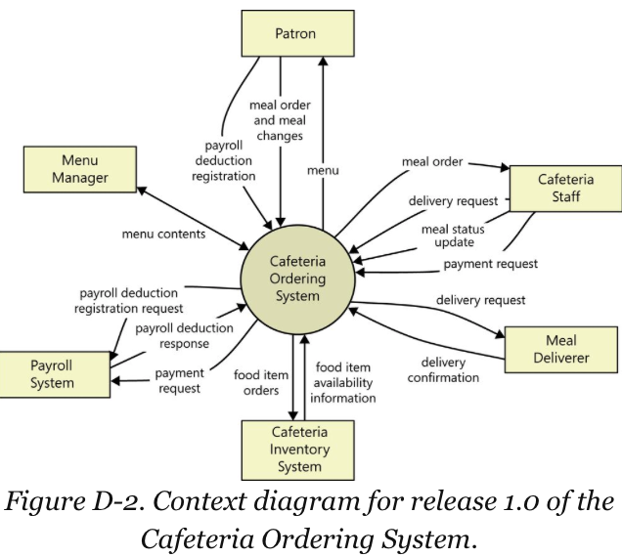
Context Diagram
Identifies objects outside the system that exchange data with the system

Slide 12
Data Flow Diagram
Basic tool of structured analysis
Identifies processes, data stores, external entities, and flows among them
Elaborates on the information in the context diagram
Level 0 data flow diagram is the highest level
External entities are shown as rectangles
Processes are represented as circles or bubbles
Each process that appears as a separate bubble on the Level 0 diagram can be further expanded into separate data flow diagrams

Slide 13
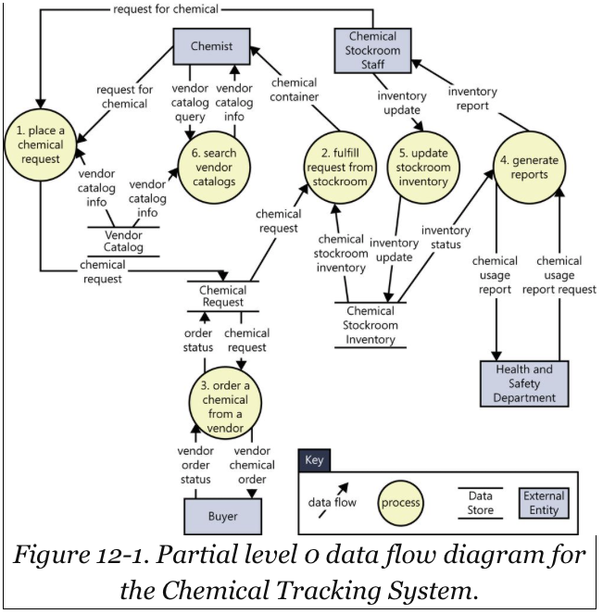
Data Flow Diagram
Identifies processes, data stores, external entities, and flows among them

Slide 14
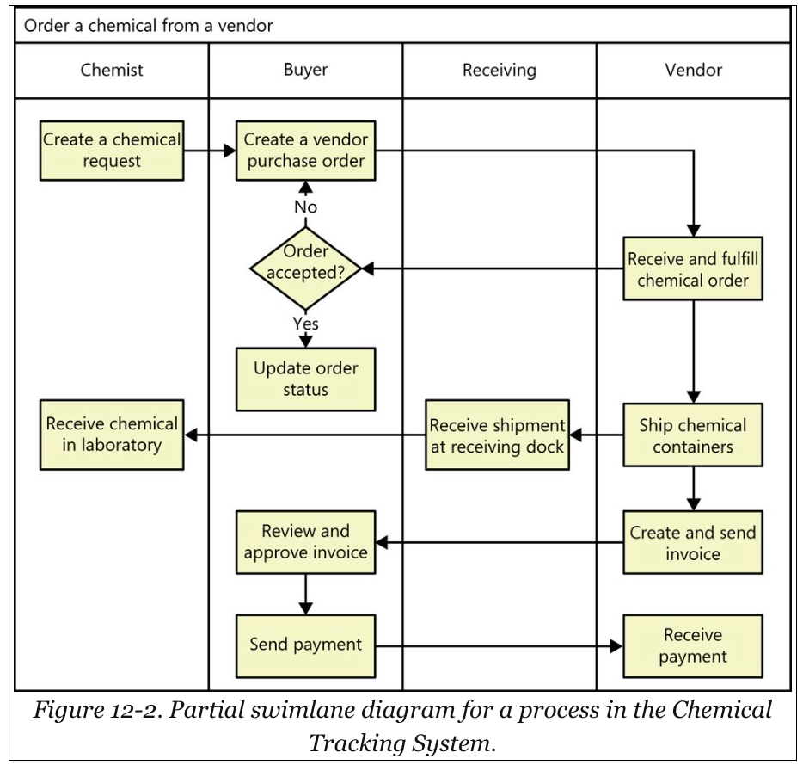
Swim Lane Diagram
Shows sequential steps of a business process flow, divided into lanes

Slide 15
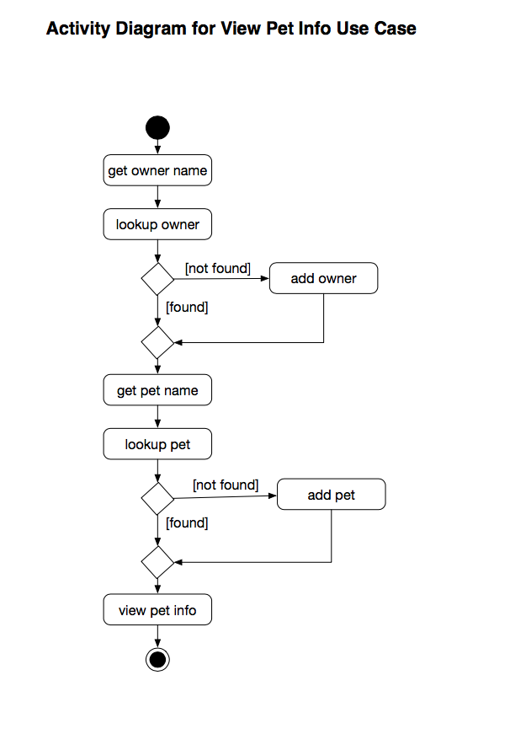
Activity Diagram (Review)
Depicts a process flow proceeding from one activity to another

Slide 16
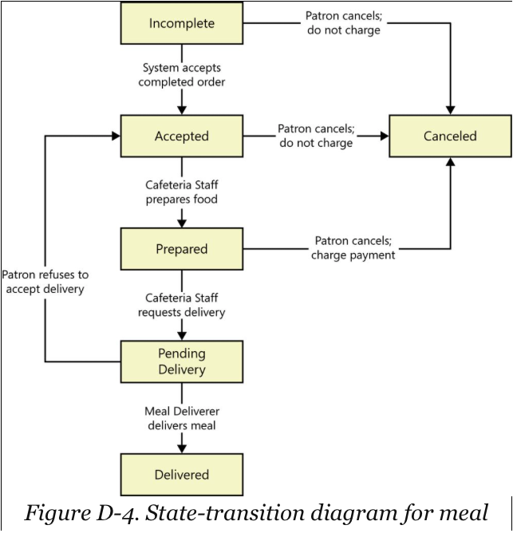
State Transition Diagram
Shows the sequence of states that an object in a system goes through in response to events

Slide 17
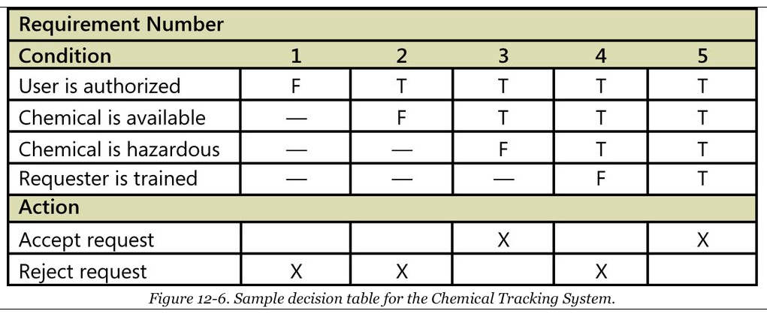
Decision Tree
Depicts the actions a system takes in response to specific conditions

Slide 18
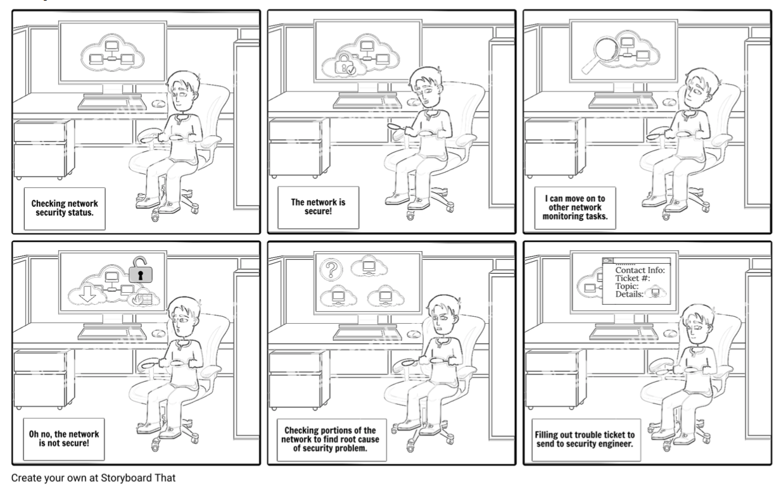
Storyboard

Slide 19
Summary
In this module, we talked about:
Modeling components of a planned system
Adding diagrams to your requirements analysis documentation
When and why to model and diagram
Which diagrams work best under various circumstances
Types of diagrams:
Use case
Context
Data flow
Swim lane
State transition
Activity
Storyboard

