Slide 1
systems analysis
Documenting Requirements

Slide 2
Topics
The purpose, structure, and contents of the Software Requirements Specification (SRS)
Writing excellent requirements
Characteristics of excellent requirements statements
Writing style
Level of detail
Avoiding ambiguity

Slide 3

SRS “Document”
Requirements specifications don’t have to be a “document”
They could be a
Spreadsheet
Wiki
Database
Output from a Requirements Management (RM) tool
In this class we will write a document, based on the RaiderSoft template, which is based on the SRS template in our textbook

Slide 4

Writing the SRS
Don’t try to “boil the ocean,” at least not at first.
Progressively refine the detail.
Be aware that you will never get perfect requirements.
Don’t give up too soon though.
Do not rely on telepathy and clairvoyance as substitutes for solid requirements specification! ☺ They never work.

Slide 5
The SRS
States the functions and capabilities that a software system must provide, its characteristics, and the constraints that it must respect
Provides the basis for subsequent project planning, design, and coding
Provides the foundation for system testing and user documentation
Does not contain:
Design details
Construction specifications
Testing plans
Project management details

Slide 6
Audience for the SRS
Customers
Software development teams
Testers
Maintenance and support staff
Documentation writers
Training personnel
Sales and marketing staff
Project managers
Legal staff
Subcontractors

Slide 7
Characteristics of Excellent Requirements Statements
Complete
Correct
Feasible
Necessary
Prioritized
Unambiguous
Verifiable

Slide 8
Functional Requirements
The most important part of a Software Requirements Specification
A functional requirement
Documents the software capabilities that must be implemented for the user to carry out a feature’s services or perform a use case
Describes how the product should respond to anticipated error conditions and to invalid inputs and actions
Uses the “shall” keyword
Is labeled with a unique label

Slide 9
System or User Perspective?
You can write functional requirements from the perspective of either something the system does or something the user can do
The system shall <action verb> <observable result>
The user shall <action verb> <observable result>
It’s fine to intermingle these two styles

Slide 10
Functional Requirement from System Point of View
<optional precondition> <optional trigger event> the system shall <expected system response>
Example:
If the requested chemical is found in the chemical stockroom, the system shall display a list of all containers of the chemical that are currently in the stockroom.

Slide 11
Functional Requirement from User Point of View
The <user class or actor name> shall be able to <do something> <to some object> <qualifying conditions, response time, or quality statement>
Example:
The Chemist shall be able to reorder any chemical they have ordered in the past by retrieving and editing the order details.

Slide 12
Non-functional Requirements
Also called quality attributes
Specific, quantitative, and verifiable requirements for qualities such as
Usability and ease of learning the system
Performance
Security
Safety
Availability
Efficiency
Installability
etc.
Uses the “shall” keyword

Slide 13
The Keyword “Shall”
Yes, it sounds a bit stiff, but the keyword “shall” is standard in functional and quality requirements specifications.
Alternatives (such as should, may, needs to, will) are ambiguous and awkward.
If you wish to use an alternative, the main goal is to be consistent.
Some experienced authors use different verbs to indicate nuances:
Shall versus may
Should versus must

Slide 14
Writing Style
Write requirements in complete sentences using proper grammar, spelling, and punctuation.
Put the punch line (the statement of need or functionality) first, followed by supporting details.
Use simple and straightforward language appropriate to the user domain.
Avoid jargon.
Define specialized terms in a glossary.

Slide 15
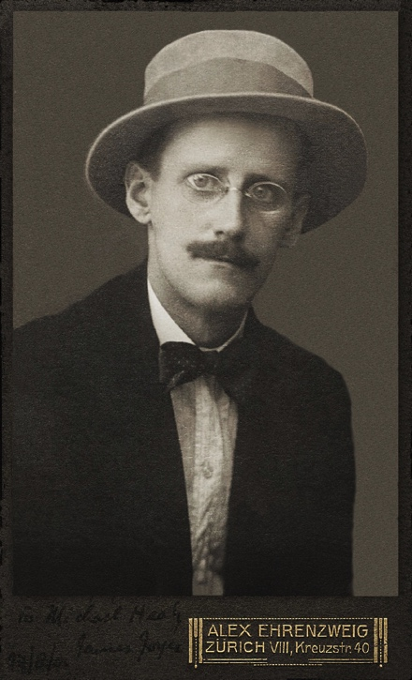
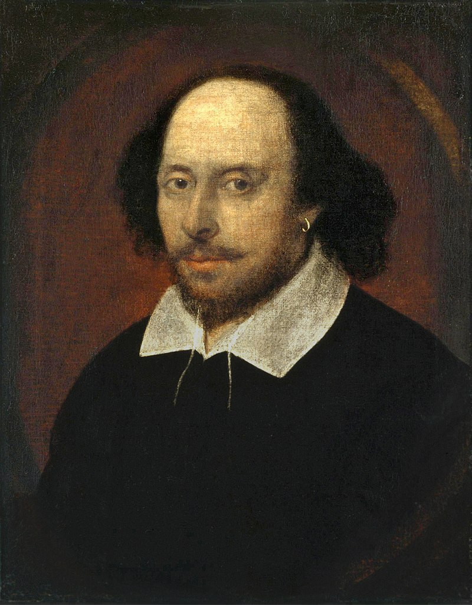
Writing Style (continued)
Keep sentences and paragraphs short and direct. You aren’t trying to be James Joyce here! ☺
Don’t use multiple terms for the same concept just to achieve variety (e.g. customer, client, user, patron). You aren’t trying to be Shakespeare here!

Slide 16
Avoid Ambiguity
Avoid
Fuzzy words
Synonyms (be consistent and use the same word each time for a concept)
Adverbs (reasonably, appropriately, generally, usually, quickly)
A/B construct (e.g. delivery/fulfillment)
Unclear boundary values
For example, “Vacation requests of up to 5 days do not require approval. Vacation requests of 5 to 10 days require supervisor approval.”

Slide 17
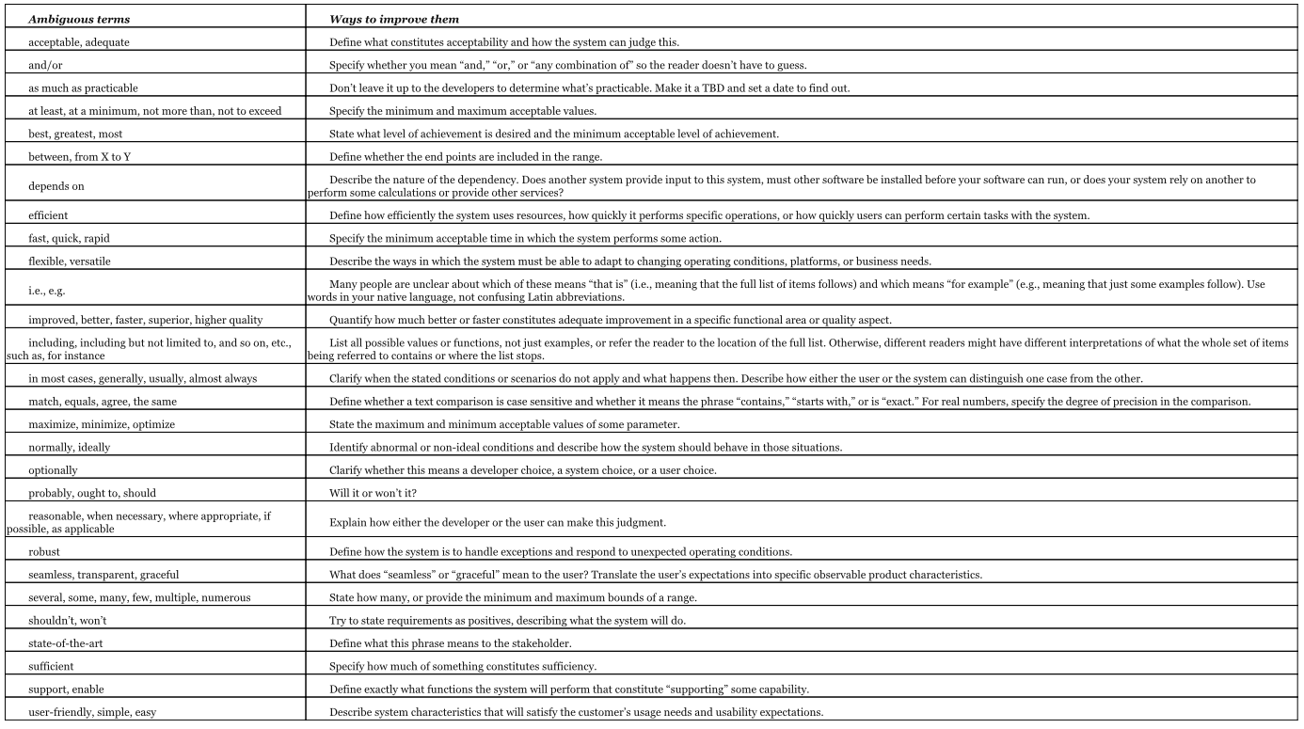
Ambiguous Terms to Avoid (See Wiegers & Beatty, page 214)

Slide 18
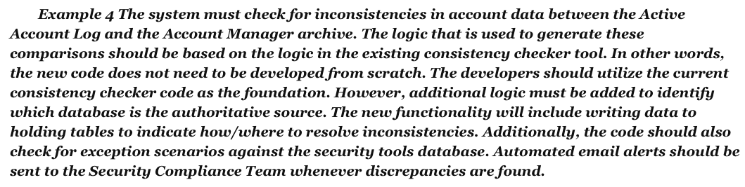
How Would You Rewrite These Requirements?
The Background Task Manager shall provide status messages at regular intervals not less than every 60 seconds.
Corporate project charge numbers should be validated online against the master corporate charge number list, if possible.
The device tester shall allow the user to easily connect additional components, including a pulse generator, a voltmeter, a capacitance meter, and customer probe cards.

Slide 19
Contents of SRS
See template and Chapter 10
Most important components
Product perspective (the product’s context and origin)
User classes
System features, each identified with a unique ID
Functional requirements for each feature
Logical data model with context and other diagrams
See chapters 12 and 13
Quality attributes

Slide 20
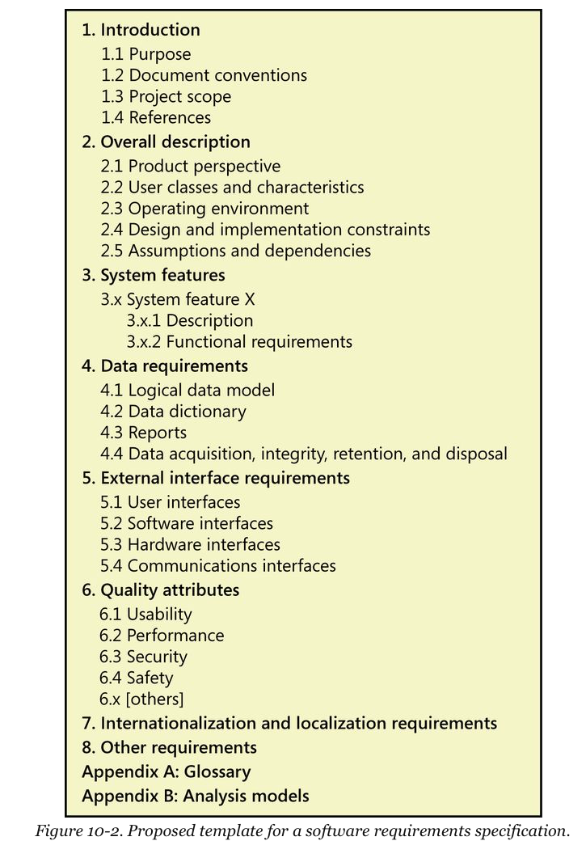
SRS Template

Slide 21
Summary
In this module, we talked about:
The Software Requirements Specification (SRS)
Purpose
Audience
Structure
Contents
How to write excellent requirements statements
What constitutes an excellent requirements statement?
Clear writing style
Appropriate level of detail
Not ambiguous

