Slide 1
systems analysis
Specifying Data Requirements

Slide 2
Topics
The importance of specifying data requirements
Modeling data relationships
Developing Entity Relationship Diagrams
Designing Class Diagrams
Developing a Data Dictionary

Slide 3
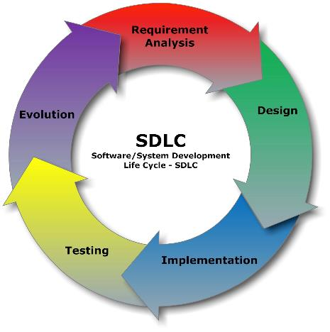
Where Are We?
We are still in Requirements Analysis, but next week we will move on to discussing development tools and testing!

Slide 4

Why Specify Data Requirements?
Bad things happen when there are ambiguities about data
Buffer overflows, overwriting data or program code
Picking up extra padding characters
Syntax errors
Nonstandard variable names, causing developers to not use the same variable name for the same data
Nonstandard methods for validating data items and user input

Slide 5
Modeling Data Relationships
Not to be confused with the data flow diagram, which specifies, the flow of data
Data models depict the system’s data relationships
A commonly-used data model is the Entity Relationship Diagram (ERD)
Object-oriented programming projects use Class diagrams
A data model provides a high-level view of the system’s data
A Data Dictionary provides a detailed view of the system’s data

Slide 6
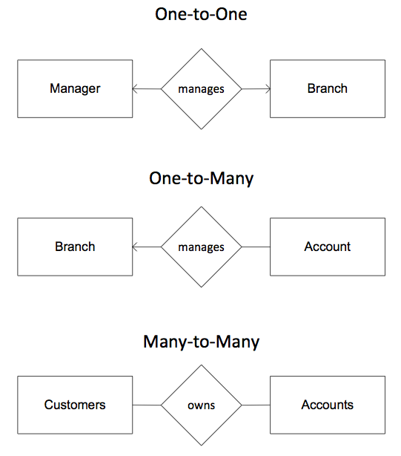
Cardinality
When modeling data relationships, an important concept is cardinality
Cardinality refers to the quantity of instances of a particular data entity relating to another entity
Possible quantities are
One-to-one
One-to-many
Many-to-many

Slide 7
Entity Relationship Diagram
Represents logical groups of information from the problem domain and their interconnections
Helps you understand and communicate the data components of the business or the system
Used during requirements analysis phase of software development
Also often used during database design, later in the development process
Entities can be physical items (including people), aggregations of data, actors, data stores
Entities are named as singular nouns and shown in rectangles on an ERD

Slide 8
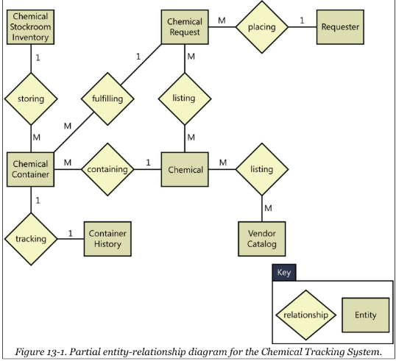
ERD Example
Shows
Entities
Relationship between entities
Cardinality
1 means 1-to-1
M means 1-to-many

Slide 9
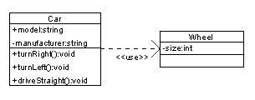
UML Class Diagram
Describes the structure of a system by modeling its classes, attributes, operations, and relationships between objects
Shows the data attributes for individual classes (which correspond to entities in an ERD)
Specifies the logical link between classes
Indicates the cardinality (multiplicity) of those links
One-to-one, one-to many, or many-to-many
Used in object-oriented development methods

Slide 10
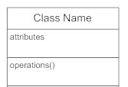
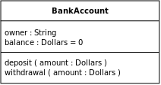
Class Diagram Components
A class is depicted in a rectangle
In the rectangle, include:
Class name at the top
Attributes associated with the class in the middle section
Operations (methods) that an object of this class can perform in the bottom section

Slide 11
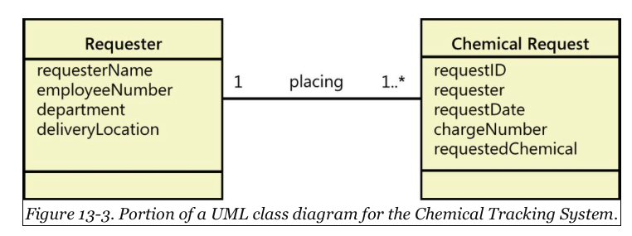
Class Diagram Example
This example doesn’t have the Operations section filled in yet at this point in the software development process
In Class diagrams, the relationship to another Class is depicted with a labeled line
The 1..* notation means “one or more” cardinality

Slide 12
Indicating Cardinality
Indicator | Meaning
0 | Zero
0..1 | Zero or one
1 | Exactly one
0..* | Zero or more
1..* | One or more
* | Another way to indicate one or more
n | Exactly n
0..n | Zero to n
1..n | One to n
m..n | At least m but no more than n

Slide 13
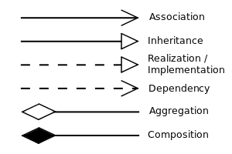

Class Relationships
Composition Example
A building is composed of one or more rooms, and a room may be composed of several sub-rooms.

Slide 14
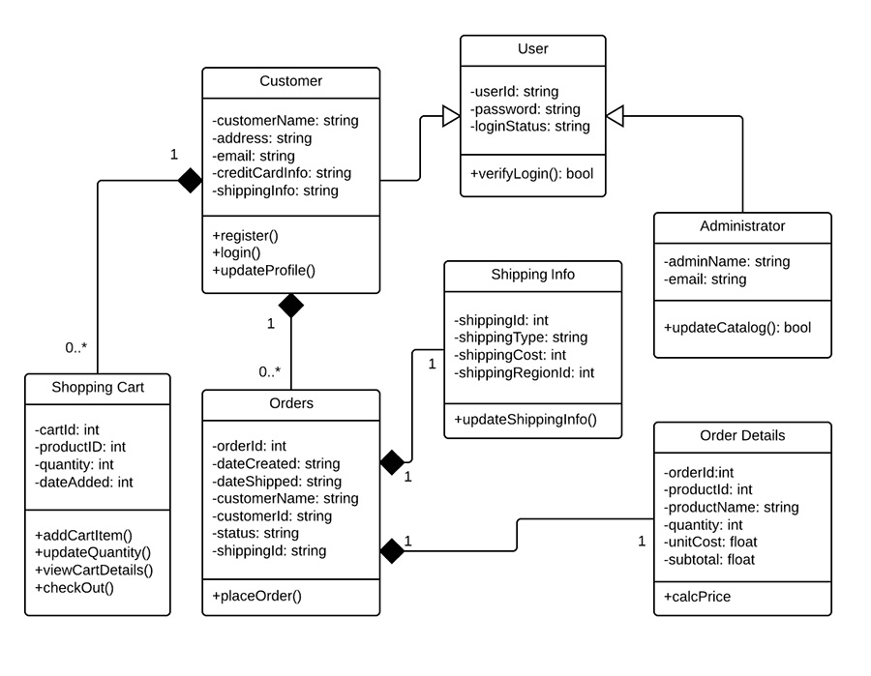
A Class Diagram Example for an Online Shopping System

Slide 15
UML Class Diagram
For more info on UML Class Diagrams, see
https://www.smartdraw.com/class-diagram/
https://www.lucidchart.com/pages/uml/class-diagram
http://www.agilemodeling.com/artifacts/classDiagram.htm

Slide 16
The Data Dictionary
The Data Dictionary is a collection of detailed information about the data entities used in an application
Composition
Data types
Allowed values
Etc.
Collecting this information helps developers
Write programs correctly
Identify data validation criteria
Minimize integration problems
The Data Dictionary complements the SRS glossary, which defines application domain or business terms, abbreviations, and acronyms

Slide 17
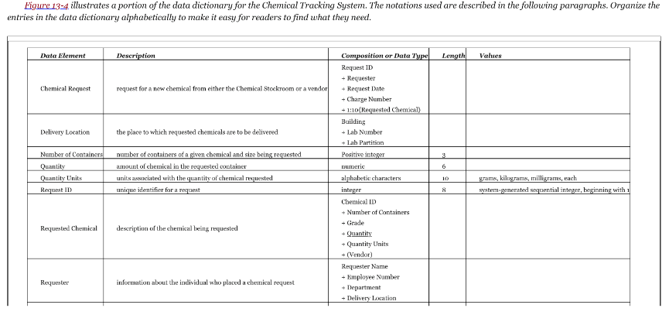
Data Dictionary Example

Slide 18
Summary
In this module, we talked about:
The importance of specifying data requirements
Modeling data relationships with Entity Relationship and Class diagrams
Developing a Data Dictionary

