Slide 1
systems analysis
Development Tools and Testing

Slide 2
Topics
Version control systems
Git
GitHub
Testing

Slide 3
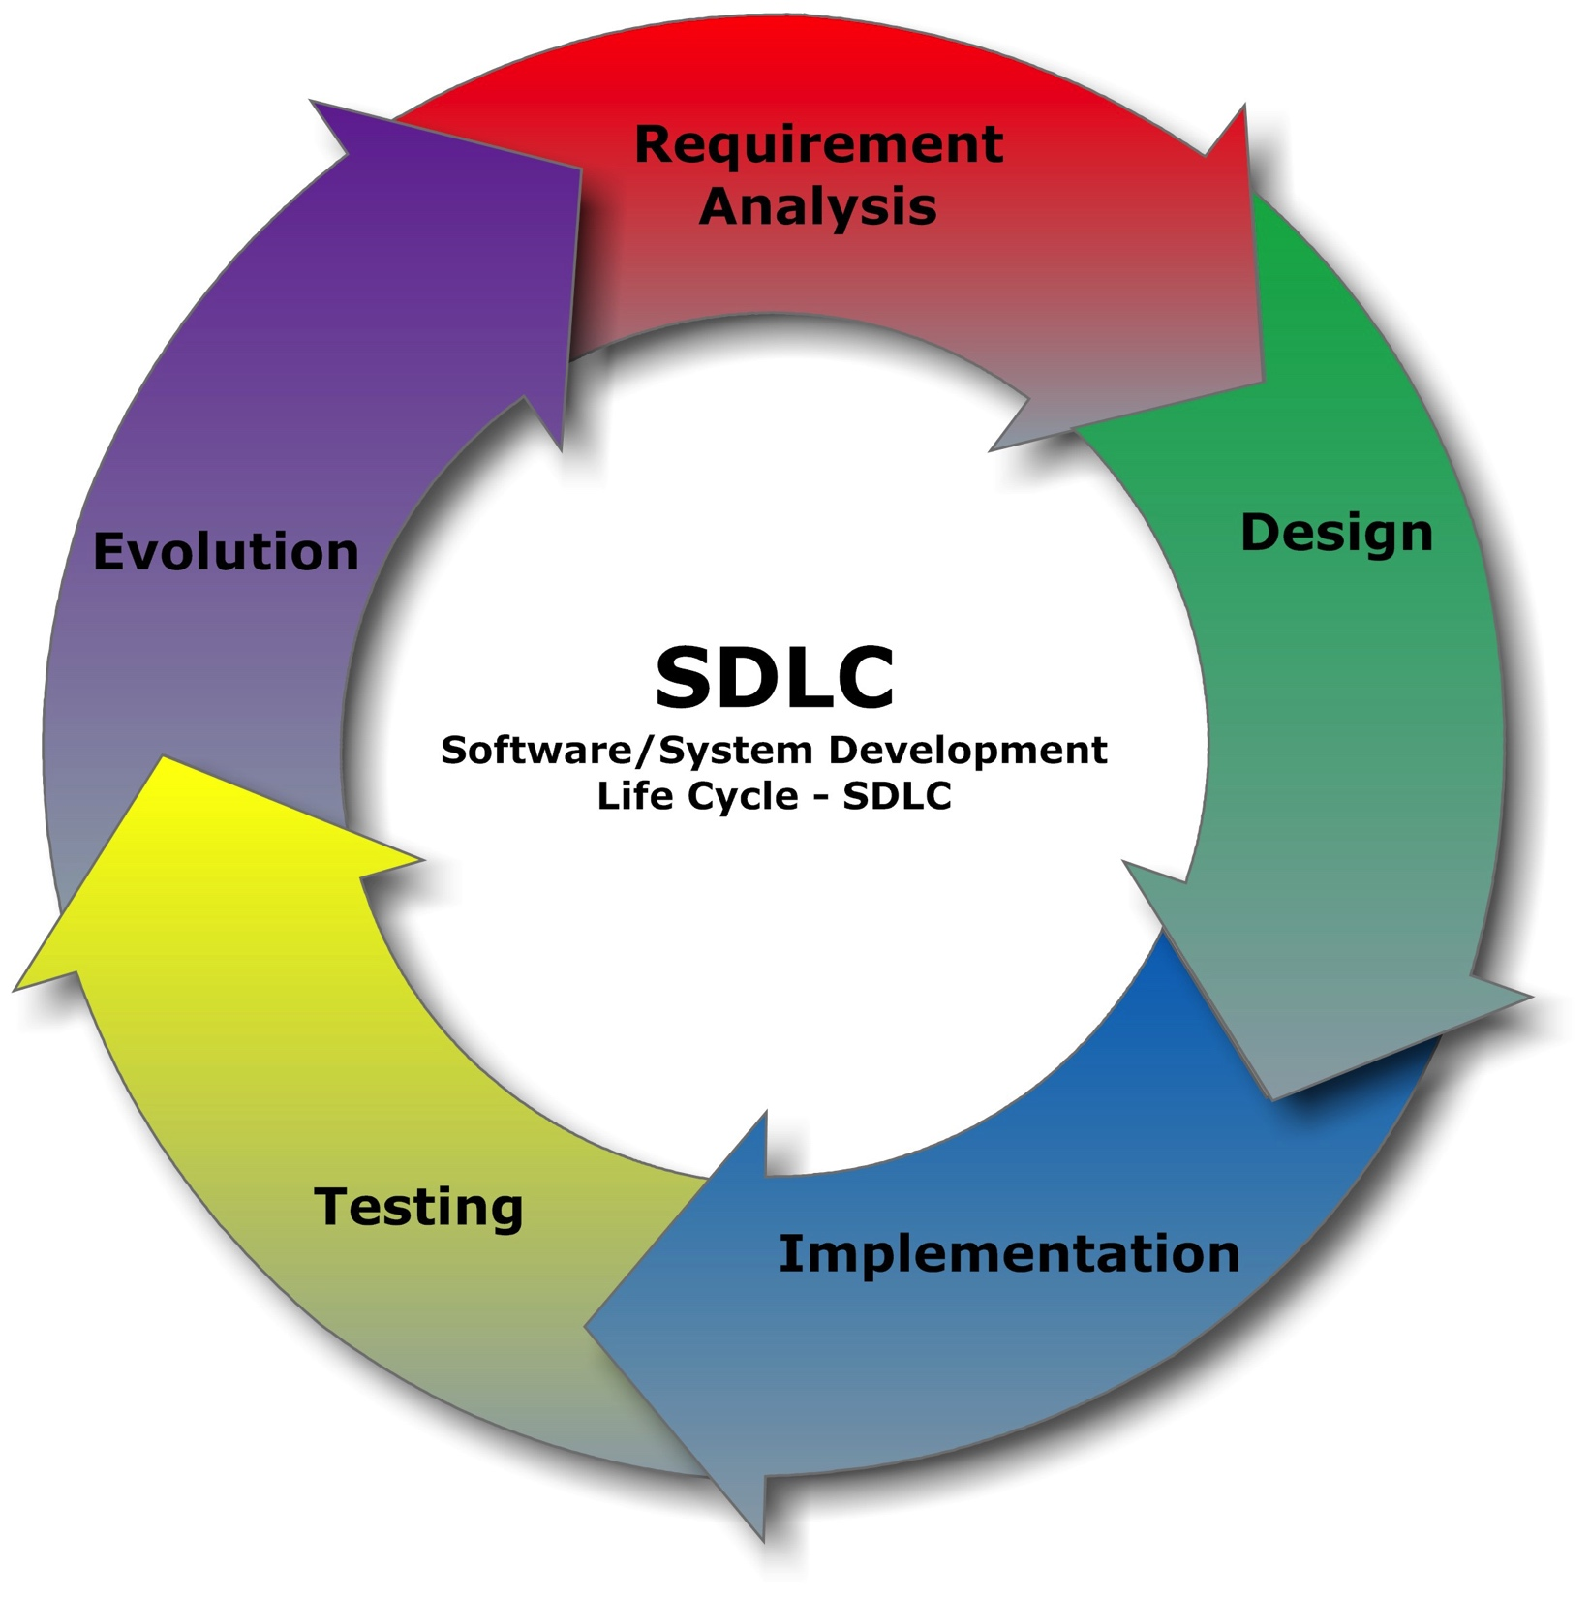
Where Are We?
We are moving on to Implementation and Testing!
This class doesn’t cover much related to implementation, however, except Git and GitHub

Slide 4
Version Control
What is “version control,” and why should you care?
Version control is a system that records changes to a file or set of files over time so that you can recall specific versions later.
For our purposes, we will use software source code and webpage files as the files being version-controlled, though in reality you can use version control with nearly any type of file on a computer.

Slide 5
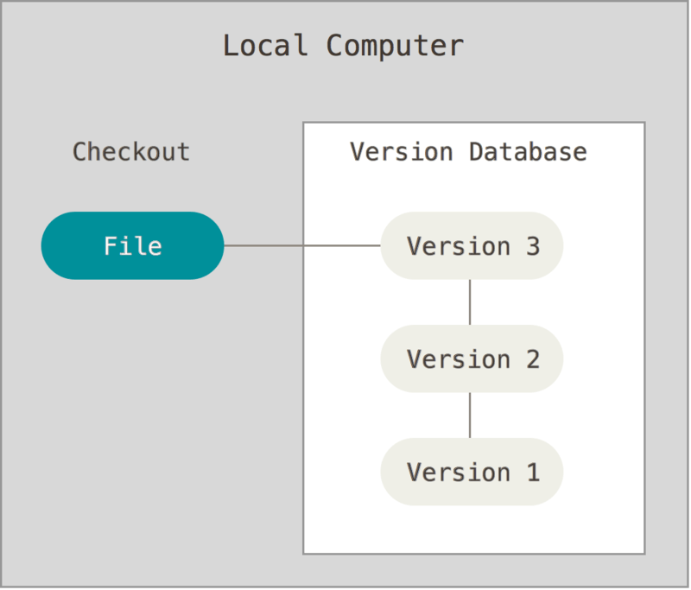
Local Version Control Systems
Instead of just copying files to directories to maintain versions, use a system, such as Revision Control System (RCS) or others

Slide 6
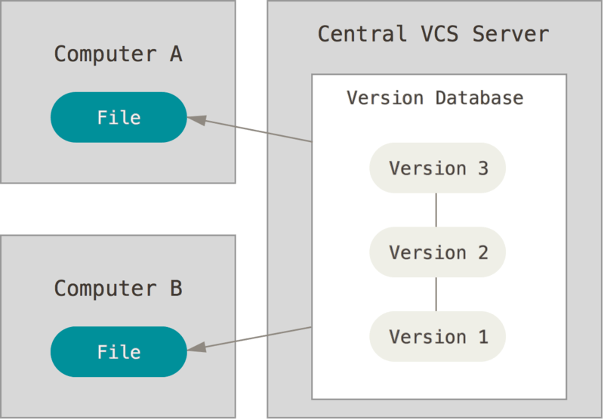
Centralized Version Control Systems
If you need to collaborate with other developers, use a centralized server to store your versions

Slide 7
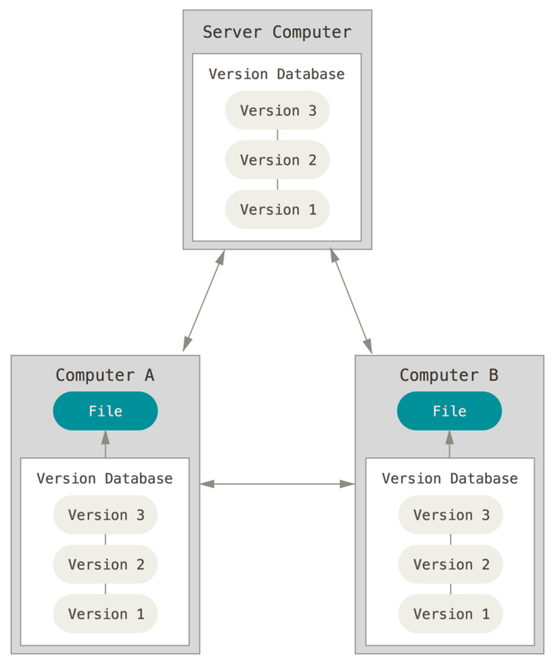
Distributed Version Control Systems
To avoid the risks associated with a single point of failure (the one server that stores versions), use a distributed VCS
Git is a distributed VCS

Slide 8
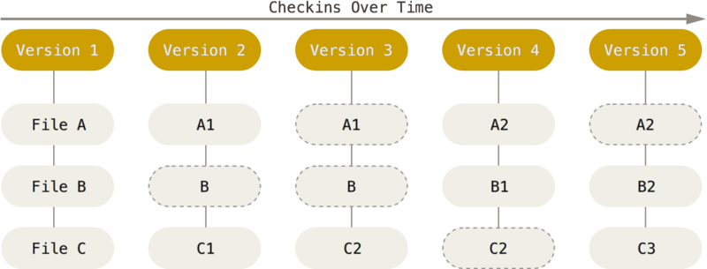
Git, the Most Popular Distributed VCS
To be efficient, if files have not changed, Git doesn’t store the file again, just a link to the previous identical file it has already stored.
Git stores data as snapshots of the project over time.

Slide 9
Git Features
Distributed development
  Git gives each developer a local copy of the full development history.
  Most operations in Git need only local files and resources to operate.
Support for large non-linear development projects
  Git supports rapid branching and merging.
Integrity
  Everything in Git is check-summed before it is stored and is then referred to by that checksum.
History
  Git remembers everything you do, so it’s easy to backtrack if you make a mistake.
  It is hard to get Git to erase data in any way.

Slide 10
The Three Areas of Git
The Git directory (repository) is where Git stores the metadata and object database for your project. This is the most important part of Git, and it is what is copied when you clone a repository from another computer.
The working tree (directory) is a single checkout of one version of the project. These files are pulled out of the compressed database in the Git directory and placed on disk for you to use or modify.
The staging area is a file, generally contained in your Git directory, that stores information about what will go into your next commit. Its technical name in Git parlance is the index, but the phrase staging area works just as well.

Slide 11
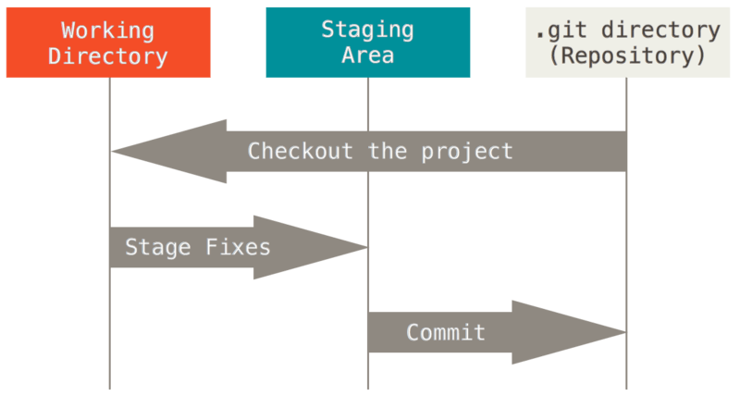
The Three Areas of Git

Slide 12
Git Workflow
You modify files in your working tree.
You selectively stage just those changes you want to be part of your next commit, which adds only those changes to the staging area.
You do a commit, which takes the files as they are in the staging area and stores that snapshot permanently to your Git directory.

Slide 13
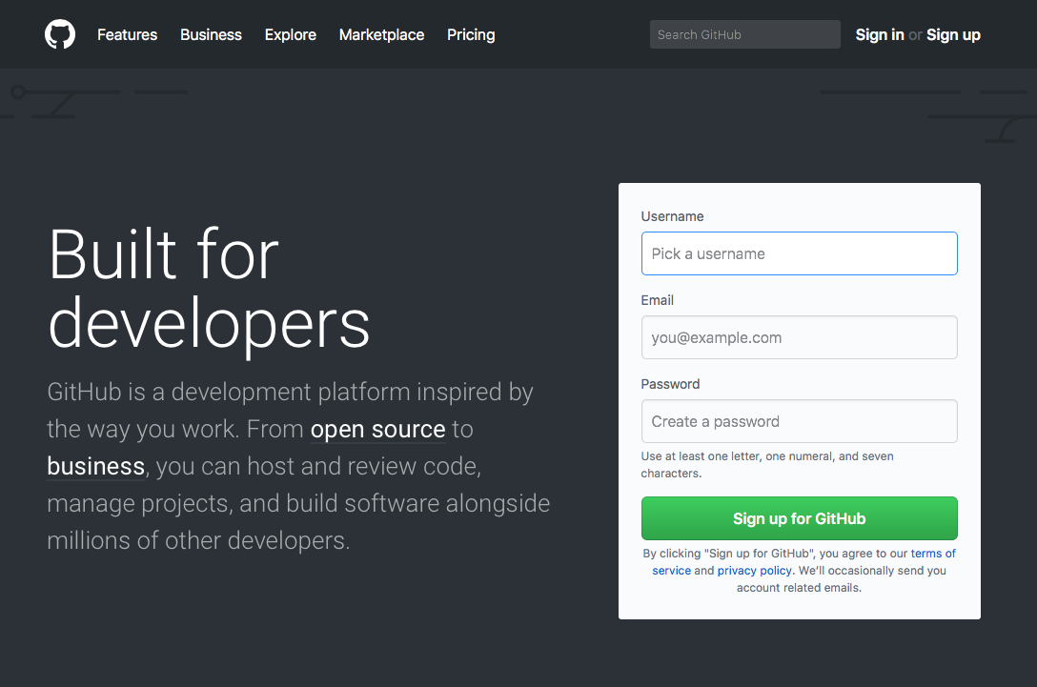
What is GitHub?
A web-based version of Git
A hosting service for Git repositories
https://github.com

Slide 14
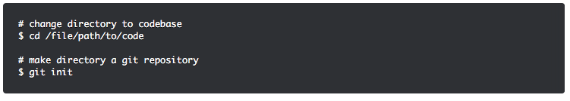
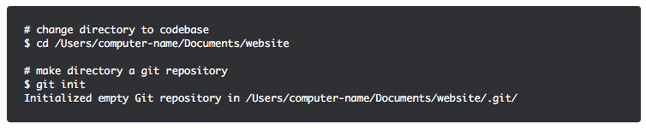
Getting Started with Git
git init
This command turns a directory into an empty Git repository. This is the first step in creating a repository. After running git init, adding and committing files or directories is possible.

Slide 15
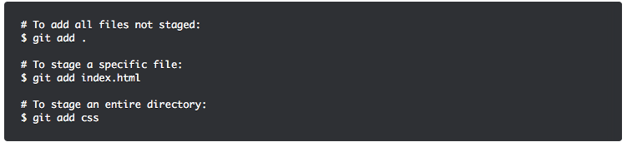
Getting Started with Git
git add
Adds files to the staging area

Slide 16

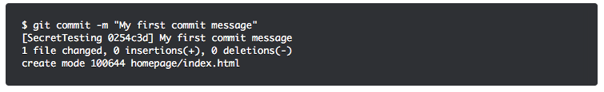
Getting Started with Git
git commit
Records the changes made to the files to a local repository. For easy reference, each commit has a unique ID.

Slide 17
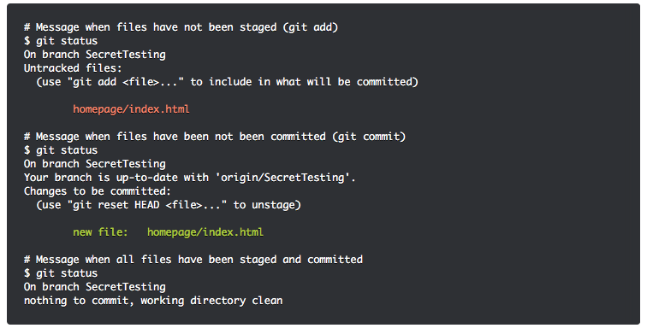
Getting Started with Git
git status
This command returns the current state of the repository. The command will be your best friend when working with Git!

Slide 18
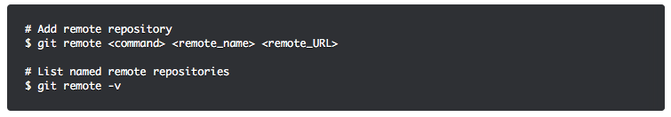
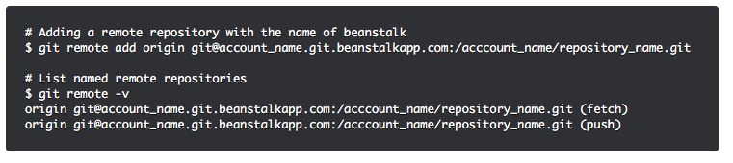
Getting Started with Git
git remote
Connects a local repository with a remote repository.
Note: A remote repository can have any name. It is common practice to name the remote repository origin.

Slide 19
Getting Started with Git
git pull
Gets the latest version of a repository. This pulls the changes from the remote repository to the local computer.

Slide 20
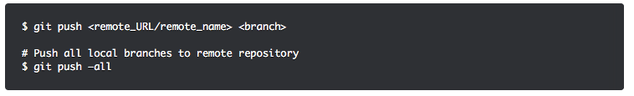
Getting Started with Git
git push
Sends local commits to the remote repository

Slide 21

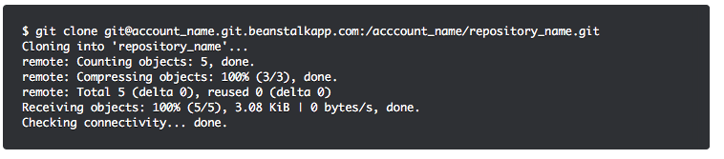
Getting Started with Git
git clone
Creates a local working copy of an existing remote repository

Slide 22
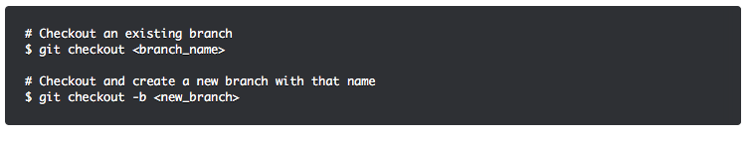
Getting Started with Git
git checkout
To start working in a different branch, use git checkout to switch branches.

Slide 23

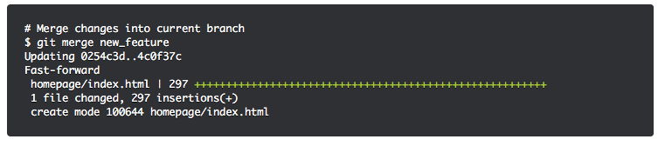
Getting Started with Git
git merge
Integrates branches together; combines the changes from one branch with another branch. For example, use git merge to merge the changes made in a staging branch into the stable branch.

Slide 24
Testing
The Test Plan and testing environment should be established as early as possible, ideally as soon as requirements have been signed off.

Slide 25
Testing
Test Suite
  Test cases
    A set of test cases that cover all requirements or use cases
  Test Traceability Matrix
    A table that shows which tests cover which requirements or use cases.
    The TTM ensures that all requirements are covered.

Slide 26
Choosing Test Cases
All requirements must be covered by a test case.
  Use Cases are very useful here.
There should be at least one test case for each flow through each Use Case.

Slide 27
Test Case Elements
Identifier. Identifier with a required style of VERB-NOUN
Title. One-sentence description of the test case
Author name. First and last name of the person who wrote the test case
Preconditions. What must be executed to get the system in the state necessary to receive the test inputs; can include references to other test cases that must be run first
Dialog. Must have specific inputs (actual data values), NOT a generalized description of the data values (as in use cases). Should have minimal “if this do that” - too many means you need more test cases
Expected outputs. Include expected machine state; example: records entered in the database
Analysis procedures. After test is run, how do we verify whether the outputs received match the expected outputs?

Slide 28
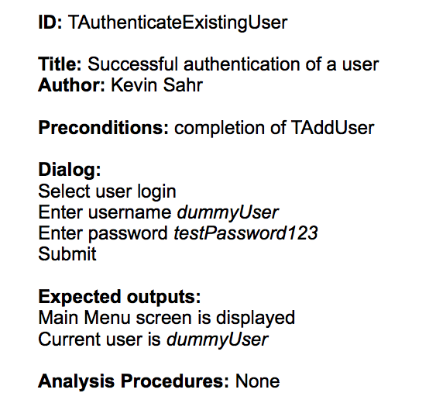
Test Case Example

Slide 29
Testing Analysis Procedures
After test is run, how do we verify whether the outputs received match the expected outputs?
  Text-based outputs can use diff (Unix command)
  More complex cases may require more explanation
  Could be a series of questions, for example:
    Has a new patient record been created in the database?
    Does the new patient record contain the correct phone number?

Slide 30
Test Traceability Matrix
The TTM is a table that identifies the coverage provided by test cases.
Table has requirements or Use Cases on one axis and test case identifiers on the other. Break into multiple tables if needed.
Put an “X” in cells where a test covers a requirement; or you could indicate the degree to which the test case covers the requirement.
  P -> primary coverage
  I -> incomplete coverage
Need a convenient place to summarize testing status? Add additional column.

Slide 31
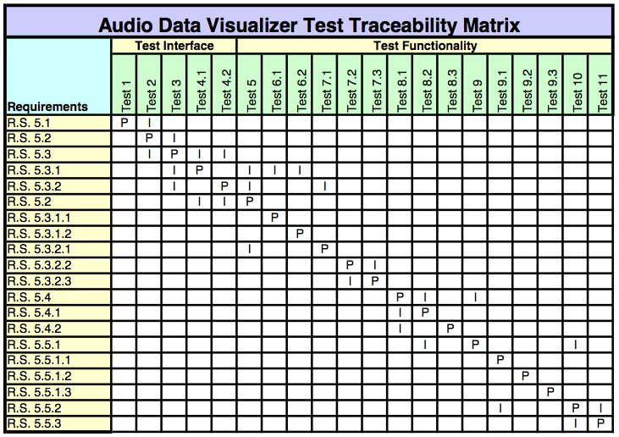
Test Traceability Matrix Example

Slide 32
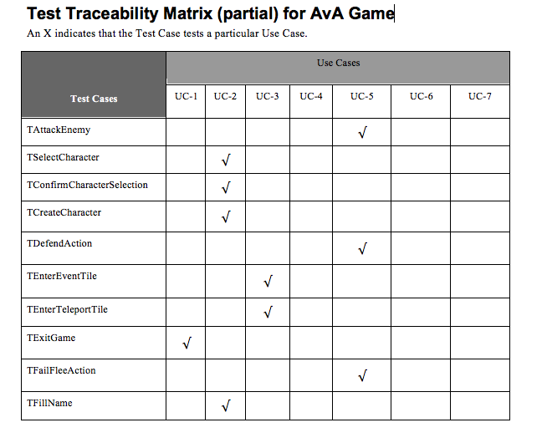
Another Test Traceability Matrix Example

Slide 33
Summary
In this module, we talked about:
  Version control systems
    Local, centralized, distributed
  Git
  GitHub
  Testing
    Test Plans
      Test cases
      TTM

