Slide 1
systems analysis
Agile Development

Slide 2
Topics
What is Agile?
Why was Agile developed?
Characteristics of Agile
Agile team roles
The Agile Manifesto

Slide 3
What is Agile Development?
A set of software development methods that encourage
Continuous collaboration among stakeholders
Rapid and frequent delivery of small increments of useful functionality

Slide 4
Waterfall versus Agile
Waterfall
Predictive
Plan-driven
Minimizes risk by doing extensive planning and documentation before any software development
Works well when requirements are well understood and likely to remain relatively stable during the project
Agile
Adaptive
Change-driven
Minimizes risk by accommodating the inevitable change that occurs in projects
Works well for projects with uncertain or volatile requirements

Slide 5
Software Engineering Methodologies
Refer to University of Alberta Course Notes for more details (in the Introduction section of our Moodle site)
Linear Models
Agile and Related Models
Other Agile-Related Models
Waterfall
V-Model
Sawtooth Model
Agile
Scrum
Extreme Programming
Lean Software Development
Kanban

Slide 6
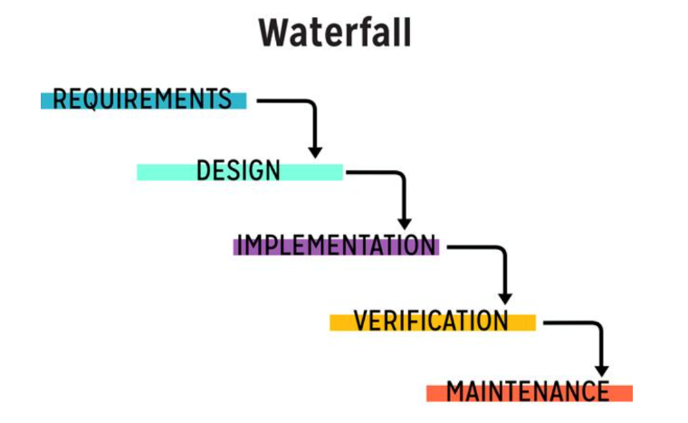
Waterfall (Review)

Slide 7
Why was Agile Developed?
Large projects that use a waterfall approach are often delivered late, and fail to meet users’ expectations.
Stakeholders often change their requirements during the course of a long project.
Developers and project mangers have long realized that development steps ideally should be performed in overlapping phases and multiple iterations of phases.

Slide 8
Characteristics of Agile Methods
Iterative and incremental development
Development in short cycles called iterations (or sprints in Scrum)
Iterations can be as short as one week or as long as a month
During each iteration, the development team adds a small set of functionality based on priorities established by the customer, tests it, and validates it with acceptance criteria established by the customer.

Slide 9
Characteristics of Agile Methods (continued)
Subsequent iterations modify what already exists
Enrich features
Add new features
Correct defects
Implement changes due to ongoing participation with customer
Goal: potentially shippable software at the end of each iteration, even if it is just a small portion of the desired product

Slide 10
Agile Product Backlog
A list of requests for work that the team might perform
Composed of User Stories
May also include other requirements and defects to be corrected
Maintained on story cards, Kanban board, in tools
Prioritization of the backlog is an ongoing activity
Selects which work items go into upcoming iterations and which items are discarded from the backlog

Slide 11
Agile User Stories (Review)
User stories have a specific format:
As a [persona],
I want to [do something],
so that I can [realize a reward]
Examples:
As Helen the HR Manager, I want to screen an engineering candidate, so I know their skills profile.
As a customer, I want to withdraw cash from an ATM, so that I don't have to wait in line at the bank.

Slide 12
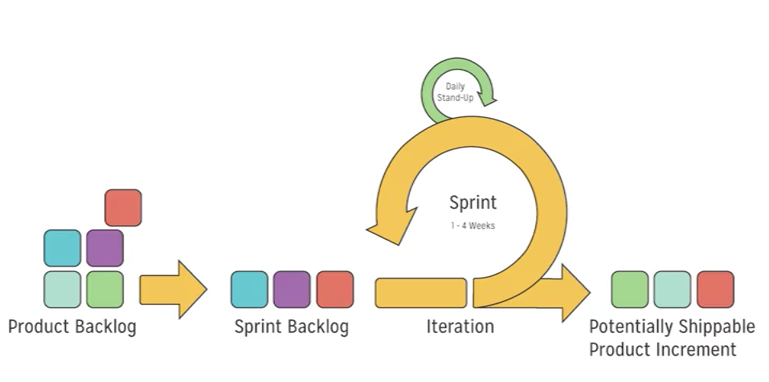
Scrum

Slide 13
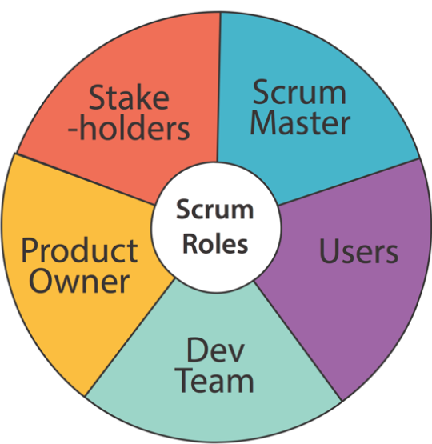
Scrum Roles

Slide 14
Scrum Product Owner
The product owner is the one person who is responsible for the product.
All product requirements for the developers must come through this role.
The list of requirements for the product is gathered in a product backlog, which the product owner is responsible for.
The product owner also determines the priorities of these requirements and ensures the requirements are clearly defined.

Slide 15
Scrum Master
The scrum master makes sure the scrum team adheres to scrum practices, by assisting the product owner and the development team.
For the product owner, this help includes suggesting techniques to manage the product backlog, to attain clear requirements, and to prioritize for maximum value.
For the development team members, this help includes coaching the team to self-organize and remove roadblocks.
The scrum master also facilitates the four events within a sprint:
Sprint planning
Daily scrums
Sprint review
Sprint retrospective

Slide 16
Scrum Development Team
Scrum development teams are small, self-organizing teams, ideally between three and nine people.
They are self-contained, consisting of everyone and everything needed to complete the product.
Each member generally takes on mixed tasks, such as both coding and testing, rather than having dedicated coders and testers.
Everyone on the team is responsible for the team’s work products; accountability rests with the entire team.
No one outside the development team, not even the scrum master or product owner, tells the team how to turn the backlog of requirements for a sprint into developer tasks to produce an increment of working software.

Slide 17
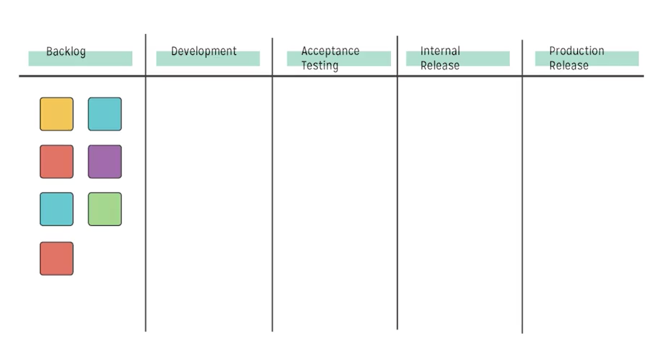
Kanban

Slide 18
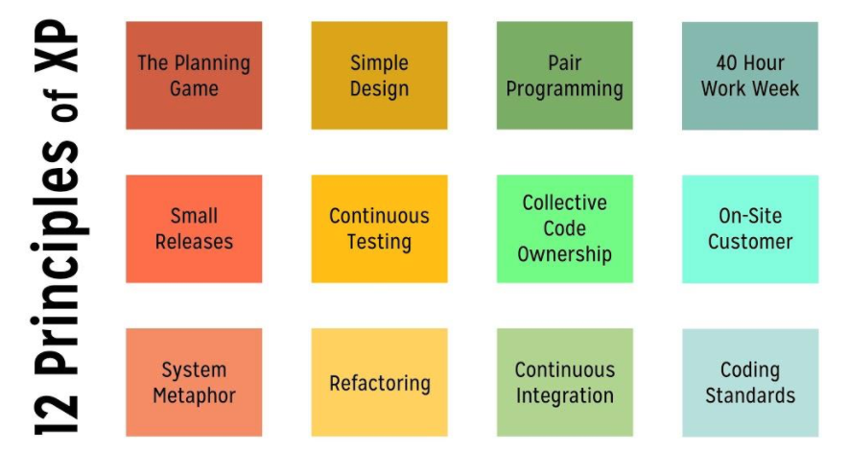
Extreme Programming

Slide 19
Lean Software Development
Lean is based on seven principles:
Eliminate waste
Amplify learning
Decide as late as possible
Deliver as fast as possible
Empower the team
Build quality in
See the whole

Slide 20
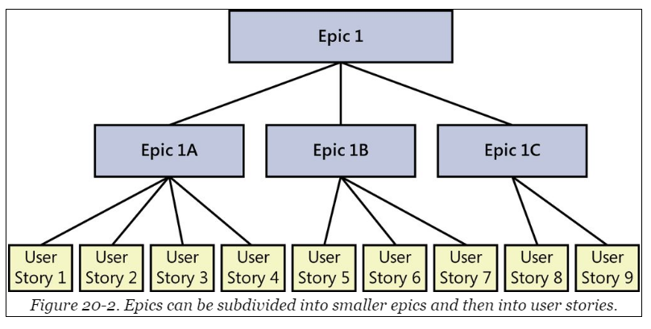
Agile Epic Stories are Subdivided into User Stories

Slide 21
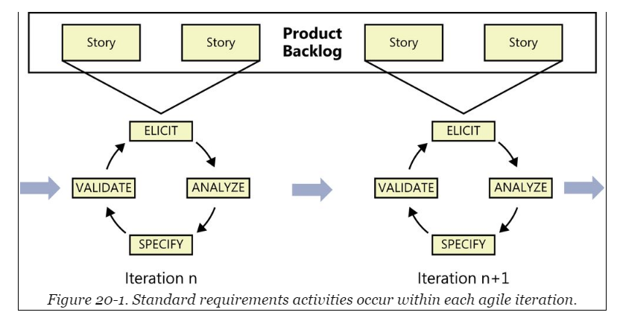
Requirements Activities with Each Iteration

Slide 22
The Agile Manifesto
In 2001, seventeen software developers met at the Snowbird resort in Utah to discuss lightweight development methods.
Together they published the Manifesto for Agile Software Development.
The Manifesto declares values and principles.

Slide 23
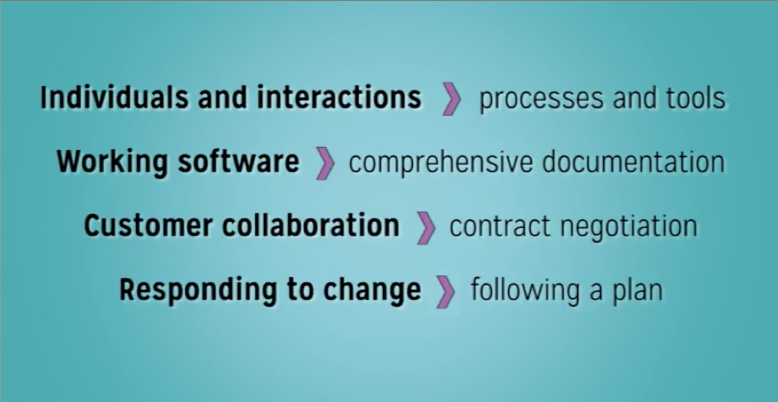
Agile Values
See the Agile Manifesto

Slide 24
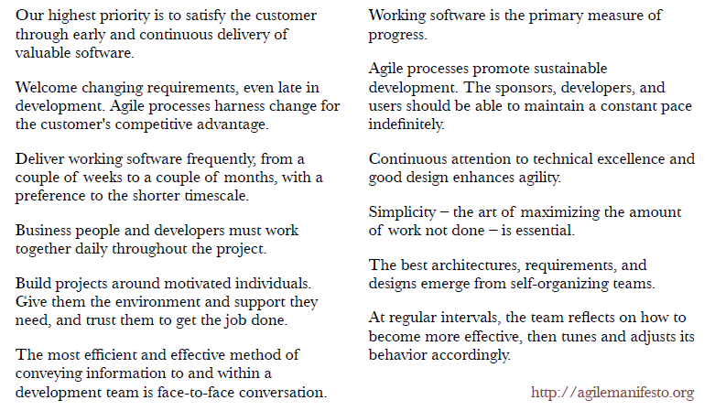
12 Principles of Agile
See the Agile Manifesto

Slide 25
Summary
In this module, we talked about:
The problems with waterfall that Agile attempts to address
The characteristics of Agile
Backlogs and User Stories
The Agile Manifesto

