Slide 1
systems analysis
Planning and Scheduling

Slide 2
Topics
Planning
The importance of planning
Types of planning
Terminology
Charts
Gantt charts
Gantter
CPM charts
PERT charts
Agile planning
Analysis paralysis

Slide 3
The Importance of Planning
Measure twice. Cut once.
Think before you act.
Do it right!
Right product for the clients that is validated to meet the client’s needs
Right software that is verified to conform to a specified design, satisfies a stated set of requirements, and does not have defects
Right project management with enough process to organize the work, but not so much process that it gets in the way

Slide 4
Types of Planning
Release planning is used to plan the project as a whole. Common release planning techniques include Gantt charts and release plans.
Iteration planning is a technique that involves designing and developing the tasks that will be completed in a certain iteration of the project. Common iteration planning techniques include PERT charts, CPM charts, and iteration plans.
Risk planning involves preparing for risks in order to avoid negative repercussions in both creation and support of the product.

Slide 5
Terminology
Term | Definition
Task | A small, manageable step of a project that must be completed; everything in a project can be broken down into tasks
Role | A duty that a person takes on or plays in some relation to the product, such as programmer, tester, designer, client, or product manager
Work product | An output produced by a task or process
Work breakdown structure | A breakdown of a project into smaller components, usually specified hierarchically
Schedule | Tasks of a project that are mapped to a timeline
Milestone | An internal checkpoint used to measure progress (not time based, but event or action based)
Dependency | A situation where one task can’t be completed before another task is completed, or at least partially completed

Slide 6
Work Breakdown Structure (WBS)
A project management and systems engineering technique
A deliverable-oriented breakdown of a project into smaller components
The Project Management Body of Knowledge defines the WBS as a “a hierarchical decomposition of the total scope of work to be carried out by the project team to accomplish the project objectives and create the required deliverables.”

Slide 7
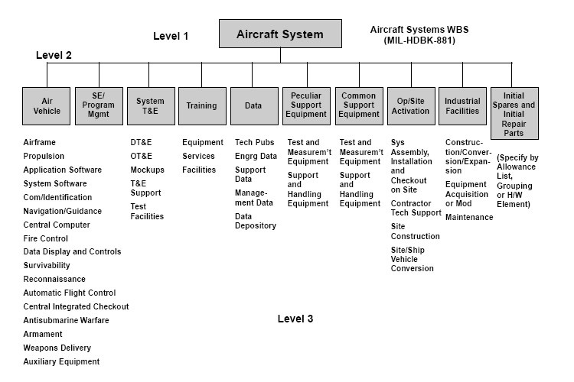
WBS Example
Image extracted from “Systems Engineering Fundamentals.” Defense Acquisition University Press, 2001

Slide 8
Gantt Charts
Gantt charts are simple tools for visualizing project plans or schedules.
They are a kind of cascading horizontal bar chart.
Gantt charts can also be used to visualize task dependencies, the length of tasks, and deadlines.
Gantt charts are useful in both Waterfall and Agile projects.

Slide 9
Gantt Charts (continued)
Gantt charts plot tasks on the left-hand side of the chart against dates, which are displayed at the top of the chart.
Each task is listed separately, one by one, and given its own horizontal bar.
The first scheduled task is at the top of the chart, and progressive tasks are displayed underneath it.
Each task’s bar represents the duration of that task from its start date to its finish date.

Slide 10
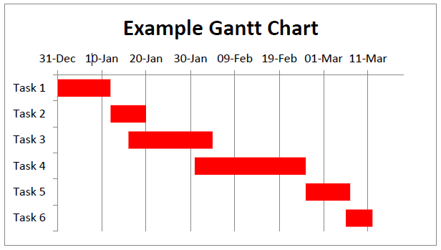
Template of a Gantt Chart
Below is a rough template of what a Gantt chart looks like. In a real example, the tasks would be given descriptive names, and there would probably be several more tasks.

Slide 11
Using Gantt Charts in Agile Projects
In order to use Gantt charts successfully with Agile methods:
Additional context should be provided to tasks (such as identifying if there are task dependencies).
Parts of the chart can be sectioned off as sprints.
The charts must be used with an understanding of flexibility and adaptation to project needs (in other words, the chart could change as the project unfolds).

Slide 12
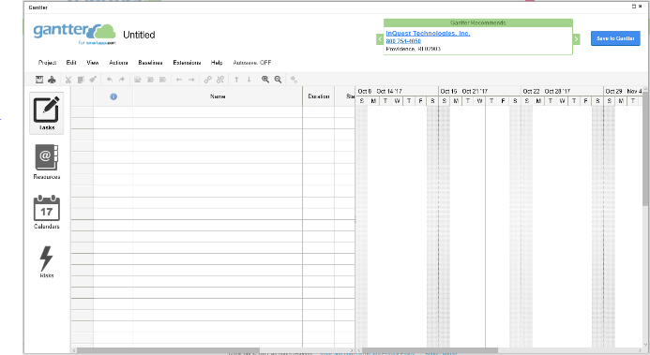
Gantter
Web-based project scheduling
https://gantter.com
Gantter is a little quirky; be patient if you use it! ☺

Slide 13
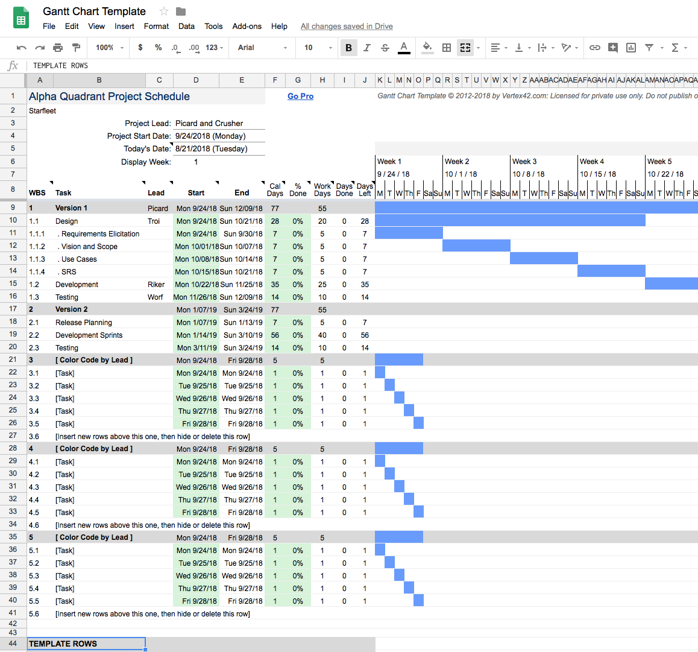
Using Google Sheets for Gantt Charts

Slide 14
Creating Critical Path Method (CPM) Charts
Break down the tasks
Add time estimates
Determine dependencies
Create a path

Slide 15
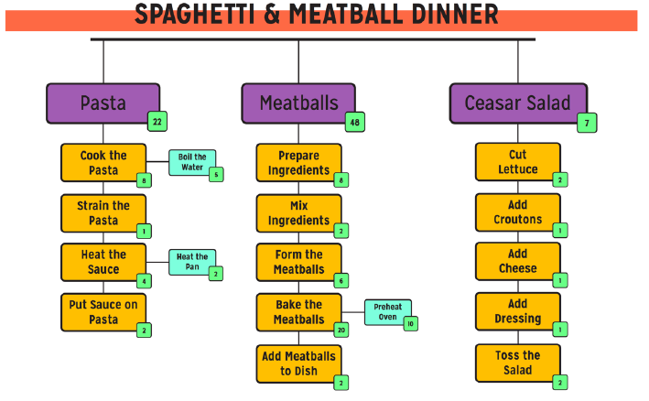
CPM Chart Steps 1-3
Tasks are broken down with time estimates in the little green boxes; dependencies are noted

Slide 16
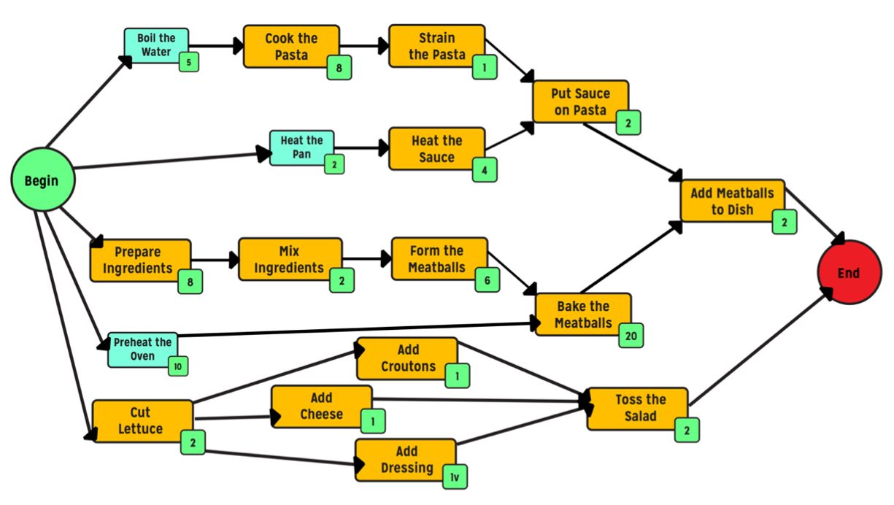
CPM Chart Step 4
Create paths
The critical path is the longest duration path of tasks between logical points.

Slide 17
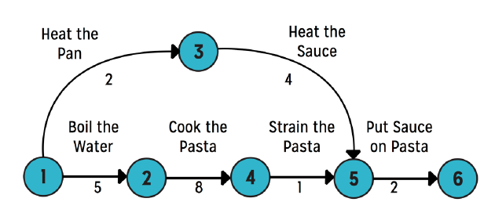
Program Evaluation and Review Technique (PERT) Chart
Similar to CPM charts, PERT charts are visual representations of a project and its tasks and dependencies.
PERT charts use nodes and edges in their graphical depictions.

Slide 18
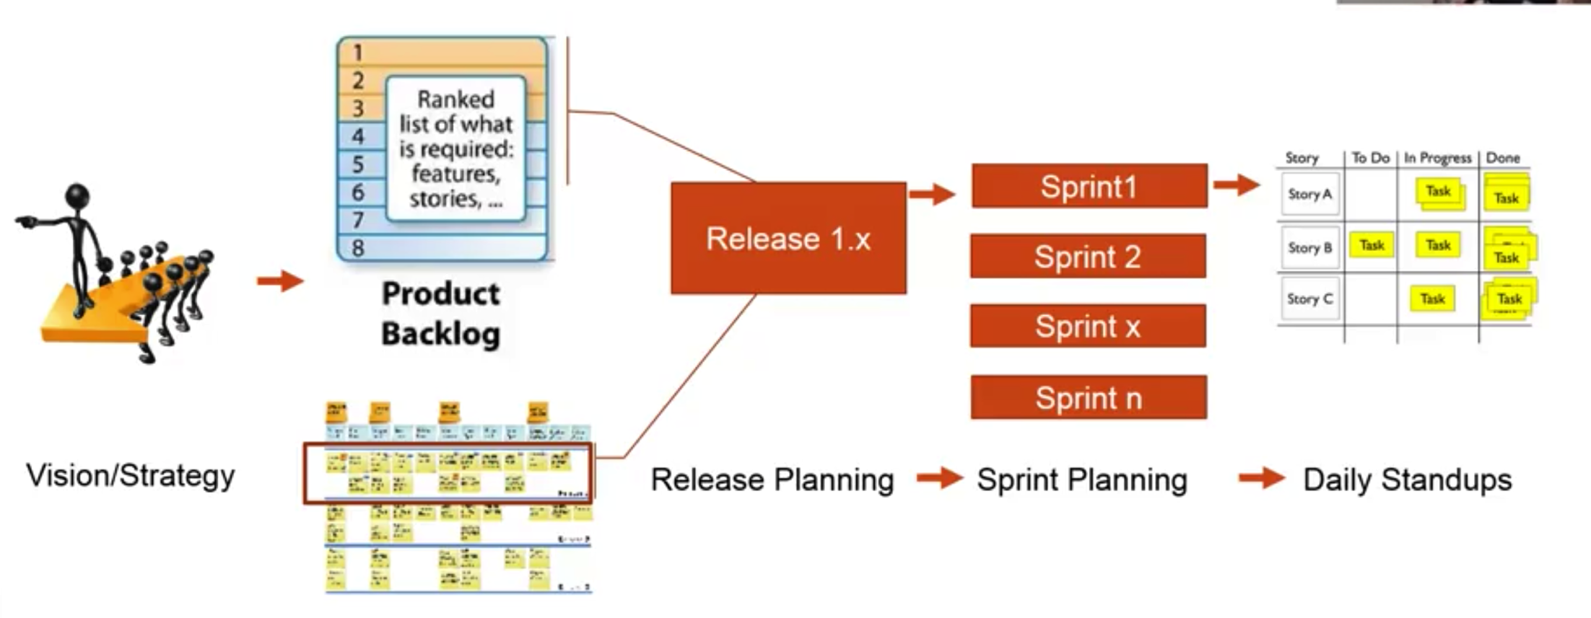
Agile Planning

Slide 19

Agile Estimating
Planning poker?!
https://youtu.be/MrIZMuvjTws
https://www.planningpoker.com

Slide 20

Analysis Paralysis
Don’t get stuck spending too much time eliciting requirements, analyzing requirements, documenting requirements, planning, creating planning charts.
The term analysis paralysis is used to refer to a problem where a software development team gets stalled trying to do a compete job of analyzing requirements, leading to stagnation of the project.

Slide 21
Summary
In this module, we talked about:
Planning
Types of plans
Charts used in planning
Gantt charts
CPM charts
PERT charts
Avoiding the evil analysis paralysis problem!

