Slide 1

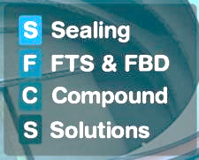
SFC Solutions
Weekly S&OP Nov ’22

Slide 2

Bawal: Overview of Supply and Demand consumption vs defined ICP for Nov 22
Demand
Q5 (30% > ICP)
X451 (22% > ICP)
Sprint (17% < ICP)
Y1K ( 19% < ICP)
YOM (44% < ICP)
Supply:
X-104 & Q5 Supply issue due to customer Ramp-up & Quality Issue
VW Supply issue due to Glass Run Prod. Issue at plant
Pune WH stock need to built as per Customer norms in WHS to avoid PF
Premium Fright : Zero (Till Date)

Slide 3
Chennai: Overview of Supply and Demand consumption vs defined ICP for Nov 22
Supply:
No Constraint of Supply from CNS
Demand:
No Issue

Slide 4
MNSR: Overview of Supply and Demand consumption vs defined ICP for Nov 22
Demand:
U321 (39% < ICP) Scorpio (19% > ICP)
Alto (30% < ICP) Nissan (20% > ICP)
YCA (15% < ICP)
YG8(EECO) (36% < ICP)
Supply:
M&M / Nissan Stock Built Up Activity in progress
Need to build up stock in WH to avoid customer line stoppage
Air Freight : 1.5Lacs Approx. for Chennai & Nashik

Slide 5
Sanand / SBD: Overview of Supply and Demand consumption vs defined ICP for Nov 22
Sahibabad
Sanand
Supply: SBD & SND
No Constraint in Supply
Demand: SBD & SND
TATA Cub & One Ton (16% & 45% < ICP)
FCA 556 (14% < ICP)
FCA 5960( 31% > ICP )

Slide 6
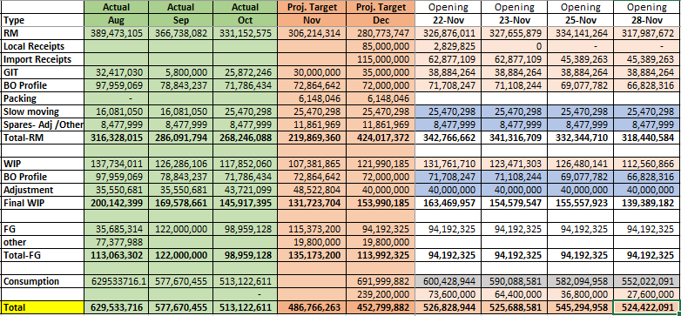
Inventory Projection – Nov’22

Slide 7
Thank You..!

