Slide 1
Identification of incorrectly oriented particles in cryo-EM single particle analysis
2021/08/24

Slide 2
Outline
01
Introduction
02
Material and Method
03
Result
04
Discussion and Conclusion

Slide 3
https://www.ypppt.com/
01
Introduction

Slide 4
Basic idea
To obtain more precise 3D map
01
02
Projection’s orientation most
are unknown.
Incorrectly aligned particles
Some matching process can obtain information.
(i.e. three orientation angles and two in-plane displacements)
Considering simultaneously several objective functions.
Notes:
再來就是有多algorithm去估計orientation problem ,雖然已經會盡量去避免local minima了
但還是會有一些被不正確align的particle,

Slide 5
“
A novel approach to validate angular assignment
Assumption :
The orientation assigned to a particular projection should be consistent with the angular assignment that has less noise in goal function.
To denoise the landscape of a goal function, signal spectral decomposition that based on graph theory can be applied, we can exploit the spatial relationship between neighboring orientations in relation to the registration parameters and the similarity criterion used for matching projections.
Identify low-reliability projections

Slide 6
https://www.ypppt.com/
02
Material and Method

Slide 7

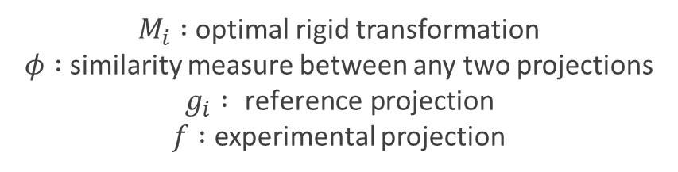

Angular assignment method :
$${}_{{ g}_{i}∈ℜ}^{argmax}{ φ(g_{i},M_{i}(f))}$$
$M_{i} :$optimal rigid transformation
$φ :$similarity measure between any two projections
$$g_{i} : \text{reference} \text{projection}$$
$f :$ experimental projection
Given a reference projection $g_{i}$ ,
If orientation assigned to experimental projection is correct ,
the neighboring reference projections $g_{j}$ ,also yield a high similarity value($i.e. φ(g_{j},M_{i}(f))$).
The orientation assigned to experimental projection is incorrect ,
due to the spurious similarity for some of the neighboring reference $g_{j}$.

Slide 8
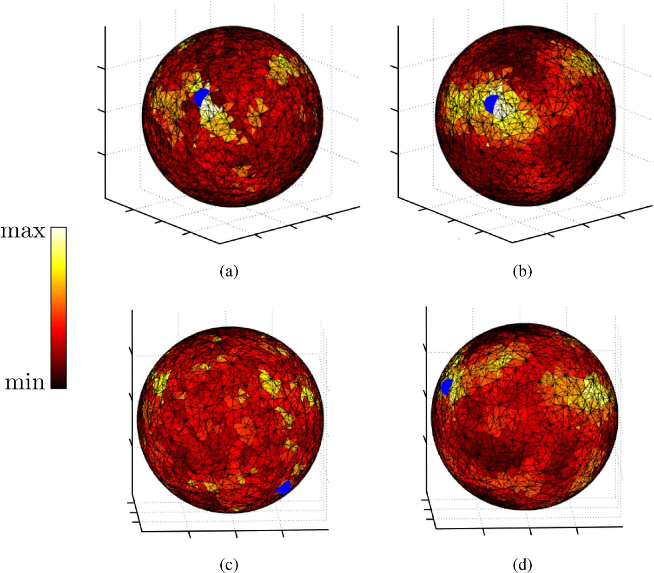
Lowpass filter version

Slide 9
Graph Signal Processing (GSP)
It is possible to incorporate the relationship among data samples as part of the analysis process.
Classical signal processing :
Deal with :
functions defined over a set of discretized values typically arranged over a regular grid.
Graph signal processing :
Deal with :
functions defined over the nodes of a graph, nodes that likely have an irregular distribution in space.
Notes:
1.To remove spurious similarity from objective function
2.(this is especially useful for the method we propose here because we compare any experimental projection against a set of synthetically generated reference projections from known orientations; projections that keep a spatial relationship among them).

Slide 10
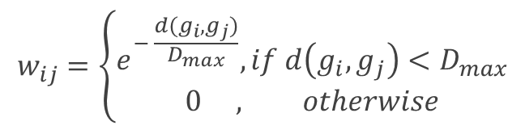
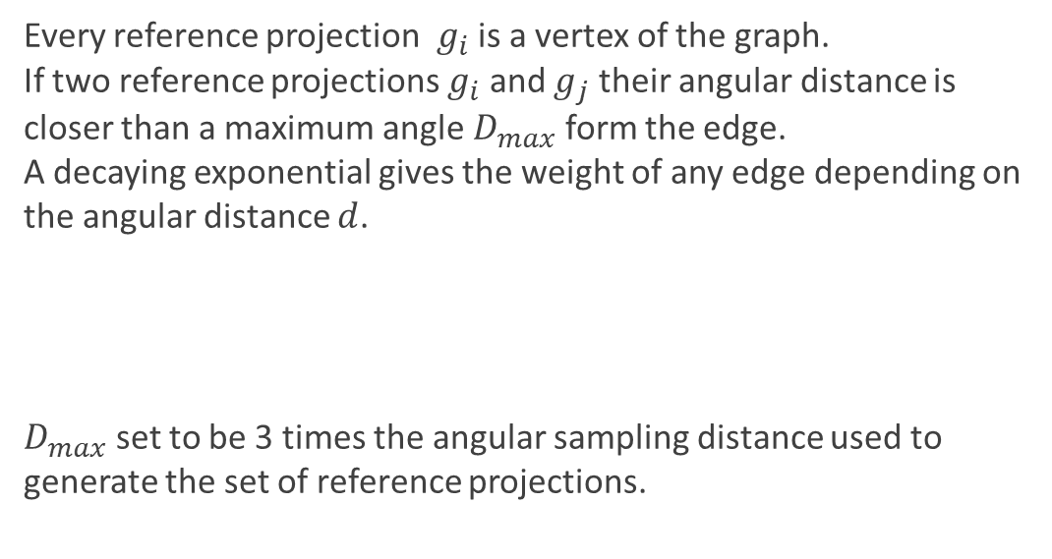
Graph Signal Processing (GSP)
Graph is defined by a set of vertices $V$ and a set of edges $E$ connecting the vertices.
Every edge $e=(v,v′)∈E$ may have a weight $w\left(v,v^{′}\right)∈ ℝ$ associated to it.
Approach proposed here:
Every reference projection $g_{i}$ is a vertex of the graph.
If two reference projections $g_{i}$ and $g_{j}$ their angular distance is closer than a maximum angle$D_{max}$form the edge.
A decaying exponential gives the weight of any edge depending on the angular distance $d$.
$D_{max}$ set to be 3 times the angular sampling distance used to generate the set of reference projections.
$$w_{ij}=\left\{\begin{aligned}e^{− \frac{d(g_{i},g_{j})}{D_{max}}},if d\left(g_{i},g_{j}\right)<D_{max} \\ 0 , otherwise\end{aligned}\right.$$
Notes:
whose values are known for the graph vertices $(φ\left(v\right) \text{for} \text{all} v∈V)$
dmax是生成reference projection 時所用ㄉangular distㄉ三倍

Slide 11
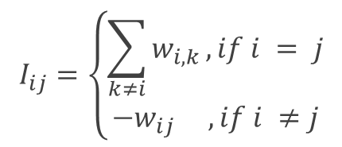
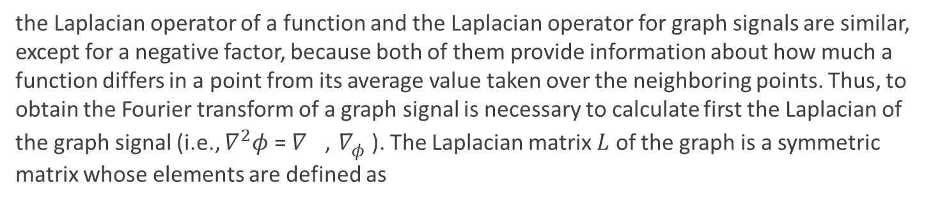
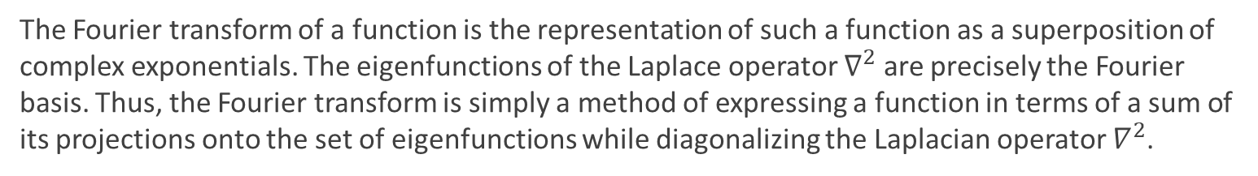
Graph Signal Processing (GSP)
Fourier Transform:
The Fourier transform of a function is the representation of such a function as a superposition of complex exponentials. The eigenfunctions of the Laplace operator $∇^{2}$ are precisely the Fourier basis. Thus, the Fourier transform is simply a method of expressing a function in terms of a sum of its projections onto the set of eigenfunctions while diagonalizing the Laplacian operator $∇^{2}$.
Extend to graph signal
the Laplacian operator of a function and the Laplacian operator for graph signals are similar, except for a negative factor, because both of them provide information about how much a function differs in a point from its average value taken over the neighboring points. Thus, to obtain the Fourier transform of a graph signal is necessary to calculate first the Laplacian of the graph signal (i.e., $∇^{2}φ$ = $∇^{}$, $∇_{φ}^{}$). The Laplacian matrix $L$ of the graph is a symmetric matrix whose elements are defined as
$$I_{ij}=\left\{\begin{aligned}\sum_{k≠i}{w_{i,k}},if i = j \\ −w_{ij} ,if i ≠j\end{aligned}\right.$$
Notes:
在函數裡的 Fourier transform 是將函數表示成 .
Lapalace operator 的 eigenfunctions 是 fourier basis.
Fourier transform 其實只是一種在對角化operator時,一個表示projection在eigenfunction上總和的函數
因為它們都提供了關於一個函數在一個點上與其在相鄰點上取的平均值有多少不同的信息

Slide 12
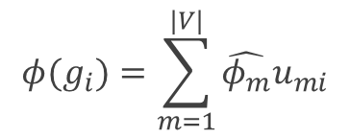

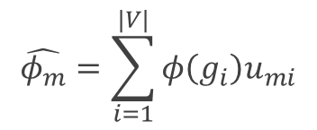
Graph Signal Processing (GSP)
The eigenvalues of $L$ play the role of frequency and its eigenvectors play the role of the Fourier basis.
Graph Fourier Transform :
$$\hat{φ_{m}}=\sum_{i=1}^{|V|}{φ\left(g_{i}\right)u_{mi}}$$
$u_{mi}$ : i-th component of the m-th eigenvector
Inverse Fourier Transform :
$$φ(g_{i})=\sum_{m=1}^{|V|}{\hat{φ_{m}}u_{mi}}$$
Notes:
M plays the role of Fourier index, as in the Discrete Fourier Transform)
The graph Fourier transform (and its inverse) gives a way to represent a signal in two different domains: the vertex domain and the graph spectral domain.

Slide 13


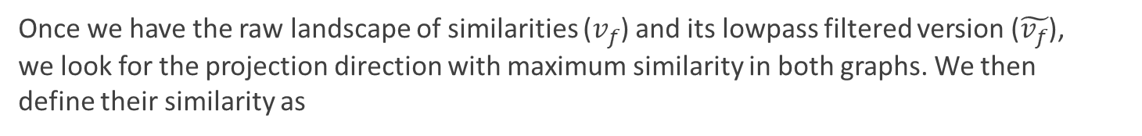
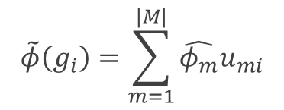
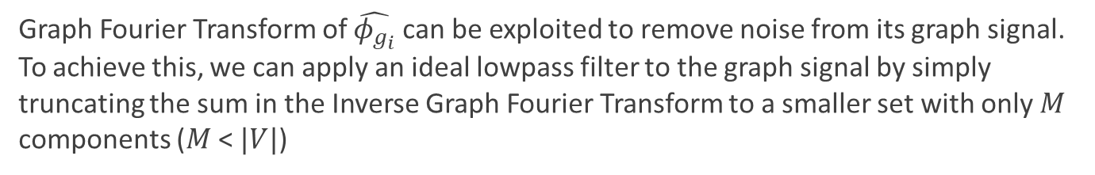
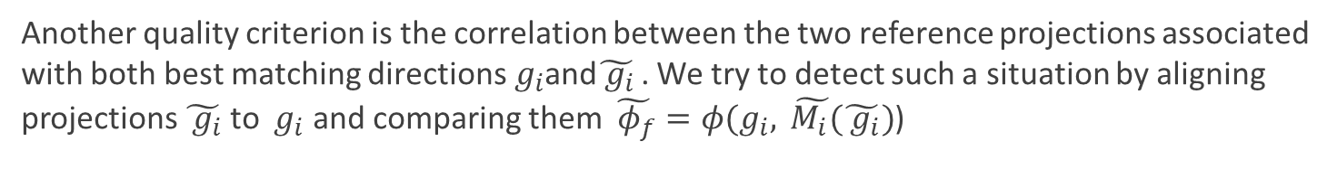
Graph Signal Processing (GSP)
Graph Fourier Transform of $\hat{φ_{g_{i}}}$ can be exploited to remove noise from its graph signal. To achieve this, we can apply an ideal lowpass filter to the graph signal by simply truncating the sum in the Inverse Graph Fourier Transform to a smaller set with only $M$ components ($M$ < $|V|$)
$$\tilde{φ}\left(g_{i}\right)=\sum_{m=1}^{|M|}{\hat{φ_{m}}u_{mi}}$$
Once we have the raw landscape of similarities ($v_{f}$) and its lowpass filtered version ($\tilde{v_{f}}$), we look for the projection direction with maximum similarity in both graphs. We then define their similarity as
${d_{f}=v}_{f}$, $\tilde{v_{f}}$
, : standard inner product in $ℝ^{3}$.
Another quality criterion is the correlation between the two reference projections associated with both best matching directions${ g}_{i}$and$\tilde{ g_{i}}$ . We try to detect such a situation by aligning projections $\tilde{ g_{i}}$ to ${ g}_{i}$ and comparing them $\tilde{ φ_{f}}=φ(g_{i},\tilde{ M_{i}(}\tilde{ g_{i}})$)
Notes:
In our algorithm, we choose the subset of M Fourier components to be those with the largest energies and whose combined energies amount for 95% of the total spectral energy. Hence, the fltered landscape ϕ̃(gi) is a smoother version of the landscape of similarities
(best matching reference in the unfltered graph)
(best matching reference in the fltered graph)

Slide 14
https://www.ypppt.com/
03
Result

Slide 15
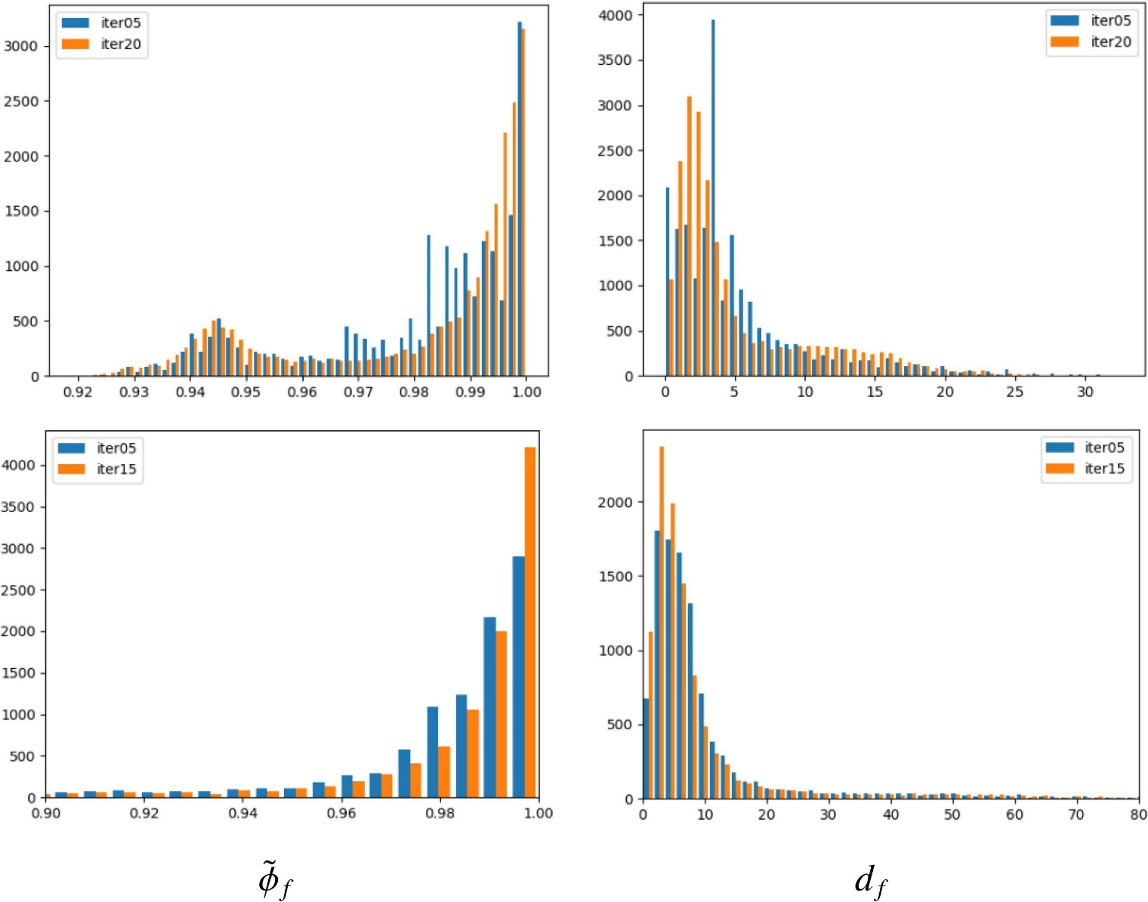

Brome Mosaic Virus (BMV)
$β$-galactosidase

Slide 16
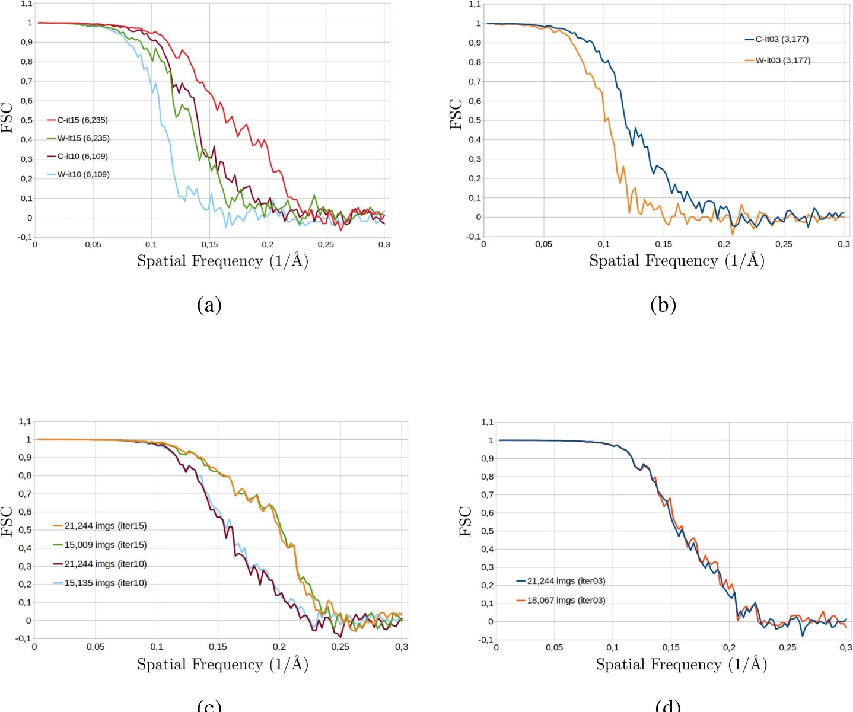
Brome Mosaic Virus (BMV)
Projections : 21,244
Voltage : 300 kV
Magnification : 50,000
Spherical aberration : 4.1 mm
Amplitude contrast : 0.1
Pixel size : 0.99 Å/pix
0.171
0.127
0.163
0.212
0.12
0.156
Relion
Xmipp
0.224
0.198
0.228
0.198
0.205
0.201

Slide 17
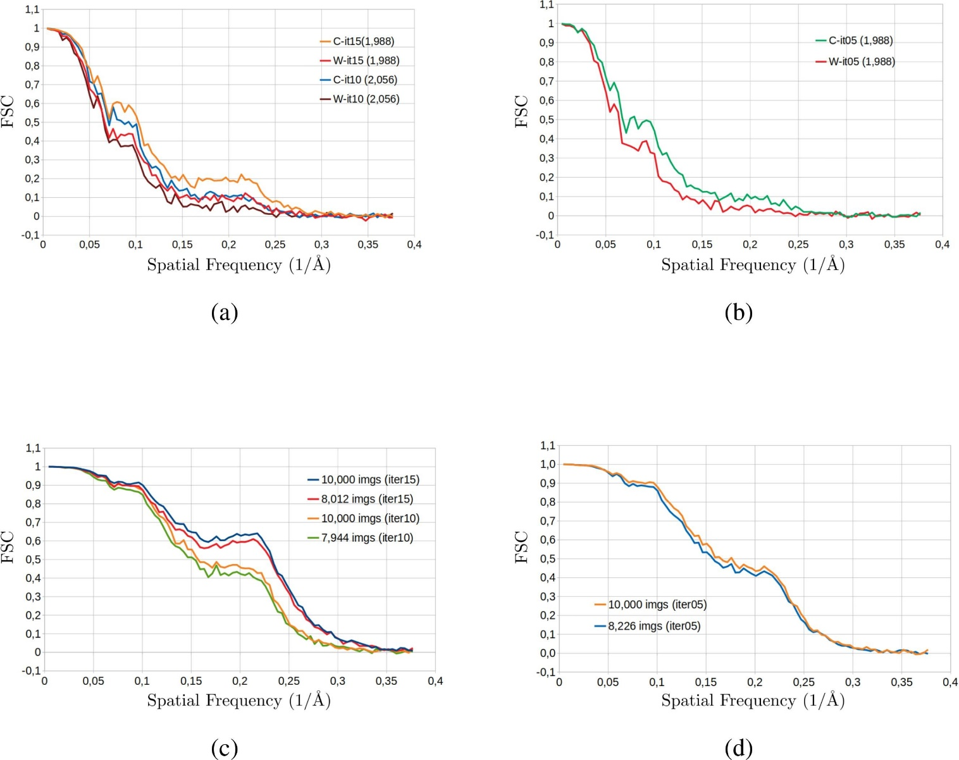
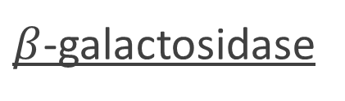
$β$-galactosidase
Projections : 10,000
Voltage : 300 kV
Magnification : 50,000
Spherical aberration : 2.7 mm
Amplitude contrast : 0.1
Pixel size : 0.32 Å/pix
Relion
Xmipp

Slide 18
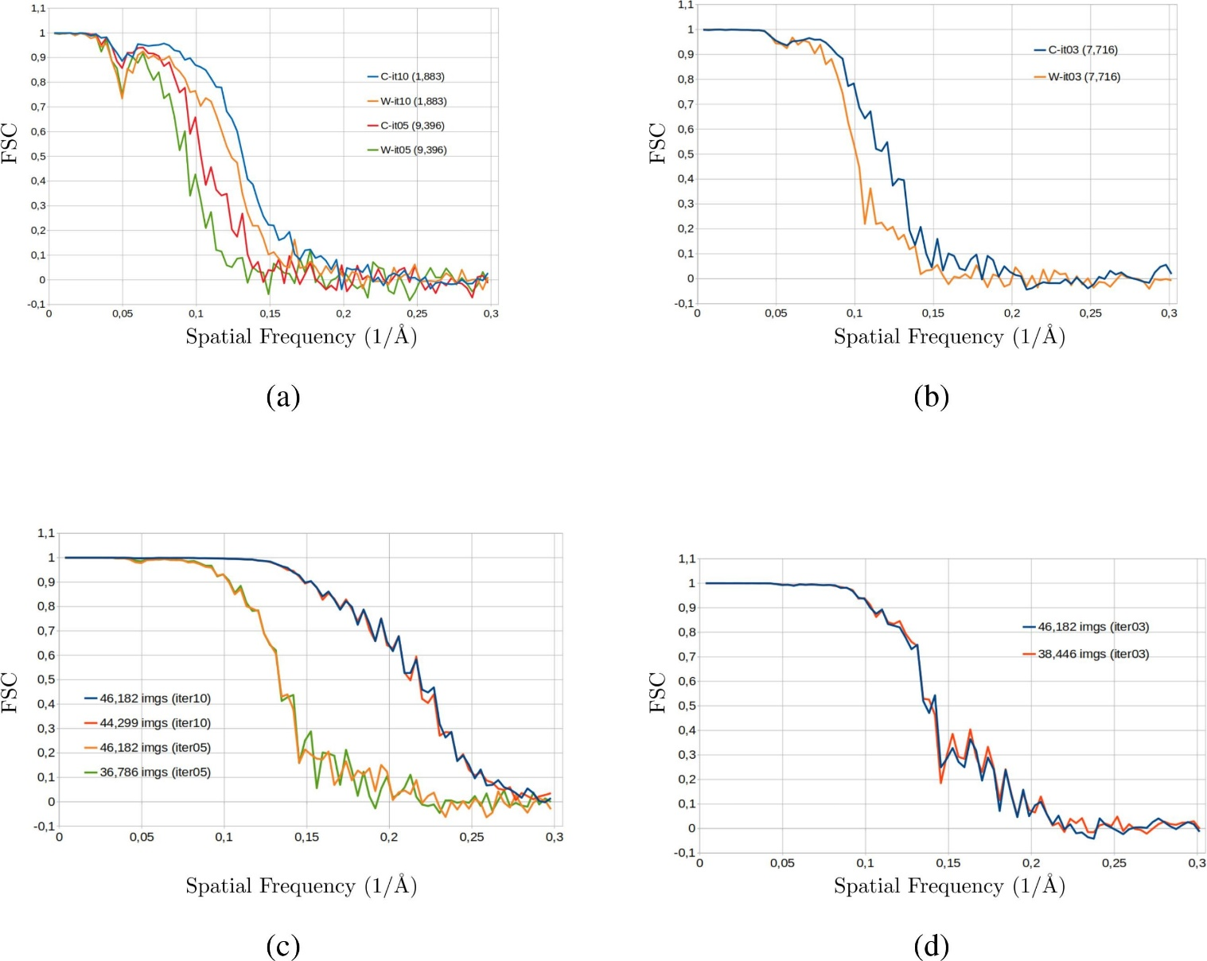
Apoferritin
Projections : 46,182
Voltage : 300 kV
Magnification : 50,000
Spherical aberration : 2.7 mm
Amplitude contrast : 0.1
Pixel size : 0.94 Å/pix
Relion
Xmipp

Slide 19
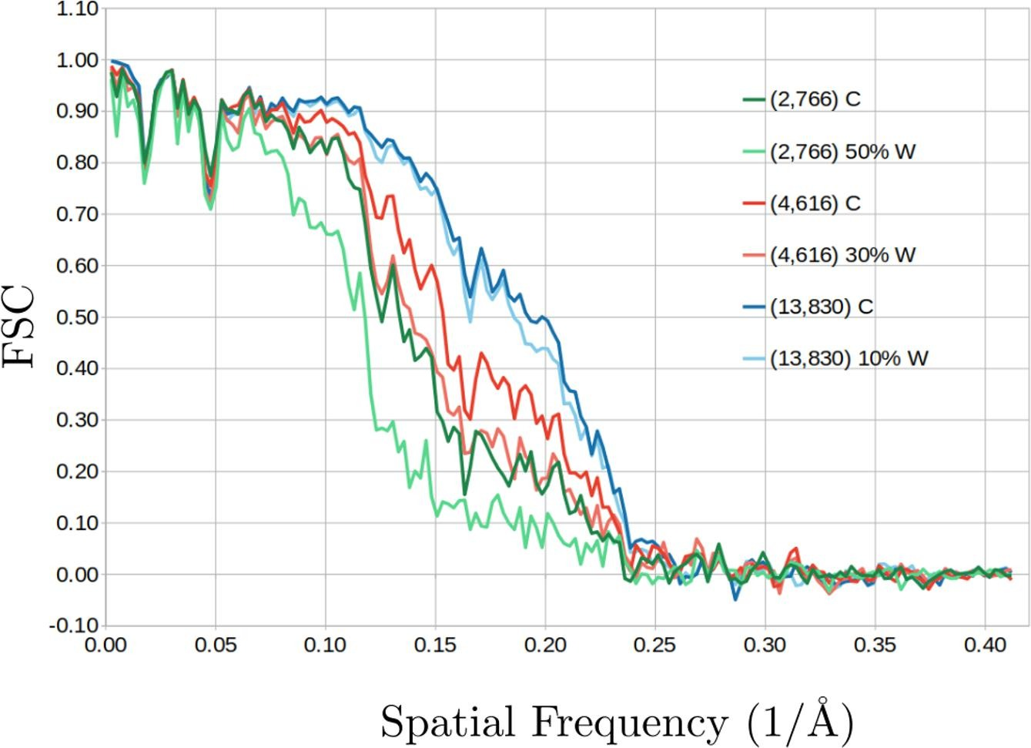
0.226
0.236
0.16
0.213
0.21
0.233
Notes:
EMD-6000

Slide 20
https://www.ypppt.com/
04
Discussion and Conclusion

Slide 21
Discussion and Conclusion
1. In reconstructing a 3D map, some errors occur in the refinement process when using the projection-matching approach. These errors are mainly due to the incorrect estimation of the projections’ orientations and heterogeneity of the specimens sampled in the experimental projections and undetected during the classification stage.
2. In the new approach, the assignment validation is possible to identify projections that contribute little to improving the map’s resolution.
Notes:
2. Notably, such a validation procedure can be used in conjunction with any orientation-assigning method as part of any refnement process

