Slide 1
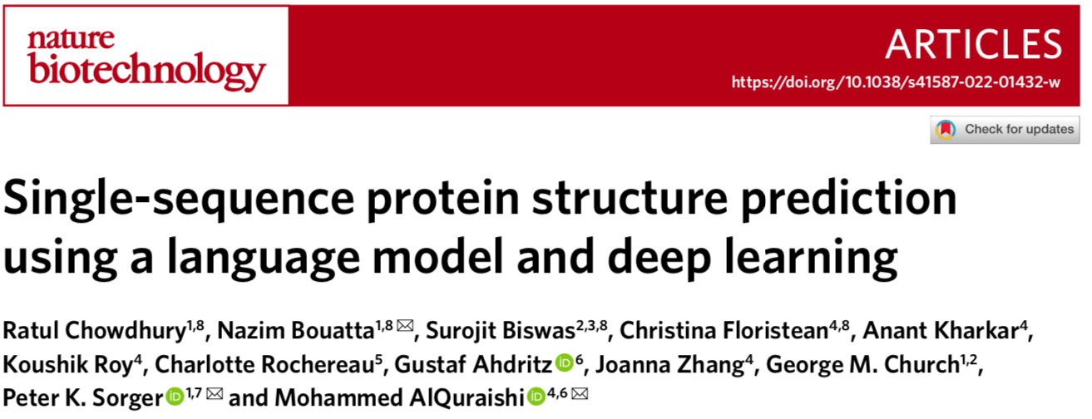

Slide 2
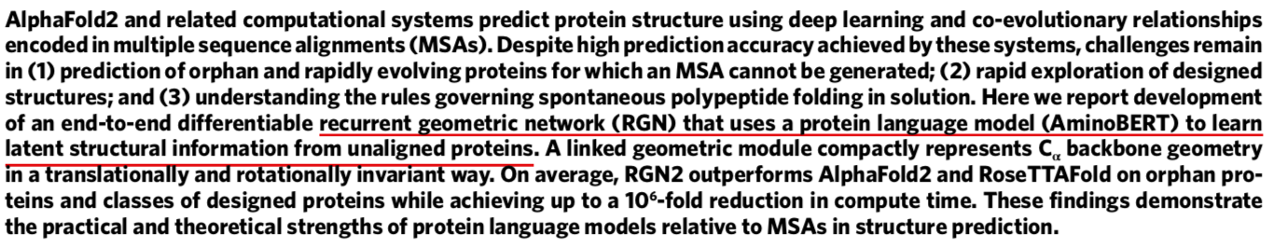
Abstract
MSA may not well perform on protein lacking homology information.
Language models may help explore relationships of whole sequences.

Slide 3
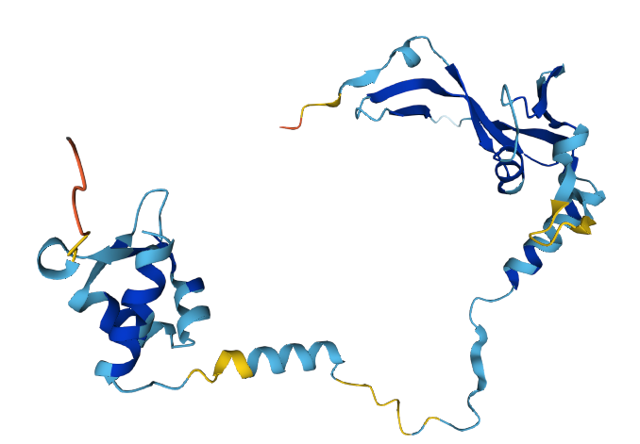
Architecture of protein structure prediction
Protein Sequence
Sequence
Module
Structure
Module
MAERGELDLTGAKQNTGVWLVKVPKYLSQQWAKASGRGEVGKLRIAK……….

Slide 4
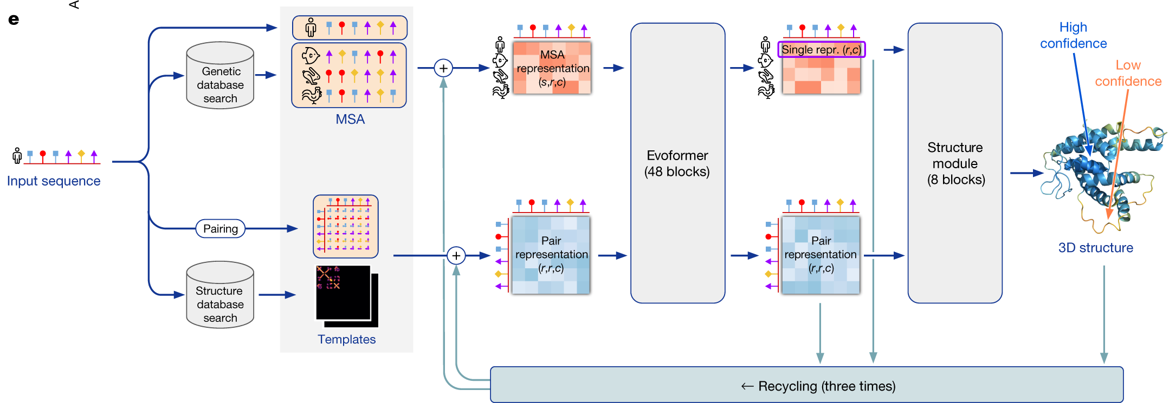
Architecture of AlphaFold2 (AF2)

Slide 5
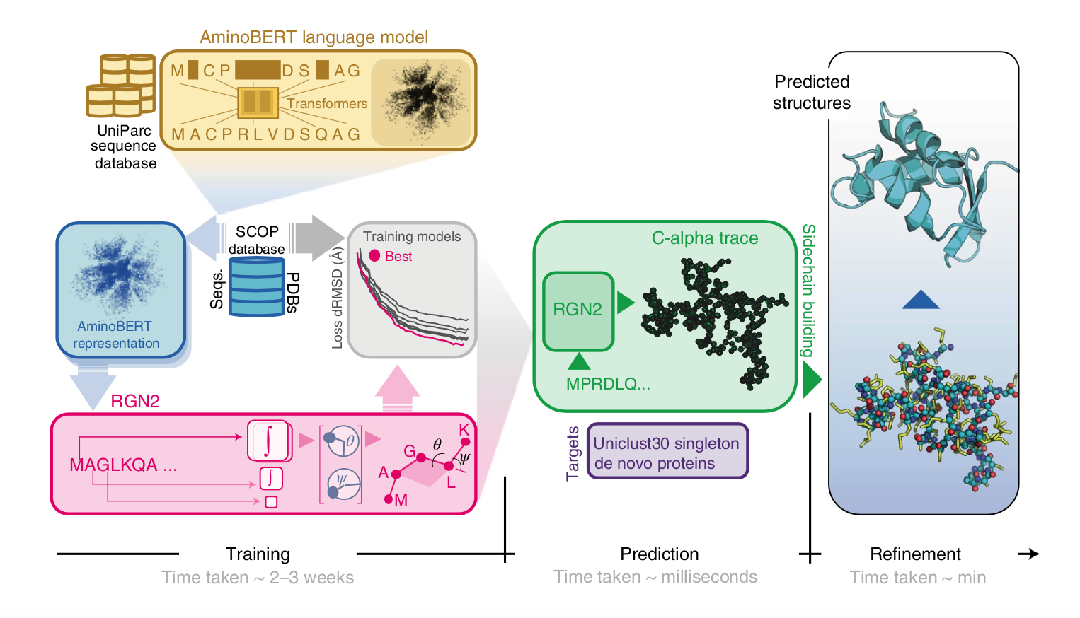
Architecture of RGN2

Slide 6
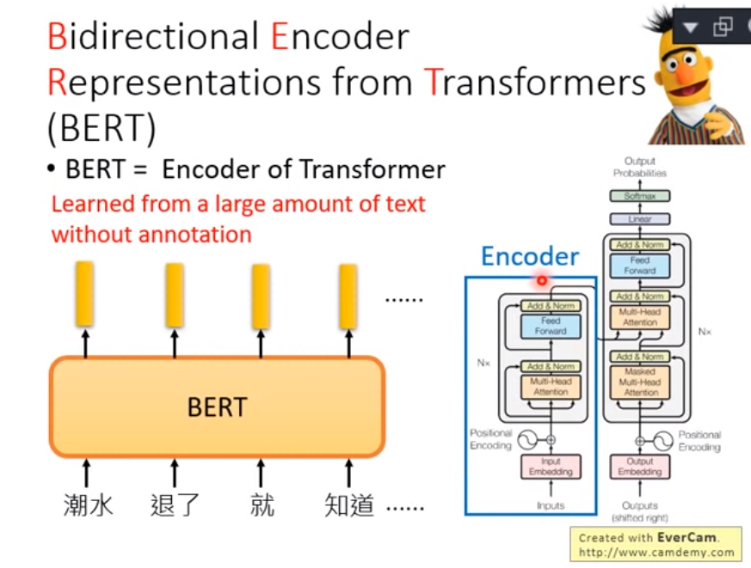
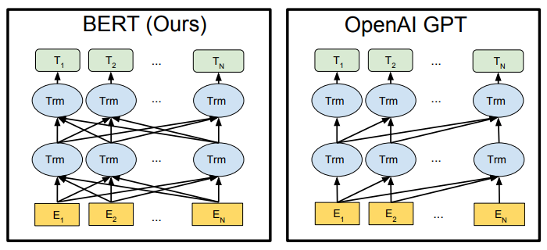
AminoBERT
https://www.youtube.com/@HungyiLeeNTU

Slide 7
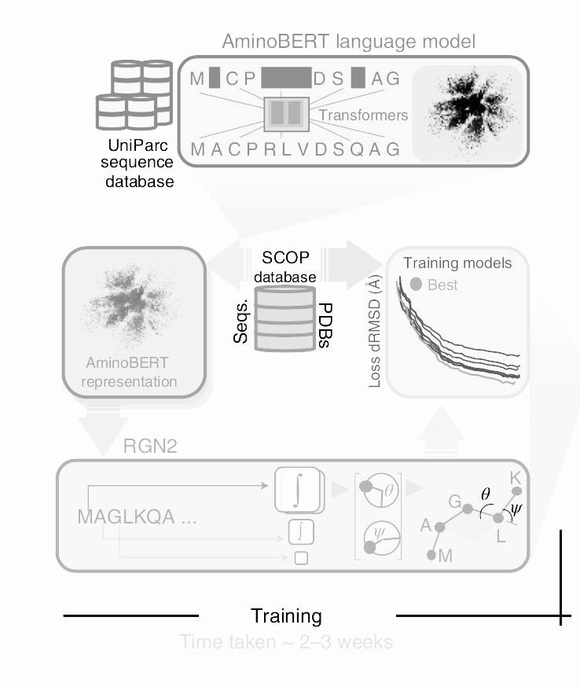
Architecture of RGN2
Develop a Encoder for protein sequence
Introduce the representation to 3D model prediction

Slide 8
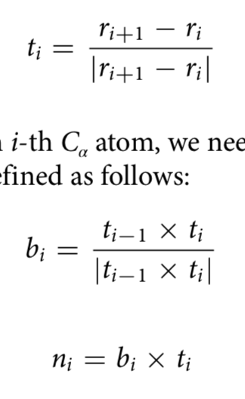
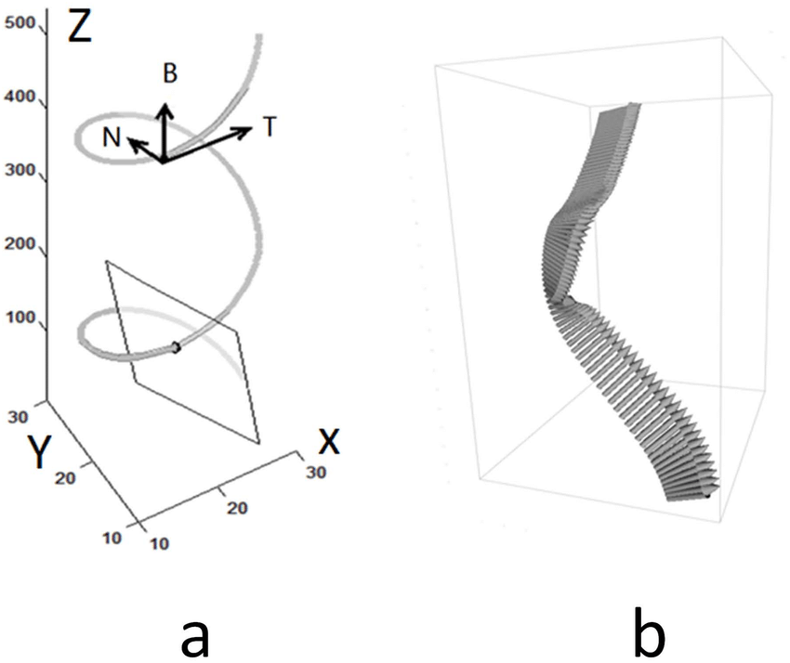
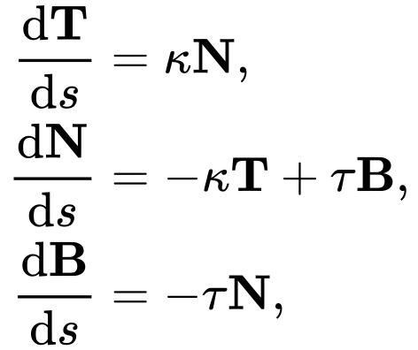
Frenet–Serret Formulas for Geometry module
Frenet–Serret Formulas

Slide 9
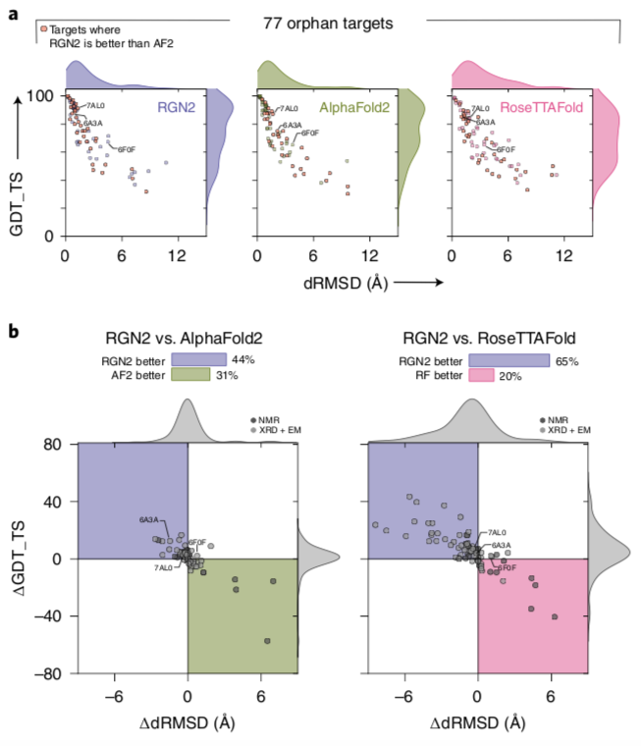
RGN2 Perform on Orphan Sequence
GDT_TS: The higher GDT_TS score → Better prediction
dRMSD: The smaller dRMSD score → Better prediction

Slide 10
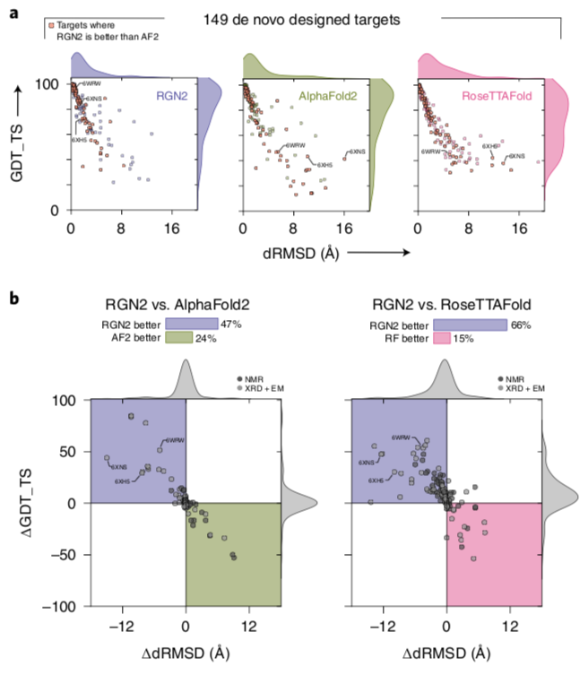
RGN2 Perform on Designed Sequence

Slide 12
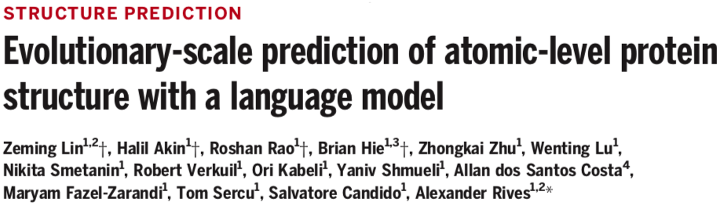
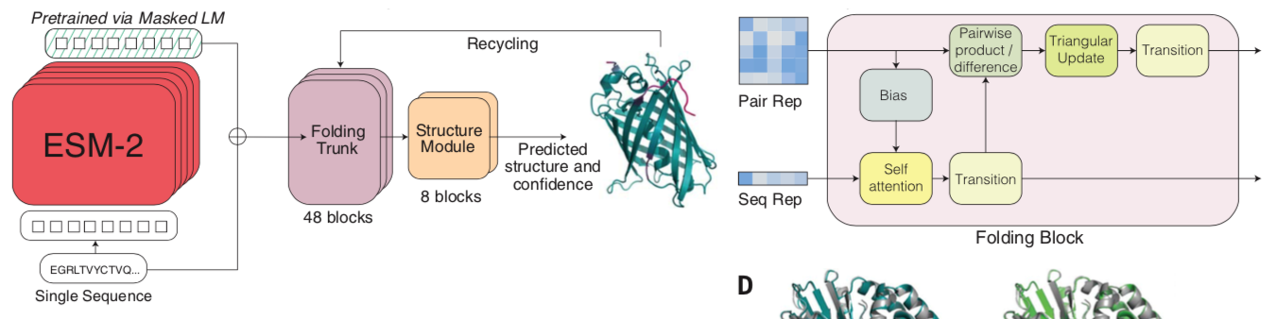
Architecture of ESMFold2

