Slide 1

Estimation of Orientation and Camera Parameters from Cryo-Electron Microscopy Images with Variational Autoencoders and Generative Adversarial Networks
SLAC

Slide 2
Image formation model
Projects the 3D volume along the Z-axis
$$x_{i}=PSF_{i}∗P\left[R_{i}V\right]+η_{i}, i=1…n$$
Point spread function
Orientation of the particle

Slide 3
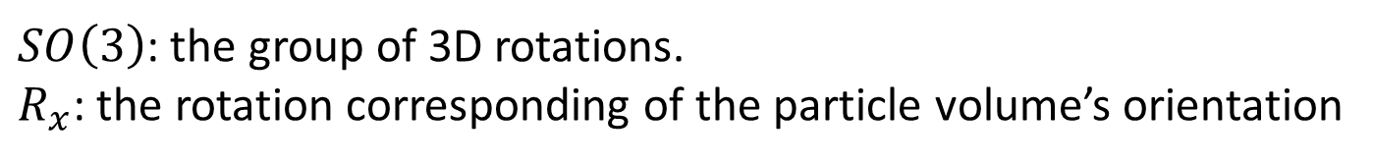
Ideal cryo-EM data space
The author first consider the ideal cryo-EM space, written $C_{V}\left(Ω\right)$.
$$C_{V}\left(Ω\right)=\left\{x∈L_{2}\left(Ω\right) \right| ∃!R_{x}∈SO\left(3\right), x=PSF∗P(R_{x}⋅V)\}$$
$SO\left(3\right)$: the group of 3D rotations.
$R_{x}$: the rotation corresponding of the particle volume’s orientation

Slide 4
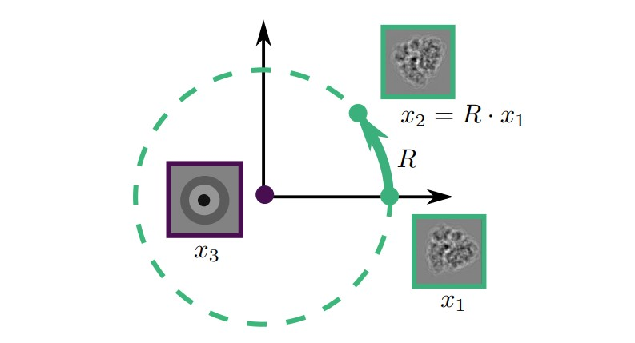
Image with Inplane Rotations
The author first consider the ideal cryo-EM space, written $C_{V}\left(Ω\right)$.
$$C_{V}^{2D}\left(Ω\right)=\left\{x∈L_{2}\left(Ω\right) \right| ∃R_{x}∈SO\left(2\right), x=PSF∗P(R_{x}⋅V)\}$$
Where the axis of the rotation in $SO\left(2\right)$ corresponds to the axis of the projection $P$.
From now on, the author restrict their focus on $C_{V}^{2D}\left(Ω\right)$ , a subspace of $C_{V}\left(Ω\right)$.
Figure. Action of 2D rotations on the space of images $L_{2}\left(Ω\right)$, schematically represented as $ℝ^{2}$.

Slide 5
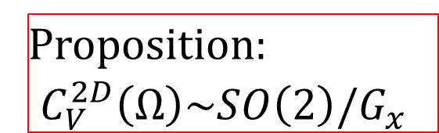

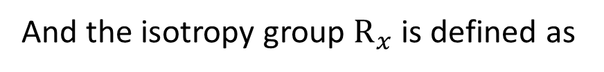
Image with Inplane Rotations
The orbit $O_{x}$ of an image $x∈L_{2}\left(Ω\right)$ by the action $ρ$ of $SO\left(2\right)$ is defined as
$$O_{x}=\left\{x^{′}∈L_{2}\left(Ω\right)\right|∃R∈SO\left(2\right),x^{′}=R⋅x\}$$
And the isotropy group $R_{x}$ is defined as
$$R_{x}=\left\{R∈SO(2)\right|R⋅x=x\}$$
Proposition:
$$C_{V}^{2D}\left(Ω\right)\sim SO\left(2\right)/G_{x}$$

Slide 6

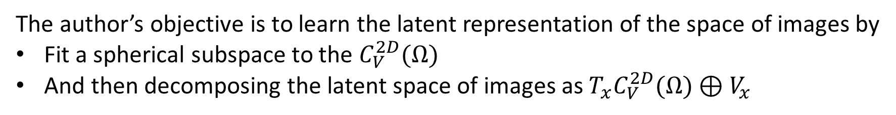
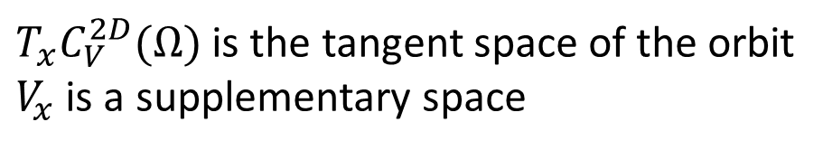
Observed cryo-EM data space
Locally at each cryo-EM image $x∈C_{V}^{2D}(Ω)$, the space of 2D images decomposes as a sum:
$$L_{2}(Ω)=T_{x}C_{V}^{2D}(Ω)⊕V_{x}$$
$T_{x}C_{V}^{2D}(Ω)$ is the tangent space of the orbit
$V_{x}$ is a supplementary space
The author’s objective is to learn the latent representation of the space of images by
Fit a spherical subspace to the $C_{V}^{2D}(Ω)$
And then decomposing the latent space of images as $T_{x}C_{V}^{2D}(Ω)⊕V_{x}$

Slide 7
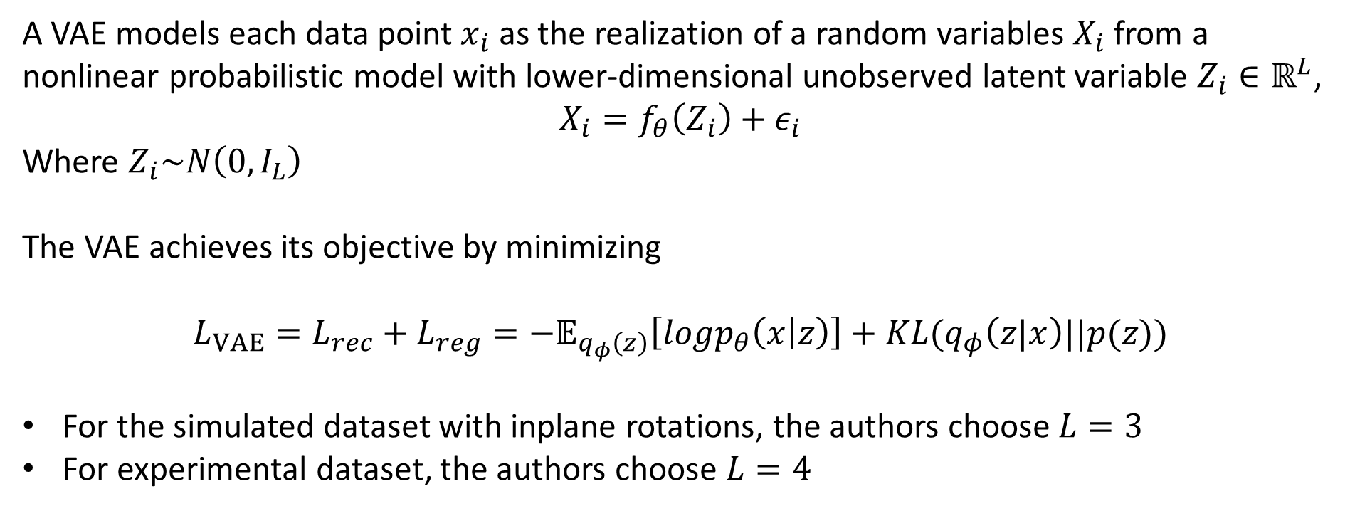
Review of VAE
A VAE models each data point$x_{i}$ as the realization of a random variables $X_{i}$ from a nonlinear probabilistic model with lower-dimensional unobserved latent variable $Z_{i}∈ℝ^{L}$,
$$X_{i}=f_{θ}\left(Z_{i}\right)+ε_{i}$$
Where $Z_{i}\sim N\left(0,I_{L}\right)$
The VAE achieves its objective by minimizing
$$L_{VAE}=L_{rec}+L_{reg}=−𝔼_{q_{φ}\left(z\right)}\left[logp_{θ}\left(x | z\right)\right]+KL(q_{φ}\left(z|x\right)||p(z))$$
For the simulated dataset with inplane rotations, the authors choose $L=3$
For experimental dataset, the authors choose $L=4$
Notes:
L=3 with a circle and defocus
L=4 ‘’ + nuisance variables

Slide 8
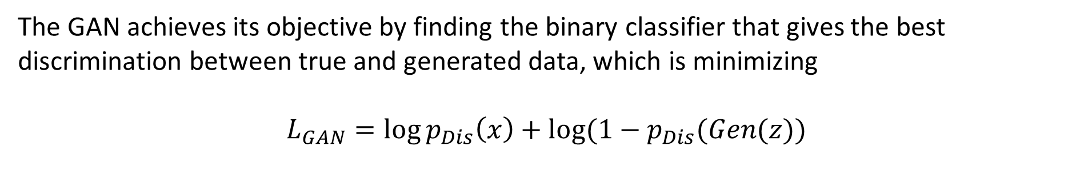
Review of GAN
The GAN achieves its objective by finding the binary classifier that gives the best discrimination between true and generated data, which is minimizing
$$L_{GAN}=\log{p_{Dis}\left(x\right)+log⁡(1−p_{Dis}(Gen(z))}$$

Slide 9
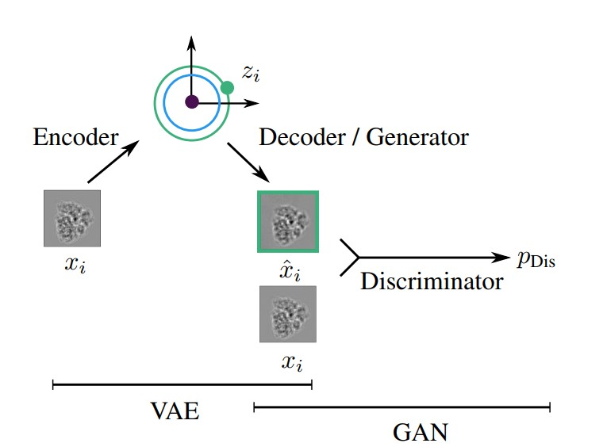
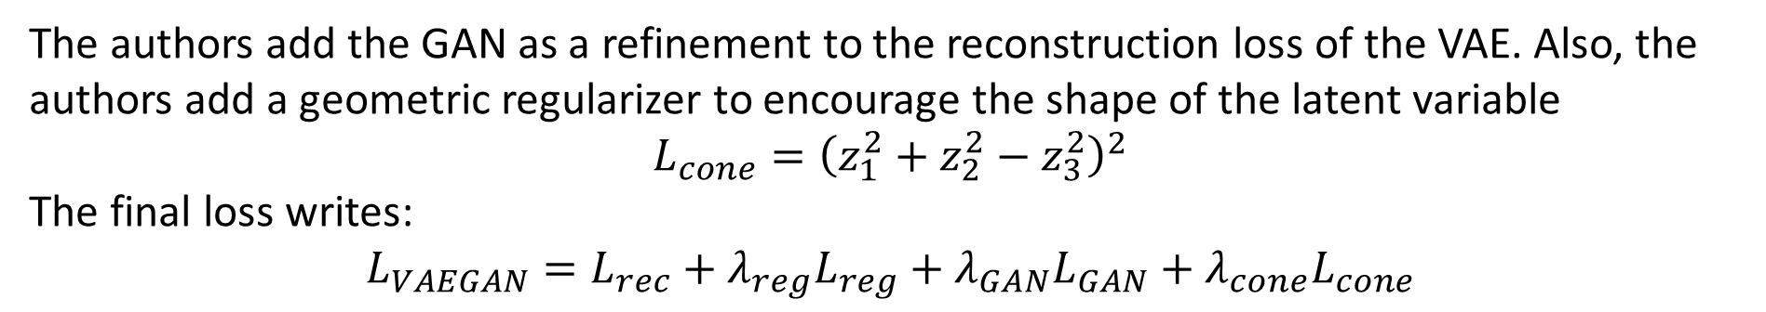
VAE-GAN with geometric regularization
The authors add the GAN as a refinement to the reconstruction loss of the VAE. Also, the authors add a geometric regularizer to encourage the shape of the latent variable
$$L_{cone}={\left(z_{1}^{2}+z_{2}^{2}−z_{3}^{2}\right)}^{2}$$
The final loss writes:
$$L_{VAEGAN}=L_{rec}+λ_{reg}L_{reg}+λ_{GAN}L_{GAN}+λ_{cone}L_{cone}$$

Slide 10
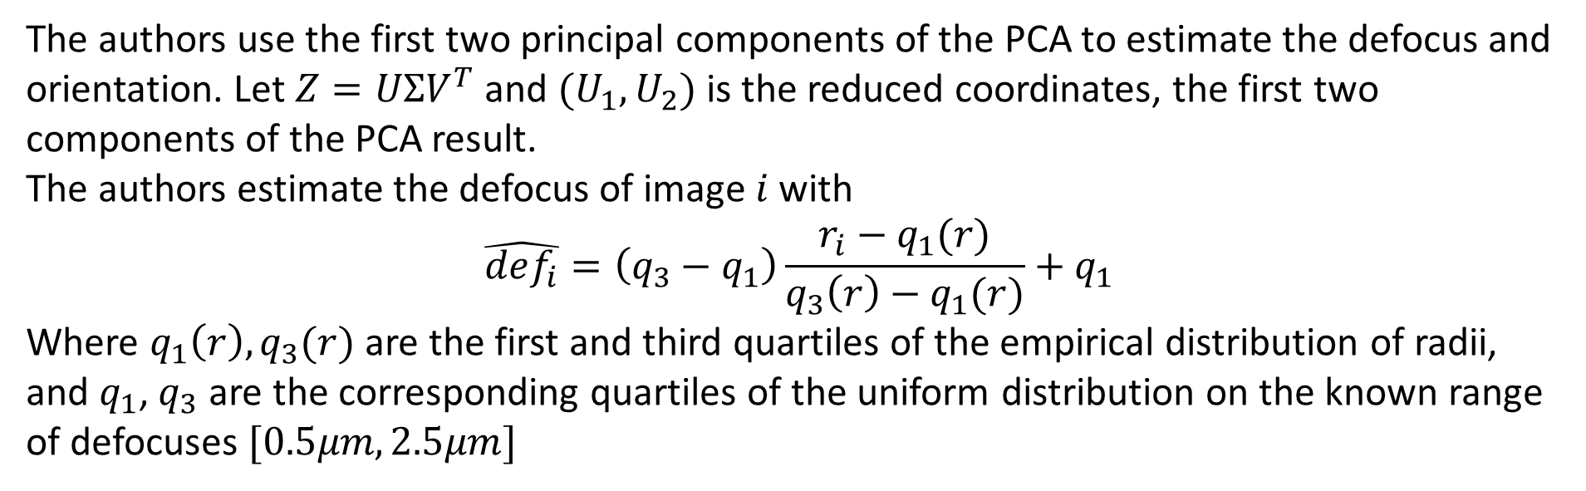
Estimation of defocus and orientation
The authors use the first two principal components of the PCA to estimate the defocus and orientation. Let $Z=UΣV^{T}$ and $(U_{1},U_{2})$ is the reduced coordinates, the first two components of the PCA result.
The authors estimate the defocus of image $i$ with
$$\hat{def_{i}}=\left(q_{3}−q_{1}\right)\frac{r_{i}−q_{1}(r)}{q_{3}\left(r\right)−q_{1}(r)}+q_{1}$$
Where $q_{1}\left(r\right),q_{3}(r)$ are the first and third quartiles of the empirical distribution of radii, and $q_{1}$, $q_{3}$ are the corresponding quartiles of the uniform distribution on the known range of defocuses $[0.5μm,2.5μm]$

Slide 11
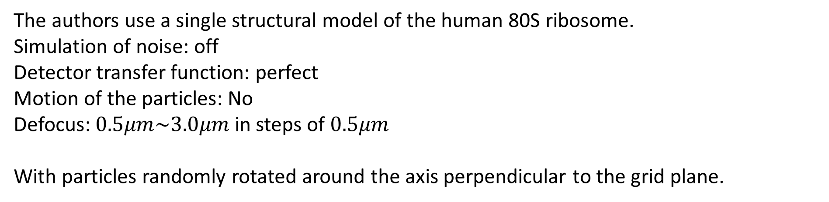
Simulated dataset
The authors use a single structural model of the human 80S ribosome.
Simulation of noise: off
Detector transfer function: perfect
Motion of the particles: No
Defocus: $0.5μm\sim 3.0μm$ in steps of $0.5μm$
With particles randomly rotated around the axis perpendicular to the grid plane.

Slide 12
Experimental dataset
Experimental dataset is also created from samples of human 80S ribosomes.
7664 micrograph movies were used to be preprocessed in RELION 3.0, involved
Motion correction
CTF estimation
And picking the particles with “Autopick” tool in RELION, yielding more than 1,000,000 particles with rescaled size 180x180.
The first experimental dataset (view 39) represents the real dataset equivalent to the simulated case
The second (view 93) has n=8,278 and the third has n=4,917 images.

Slide 13
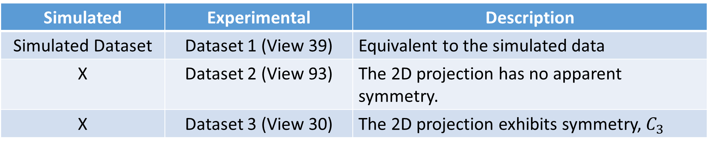
dataset summary
Both simulated and experimental datasets are using 80S ribosome.
Simulated | Experimental | Description
Simulated Dataset | Dataset 1 (View 39) | Equivalent to the simulated data
X | Dataset 2 (View 93) | The 2D projection has no apparent symmetry.
X | Dataset 3 (View 30) | The 2D projection exhibits symmetry, $C_{3}$

Slide 14
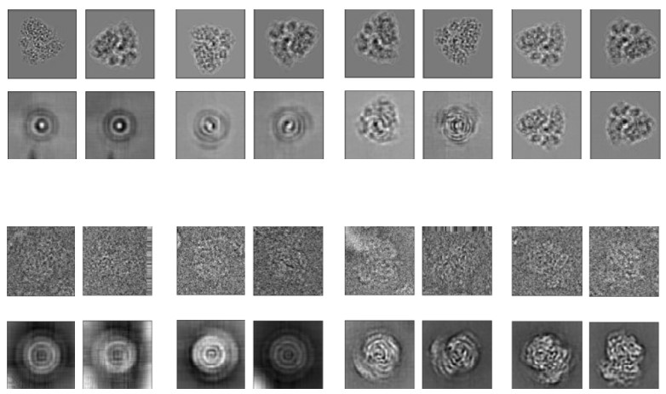
Training VAE-GAN learns successive orbits
The authors observe that VAE-GAN has the following properties:
It starts with a prior distribution on the latent variables that concentrates at the origin.
During training, the radii of the circles is increasing.
At the end of the training, the images reconstructed from the simulated dataset are visually almost indistinguishable from the original images.
Simulated dataset
Reconstruction
Experimental dataset
(view 93)
Reconstruction

Slide 15
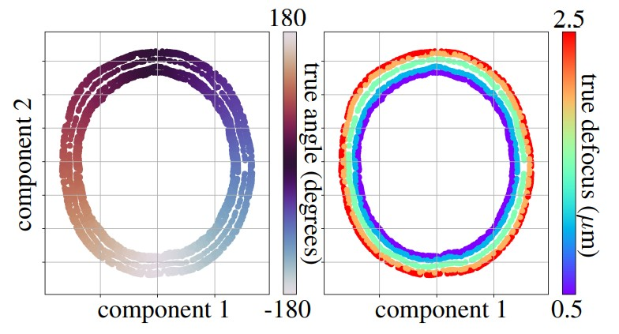
Latent space of the Simulated dataset
The authors proclaims that the latent space has disentangled the camera parameter (defocus) from the ribosome’s orientation.
In polar coordinates, the defocus is related to the radius, while the ribosome’s orientation is given by the angle.

Slide 16
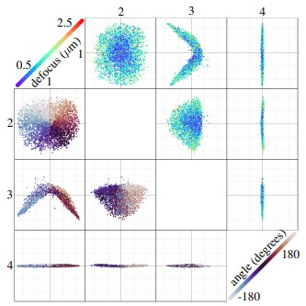
Orbits in the absence of symmetry
As in the simulated case, the geometry of the group action leads to a natural disentanglement of the camera parameter from the orientation’s angle.
Figure. Cryo-EM images from the experimental dataset on view 39 in latent space (L=4).

Slide 17
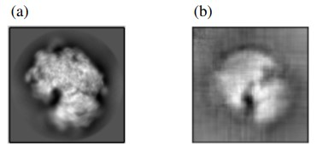
Orbits in the presence of symmetry
The authors observe that the latent space has captured the $C_{3}$ symmetry, which will be shown in the latter slide.
Figure. Symmetries of the particle in view 30, (a) 2D class average taken from RELION. (b) VAE-GAN reconstruction, suggesting a $C_{3}$ symmetry.

Slide 18
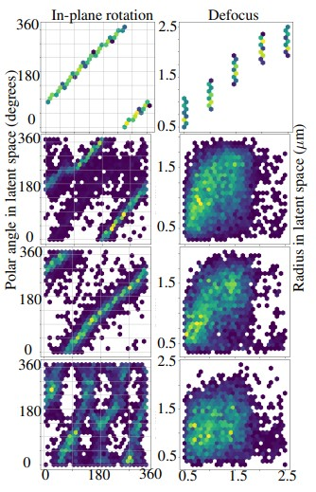

Comparison of the four Dataset
Figure. Unsupervised estimations of angles (left) and defocus (right), compared to RELION (x-axis).
(top) Simulated dataset.
(bottom three) Experimental views 93,39,30.
Hexagonal bins with at least one data point are plotted, and highly populated bins are brighter.
Can see $C_{3}$ symmetry

