Slide 1
Asymptotics and connections to non-Bayesian approaches
林思涵
2020/09/22

Slide 2
Outline
Normal approximations to the posterior distribution
Large-sample theory
Counterexamples to the theorems
Frequency evaluations of Bayesian inferences
Bayesian interpretations of other statistical methods

Slide 3
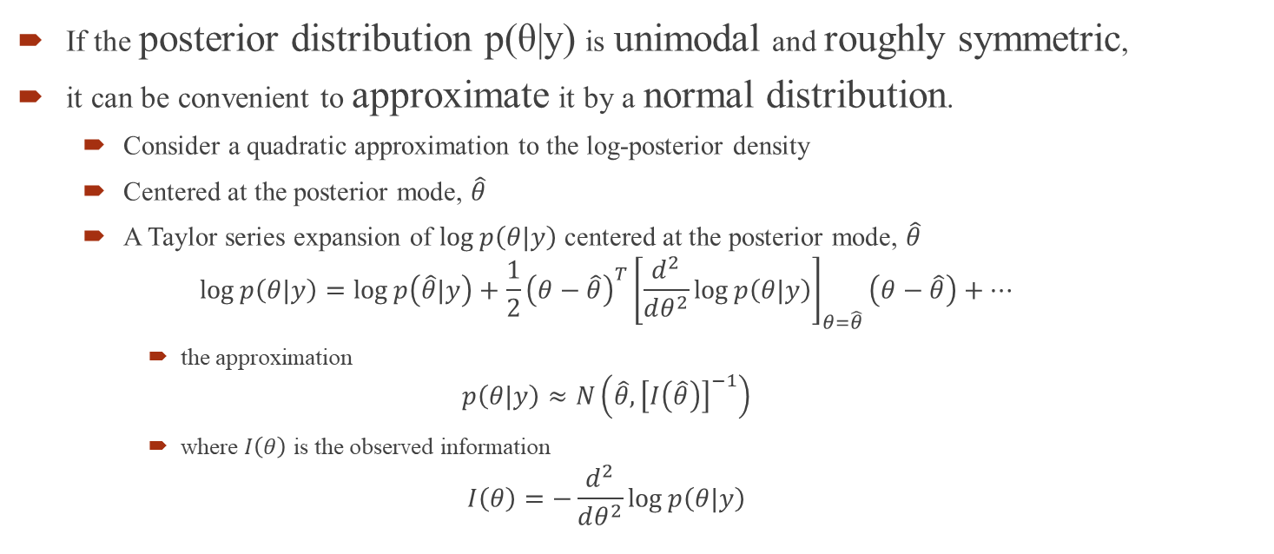
Normal approximations to the posterior distribution
If the posterior distribution p(θ|y) is unimodal and roughly symmetric,
it can be convenient to approximate it by a normal distribution.
Consider a quadratic approximation to the log-posterior density
Centered at the posterior mode, $\hat{θ}$
A Taylor series expansion of $\log{p\left(θ|y\right)}$ centered at the posterior mode, $\hat{θ}$
$$\log{p\left(θ|y\right)}=\log{p\left(\hat{θ}|y\right)}+\frac{1}{2}{\left(θ−\hat{θ}\right)}^{T}{\left[\frac{d^{2}}{dθ^{2}}\log{p\left(θ|y\right)}\right]}_{θ=\hat{θ}}\left(θ−\hat{θ}\right)+…$$
the approximation
$$p\left(θ|y\right)≈N\left(\hat{θ},{\left[I\left(\hat{θ}\right)\right]}^{−1}\right)$$
where $I\left(θ\right)$ is the observed information
$$I\left(θ\right)=−\frac{d^{2}}{dθ^{2}}\log{p\left(θ|y\right)}$$

Slide 4
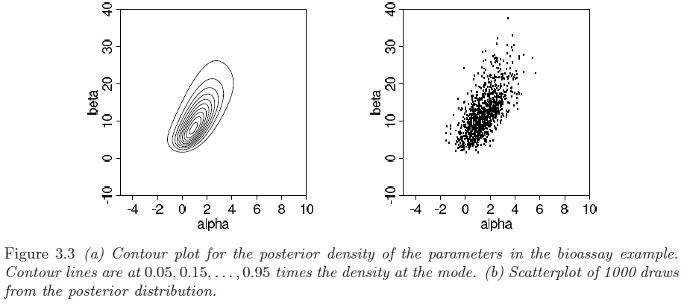
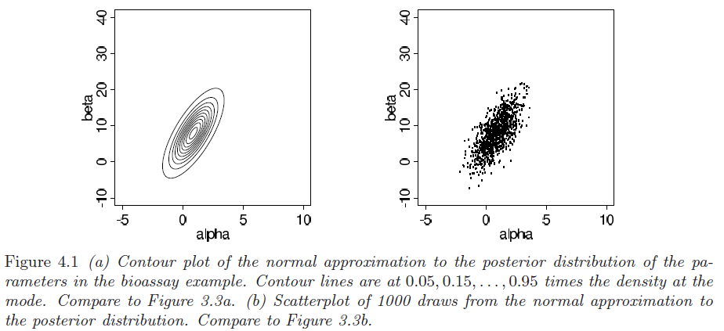
真實狀態
常態近似

Slide 5
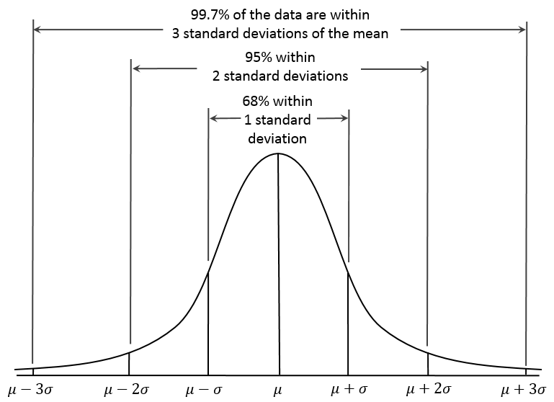
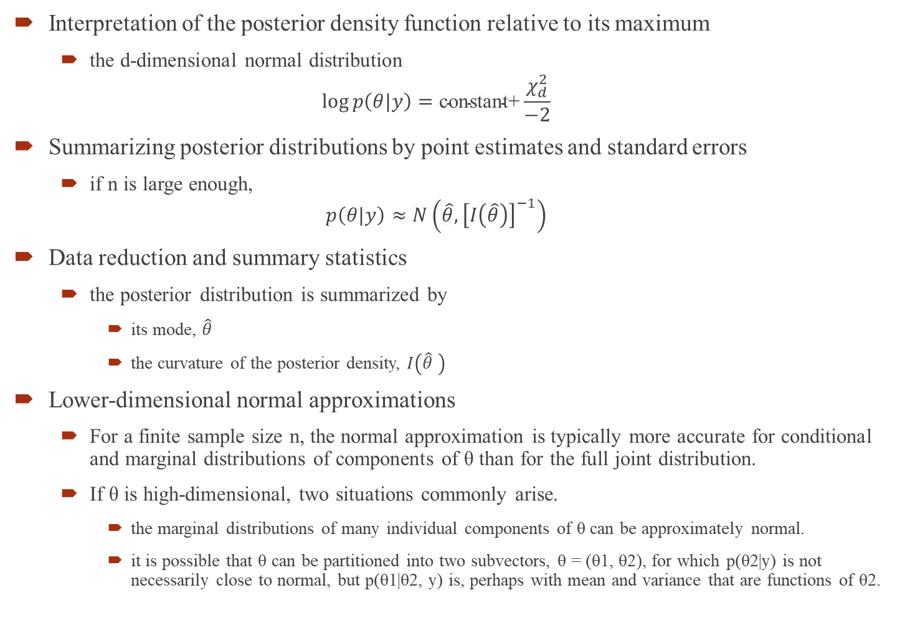
Interpretation of the posterior density function relative to its maximum
the d-dimensional normal distribution
$$\log{p\left(θ|y\right)}=\text{constant}\text{+}\frac{χ_{d}^{2}}{−2}$$
Summarizing posterior distributions by point estimates and standard errors
if n is large enough,
$$p\left(θ|y\right)≈N\left(\hat{θ},{\left[I\left(\hat{θ}\right)\right]}^{−1}\right)$$
Data reduction and summary statistics
the posterior distribution is summarized by
its mode, $\hat{θ}$
the curvature of the posterior density, $I\left(\hat{θ} \right)$
Lower-dimensional normal approximations
For a finite sample size n, the normal approximation is typically more accurate for conditional and marginal distributions of components of θ than for the full joint distribution.
If θ is high-dimensional, two situations commonly arise.
the marginal distributions of many individual components of θ can be approximately normal.
it is possible that θ can be partitioned into two subvectors, θ = (θ1, θ2), for which p(θ2|y) is not necessarily close to normal, but p(θ1|θ2, y) is, perhaps with mean and variance that are functions of θ2.

Slide 6
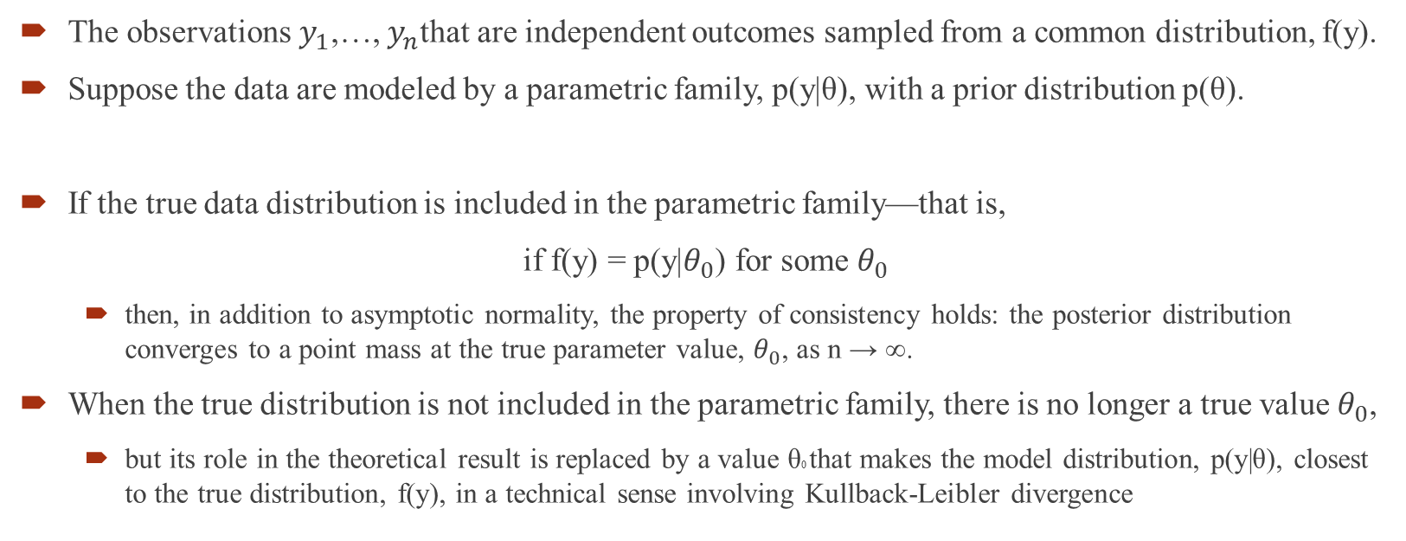
Large-sample theory
The observations $y_{1}$,…, $y_{n}$that are independent outcomes sampled from a common distribution, f(y).
Suppose the data are modeled by a parametric family, p(y|θ), with a prior distribution p(θ).
If the true data distribution is included in the parametric family—that is,
if f(y) = p(y|$θ_{0}$) for some $θ_{0}$
then, in addition to asymptotic normality, the property of consistency holds: the posterior distribution converges to a point mass at the true parameter value, $θ_{0}$, as n → ∞.
When the true distribution is not included in the parametric family, there is no longer a true value $θ_{0}$,
but its role in the theoretical result is replaced by a value θ0 that makes the model distribution, p(y|θ), closest to the true distribution, f(y), in a technical sense involving Kullback-Leibler divergence

Slide 7
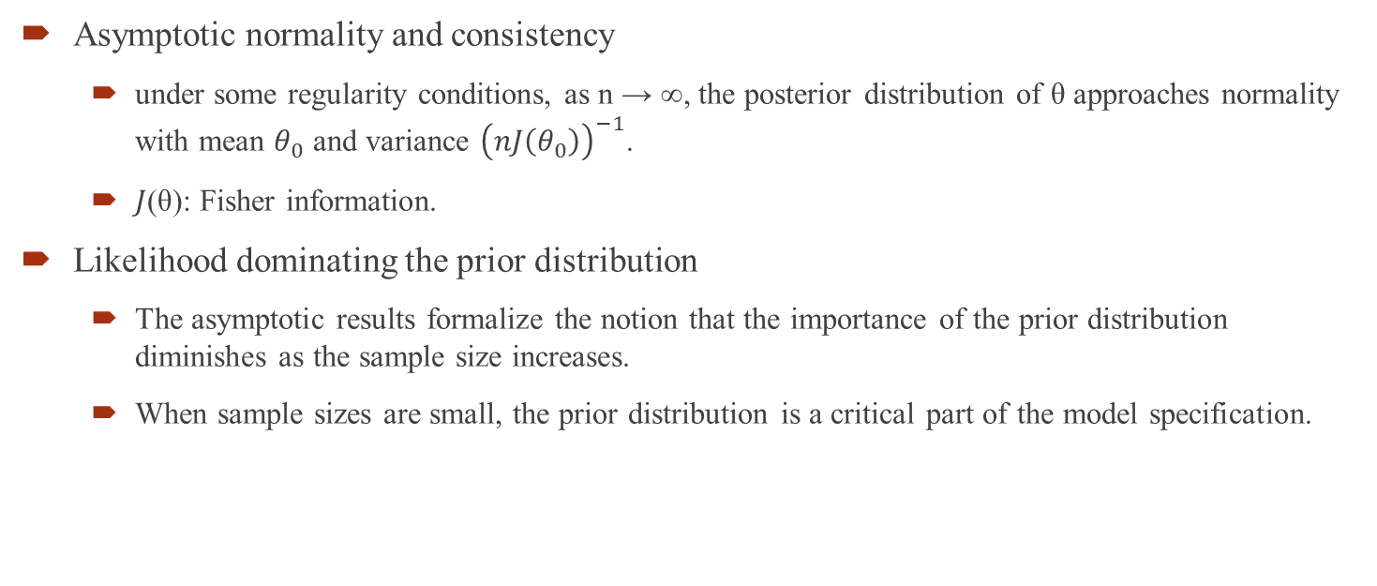
Large-sample theory
Asymptotic normality and consistency
under some regularity conditions, as n → ∞, the posterior distribution of θ approaches normality with mean $θ_{0}$ and variance ${\left(nJ\left(θ_{0}\right)\right)}^{−1}$.
$J$(θ): Fisher information.
Likelihood dominating the prior distribution
The asymptotic results formalize the notion that the importance of the prior distribution diminishes as the sample size increases.
When sample sizes are small, the prior distribution is a critical part of the model specification.

Slide 8
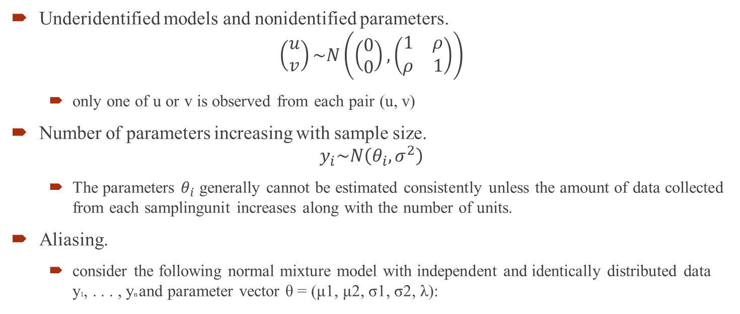
Counterexamples to the theorems
Underidentified models and nonidentified parameters.
$$\left(\begin{matrix}u \\ v\end{matrix}\right)\sim N\left(\left(\begin{matrix}0 \\ 0\end{matrix}\right),\left(\begin{matrix}1 & ρ \\ ρ & 1\end{matrix}\right)\right)$$
only one of u or v is observed from each pair (u, v)
Number of parameters increasing with sample size.
$$y_{i}\sim N\left(θ_{i},σ^{2}\right)$$
The parameters $θ_{i}$ generally cannot be estimated consistently unless the amount of data collected from each samplingunit increases along with the number of units.
Aliasing.
consider the following normal mixture model with independent and identically distributed data y1, . . . , yn and parameter vector θ = (μ1, μ2, σ1, σ2, λ):

Slide 9
Counterexamples to the theorems
Unbounded likelihoods.
If we set μ1 = yi for any arbitrary yi, and let σ1 → 0, then the likelihood approaches infinity. As n → ∞, the number of modes of the likelihood increases.
If the prior distribution is uniform on σ1 and σ2 in the region near zero, there will be likewise an increasing number of posterior modes, with no corresponding normal approximations.
Improper posterior distributions.
An improper prior distribution is only a convenient approximation, and if it does not give rise to a proper posterior distribution then the sought convenience is lost.
An improper posterior distribution cannot occur except with an improperprior distribution.

Slide 10
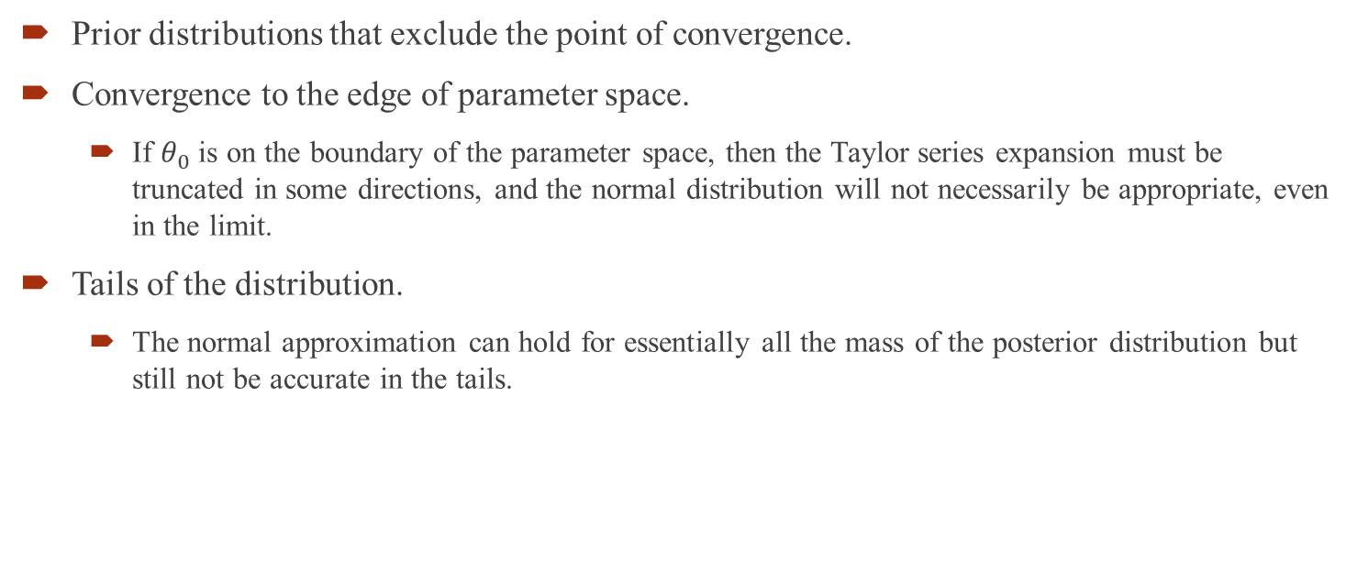
Counterexamples to the theorems
Prior distributions that exclude the point of convergence.
Convergence to the edge of parameter space.
If $θ_{0}$ is on the boundary of the parameter space, then the Taylor series expansion must be truncated in some directions, and the normal distribution will not necessarily be appropriate, even in the limit.
Tails of the distribution.
The normal approximation can hold for essentially all the mass of the posterior distribution but still not be accurate in the tails.

Slide 11

Frequency evaluations of Bayesian inferences
Large-sample correspondence
Suppose that the normal approximation for the posterior distribution of θ holds;
then we can transform to the standard multivariate normal
Point estimation, consistency, and efficiency
Confidence coverage

Slide 12
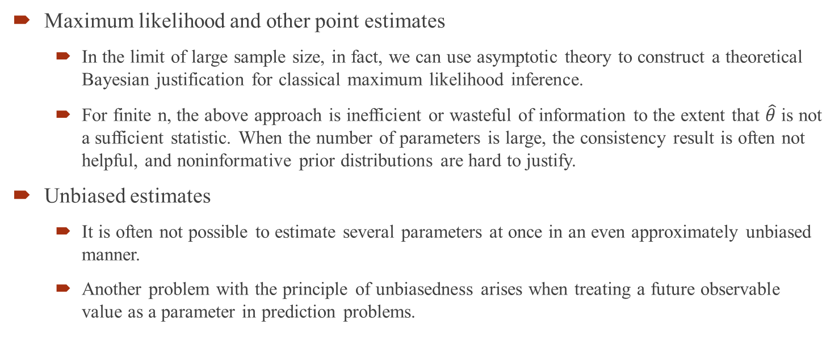
Bayesian interpretations of other statistical methods
Maximum likelihood and other point estimates
In the limit of large sample size, in fact, we can use asymptotic theory to construct a theoretical Bayesian justification for classical maximum likelihood inference.
For finite n, the above approach is inefficient or wasteful of information to the extent that $\hat{θ}$ is not a sufficient statistic. When the number of parameters is large, the consistency result is often not helpful, and noninformative prior distributions are hard to justify.
Unbiased estimates
It is often not possible to estimate several parameters at once in an even approximately unbiased manner.
Another problem with the principle of unbiasedness arises when treating a future observable value as a parameter in prediction problems.

Slide 13
Bayesian interpretations of other statistical methods
Confidence intervals
Even in small samples, Bayesian (1 −α) posterior intervals often have close to (1 −α) confidence coverage under repeated samples conditional on θ.
Hypothesis testing
For a continuous parameter θ, the question ‘Does θ equal 0?’ can generally be rephrased more usefully as ‘What is the posterior distribution for θ?’
On the other hand, the posterior probability that θ > 0 is 84%, which is a more satisfactory and informative conclusion than the dichotomous verdict ‘reject’ or ‘do not reject.’
Multiple comparisons and multilevel modeling
We prefer to handle multiple comparisons problems using hierarchical models
Nonparametric methods, permutation tests, jackknife, bootstrap

Slide 14
The End

