Slide 1
Bayesian Data Analysis
Cheng-Yu Hung

Slide 2
Introduction

Slide 3
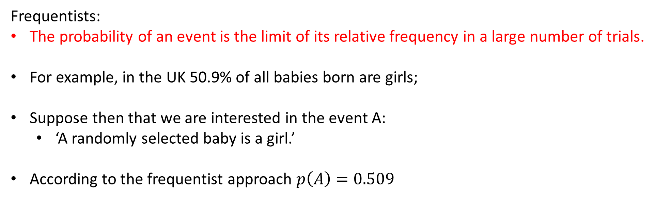
What is probability?
Frequentists:
The probability of an event is the limit of its relative frequency in a large number of trials.
For example, in the UK 50.9% of all babies born are girls;
Suppose then that we are interested in the event A:
‘A randomly selected baby is a girl.’
According to the frequentist approach $p\left(A\right)=0.509$

Slide 4
What is probability?
Bayesianism:
Probability is a measure of the degree of belief about an event.
Statement A: ‘Britain sweeps the boards at 2020 London Olympics, winning 36 Gold Medals.’
Since this is a statement about a future event, nobody can state with any certainty whether or not it is true. Different people may have different beliefs in the statement depending on their specific knowledge of factors that might effect its likelihood.

Slide 5
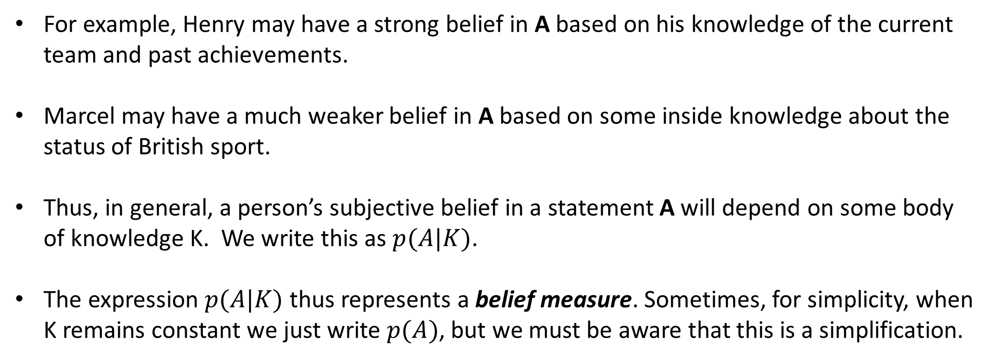
What is probability?
For example, Henry may have a strong belief in A based on his knowledge of the current team and past achievements.
Marcel may have a much weaker belief in A based on some inside knowledge about the status of British sport.
Thus, in general, a person’s subjective belief in a statement A will depend on some body of knowledge K. We write this as $p(A|K)$.
The expression $p(A|K)$ thus represents a belief measure. Sometimes, for simplicity, when K remains constant we just write $p(A)$, but we must be aware that this is a simplification.

Slide 6
Frequentist inference exercise
Scene A: We are supervising a wire factory, we need to measure the strength of the wire.
Scene B: We are carrying on an research about the correlation between heart attack and a factor. The data come from family doctors’ database.
Scene C: At 3 a.m., an alarm went off and a man ran off with a big bag. The police arrested the man without hesitation.

Slide 7


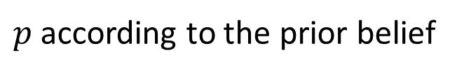
Why are we here?
Data Observed | H
Frequentist
Bayesian
$$p=1$$
$p$ according to the prior belief

Slide 8
The case of Coin Flips
Data Observed | H | H | H | H | H
Belief | Fair | Skewed | More Skewed | Even More… | Even Even More…
Belief Updates
Prior Belief

Slide 9
Priors
Priors can be strong or weak
Weak Prior
A few observations are sufficient to change our belief significantly.
New Coin
Strong Prior
Coin is lab tested for 1 million Tosses.
50% T 50% H is observed.
One more observation will not change our belief significantly.

Slide 10
A big advantage of a Bayesian approach
Allows a principled approach to the exploitation of all available data
With an emphasis on continually updating one’s models as data accumulate

Slide 11

Statement of Bayes’ rule
$$p\left(θ | y\right)∝p\left(θ\right)p(y|θ)$$
Posterior
Prior
Likelihood
The prior is the probability of the parameter and represents what was thought before seeing the data.
The likelihood is the probability of the data given the parameter and represents the data now available.
The posterior represents what is thought given both prior information and the data just seen.
It relates conditional density of a parameter (posterior probability) with its unconditional density(prior, since depends on information present before the experiment.)

Slide 12
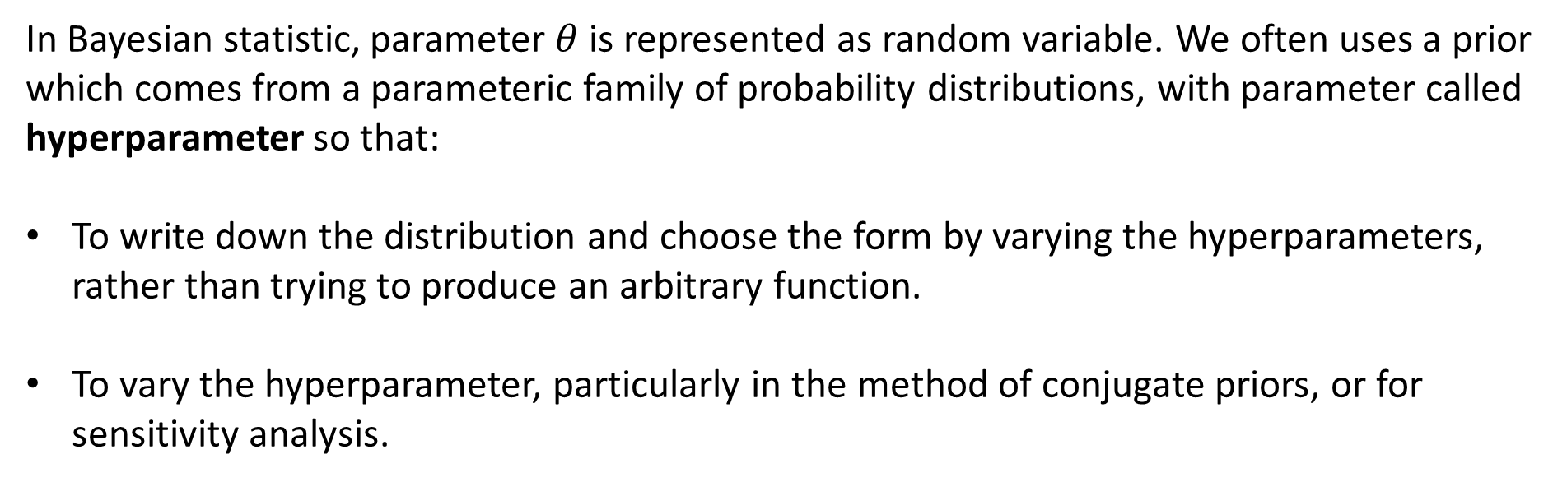
Choice of priors
In Bayesian statistic, parameter $θ$ is represented as random variable. We often uses a prior which comes from a parameteric family of probability distributions, with parameter called hyperparameter so that:
To write down the distribution and choose the form by varying the hyperparameters, rather than trying to produce an arbitrary function.
To vary the hyperparameter, particularly in the method of conjugate priors, or for sensitivity analysis.

Slide 13
Subjective assessment of prior probabilities
A prior should:
Tell where the probability mass is concentrated, without taking too seriously the details, especially the tails of the distribution.
The nice feature of Byes’ theorem is the ability of transform such vague, fuzzy priors into solid estimates, if a sufficient amount of good quality data are at hand.
→The use of improper priors is not considered to be problematic. Indeed, improper priors can just be considered a convenient way of modelling relative beliefs.

Slide 14
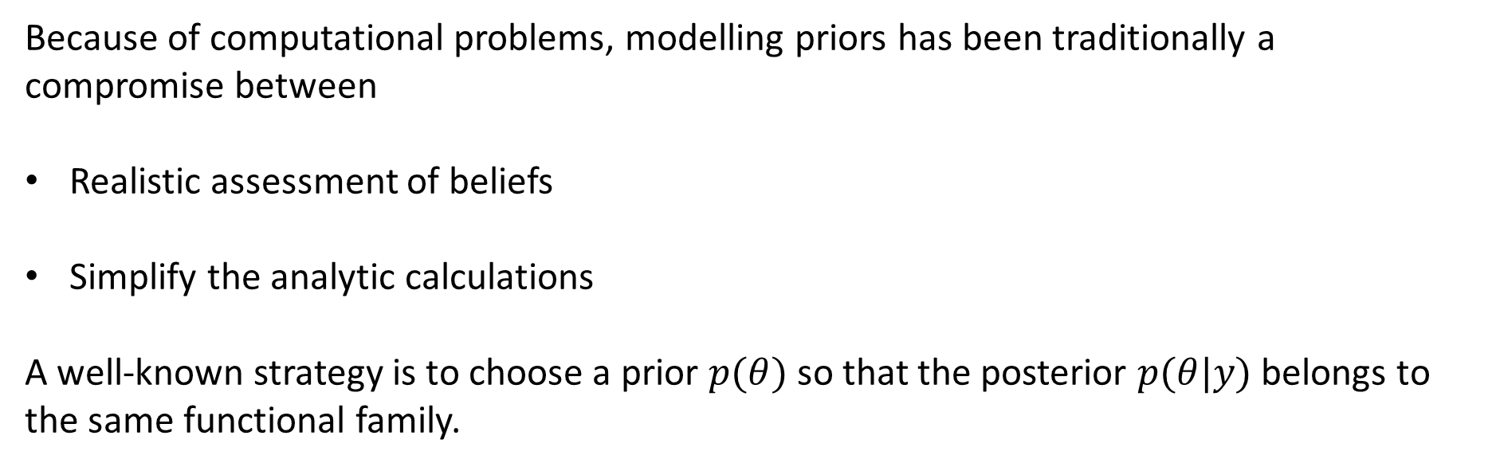
Conjugate Prior
Because of computational problems, modelling priors has been traditionally a compromise between
Realistic assessment of beliefs
Simplify the analytic calculations
A well-known strategy is to choose a prior $p(θ)$ so that the posterior $p(θ|y)$ belongs to the same functional family.

Slide 15

Conjugate Prior: Example
For example, suppose we now consider the binomial distribution. Apart from the binomial coefficient,
$$p\left(y | θ\right)=Bin(y|n,θ)∝θ^{y}{(1−θ)}^{n−y}$$
Which has the same structure as the Beta distribution. Thus, if we parameterize such a prior density of the same form as
$${p(θ)∝θ}^{α−1}{(1−θ)}^{β−1}$$
Then the posterior density for $θ$ is
$${p(θ|y)∝θ}^{y+α−1}{(1−θ)}^{n−y+β−1}=Beta(α+y,β+n−y)$$
Which is of the same form as the prior distribution.

Slide 16
Single-parameter Models

Slide 17
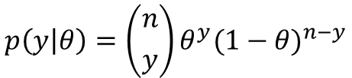
Binomial
Let $y$ be the total number of successes in the $n$ trials. Then the Binomial sampling model is,
$$p\left(y | θ\right)=\left({n \atop y}\right)θ^{y}{(1−θ)}^{n−y}$$
Where all the probabilities discussed for this problem are assumed to be conditional on a fixed number $n$.

Slide 18
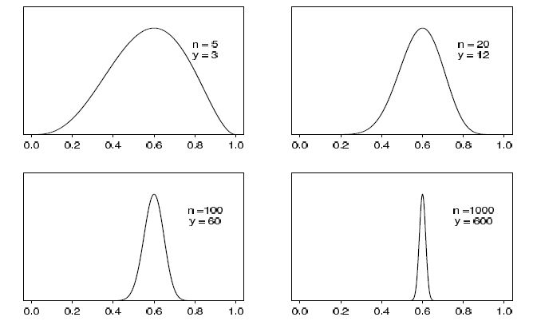
Binomial(Prior : Uniform)
For simplicity, we assume that the prior distribution for $θ$ is uniform on the interval $[0,1]$.
Elementary application of Bayes’ rule yields,
$$p\left(θ | y\right)∝θ^{y}{\left(1−θ\right)}^{n−y}\sim Beta(y+1,n−y+1)$$
Unnormalized posterior density for binomial parameter $θ$, based on uniform prior distribution and $y$ successes out of $n$ trials. Curves displayed for several values of $n$ and $y$.

Slide 19
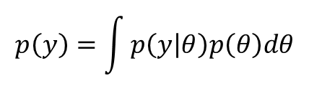

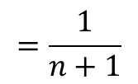
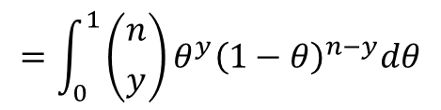
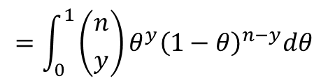
Binomial(Prior : Uniform)
$$p\left(θ | y\right)∝θ^{y}{\left(1−θ\right)}^{n−y}\sim Beta(y+1,n−y+1)$$
Marginal density
$$p\left(y\right)=\int{p\left(y | θ\right)p\left(θ\right)dθ}$$
For all $y=0,…,n$,
$$=\int_{0}^{1}{\left({n \atop y}\right)}θ^{y}{\left(1−θ\right)}^{n−y}dθ$$
$$=\int_{0}^{1}{\left({n \atop y}\right)}θ^{y}{\left(1−θ\right)}^{n−y}dθ$$
$$=\frac{1}{n+1}$$

Slide 20
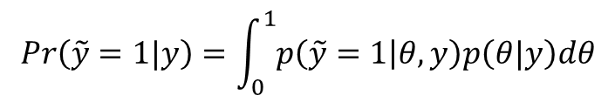
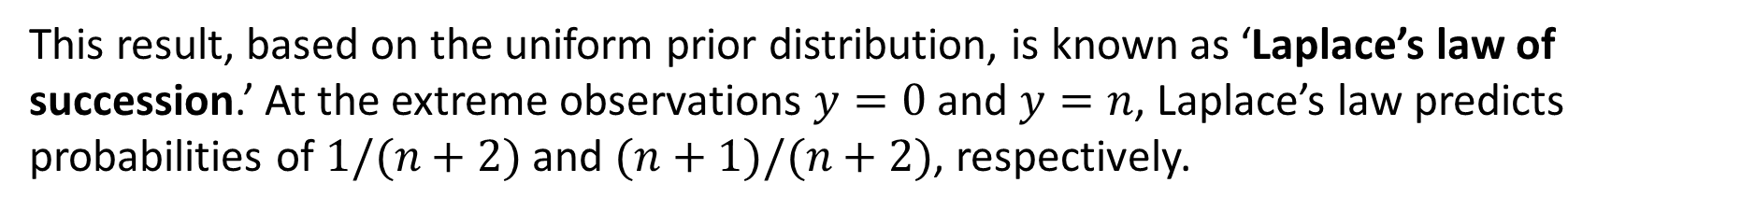
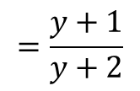

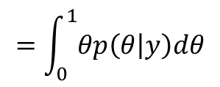
Binomial(Prior : Uniform)
$$p\left(θ | y\right)∝θ^{y}{\left(1−θ\right)}^{n−y}\sim Beta(y+1,n−y+1)$$
Prediction
$$Pr\left(\tilde{y}=1|y\right)=\int_{0}^{1}{p\left(\tilde{y}=1 | θ,y\right)p\left(θ|y\right)dθ}$$
$$=\int_{0}^{1}{θp\left(θ | y\right)dθ}$$
$$=𝔼[θ|y]$$
$$=\frac{y+1}{y+2}$$
This result, based on the uniform prior distribution, is known as ‘Laplace’s law of succession.’ At the extreme observations $y=0$ and $y=n$, Laplace’s law predicts probabilities of $1/(n+2)$ and $(n+1)/(n+2)$, respectively.

Slide 21
Binomial(Prior : Uniform)
$$p\left(θ | y\right)∝θ^{y}{\left(1−θ\right)}^{n−y}\sim Beta(y+1,n−y+1)$$
Prediction
$$Pr\left(\tilde{y}=1|y\right)=\int_{0}^{1}{p\left(\tilde{y}=1 | θ,y\right)p\left(θ|y\right)dθ}$$
$$=\int_{0}^{1}{θp\left(θ | y\right)dθ}$$
$$=𝔼[θ|y]$$
$$=\frac{y+1}{y+2}$$
This result, based on the uniform prior distribution, is known as ‘Laplace’s law of succession.’ At the extreme observations $y=0$ and $y=n$, Laplace’s law predicts probabilities of $1/(n+2)$ and $(n+1)/(n+2)$, respectively.

Slide 22
Binomial(Prior : Beta)
As we showed before, if we parameterize the prior density as beta distribution with hyperparameters $α$ and $β$:
$$p\left(θ | y\right)∝θ^{y+α−1}{\left(1−θ\right)}^{n−y+β−1}\sim Beta(α+y,β+n−y)$$

Slide 23
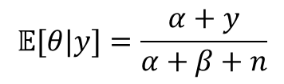
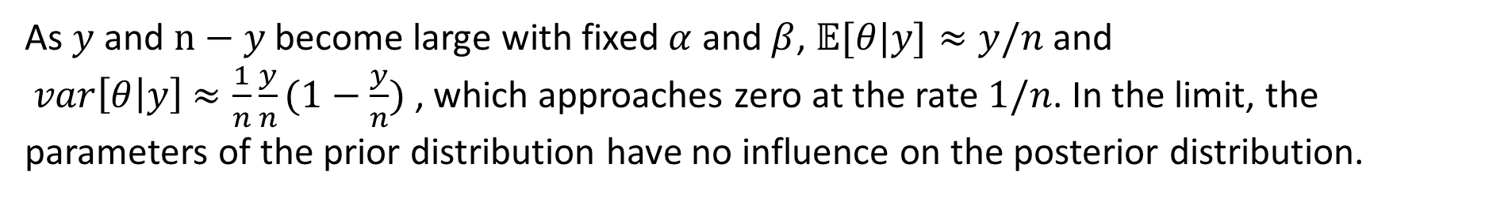
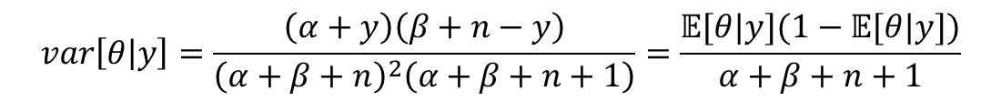
Binomial(Prior : Beta)
$$p\left(θ | y\right)∝θ^{y+α−1}{\left(1−θ\right)}^{n−y+β−1}\sim Beta(α+y,β+n−y)$$
Posterior mean
$$𝔼[θ|y]=\frac{α+y}{α+β+n}$$
Which always lies between the sample proportion, $y/n$ and the prior mean $α/(α+β)$.
Posterior Variance
$$var\left[θ | y\right]=\frac{\left(α+y\right)\left(β+n−y\right)}{{\left(α+β+n\right)}^{2}\left(α+β+n+1\right)}=\frac{𝔼[θ|y](1−𝔼[θ|y])}{α+β+n+1}$$
As $y$ and $n−y$ become large with fixed $α$ and $β$, $𝔼[θ|y]≈y/n$ and
$var\left[θ | y\right]$ $≈\frac{1}{n}\frac{y}{n}(1−\frac{y}{n})$ , which approaches zero at the rate $1/n$. In the limit, the parameters of the prior distribution have no influence on the posterior distribution.

Slide 24
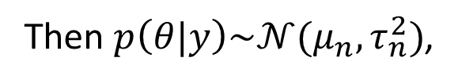


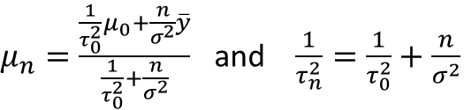

Normal with known variance(Prior : normal)
$$p\left(y\right)\sim 𝒩(θ,σ^{2})$$
$$p\left(θ\right)\sim 𝒩(μ_{0},τ_{0}^{2})$$
Then $p\left(θ|y\right)\sim 𝒩(μ_{n},τ_{n}^{2})$,
Where
$μ_{n}=\frac{\frac{1}{τ_{0}^{2}}μ_{0}+\frac{n}{σ^{2}}\overline{y}}{\frac{1}{τ_{0}^{2}}+\frac{n}{σ^{2}}}$ and $\frac{1}{τ_{n}^{2}}=\frac{1}{τ_{0}^{2}}+\frac{n}{σ^{2}}$
As $τ_{0}→∞$ with n fixed, or as $n→∞$ with $τ_{0}^{2}$ fixed, we have:
$$p\left(θ|y\right)≈𝒩(θ|\overline{y},\frac{σ^{2}}{n})$$

Slide 25



Poisson(Prior: Gamma)
$$p\left(y\right)∝θ^{\sum{y_{i}}}e^{−nθ}$$
Which is of the form of a Gamma distribution.
Thus let Prior distribution as Gamma distribution:
$$p\left(θ\right)\sim Gamma(α,β)$$
Then the posterior distribution is:
$$p\left(θ|y\right)\sim Gamma(α+n\overline{y},β+n)$$

Slide 26
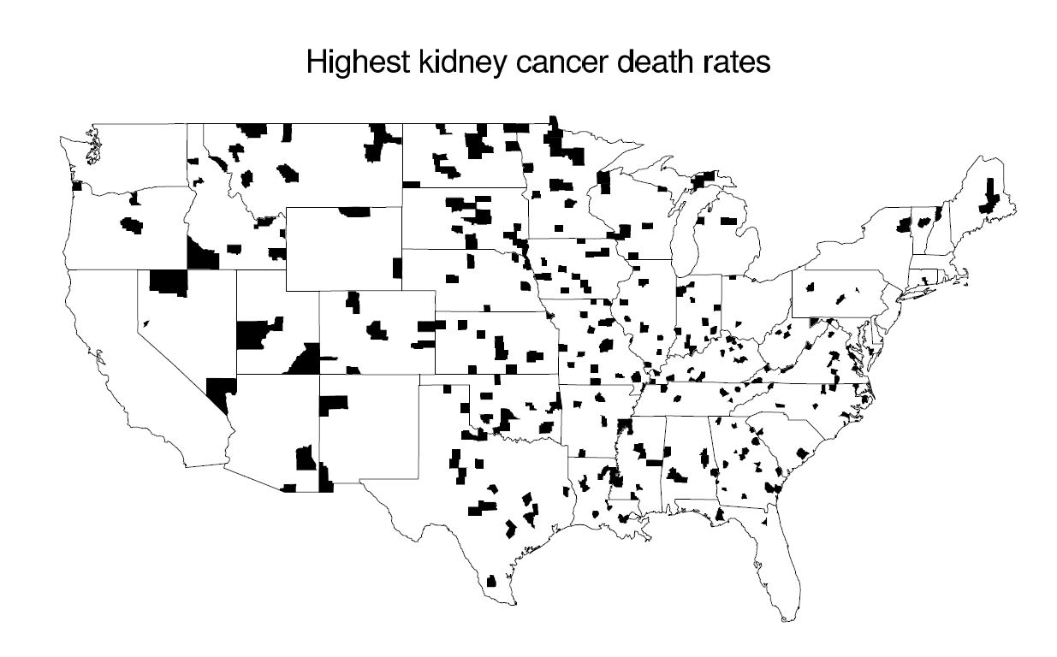
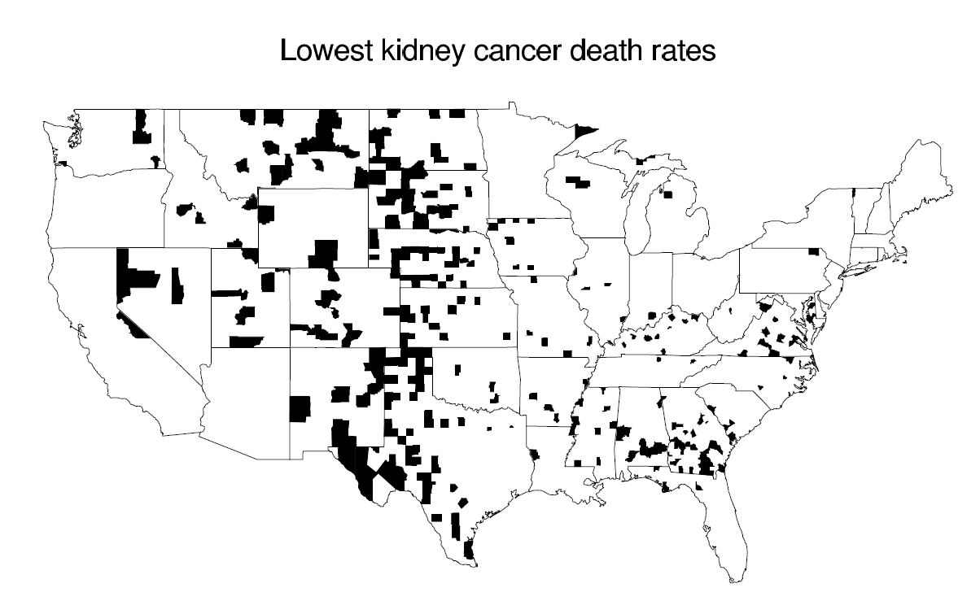
Example: informative prior distribution
The counties of the U.S. with the highest/lowest 10% age-standardized death rates for cancer of kidney/ureter for U.S. white males, 1980-1989.
Why are most of the shaded counties in the middle of the country?

Slide 27
Example: informative prior distribution
The issue is sample size.
For a county of population 1000:
Zero kidney cancer deaths → tied for the lowest rate in the country.
One kidney cancer deaths → have a rate of 1 per 10,000 per year, which is high enough to put it in the top 10%.

Slide 28

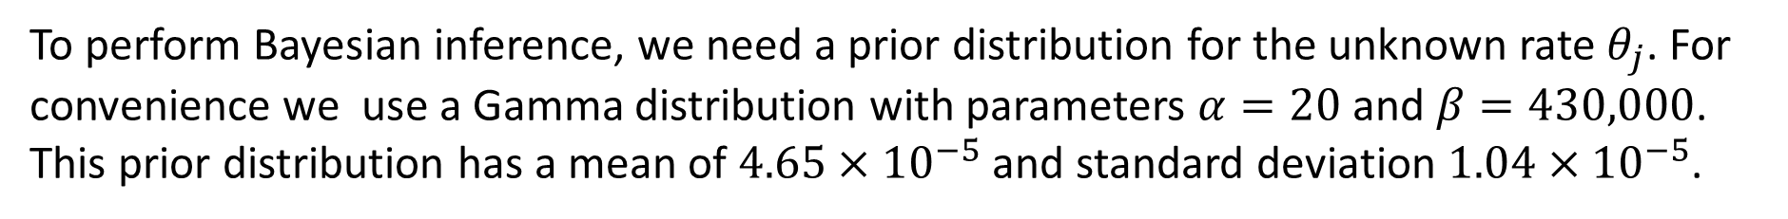
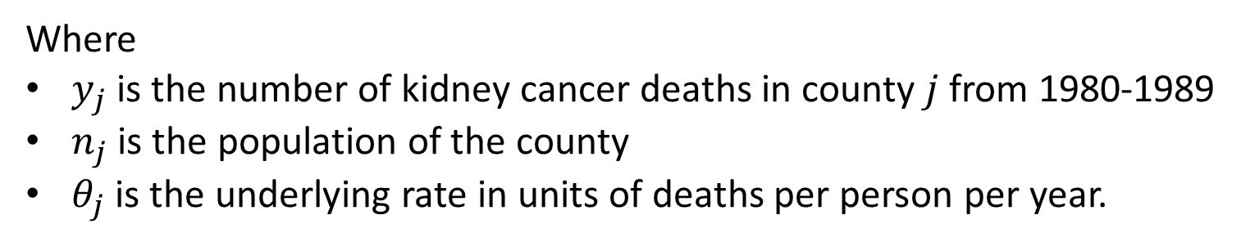
Example: informative prior distribution
It is natural to estimate the underlying cancer death rate in each county $j$ using the model
$$y_{j}\sim Poisson(10n_{j}θ_{j})$$
Where
$y_{j}$ is the number of kidney cancer deaths in county $j$ from 1980-1989
$n_{j}$ is the population of the county
$θ_{j}$ is the underlying rate in units of deaths per person per year.
To perform Bayesian inference, we need a prior distribution for the unknown rate $θ_{j}$. For convenience we use a Gamma distribution with parameters $α=20$ and $β=430,000$. This prior distribution has a mean of $4.65×{10}^{−5}$ and standard deviation $1.04×{10}^{−5}$.
$$θ_{j}|y_{j}\sim Gamma(20+y_{j},430,000+10n_{j})$$

Slide 29
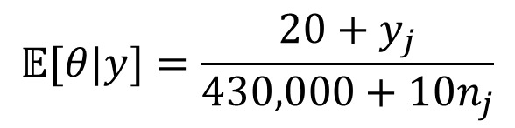
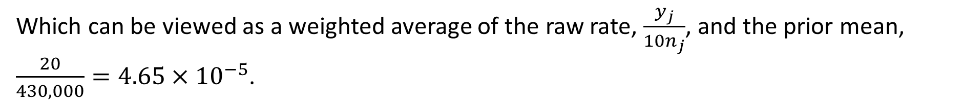
Example: informative prior distribution
$$θ_{j}|y_{j}\sim Gamma(20+y_{j},430,000+10n_{j})$$
$$𝔼[θ|y]=\frac{20+y_{j}}{430,000+10n_{j}}$$
Which can be viewed as a weighted average of the raw rate, $\frac{y_{j}}{10n_{j}}$, and the prior mean, $\frac{20}{430,000}=4.65×{10}^{−5}$.

Slide 30
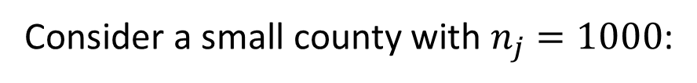
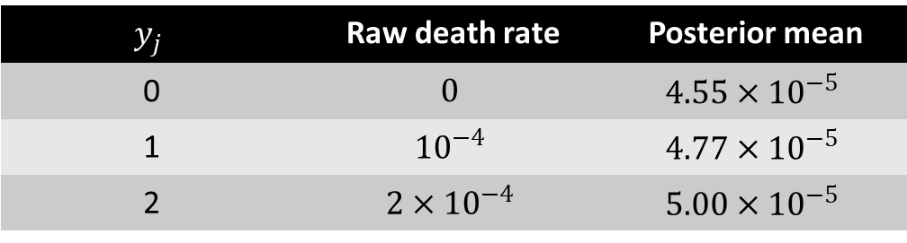
Example: informative prior distribution
$$θ_{j}|y_{j}\sim Gamma(20+y_{j},430,000+10n_{j})$$
Consider a small county with $n_{j}=1000$:
$$y_{j}$$ | Raw death rate | Posterior mean
0 | $$0$$ | $$4.55×{10}^{−5}$$
1 | $${10}^{−4}$$ | $$4.77×{10}^{−5}$$
2 | $$2×{10}^{−4}$$ | $$5.00×{10}^{−5}$$
With such a small population size, the data are dominated by the prior distribution.

Slide 31
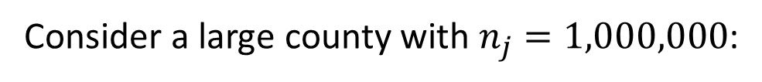
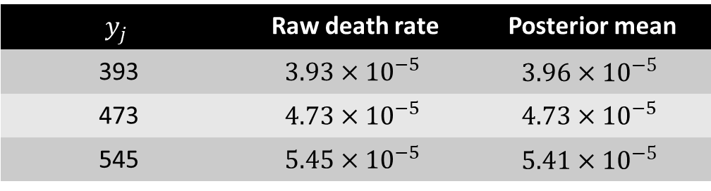
Example: informative prior distribution
$$θ_{j}|y_{j}\sim Gamma(20+y_{j},430,000+10n_{j})$$
Consider a large county with $n_{j}=1,000,000$:
$$y_{j}$$ | Raw death rate | Posterior mean
393 | $$3.93×{10}^{−5}$$ | $$3.96×{10}^{−5}$$
473 | $$4.73×{10}^{−5}$$ | $$4.73×{10}^{−5}$$
545 | $$5.45×{10}^{−5}$$ | $$5.41×{10}^{−5}$$
In this large county, the data dominate the prior distribution.

Slide 32
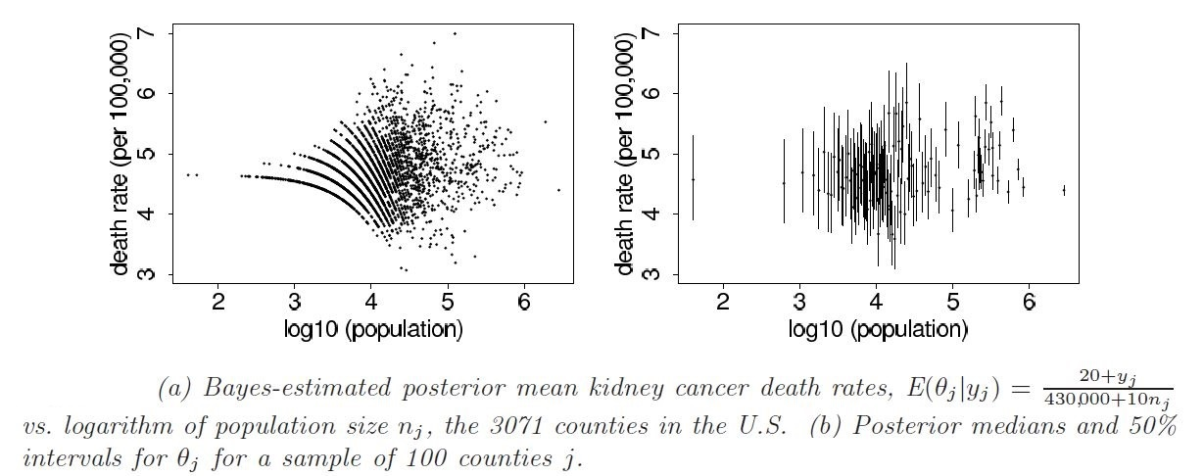
Example: informative prior distribution
$$θ_{j}|y_{j}\sim Gamma(20+y_{j},430,000+10n_{j})$$
Comparing counties of different sizes:

Slide 33
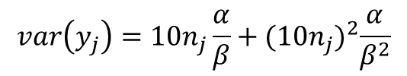
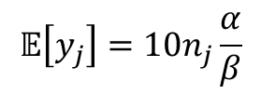
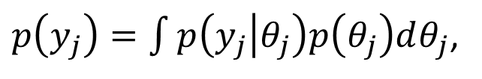
Example: informative prior distribution
Let’s step back and discuss where we got the prior distribution hyperparameters:
Note: it might seem inappropriate to use the data to set the prior distribution, but we view this as an useful approximation to our preferred approach of hierarchical modeling, in which distributional parameters such as $α, β$ in this example are treated as unknowns to be estimated.
Under the model, the observed count $y_{j}$ for any county $j$ comes from the predictive distribution,
$p\left(y_{j}\right)=\int{p\left(y_{j} | θ_{j}\right)p\left(θ_{j}\right)dθ_{j}}$,
which is this case is $NegBin\left(α,\frac{β}{10n_{j}}\right)$, with mean and variance:
$$𝔼\left[y_{j}\right]=10n_{j}\frac{α}{β}$$
$$var\left(y_{j}\right)=10n_{j}\frac{α}{β}+{(10n_{j})}^{2}\frac{α}{β^{2}}$$

Slide 34
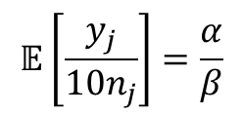
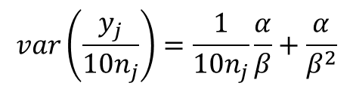
Example: informative prior distribution
Matching the observed mean and variance to their expectations and solving for $α, β$ yields the parameters of the prior distribution.
$$𝔼\left[\frac{y_{j}}{10n_{j}}\right]=\frac{α}{β}$$
$$var\left(\frac{y_{j}}{10n_{j}}\right)=\frac{1}{10n_{j}}\frac{α}{β}+\frac{α}{β^{2}}$$
In the future, we will discuss how to estimate this and other prior distributions in a more Bayesian manner, using hierarchical models.

Slide 35
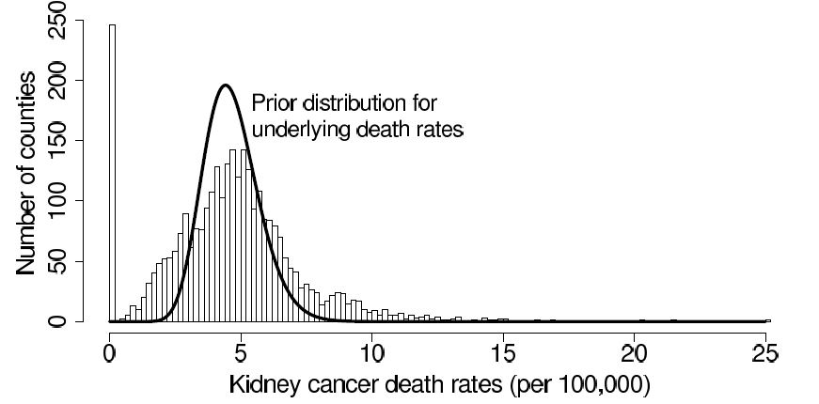
Example: informative prior distribution
Empirical distribution of the age-adjusted kidney cancer death rates, $\frac{y_{j}}{10n_{j}}$, for the 3071 counties in the U.S., along with the $Gamma(20, 430,000)$ prior distribution for the underlying cancer rates $j$ .

Slide 36
Noninformative prior distribution
Noninformative prior distribution:
‘to let the data speak for themselves’
Often described as vague, flat, diffuse or noninformative
Weakly informative prior distribution:
enough to ‘regularize’ the posterior distribution, i.e., to keep it roughly within reasonable bounds
Notes:
When prior distributions have no population basis, they can be difficult to construct, and there has long been a desire for prior distributions that can be guaranteed to play a minimal role in the posterior distribution. Such distributions are sometimes called ‘reference prior distributions,’ and the prior density is described as vague, flat, diffuse or noninformative.
The rationale for using noninformative prior distributions is often said to be ‘to let the data speak for themselves,’ so that inferences are unaffected by information external to the current data.

Slide 37
Multi-parameter Models

Slide 38
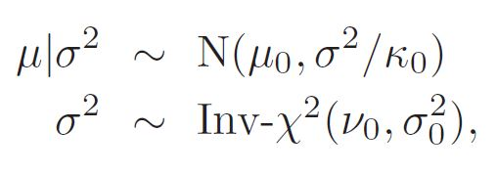
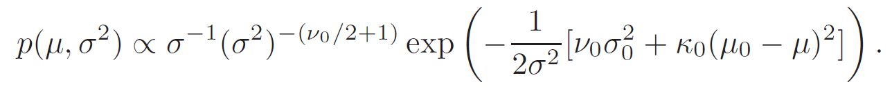
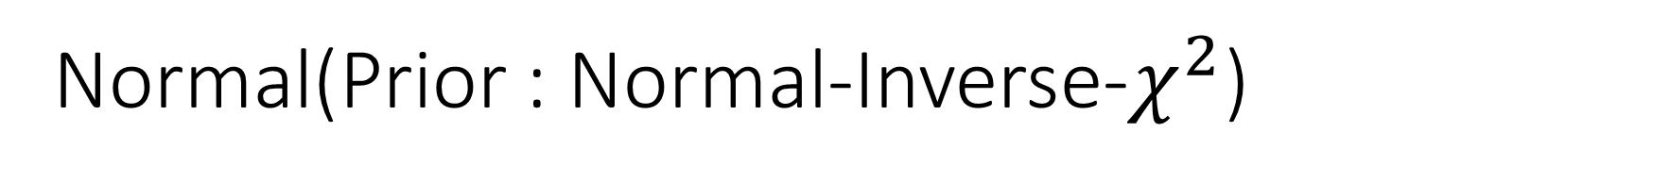
Normal(Prior : Normal-Inverse-$χ^{2}$)
A convenient parameterization is given by below:
Which corresponds to the joint prior density,
We label this the $N$-$Inv−χ^{2}(μ,σ^{2}|μ_{0},\frac{σ_{0}^{2}}{κ_{0}};υ_{0},σ_{0}^{2})$ density.

Slide 39
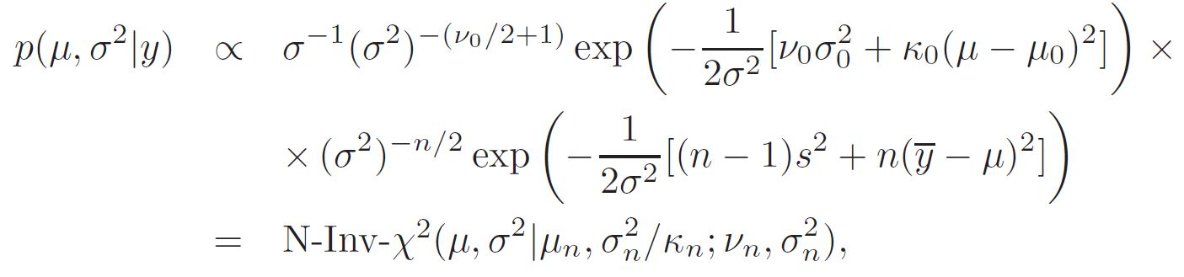
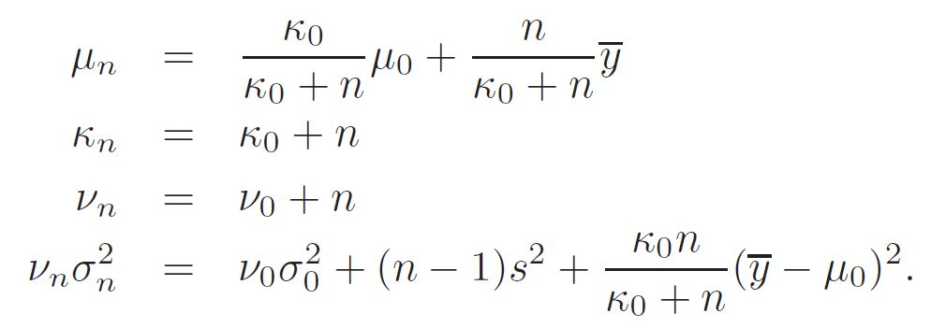
Normal(Prior : Normal-Inverse-$χ^{2}$)
Posterior density
Where, after some algebra, it can be shown that

Slide 40
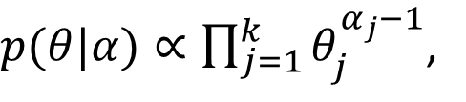
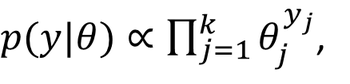
Multinomial(Prior :Dirichlet)
$p(y|θ)∝\prod_{j=1}^{k}{θ_{j}^{y_{j}}}$,
The conjugate prior distribution is known as the Dirichlet,
$p(θ|α)∝\prod_{j=1}^{k}{θ_{j}^{α_{j}−1}}$,
The resulting posterior distribution for the $θ_{j}$’s is Dirichlet with parameters $α_{j}+y_{j}$.

Slide 41
Hierarchical Models

Slide 42
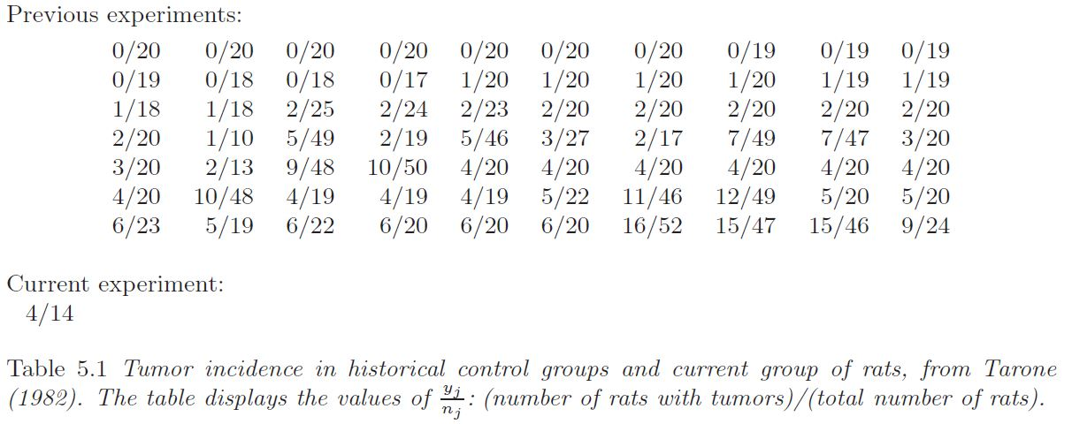
Hierarchical Models

Slide 43
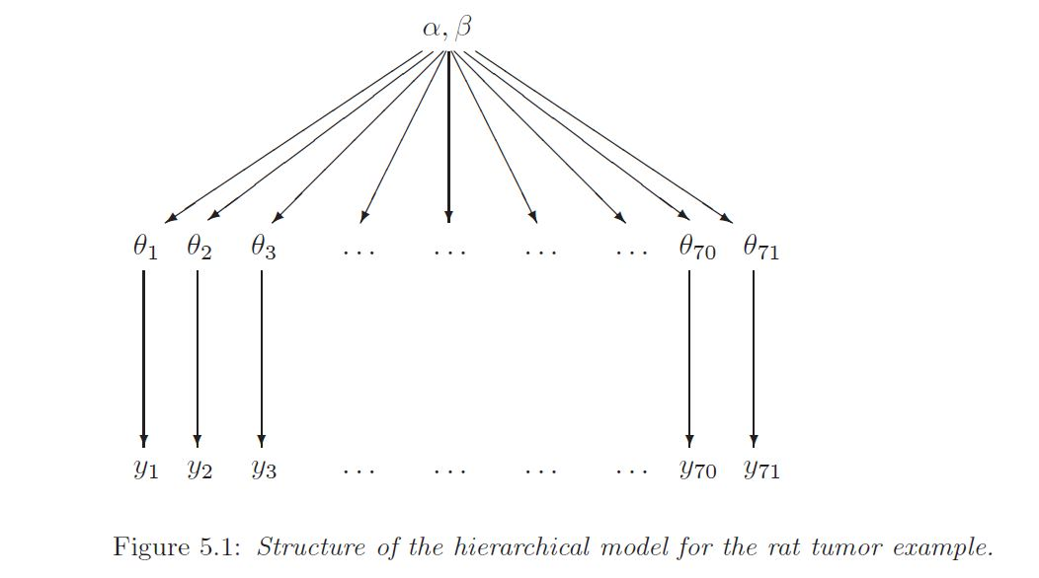
Hierarchical Models

Slide 44
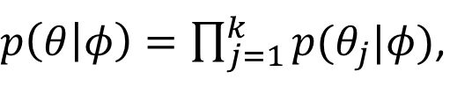
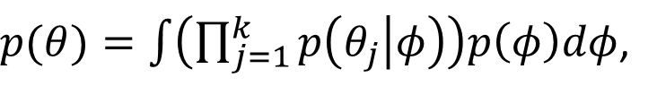
Hierarchical Models
exchangeability
$p(θ_{1},θ_{2},…,θ_{J})$ is invariant to permutations of the indexes.
Then
$p\left(θ | φ\right)=\prod_{j=1}^{k}{p(θ_{j}|φ)}$,
and
$p(θ)=\int{\left(\prod_{j=1}^{k}{p\left(θ_{j} | φ\right)}\right)p\left(φ\right)dφ}$,

Slide 45
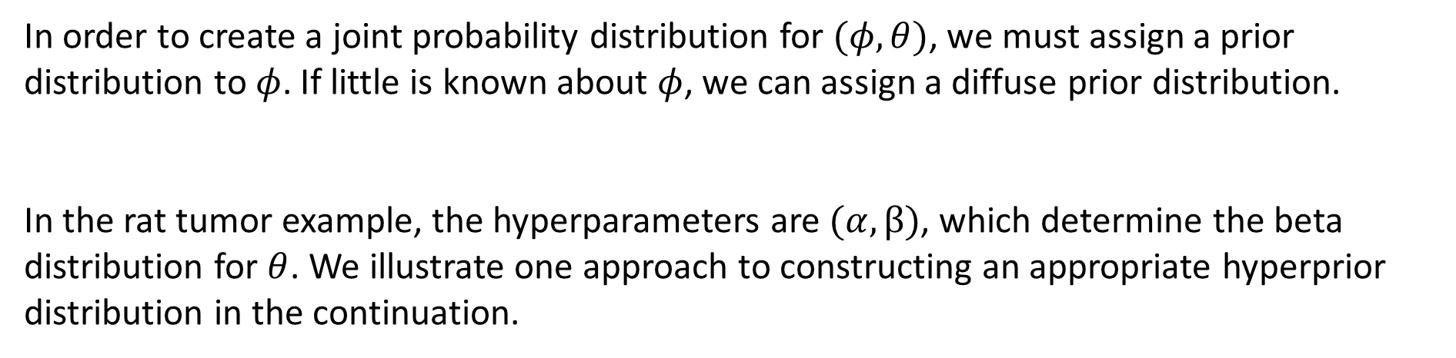
Hierarchical Models
Hyperprior distribution
In order to create a joint probability distribution for $(φ,θ)$, we must assign a prior distribution to $φ$. If little is known about $φ$, we can assign a diffuse prior distribution.
In the rat tumor example, the hyperparameters are $(α,β)$, which determine the beta distribution for $θ$. We illustrate one approach to constructing an appropriate hyperprior distribution in the continuation.

Slide 46
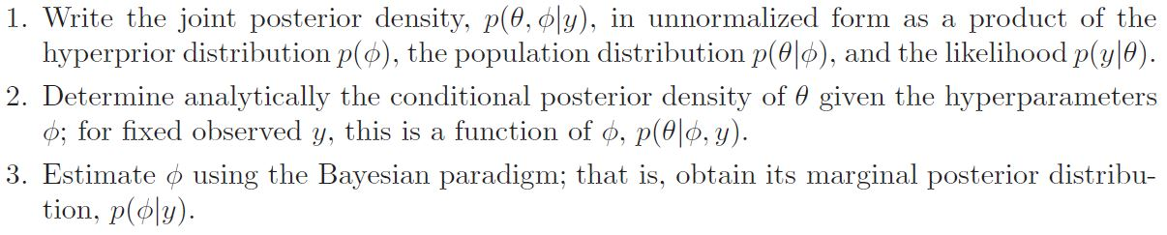

Hierarchical Models
Where step 3 can use the conditional probability formula,

