Slide 1


Covariance Matrix Estimation and its Application in Cryo-EM
Shao-Hsuan Wang
Institute of Statistical Science, Academia Sinica
Notes:
Good afternoon, I’m Shao-Hsuan Wang,
today I will give a short talk about On asymptotic normality of CDM-PCA in HDLSS.

Slide 2
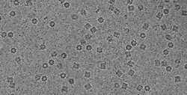
Covariance matrix estimation for the
Cryo-EM Problem
PCA and CDM-PCA in the HDLSS data
Asymptotic Theory
Simulation Result
Outline
Notes:
Iv divide my presentation into five parts. First, I will introduce some background of HDLSS data,
Spiked covariance model and Yata and Aoshima’s work.
Second, I will introduce our work and provide numerical study results.

Slide 3
Covariance matrix estimation for the
Cryo-EM Problem
PCA and CDM-PCA in the HDLSS data
Asymptotic Theory
Simulation Result
Outline
Notes:
Iv divide my presentation into five parts. First, I will introduce some background of HDLSS data,
Spiked covariance model and Yata and Aoshima’s work.
Second, I will introduce our work and provide numerical study results.

Slide 4


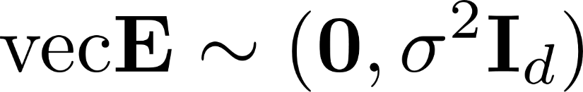


Signal-plus-noise model
(image)
(signal)
(noise)
Notes:
We start with a data matrix. Suppose that X is d by n data matrix.
For an individual i, xi is (x_i1,…, xid). X_i I from 1 to n are iid rv with mean zero and covariance matrix.

Slide 5
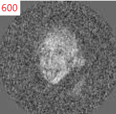

Signal-plus-noise model
(image)
(noise)
[1] Henderson, R. (2013). Avoiding the pitfalls of single particle cryo-electron microscopy: Einstein from noise
[2] Wang, Yao, Cheng, and Tu (2019+). Quantification of model bias underlying the phenomenon of “Einstein from Noise”
Notes:
We start with a data matrix. Suppose that X is d by n data matrix.
For an individual i, xi is (x_i1,…, xid). X_i I from 1 to n are iid rv with mean zero and covariance matrix.

Slide 6
Spiked Covariance model (Johnstone, 2001)
(image)
(signal)
(noise)
Notes:
We start with a data matrix. Suppose that X is d by n data matrix.
For an individual i, xi is (x_i1,…, xid). X_i I from 1 to n are iid rv with mean zero and covariance matrix.

Slide 7
Spiked Covariance model (Johnstone, 2001)
Notes:
We start with a data matrix. Suppose that X is d by n data matrix.
For an individual i, xi is (x_i1,…, xid). X_i I from 1 to n are iid rv with mean zero and covariance matrix.

Slide 8
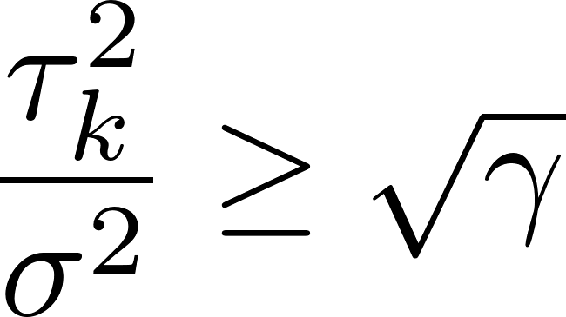

Spectrum of the sample covariance matrix in the spiked model (Baik and Silverstein, 2006)
Notes:
We start with a data matrix. Suppose that X is d by n data matrix.
For an individual i, xi is (x_i1,…, xid). X_i I from 1 to n are iid rv with mean zero and covariance matrix.

Slide 9
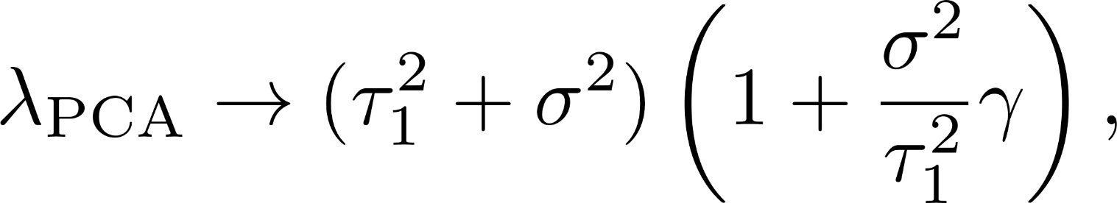
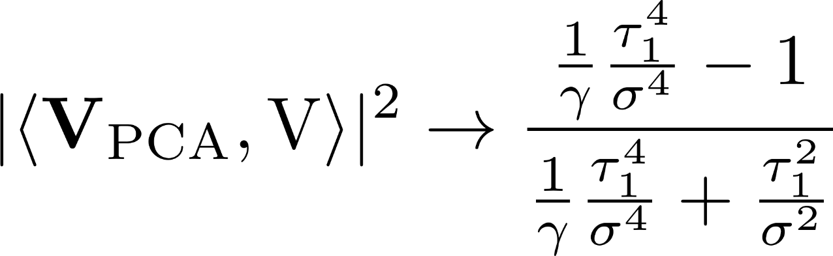
Spectrum of the sample covariance matrix in the spiked model (Baik and Silverstein, 2006)
Notes:
We start with a data matrix. Suppose that X is d by n data matrix.
For an individual i, xi is (x_i1,…, xid). X_i I from 1 to n are iid rv with mean zero and covariance matrix.

Slide 10
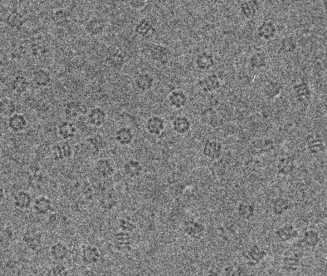






Spectrum of the sample covariance matrix in the spiked model (Baik and Silverstein, 2006)
Notes:
We start with a data matrix. Suppose that X is d by n data matrix.
For an individual i, xi is (x_i1,…, xid). X_i I from 1 to n are iid rv with mean zero and covariance matrix.

Slide 11
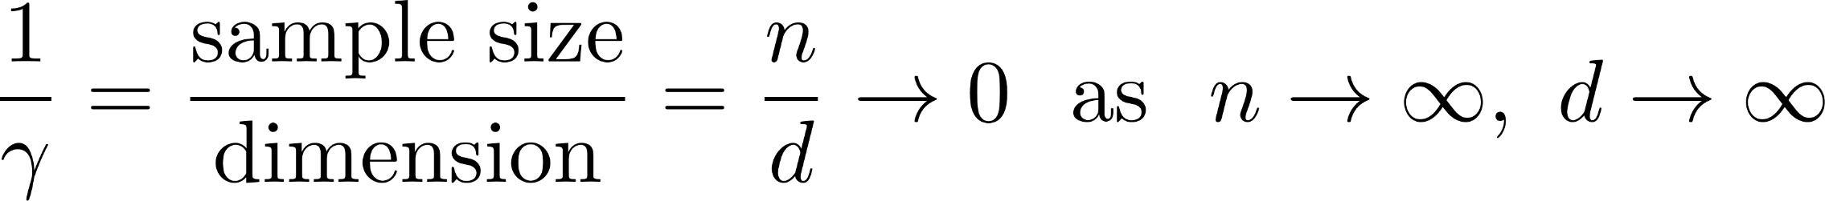
Notes:
We start with a data matrix. Suppose that X is d by n data matrix.
For an individual i, xi is (x_i1,…, xid). X_i I from 1 to n are iid rv with mean zero and covariance matrix.

Slide 12
Covariance matrix estimation for the
Cryo-EM Problem.
PCA and CDM-PCA in the HDLSS data
Asymptotic Theory
Simulation Result
Outline
Notes:
Iv divide my presentation into five parts. First, I will introduce some background of HDLSS data,
Spiked covariance model and Yata and Aoshima’s work.
Second, I will introduce our work and provide numerical study results.

Slide 13
High-dimension, low-sample-size (HDLSS) data occurs in many modern science fields such as genetic microarrays, medical imaging, text recognition, finance, chemometrics, and so on.
Principal Component Analysis (PCA) is an important tool for dimension reduction especially when the dimension is very high.
Notes:
We start with a data matrix. Suppose that X is d by n data matrix.
For an individual i, xi is (x_i1,…, xid). X_i I from 1 to n are iid rv with mean zero and covariance matrix.

Slide 14
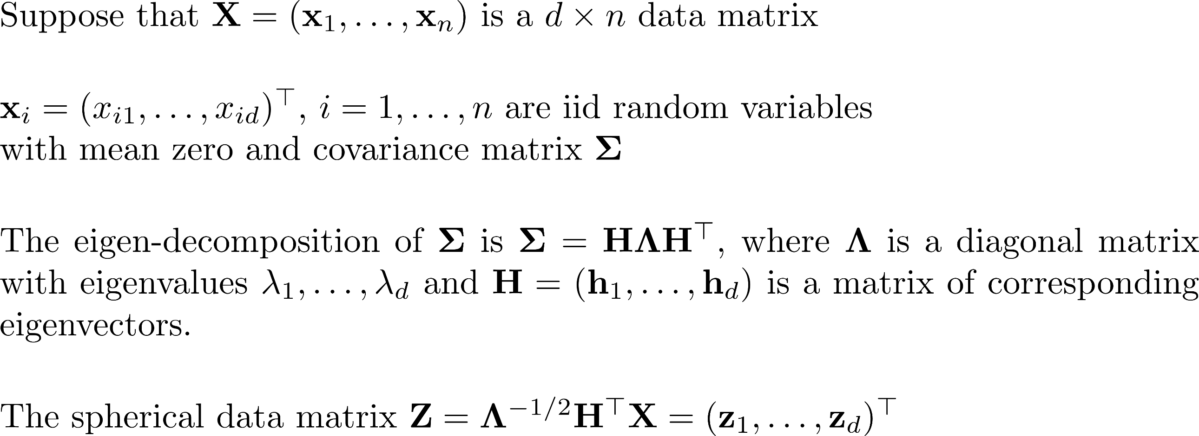
A data matrix
1
2
3
4
Notes:
We start with a data matrix. Suppose that X is d by n data matrix.
For an individual i, xi is (x_i1,…, xid). X_i I from 1 to n are iid rv with mean zero and covariance matrix.

Slide 15
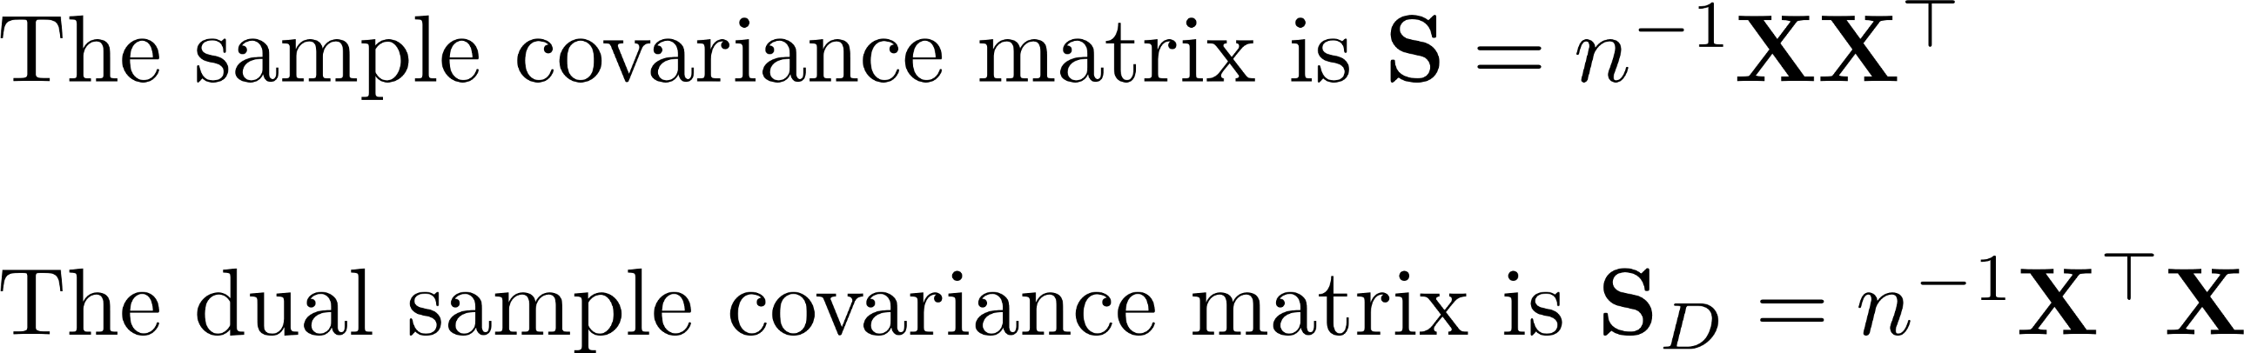
Sample covariance matrix and its dual
1
2
Notes:
Sampe covraince matrix is a famous estimator for Sigma
Change positions of two matrices. Note that when $d$ is larger and
$n$ is small, we tend to use S_D instead of S . It is because there is
A computational efficiency.

Slide 16
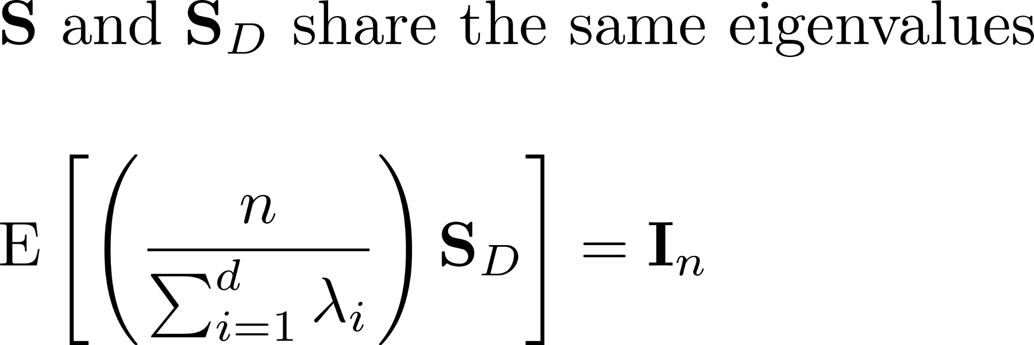

Two facts
1
2
Notes:
There are two facts. First, S and S_D share the same eigenvalue because for any two matrice A and B, A tiems B and B times A share the same eigenvalues. Second, the dual matrix SD can be expressed as the form sum zi zi^\top, we have

Slide 17
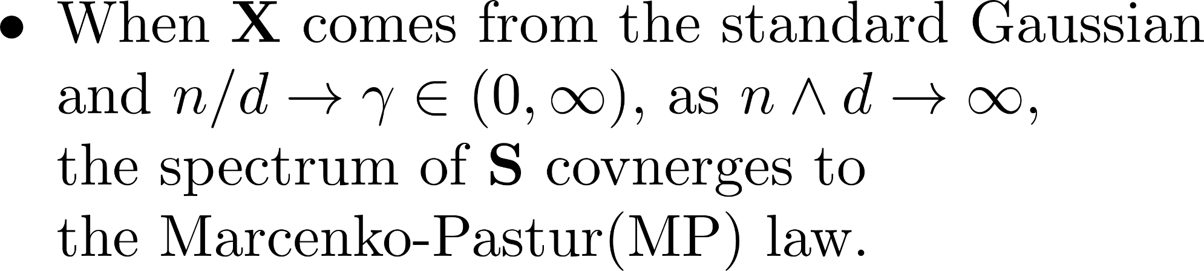
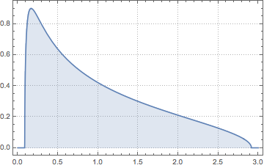
population eigenvalues
Notes:
Marcenko-Pastur (abbreviated as MP) law
N over d convergents to gamma, a finite positive number as both n, go to large.
It is well known that MP law is a kind of semi-circle law. [Most of eigenvalues are round 1, but not all. ]

Slide 18


Question: In HDLSS, can the eigenvalues and eigenvectors of be estimated from that of ?
Notes:
The HDLSS problem is big so we focus on an interesting model:
Spiked covariance model

Slide 19












Spiked covariance model
=
Notes:
What is spiked covariance model. It is to model the structure of a populatin covariance matrix Sigma
We do spectral decomposition of population covariance, and then we have two groups. One is leading group, another is
Tail group. Here, we use blue and red color.
\lambda_j is a power function of d
\lmbda_j is bounded

Slide 20
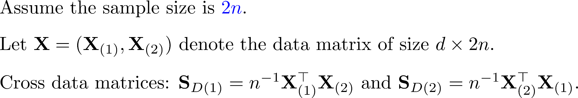

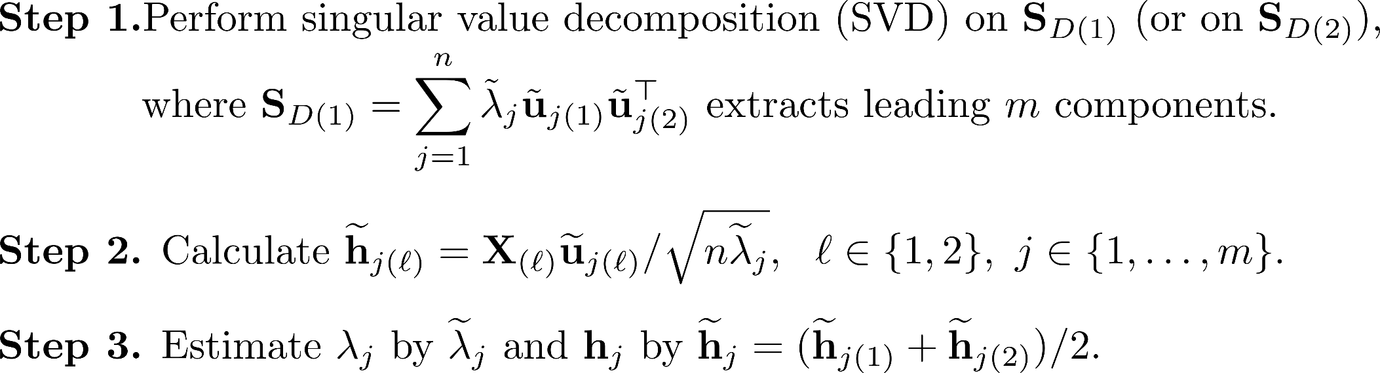
Cross data matrix (CDM) PCA (Yata and Aoshima, 2010)

Slide 21
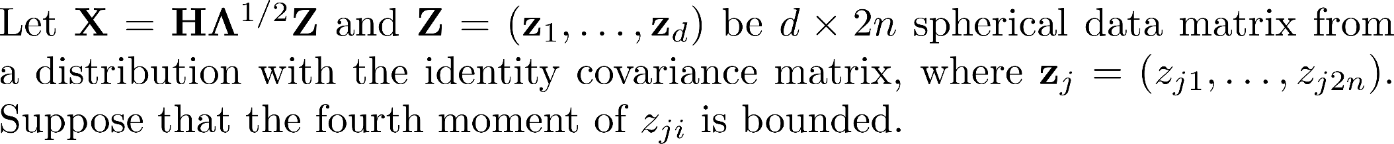


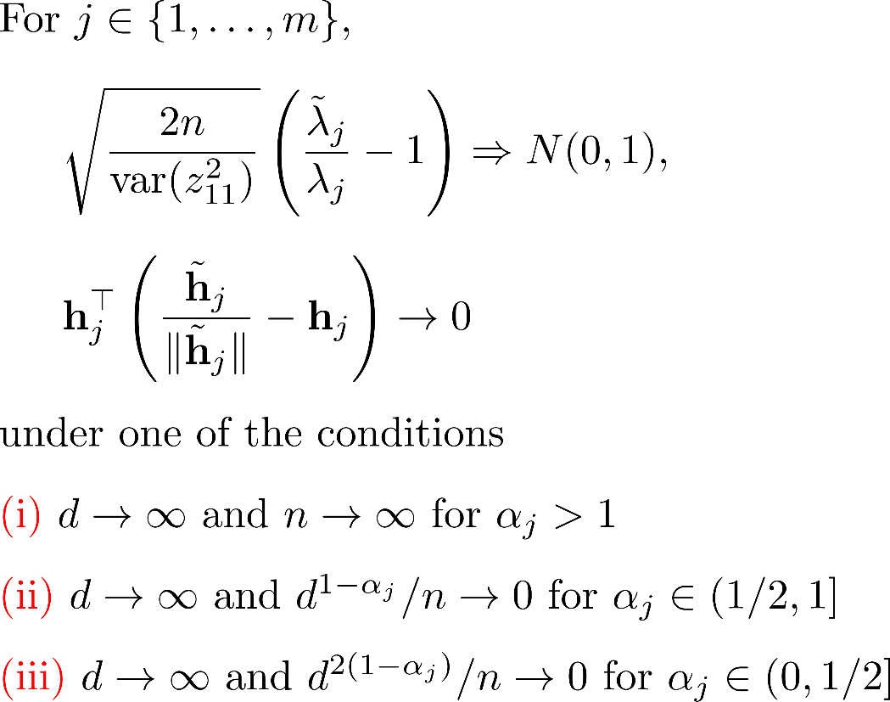
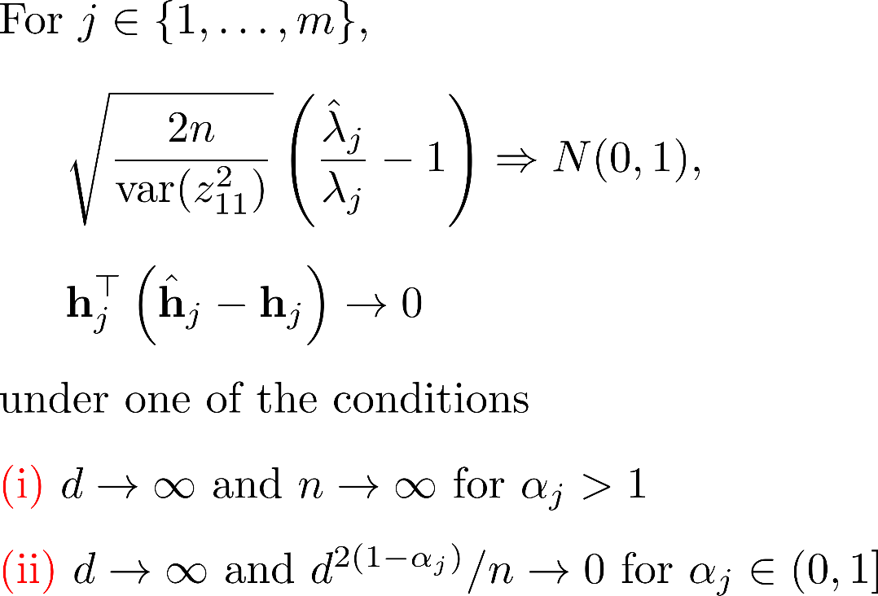
CDM-PCA and PCA (Yata and Aoshima, 2009, 2010)

Slide 22
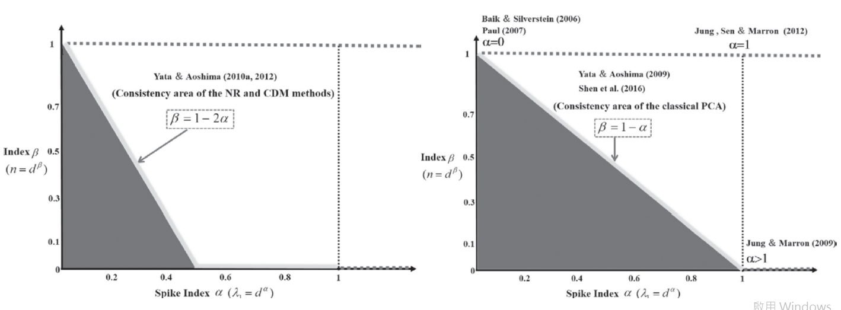
Consistency region: CDM-PCA v.s. PCA ( Aoshima et al., 2018)

Slide 23
Covariance matrix estimation for the
Cryo-EM Problem
PCA and CDM-PCA in the HDLSS data
Asymptotic Theory
Simulation Result
Outline
Notes:
Iv divide my presentation into five parts. First, I will introduce some background of HDLSS data,
Spiked covariance model and Yata and Aoshima’s work.
Second, I will introduce our work and provide numerical study results.

Slide 24
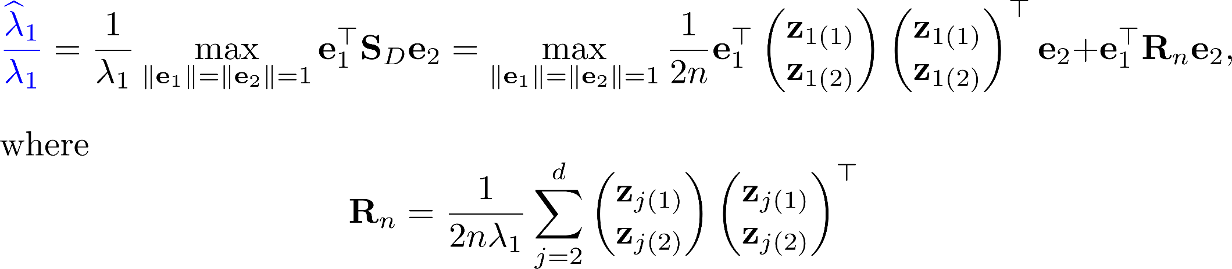
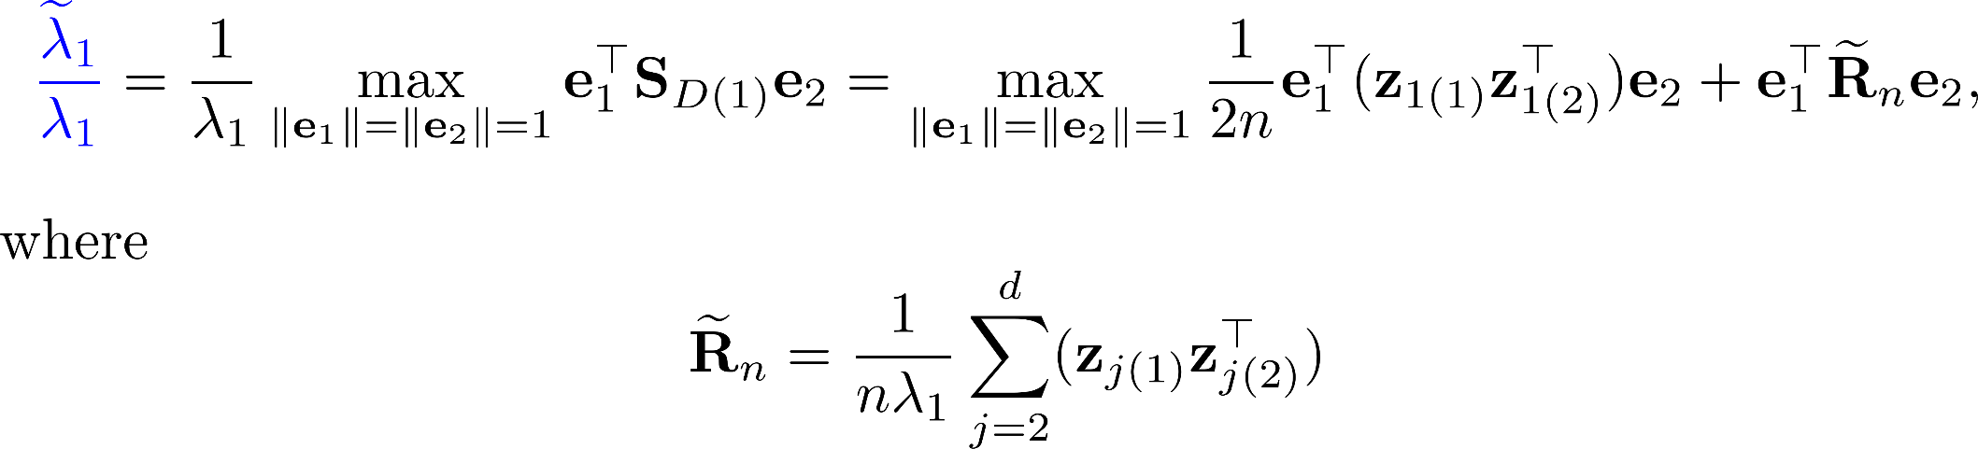
Broader consistency region for CDM-PCA (W., Huang and Chen, 2019)

Slide 25

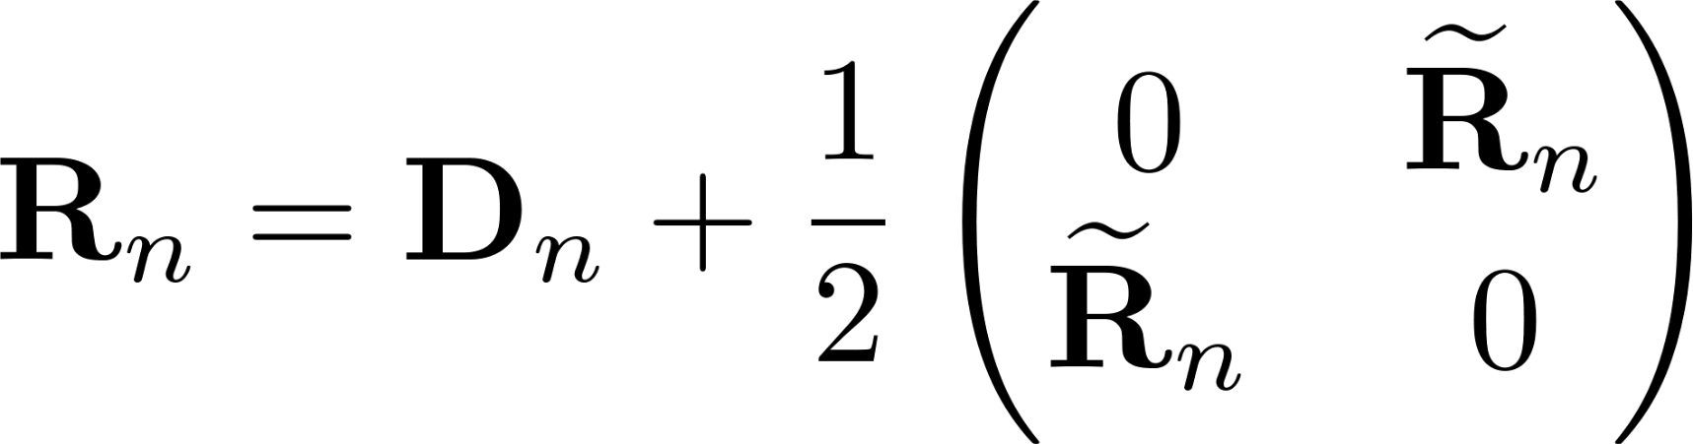
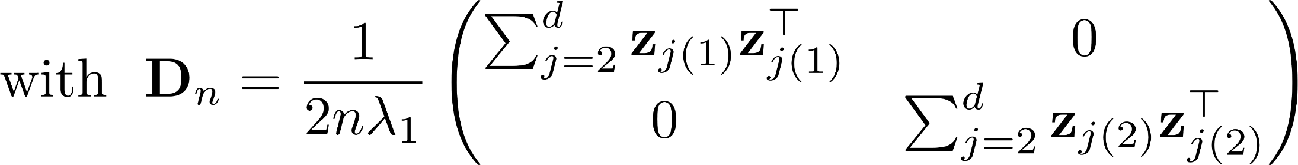
Broader consistency region for CDM-PCA (W., Huang and Chen, 2019)

Slide 26

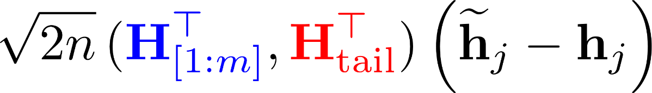

Asymptotic normality
Notes:
Next, I will show you ,,,
(because time is limited, I just show you a brief result and our main idea)

Slide 27
Notes:
Next, I will show you ,,,
(because time is limited, I just show you a brief result and our main idea)

Slide 28
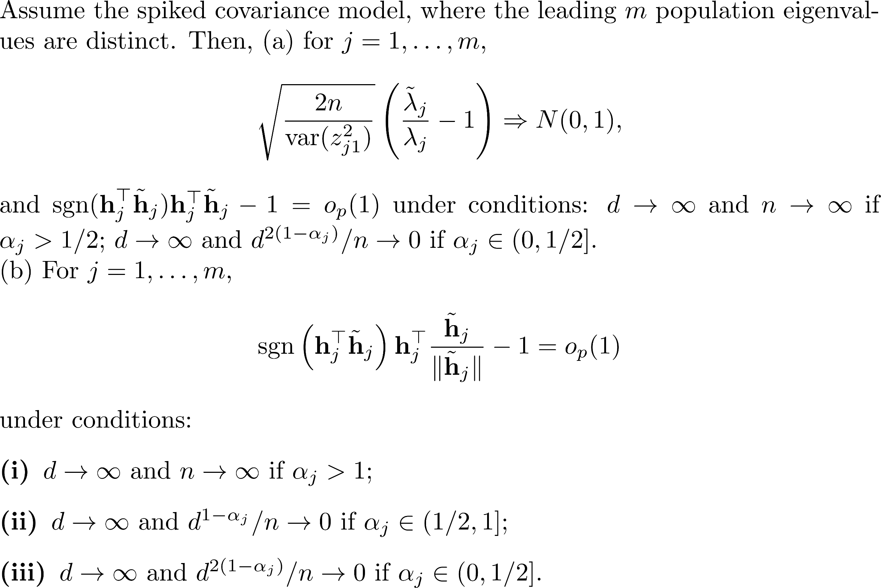
Theorem 1. (Yata and Aoshima, 2012)

Slide 29
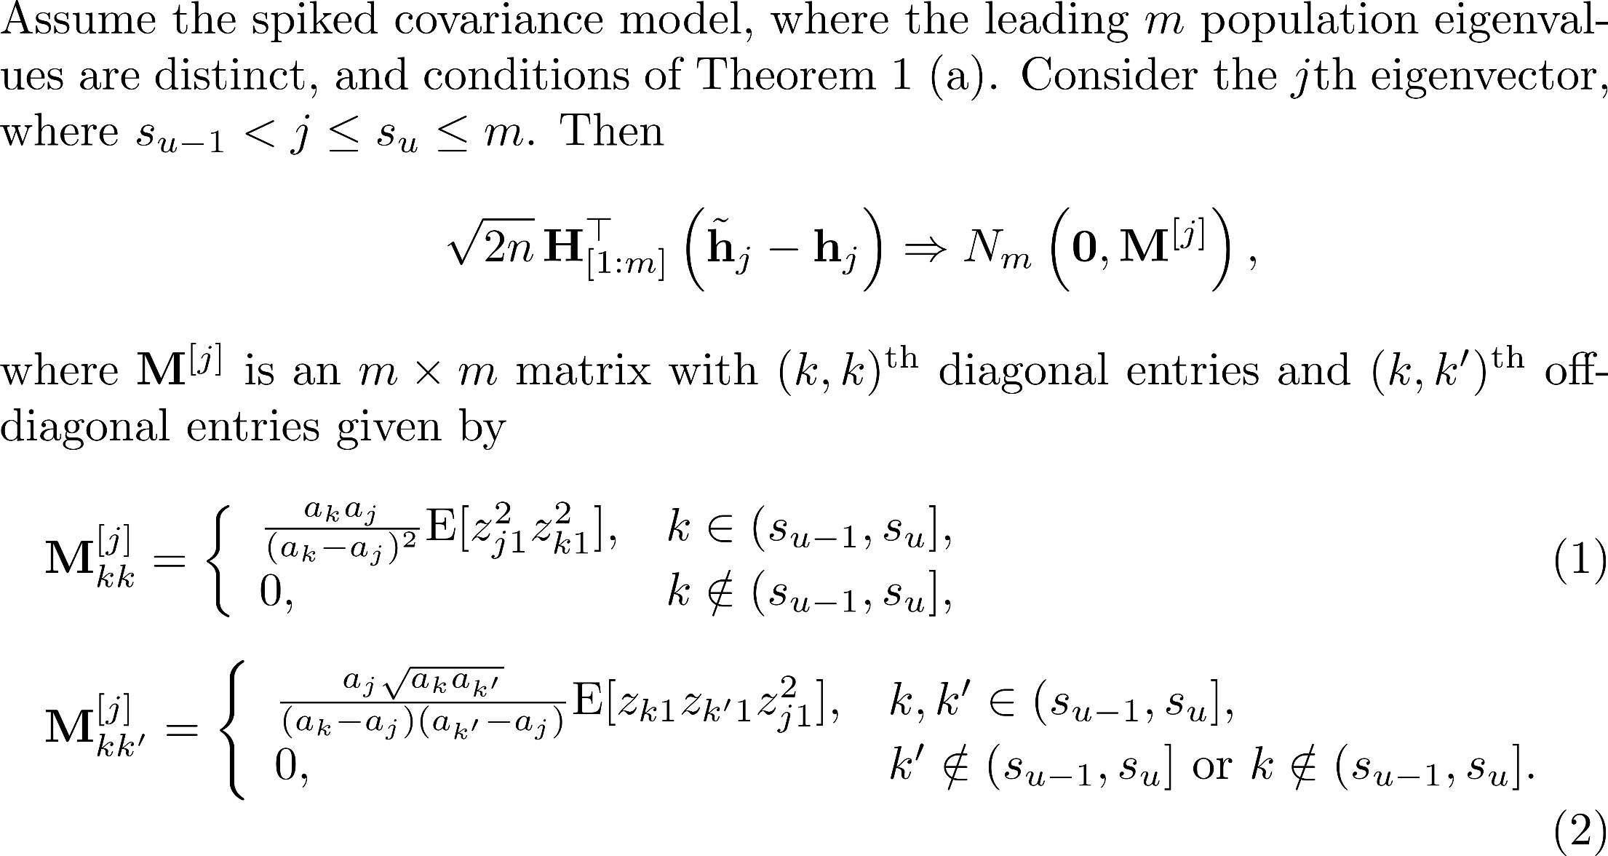
Theorem 2 (CDM-PCA). (W., Huang and Chen, 2019)

Slide 30
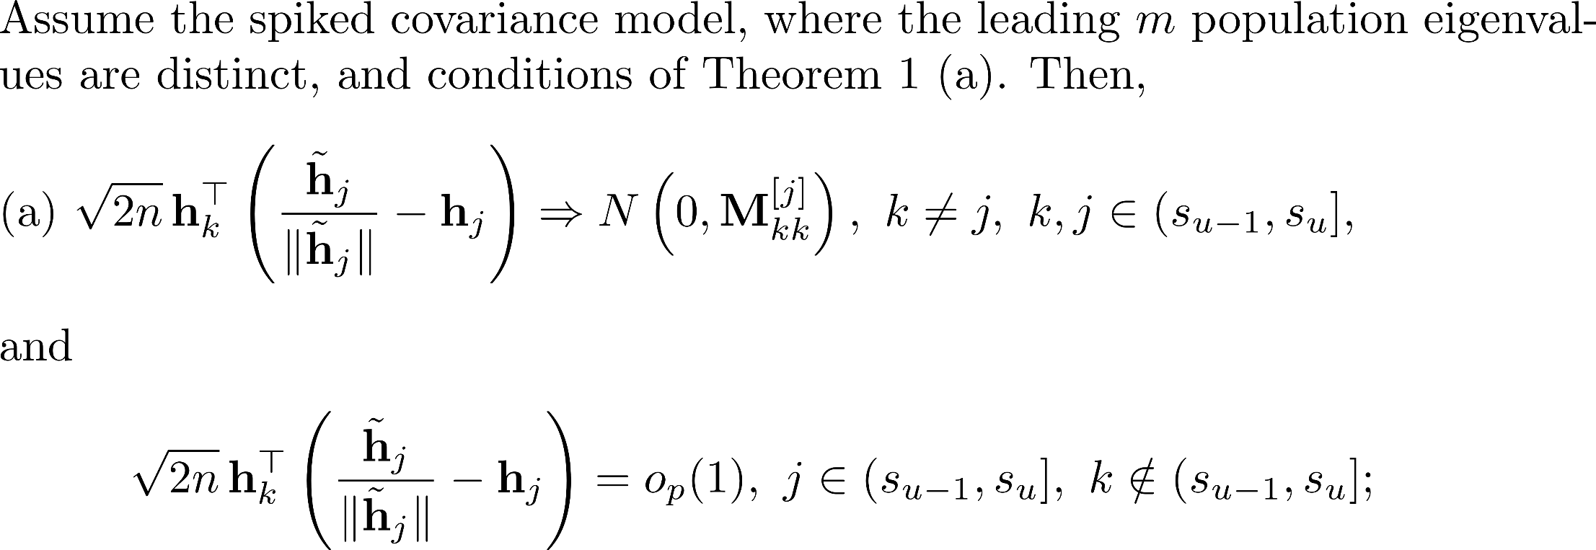
Theorem 3. (W., Huang and Chen, 2019)

Slide 31
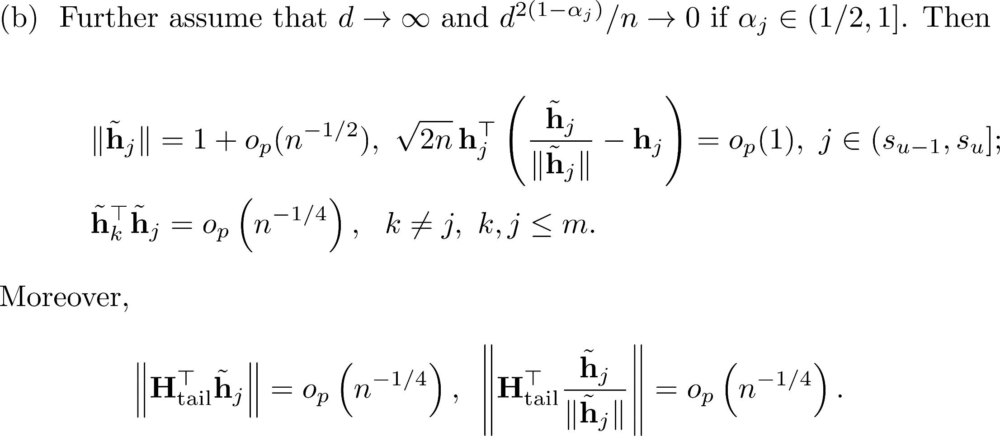

Slide 32
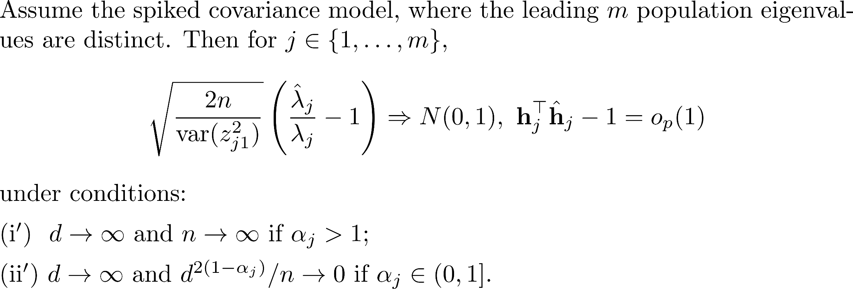
Theorem 4. (Yata and Aoshima, 2009)

Slide 33
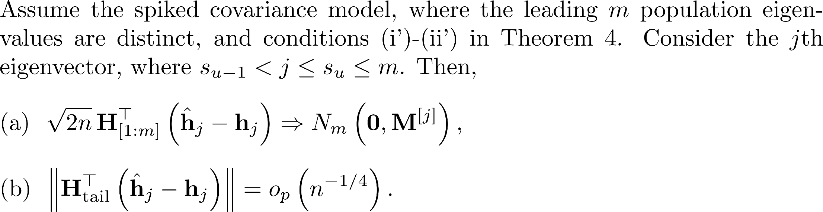
Theorem 5(PCA). (W., Huang and Chen, 2019)

Slide 34
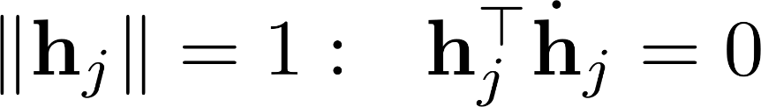
The key of our proofs: a perturbation method
1
2
3

Slide 35
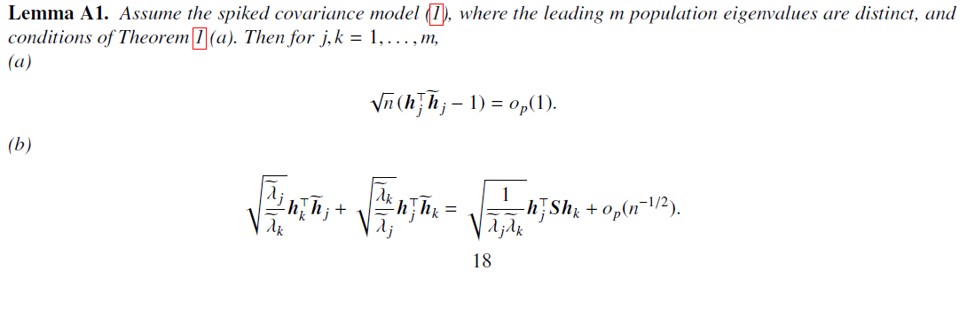
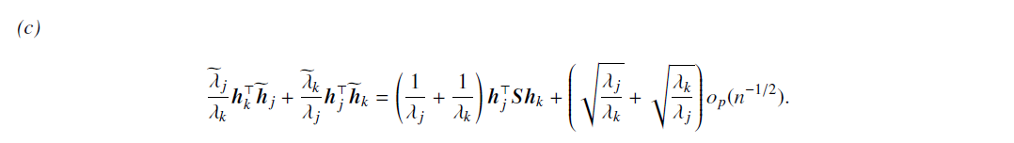
The key of our proofs: a perturbation method

Slide 36
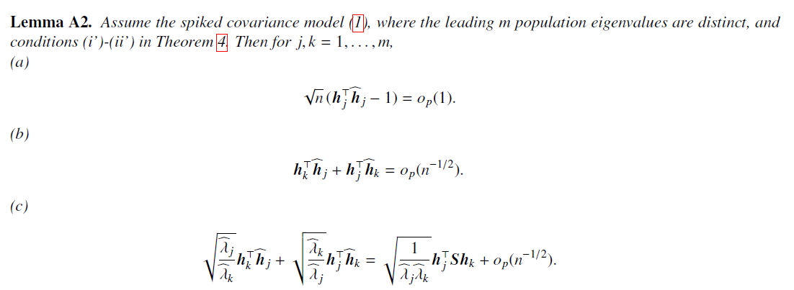
The key of our proofs: a perturbation method

Slide 37
Covariance matrix estimation for the
Cryo-EM Problem
PCA and CDM-PCA in the HDLSS data
Asymptotic Theory
Simulation Result
Outline
Notes:
Iv divide my presentation into five parts. First, I will introduce some background of HDLSS data,
Spiked covariance model and Yata and Aoshima’s work.
Second, I will introduce our work and provide numerical study results.

Slide 38
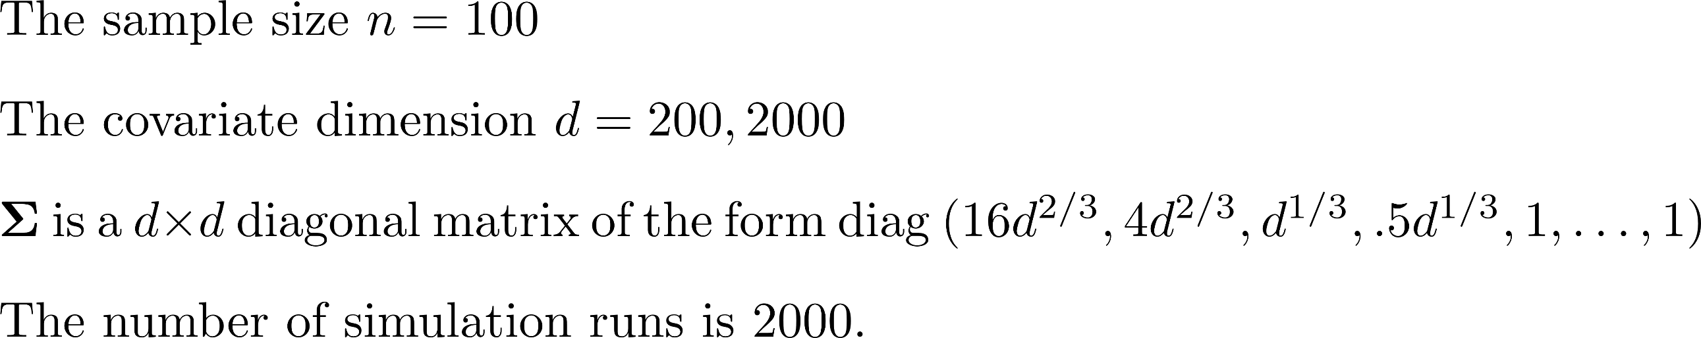
Setting
Notes:
We found the estimated direction of CDM is better than that of PCA

Slide 39
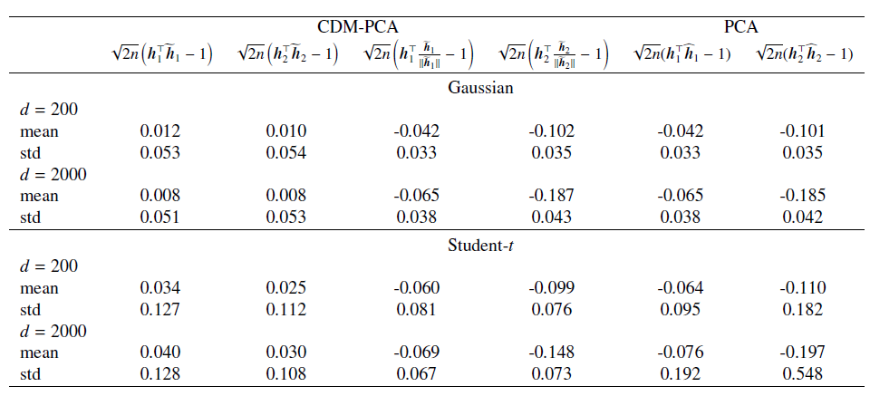
Table 1: (Degenerate asymptotic normality)

Slide 40
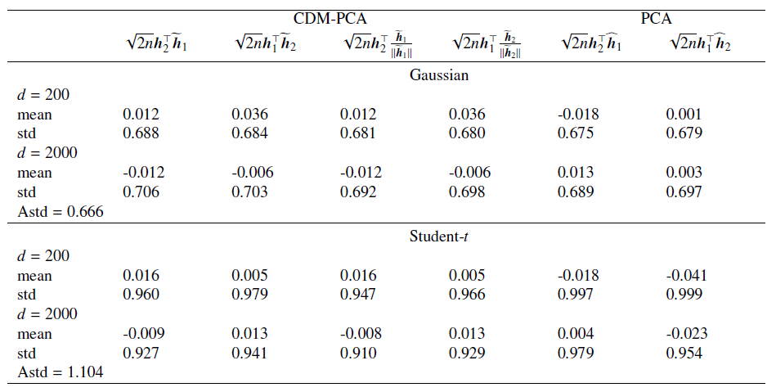
Table 2: (Asymptotic normality)

Slide 41
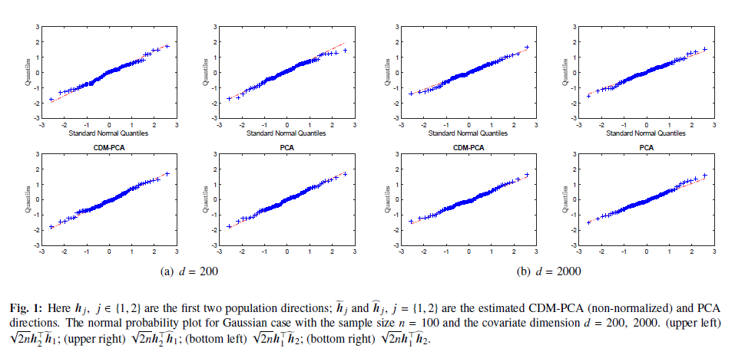

Slide 42
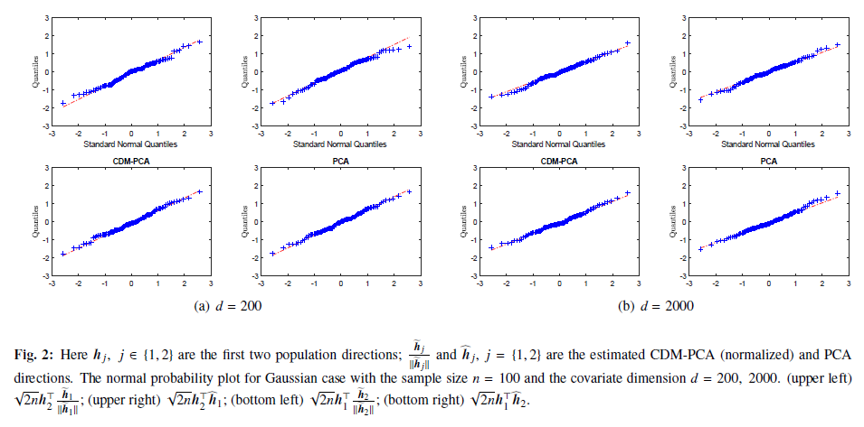

Slide 43
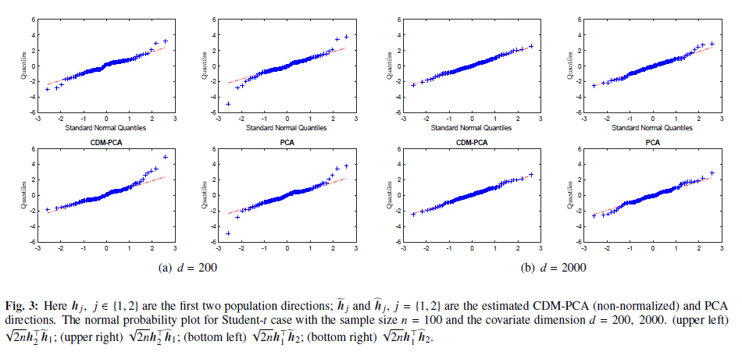

Slide 44
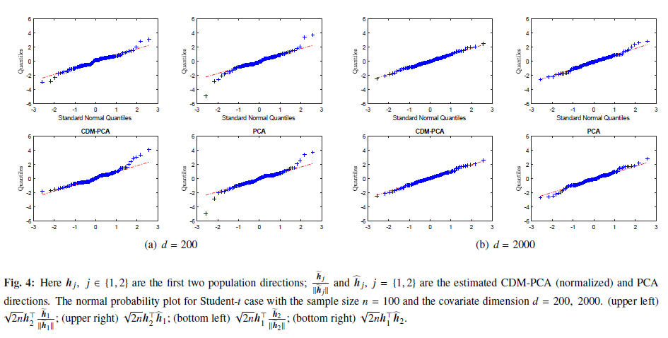

Slide 45
Thanks for your attention

