Slide 1
Recovery of conformational continuum from single-particle cryo-EM data: Optimization of ManifoldEM informed by ground-truth studies
林思涵
2021/07/20

Slide 2
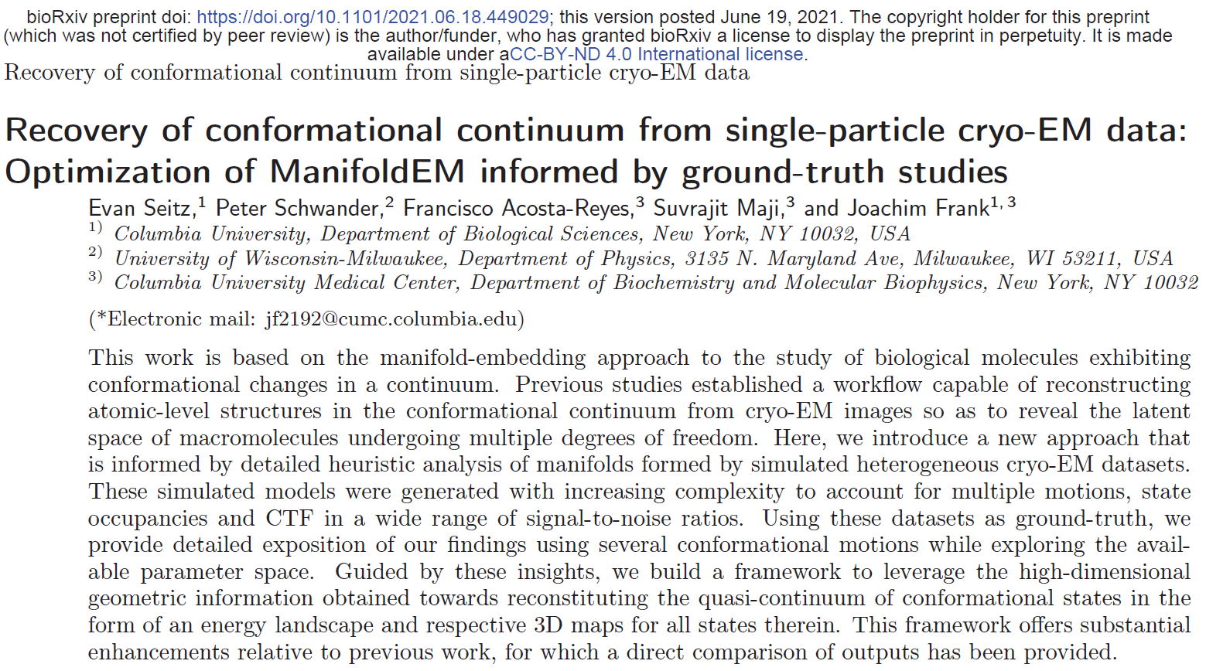
應用於3D Reconstruction之後

Slide 3





Cryo-EM Analysis Workflow
Motion、CTF
Corrections
Particle Picking
2D Clustering
3D Reconstruction
3D Reconstruction
$$⋮$$
Cleaned particle image set

Slide 4
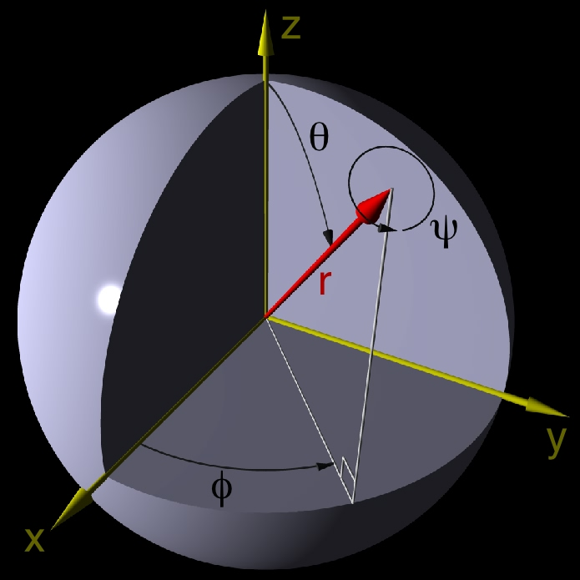

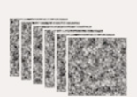

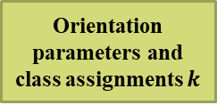


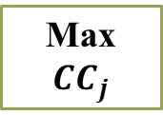

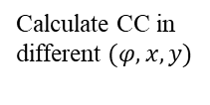



3D Reconstruction
$$\left(φ_{1},θ_{1},ψ_{1}\right)$$
已知訊息
$$\left(φ_{2},θ_{2},ψ_{2}\right)$$
$$\left(φ_{3},θ_{3},ψ_{3}\right)$$
Particle images
Max ${CC}_{j}$
$$⋮$$
$$⋮$$
$${CC}_{1}$$
$${CC}_{2}$$
$${CC}_{3}$$
$${CC}_{4}$$
$${CC}_{5}$$
…
$$\left(φ_{n},θ_{n},ψ_{n}\right)$$
Orientation parameters and class assignments $k$
3D models
Uniform project
with angle ${(Ф,θ)}_{j}$
Calculate CC in
different $(φ,x,y)$
2D projections
3D maps
Filtering

Slide 5
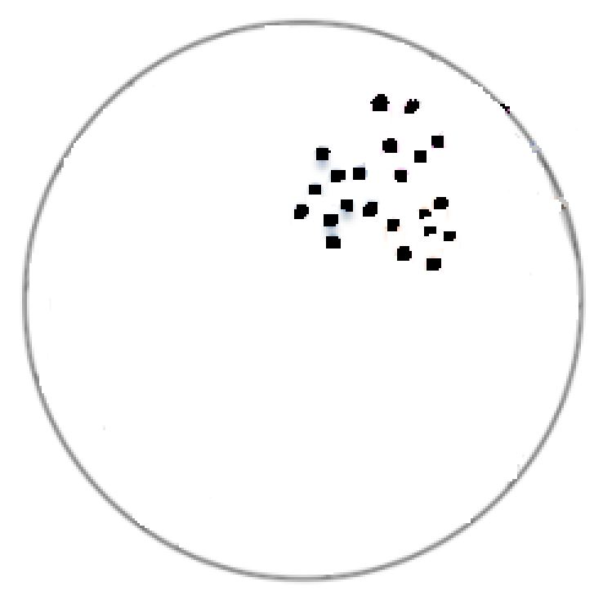






Review: 3D Reconstruction
3D Models
$$\left(φ_{1},θ_{1},ψ_{1}\right)$$
$$\left(φ_{2},θ_{2},ψ_{2}\right)$$
$$\left(φ_{3},θ_{3},ψ_{3}\right)$$
$$⋮$$
$$⋮$$
$$\left(φ_{n},θ_{n},ψ_{n}\right)$$

Slide 6
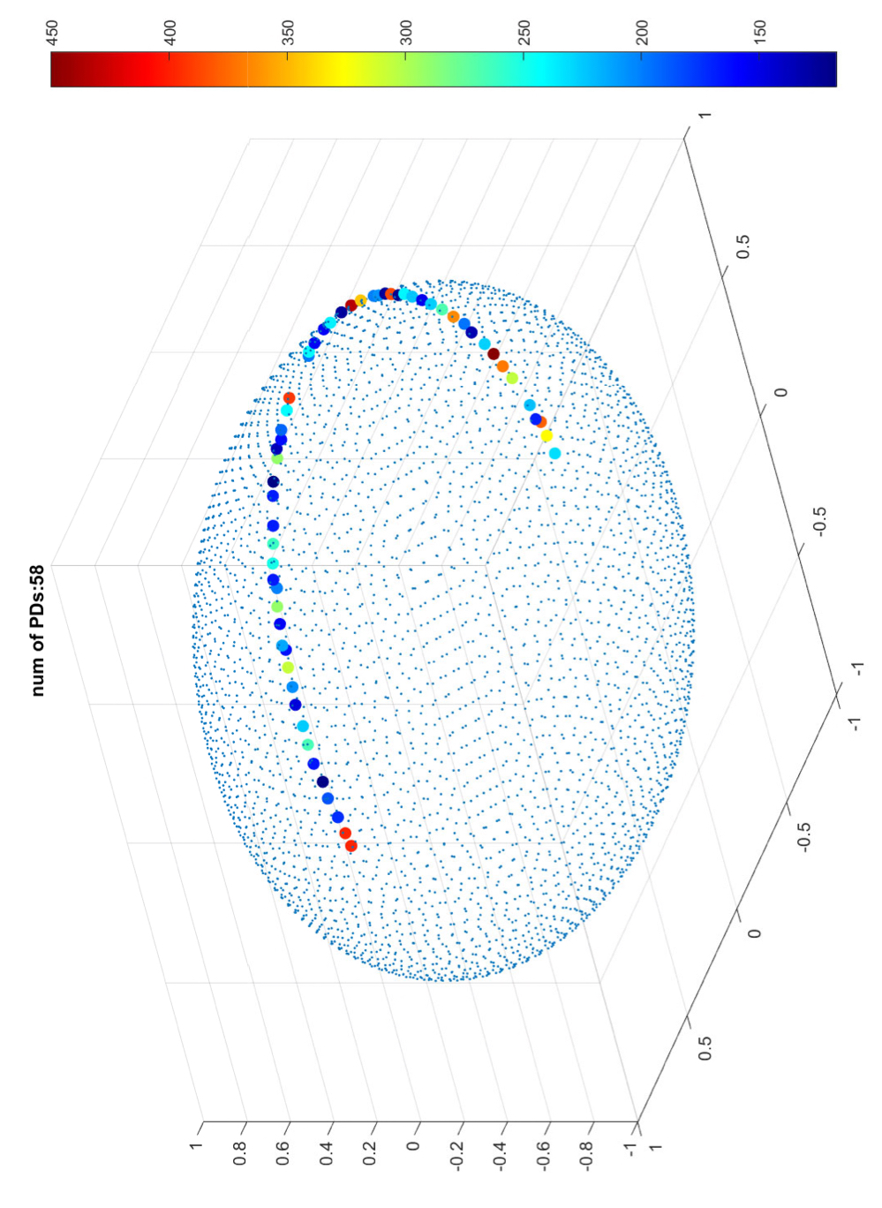
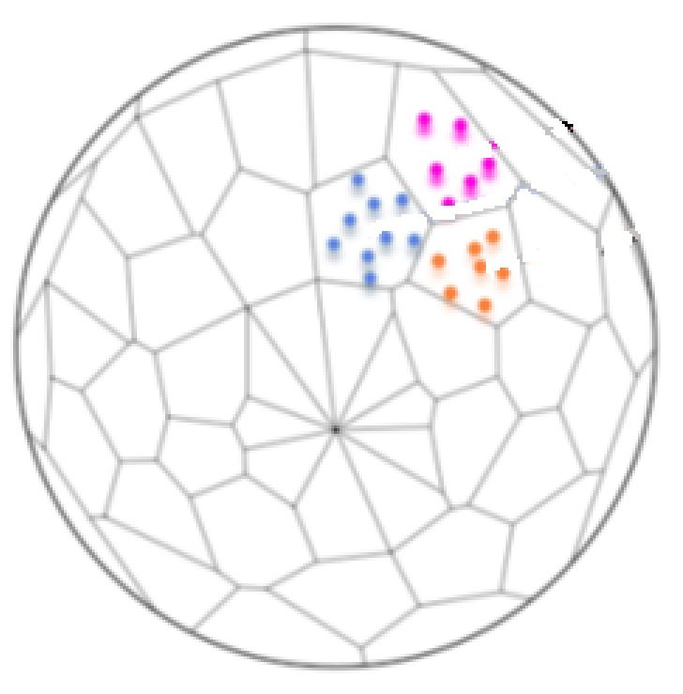
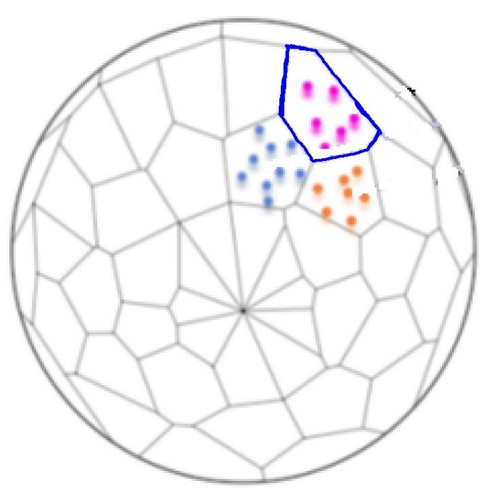
Projection Directions
PD 位置
3D Models
$$\left(φ_{1},θ_{1},ψ_{1}\right)$$
$$\left(φ_{2},θ_{2},ψ_{2}\right)$$
$$\left(φ_{3},θ_{3},ψ_{3}\right)$$
$$⋮$$
$$⋮$$
$$\left(φ_{n},θ_{n},ψ_{n}\right)$$
Projection Directions (PDs)
每個PD的影像數量不同
影像
數量

Slide 7
Data
The heat shock protein Hsp90 was chosen as a starting structure due to its simple design - exhibiting two arm-like domains (chain A and B, containing 677 residues each) connected together in an overarching V-shape.
Instead of a single conformational motion (arms open to closed, as in vivo), we decided to create three easily-identifiable and fully-decoupled domain motions, which we refer to as CM1, CM2 and CM3.
CM was designed to cover a unique range of motions, with the cascade of overlaid states making up CM1 occupying the largest spatial region, followed in magnitude by CM2 and then by CM3.
In the following analysis, these state spaces are termed SS1, SS2, and SS3, and defined by:
(1) 20 states exhibiting one degree of freedom (CM1);
(2) 400 states (20x20) with two degrees of freedom (CM1, CM2); and
(3) 1000 states (10x10x10) with three degrees of freedom (CM1, CM2, CM3), respectively.

Slide 8
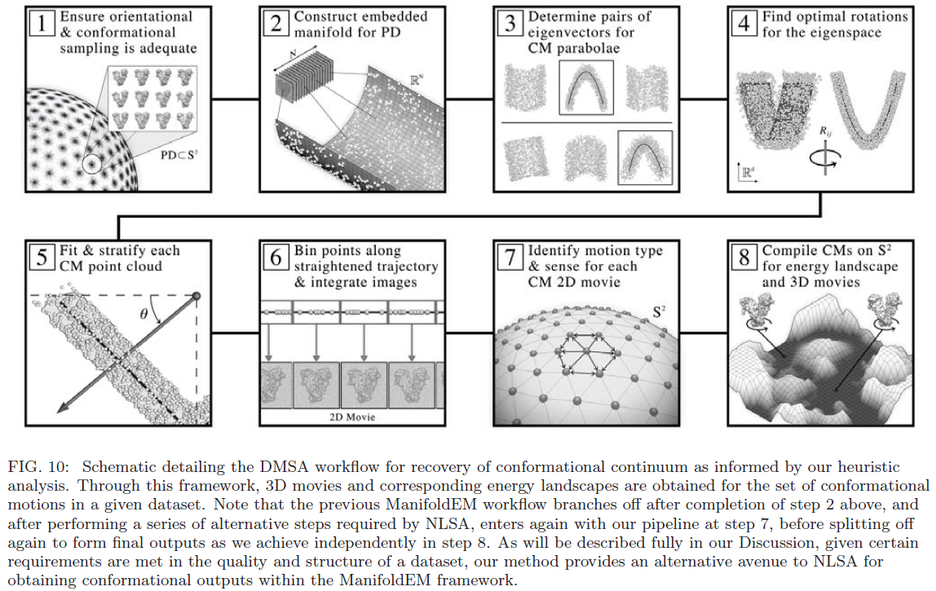
Direct Manifold Subspace Analysis (DMSA workflow)

Slide 9
Direct Manifold Subspace Analysis (DMSA workflow)
Manifold Embedding
Manifold Rotations
Manifold Binning
Compile Bins
Visualize Volumes

Slide 10
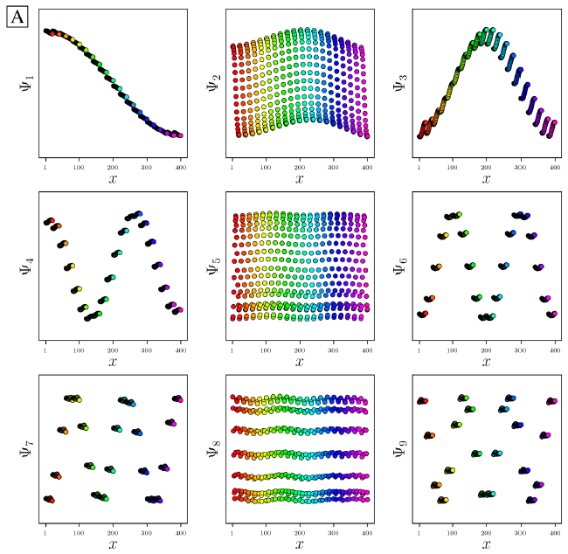
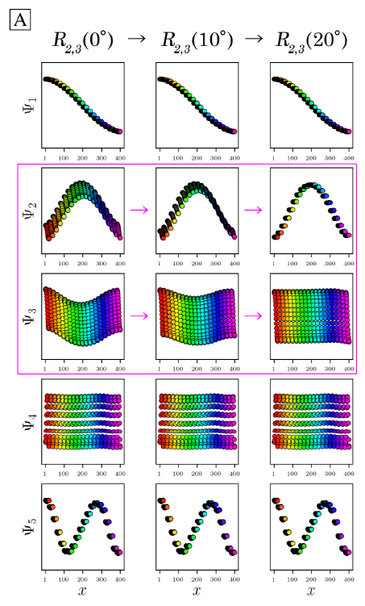
DMSA. Manifold Embedding
PD1,SS2
PD3,SS2
Diffusion map
PCA

Slide 11
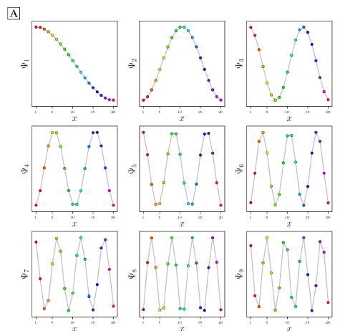
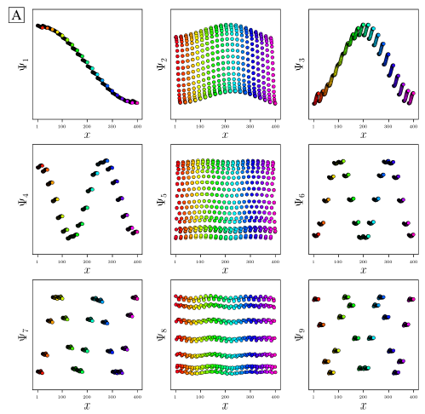
PD1 in SS1(CM1)
PD1 in SS2 (CM1xCM2)

Slide 12
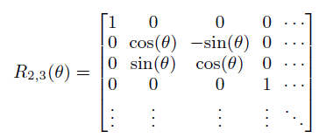

DMSA. Manifold Rotations 1
PD3,SS2
旋轉之前需要先將$Ψ_{k}$做normalize (-1,1)

Slide 13
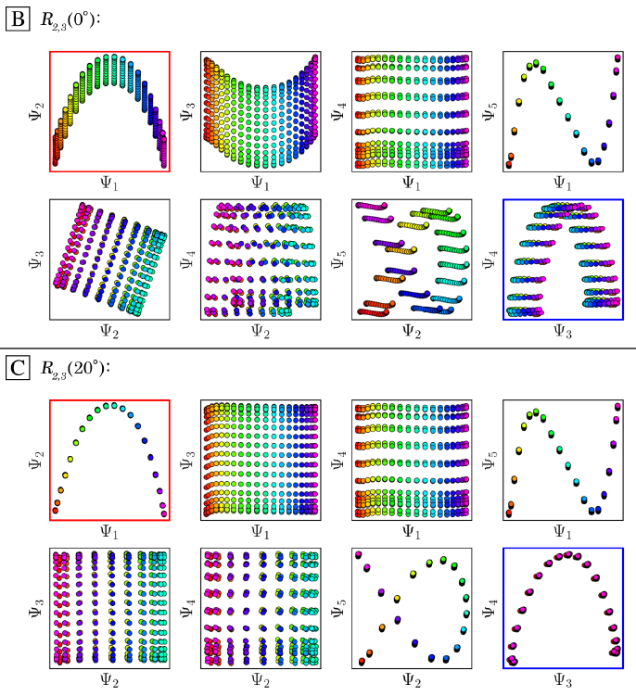

DMSA. Manifold Rotations 2
PD3,SS2
目的：越靠近
越好

Slide 14
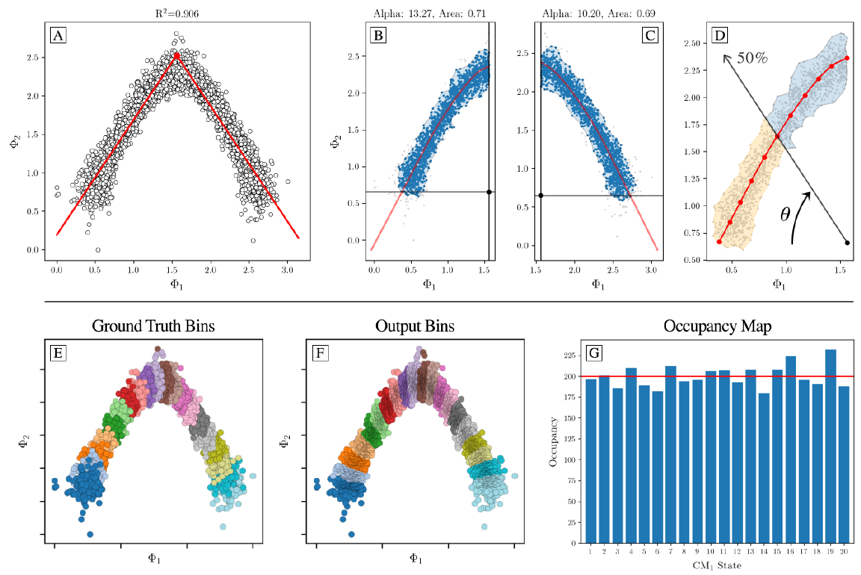
DMSA. Manifold Binning

Slide 15
Direct Manifold Subspace Analysis (DMSA workflow)

Slide 16
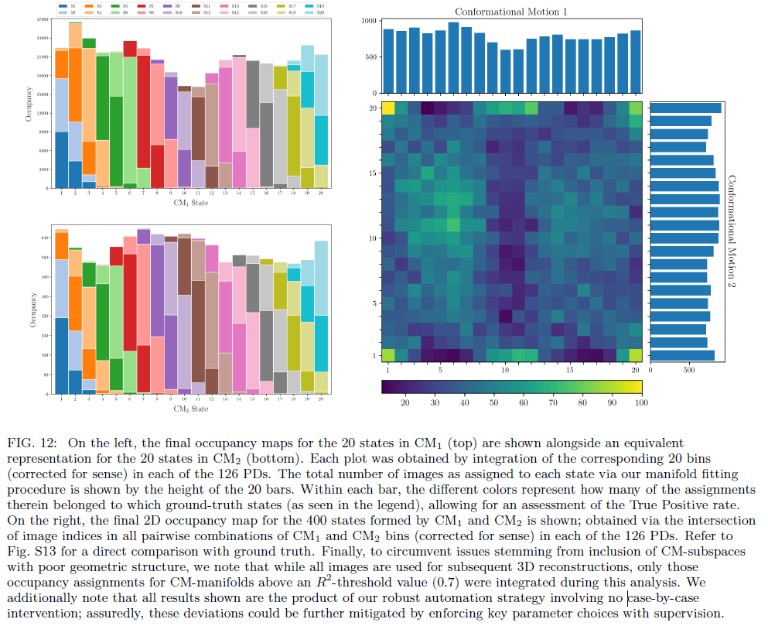

Slide 17
The End

