Slide 1

Inferring a Continuous Distribution of Atom Coordinates from Cryo-EM Images using VAEs
DeepMind

Slide 2



Auto-Encoder
Autoencoders are an unsupervised learning technique in which we leverage neural networks for the task of representation learning.
$$z_{i}$$
Encoder
Decoder
$$X_{i}$$
$$\hat{X_{i}}$$
Latent
Variable
As close as possible

Slide 3
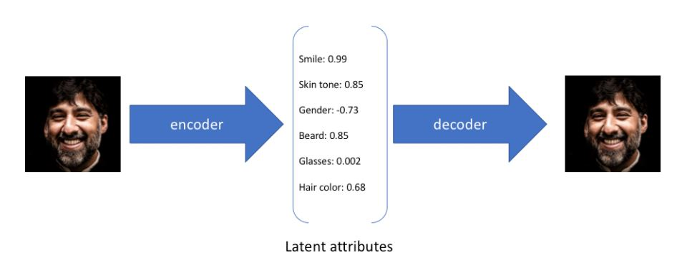
Auto-Encoder
To provide an example, let’s suppose we’ve trained an Auto-Encoder model on a large dataset of faces with a encoding dimension of 6.
However, we may prefer to represent each latent attribute as a range of possible values.

Slide 4
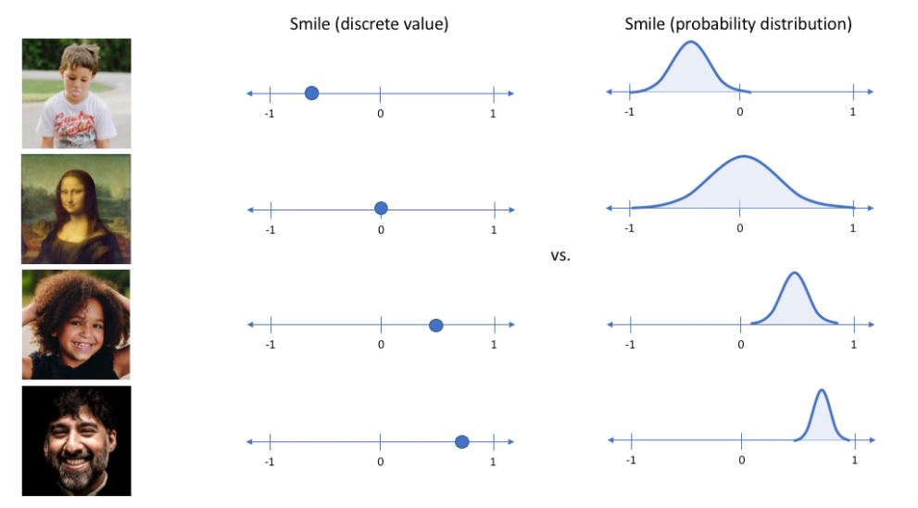
Variational Auto-Encoder
Using a variational autoencoder, we can describe latent attributes in probabilistic terms.

Slide 5
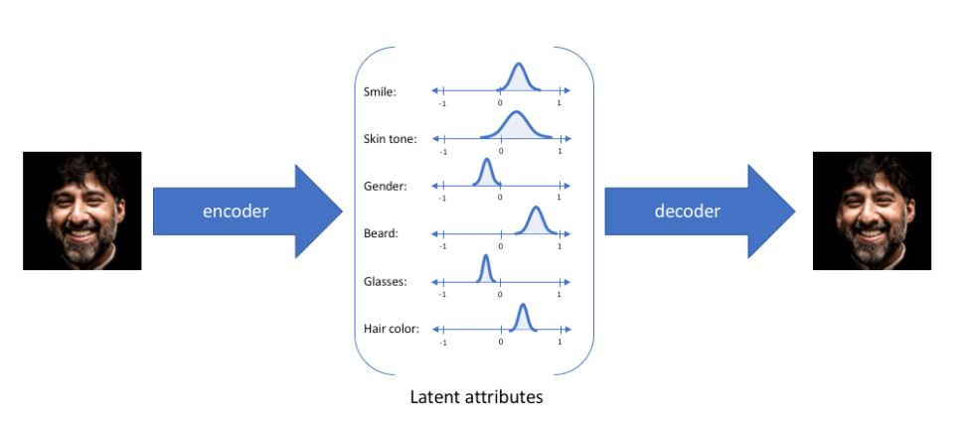
Variational Auto-Encoder
With this approach, we'll now represent each latent attribute for a given input as a probability distribution. When decoding from the latent state, we'll randomly sample from each latent state distribution to generate a vector as input for our decoder model.

Slide 6

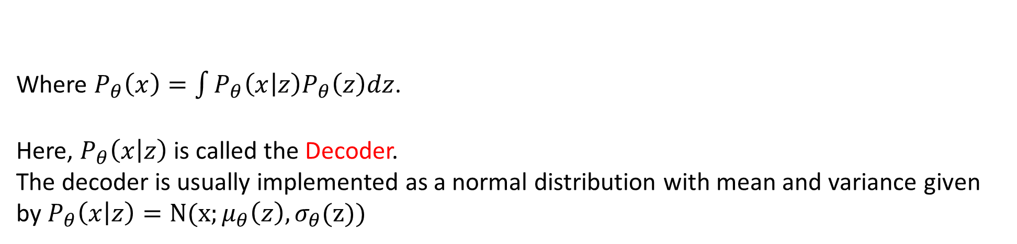
Statistical Motivation
z
x
Unobserved
Observed
Given a dataset $X$ of data, the goal is to find the parameters of the VAE that
$$\max_{θ}{\log{P_{θ}}(X)}$$
Where $P_{θ}\left(x\right)=\int{P_{θ}\left(x | z\right)P_{θ}\left(z\right)dz}$.
Here, $P_{θ}\left(x | z\right)$ is called the Decoder.
The decoder is usually implemented as a normal distribution with mean and variance given by $P_{θ}\left(x | z\right)=N(x;μ_{θ}\left(z\right),σ_{θ}(z))$

Slide 7
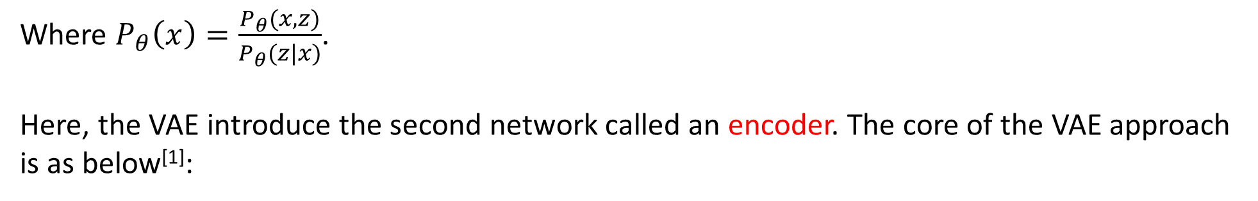
Statistical Motivation
z
x
Unobserved
Observed
Given a dataset $X$ of data, the goal is to find the parameters of the VAE that
$$\max_{θ}{\log{P_{θ}}(X)}$$
Where $P_{θ}\left(x\right)=\frac{P_{θ}(x,z)}{P_{θ}(z|x)}$.
Here, the VAE introduce the second network called an encoder. The core of the VAE approach is as below^{[1]}:
$$\log{P_{θ}\left(x\right)−KL[Q_{φ}(z|x)||P_{θ}(z|x)]}=E_{z\sim Q_{φ}(∙|x)}\left[\log{P_{θ}\left(x | z\right)}\right]−KL[Q_{φ}(z|x)||P_{θ}(z)]$$
[1]: See Kingma and Welling (2019) or Doersch (2021) for a deviation.

Slide 8
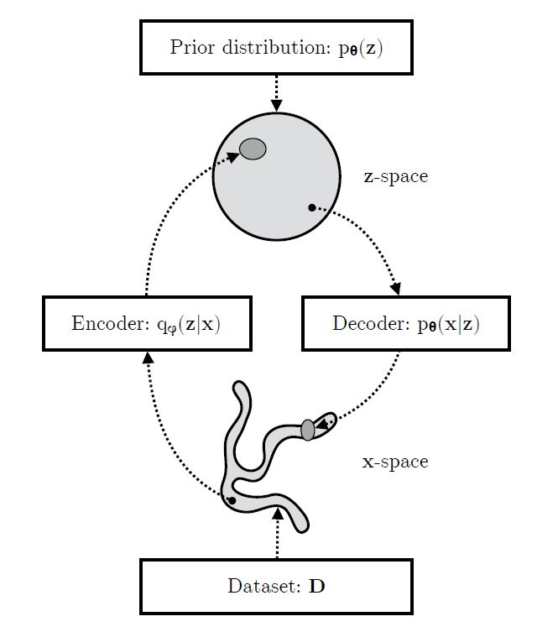

Summary of Variational Auto-Encoder
$$p\left(x|z\right)$$

Slide 9
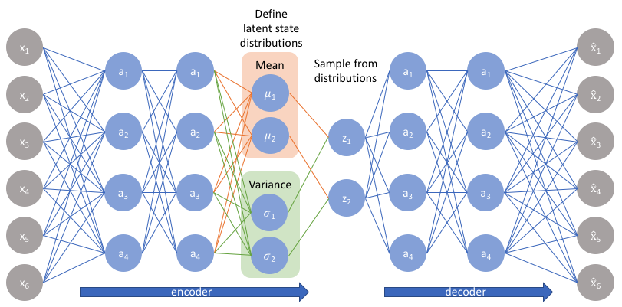
Summary of Variational Auto-Encoder

Slide 10
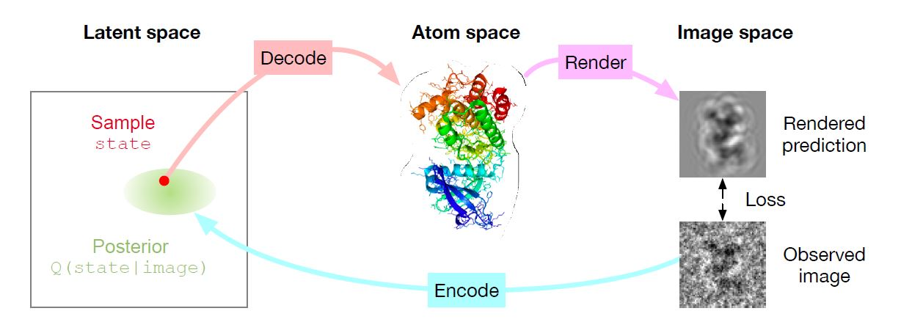
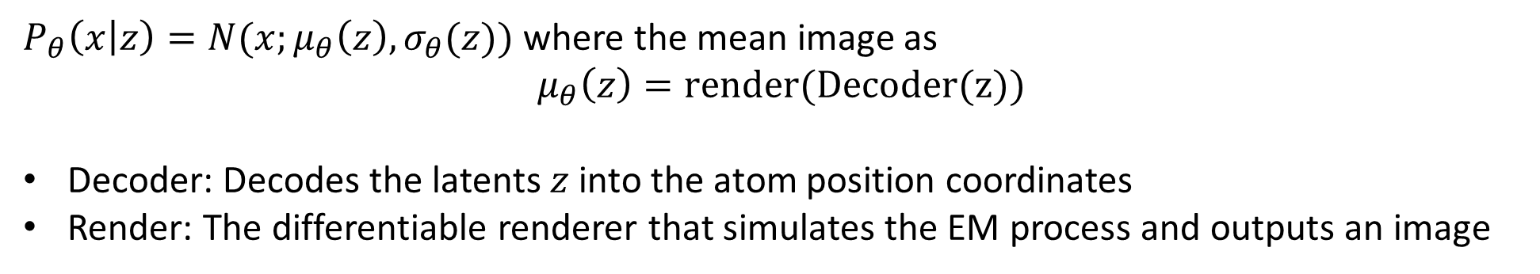
Overview of the proposed method
$P_{θ}\left(x | z\right)=N(x;μ_{θ}\left(z\right),σ_{θ}(z))$ where the mean image as
$$μ_{θ}\left(z\right)=render(Decoder(z))$$
Decoder: Decodes the latents $z$ into the atom position coordinates
Render: The differentiable renderer that simulates the EM process and outputs an image
Notes:
(1) modelling the full forward process that generates an EM image: starting from latent variables that capture conformation and pose, passing through
atom coordinates, and finally outputting a rendered EM image; and (2) training an inverse model (‘encoder’) that predicts a posterior over the latent variables given a noisy EM image.
Once the model is trained, the prior over latent space should match the accumulated posterior from all the training images, and we can use this prior to investigate the distribution of the protein conformations in atom coordinate space. We evaluate the methodology on high quality simulations and show that the method can recover multi-modality.

Slide 11
Overview of the proposed method
The benefit is twofold:
Explicitly add prior knowledge in atom space
Directly sample atom positions at test time
This is in contrast to prior work that uses VAEs in image space only^{[1]}.
[1]:Zhong et al., 2021

Slide 12
Overview of the proposed method
The benefit is twofold:
Explicitly add prior knowledge in atom space
Directly sample atom positions at test time
This is in contrast to prior work that uses VAEs in image space only^{[1]}.
[1]:Zhong et al., 2021

Slide 13
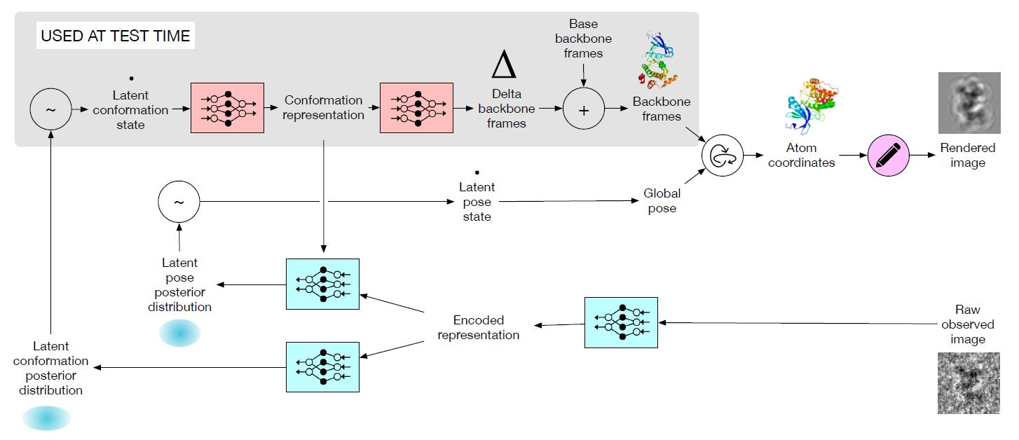
Model Components

Slide 14
Model Components: Encoder
One way we do this is by conditioning the pose encoder on samples of the conformation, allowing the model to capture a multi-modal distribution more easily.

Slide 15
Model Components: Decoder
The pose latents are directly used as a global 2D translation and 3D rotation.

Slide 16
Model Components: Protein structure
The author define all conformations relative to a base conformation.
In the presented experiments the author simply use a single state conformation from the Protein Data Bank.

Slide 17
Model Components: Renderer
The author model the electron density for each heavy atom by a single Gaussian blob with standard deviation 1Å and unit mass.
By using Gaussian, the author can compute the rendering function directly.
Notes:
The final conformation is obtained by predicting a relative translation and rotation for each residue (termed ‘delta backbone frames’ in Figure 2). Each residue (including its sidechain) is represented as an individual rigid body (Jumper et al., 2020), the inter-residue bonds along the backbone are only indirectly constrained by the backbone continuityloss (see below).

Slide 18
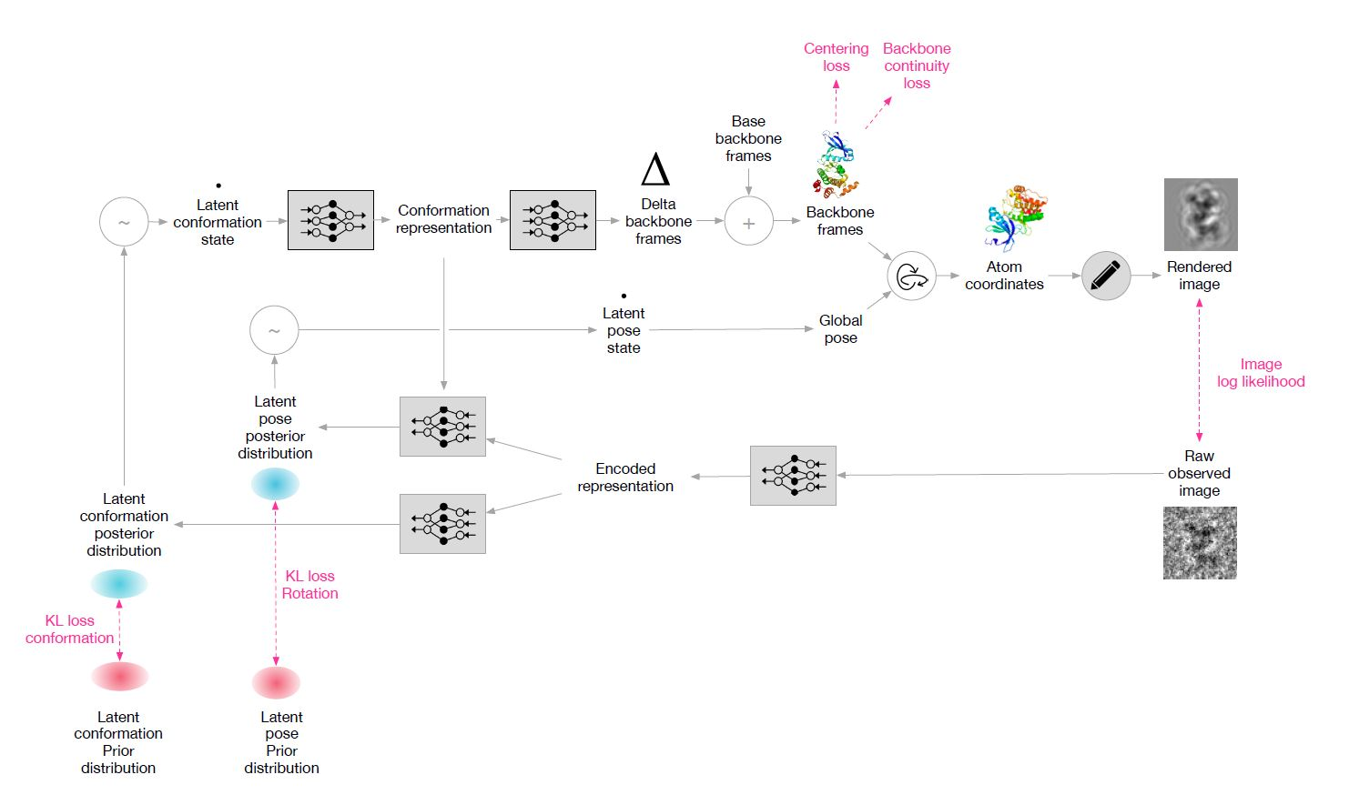
Losses used to train the model

Slide 19
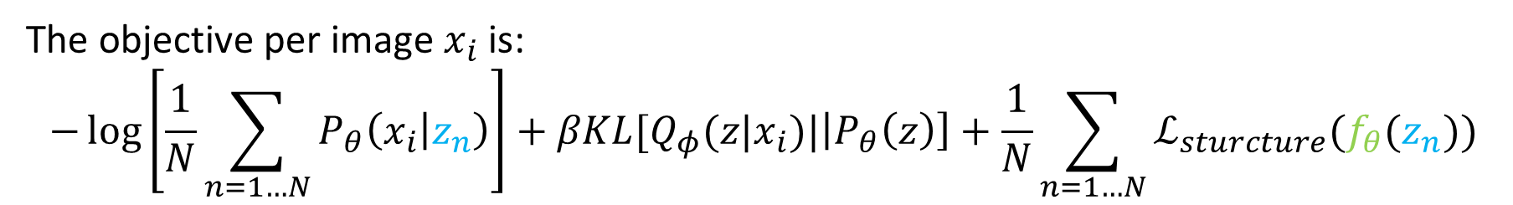
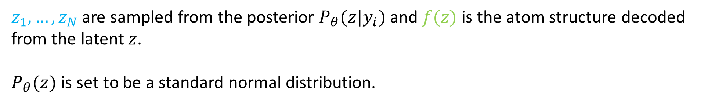
Losses used to train the model
The objective per image $x_{i}$ is:
$$−\log\left[\frac{1}{N}\sum_{n=1…N}{P_{θ}\left(x_{i} | z_{n}\right)}\right]+βKL[Q_{φ}(z|x_{i})|\left|P_{θ}\left(z\right)\right]+\frac{1}{N}\sum_{n=1…N}{ℒ_{sturcture}(f_{θ}(z_{n}))}$$
$z_{1},…,z_{N}$ are sampled from the posterior $P_{θ}(z|y_{i})$ and $f(z)$ is the atom structure decoded from the latent $z$.
$P_{θ}(z)$ is set to be a standard normal distribution.

Slide 20
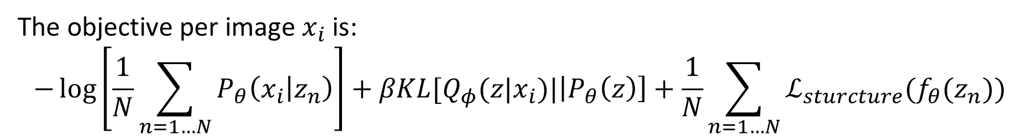
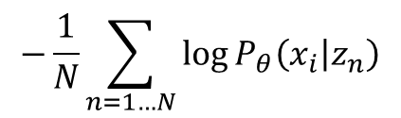
Losses used to train the model
The objective per image $x_{i}$ is:
$$−\log\left[\frac{1}{N}\sum_{n=1…N}{P_{θ}\left(x_{i} | z_{n}\right)}\right]+βKL[Q_{φ}(z|x_{i})|\left|P_{θ}\left(z\right)\right]+\frac{1}{N}\sum_{n=1…N}{ℒ_{sturcture}(f_{θ}(z_{n}))}$$
$$−\frac{1}{N}\sum_{n=1…N}{\log{P_{θ}\left(x_{i} | z_{n}\right)}}$$

Slide 21
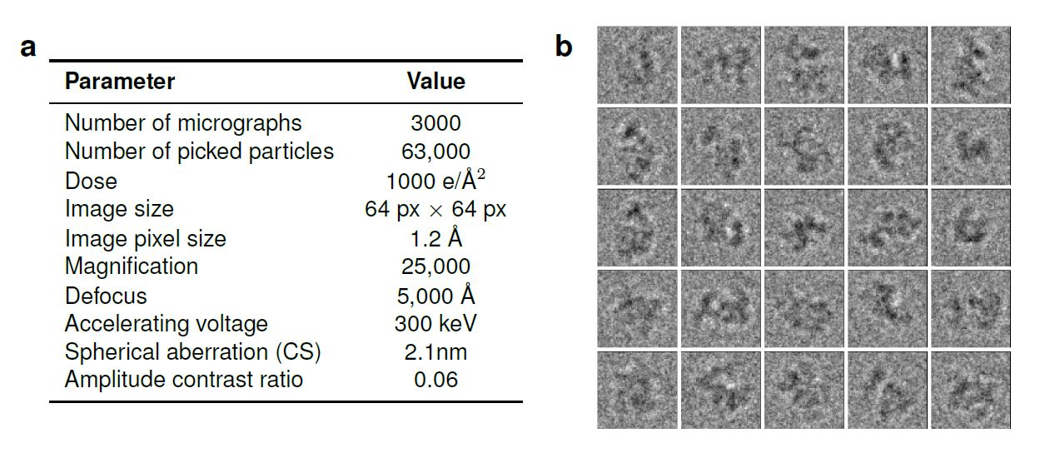
Simulated dataset
Take the conformations from an externally validated Molecular Dynaimcs
The author selected a proten whose size (33 kDa, 282 residues)
They applied a ~10 times higher-than-usual electron dose to increase the difficulty

Slide 22
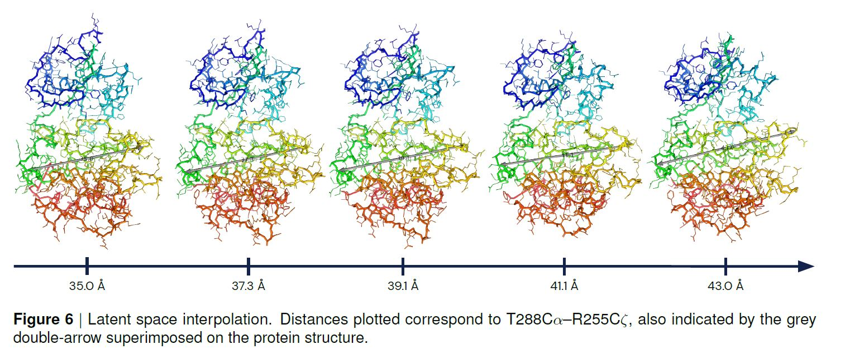
Simulated dataset
Notes:
we fit the true distribution to within 3.35 Angstrom.

Slide 23
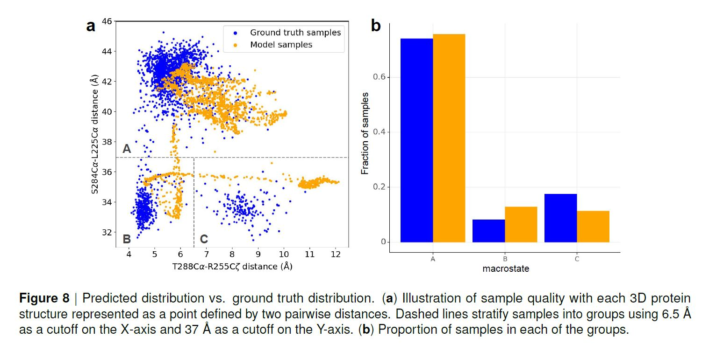
Simulated dataset
The author investigated marginal distributions to investigate how well they have recovered the set of all states present in the data.

Slide 24
Discussion
The disentangling of the distributions over poses and conformations is especially crucial.
The other major challenge is the extremely low signal-to-noise ratio in the Cryo-EM images.

