Slide 1
Noise2Self: Blind Denoising by Self-Supervision
Hung Yi Wu

Slide 2
Summary: Noise2Self: Blind Denoising by Self-Supervision
Problem:
high-dimensional noisy measurements
Assumption:
The noise is independence across different dimensions of the measurement
The true signal exhibits some correlation
Contribution:
Propose a general framework for denoising high-dimensional noisy measurements
requiring no estimate of the noise, and no clean training data

Slide 3
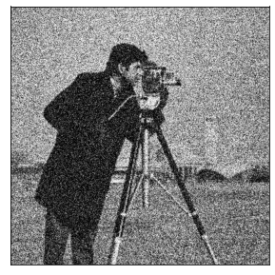
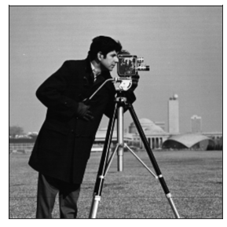

Overview: image denoise
Model:
Input →Output
Peak Signal to Noise Ratio(PSNR) $=10×log⁡(\frac{MAX_{I}^{2}}{MSE})$
f

Slide 4

Learning from clean label
Loss function: $E|\left|f\left(x\right)−y\right||$
f
Noisy measurement
Clean label

Slide 5
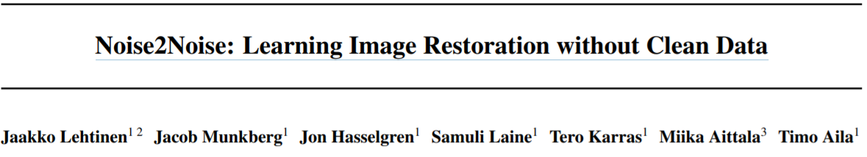
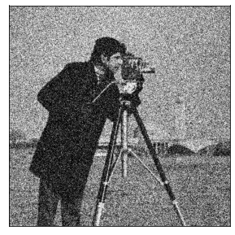
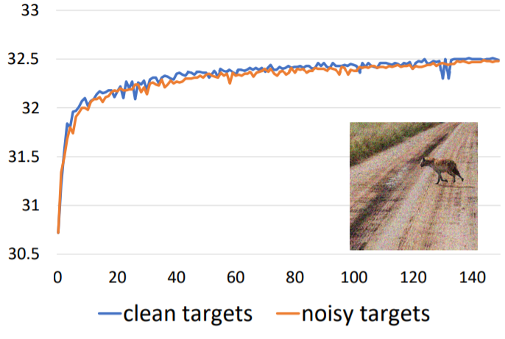
f
Noisy measurement 1
Noisy measurement 2

Slide 6
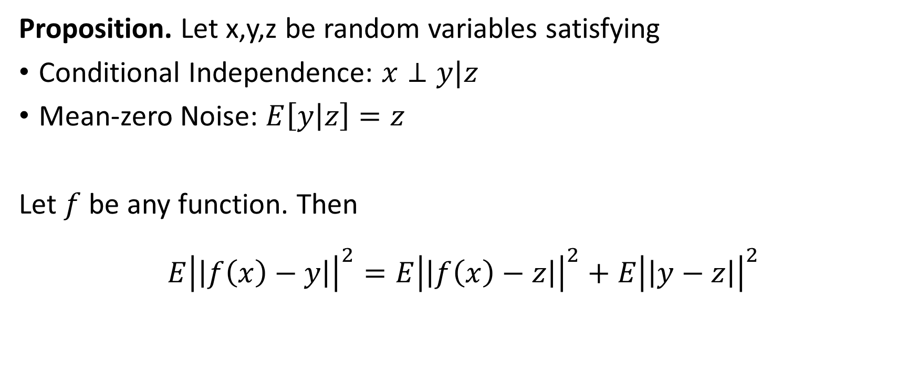
Learning from Noisy Labels
Proposition. Let x,y,z be random variables satisfying
Conditional Independence: $x⊥y|z$
Mean-zero Noise: $E\left[y | z\right]=z$
Let $f$ be any function. Then
$$E{\left|\left|f\left(x\right)−y\right|\right|}^{2}=E{\left|\left|f\left(x\right)−z\right|\right|}^{2}+E{\left|\left|y−z\right|\right|}^{2}$$
X: training data
Y: noisy label
Z: ground gruth
Noisy Label Loss
Ground Truth Loss
Noise Variance

Slide 7
In some cases, we may not obtain multiple measurements of the same signal
f
Noisy measurement 1
Noisy measurement 2

Slide 8

Learning with self-label (self-supervision)
Loss function:
$$E{\left|\left|f\left(x\right)−x\right|\right|}^{2}$$
Trivial solution:
$$argmin E{\left|\left|f\left(x\right)−x\right|\right|}^{2}=Identity$$

Slide 9

J-invariant functions
We call $f:R^{m}→R$ is $J$-invariant if
$x∈R^{m}$
$J$: Partition of the dimensions $\left\{1,…,m\right\}$ and let $j∈J$
$f{\left(x\right)}_{j}$ does not depend on the value of $x_{j}$ for all $j∈J$

Slide 10
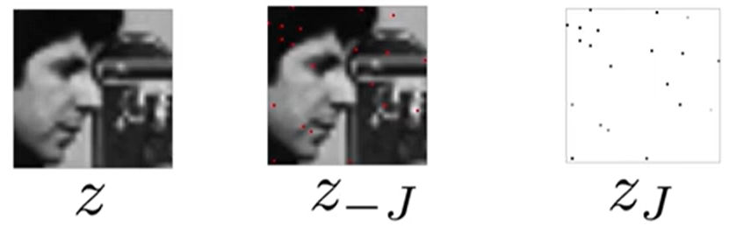
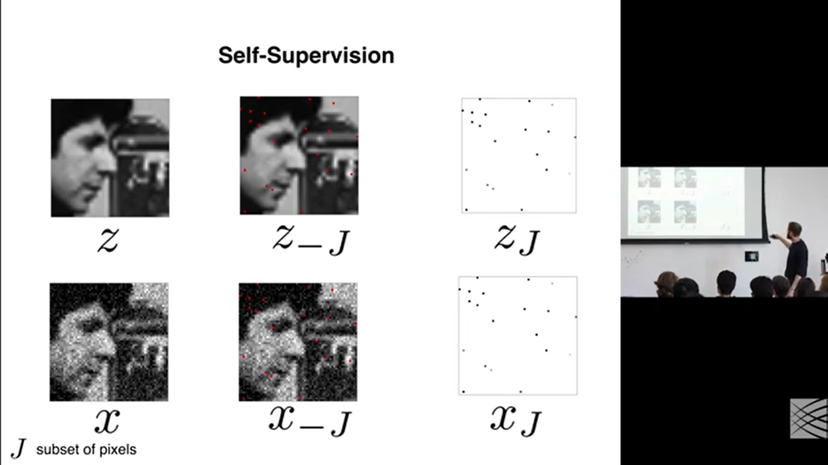
Self-supervision

Slide 11
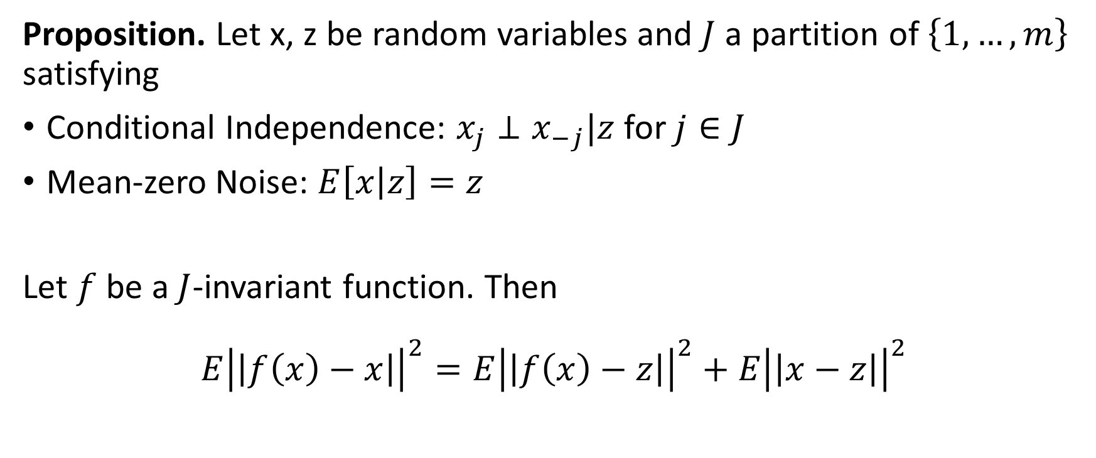
Theory
Proposition. Let x, z be random variables and $J$ a partition of $\left\{1,…,m\right\}$ satisfying
Conditional Independence: $x_{j}⊥x_{−j}|z$ for $j∈J$
Mean-zero Noise: $E\left[x | z\right]=z$
Let $f$ be a $J$-invariant function. Then
$$E{\left|\left|f\left(x\right)−x\right|\right|}^{2}=E{\left|\left|f\left(x\right)−z\right|\right|}^{2}+E{\left|\left|x−z\right|\right|}^{2}$$
X: noisy data
Z: ground truth
Self-supervised loss
Ground truth loss
Noise variance

Slide 12
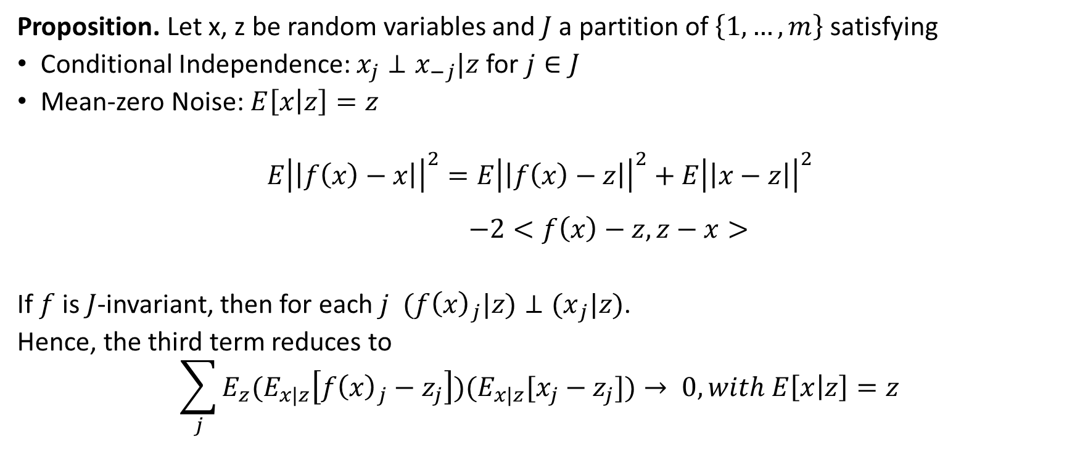
Theory
Proposition. Let x, z be random variables and $J$ a partition of $\left\{1,…,m\right\}$ satisfying
Conditional Independence: $x_{j}⊥x_{−j}|z$ for $j∈J$
Mean-zero Noise: $E\left[x | z\right]=z$
$$E{\left|\left|f\left(x\right)−x\right|\right|}^{2}=E{\left|\left|f\left(x\right)−z\right|\right|}^{2}+E{\left|\left|x−z\right|\right|}^{2}$$
$$−2<f\left(x\right)−z,z−x>$$
If $f$ is $J$-invariant, then for each $j$ $(f{\left(x\right)}_{j}|z)⊥{(x}_{j}|z)$.
Hence, the third term reduces to
$$\sum_{j}{E_{z}(E_{x|z}\left[f{\left(x\right)}_{j}−z_{j}\right])(E_{x|z}[x_{j}−z_{j}]})→ 0, with E\left[x | z\right]=z$$

Slide 13
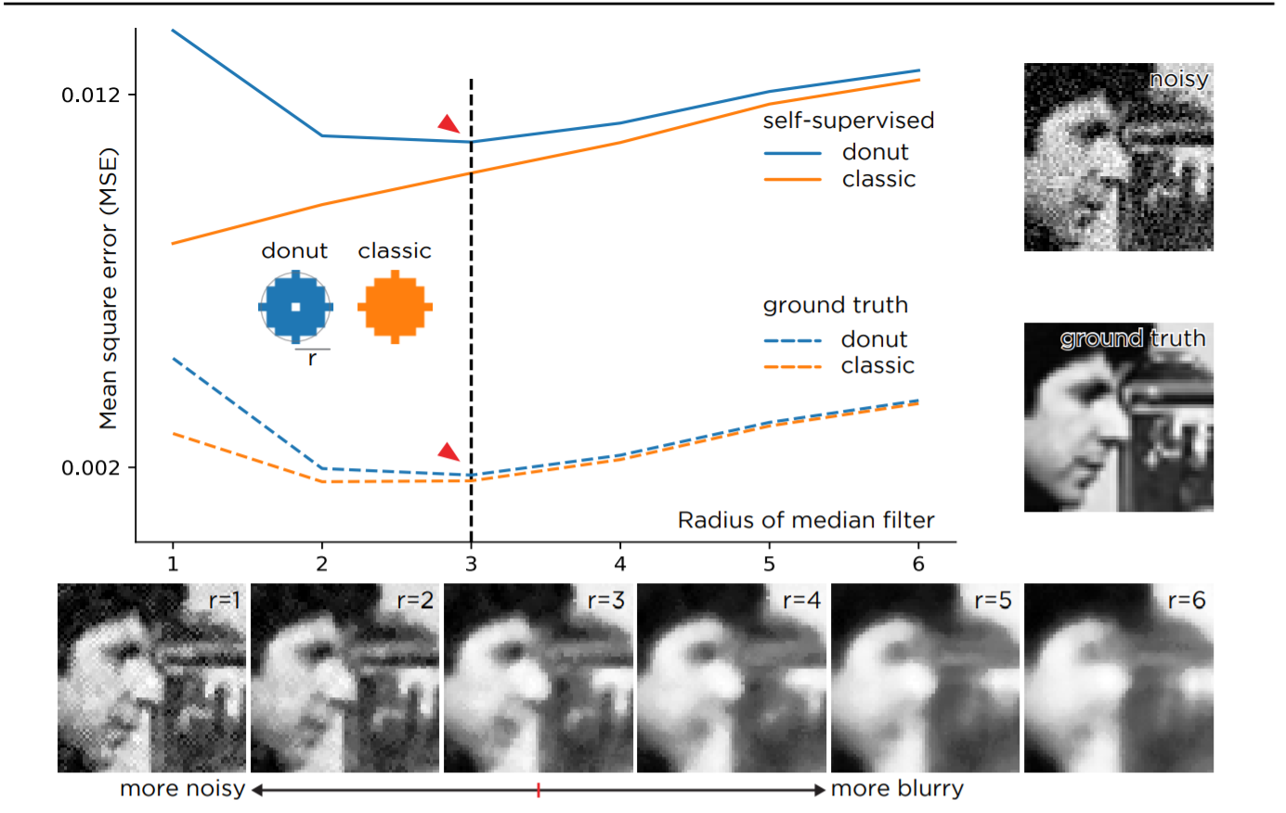
Example: median filter

Slide 14
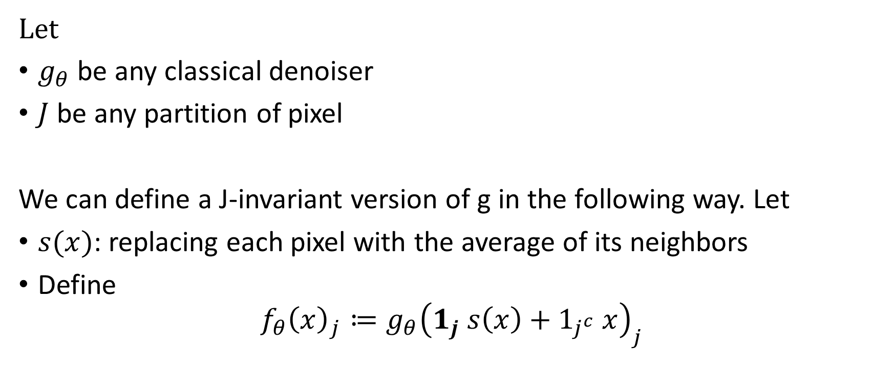
Calibration existing models
Let
$g_{θ}$ be any classical denoiser
$J$ be any partition of pixel
We can define a J-invariant version of g in the following way. Let
$s(x)$: replacing each pixel with the average of its neighbors
Define
$$f_{θ}{\left(x\right)}_{j}≔g_{θ}{\left(1_{j} s\left(x\right)+1_{j^{c}} x\right)}_{j}$$

Slide 15
J-invariant Deep CNN

Slide 16
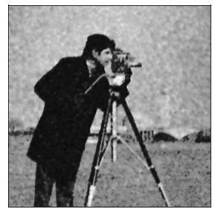
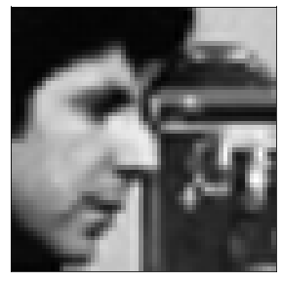
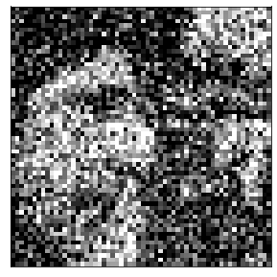
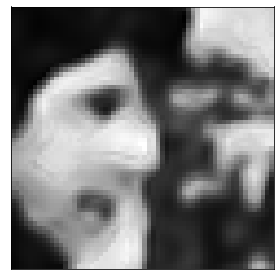
Single shot training
Clean Noisy Denoised
Notes:
Pixel value : [0,1]
Normal variance = 0.1

Slide 17
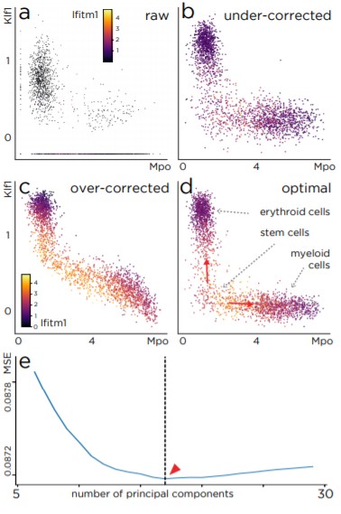
Single-Cell Example
single-cell transcriptomic experiments
20,000-dimensional vector of counts with thousands of observations
Principal Component Regression
(a) Raw expression of three genes
(e) Self-supervised loss for principal component regression.
(d) the denoised data for the optimal number of principal components(17, red arrow).
(c) result of using too few components
(b) result of using too many.

Slide 18
References
Jaakko Lehtinen, Jacob Munkberg, Jon Hasselgren, Samuli Laine, Tero Karras, Miika Aittala, Timo Aila. Noise2Noise: Learning Image Restoration without Clean Data
Joshua Batson, Loic Royer. Noise2Self: Blind Denoising by Self-Supervision
http://proceedings.mlr.press/v97/batson19a/batson19a.pdf
https://youtu.be/jwp1MsSXOZ4

