Slide 1
Effective PCA for high-dimension, low-sample-size data (HDLSS data)
林思涵
2019/01/03

Slide 2
Introduction

Slide 3
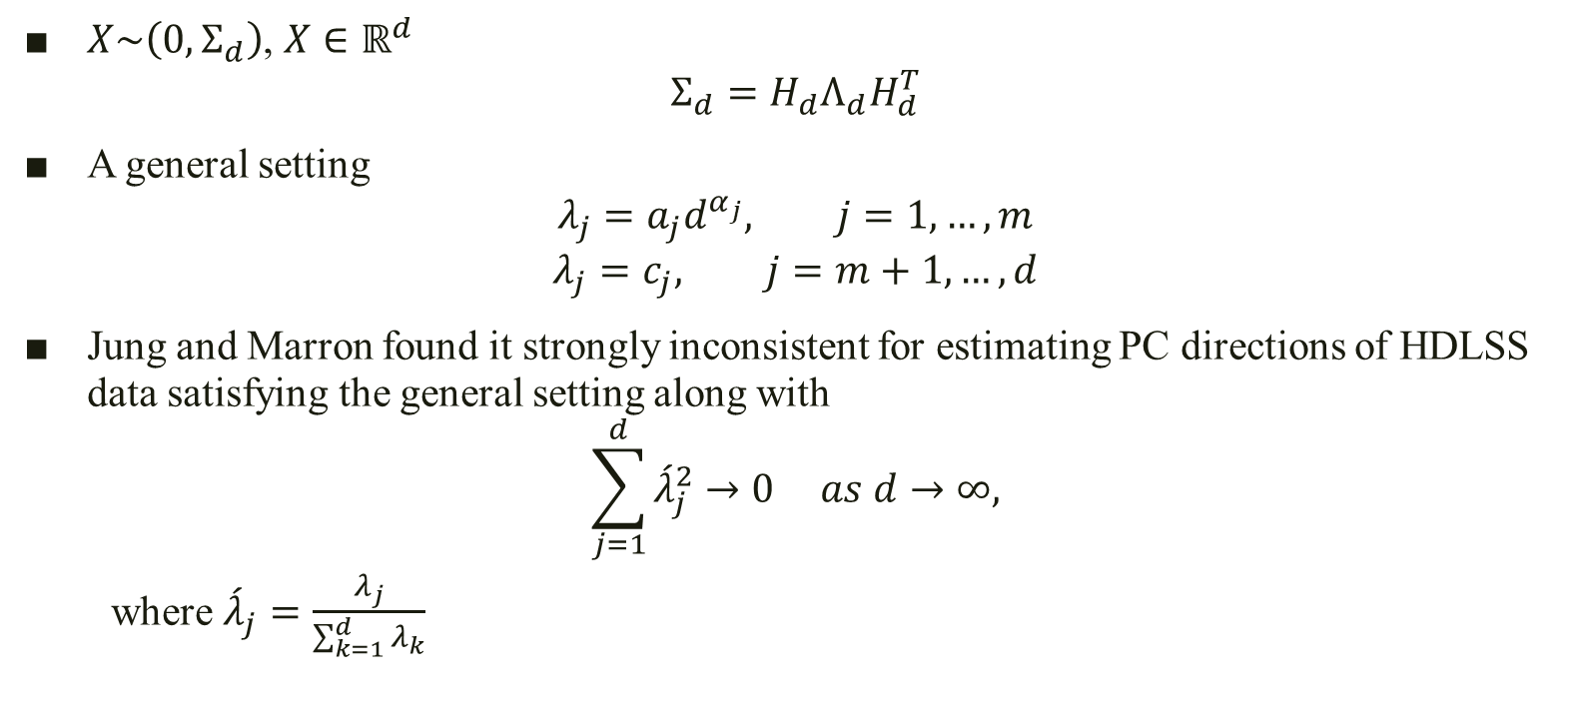
Population view
$X\sim \left(0,Σ_{d}\right)$, $X∈ℝ^{d}$
$$Σ_{d}=H_{d}Λ_{d}H_{d}^{T}$$
A general setting
$$λ_{j}=a_{j}d^{α_{j}}, j=1,…,m$$
$$λ_{j}=c_{j}, j=m+1,…,d$$
Jung and Marron found it strongly inconsistent for estimating PC directions of HDLSS data satisfying the general setting along with
$$\sum_{j=1}^{d}{{\acute{λ}}_{j}^{2}}→0 as d→∞,$$
where ${\acute{λ}}_{j}=\frac{λ_{j}}{\sum_{k=1}^{d}{λ_{k}}}$

Slide 4
How to get eigenvalues?

Slide 5
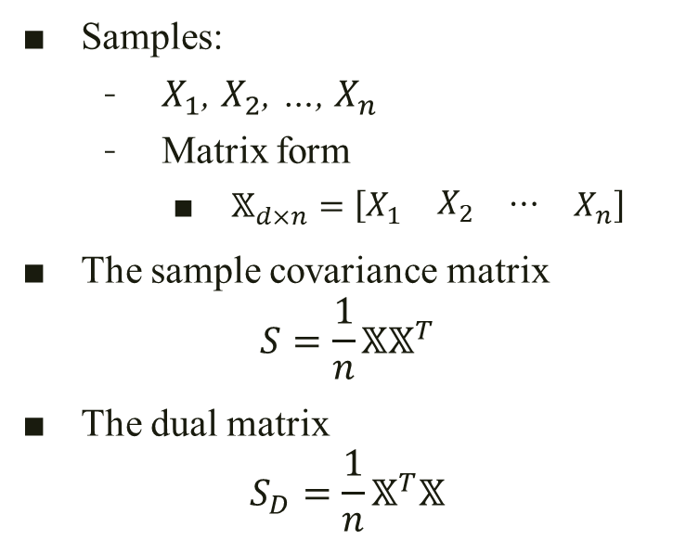




Traditional PCA (Covariance matrix, $S$(${\hat{Σ}}_{d}$))
Samples:
$X_{1}$, $X_{2}$, …, $X_{n}$
Matrix form
$𝕏_{d×n}=\left[\begin{matrix}X_{1} & \begin{matrix}X_{2} & ⋯\end{matrix} & X_{n}\end{matrix}\right]$
The sample covariance matrix
$$S=\frac{1}{n}𝕏𝕏^{T}$$
The dual matrix
$$S_{D}=\frac{1}{n}𝕏^{T}𝕏$$
$d>n$
$S$ and $S_{D}$ share the same non-zero eigenvalues
$$S_{D}=\sum_{j=1}^{n}{{\hat{λ}}_{j}{\hat{u}}_{j}{\hat{u}}_{j}^{T}}$$
($d×d$)
($n×n$)

Slide 6
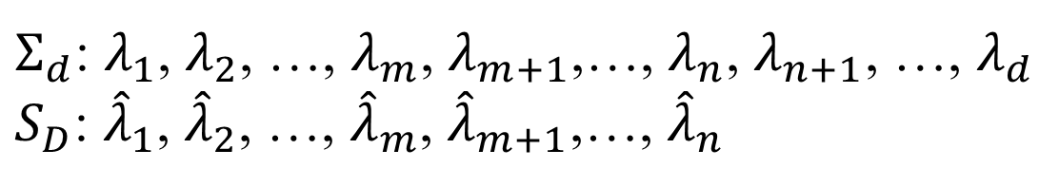
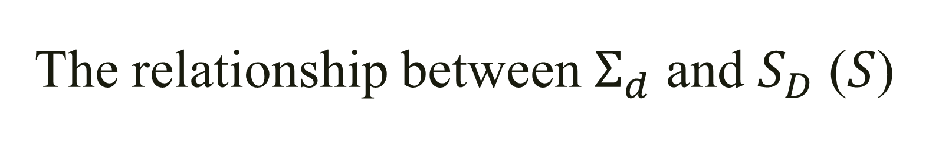
The relationship between $Σ_{d}$ and $S_{D}$ ($S$)
$Σ_{d}$: $λ_{1}$, $λ_{2}$, …, $λ_{m}$, $λ_{m+1}$,…, $λ_{n}$, $λ_{n+1}$, …, $λ_{d}$
$S_{D}$: ${\hat{λ}}_{1}$, ${\hat{λ}}_{2}$, …, ${\hat{λ}}_{m}$, ${\hat{λ}}_{m+1}$,…, ${\hat{λ}}_{n}$

Slide 7
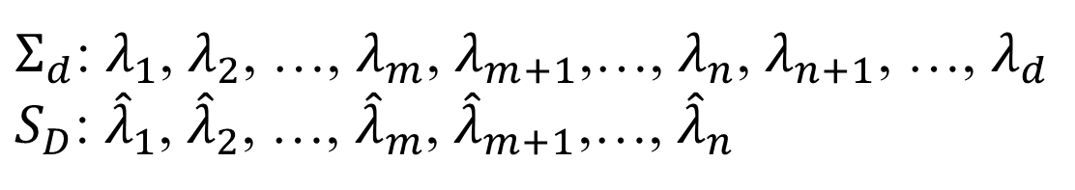
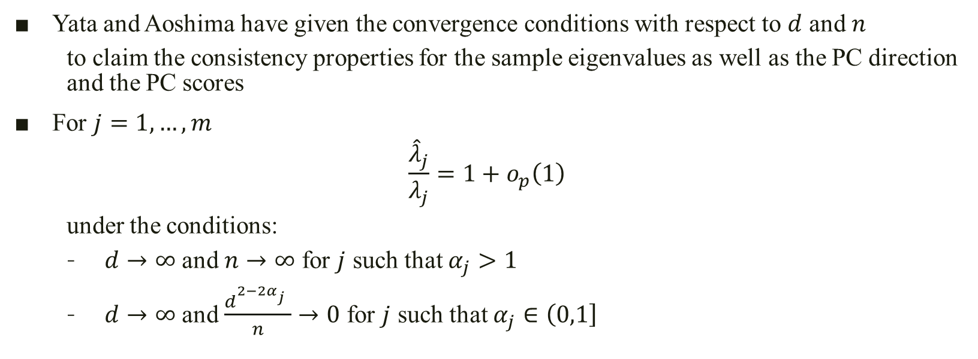


$λ_{j}=a_{j}d^{α_{j}}$, $j=1,…,m$
$λ_{j}=c_{j}$, $j=m+1,…,d$
$Σ_{d}$: $λ_{1}$, $λ_{2}$, …, $λ_{m}$, $λ_{m+1}$,…, $λ_{n}$, $λ_{n+1}$, …, $λ_{d}$
$S_{D}$: ${\hat{λ}}_{1}$, ${\hat{λ}}_{2}$, …, ${\hat{λ}}_{m}$, ${\hat{λ}}_{m+1}$,…, ${\hat{λ}}_{n}$
Yata and Aoshima have given the convergence conditions with respect to $d$ and $n$
to claim the consistency properties for the sample eigenvalues as well as the PC direction and the PC scores
For $j=1,…,m$
$$\frac{{\hat{λ}}_{j}}{λ_{j}}=1+o_{p}\left(1\right)$$
under the conditions:
$d→∞$ and $n→∞$ for $j$ such that $α_{j}>1$
$d→∞$ and $\frac{d^{2−2α_{j}^{}}}{n}→0$ for $j$ such that $α_{j}∈\left(\left.0,1\right]\right.$

Slide 8
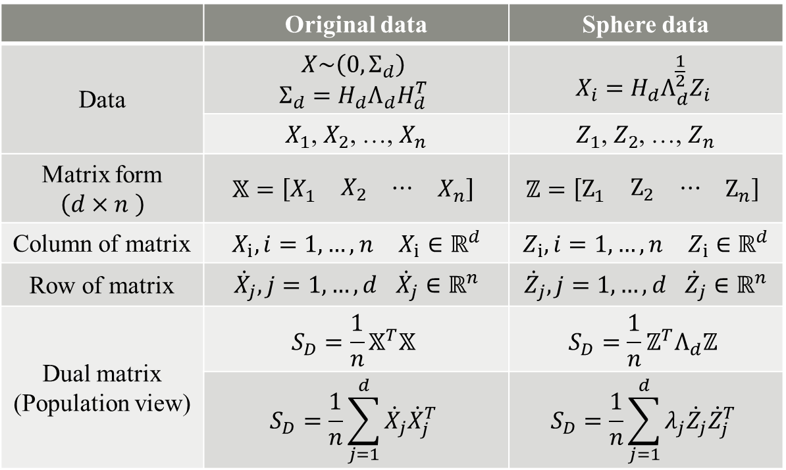

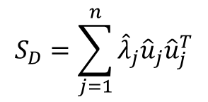
To be translated to sphered data $$Z=Λ_{d}^{−\frac{1}{2}}H_{d}^{T}X$$
 | Original data | Sphere data
Data | $$X\sim \left(0,Σ_{d}\right)$$ $$Σ_{d}=H_{d}Λ_{d}H_{d}^{T}$$ | $$X_{i}={H_{d}Λ_{d}^{\frac{1}{2}}Z}_{i}$$
 | $X_{1}$, $X_{2}$, …, $X_{n}$ | $Z_{1}$, $Z_{2}$, …, $Z_{n}$
Matrix form $$\left(d×n \right)$$ | $$𝕏=\left[\begin{matrix}X_{1} & \begin{matrix}X_{2} & ⋯\end{matrix} & X_{n}\end{matrix}\right]$$ | $$ℤ=\left[\begin{matrix}Z_{1} & \begin{matrix}Z_{2} & ⋯\end{matrix} & Z_{n}\end{matrix}\right]$$
Column of matrix | $X_{i}, i=1,…,n$ $X_{i}∈ℝ^{d}$ | $Z_{i}, i=1,…,n$ $Z_{i}∈ℝ^{d}$
Row of matrix | ${\dot{X}}_{j}, j=1,…,d$ ${\dot{X}}_{j}∈ℝ^{n}$ | ${\dot{Z}}_{j}, j=1,…,d$ ${\dot{Z}}_{j}∈ℝ^{n}$
Dual matrix (Population view) | $$S_{D}=\frac{1}{n}𝕏^{T}𝕏$$ | $$S_{D}=\frac{1}{n}ℤ^{T}Λ_{d}ℤ$$
 | $$S_{D}=\frac{1}{n}\sum_{j=1}^{d}{{\dot{X}}_{j}{\dot{X}}_{j}^{T}}$$ | $$S_{D}=\frac{1}{n}\sum_{j=1}^{d}{λ_{j}{\dot{Z}}_{j}{\dot{Z}}_{j}^{T}}$$
$$S_{D}=\sum_{j=1}^{n}{{\hat{λ}}_{j}{\hat{u}}_{j}{\hat{u}}_{j}^{T}}$$
(Sample view)

Slide 9

$λ_{j}=a_{j}d^{α_{j}}$, $j=1,…,m$
$λ_{j}=c_{j}$, $j=m+1,…,d$
$Σ_{d}$: $λ_{1}$, $λ_{2}$, …, $λ_{m}$, $λ_{m+1}$,…, $λ_{n}$, $λ_{n+1}$, …, $λ_{d}$
$S_{D}$: ${\hat{λ}}_{1}$, ${\hat{λ}}_{2}$, …, ${\hat{λ}}_{m}$, ${\hat{λ}}_{m+1}$,…, ${\hat{λ}}_{n}$
Rewritten by $ℤ$
If $z_{ji}$, $j=1,…,d$ ($i=1,…,n$ ) are independent
$$\frac{{\hat{λ}}_{j}}{λ_{j}}=1+o_{p}\left(1\right)$$
The conditions are modified as:
$d→∞$ and $n→∞$ for $j$ such that $α_{j}>1$
$d→∞$ and $\frac{d^{1−α_{j}^{}}}{n}→0$ for $j$ such that $α_{j}∈\left(\left.0,1\right]\right.$

Slide 10
New estimation methodology

Slide 11


New PCA (Cross-data-matrix, $S_{D\left(1\right)}$)
Data: $𝕏=\left[\begin{matrix}X_{1} & \begin{matrix}X_{2} & ⋯\end{matrix} & X_{N}\end{matrix}\right]$ ($X\sim \left(0,Σ_{d}\right)$)
Split into 2 part:
$𝕏_{\left(1\right)}=\left[\begin{matrix}X_{\left(1\right)1} & \begin{matrix}X_{\left(1\right)2} & ⋯\end{matrix} & X_{\left(1\right)n_{1}}\end{matrix}\right]$
$𝕏_{\left(2\right)}=\left[\begin{matrix}X_{\left(2\right)1} & \begin{matrix}X_{\left(2\right)2} & ⋯\end{matrix} & X_{\left(2\right)n_{2}}\end{matrix}\right]$
$n_{1}+n_{2}=N$
2 situations
$n_{1}=n_{2}=n$, $N=2n$
$$S_{D\left(1\right)}=\frac{1}{n}𝕏_{\left(1\right)}^{T}𝕏_{\left(2\right)}$$
$n_{1}≠n_{2}$
$$S_{D\left(1\right)}=\frac{1}{\sqrt{n_{1}n_{2}}}𝕏_{\left(1\right)}^{T}𝕏_{\left(2\right)}$$
As the example

Slide 12

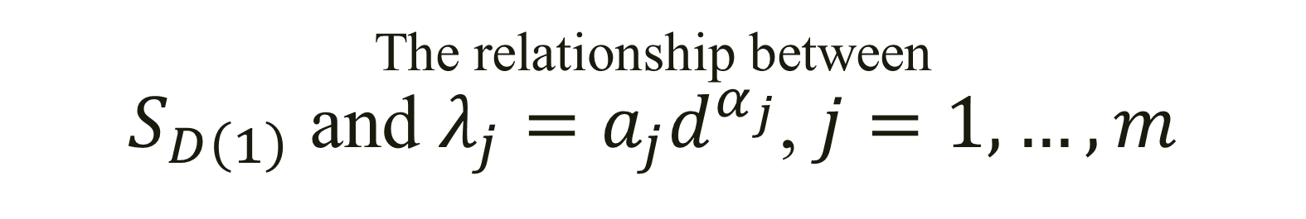



The relationship between $S_{D\left(1\right)}$ and $λ_{j}=a_{j}d^{α_{j}}$, $j=1,…,m$
Population view
Sample view
$𝕏_{\left(1\right)}=H_{d}{Λ_{d}^{\frac{1}{2}}ℤ}_{\left(1\right)}$
$𝕏_{\left(2\right)}=H_{d}{Λ_{d}^{\frac{1}{2}}ℤ}_{\left(2\right)}$
$$S_{D\left(1\right)}=\frac{1}{n}ℤ_{\left(1\right)}^{T}Λ_{d}ℤ_{\left(2\right)}$$
$$S_{D}=\frac{1}{n}\sum_{j=1}^{d}{λ_{j}{\dot{Z}}_{\left(1\right)j}{\dot{Z}}_{\left(2\right)j}^{T}}$$
$𝕏_{\left(1\right)}=H_{d}{Λ_{d}^{\frac{1}{2}}ℤ}_{\left(1\right)}$
$𝕏_{\left(2\right)}=H_{d}{Λ_{d}^{\frac{1}{2}}ℤ}_{\left(2\right)}$
$$S_{D\left(1\right)}=\frac{1}{n}ℤ_{\left(1\right)}^{T}Λ_{d}ℤ_{\left(2\right)}$$
$$S_{D}=\frac{1}{n}\sum_{j=1}^{d}{λ_{j}{\dot{Z}}_{\left(1\right)j}{\dot{Z}}_{\left(2\right)j}^{T}}$$
$S_{D\left(1\right)}=\frac{1}{n}𝕏_{\left(1\right)}^{T}𝕏_{\left(2\right)}$
Singular values decomposition
$$S_{D\left(1\right)}=\tilde{U}\tilde{Λ}{\tilde{V}}^{T}$$
$$S_{D\left(1\right)}=\sum_{j=1}^{n}{{\tilde{λ}}_{j}{\tilde{u}}_{j}{\tilde{v}}_{j}^{T}}$$
$S_{D\left(1\right)}=\frac{1}{n}𝕏_{\left(1\right)}^{T}𝕏_{\left(2\right)}$
Singular values decomposition
$$S_{D\left(1\right)}=\tilde{U}\tilde{Λ}{\tilde{V}}^{T}$$
$$S_{D\left(1\right)}=\sum_{j=1}^{n}{{\tilde{λ}}_{j}{\tilde{u}}_{j}{\tilde{v}}_{j}^{T}}$$

Slide 13
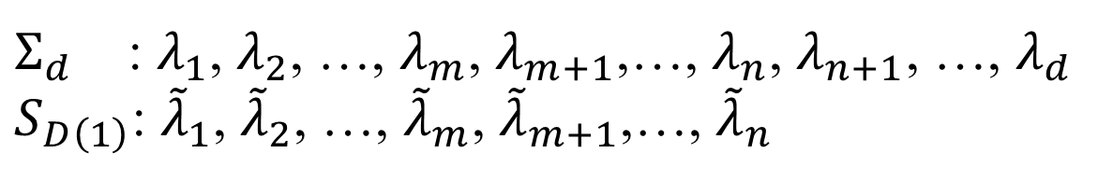



$λ_{j}=a_{j}d^{α_{j}}$, $j=1,…,m$
$λ_{j}=c_{j}$, $j=m+1,…,d$
$Σ_{d}$ : $λ_{1}$, $λ_{2}$, …, $λ_{m}$, $λ_{m+1}$,…, $λ_{n}$, $λ_{n+1}$, …, $λ_{d}$
$S_{D\left(1\right)}$: ${\tilde{λ}}_{1}$, ${\tilde{λ}}_{2}$, …, ${\tilde{λ}}_{m}$, ${\tilde{λ}}_{m+1}$,…, ${\tilde{λ}}_{n}$
Theorem
For $j=1,…,m$
$$\frac{{\tilde{λ}}_{j}}{λ_{j}}=1+o_{p}\left(1\right)$$
under the conditions:
$d→∞$ and $n→∞$ for $j$ such that $α_{j}>\frac{1}{2}$
$d→∞$ and $\frac{d^{2−2α_{j}^{}}}{n}→0$ for $j$ such that $α_{j}∈\left(\left.0,\frac{1}{2}\right]\right.$

Slide 14
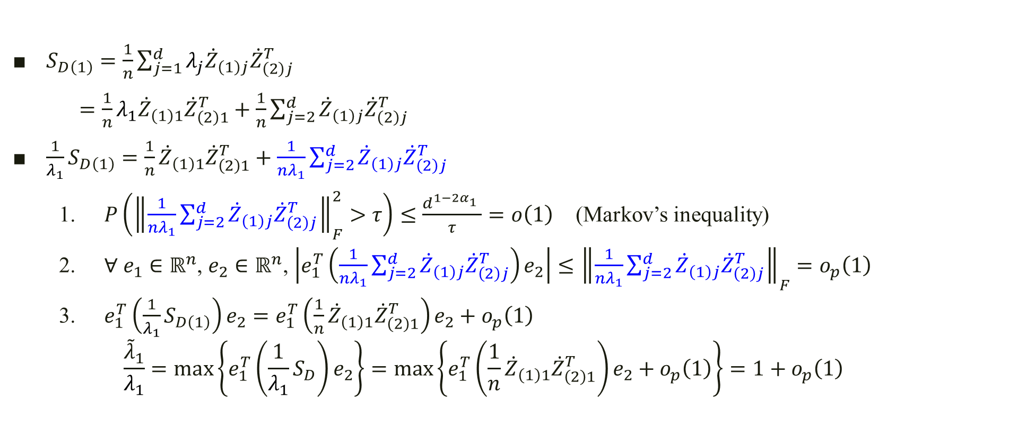
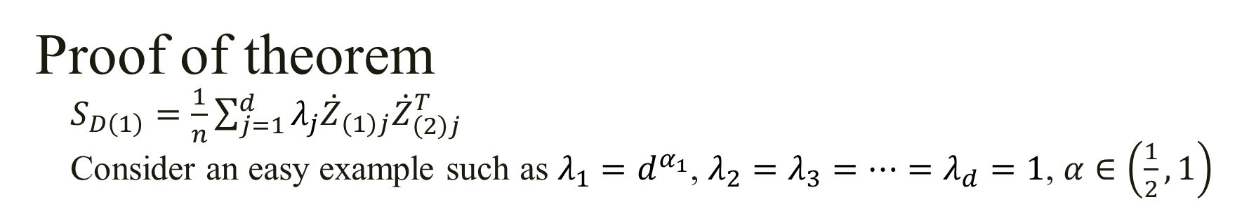
Proof of theorem $S_{D\left(1\right)}=\frac{1}{n}\sum_{j=1}^{d}{λ_{j}{\dot{Z}}_{\left(1\right)j}{\dot{Z}}_{\left(2\right)j}^{T}}$ Consider an easy example such as $λ_{1}=d^{α_{1}}$, $λ_{2}=λ_{3}=⋯=λ_{d}=1$, $α∈\left(\frac{1}{2},1\right)$
$S_{D\left(1\right)}=\frac{1}{n}\sum_{j=1}^{d}{λ_{j}{\dot{Z}}_{\left(1\right)j}{\dot{Z}}_{\left(2\right)j}^{T}}$
$=\frac{1}{n}λ_{1}{\dot{Z}}_{\left(1\right)1}{\dot{Z}}_{\left(2\right)1}^{T}+\frac{1}{n}\sum_{j=2}^{d}{{\dot{Z}}_{\left(1\right)j}{\dot{Z}}_{\left(2\right)j}^{T}}$
$\frac{1}{λ_{1}}S_{D\left(1\right)}=\frac{1}{n}{\dot{Z}}_{\left(1\right)1}{\dot{Z}}_{\left(2\right)1}^{T}+\frac{1}{nλ_{1}}\sum_{j=2}^{d}{{\dot{Z}}_{\left(1\right)j}{\dot{Z}}_{\left(2\right)j}^{T}}$
$P\left({\left\|\frac{1}{nλ_{1}}\sum_{j=2}^{d}{{\dot{Z}}_{\left(1\right)j}{\dot{Z}}_{\left(2\right)j}^{T}}\right\|}_{F}^{2}>τ\right)≤\frac{d^{1−2α_{1}^{}}}{τ}=o\left(1\right)$ (Markov’s inequality)
$∀ e_{1}∈ℝ^{n}$, $e_{2}∈ℝ^{n}$, $\left|e_{1}^{T}\left(\frac{1}{nλ_{1}}\sum_{j=2}^{d}{{\dot{Z}}_{\left(1\right)j}{\dot{Z}}_{\left(2\right)j}^{T}}\right)e_{2}\right|≤{\left\|\frac{1}{nλ_{1}}\sum_{j=2}^{d}{{\dot{Z}}_{\left(1\right)j}{\dot{Z}}_{\left(2\right)j}^{T}}\right\|}_{F}=o_{p}\left(1\right)$
$e_{1}^{T}\left(\frac{1}{λ_{1}}S_{D\left(1\right)}\right)e_{2}=e_{1}^{T}\left(\frac{1}{n}{\dot{Z}}_{\left(1\right)1}{\dot{Z}}_{\left(2\right)1}^{T}\right)e_{2}+o_{p}\left(1\right)$
$$\frac{{\tilde{λ}}_{1}}{λ_{1}}=\max_{}\left\{e_{1}^{T}\left(\frac{1}{λ_{1}}S_{D}\right)e_{2}\right\}=\max_{}\left\{e_{1}^{T}\left(\frac{1}{n}{\dot{Z}}_{\left(1\right)1}{\dot{Z}}_{\left(2\right)1}^{T}\right)e_{2}+o_{p}\left(1\right)\right\}=1+o_{p}\left(1\right)$$

Slide 15
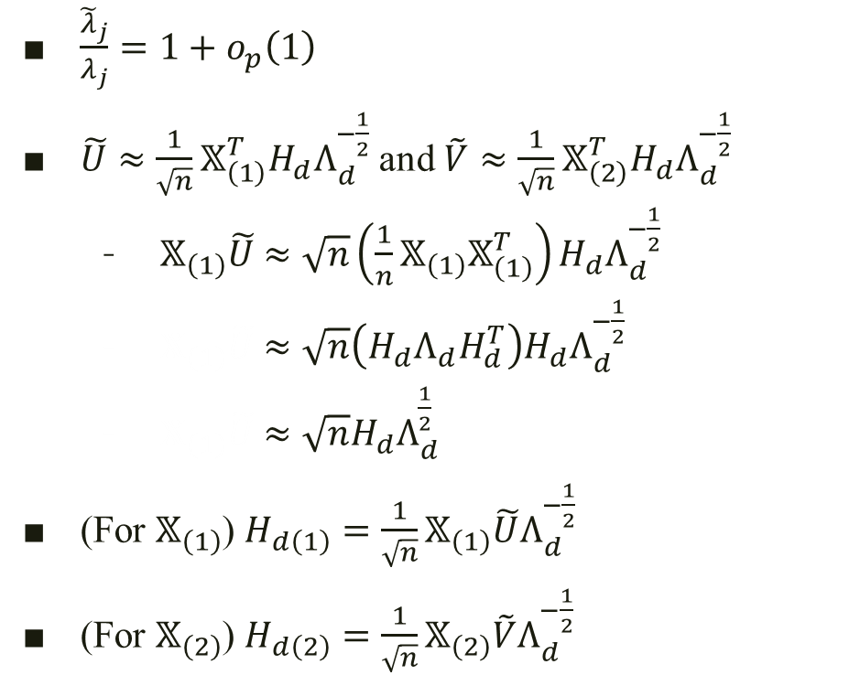
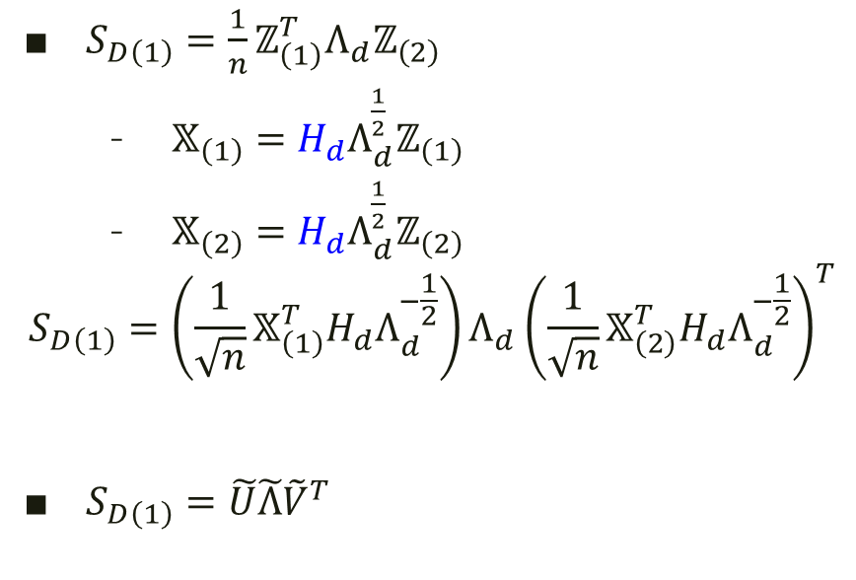
PC directions with the cross-data matrix
$S_{D\left(1\right)}=\frac{1}{n}ℤ_{\left(1\right)}^{T}Λ_{d}ℤ_{\left(2\right)}$
$𝕏_{\left(1\right)}=H_{d}{Λ_{d}^{\frac{1}{2}}ℤ}_{\left(1\right)}$
$𝕏_{\left(2\right)}=H_{d}{Λ_{d}^{\frac{1}{2}}ℤ}_{\left(2\right)}$
$$S_{D\left(1\right)}=\left(\frac{1}{\sqrt{n}}𝕏_{\left(1\right)}^{T}H_{d}Λ_{d}^{−\frac{1}{2}}\right)Λ_{d}{\left(\frac{1}{\sqrt{n}}𝕏_{\left(2\right)}^{T}H_{d}Λ_{d}^{−\frac{1}{2}}\right)}^{T}$$
$S_{D\left(1\right)}=\tilde{U}\tilde{Λ}{\tilde{V}}^{T}$
$\frac{{\tilde{λ}}_{j}}{λ_{j}}=1+o_{p}\left(1\right)$
$\tilde{U}≈\frac{1}{\sqrt{n}}𝕏_{\left(1\right)}^{T}H_{d}Λ_{d}^{−\frac{1}{2}}$ and $\tilde{V}≈\frac{1}{\sqrt{n}}𝕏_{\left(2\right)}^{T}H_{d}Λ_{d}^{−\frac{1}{2}}$
$𝕏_{\left(1\right)}\tilde{U}$ $≈\sqrt{n}\left(\frac{1}{n}𝕏_{\left(1\right)}𝕏_{\left(1\right)}^{T}\right)H_{d}Λ_{d}^{−\frac{1}{2}}$
$𝕏_{\left(1\right)}\tilde{U}$ $≈\sqrt{n}\left(H_{d}Λ_{d}H_{d}^{T}\right)H_{d}Λ_{d}^{−\frac{1}{2}}$
$𝕏_{\left(1\right)}\tilde{U}$ $≈\sqrt{n}H_{d}Λ_{d}^{\frac{1}{2}}$
(For $𝕏_{\left(1\right)}$) $H_{d\left(1\right)}=\frac{1}{\sqrt{n}}𝕏_{\left(1\right)}\tilde{U}Λ_{d}^{−\frac{1}{2}}$
(For $𝕏_{\left(2\right)}$) $H_{d\left(2\right)}=\frac{1}{\sqrt{n}}𝕏_{\left(2\right)}\tilde{V}Λ_{d}^{−\frac{1}{2}}$

Slide 16
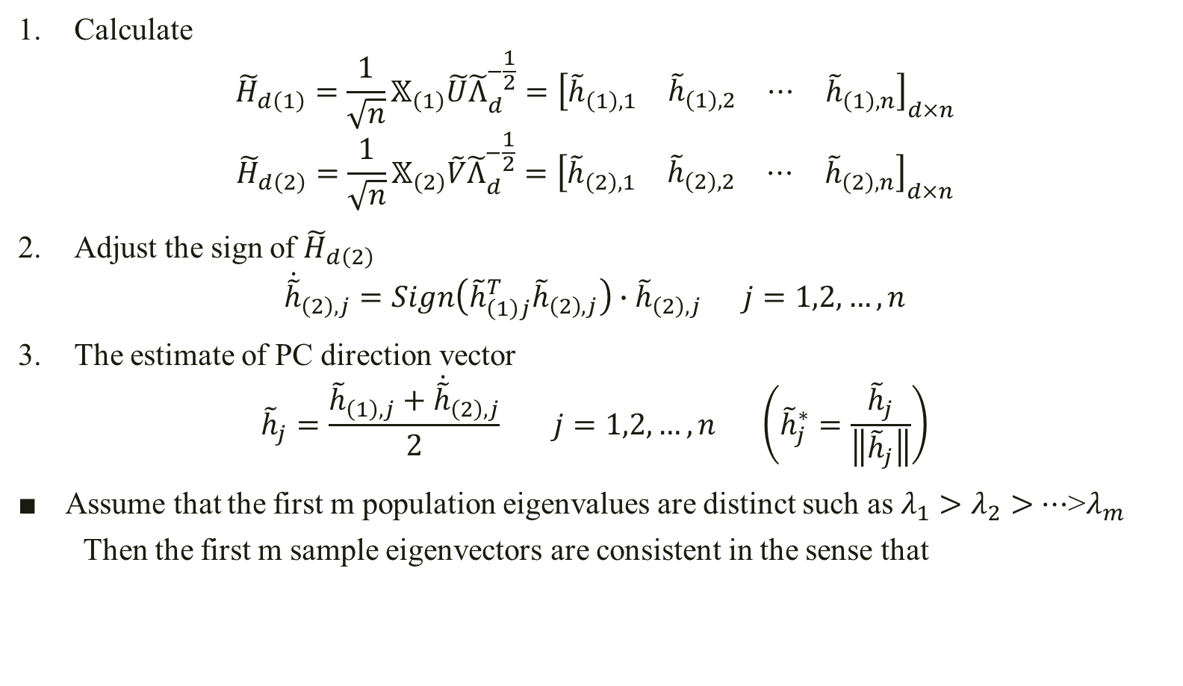
PC directions with the cross-data matrix
Calculate
$${\tilde{H}}_{d\left(1\right)}=\frac{1}{\sqrt{n}}𝕏_{\left(1\right)}\tilde{U}{\tilde{Λ}}_{d}^{−\frac{1}{2}}={\left[\begin{matrix}{\tilde{h}}_{\left(1\right),1} & \begin{matrix}{\tilde{h}}_{\left(1\right),2} & ⋯\end{matrix} & {\tilde{h}}_{\left(1\right),n}\end{matrix}\right]}_{d×n}$$
$${\tilde{H}}_{d\left(2\right)}=\frac{1}{\sqrt{n}}𝕏_{\left(2\right)}\tilde{V}{\tilde{Λ}}_{d}^{−\frac{1}{2}}={\left[\begin{matrix}{\tilde{h}}_{\left(2\right),1} & \begin{matrix}{\tilde{h}}_{\left(2\right),2} & ⋯\end{matrix} & {\tilde{h}}_{\left(2\right),n}\end{matrix}\right]}_{d×n}$$
Adjust the sign of ${\tilde{H}}_{d\left(2\right)}$
$${\dot{\tilde{h}}}_{\left(2\right),j}=Sign\left({\tilde{h}}_{\left(1\right)j}^{T}{\tilde{h}}_{\left(2\right),j}\right)∙{\tilde{h}}_{\left(2\right),j} j=1,2,…,n$$
The estimate of PC direction vector
$${\tilde{h}}_{j}=\frac{{\tilde{h}}_{\left(1\right),j}+{\dot{\tilde{h}}}_{\left(2\right),j}}{2} j=1,2,…,n \left({\tilde{h}}_{j}^{∗}=\frac{{\tilde{h}}_{j}}{\left\|{\tilde{h}}_{j}\right\|}\right)$$
Assume that the first m population eigenvalues are distinct such as $λ_{1}>$ $λ_{2}>$ $⋯$>$λ_{m}$
Then the first m sample eigenvectors are consistent in the sense that

Slide 17

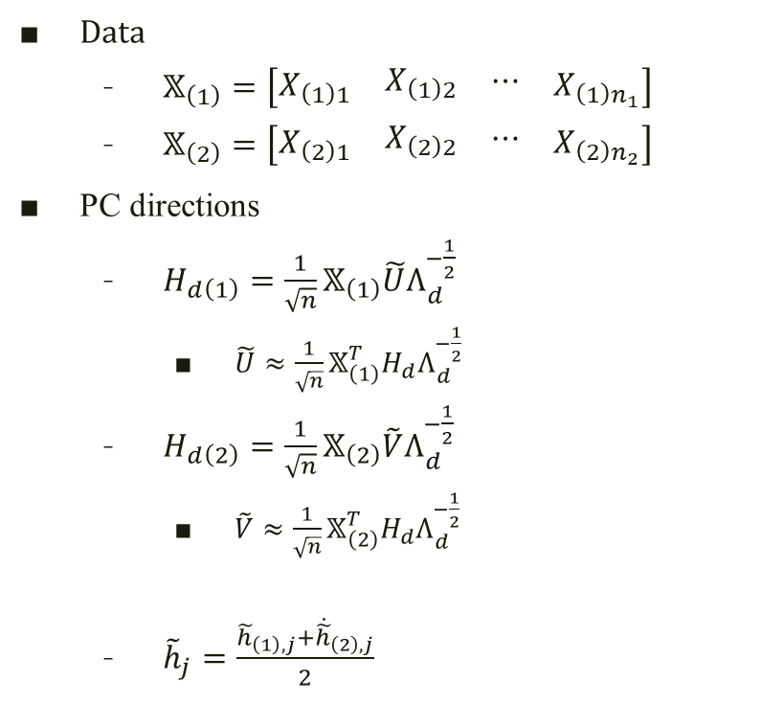
PC scores with the cross-data-matrix
Data
$𝕏_{\left(1\right)}=\left[\begin{matrix}X_{\left(1\right)1} & \begin{matrix}X_{\left(1\right)2} & ⋯\end{matrix} & X_{\left(1\right)n_{1}}\end{matrix}\right]$
$𝕏_{\left(2\right)}=\left[\begin{matrix}X_{\left(2\right)1} & \begin{matrix}X_{\left(2\right)2} & ⋯\end{matrix} & X_{\left(2\right)n_{2}}\end{matrix}\right]$
PC directions
$H_{d\left(1\right)}=\frac{1}{\sqrt{n}}𝕏_{\left(1\right)}\tilde{U}Λ_{d}^{−\frac{1}{2}}$
$\tilde{U}≈\frac{1}{\sqrt{n}}𝕏_{\left(1\right)}^{T}H_{d}Λ_{d}^{−\frac{1}{2}}$
$H_{d\left(2\right)}=\frac{1}{\sqrt{n}}𝕏_{\left(2\right)}\tilde{V}Λ_{d}^{−\frac{1}{2}}$
$\tilde{V}≈\frac{1}{\sqrt{n}}𝕏_{\left(2\right)}^{T}H_{d}Λ_{d}^{−\frac{1}{2}}$
${\tilde{h}}_{j}=\frac{{\tilde{h}}_{\left(1\right),j}+{\dot{\tilde{h}}}_{\left(2\right),j}}{2}$
PC scores
For $𝕏_{\left(1\right)}$
$H_{d\left(1\right)}^{T}𝕏_{\left(1\right)}=\sqrt{n}Λ_{d}^{\frac{1}{2}}∙{\tilde{U}}^{T}$
For $𝕏_{\left(2\right)}$
$H_{d\left(2\right)}^{T}𝕏_{\left(2\right)}=\sqrt{n}Λ_{d}^{\frac{1}{2}}∙{\tilde{V}}^{T}$

Slide 18
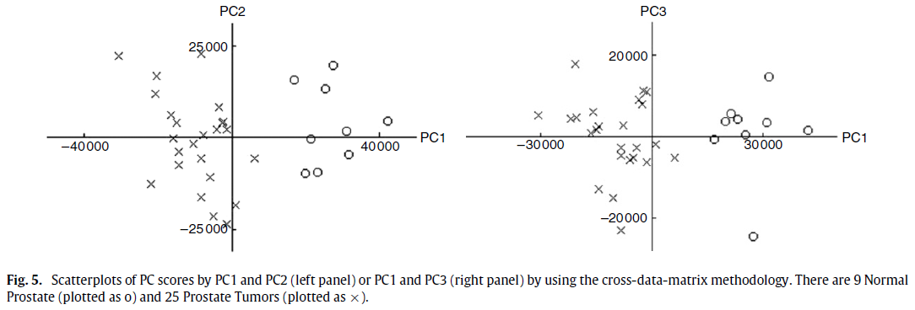




$${\tilde{h}}_{2}$$
$${\tilde{h}}_{3}$$
$${\tilde{h}}_{1}$$
$${\tilde{h}}_{1}$$

Slide 19
Geometric representations

Slide 20
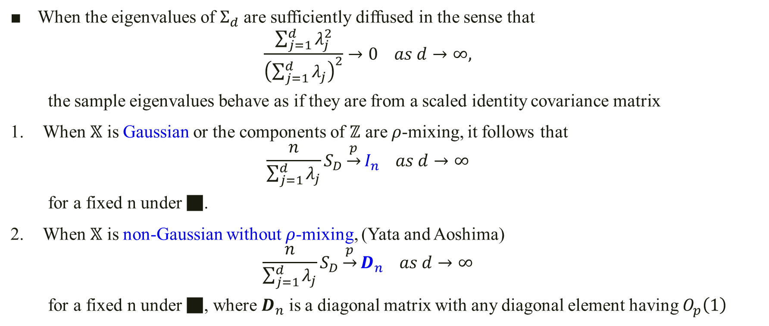
Ahn et al. (2007) and Jung and Marron (2009)
When the eigenvalues of $Σ_{d}$ are sufficiently diffused in the sense that
$$\frac{\sum_{j=1}^{d}{λ_{j}^{2}}}{{\left(\sum_{j=1}^{d}{λ_{j}}\right)}^{2}}→0 as d→∞,$$
the sample eigenvalues behave as if they are from a scaled identity covariance matrix
When $𝕏$ is Gaussian or the components of $ℤ$ are $ρ$-mixing, it follows that
$$\frac{n}{\sum_{j=1}^{d}{λ_{j}}}S_{D}\underset{→}{p}I_{n} as d→∞$$
for a fixed n under ■.
When $𝕏$ is non-Gaussian without $ρ$-mixing, (Yata and Aoshima)
$$\frac{n}{\sum_{j=1}^{d}{λ_{j}}}S_{D}\underset{→}{p}D_{n} as d→∞$$
for a fixed n under ■, where $D_{n}$ is a diagonal matrix with any diagonal element having $O_{p}\left(1\right)$

Slide 21
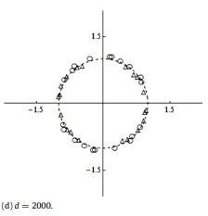
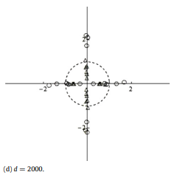
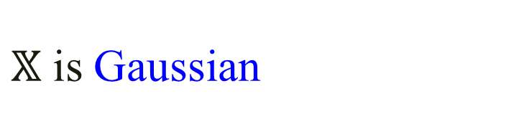


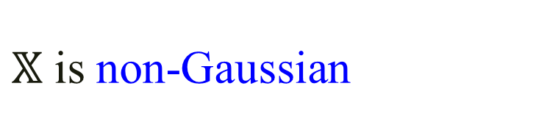

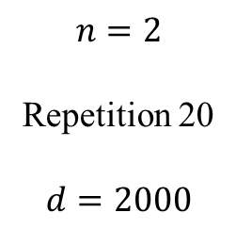
Geometric representations $S_{D}=\sum_{j=1}^{n}{{\hat{λ}}_{j}{\hat{u}}_{j}{\hat{u}}_{j}^{T}}$, $w_{j}=\frac{n}{\sum_{j=1}^{d}{λ_{j}}}S_{D}{\hat{u}}_{j}$
$𝕏$ is Gaussian
$𝕏$ is non-Gaussian
$$\frac{n}{\sum_{j=1}^{d}{λ_{j}}}S_{D}\underset{→}{p}I_{n}$$
Let $R_{n}=\left\{e∈ℝ^{n}: \left\|e\right\|=1\right\}$
$$\frac{n}{\sum_{j=1}^{d}{λ_{j}}}S_{D}\underset{→}{p}D_{n}$$
$$n=2$$
Repetition 20
$$d=2000$$

Slide 22
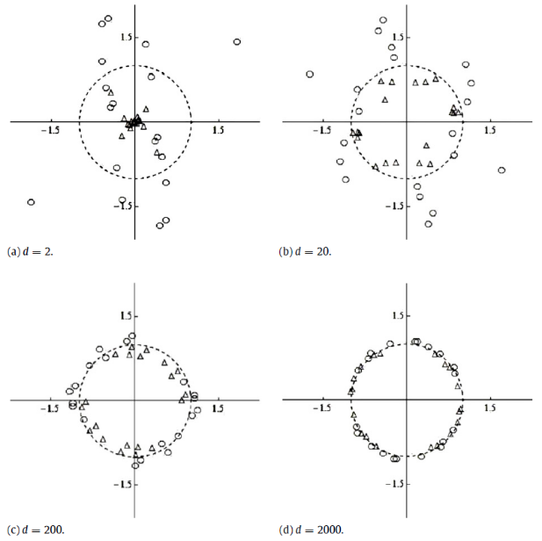
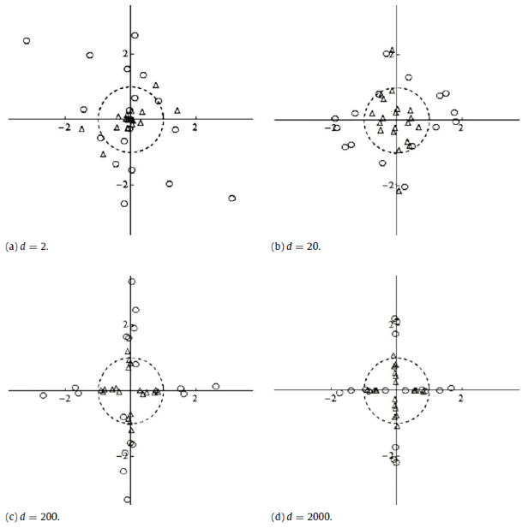

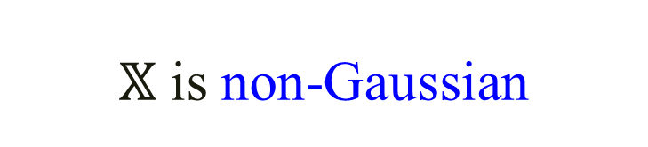
$𝕏$ is Gaussian
$𝕏$ is non-Gaussian

Slide 23
Noise-reduction methodology

Slide 24


Noise-reduction methodology $S_{D}=\frac{1}{n}𝕏^{T}𝕏$, $S_{D}=\sum_{j=1}^{n}{{\hat{λ}}_{j}{\hat{u}}_{j}{\hat{u}}_{j}^{T}}$
$${\tilde{\tilde{λ}}}_{j}={\hat{λ}}_{j}−\frac{tr\left(S_{D}\right)−\sum_{k=1}^{j}{{\hat{λ}}_{k}}}{n−j} j=1,…,n−1$$
Theorem
For $j=1,…,m$
$$\frac{{\tilde{\tilde{λ}}}_{j}}{λ_{j}}=1+o_{p}\left(1\right)$$
under the condition
$d→∞ \text{and} n→∞ \text{for} j \text{such} \text{that} α_{j}>\frac{1}{2}$
$d→∞ \text{and} \frac{d^{1−2α_{j}^{}}}{n}→0 \text{for} j \text{such} \text{that} α_{j}∈\left(\left.0,\frac{1}{2}\right]\right.$

Slide 25

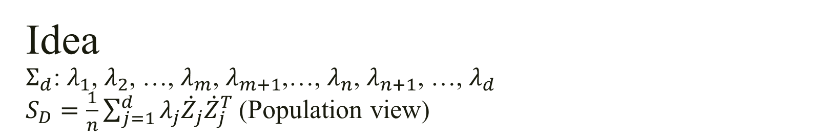
Idea $Σ_{d}$: $λ_{1}$, $λ_{2}$, …, $λ_{m}$, $λ_{m+1}$,…, $λ_{n}$, $λ_{n+1}$, …, $λ_{d}$ $S_{D}=\frac{1}{n}\sum_{j=1}^{d}{λ_{j}{\dot{Z}}_{j}{\dot{Z}}_{j}^{T}}$ (Population view)
Separate $S_{D}$ into intrinsic part $U_{1}$ and noise part $U_{2}$
$$S_{D}=\frac{1}{n}\sum_{j=1}^{d}{λ_{j}{\dot{Z}}_{j}{\dot{Z}}_{j}^{T}}=\frac{1}{n}\sum_{j=1}^{m}{λ_{j}{\dot{Z}}_{j}{\dot{Z}}_{j}^{T}}+\frac{1}{n}\sum_{j=m+1}^{d}{λ_{j}{\dot{Z}}_{j}{\dot{Z}}_{j}^{T}}=U_{1}+U_{2}$$
$$\frac{\sum_{j=m+1}^{d}{λ_{j}^{2}}}{{\left(\sum_{j=m+1}^{d}{λ_{j}}\right)}^{2}}→0 as d→∞$$

Slide 26
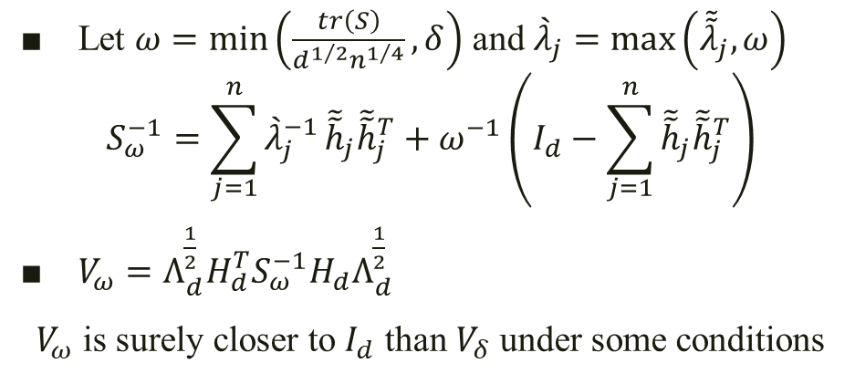
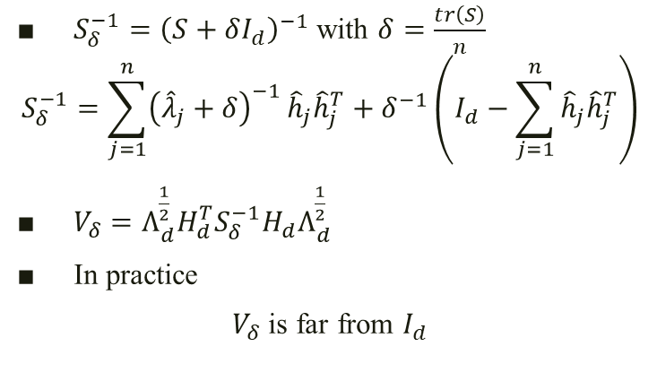
PC directions
Srivastava and Kubokawa
Noise-reduction methodology
$S_{δ}^{−1}={\left(S+δI_{d}\right)}^{−1}$ with $δ=\frac{tr\left(S\right)}{n}$
$$S_{δ}^{−1}=\sum_{j=1}^{n}{{\left({\hat{λ}}_{j}+δ\right)}^{−1}}{\hat{h}}_{j}{\hat{h}}_{j}^{T}+δ^{−1}\left(I_{d}−\sum_{j=1}^{n}{{\hat{h}}_{j}{\hat{h}}_{j}^{T}}\right)$$
$V_{δ}=Λ_{d}^{\frac{1}{2}}H_{d}^{T}S_{δ}^{−1}H_{d}Λ_{d}^{\frac{1}{2}}$
In practice
$V_{δ}$ is far from $I_{d}$
Let $ω=min\left(\frac{tr\left(S\right)}{d^{1/2}n^{1/4}},δ\right)$ and ${\grave{λ}}_{j}=max\left({\tilde{\tilde{λ}}}_{j},ω\right)$
$$S_{ω}^{−1}=\sum_{j=1}^{n}{{\grave{λ}}_{j}^{−1}}{\tilde{\tilde{h}}}_{j}{\tilde{\tilde{h}}}_{j}^{T}+ω^{−1}\left(I_{d}−\sum_{j=1}^{n}{{\tilde{\tilde{h}}}_{j}{\tilde{\tilde{h}}}_{j}^{T}}\right)$$
$V_{ω}=Λ_{d}^{\frac{1}{2}}H_{d}^{T}S_{ω}^{−1}H_{d}Λ_{d}^{\frac{1}{2}}$
$V_{ω}$ is surely closer to $I_{d}$ than $V_{δ}$ under some conditions

Slide 27

PC scores
$ℤ=Λ_{d}^{−\frac{1}{2}}H_{d}^{T}X$
$S_{D}=\frac{1}{n}ℤ^{T}Λ_{d}ℤ=UΛ_{d}U^{T}$
$U=\frac{1}{\sqrt{n}}X^{T}H_{d}Λ_{d}^{−\frac{1}{2}}$
PC scores
$$H_{d}^{T}X={\sqrt{n}\tilde{\tilde{Λ}}}_{d}^{\frac{1}{2}}U^{T}$$

Slide 28
Performances

Slide 29
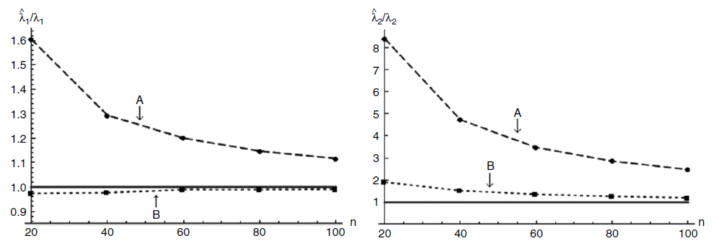
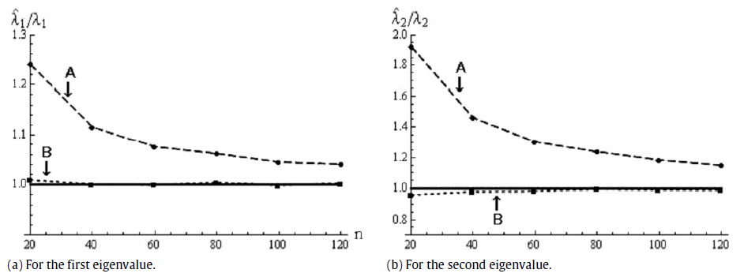
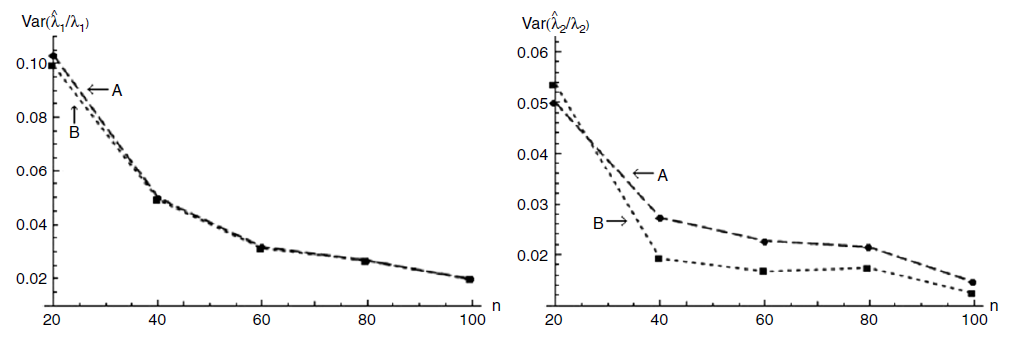
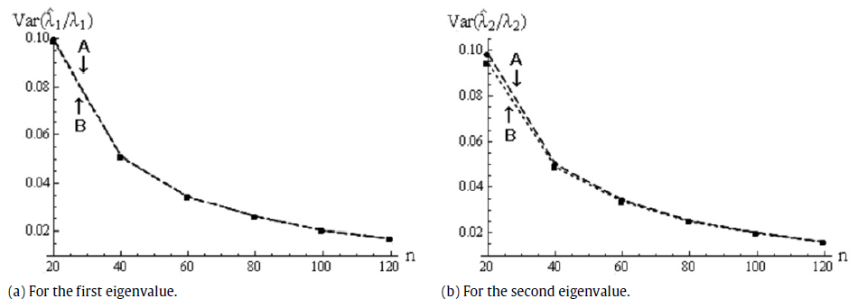
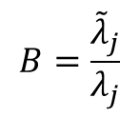
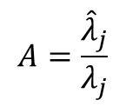

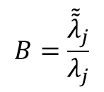
$$A=\frac{{\hat{λ}}_{j}}{λ_{j}}$$
New estimation methodology
Noise-reduction methodology
$$B=\frac{{\tilde{λ}}_{j}}{λ_{j}}$$
$$B=\frac{{\tilde{\tilde{λ}}}_{j}}{λ_{j}}$$
$$d=1600$$
Gaussian Model

Slide 30
The End

