Slide 1
Graph clustering for CryoEM
Szu-Chi Chung
Institute of Statistical Science, Academia Sinica

Slide 2
Taxonomy
Similarities
Heterogeneous Classification
Common line similarity
Homogeneous Classification
Cross correlation
Clustering method
Network dismantling (Vertex)
Graph partition / Community detection (Edge)
Notes:
https://en.wikipedia.org/wiki/Community_structure

Slide 3
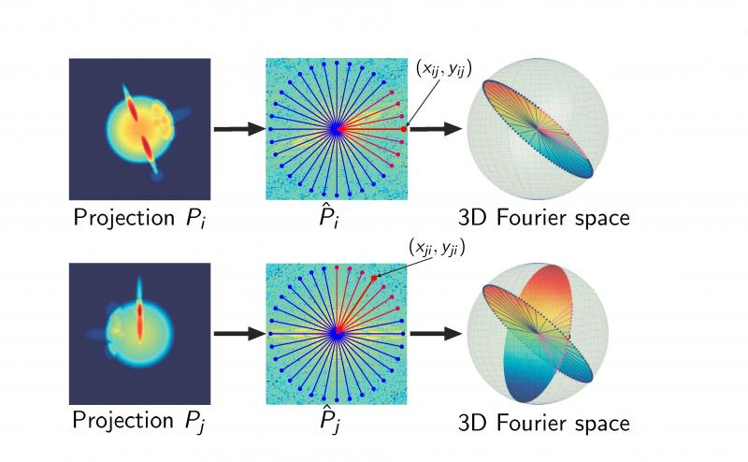
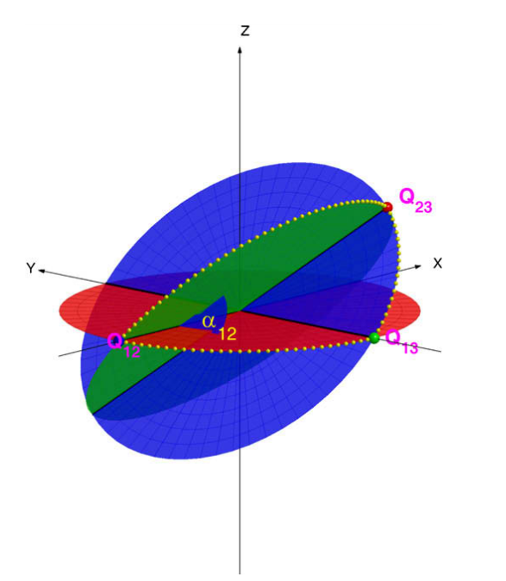
Projection-Slice Theorem
Common Line
Notes:
Only obtain initial model, since it can not iterative refine (when SNR is low do single run will not be accurate)

Slide 4
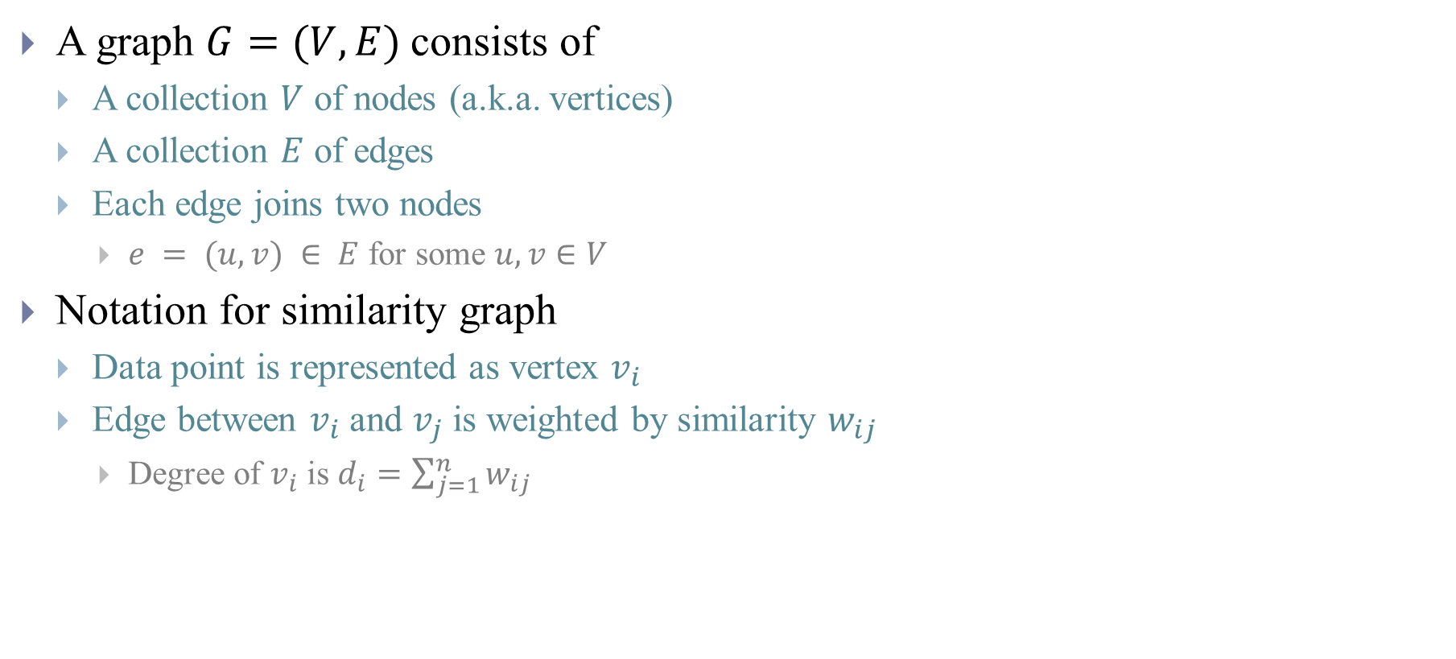
Graph
A graph $G=(V, E)$consists of
A collection $V$ of nodes (a.k.a. vertices)
A collection $E$ of edges
Each edge joins two nodes
$e = (u, v) ∈ E$ for some $u, v∈V$
Notation for similarity graph
Data point is represented as vertex $v_{i}$
Edge between $v_{i}$ and $v_{j}$ is weighted by similarity $w_{ij}$
Degree of $v_{i}$ is $d_{i}=\sum_{j=1}^{n}{w_{ij}}$
Notes:
Graph vs network
Directed vs undirected
For $A, B ε V$, $W\left(A,B\right)=\sum_{i∈A,j∈B}{w_{ij}}$
$$Vol\left(A\right)=\sum_{i∈A}{d_{i}}=\sum_{i∈A,j∈V}{w_{ij}}=asso(A,V)$$

Slide 5
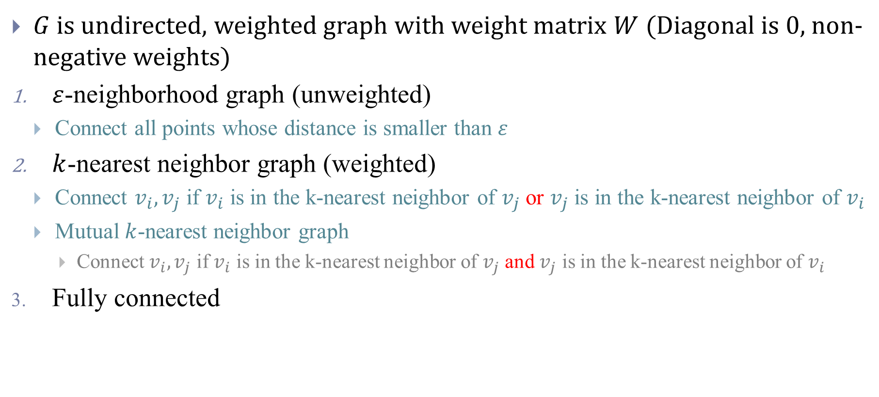
Similarity graph
$G$is undirected, weighted graph with weight matrix $W$ (Diagonal is 0, non-negative weights)
$ε$-neighborhood graph (unweighted)
Connect all points whose distance is smaller than $ε$
$k$-nearest neighbor graph (weighted)
Connect $v_{i},v_{j}$ if $v_{i}$ is in the k-nearest neighbor of $v_{j}$ or $v_{j}$ is in the k-nearest neighbor of $v_{i}$
Mutual $k$-nearest neighbor graph
Connect $v_{i},v_{j}$ if $v_{i}$ is in the k-nearest neighbor of $v_{j}$ and $v_{j}$ is in the k-nearest neighbor of $v_{i}$
Fully connected

Slide 6

[1] Herman et al., 2008
Similarity
$D\left(X_{l}, Y_{m}\right)={|X_{l}^{}−Y_{m}^{}|}^{2}$
Clustering
Max-k-cut
NP-hard
Approximated by Tabu-search

Slide 7
[1] Herman et al., 2008
Test on simulation dataset
Tends toward even split
Classify into more class and merge similar one

Slide 8

[2] Shatsky et al. 2010
$W(u,v)=\left\{\begin{aligned}{10}^{6}+CCCL(u,v) \\ 0 if u, v in the \\ same Euler angle\end{aligned}\right.$
Normalize min-cut
Spectral Clustering
Test on real data
Time consuming
Notes:
Projecting into 98 directions

Slide 9
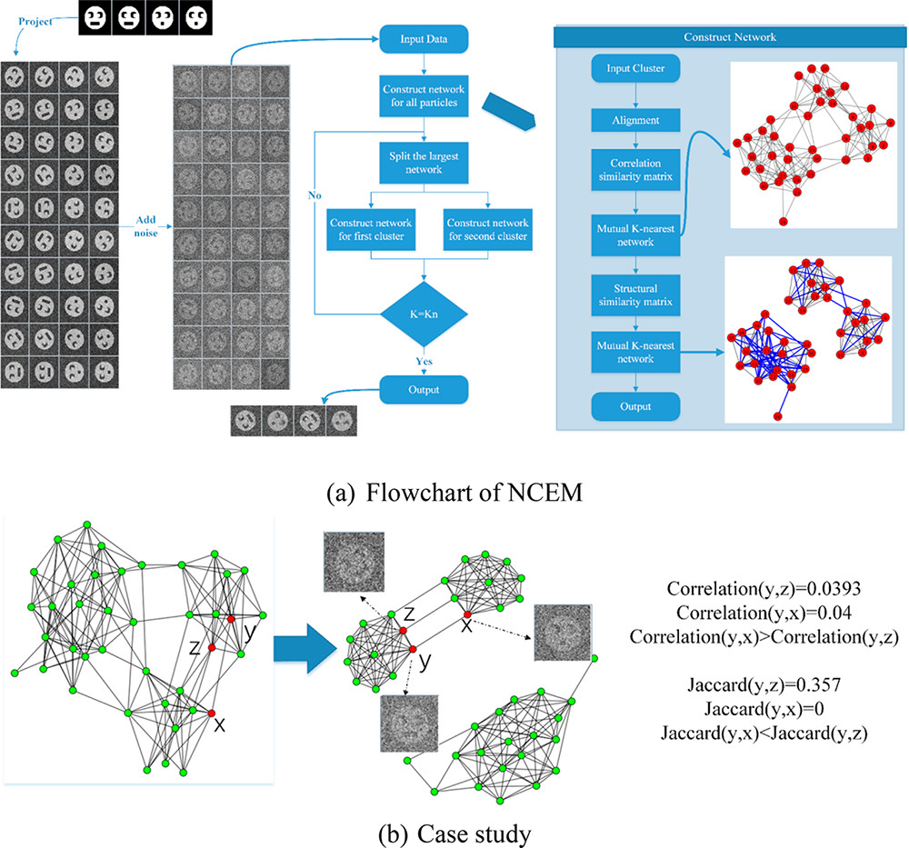
[3] Yin, Shuo, et al. 2019
Structure similarity
Jaccard index
Sorensen index
Hiearchical alignment
with spectral clustering

Slide 10
[3] Yin, Shuo, et al. 2019

Slide 11
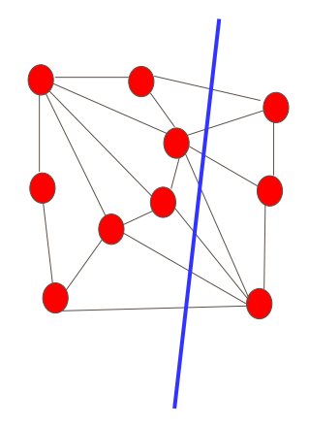
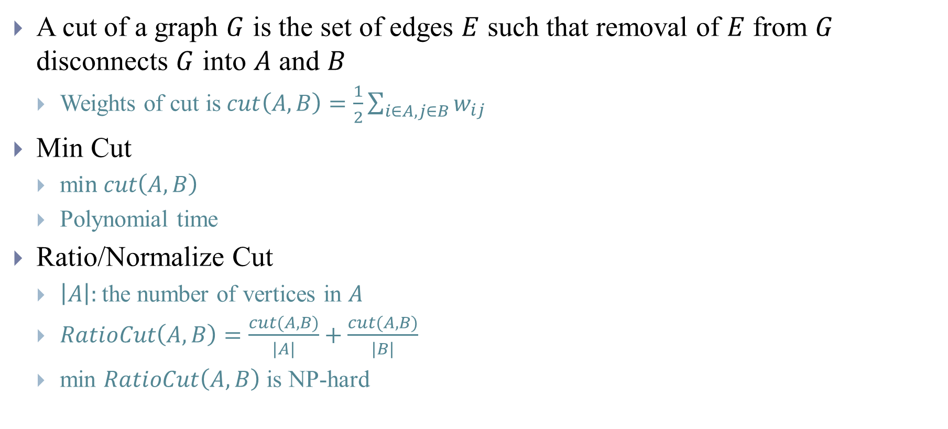


Min-Cut Problem
A cut of a graph $G$ is the set of edges $E$ such that removal of $E$ from $G$ disconnects $G$ into $A$ and $B$
Weights of cut is$cut\left(A,B\right)=\frac{1}{2}\sum_{i∈A,j∈B}{w_{ij}}$
Min Cut
m$in cut\left(A,B\right)$
Polynomial time
Ratio/Normalize Cut
$\left|A\right|:$the number of vertices in $A$
$RatioCut\left(A,B\right)=\frac{cut(A,B)}{|A|}+\frac{cut(A,B)}{|B|}$
min $RatioCut\left(A,B\right)$ is NP-hard
$$A$$
$$B$$

Slide 12
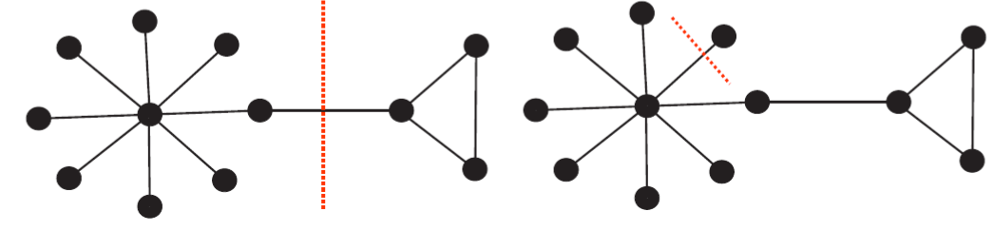

Min-Cut Problem
$cut\left(A_{1},B_{1}\right)=1$ $cut\left(A_{2},B_{2}\right)=1$
$RatioCut\left(A_{1},B_{1}\right)=\frac{1}{8}+\frac{1}{3}=\frac{11}{24}=0.46$ $RatioCut\left(A_{2},B_{2}\right)=\frac{1}{10}+\frac{1}{1}=1.1$

Slide 13
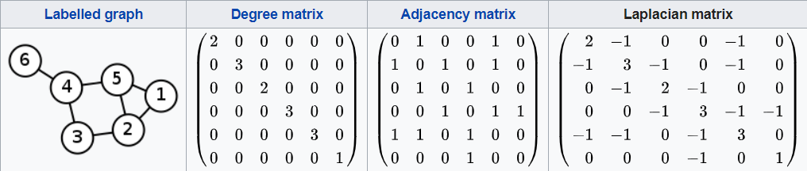

Spectral Clustering[6-7]
Unnormalized graph Laplacian
D is the degree matrix with degrees
$d_{1},…d_{n}$ on the diagonal
$L=D−W$
Notes:
Number of connected component and spectrum of L

Slide 14
Spectral Clustering
Approximate Ratio-Cut
b.
a.
Notes:
Quadratic form

Slide 15
Spectral Clustering

Slide 16
Others
A max-cut approach to heterogeneity in Cryo-EM[4]
Iteratively estimate rotations and partitions
Common line similarity
Max-cut
Goemans-Williamson
Frieze-Jerrun
Separating distinct structures of multiple macromolecular assemblies from Cryo-EM projections[5]
Common line similarity
Evaluate different measures for 1D vector
Community detection
Walktrap
Betweeness
Notes:
No alignment in [2]

Slide 17
References
[1] Herman, Gabor T., and Miroslaw Kalinowski. "Classification of heterogeneous electron microscopic projections into homogeneous subsets." Ultramicroscopy 108.4 (2008): 327-338.
[2] Shatsky, Maxim, et al. "Automated multi-model reconstruction from single-particle electron microscopy data." Journal of structural biology 170.1 (2010): 98-108. (source code)
[3] Yin, Shuo, et al. "Clustering Enhancement of Noisy Cryo-Electron Microscopy Single-Particle Images with a Network Structural Similarity Metric." Journal of chemical information and modeling (2019). (source code)
[4] Aizenbud, Yariv, and Yoel Shkolnisky. "A max-cut approach to heterogeneity in cryo-electron microscopy." Journal of Mathematical Analysis and Applications (2019).
[5] Verbeke, Eric J., et al. "Separating distinct structures of multiple macromolecular assemblies from cryo-EM projections." BioRxiv (2019): 611566. (source code)
[6] Von Luxburg, Ulrike. "A tutorial on spectral clustering." Statistics and computing 17.4 (2007): 395-416.
[7] Shi, Jianbo, and Jitendra Malik. "Normalized cuts and image segmentation." Departmental Papers (CIS) (2000): 107.

Slide 18
Packages
Igraph
R, Python, C++, Mathematica
Networkx
Graph-tool

