Slide 1

On asymptotic normality of CDM-PCA in HDLSS
Shao-Hsuan Wang
Feb 6, 2020
Institute of Statistical Science, Academia Sinica
Notes:
Good afternoon, I’m Shao-Hsuan Wang,
today I’m going to talk about : On asymptotic normality of CDM-PCA in HDLSS.

Slide 2
This is a joint work with
Su-Yun Huang
Institute of Statistical Science, Academia Sinica
Ting-Li Chen
Institute of Statistical Science, Academia Sinica
Notes:
This is a joint work with Dr. Su-Yun Huang and Dr. Ting-Li, Chen

Slide 3

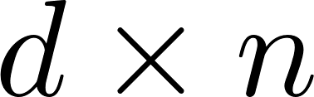

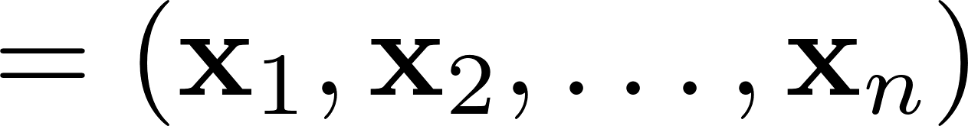
Notes:
Starting with a data matrix X of size [d by n]. it includes x_1, x_2 to x_n with d components.
x_i’s are iid random variables with mean zero and covariance matrix Sigma.
A data matrix is a very common data structure in many studies.

Slide 4

Notes:
An question is how to estimate Sigma

Slide 5
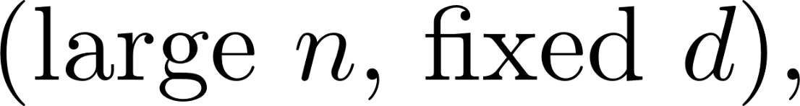



Notes:
In a classical case, that is , fixed d and large n,
We define the sample covariance matrix S, and then we have S is a consistent estimator of Sigma. More precisely, S is unbiased. We are happy.

Slide 6

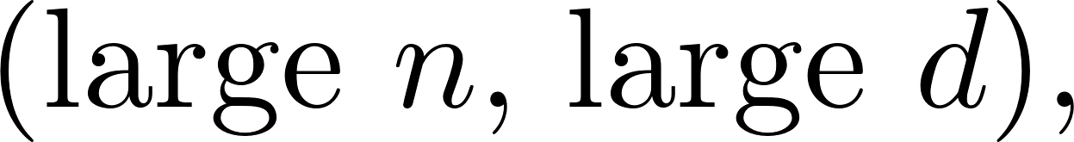
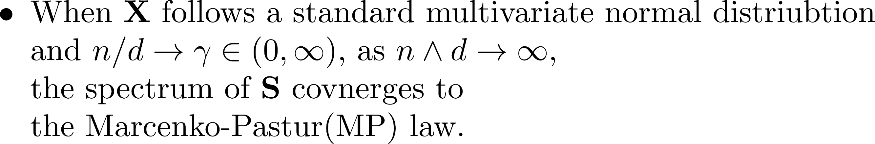
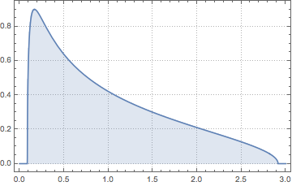



population eigenvalues
Notes:
However, in a big data, that is large d, large n. When x follows standard multivariate normal distribution in a random matrix setting, the spectrum of S converges to the MP law. All population eigenvalues are one but the estimators are not. It means that S is no longer a consistent. That is too bad.

Slide 7
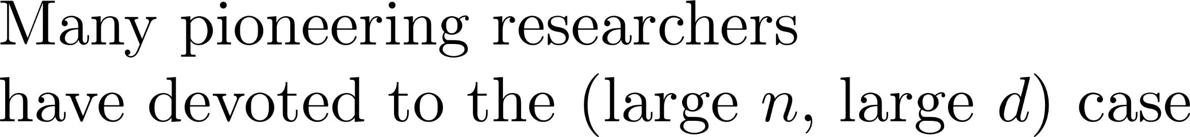



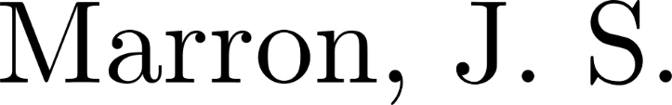


2001
Now
2020
Notes:
Many pioneering researchers have devoted to the case: large d and large n

Slide 8









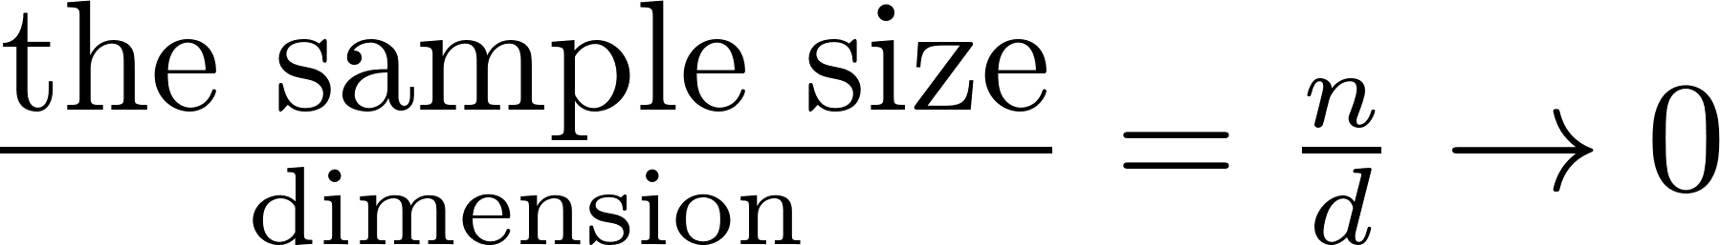
Notes:
HDLSS is a branch of this case. HDLSS means high dimension low sample size.
That is, the ratio of the sample size to dimension is low when n and d are large

Slide 9

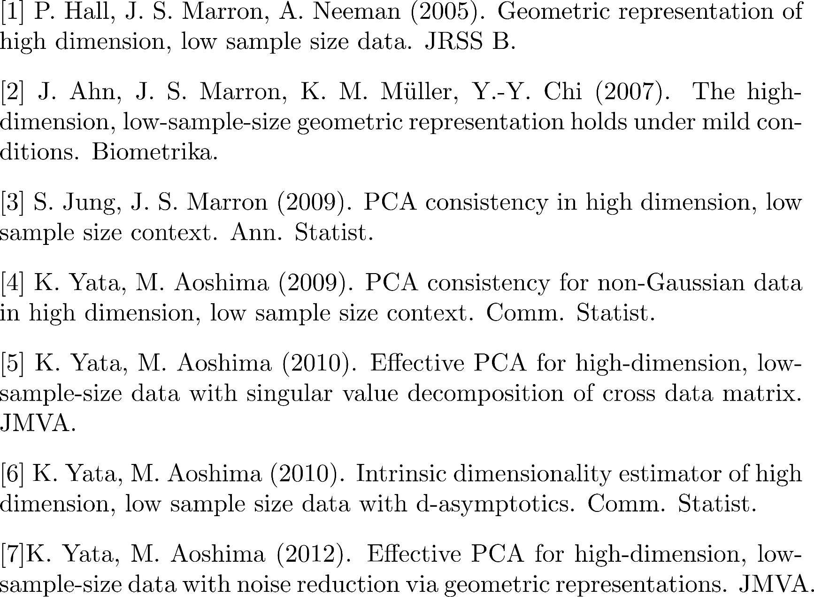
Notes:
For the HDLSS literature, Substantial works have been done.

Slide 10
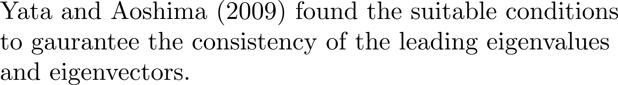
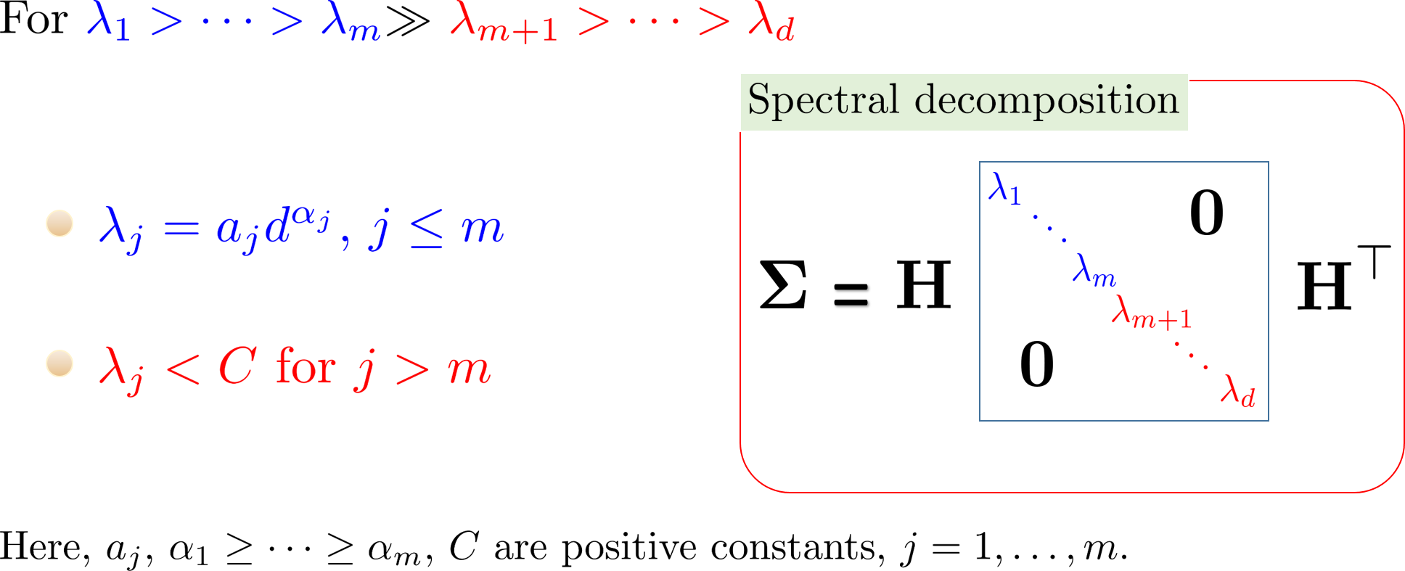
Spiked Covariance model
Notes:
Yata and Aoshima in 2009 found that … (repeat the slide)
We divide the population eigenvalues into two parts: leading and tail. For a leading part, the eigenvalue is a power function of d; for a tail part,
The eigenvalue is bounded.

Slide 11

Notes:
Yata and ashoma in 2010… (repeat slide) abbreviated as CDM-PCA

Slide 12


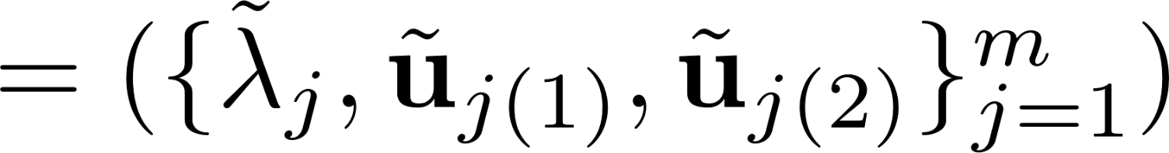
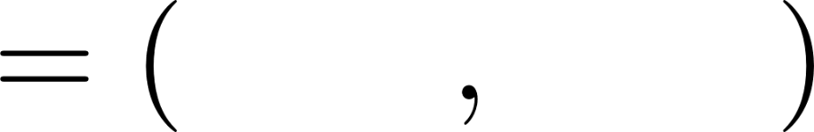
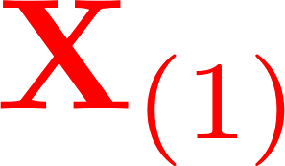
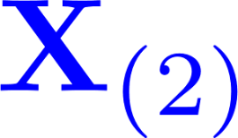
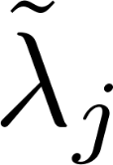
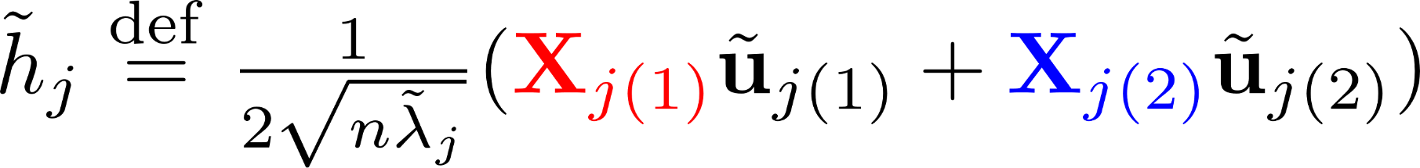
CDM-PCA eigenvalues
CDM-PCA eigenvectors
Notes:
CDM-PCA method means that
Assume the sample size is 2n
Divide the data matrix into two parts x_1 to x_n and x_{n+1} to x_{2n}, called
X1 and X2.
We calculate the cross product of X1 and X2
By the singular value decomposition, we have tilde lambda , tilde u1 tilde u2.
So we can have CDM-PCA eigenvalues and eigenvectors.

Slide 13

Notes:
Yata and Aoshima (repeat slide)

Slide 14
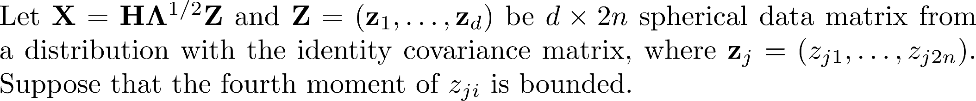


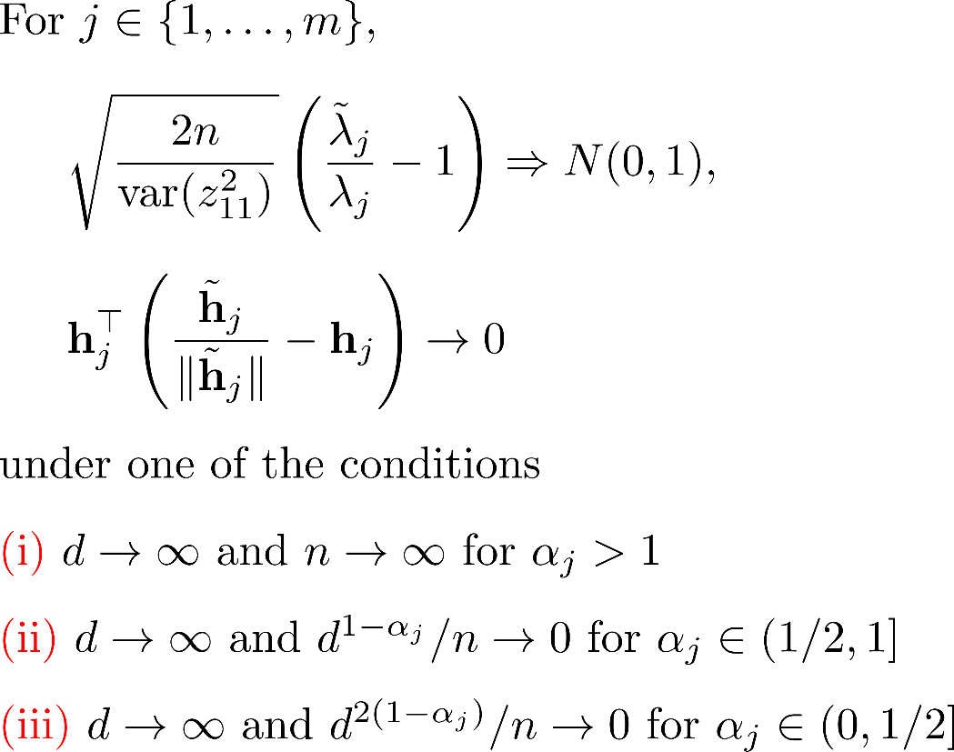
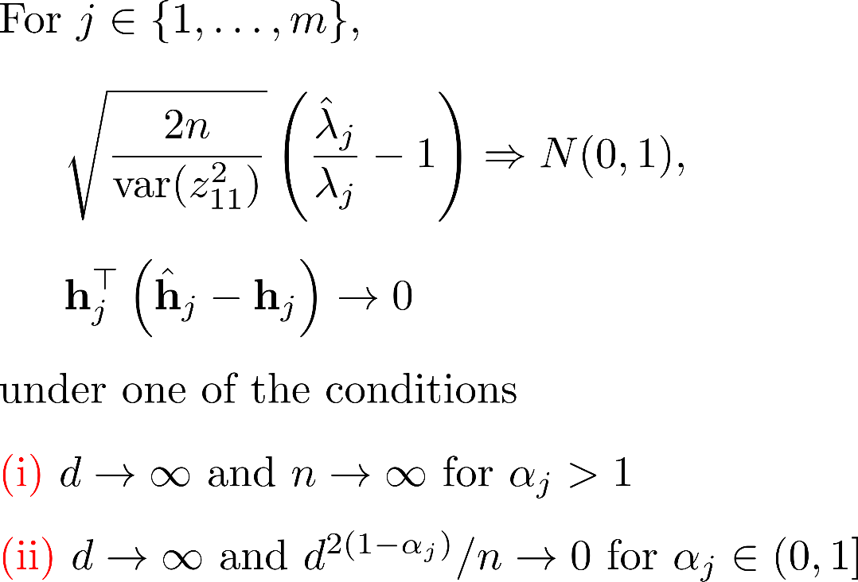
Notes:
CDM-PCA has broader consistency region to achieve the same
Asymptotic result as PCA.

Slide 15
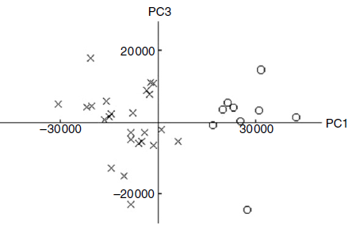
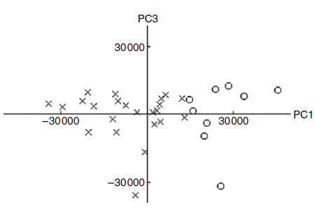
Notes:
CDM-PCA can be visualized effectively, In real data, the two clusters of CDM-PCA look like more separable than PCA

Slide 16
Our Contribution
Our Contribution
Notes:
Our contribution.

Slide 17

Our Contribution
1
Notes:
To Obtain the asymptotic normality for directions

Slide 18
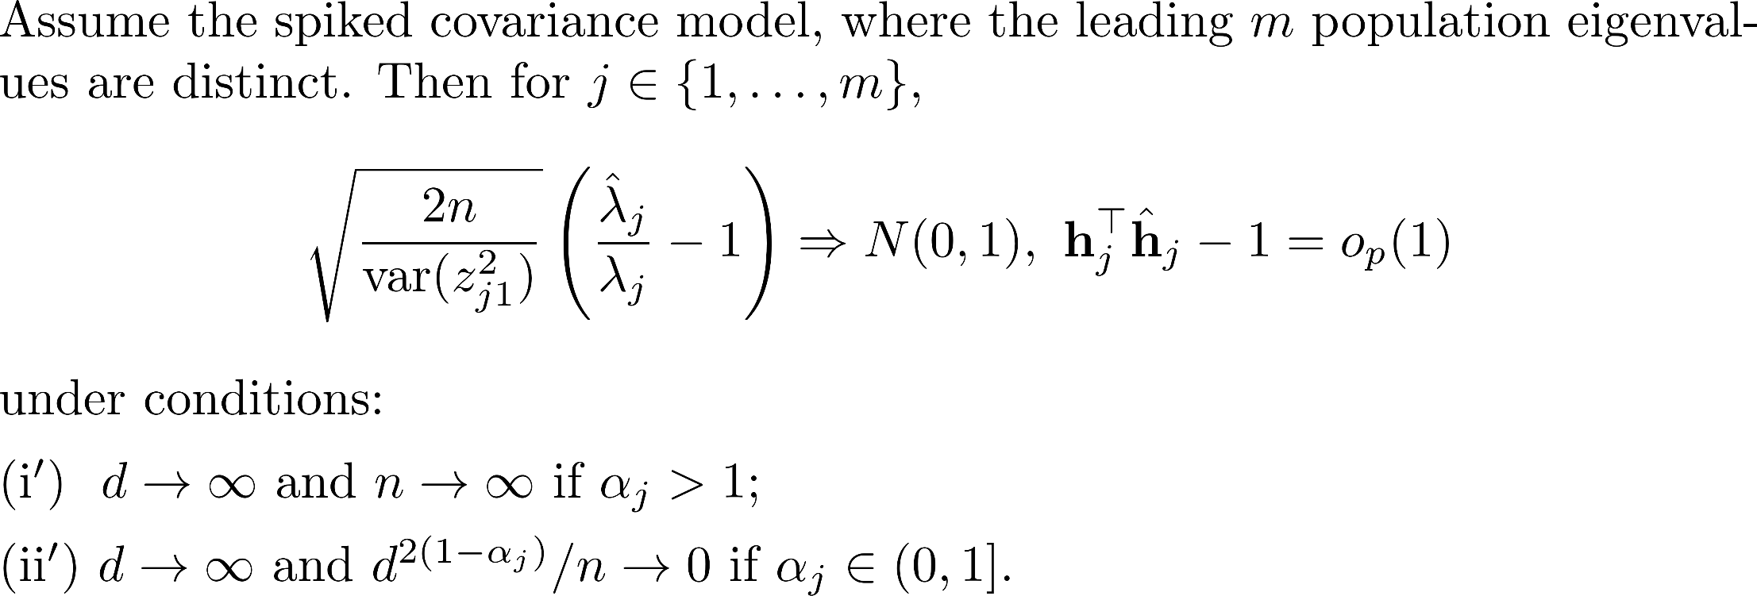
Theorem (PCA). (Yata and Aoshima, 2009, Comm. Statist.)
The asymptotic normality for PCA directions is lacking
Notes:
This is Yata and Aoshima’s theorem. The asymptotic normality for the PCA directions is lacking.

Slide 19
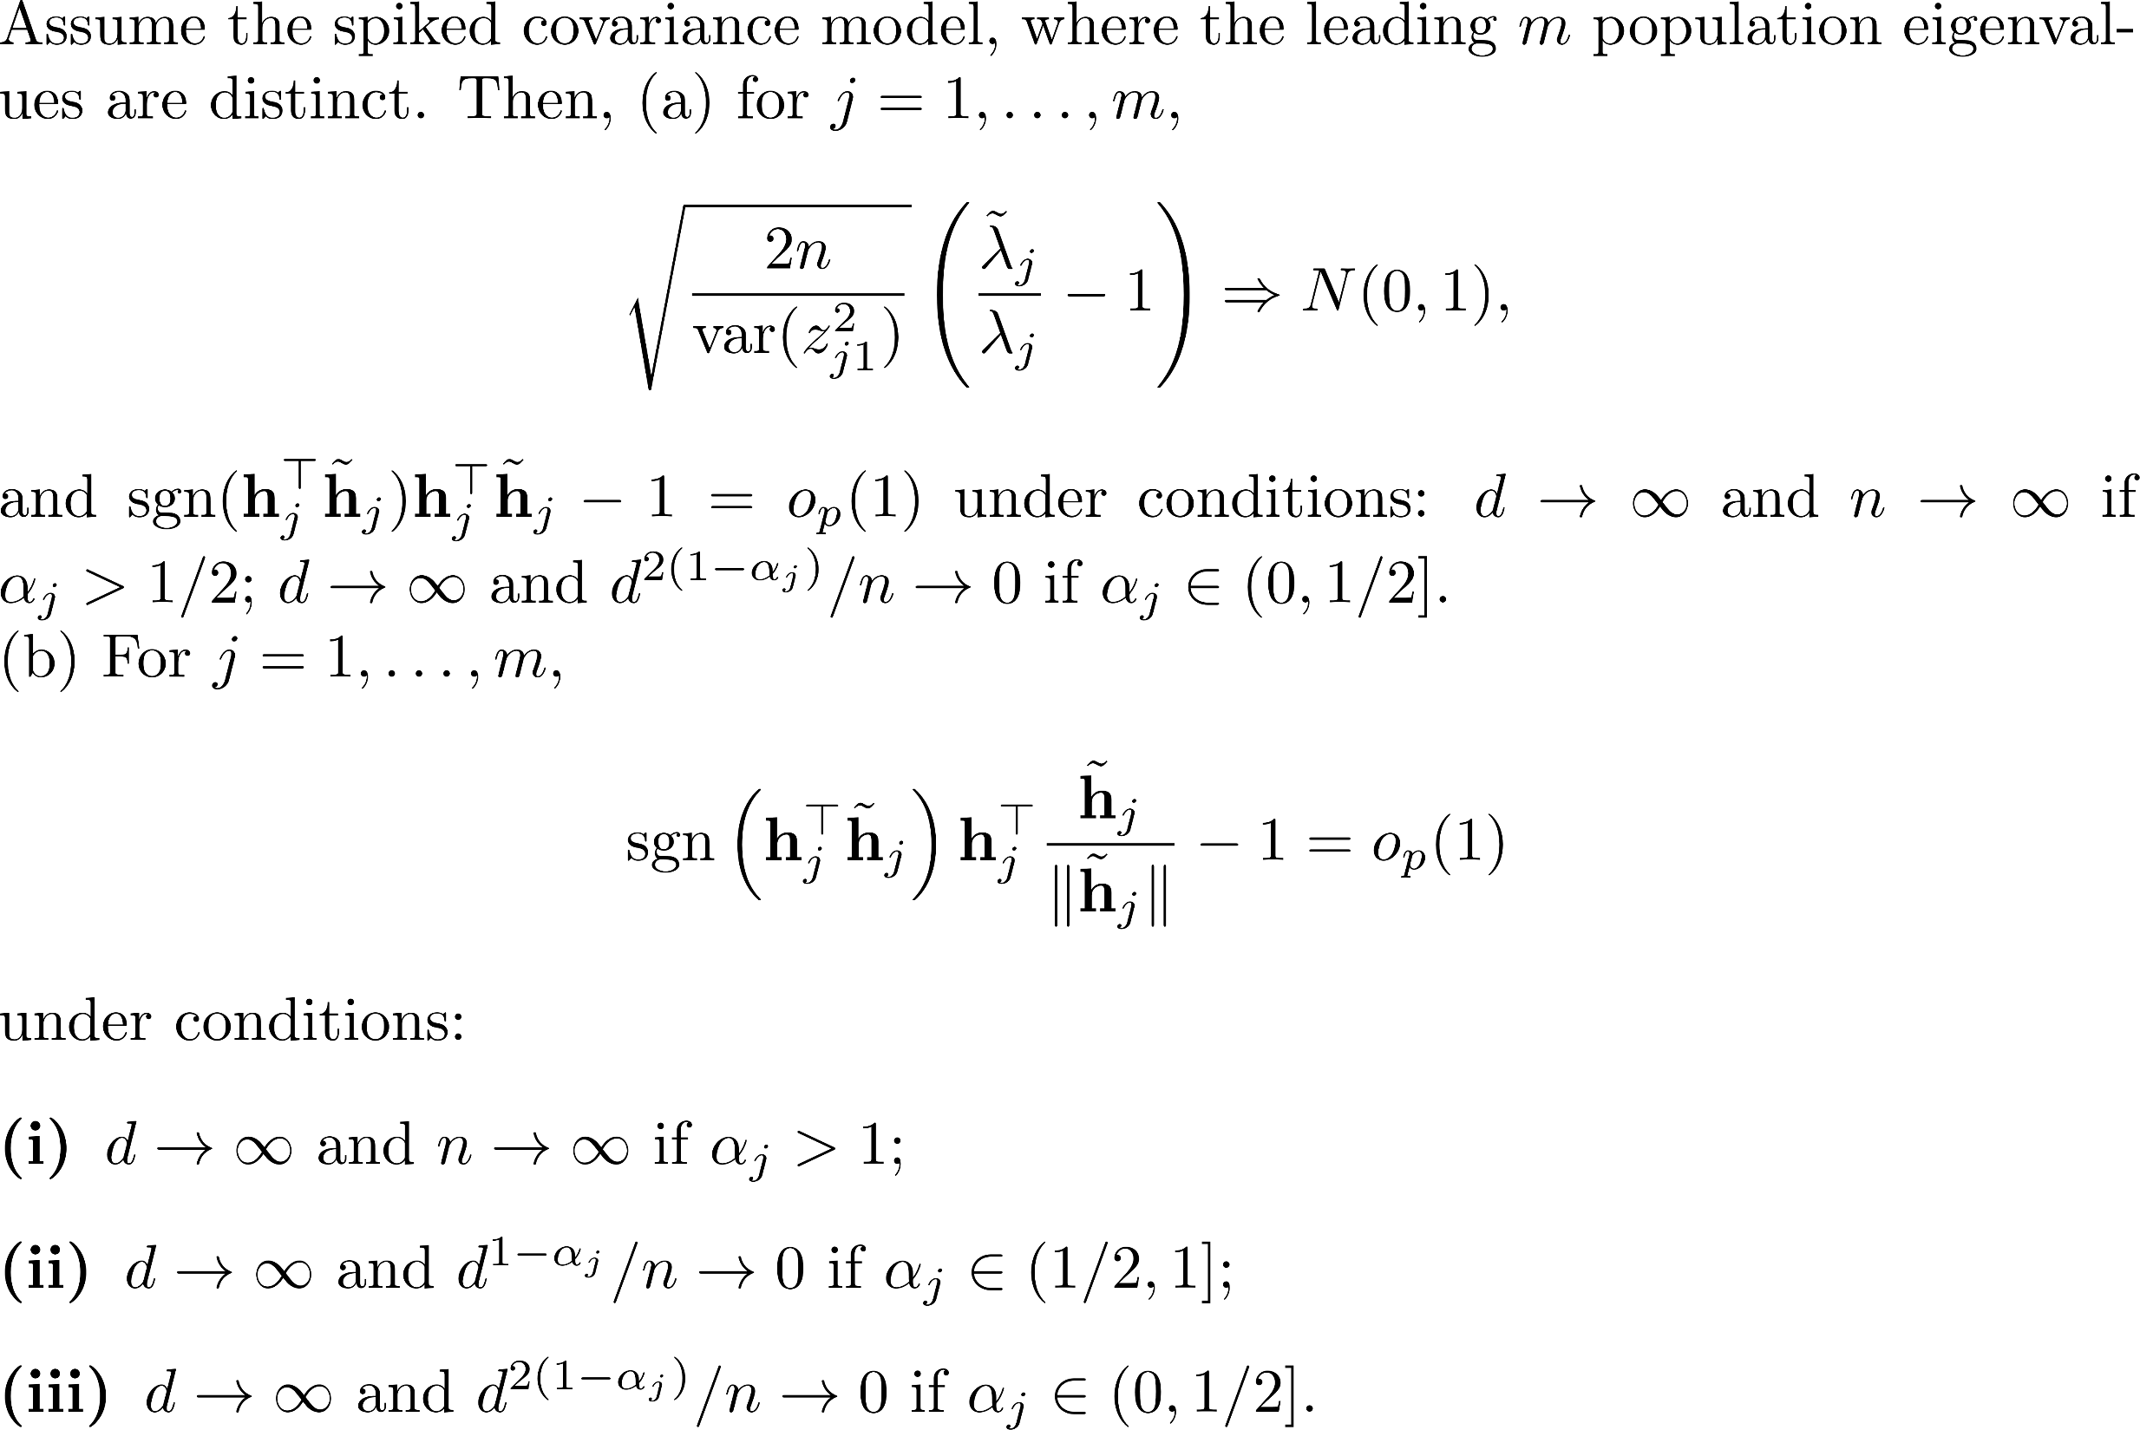
Theorem (CDM-PCA). (Yata and Aoshima, 2010, JMVA)
The asymptotic normality for CDM-PCA directions is also lacking
Notes:
Similar to PCA, the asymptotic normality for the CDM-PCA directions is also lacking.

Slide 20
So we have completed them.
Notes:
So we provide some theorems to complete them.

Slide 21
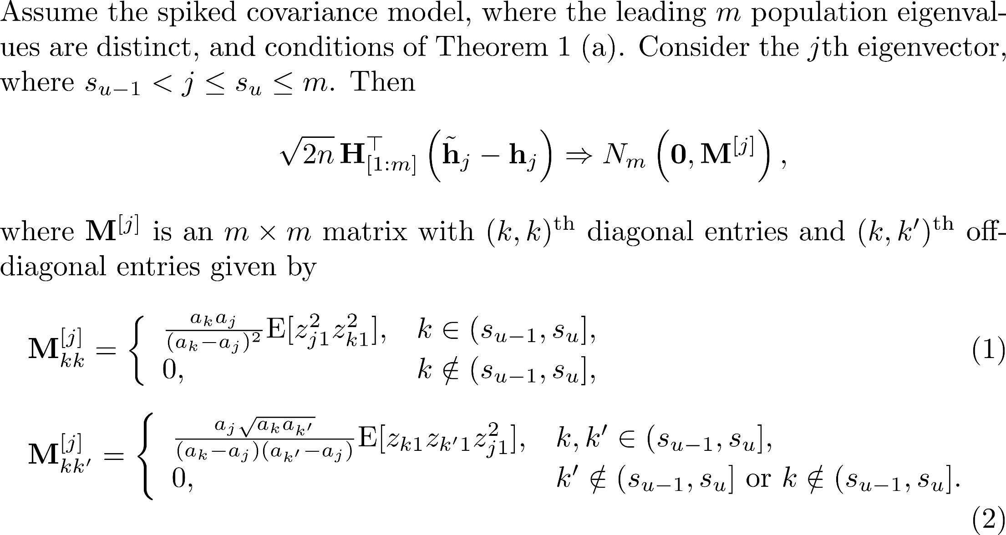
Theorem (CDM-PCA). (W., Huang and Chen, 2020 JMVA)
Notes:
I just show you our theoretical result.

Slide 22
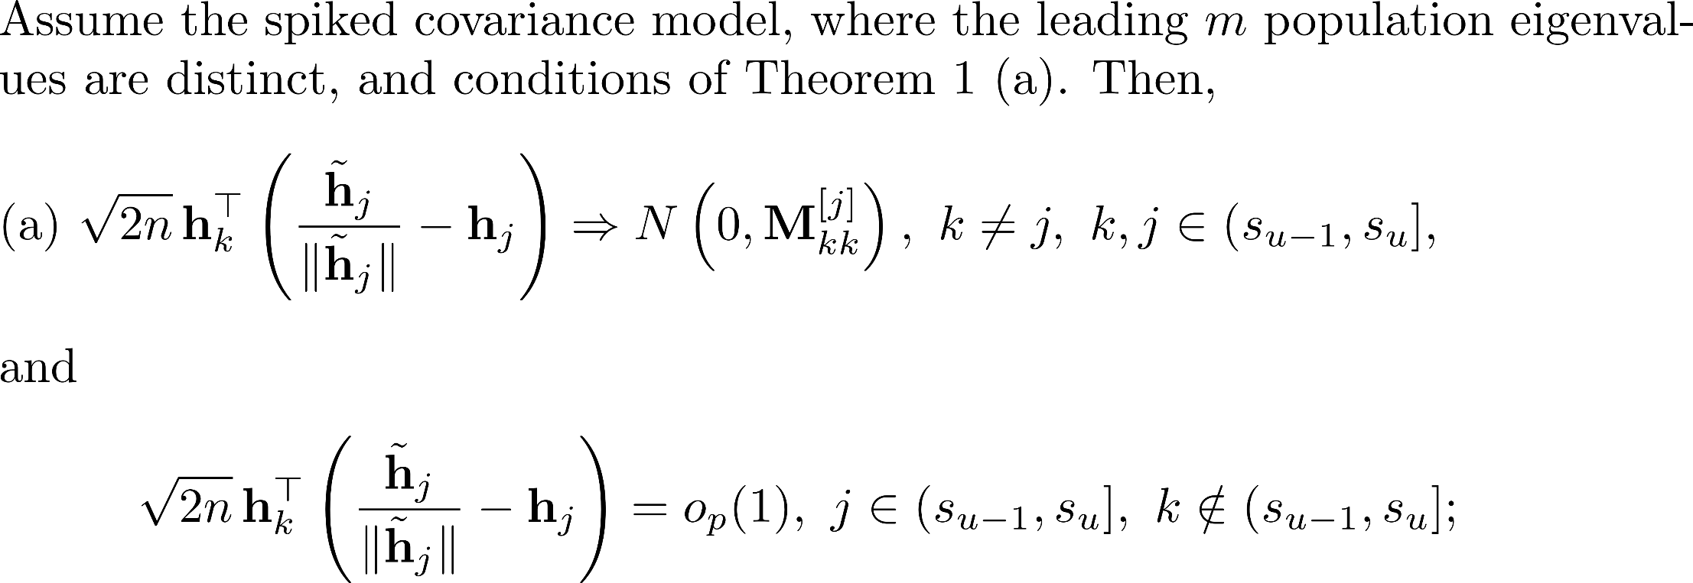
Theorem (W., Huang and Chen, 2020 JMVA)

Slide 23
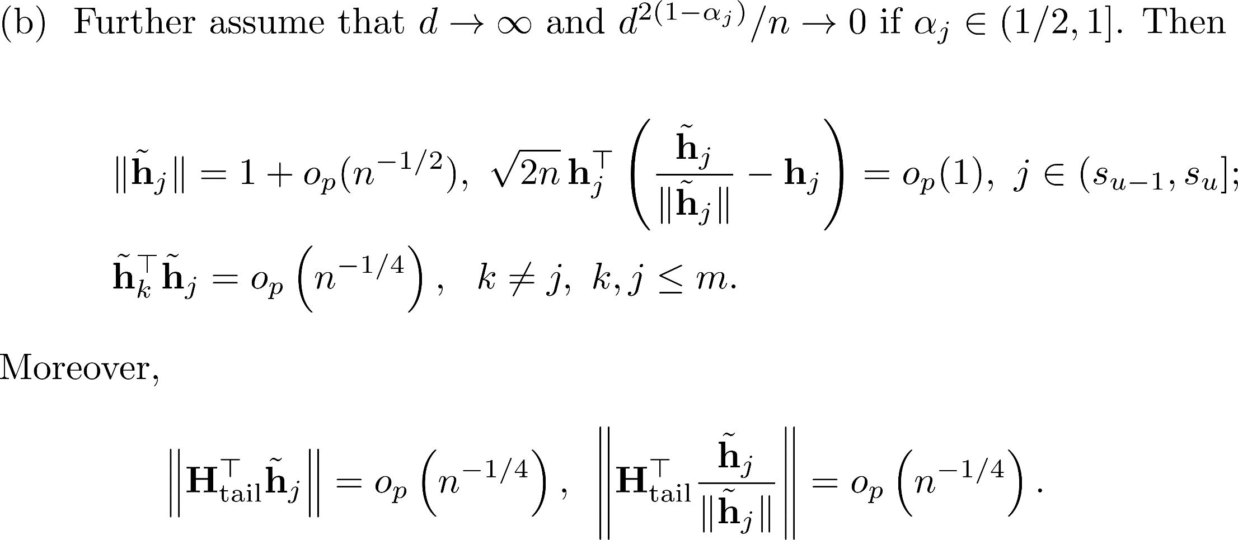

Slide 24
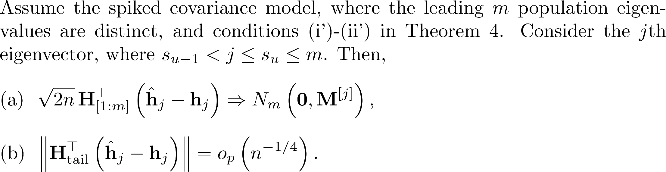
Theorem (PCA). (W., Huang and Chen, 2020 JMVA)

Slide 25

Our Contribution
2
Notes:
Second, we give a (repeat slide)

Slide 26
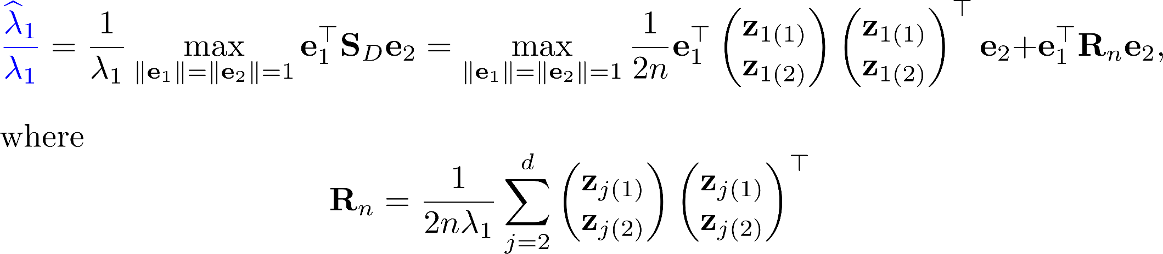
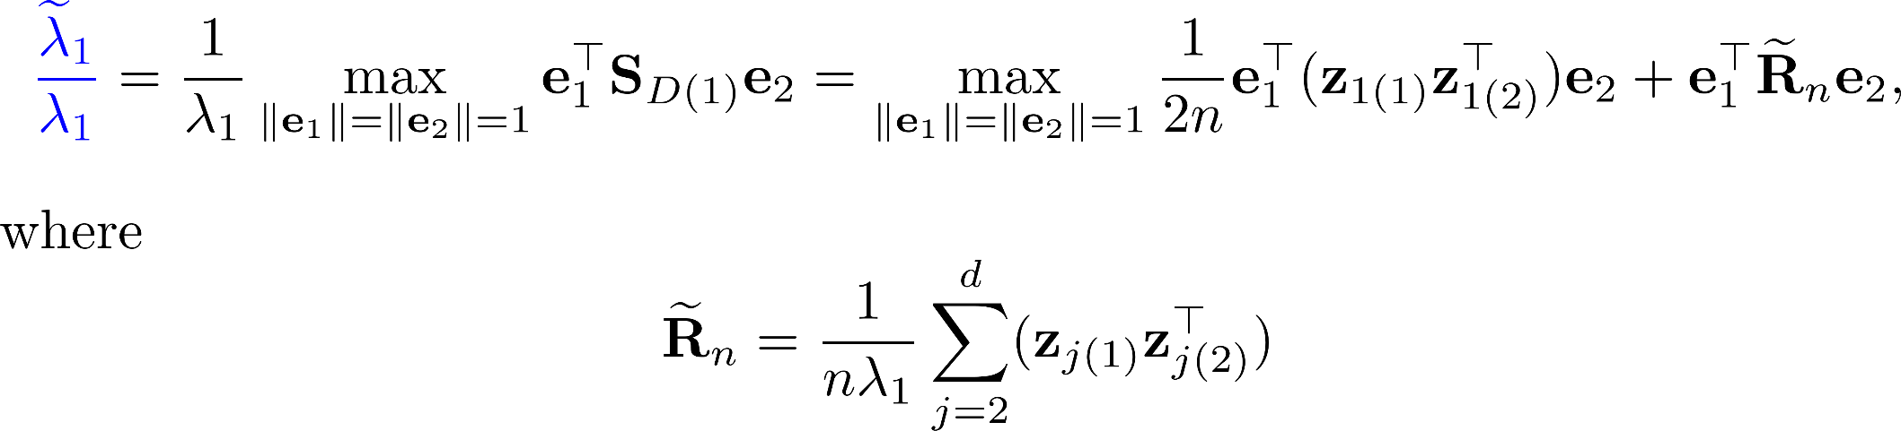
Broader consistency region for CDM-PCA
Notes:
We consider a simple spiked model

Slide 27

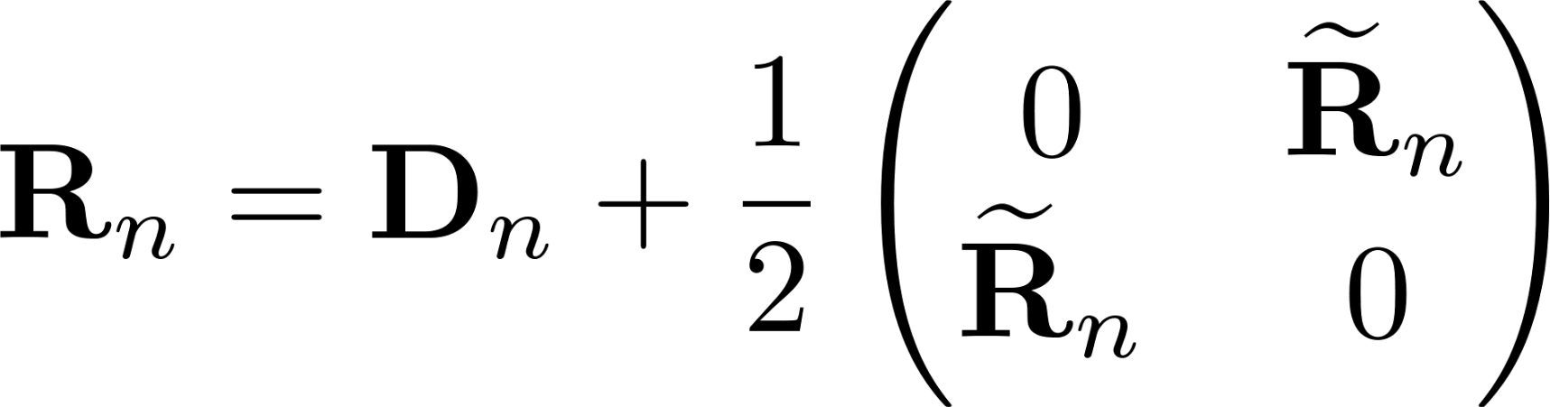
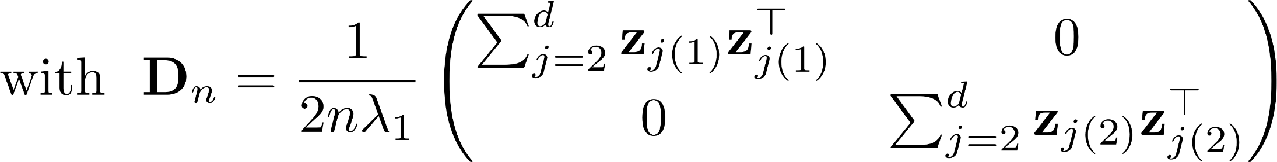
Broader consistency region for CDM-PCA
Notes:
CDM-PCA has a small-order residual. That’s is why it is better than PCA.

Slide 28
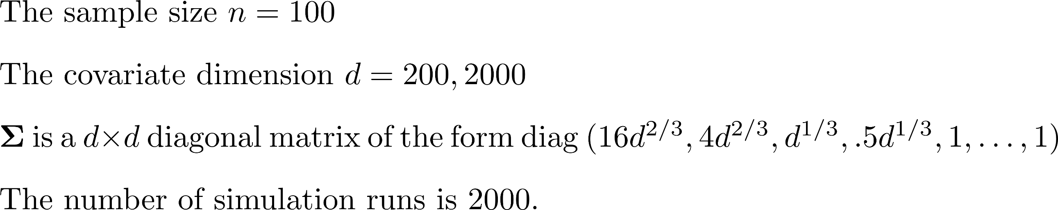
Numerical study
Notes:
This is our numerical study , sample size 100 covariate dimension d equals 200 and 2000, and four leading terms

Slide 29
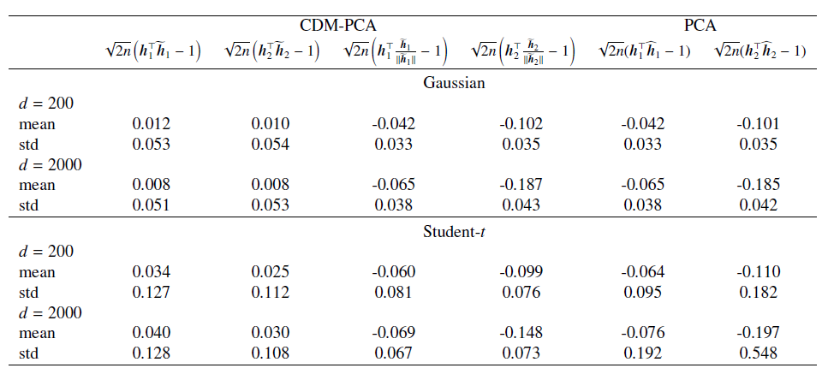
Table 1: (Degenerate asymptotic normality)
Win
Notes:
We consider Gassian and student-t , the results fit our theorems.
CDM-PCA is better, especially in student-t. In CDM-PCA, the mean is smaller than PCA.

Slide 30
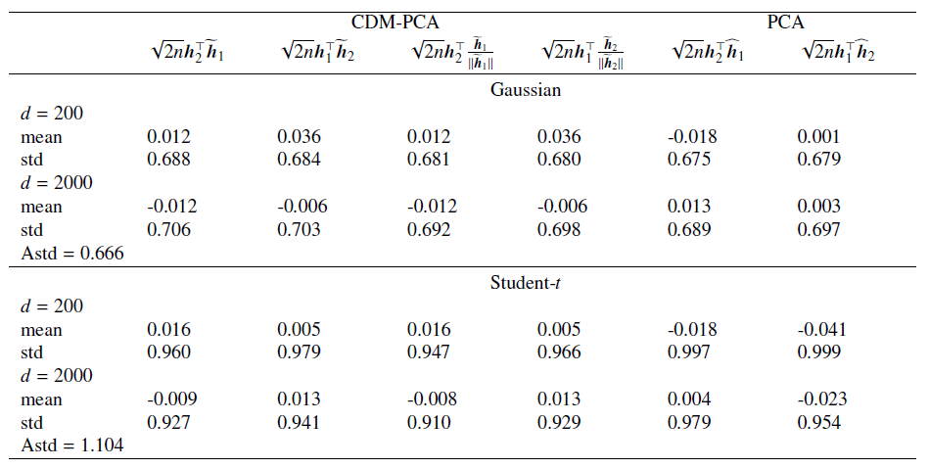
Table 2: (Asymptotic normality)
Win

Slide 31
Thanks for your attention
Notes:
My talk is in the end. Thanks for your attention.

