Slide 1
Hu’s seven moments
Shao-Hsuan Wang, 12/9,2019

Slide 2
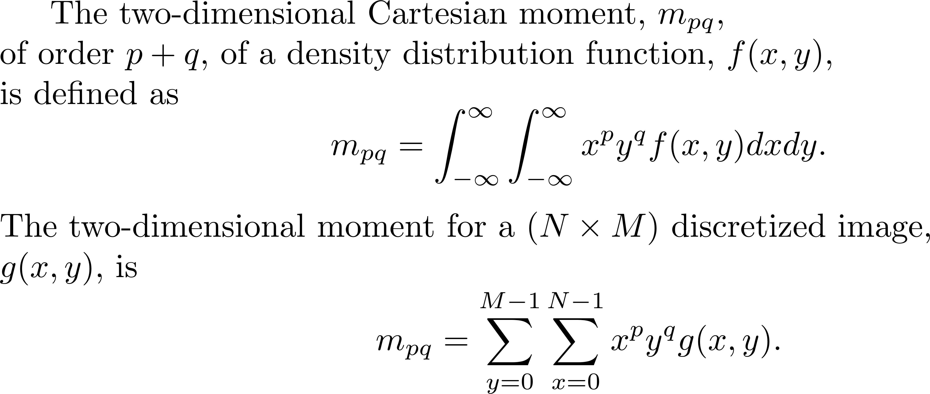
Cartesian Moment Definition

Slide 3
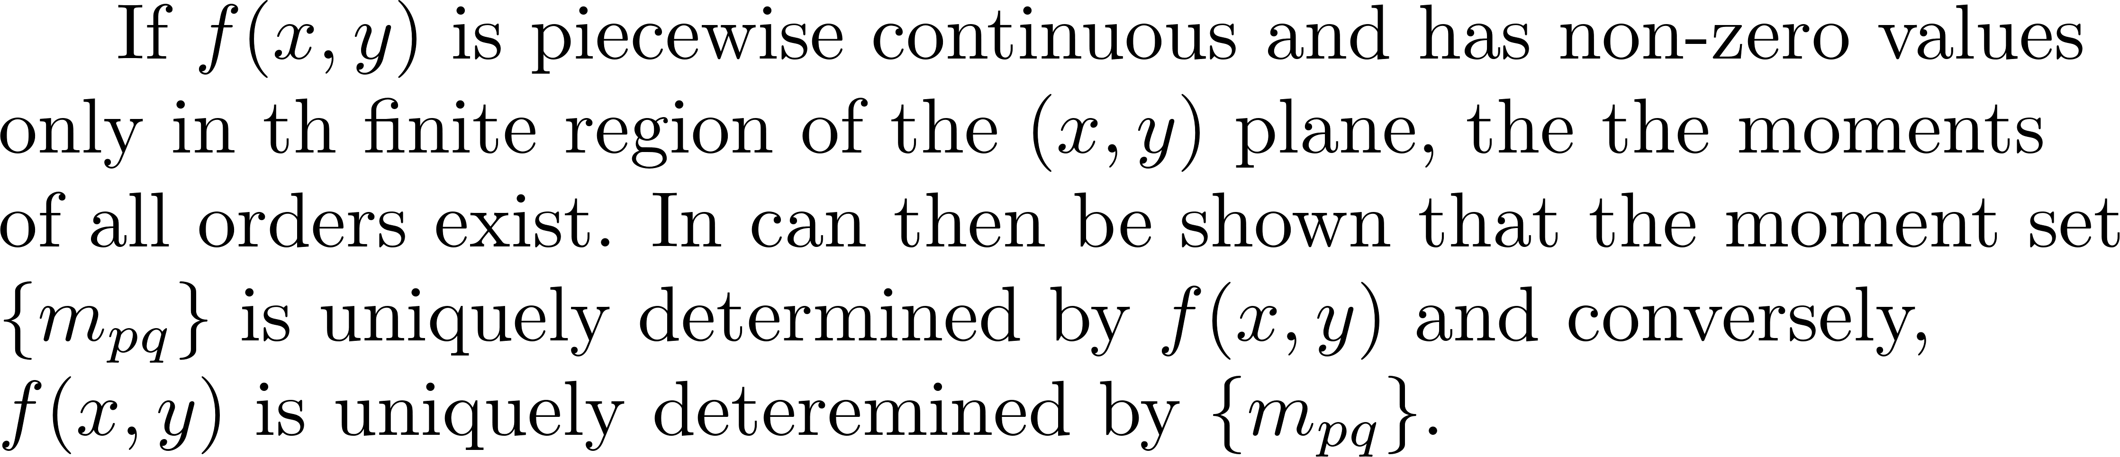
Cartesian Moment Definition
Hu’s Uniqueness Theorem

Slide 4
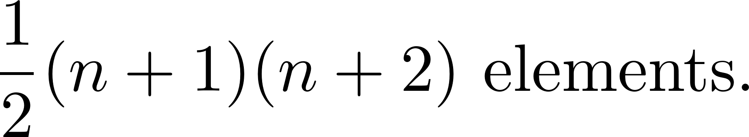
Cartesian Moment Definition
Hu’s Uniqueness Theorem
The Goal is to select a meaningful subset of moment values that contain
sufficient information to uniquely characterize the image for a specific
application

Slide 5
Properties of Low-Order Moments

Slide 6
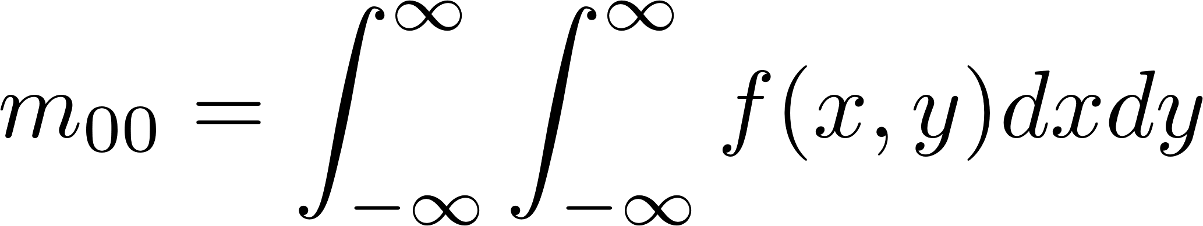
Zeroth Order Moments: Area

Slide 7
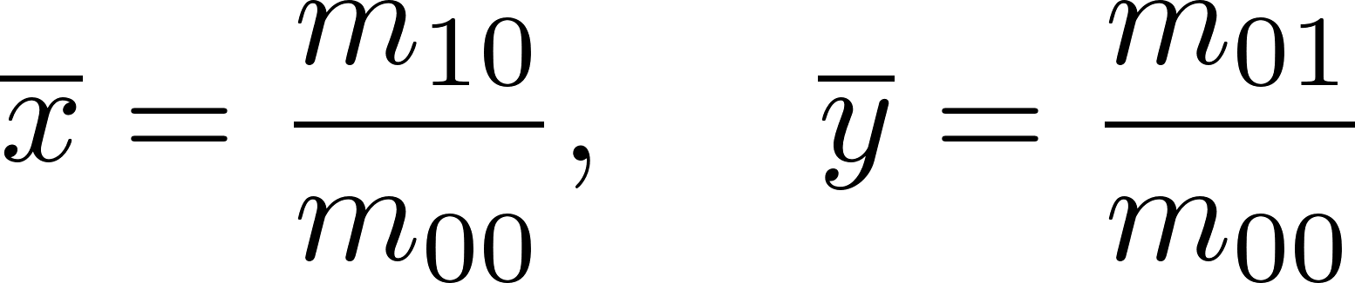
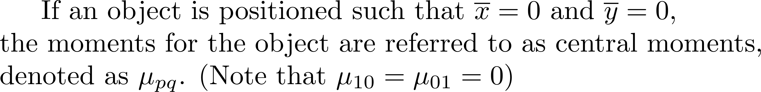
First Order Moments: Center of Mass (COM)

Slide 8
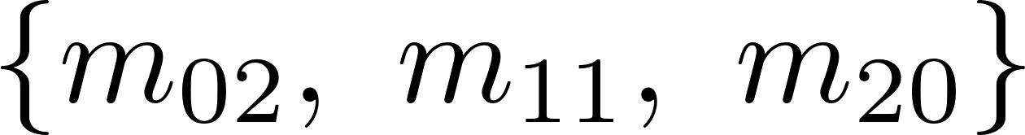
Second Order Moments: Moments of interia

Slide 9
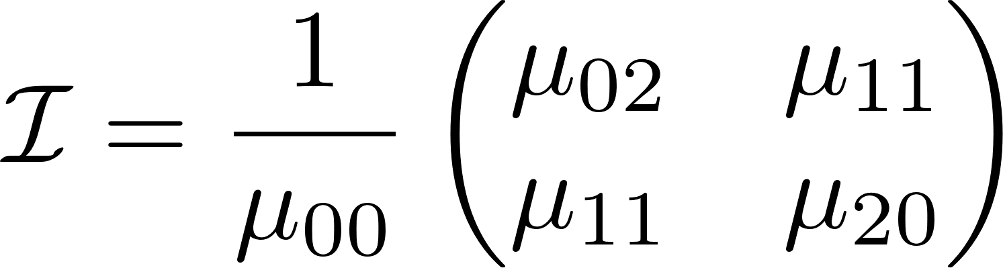
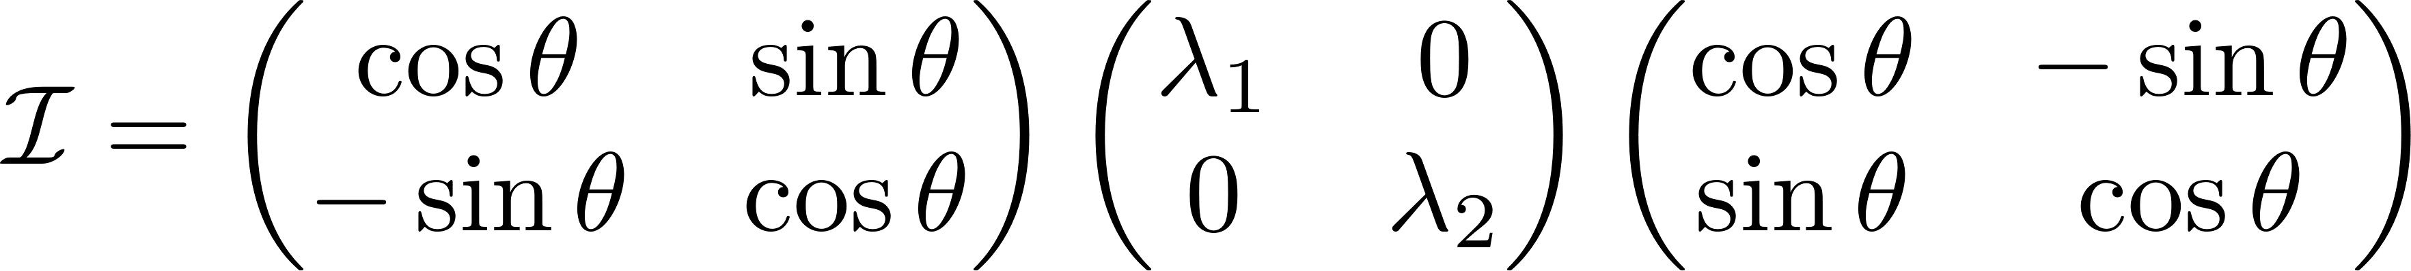
Second Order Moments: Moments of interia

Slide 10
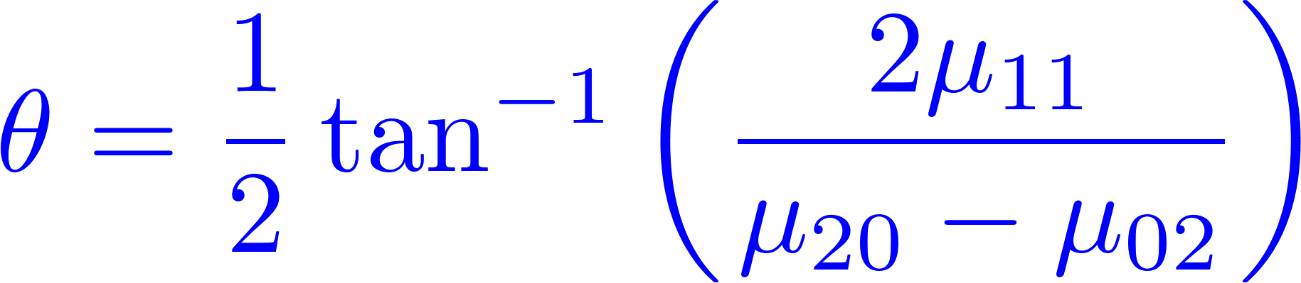
Second Order Moments: Moments of interia

Slide 11
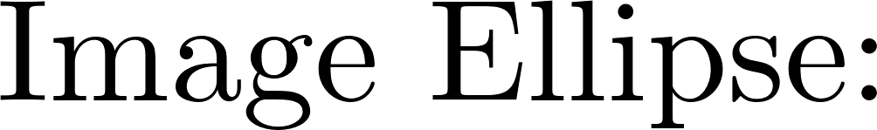
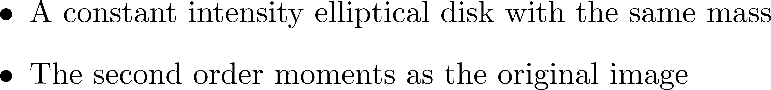


Second Order Moments: Moments of interia

Slide 12
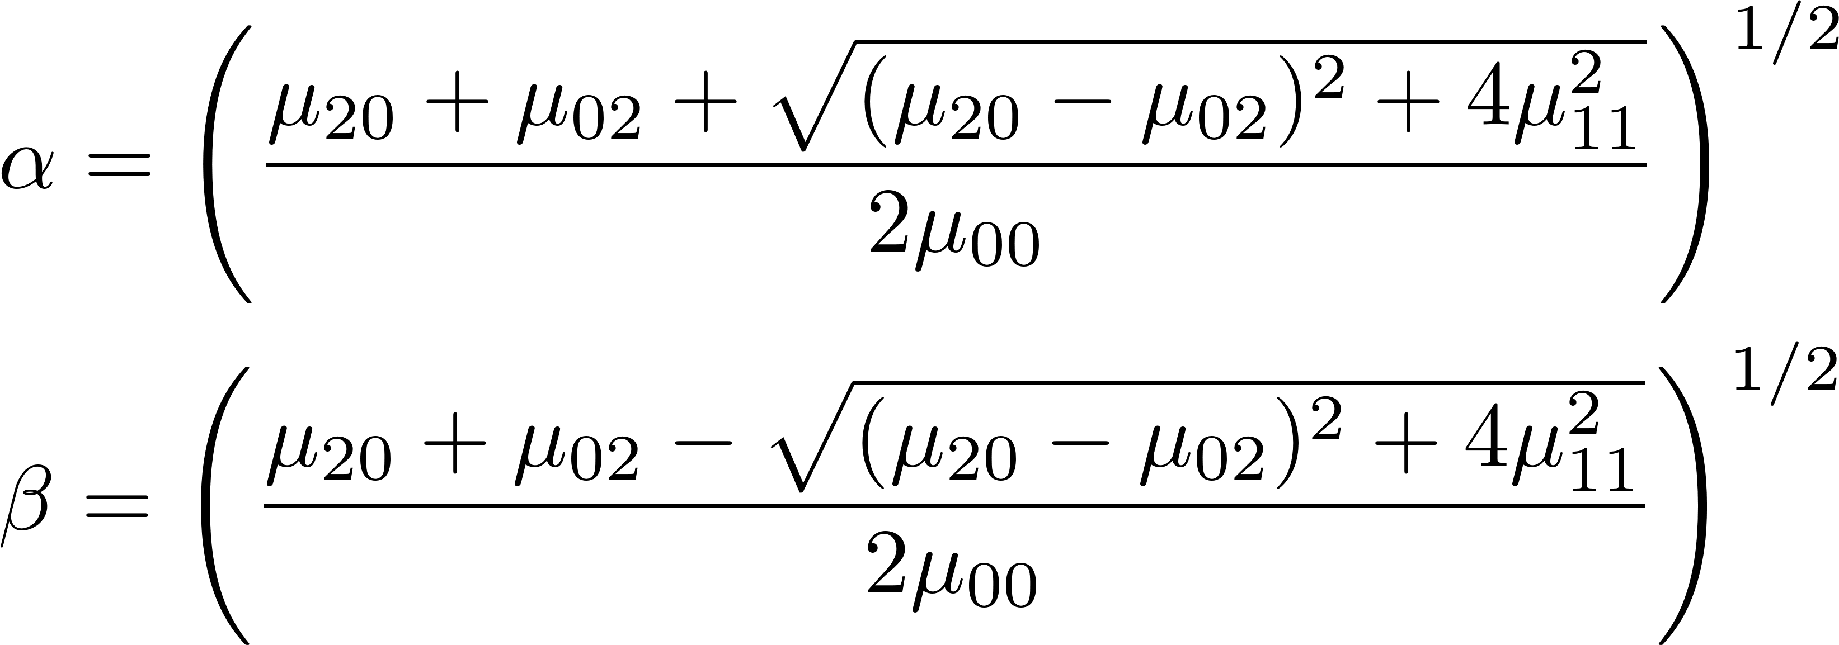
Second Order Moments: Moments of interia

Slide 13
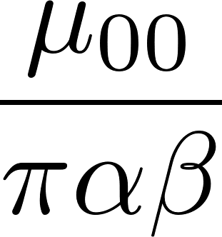
Second Order Moments: Moments of interia

Slide 14
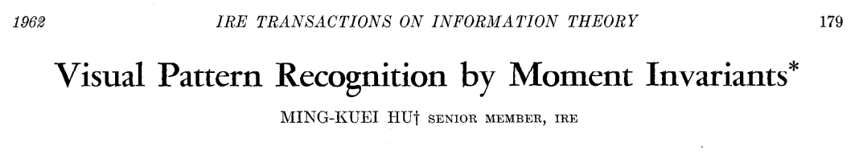
Higher Order Moments: Hu’s moments
Hu defines seven values, computed from central moments through order three, that are invariant to object scale , position, and orientation.

Slide 15
Hu’s seven moments

Slide 16
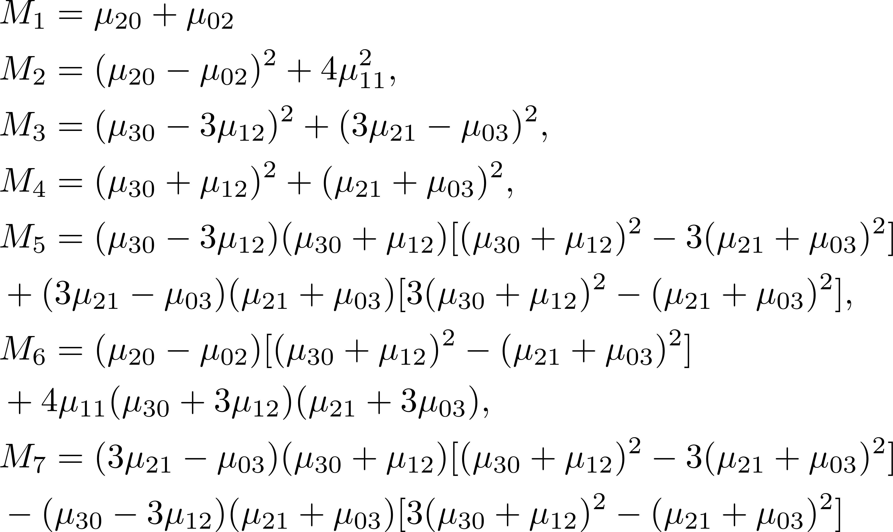
Higher Order Moments: Hu’s moments

Slide 17
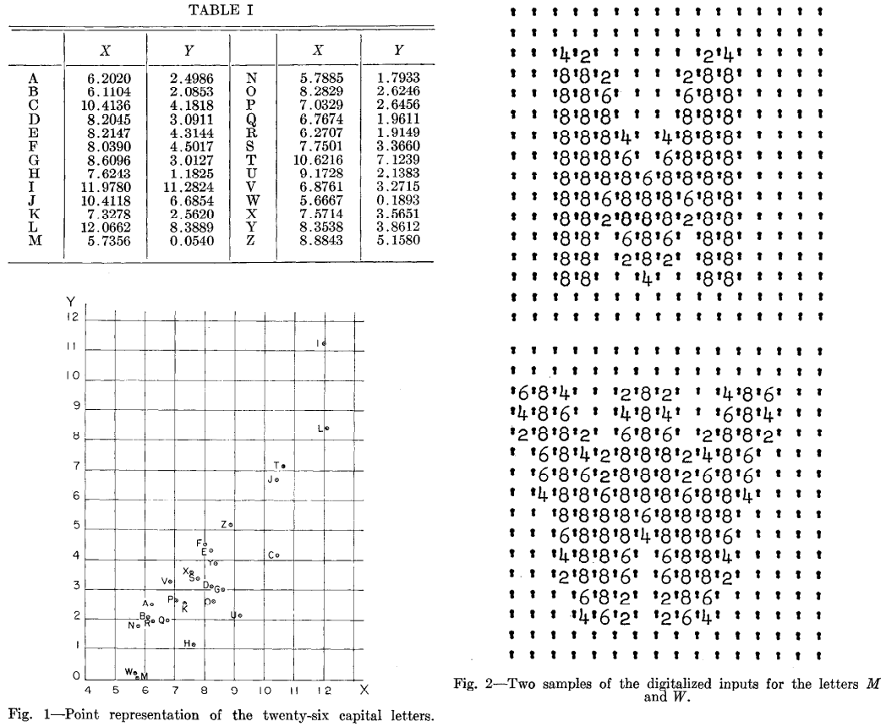
Hu’s moments (M1, M2)

Slide 18
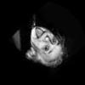
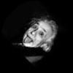
Einstein’s image

Slide 19
Opencv-Python
(base)
C:\Users\user>pip install opencv-python
import cv2
import numpy as np
# 以灰階的方式讀取圖檔
img_gray = cv2.imread('img1.jpg', cv2.IMREAD_GRAYSCALE)
# Hu Moments
# 計算標準的moments
cv2.moments(img_gray)
# 計算Hu moments
cv2.HuMoments(cv2.moments(img_gray)).flatten()

Slide 20
standard moments
#img1
'm00': 252915.0,
'm10': 13228847.0,
'm01': 13355416.0,
'm20': 738883999.0,
'm11': 705054990.0,
'm02': 746674784.0,
'm30': 43541603699.0,
'm21': 39585018190.0,
'm12': 39804858780.0,
'm03': 43575765682.0,
'mu20': 46942465.48317032,
'mu11': 6493200.919273359,
'mu02': 41429399.05622052,
'mu30': -16796399.36677473,
'mu21': -111711167.25930274,
'mu12': 63897290.20697878,
'mu03': -228540409.30264497,
'nu20': 0.0007338659212651761,
'nu11': 0.00010151019605672002,
'nu02': 0.0006476784675222504,
'nu30': -5.221312942157962e-07,
'nu21': -3.4726428602809067e-06,
'nu12': 1.986305166013597e-06,
'nu03': -7.104385712919099e-06
#img2
'm00': 251013.0,
'm10': 13260311.0,
'm01': 11982845.0,
'm20': 741980695.0,
'm11': 626551465.0,
'm02': 618704947.0,
'm30': 43347317429.0,
'm21': 34672725691.0,
'm12': 31951106007.0,
'm03': 34012898861.0,
'mu20': 41475749.77118317,
'mu11': -6468543.385203153,
'mu02': 46668541.339635834,
'mu30': -231530891.7813113,
'mu21': -64478625.77921536,
'mu12': -115746741.41218801,
'mu03': 21475009.91614424,
'nu20': 0.0006582665959608716,
'nu11': -0.00010266302739537974,
'nu02': 0.0007406820133591751,
'nu30': -7.3344644675360505e-06,
'nu21': -2.042561949529803e-06,
'nu12': -3.6666397109662114e-06,
'nu03': 6.802880425939687e-07

Slide 21
Hu’s moments
#img1
M1=1.38154439e-03,
M2=4.86455568e-08, M3=5.29835339e-11, M4=1.14017339e-10,
M5=-5.30988230e-22,
M6=-1.57455207e-14, M7=8.84597707e-21
#img2
M1=1.39894861e-03, M2= 4.89510898e-08, M3=5.97840664e-11,
M4=1.22880083e-10,
M5=-1.30564581e-21,
M6=-1.59755668e-14, M7=1.04508573e-20

Slide 22
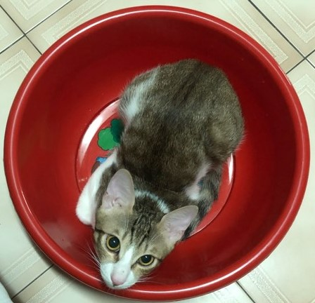
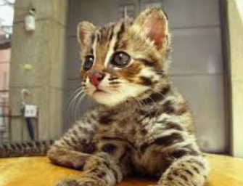
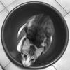
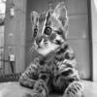
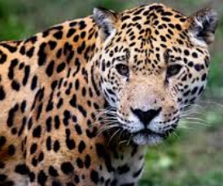

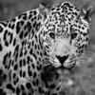

Example
C01
C02
C03
C04

Slide 23
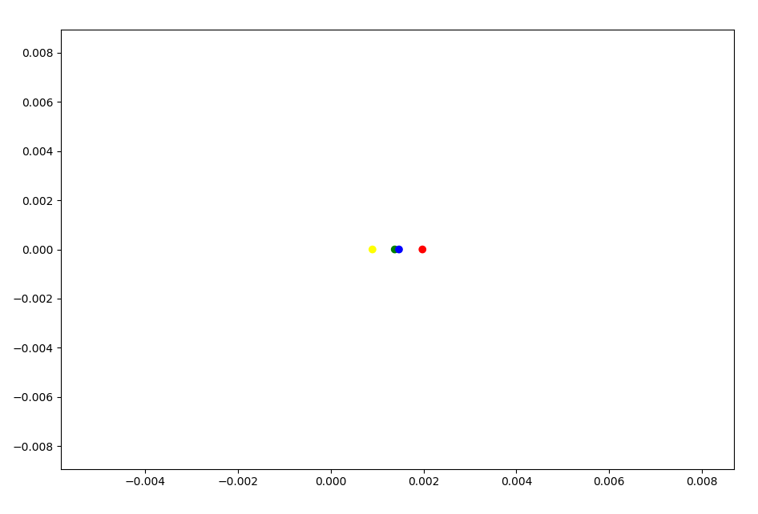
Hu’s moments (M1, M2)
C03
C02
C04
C01

Slide 24
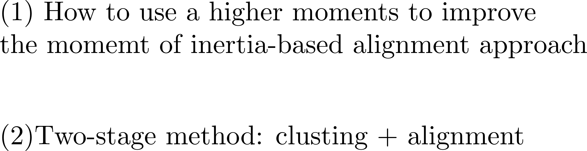
Questions

