Slide 1
Motion Correction
林思涵
2018/9/27

Slide 2
Whole Frames
Motioncorr
unblur
alignframes_lmbfgs
Optical flow

Slide 3

Notations
For a movie that consists of $T$ frames.
The translation for frame $t$：$−{\vec{𝕏}}_{t}=\left(−∆x_{t},−∆y_{t}\right)$
The movement from frame $t_{1}$ to $t_{2}$：$−{\vec{s}}_{t_{1}t_{2}}$
${\vec{s}}_{t_{1}t_{2}}={\vec{𝕏}}_{t_{1}}−{\vec{𝕏}}_{t_{2}}$

Slide 4
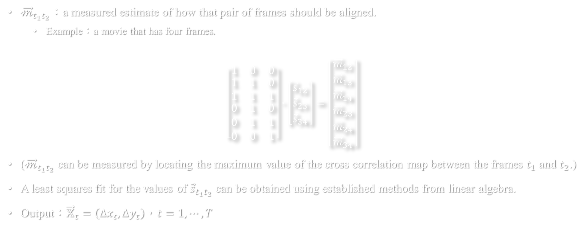
Motioncorr
${\vec{𝓂}}_{t_{1}t_{2}}$：a measured estimate of how that pair of frames should be aligned.
Example：a movie that has four frames.
$$\left[\begin{matrix}1 & 0 & 0 \\ \begin{matrix}1 \\ 1\end{matrix} & \begin{matrix}1 \\ 1\end{matrix} & \begin{matrix}0 \\ 1\end{matrix} \\ \begin{matrix}0 \\ 0 \\ 0\end{matrix} & \begin{matrix}1 \\ 1 \\ 0\end{matrix} & \begin{matrix}0 \\ 1 \\ 1\end{matrix}\end{matrix}\right]∙\left[\begin{matrix}{\vec{s}}_{12} \\ {\vec{s}}_{23} \\ {\vec{s}}_{34}\end{matrix}\right]=\left[\begin{matrix}{\vec{m}}_{12} \\ \begin{matrix}{\vec{m}}_{13} \\ \begin{matrix}{\vec{m}}_{14} \\ {\vec{m}}_{23}\end{matrix} \\ {\vec{m}}_{24}\end{matrix} \\ {\vec{m}}_{34}\end{matrix}\right]$$
(${\vec{𝓂}}_{t_{1}t_{2}}$ can be measured by locating the maximum value of the cross correlation map between the frames $t_{1}$ and $t_{2}$.)
A least squares fit for the values of ${\vec{s}}_{t_{1}t_{2}}$ can be obtained using established methods from linear algebra.
Output：${\vec{𝕏}}_{t}=\left(∆x_{t},∆y_{t}\right)$，$t=1,⋯,T$

Slide 5
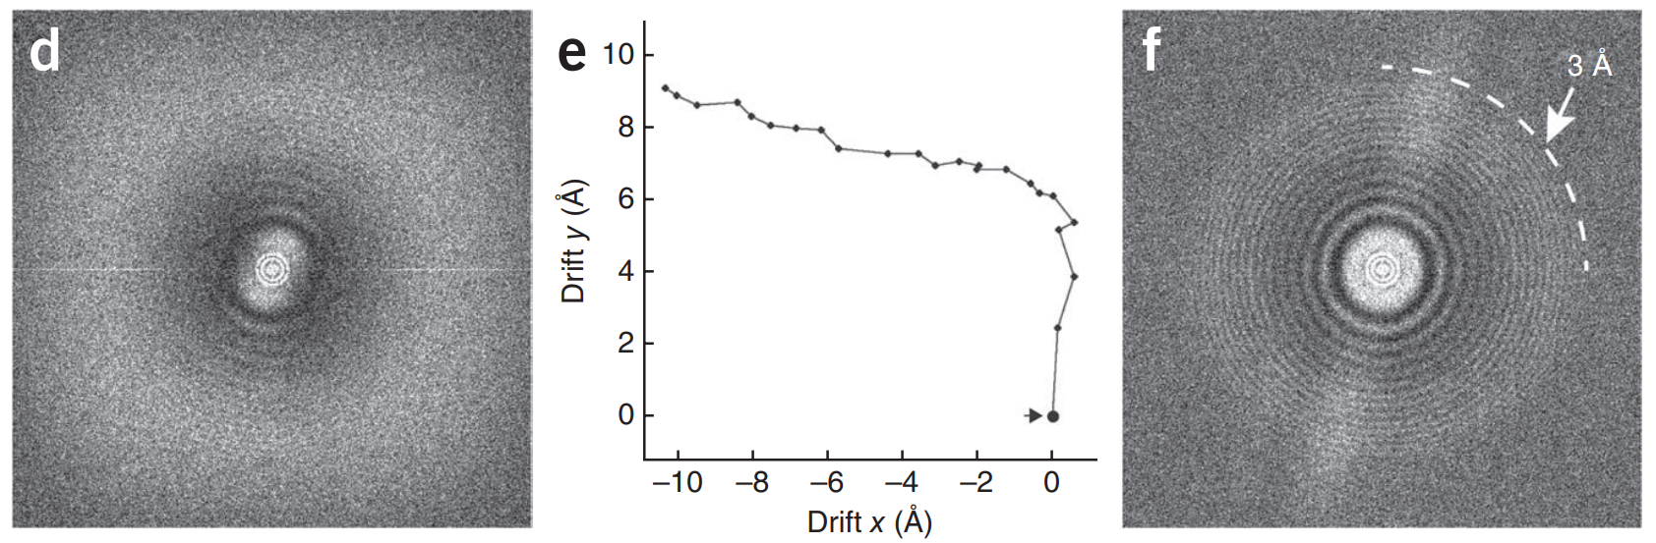

$${\vec{𝕏}}_{t}=\left(∆x_{t},∆y_{t}\right)$$

Slide 6
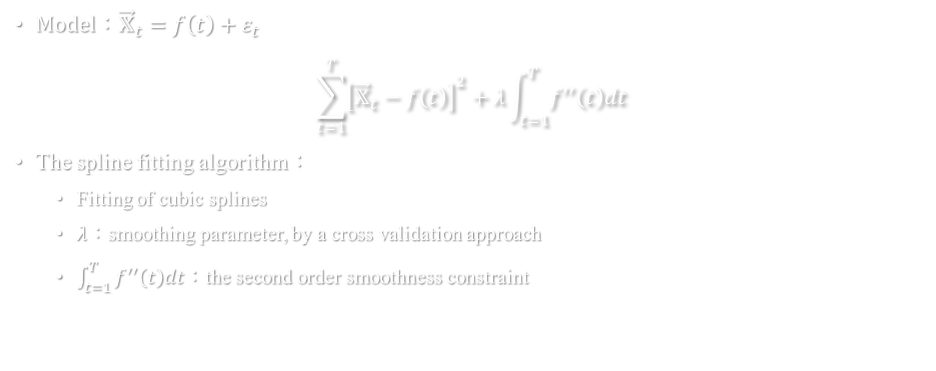
Unblur
Model：${\vec{𝕏}}_{t}=f\left(t\right)+ε_{t}$
$$\sum_{t=1}^{T}{{\left[{\vec{𝕏}}_{t}−f\left(t\right)\right]}^{2}}+λ\int_{t=1}^{T}{f^{′′}\left(t\right)dt}$$
The spline fitting algorithm：
Fitting of cubic splines
$λ$：smoothing parameter, by a cross validation approach
$\int_{t=1}^{T}{f^{′′}\left(t\right)dt}$：the second order smoothness constraint

Slide 7
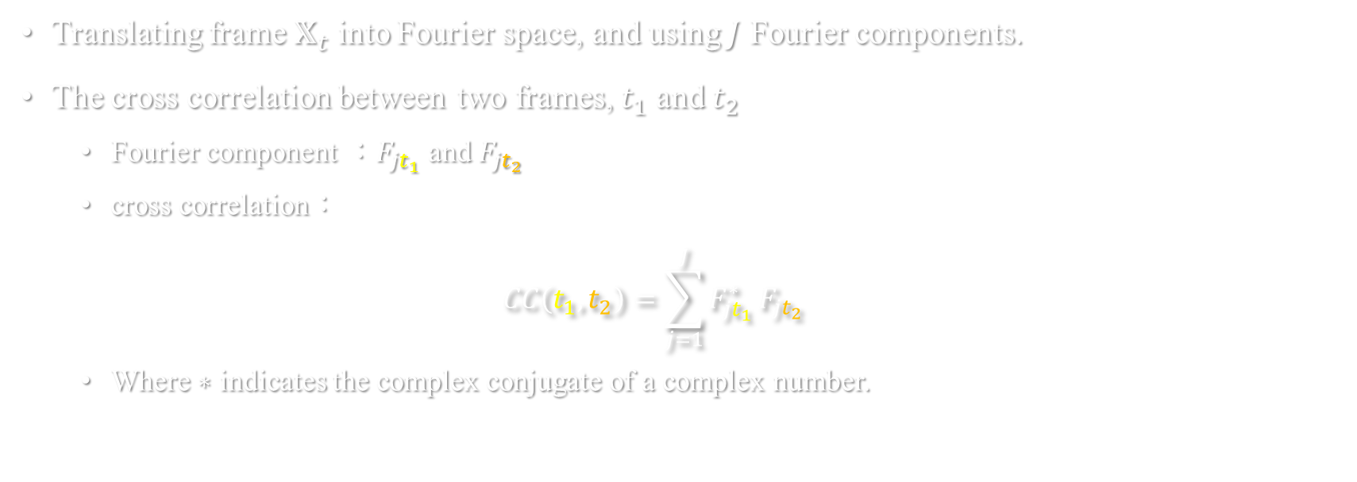
Cross correlation in Fourier space
Translating frame $𝕏_{t}$ into Fourier space, and using $J$ Fourier components.
The cross correlation between two frames, $t_{1}$ and $t_{2}$
Fourier component ：$F_{jt_{1}}$ and $F_{jt_{2}}$
cross correlation：
$$CC\left(t_{1},t_{2}\right)=\sum_{j=1}^{J}{F_{{jt}_{1}}^{∗}}F_{jt_{2}}$$
Where $∗$ indicates the complex conjugate of a complex number.

Slide 8
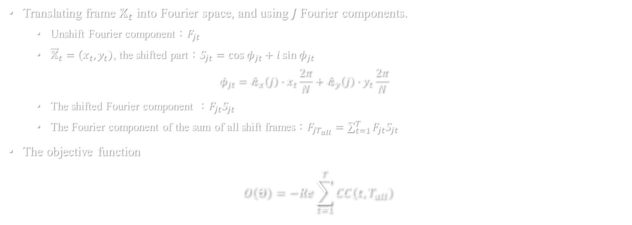
Alignframes_lmbfgs
Translating frame $𝕏_{t}$ into Fourier space, and using $J$ Fourier components.
Unshift Fourier component：$F_{jt}$
${\vec{𝕏}}_{t}=\left(x_{t},y_{t}\right)$, the shifted part：$S_{jt}=\cos{φ_{jt}}+i\sin{φ_{jt}}$
$$φ_{jt}=𝓀_{x}\left(j\right)∙x_{t}\frac{2π}{N}+𝓀_{y}\left(j\right)∙y_{t}\frac{2π}{N}$$
The shifted Fourier component ：$F_{jt}S_{jt}$
The Fourier component of the sum of all shift frames：$F_{jT_{all}}=\sum_{t=1}^{T}{F_{jt}S_{jt}}$
The objective function
$$O\left(Θ\right)=−Re\sum_{t=1}^{T}{CC\left(t,T_{all}\right)}$$

Slide 9
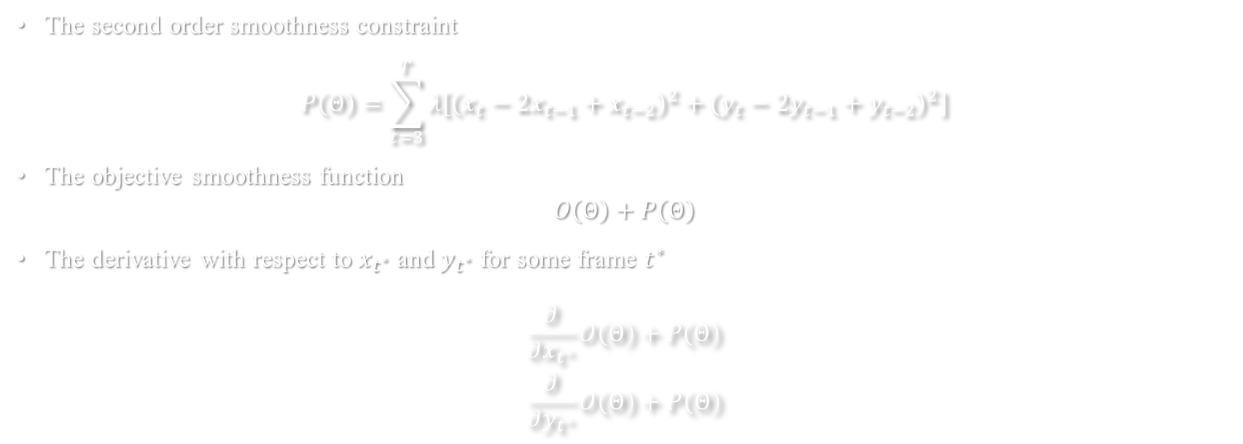
Alignframes_lmbfgs
The second order smoothness constraint
$$P\left(Θ\right)=\sum_{t=3}^{T}{λ\left[{\left(x_{t}−2x_{t−1}+x_{t−2}\right)}^{2}+{\left(y_{t}−2y_{t−1}+y_{t−2}\right)}^{2}\right]}$$
The objective smoothness function
$$O\left(Θ\right)+P\left(Θ\right)$$
The derivative with respect to $x_{t^{∗}}$ and $y_{t^{∗}}$ for some frame $t^{∗}$
$$\begin{matrix}\frac{∂}{∂x_{t^{∗}}}O\left(Θ\right)+P\left(Θ\right) \\ \frac{∂}{∂y_{t^{∗}}}O\left(Θ\right)+P\left(Θ\right)\end{matrix}$$

Slide 10
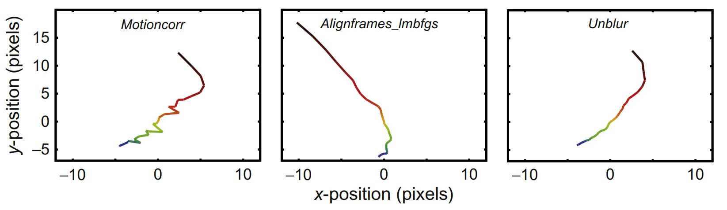
Comparison between three methods

Slide 11
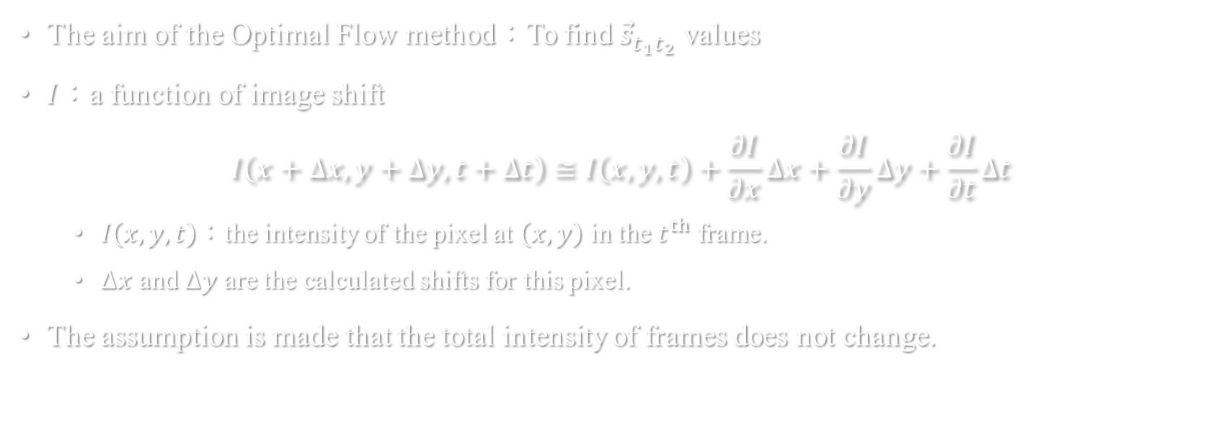
Optical flow
The aim of the Optimal Flow method：To find ${\vec{s}}_{t_{1}t_{2}}$ values
$I$：a function of image shift
$$I\left(x+∆x,y+∆y,t+∆t\right)≅I\left(x,y,t\right)+\frac{∂I}{∂x}∆x+\frac{∂I}{∂y}∆y+\frac{∂I}{∂t}∆t$$
$I\left(x,y,t\right)$：the intensity of the pixel at $\left(x,y\right)$ in the $t^{th}$ frame.
$∆x$ and $∆y$ are the calculated shifts for this pixel.
The assumption is made that the total intensity of frames does not change.

Slide 12
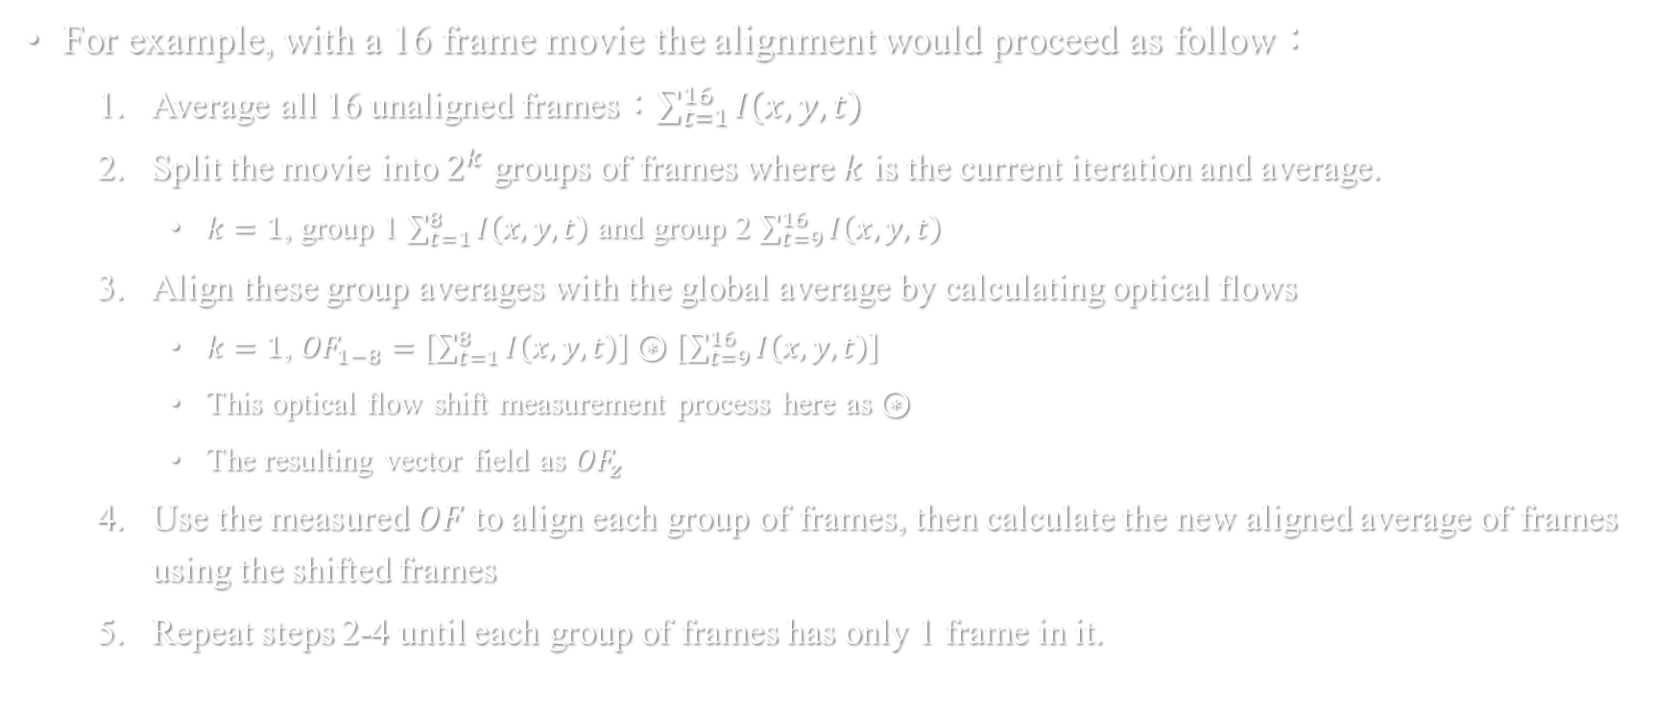
Optical flow
For example, with a 16 frame movie the alignment would proceed as follow：
Average all 16 unaligned frames：$\sum_{t=1}^{16}{I\left(x,y,t\right)}$
Split the movie into $2^{k}$ groups of frames where $k$ is the current iteration and average.
$k=1$, group 1 $\sum_{t=1}^{8}{I\left(x,y,t\right)}$ and group 2 $\sum_{t=9}^{16}{I\left(x,y,t\right)}$
Align these group averages with the global average by calculating optical flows
$k=1$, ${OF}_{1−8}=\left[\sum_{t=1}^{8}{I\left(x,y,t\right)}\right]⊛\left[\sum_{t=9}^{16}{I\left(x,y,t\right)}\right]$
This optical flow shift measurement process here as $⊛$
The resulting vector field as ${OF}_{z}$
Use the measured $OF$ to align each group of frames, then calculate the new aligned average of frames using the shifted frames
Repeat steps 2-4 until each group of frames has only 1 frame in it.

Slide 13
The individual particle motion correction procedure
To be continued…

