Slide 1

NCHC GPU Hackathorn - Accelerated Multi-reference Alignment
Szu-Chi Chung, Cheng-Yu Hung, Huei-Lun Siao, Hung-Yi Wu
Institute of Statistical Science, Academia Sinica
Ryan Jeng
Nvidia

Slide 2

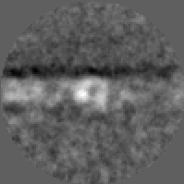
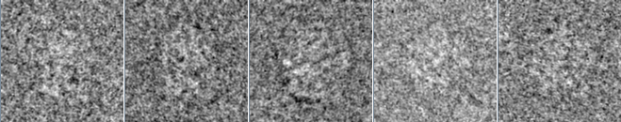
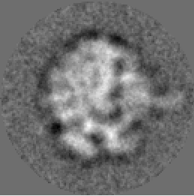
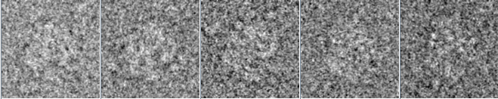
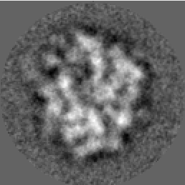
Cryo-EM Image Processing
Alignment and Clustering

Slide 3
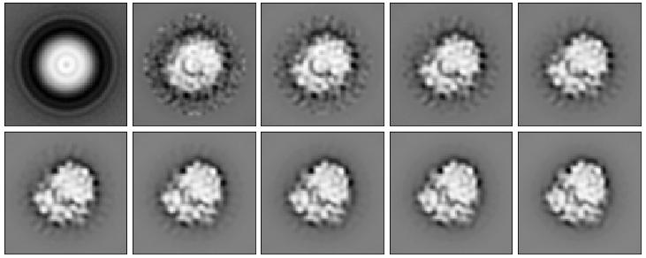
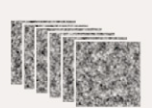



Reference-free alignment [1]
Fast reference-free alignment [2]
Maximum likelihood alignment [3,4]
Fuzzy estimate of latent variable
Model parameters are calculated using weighted averages over all possible latent variables
Particle images
Max ${CC}_{j}$
$${CC}_{1}$$
$${CC}_{2}$$
$${CC}_{3}$$
$${CC}_{4}$$
$${CC}_{5}$$
…
average
Orientation parameters
Calculate CC in
different $(φ,x,y)$

Slide 4


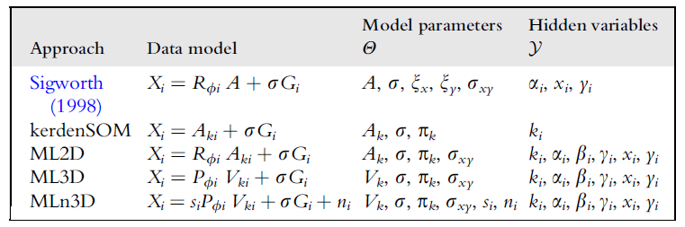





Reference-based alignment
Multireferece alignment [2]
Maximum likelihood, RELION [4,5]
Maximum posterior in maximization step
Particle images
Max ${CC}_{j}$
$${CC}_{1}$$
$${CC}_{2}$$
$${CC}_{3}$$
$${CC}_{4}$$
$${CC}_{5}$$
…
$$+\ln{p(θ)}$$
Orientation parameters and class assignments $k$
Calculate CC in
different $(φ,x,y)$
2D Reference

Slide 5
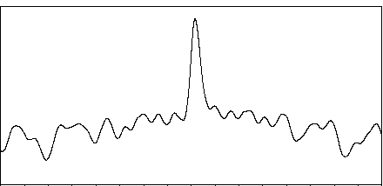
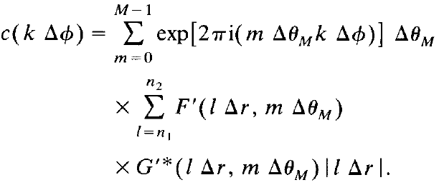


Aligment Step [1,6,7]
$$c$$
Resample to polar coordinate (RPC)
Translational is exhaustive search (CPU)
Resample to polar coordinates (GPU kernel)
Apply FFT (cufft)
Calculate CCF (gpu_aln_noref.cu#691) (GPU kernel)
Rotational cross-correlation function
Apply IFFT(cufft)
$$Φ$$
Convolution theorem

Slide 6
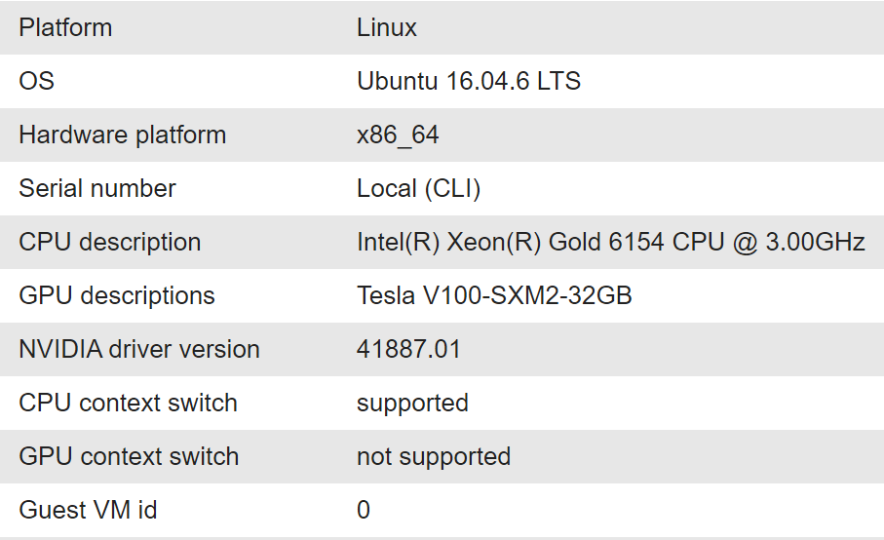
TWCC
Development container
Interactive contatiner
Schedule container
C.super
HPC cluster
Virtual Computing Sevice
No GPU

Slide 7
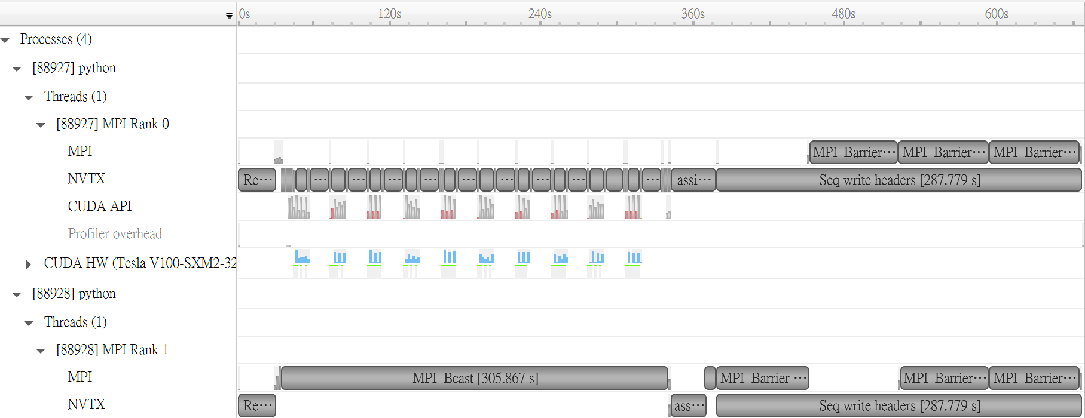
NVTX and Nsight System
Nsight system
NVIDIA® Tools Extension SDK
(NVTX)
Cuda-memcheck
Cuda libraries
Mathematical libraries: cuBLAS, cuRAND, cuFFT, cuSPARSE, cuTENSOR, cuSOLVER, nvGRAPH
Parallel algorithm libraries: Thrust, Cub
Image and video libraries: nvJPEG, NPP, Optical Flow SDK
Communication libraries: NVSHMEM, NCCL
Deep learning libraries: cuDNN, TensorRT, Jarvis, DALI
Third party: CuPy, OpenACC, OpenCV, Tensorly, Pytorch, Tensorflow

Slide 8
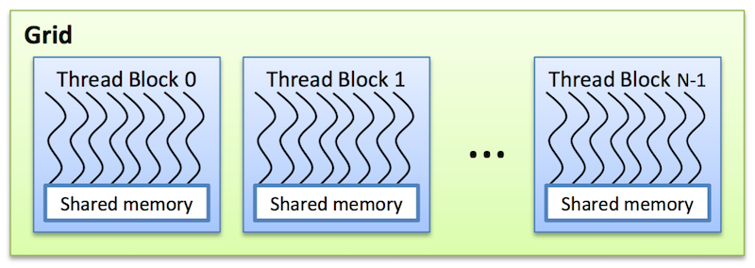



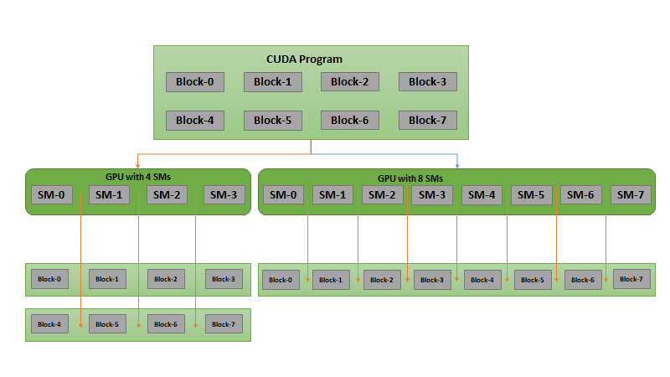
Implementation: MPI and CUDA
Amdahl's law
MPI (Message Passing Interface)
Solution for distributed system
Parallelize in single node
OpenMP
CUDA
OpenCL
…
Notes:
A thread block consists of 32-thread warps
A warp is executed physically in parallel (SIMD) on a multiprocessor
Shared memory multiprocessing programming
These are read-only memory spaces accessible by all threads.
Constant memory is used to cache values that are shared by all functional units
Texture memory is optimized for texturing operations provided by the hardware

Slide 9
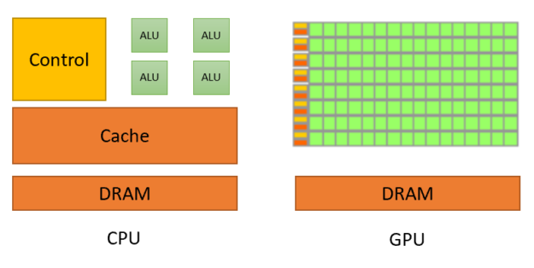
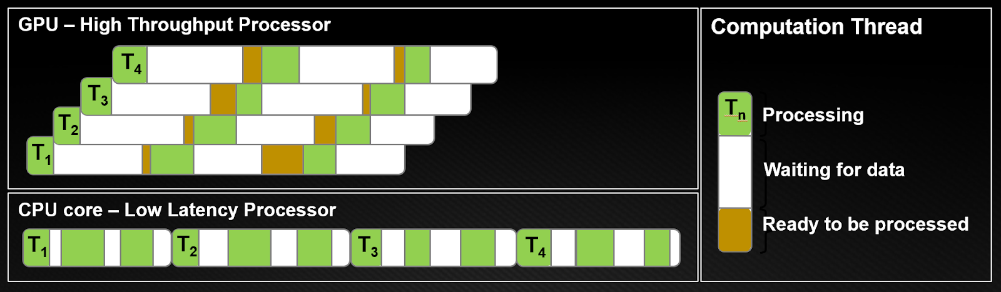
SIMT (Single Instruction, Multiple Thread)
Hide latency with lightweight threads
Host
Device
Gcc
Nvcc, Nvrtc
Notes:
GPUs dedicate most of their transistors for data processing while CPUs also need to reserve die area for big caches, control units, and so on. CPU processors work on the principle of minimizing latency within each thread while GPUs hide the instruction and memory latencies with computation. Figure 3 shows the difference in computation threads.
https://developer.nvidia.com/blog/cuda-refresher-reviewing-the-origins-of-gpu-computing/

Slide 10
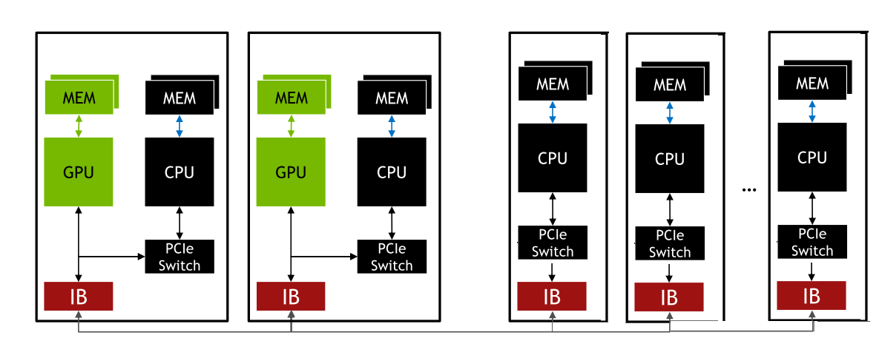
MPI+CUDA
Use the architecture from https://sphire.mpg.de/wiki/doku.php?id=gpu_isac
Parallel reading and preprocess the data on N process with CPU
Send data to the first n process
Processing on n GPU+CPU (Multiple process need MPS or CUDA Stream)
Read back data to N process with CPU and write out data
Rank0
Rank1
Rank2
Rank3
RankN

Slide 11
Fetch data
1024
Size check and divide it into batches
Using binary search
Texture memory
Allocate and transfer using cudaMallocPitch (Initialize) and cudaMemcpy2D (Fetch data)
Faster host to/from device IO
Images array in global memory
d_image_data []
Hold data for imgs (1) after polar conversion and (2) after rotation and shift
512
256
768
128
372
640
896
…
img_tex_obj
metadata
u_img_tex_data[0]
imgs
imgs
…
imgs
img_num_per_text

Slide 12
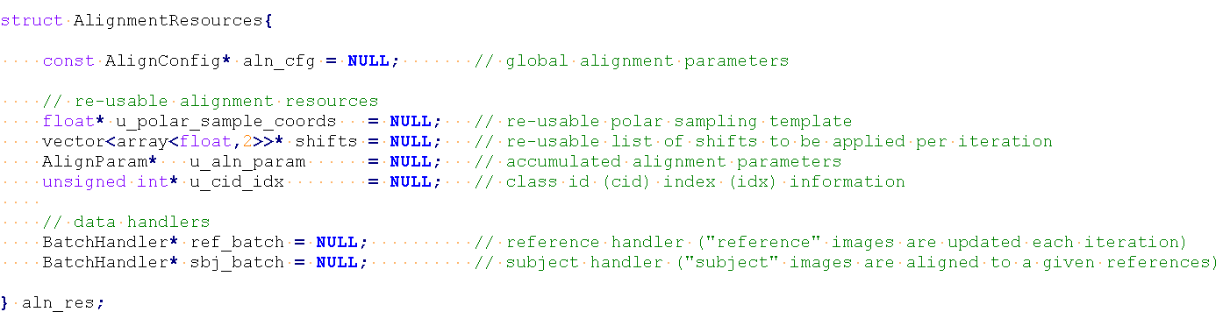
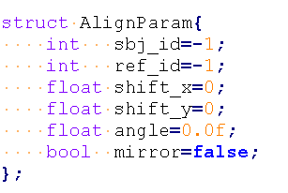
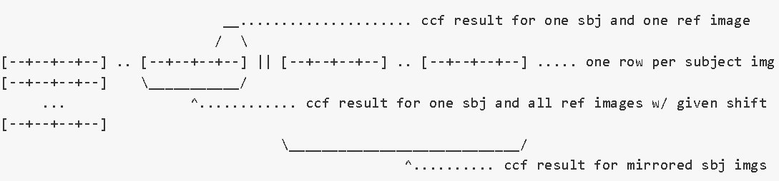
Data Layout
Metadata
Ccf table
Ring_len+2

Slide 13
Batch operation for computing cross correlation
Parallel over images, refs and orientations (Shift not added)
Threads has mechanism for communications and synchronizations (Share memory)
Notes:
Newest CUDA have cooperative groups

Slide 14
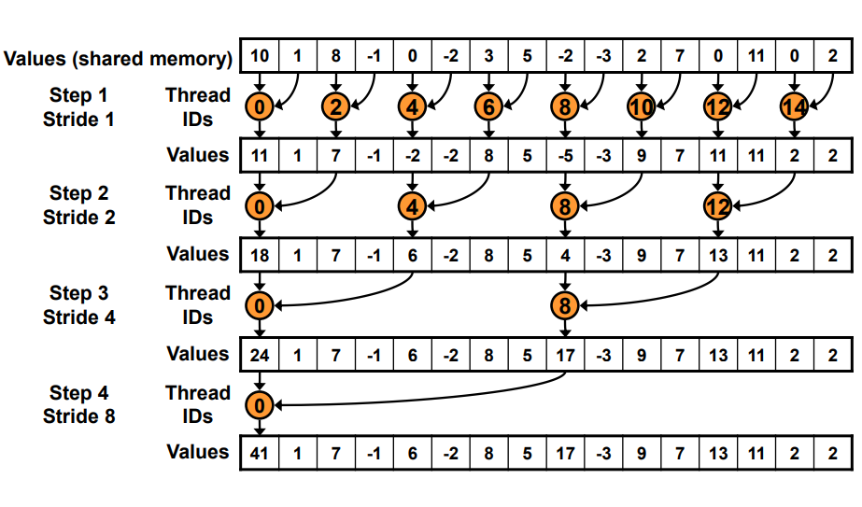
Parallel reduction to find optimal params
Initialize and parallel reduction
Cub and Thrust provides state-of-the-art, reusable software components for every layer of the CUDA programming model
Block-wide "collective" primitives

Slide 15
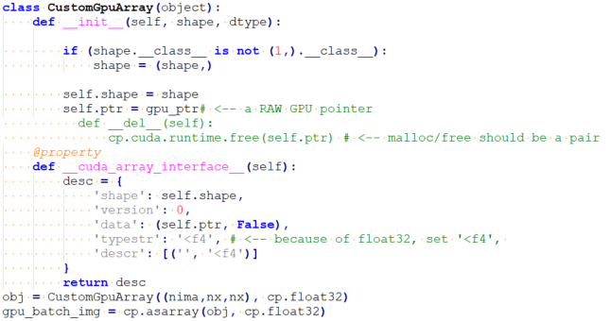
Averaging using CuPy
Wrap pointer
Reuse existing gpu buffer
__cuda_array_interface__
The cuda array interface is created for interoperability between different implementation of GPU array-like objects in various projects
Pytorch, CuPy, Rapids, Numba…

Slide 16
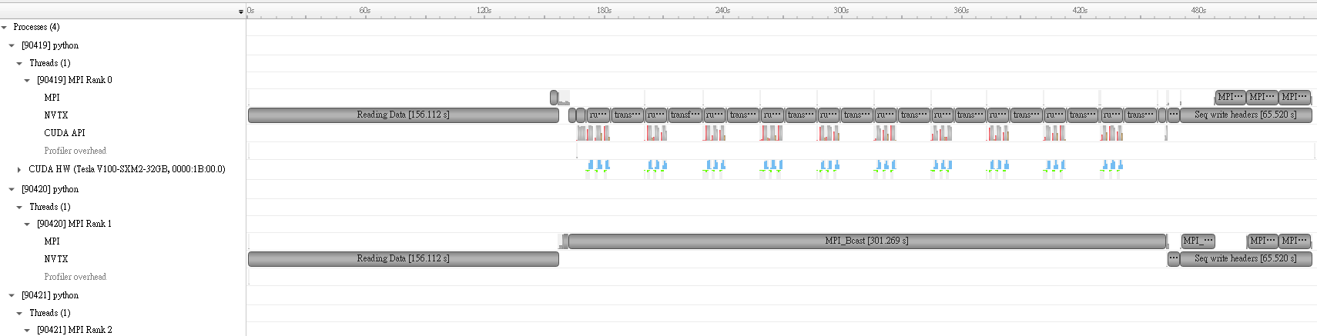
Writing to disk
EMAN2 use its own MPI interface called Pydusa and the HDF version is not up-to-date
We have compare BDB and HDF
May switch to Mpi4Py and newest HDF version to support parallel writing

Slide 17
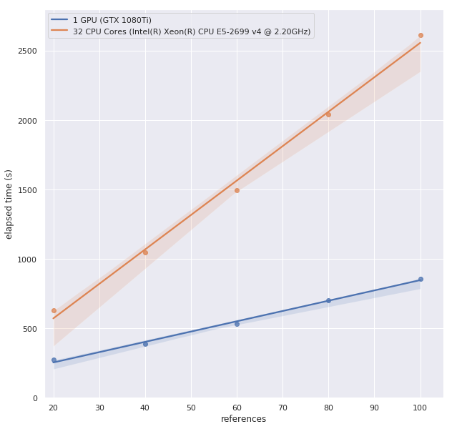

Benchmark
Multireference alignment
80S ribosome
105247 images with $90×90$ pixels
(Excluding data writing time)
search range set 3 pixels in each
direction and run six iterations
2.3~3.0 times faster on our machine
12 times faster on TWCC
(Recall that twcc only have 4 cores)

Slide 18
Benchmark
Reference-free alignment (on TWCC)
search range set 3 pixels in each direction and run 10 iterations
4 core CPU – 768s
1 GPU (Original) – 249s
1 GPU (Ours) – 137s

Slide 19
Future work
Possible optimization
CUDA stream to overlap data reading and kernel computation
Utilize exiting library for better performance
Parallel writing
GPU-Aware MPI
…
Organize the project (https://github.com/phonchi/Multireferece_alignment)
Reference-free alignment
Multi-reference alignment
Multi-group alignment
Parallel rotation_shift and conversion

Slide 20
References
[1] Penczek, Pawel, Michael Radermacher, and Joachim Frank. "Three-dimensional reconstruction of single particles embedded in ice." Ultramicroscopy 40.1 (1992): 33-53.
[2] https://sphire.mpg.de/wiki/doku.php?id=gpu_isac
[3] Sigworth, Fred J. "A maximum-likelihood approach to single-particle image refinement." Journal of structural biology 122.3 (1998): 328-339.
[4] Sigworth, Fred J., et al. "An introduction to maximum-likelihood methods in cryo-EM." Methods in enzymology. Vol. 482. Academic Press, 2010. 263-294.
[5] Scheres, Sjors HW. "RELION: implementation of a Bayesian approach to cryo-EM structure determination." Journal of structural biology 180.3 (2012): 519-530.
[6] Joyeux, Laurent, and Pawel A. Penczek. "Efficiency of 2D alignment methods." Ultramicroscopy 92.2 (2002): 33-46.
[7] Cong, Yao, Julio A. Kovacs, and Willy Wriggers. "2D fast rotational matching for image processing of biophysical data." Journal of structural biology 144.1-2 (2003): 51-60.

Slide 21
Appendix

