Slide 1
The art of using t-SNE for single-cell transcriptomics
林思涵
2019/03/21

Slide 2
Outline
完整t-SNE演算法
The art of using t-SNE for single-cell transcriptomics 與 t-SNE演算法
比較RP t-SNE 與The art of using t-SNE for single-cell transcriptomics

Slide 3
完整t-SNE演算法
參數設定：
Perplexity
Exaggeration
ExaggerationStop
Momentum
MomentumChange
LearningRate

Slide 4
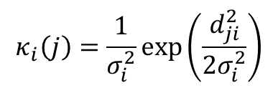







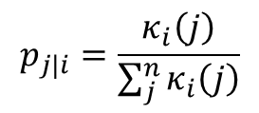
t-SNE
$$X_{1}, X_{2}, ⋯⋯, X_{n}$$
Perplexity = u
Similarity
Matrix
$$σ_{1}^{2}$$
$$σ_{2}^{2}$$
$$σ_{i}^{2}$$
$$σ_{n}^{2}$$
計算高維度資料之similarity matrix
利用Perplexity計算每個資料點的$σ_{i}^{2}$
計算高維度資料之probability matrix
利用gradient update遞迴1000次求Y
前200遞迴時，exaggeration為4
前250遞迴，momentum為0.5，之後為0.8
$$κ_{i}\left(j\right)=\frac{1}{σ_{i}^{2}}exp\left(\frac{d_{ji}^{2}}{2σ_{i}^{2}}\right)$$
$$p_{j|i}=\frac{κ_{i}\left(j\right)}{\sum_{j}^{n}{κ_{i}\left(j\right)}}$$
$$p_{ij}=\frac{p_{j|i}+p_{i|j}}{2n}$$
Probability
Matrix

Slide 5

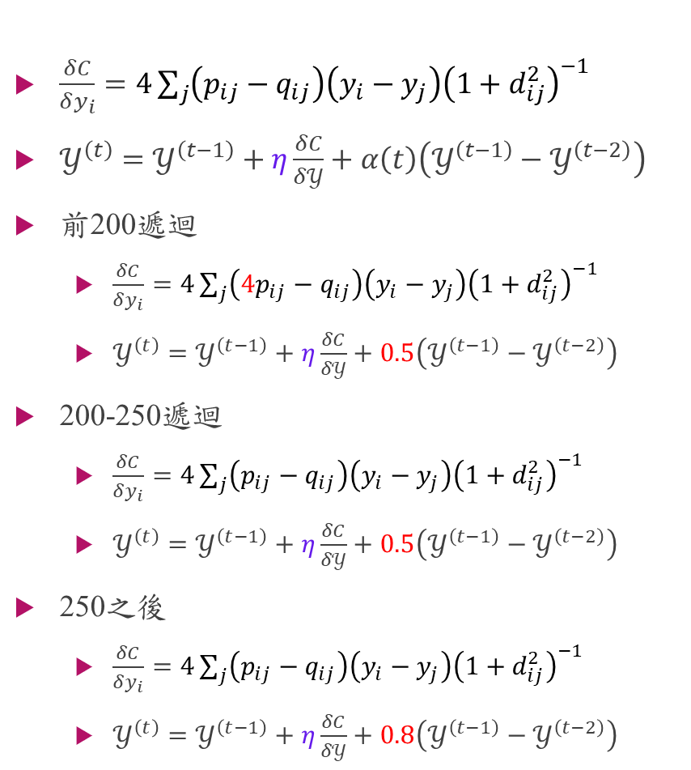
t-SNE
$\frac{δC}{δy_{i}}=4\sum_{j}{\left(p_{ij}−q_{ij}\right)\left(y_{i}−y_{j}\right){\left(1+d_{ij}^{2}\right)}^{−1}}$
$𝒴^{\left(t\right)}=𝒴^{\left(t−1\right)}+η\frac{δC}{δ𝒴}+α\left(t\right)\left(𝒴^{\left(t−1\right)}−𝒴^{\left(t−2\right)}\right)$
前200遞迴
$\frac{δC}{δy_{i}}=4\sum_{j}{\left({4p}_{ij}−q_{ij}\right)\left(y_{i}−y_{j}\right){\left(1+d_{ij}^{2}\right)}^{−1}}$
$𝒴^{\left(t\right)}=𝒴^{\left(t−1\right)}+η\frac{δC}{δ𝒴}+0.5\left(𝒴^{\left(t−1\right)}−𝒴^{\left(t−2\right)}\right)$
200-250遞迴
$\frac{δC}{δy_{i}}=4\sum_{j}{\left(p_{ij}−q_{ij}\right)\left(y_{i}−y_{j}\right){\left(1+d_{ij}^{2}\right)}^{−1}}$
$𝒴^{\left(t\right)}=𝒴^{\left(t−1\right)}+η\frac{δC}{δ𝒴}+0.5\left(𝒴^{\left(t−1\right)}−𝒴^{\left(t−2\right)}\right)$
250之後
$\frac{δC}{δy_{i}}=4\sum_{j}{\left(p_{ij}−q_{ij}\right)\left(y_{i}−y_{j}\right){\left(1+d_{ij}^{2}\right)}^{−1}}$
$𝒴^{\left(t\right)}=𝒴^{\left(t−1\right)}+η\frac{δC}{δ𝒴}+0.8\left(𝒴^{\left(t−1\right)}−𝒴^{\left(t−2\right)}\right)$
計算高維度資料之similarity matrix
利用Perplexity計算每個資料點的$σ_{i}^{2}$
計算高維度資料之probability matrix
利用gradient update遞迴1000次求Y
前200遞迴時，exaggeration為4
前250遞迴，momentum為0.5，之後為0.8

Slide 6
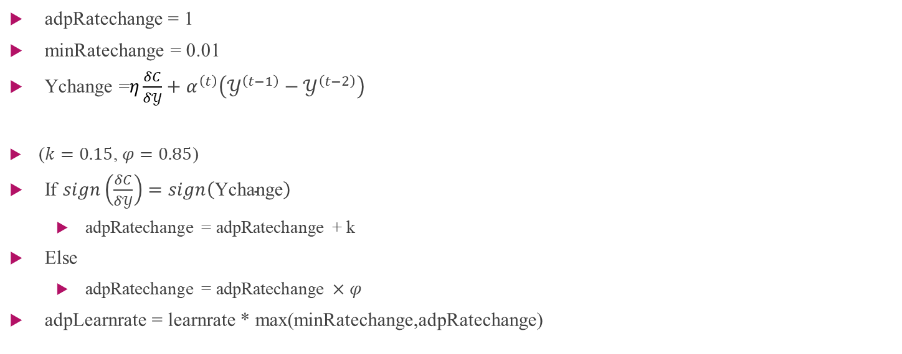
Adaptive learning rate
adpRatechange = 1
minRatechange = 0.01
Ychange =$η\frac{δC}{δ𝒴}+α^{\left(t\right)}\left(𝒴^{\left(t−1\right)}−𝒴^{\left(t−2\right)}\right)$
($k=0.15$, $φ=0.85$)
If $sign\left(\frac{δC}{δ𝒴}\right)=sign\left(\text{Ychange}\right)$
adpRatechange = adpRatechange + k
Else
adpRatechange = adpRatechange $×φ$
adpLearnrate = learnrate * max(minRatechange,adpRatechange)

Slide 7
The art of using t-SNE for single-cell transcriptomics
資料來源 | 樣本數 | 群數
Tasic et al. (2017) | 23822 | 133
Cadwell et al. (2016) | 46
Tasic et al. (2016) | 1679 | 49
Macosko et al. (2015) | 44808 | 39
Shekhar et al. (2016) | 27499 | 26
Harris et al. (2018) | 3663 | 49
10x Genomics | 1306127 | 39

Slide 8
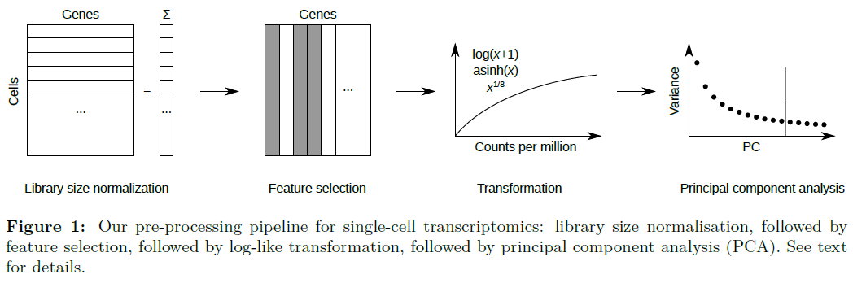
Pre-processing pipeline

Slide 9
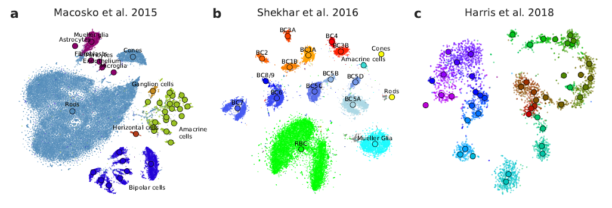
t-SNE plots (1)
資料來源
Tasic et al. (2017)
Cadwell et al. (2016)
Tasic et al. (2016)
Macosko et al. (2015)
Shekhar et al. (2016)
Harris et al. (2018)
10x Genomics

Slide 10
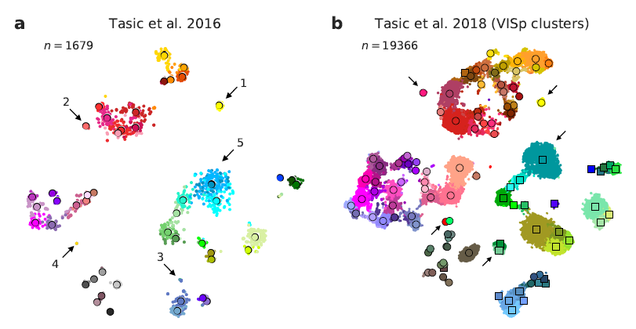
t-SNE plots (2)
資料來源
Tasic et al. (2017)
Cadwell et al. (2016)
Tasic et al. (2016)
Macosko et al. (2015)
Shekhar et al. (2016)
Harris et al. (2018)
10x Genomics

Slide 11
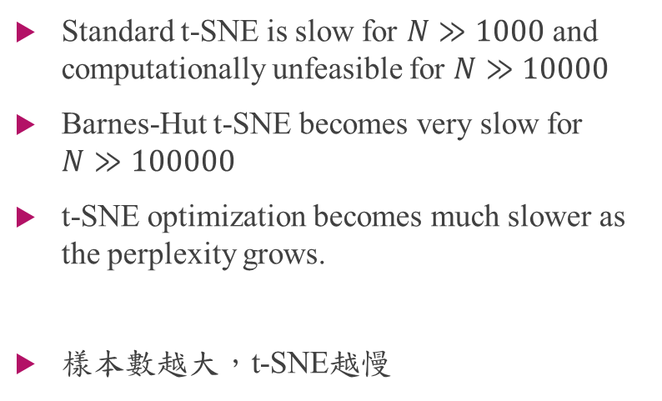
修改t-SNE
t-SNE 問題
解法
Standard t-SNE is slow for $N≫1000$ and computationally unfeasible for $N≫10000$
Barnes-Hut t-SNE becomes very slow for $N≫100000$
t-SNE optimization becomes much slower as the perplexity grows.
樣本數越大，t-SNE越慢
隨機抽取小樣本做t-SNE
PCA結果為初始值
Perplexity = 500
Exaggeration = 12 , stop time = 250
Learning rate = 200
將剩餘的點標註在t-SNE的圖上(kNN法)
將2.的結果當成新的初始值，再跑一次t-SNE
Perplexity = 30
Exaggeration = 4 , stop time = 500
Learning rate = 1000

Slide 12
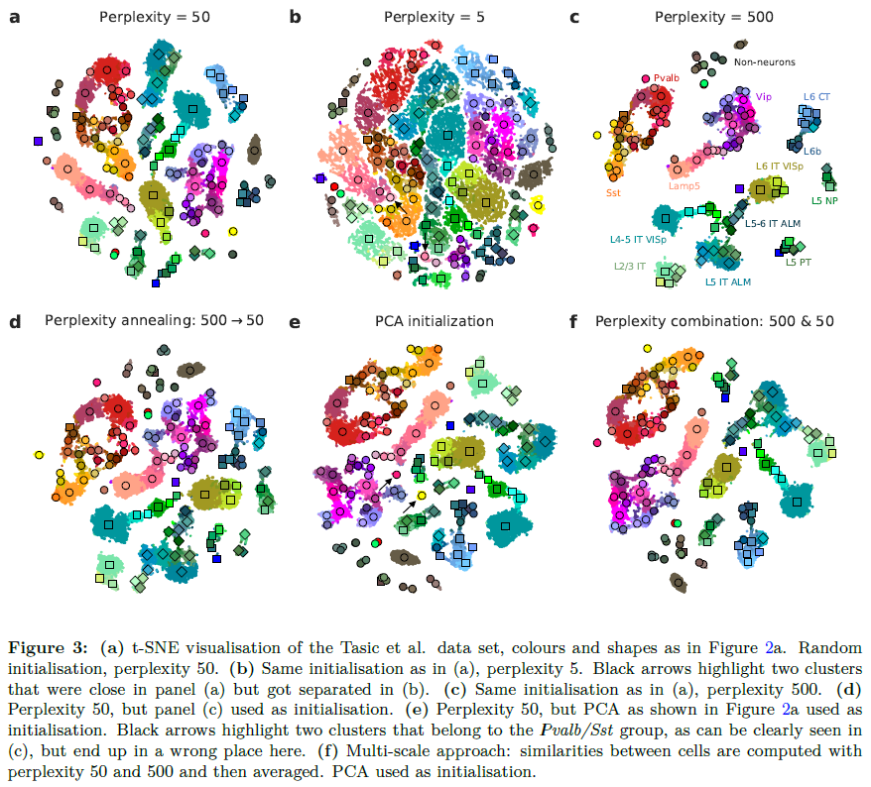
Perplexity越大
可用來建構初始模型
資料來源
Tasic et al. (2017)
Cadwell et al. (2016)
Tasic et al. (2016)
Macosko et al. (2015)
Shekhar et al. (2016)
Harris et al. (2018)
10x Genomics
以Perplexity 500為起始
再用50跑t-SNE
可以放鬆500的t-SNE圖

Slide 13



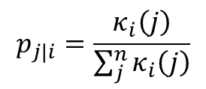
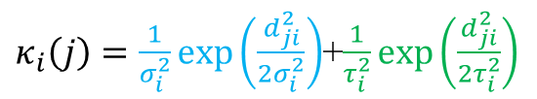


Perplexity Combination
$$X_{1}, X_{2}, ⋯⋯, X_{n}$$
Perplexity = u
Perplexity = v
Similarity
Matrix
$$σ_{1}^{2}$$
$$σ_{2}^{2}$$
$$σ_{i}^{2}$$
$$σ_{n}^{2}$$
$$τ_{1}^{2}$$
$$τ_{2}^{2}$$
$$τ_{i}^{2}$$
$$τ_{n}^{2}$$
$κ_{i}\left(j\right)=\frac{1}{σ_{i}^{2}}exp\left(\frac{d_{ji}^{2}}{2σ_{i}^{2}}\right)$+$\frac{1}{τ_{i}^{2}}exp\left(\frac{d_{ji}^{2}}{2τ_{i}^{2}}\right)$
$$p_{j|i}=\frac{κ_{i}\left(j\right)}{\sum_{j}^{n}{κ_{i}\left(j\right)}}$$
$$p_{ij}=\frac{p_{j|i}+p_{i|j}}{2n}$$
Probability
Matrix

Slide 14
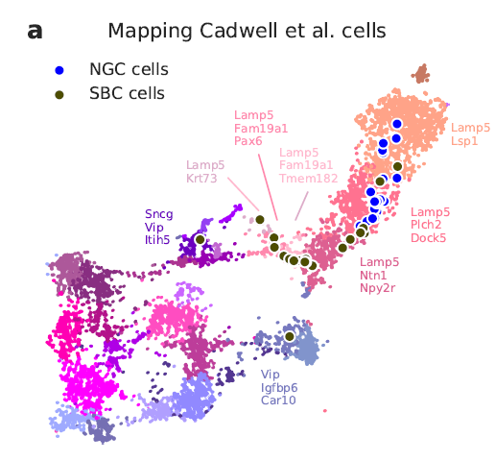
Positioning new points on an existing t-SNE atlas
We find its k=25 nearest neighbors among the Tasic et al. reference cells, using Pearson correlation across the most variable Tasic et al. genes as distance.
Then we position the cell at the median t-SNE location of these k reference cells.
資料來源
Tasic et al. (2017)
Cadwell et al. (2016)
Tasic et al. (2016)
Macosko et al. (2015)
Shekhar et al. (2016)
Harris et al. (2018)
10x Genomics

Slide 15
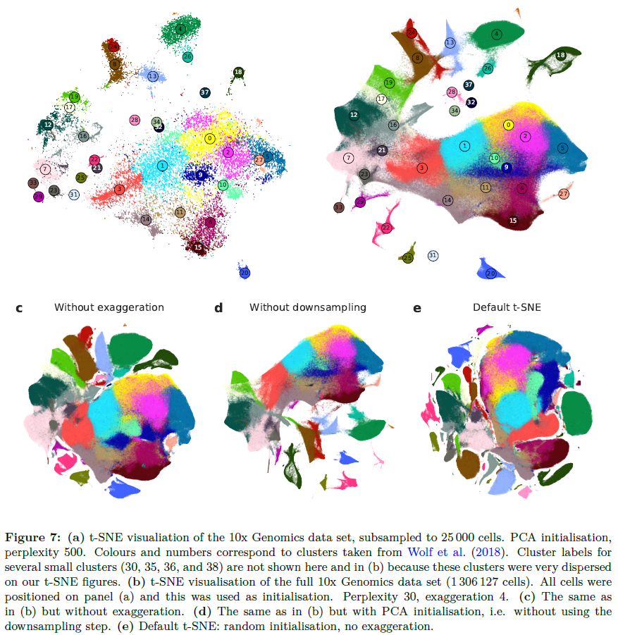
25000樣本做模型
將剩餘點標記在模型上
再跑t-SNE
最後成品
其他不同參數設定之成果

Slide 16
比較兩種改良t-SNE
Kobak and Berens (2018)
RP t-SNE
抽取小樣本且用嚴苛參數建立概略模型
將剩餘點標記在模型上，建立初始模型
輸入初始模型，放寬參數設定，得到最後的t-SNE圖
要跑兩次t-SNE
使用python裡的fast_tsne
將大樣本分別切成數份小樣本
每份小樣本進行t-SNE
合併小樣本結果
再重新分組，跑t-SNE
數次後之結果即為輸出

Slide 17
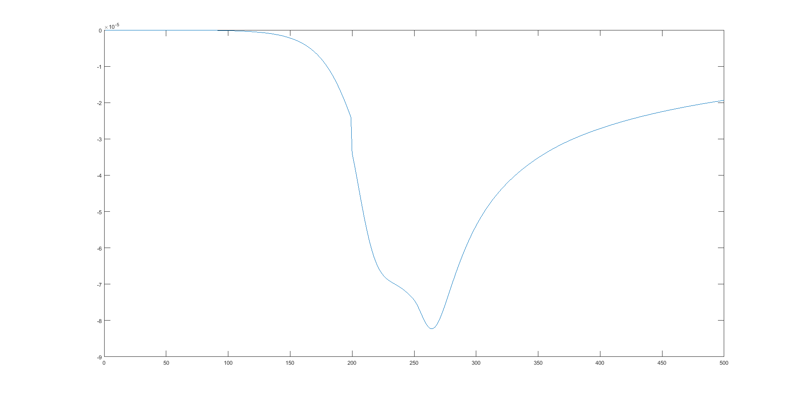
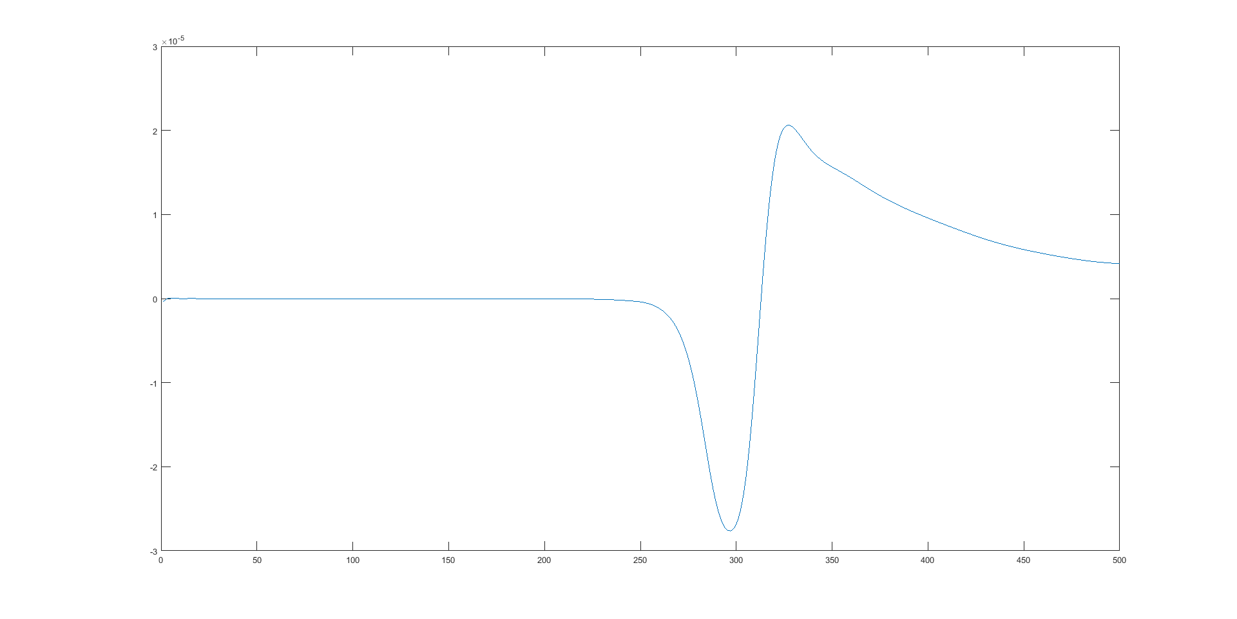
exaggeration = 4
exaggeration = 12

