Slide 1
Detecting consistent common lines in cryo-EM by voting
Szu-Chi Chung
Institute of Statistical Science, Academia Sinica

Slide 2
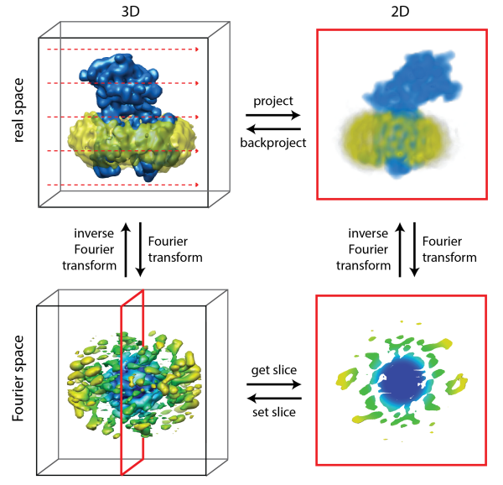
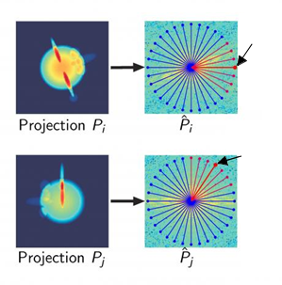
Projection-Slice Theorem (3D)
2D projections from the same 3D object share a common line
Finding common line:
Calculating similarity in Fourier space using radial line
Notes:
https://embo2017.cryst.bbk.ac.uk/embo2017/course/Lectures/Lecture%2013%20-%20Sjors%20Scheres_p4.pdf
Fourier space following is easy:
Convolution, filter, Cross correlation
Linear model

Slide 3
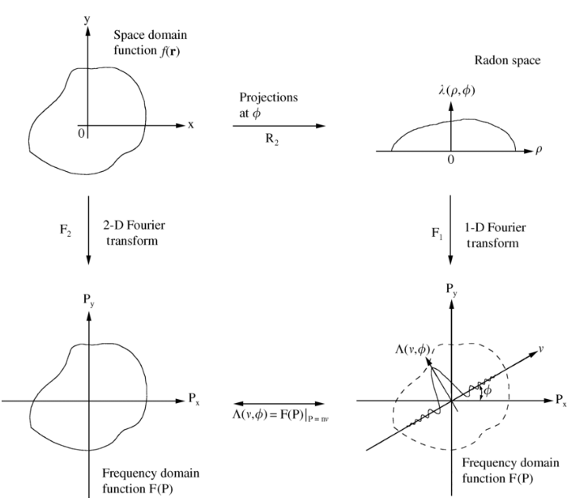
Projection-Slice Theorem (2D)
2D
1D
Finding common line:
Calculating similarity in Fourier space using radial line
Calculating similarity in real space using Sinogram line (projection line) - Faster
Notes:
https://www.researchgate.net/figure/Central-slice-theorem-the-1D-Fourier-transform-of-a-Radon-projection-at-angle-0-is_fig11_222275232
Fourier transform is a unitary operator

Slide 4

Radon Transform
Parameterizing Parallel-Beam
Radom transform $[Rf]$
Projection-Slice Theorem [1]
Notes:
Dirac delta function
Note that [0; 180] captures all necessary projections of the object. The angular range [180; 360] gives a \mirror image.“
In addition to the Poisson noise discussed previously, data can be affected by numerous other issues.
- Detector noise.
- Scatter (some X-rays do not follow straight line).
- X-rays are not monochromatic, but have full spectrum. Attenuation
coefficient depends on energy ! beam hardening.
- Bad detectors, e.g., void measurements.
- Too dense features in the object, e.g., metal blocking rays completely.
- Object changing during acquisition, e.g., motion.

Slide 5

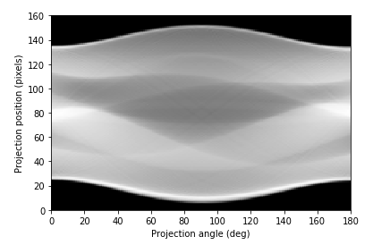
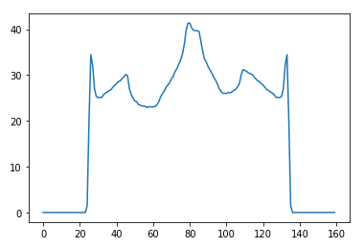
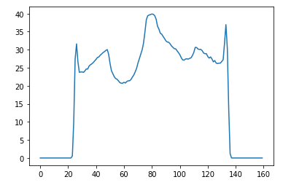


Radon transform [1,2]
0 degree
5 degree
Sinogram
$$s$$
Radom transform
$θ$
Projection

Slide 6
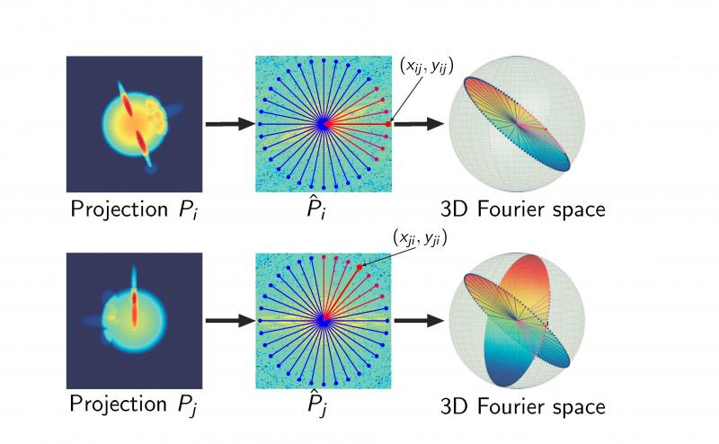
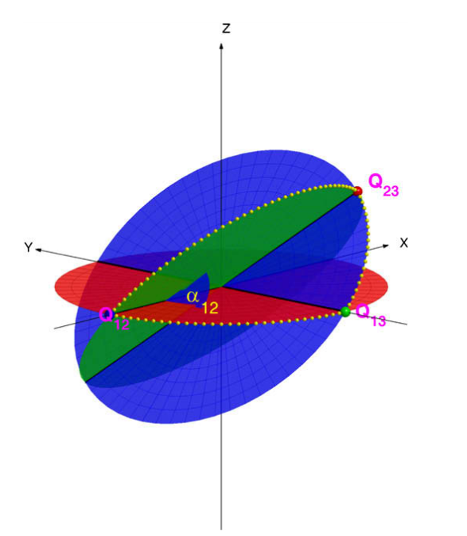
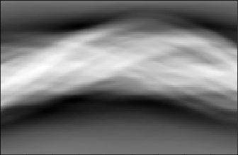
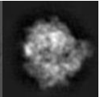
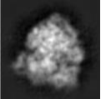
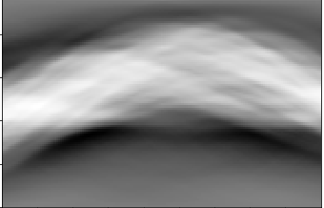

Angular reconstruction in cryo-EM [3]
Projection-Slice Theorem $→$ Common Line
Number of good common lines needed for assigning the Euler angles of $N$ projections is $O(N)$ (Note that we have $\frac{N(N−1)}{2}$ common lines)
Angular Reconstruction (method that using common line detection)
IMAGIC, Spider, Xmipp, Aspire
Notes:
Only obtain initial model, since it can not iterative refine (when SNR is low do single run will not be accurate)

Slide 7
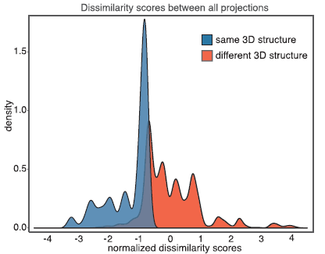
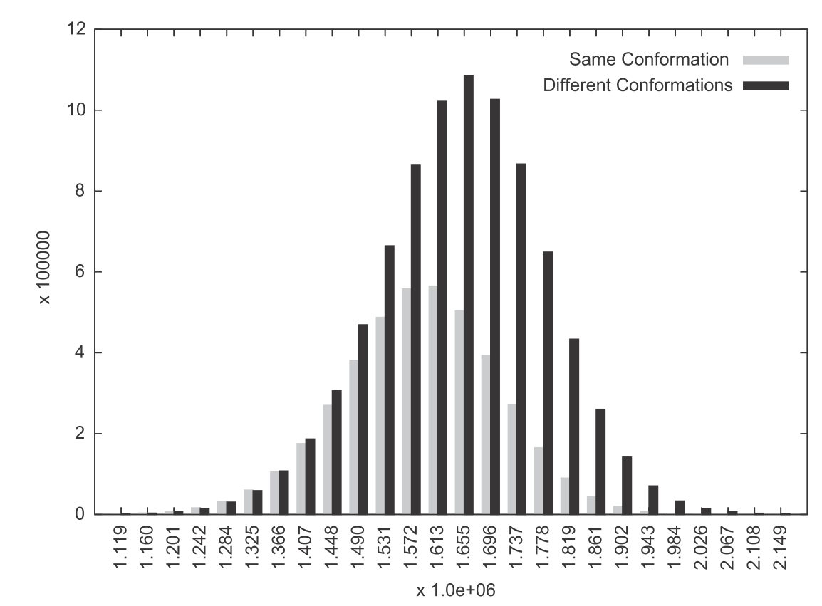
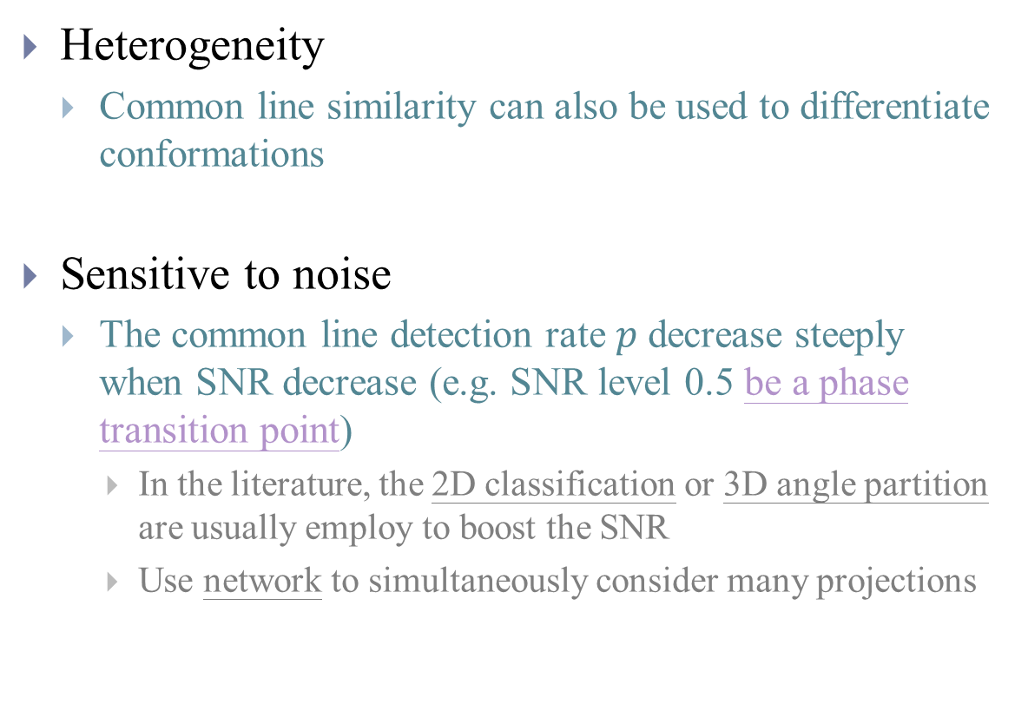
Detection of common line
Heterogeneity
Common line similarity can also be used to differentiate conformations
Sensitive to noise
The common line detection rate $p$ decrease steeply when SNR decrease (e.g. SNR level 0.5 be a phase transition point)
In the literature, the 2D classification or 3D angle partition are usually employ to boost the SNR
Use network to simultaneously consider many projections
From here

Slide 8
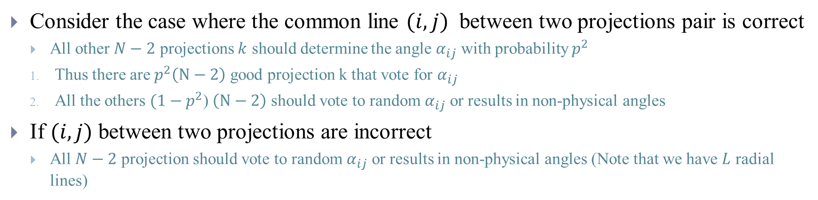

Idea of voting [4]
Consider the case where the common line $(i,j)$ between two projections pair is correct
All other $N−2$ projections $k$ should determine the angle $α_{ij}$ with probability $p^{2}$
Thus there are $p^{2}\left(N−2\right)$ good projection k that vote for $α_{ij}$
All the others $(1−p^{2}$) $\left(N−2\right)$ should vote to random $α_{ij}$ or results in non-physical angles
If $(i,j)$ between two projections are incorrect
All $N−2$ projection should vote to random $α_{ij}$ or results in non-physical angles (Note that we have $L$ radial lines)
If $p^{2}\left(N−2\right)≫1$, we can distinguish correct and incorrect common line (Note $p>\frac{2}{L^{2}}$)
Correct
Incorrect
$$α_{ij}$$

Slide 9




Non-physical angle
Build common line matrix
The directional vector of each radial line are the radial line of unit sphere
The intersections of three projections are denoted as $Q_{12}, Q_{13},Q_{23}$
They must satisfy the following inner product
$$\left\langle {\vec{Q}}_{23},{\vec{Q}}_{13}\right\rangle =$$
$$\left\langle {\vec{Q}}_{23},{\vec{Q}}_{12}\right\rangle =$$
$$\left\langle {\vec{Q}}_{13},{\vec{Q}}_{12}\right\rangle =$$
Notes:
https://math.stackexchange.com/questions/73237/parametric-equation-of-a-circle-in-3d-space

Slide 10

Non-physical angle
Assume we place projection 1 on x-y plane and let
By $c$ we get
Projection 2 can be written as (using ${\overset{⃑}{Q}}_{12}$ and $(0,\cos{α_{12}},\sin{α_{12}})$ as unit vector)
${\vec{Q}}_{12}\cos{θ_{2}}+(0,\cos{α_{12}},\sin{α_{12}})\sin{θ_{2}}$=
From $b$ we get $Q_{23}=\left(b, y, z\right),$since $b$ is on projection 2, we get
From $a$ we get the condition of physical angle
Notes:
https://math.stackexchange.com/questions/73237/parametric-equation-of-a-circle-in-3d-space
Red green blue

Slide 11



Voting algorithm
Build common line matrix
Verify condition
Add $α_{12}$ to histogram
$$α_{ij}$$
Record peak $ρ$

Slide 12

Voting and filtering
Retain only $p/2$ percent tile
of highest correlation or peak $ρ$
Only histogram filtering
improves with $N$
Voting can improve the accuracy in given SNR and can get benefit from increasing sample size

Slide 13

Voting and filtering
The choice of threshold
Plot histogram of all peaks $ρ$ (use $p/2$ as threshold)
Experiment data use $γ/\sqrt{N}$ ($γ=2,4,8…$, remember that $p^{2}\left(N−2\right)≫1$)

Slide 14
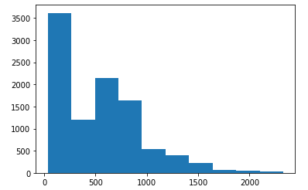
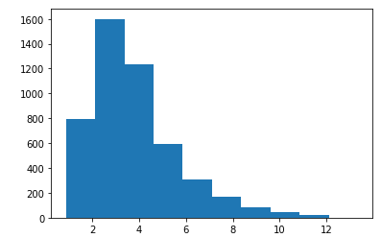
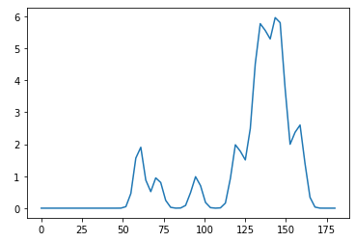
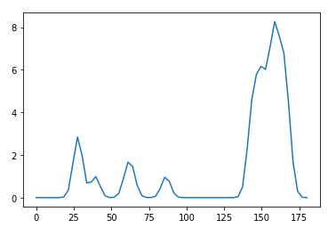
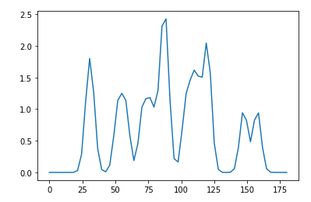
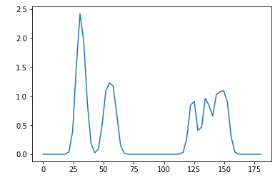


Apply to network (data from [5])
Common line similarity
Peak $ρ$
Filtering common lines
Use peak $ρ$ instead of
common line similarity
to construct graph?
Test with different structures
Direct distinguish structure without
graph clustering?
Same structure
Different structure

Slide 15
Reference
[1] http://www2.compute.dtu.dk/~pcha/HDtomo/SCforCT.html
[2] https://scikit-image.org/docs/dev/auto_examples/transform/plot_radon_transform.html
[3] Wang, Lanhui, Amit Singer, and Zaiwen Wen. "Orientation determination of cryo-EM images using least unsquared deviations." SIAM journal on imaging sciences 6.4 (2013): 2450-2483.
[4] Singer, A., Coifman, R. R., Sigworth, F. J., Chester, D. W., & Shkolnisky, Y. (2010). Detecting consistent common lines in cryo-EM by voting. Journal of structural biology, 169(3), 312-322.
[5] Verbeke, E. J., Zhou, Y., Horton, A. P., Mallam, A. L., Taylor, D. W., & Marcotte, E. M. (2020). Separating distinct structures of multiple macromolecular assemblies from cryo-EM projections. Journal of structural biology, 209(1), 107416.
[6] 2D implementation of Relion and CryoSparc https://github.com/Arunabh98/EPFL-CryoEM

Slide 16
Appendix

Slide 17
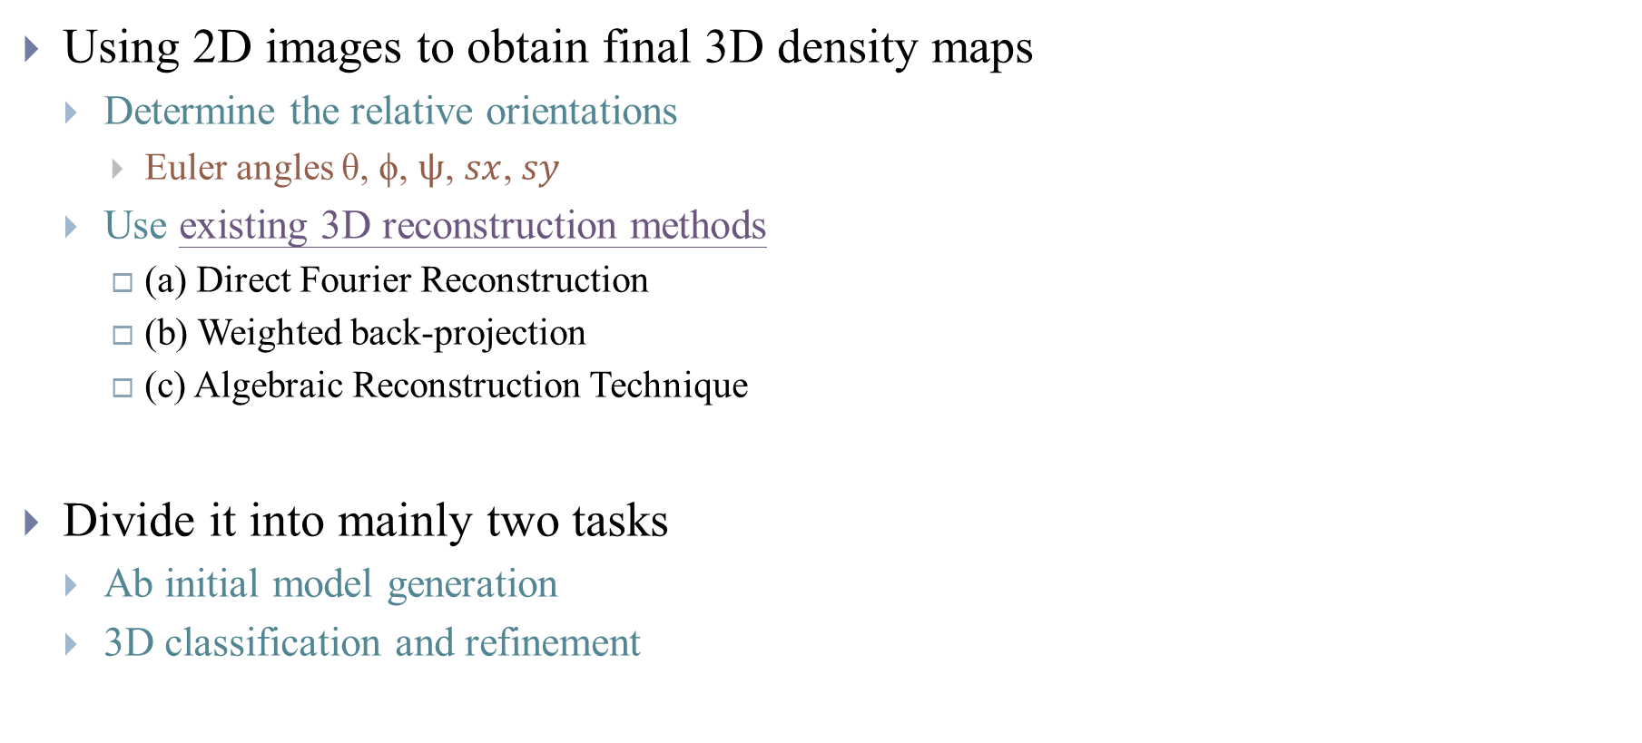
Introduction
Using 2D images to obtain final 3D density maps
Determine the relative orientations
Euler angles θ, ϕ, $ψ$, $sx$, $sy$
Use existing 3D reconstruction methods
(a) Direct Fourier Reconstruction
(b) Weighted back-projection
(c) Algebraic Reconstruction Technique
Divide it into mainly two tasks
Ab initial model generation
3D classification and refinement

Slide 18
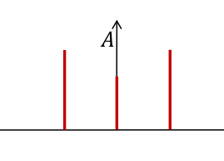


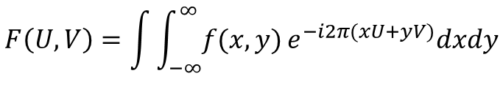
Introduction
2D Fourier transform
$$y$$
Intensity vs frequency
Result is complex number
2D Shift
$$x$$
$$F\left(U,V\right)=\int{\int_{−∞}^{∞}{f(x,y)}e^{−i2π(xU+yV)}dxdy}$$
Notes:
1. Symmetric around original points!
2. Reference also see https://www.youtube.com/watch?v=nyk75ufbP74&t=0s&index=18&list=PL8_xPU5epJdctoHdQjpfHmd_z9WvGxK8-

Slide 19
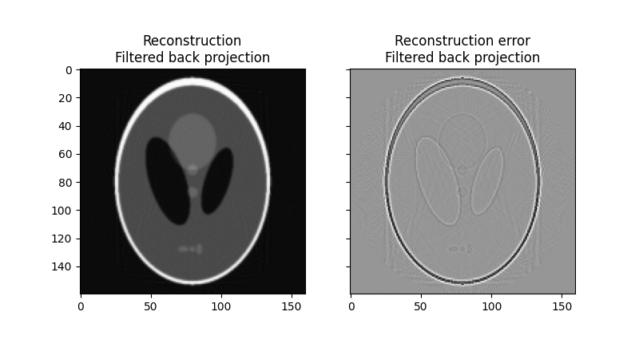
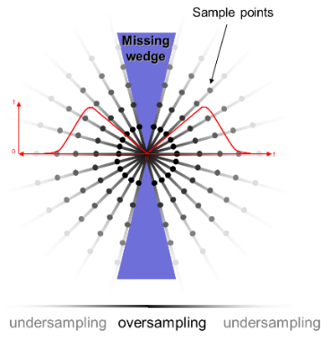
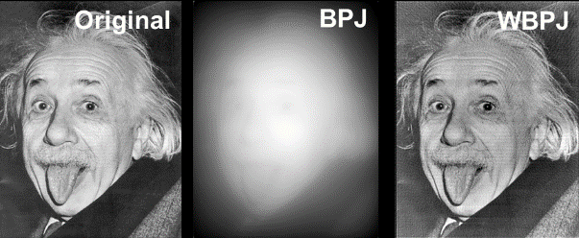
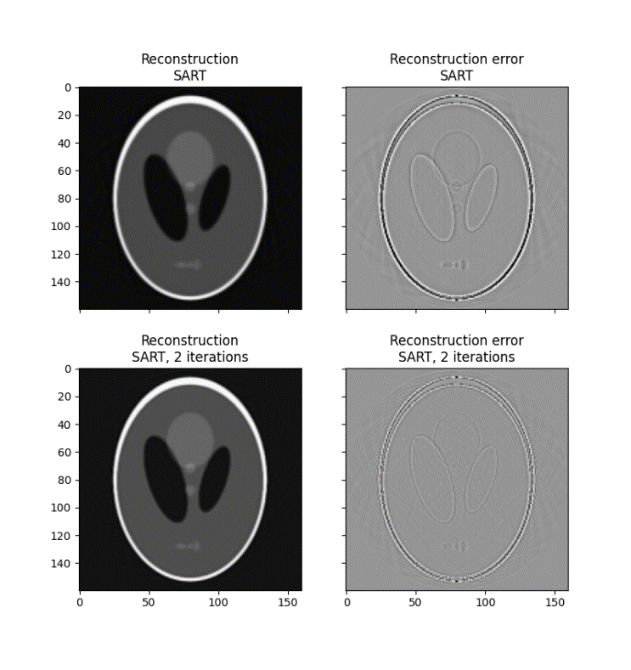
Reconstruction from Sinogram [1,2] (Tomography)
Filtered Back Projection (FBP or WBPJ)
Simultaneous Algebraic Reconstruction Technique (SART)
Notes:
https://www.int.kit.edu/1731.php

Slide 20
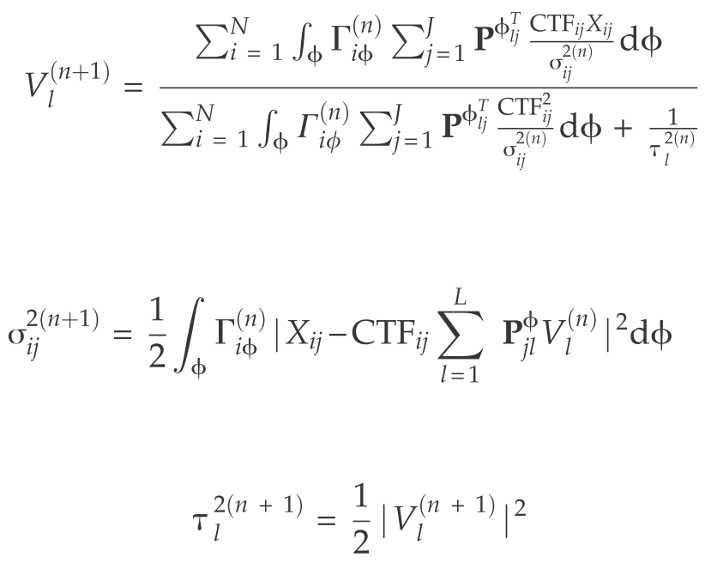
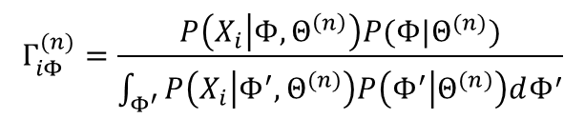
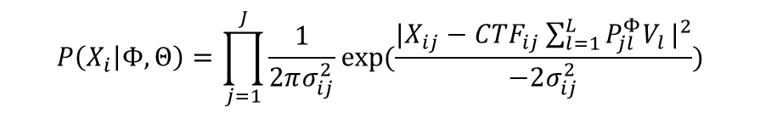

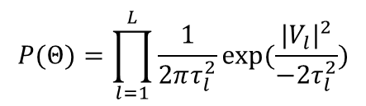
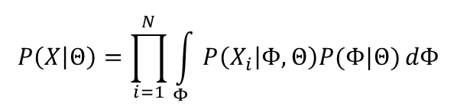
Reconstruction from unknown angles [6]
$P\left(Θ | X\right)∝P\left(X | Θ\right)P(Θ)$
$$P\left(X_{i} | Φ,Θ\right)=\prod_{j=1}^{J}{\frac{1}{2πσ_{ij}^{2}}exp⁡(\frac{|{X_{ij}−{CTF}_{ij}\sum_{l=1}^{L}{P_{jl}^{Φ}V_{l}}|}^{2}}{−2σ_{ij}^{2}})}$$
$$P\left(X | Θ\right)=\prod_{i=1}^{N}{\int_{Φ}{P\left(X_{i} | Φ,Θ\right)P(Φ|Θ)}dΦ}$$
RELION (ML-EM)
$$P(Θ)=\prod_{l=1}^{L}{\frac{1}{2πτ_{l}^{2}}exp⁡(\frac{|{V_{l}|}^{2}}{−2τ_{l}^{2}})}$$
$$Γ_{iΦ}^{(n)}=\frac{P\left(X_{i} | Φ,Θ^{\left(n\right)}\right)P(Φ|Θ^{(n)})}{\int_{Φ^{′}}{P\left(X_{i} | Φ^{′},Θ^{(n)}\right)P\left(Φ^{′} | Θ^{(n)}\right)dΦ^{′}}}$$

Slide 21

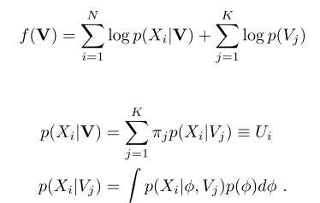
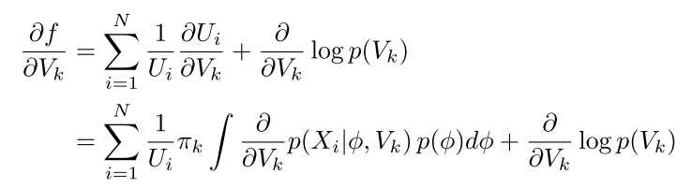
Reconstruction from unknown angles [6]
CryoSparc (Gradient descent)

Slide 22
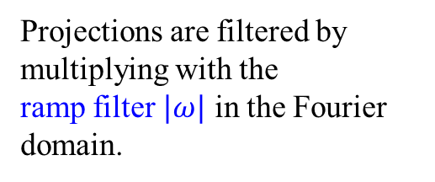
Filtered Back Projection
Using Fourier Slice Theorem
Projections are filtered by multiplying with the
ramp filter $|ω|$ in the Fourier domain.
Notes:
https://mathinsight.org/double_integral_change_variables_introduction#mjx-eqn-cvarformula

Slide 23
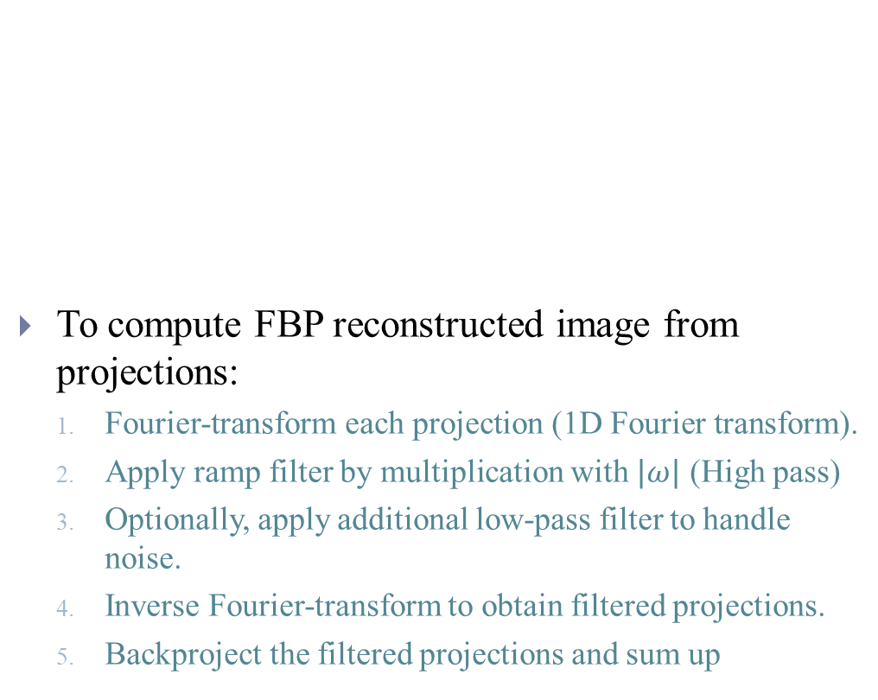
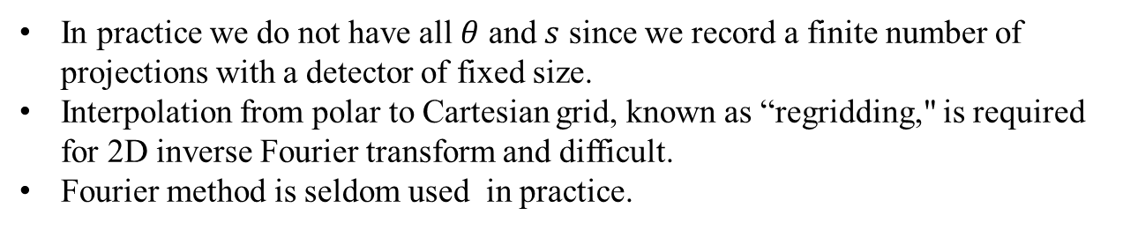
Filtered Back Projection
To compute FBP reconstructed image from projections:
Fourier-transform each projection (1D Fourier transform).
Apply ramp filter by multiplication with $|ω|$ (High pass)
Optionally, apply additional low-pass filter to handle noise.
Inverse Fourier-transform to obtain filtered projections.
Backproject the filtered projections and sum up
In practice we do not have all $θ$ and $s$ since we record a finite number of projections with a detector of fixed size.
Interpolation from polar to Cartesian grid, known as “regridding," is required for 2D inverse Fourier transform and difficult.
Fourier method is seldom used in practice.

Slide 24




Algebraic Reconstruction Technique
$$P_{i}\left(z\right)$$
$$x$$
$$z$$
$$P_{i}\left(z\right)=z+\frac{(x−z)∙r_{i}}{{\left\|r_{i}\right\|}_{2}^{2}}r_{i}$$

Slide 25
Algebraic Reconstruction Technique
Cimmino’s method accesses the rows simultaneously and computes the next iteration vector:
Notes:
Karczmarz, Cimmino and similar algebraic iterative methods are usually considered as solvers for systems of linear equations.
But it is more convenient to consider them as optimization methods.
Within this framework we can easily handle common extensions:

