Slide 1
Highly accurate protein structure prediction with AlphaFold
DeepMind

Slide 2
Comparison
Alphafold (2018) :
Predict the distance between each pair of amino acid sequence and angle of chemical bond that connect them, then using CNN to reconstruct 3D structure.
→cons : ignore the information of protein structure
Alphafold2 (2021) :
Change CNN to graph network, using information about proteins to construct a graph of how near to one another different amino acids are.

Slide 3
Confidence Measurement
Predicted local-distance difference test (pLDDT)
Reliably predicts the Cα local-distance difference test (lDDT-Cα) accuracy of the corresponding prediction.
Not sensitive to what fraction of the residues can be aligned using single rotation and translation
(disadvantage for assessing whether model is confident in overall for large chains)
Template modelling score (TM-score)
Provide a predictor of global superposition metric.
*lDDT: a superposition-free score which evaluates local distance differences in a model compared to a reference structure.

Slide 4
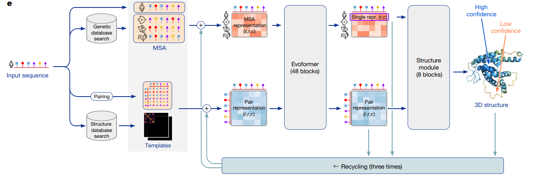
Model architecture

Slide 5
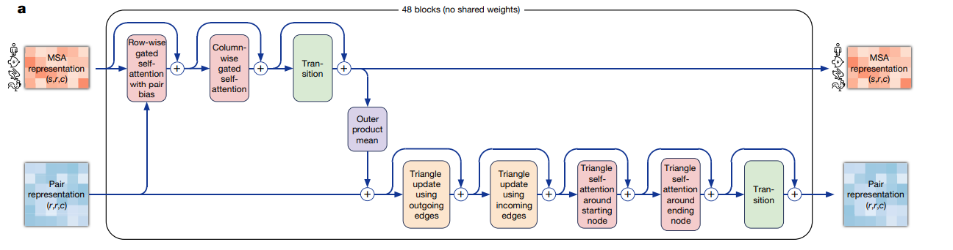
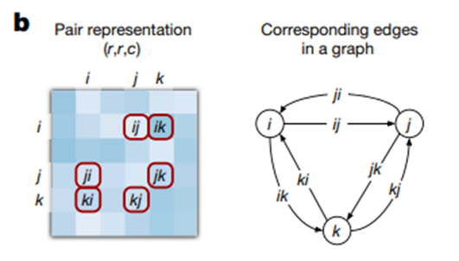
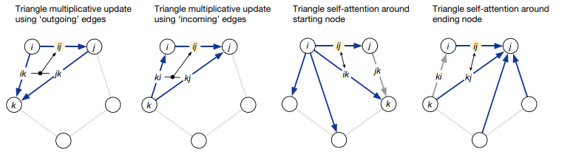
Evoformer

Slide 6
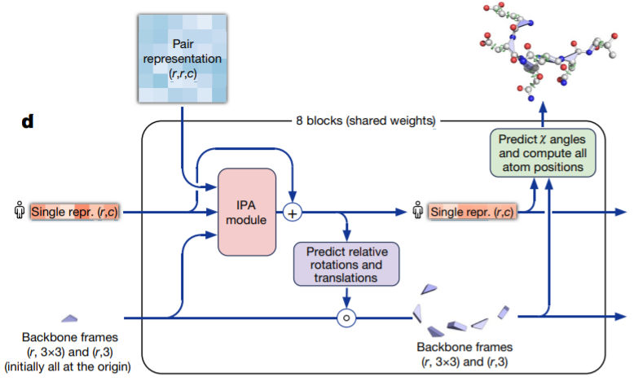
Structure Module

Slide 7
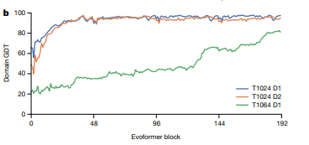
Interpreting
neural network
To understand how AlphaFold predicts protein structure, we trained a separate structure module for each of the 48 Evoformer blocks in the network while keeping all parameters of the main network frozen. Including our recycling stages, this provides a trajectory of 192 intermediate structures
Lmrp
Lmrp
SARS-CoV-2

Slide 8
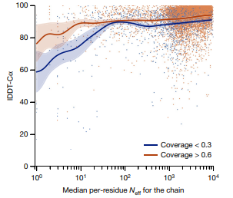
MSA depth

Slide 9
Discussion
1. AlphaFold is a combination of the bioinformatics and physical approaches
2. The ability to handle underspecified structural conditions
3. AlphaFold has already demonstrated its utility to the experimental community

