Slide 4
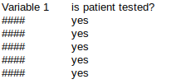
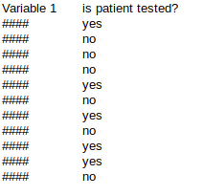
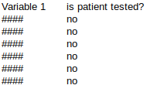
Deduplication based on variable 1
Drop
duplicates
Append to
the tested
patients
dataset
Create a dataframe of var1 duplicates and remove those rows from the original dataset
Is there any
Var1 duplicate
of tested samples
among
non-tested?
Repeat
for
variable2
Append
deduplicated
portions to
the original
dataframe
Divide
tested
and not
no
yes
drop
drop
Drop
duplicates

