Slide 1
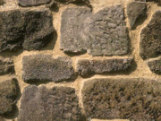
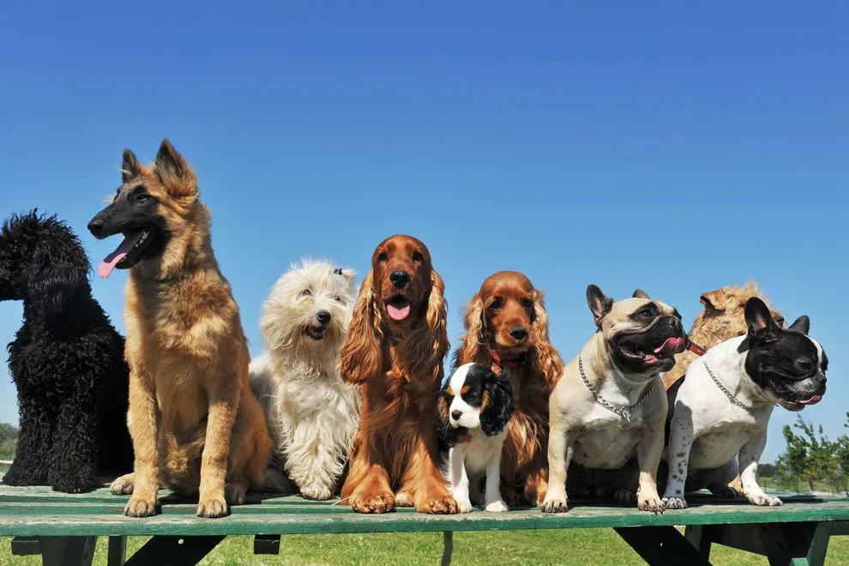




OpenDogNet
How to detect dog breeds with a smartphone

Slide 2
Outline
Introduction
- Why this app, what do we want to achieve ?
The theory
  - How does such an app work ?
  - Convolutional neural networks (CNN) : the artificial intelligence (AI) technology powering the breed identification
  - How do I cast a the neural network into a simple intuitive Android app ?
The practice
  - Let’s test it in real life !
Conclusions
  - does this stuff work or maybe it would be better to get something else even if will cost me money or time watching ads ?

Slide 3

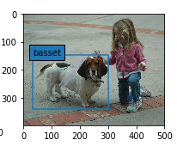
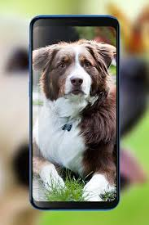

The goal
We use the technology of supervised deep learning to :
Identify with good accuracy (P > 80 %) the breed of a dog on a photo
Build a small app (< 20 MB) that will make run the AI program on an Android device
All to be done using Open Souce software only, the app will be free of charge and will not display ads

Slide 4
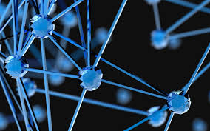
How does it work ?
What is deep learning ? What is a CNN ?
How can I build and train a deep learning alghorithm ?
How do can I deploy the trained AI to an Android app ?

Slide 5
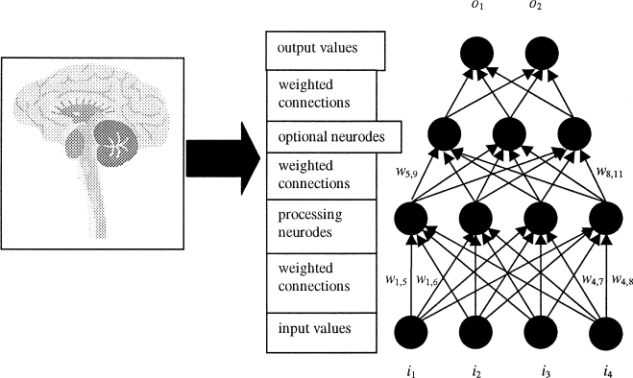
Neural networks : principle of DL
Connected units, named neurons, stacked on layers (that is why is « deep »)
https://www.sciencedirect.com/topics/chemical-engineering/neural-network
Some connections are more equal than the others, so some input information becomes more important than the rest

Slide 6
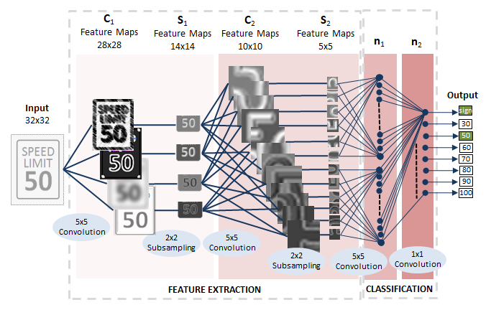
From images to probabilities
Extract edges from the image, identify which edges are most important (neuron weight), pass over to the next layer
Lines to numbers
Label assignment

Slide 7

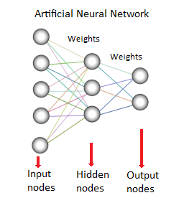
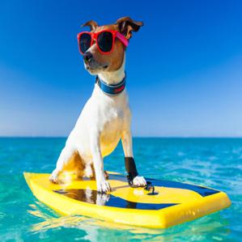
How an AI learns
Input
CNN backbone
flatten
Fully
Connected
Output (4_classes)
Each class has probability 0<P<1
Labels
3 classes = False (0)
1 class = True (1)
299 X 299 X
3
Image features selection
Classification
Check output with labels and update weights to have a better match

Slide 8
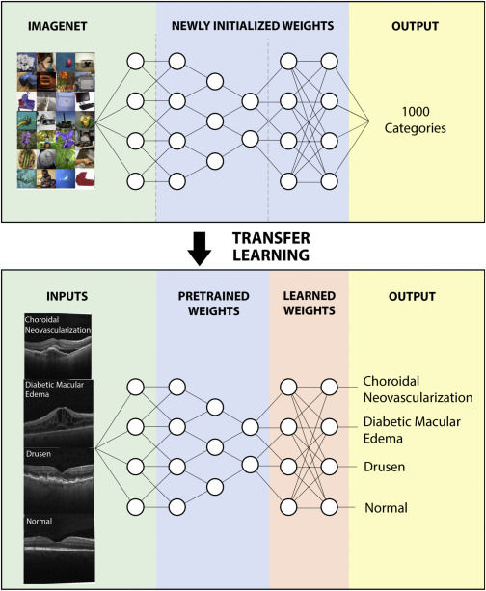
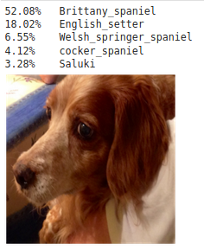
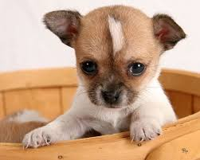
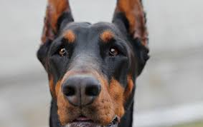
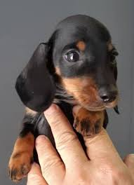
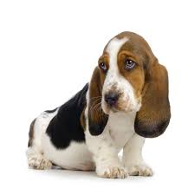
Deep learning applied to breeds
Test the AI
Image input
Classification with
trained model
Probabilities
output
1000 catégories
Breed 1 : probability
Breed 2 : probability
Breed 3 : probability
Breed 4 : probability

Slide 9

Building our deep learning model
Where do I get photos etc. ?
Preprocessing – prepare the data for the AI
Coding the neural network

Slide 10
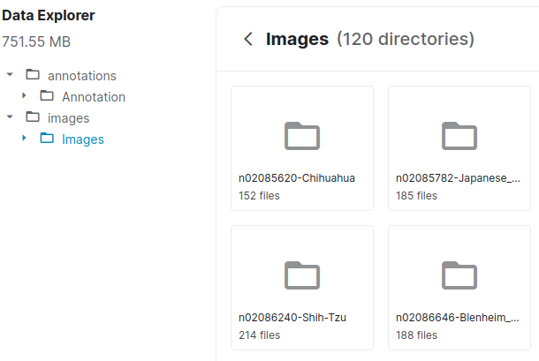
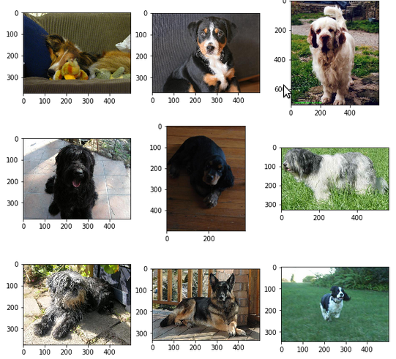
The data to train our model
Stanford dogs
dataset
120 folders (one for each breed) containing a total of 20000+ photos
All available for free from Kaggle.com

Slide 11
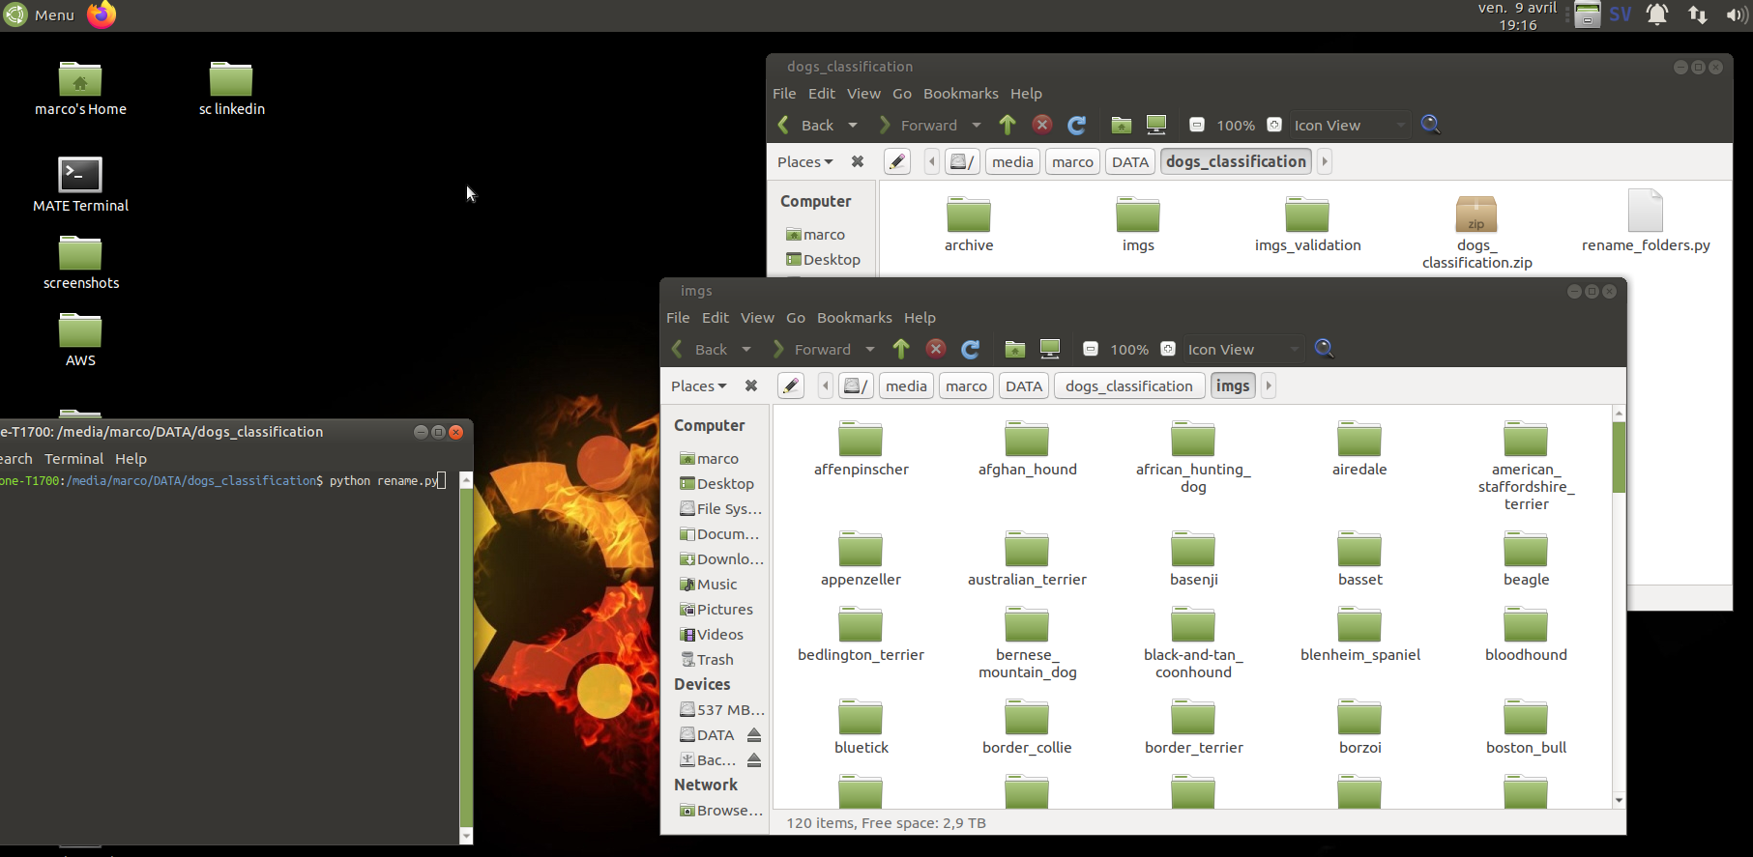
Data pre-processing
Our alghorithm needs labels to understand what a photo corresponds to
Solution : rename each folder and I state that the folder name is the label for each photo that is inside it

Slide 12



How do I build an AI
Time to get to my programming console
- Program in Python and use already written code (libraries) made for deep learning
- Run the program on a powerful server (cloud computing) so that it processes data much faster than my home PC

Slide 13
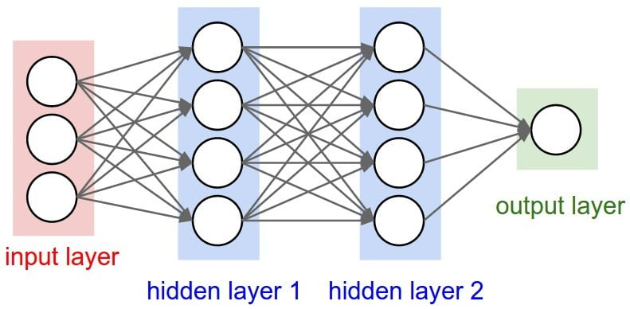

Deploy it to Android
Fully trained
Precise (85% accuracy)
Lightweight (<50 MB)
Works offline

Slide 14

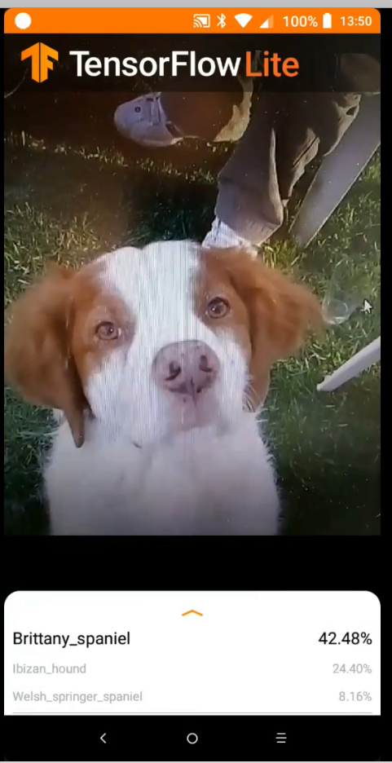


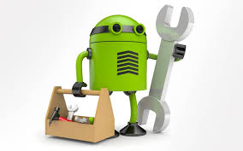
From the PC to the phone
Build the CNN
Train it on dogs photos
(Colabs GPU)
APK
file
85 % accuracy
Tensorflow-Lite
converter
Model file
(.tflite)

Slide 15

Test it on the field !!!
Walk around Marseille old harbour (Vieux Port) and kindly ask dog owners

Slide 16
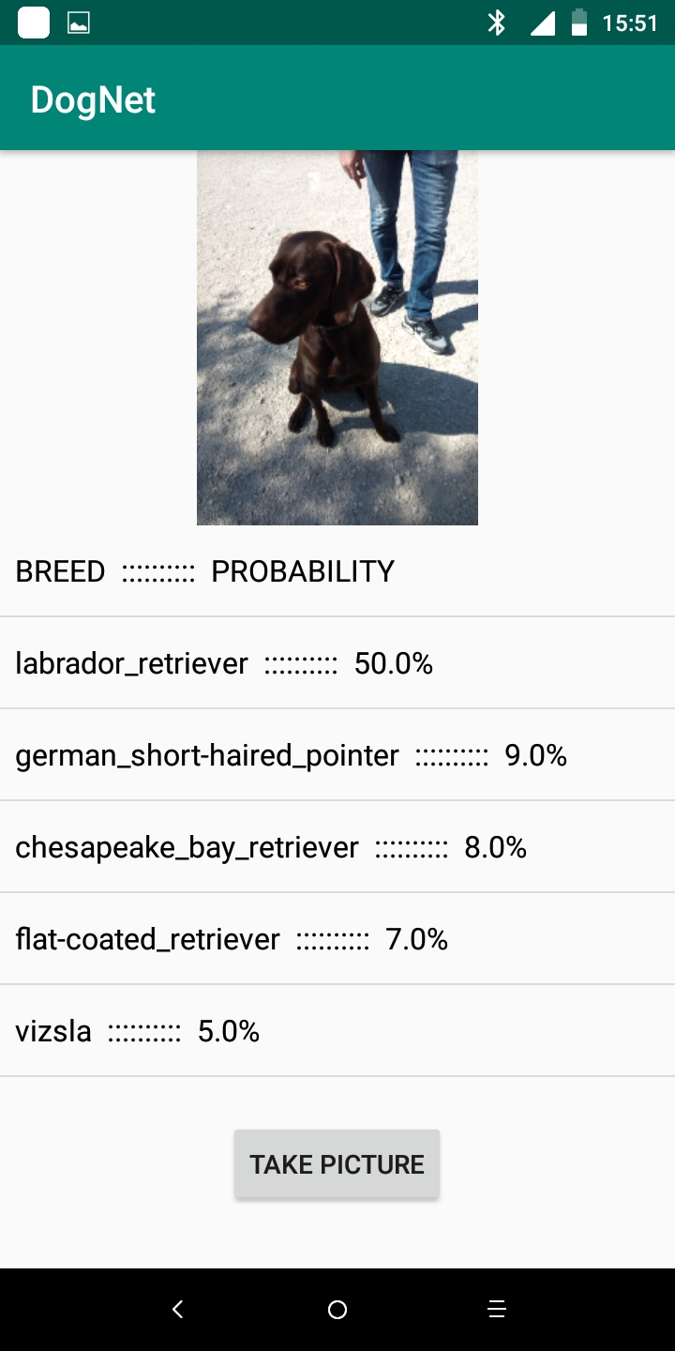
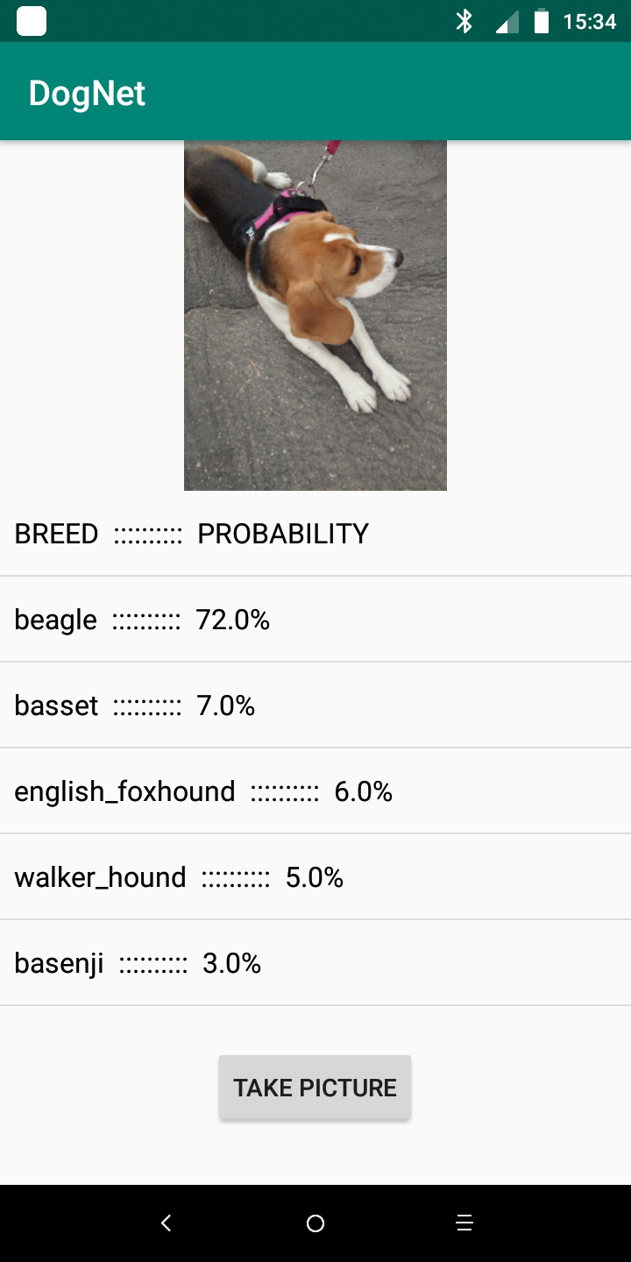
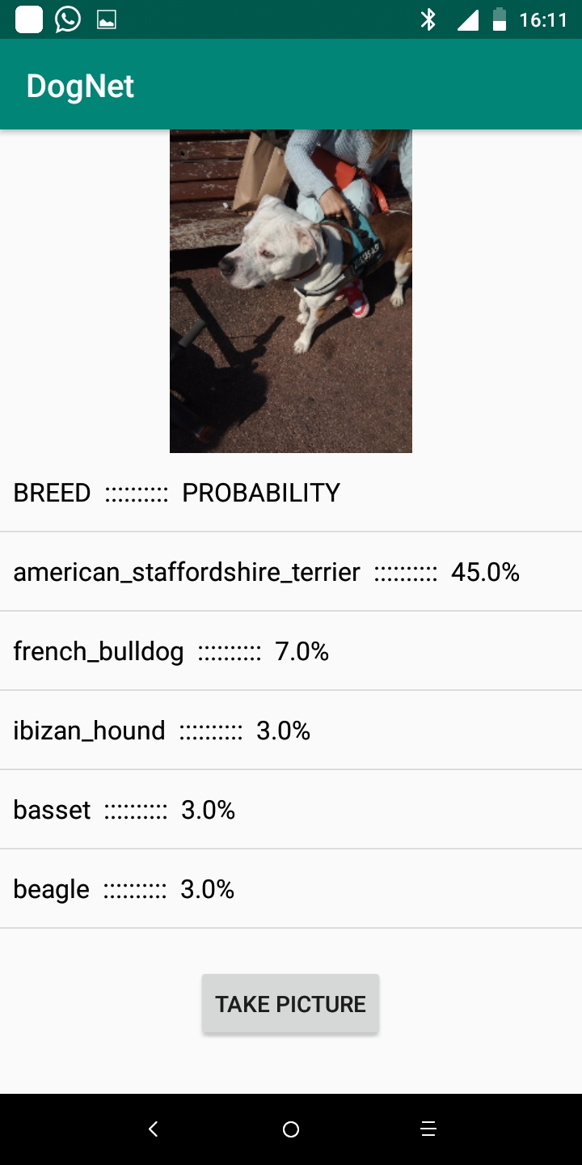
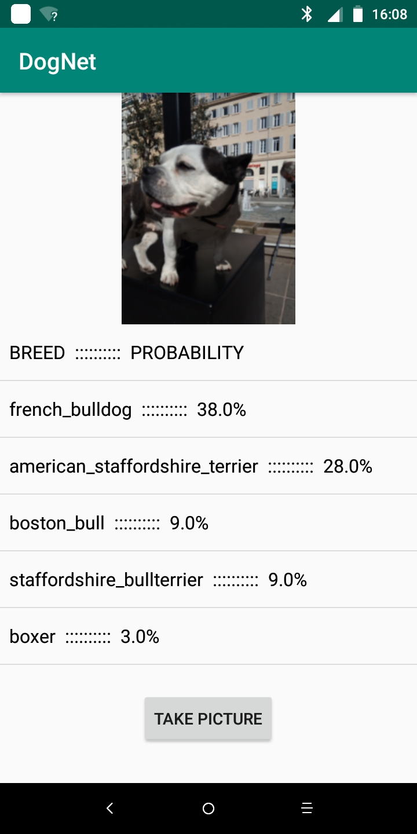
The aftermath
Mixed breed
Correct breed

Slide 17
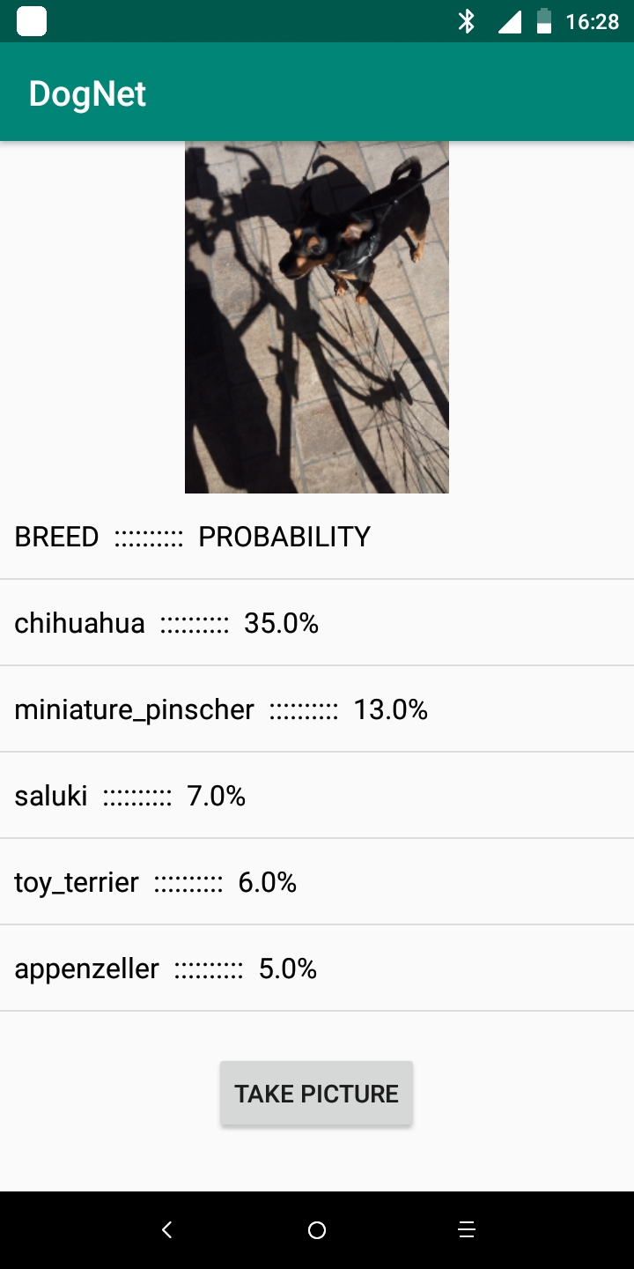
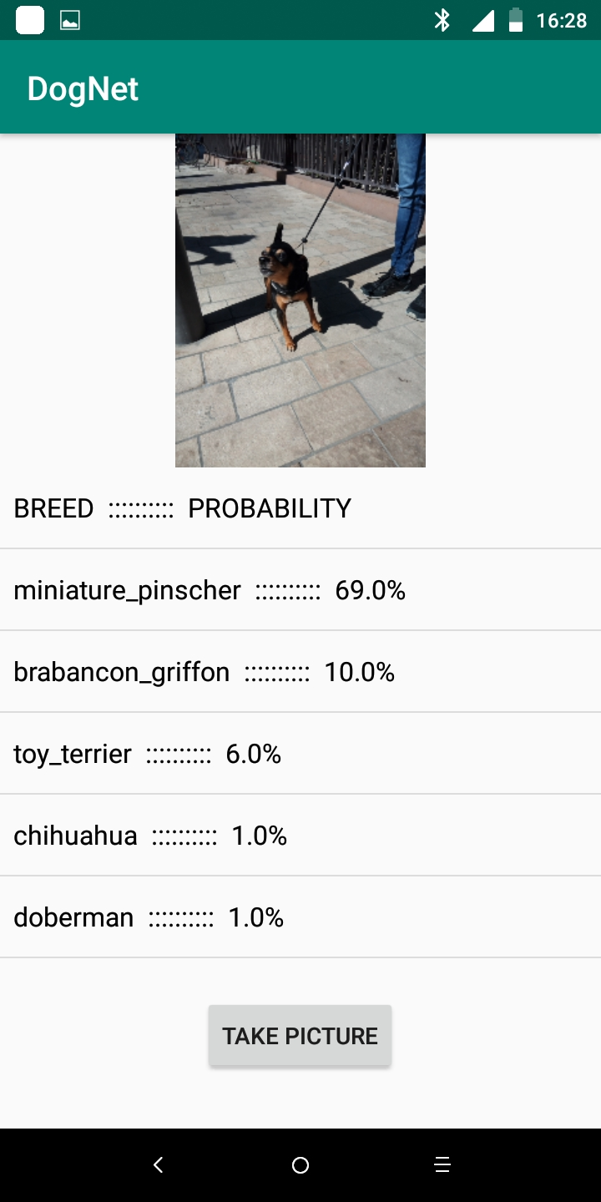
Shadows can confuse an AI
wrong
right
Too many shadows add extra contours

Slide 18
Conclusions
Deep learning model developed with Tensorflow light works like a charm (85 % accuracy on test set)
When deployed to Android, we obtain a lightweight app (14 MB) that recognises correctly most breeds
Dog owners get quite interested and ask questions when they see the app in action
Links to Python codes, references etc. can be found below,
in the video description

Slide 19
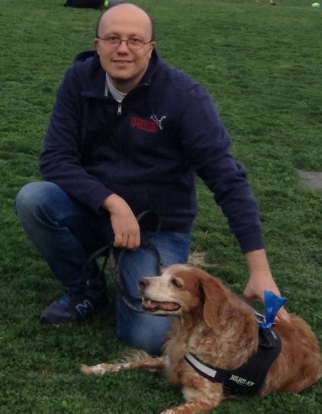
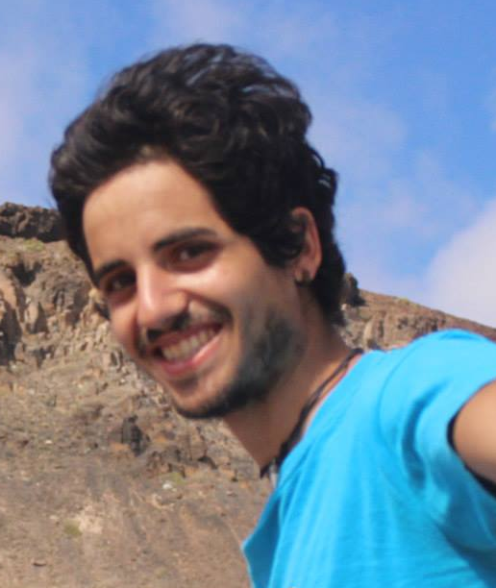

Credits
Android developer : Giulio Giandonato
Main model for test photos: Ala (Giulio’s dog)
Video editing : Giovanni Brajato
Translations
Leszek Spalek : Polish
Kani Pae : Thai
Roberto di Pace : Swedish
Amine Hocine : Arabic
Belinda Verhagen : Dutch
Susan Barnes : German
Oleg Rofman : Russian
Joana Sadio : Portuguese
…. and more friends who translated the app description into even more languages

