Slide 1


Machine Learning for mailing campaigns

Slide 2
Outline
Introduction
- Project aim – business value
Data cleaning and exploration
- Elimination of duplicates and unreasonable values
- Imputation of missing values
- Is our dataset balanced ? Does it contain outliers ?
Modelling
- Data preparation : features engineering, categorical encoding, scaling
- Evaluation of several machine learning (ML) models
- Can the best performing model answer our business questions ?
Conclusions
- Machine learning model performance
- The features that identify an ideal mailing target group of residents

Slide 3

Business case
Extensively mailing a large population is costly and inefficient
Manually identifying responders, who may turn to target customers, would take too long
Solution : get a software to identify them automatically
The data collected so far will « train » it for the job

Slide 4
Project goal
From the personal data collected from the population of a large residential area we want to:
Build a ML model that automatically predicts the whether a resident will respond or not to mailings
Identify the features of a the resident that would most probably respond

Slide 5

THE DATA
Dataset exploration and cleaning : good data valuable insight

Slide 6
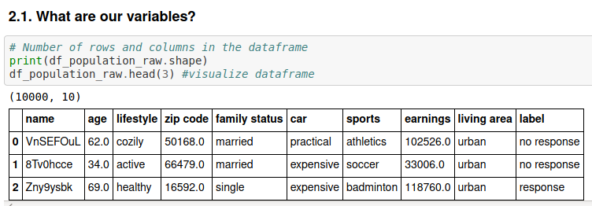
The dataset
- 9 predictive variables, 1 target variable « label »
10000 samples (residents)

Slide 7
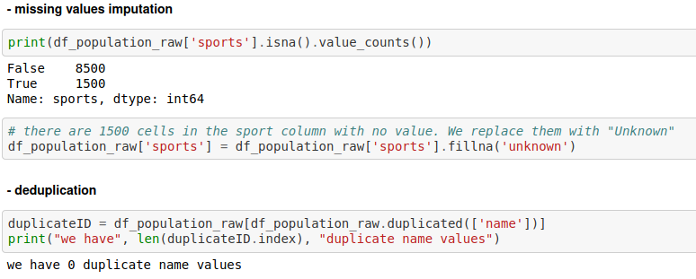
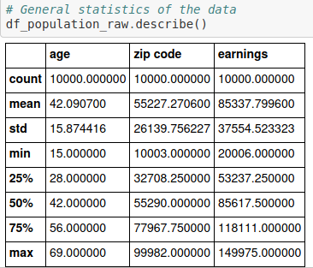
Data cleaning
1) Check for duplicate values
2) Fill missing values (es. Sport = ‘unknown’)
3) Check for unreasonable values (es. Negative age)
No negative values

Slide 8


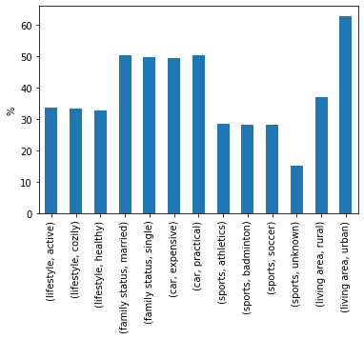
Distribution of categorical data
No response : 66 %
Response : 34 %
- Are categorical features balanced ?
evenly distributed
- Categorical features are balanced

Slide 9
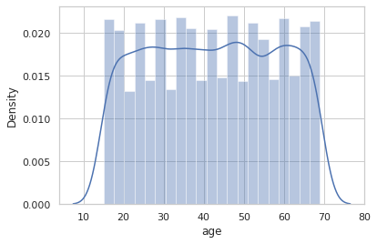
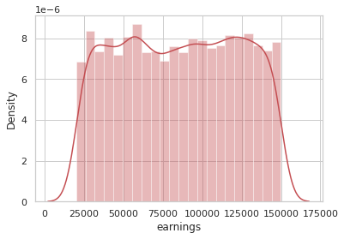
Distribution of numerical data
- Are numerical features balanced ?
- Numerical features are well balanced, evenly distributed, no outliers

Slide 10
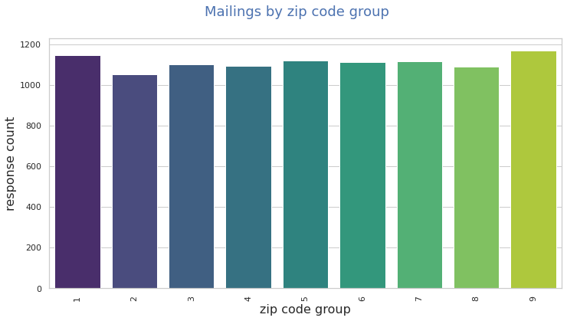
Distribution of geographical data
« Postcode group » feature
Postcode group 1 : 10000- 19999
Postcode group 2 : 20000- 29999
Etc.
Coded in Python as
Zip code//10000
- Are zip codes evenly distributed ?

Slide 11
Preliminary conclusion : the data
Our data are clean
The only variable containing empty values is « sport »
Data are evenly distributed : this is a balanced dataset, no outliers

Slide 12

THE MODEL
- data preparation (encoding)
- selection of the best model

Slide 13

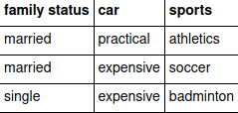
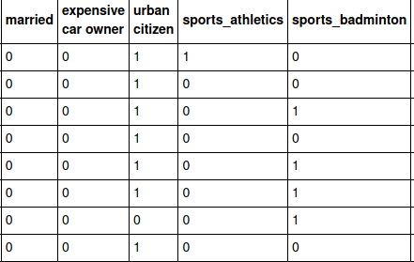


Feature encoding
Human vs. Artificial intelligence (AI) brain
What humans see
What an AI needs to see
predictors
target
Features transformed using binary and one-hot encoding
1 = yes
0 = no

Slide 14
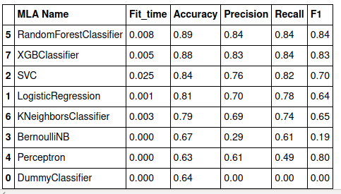

Model selection : test several
The candidates are those tailored to binary classification : responded or not
Competition results
- Best 2 are « random forest » and « xg-boost » classifiers
- Recall is the most important metric : as low false negatives as possible since we don’t want to miss responders

Slide 15


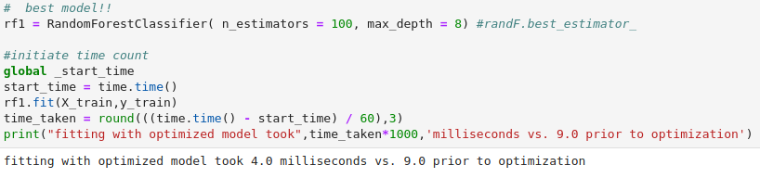
Model hyperparameters tuning
Choice of parameters
to tune
Select best combination
Random Search
The random forest model takes longer that XG-boost. We tuned it to make it faster

Slide 16
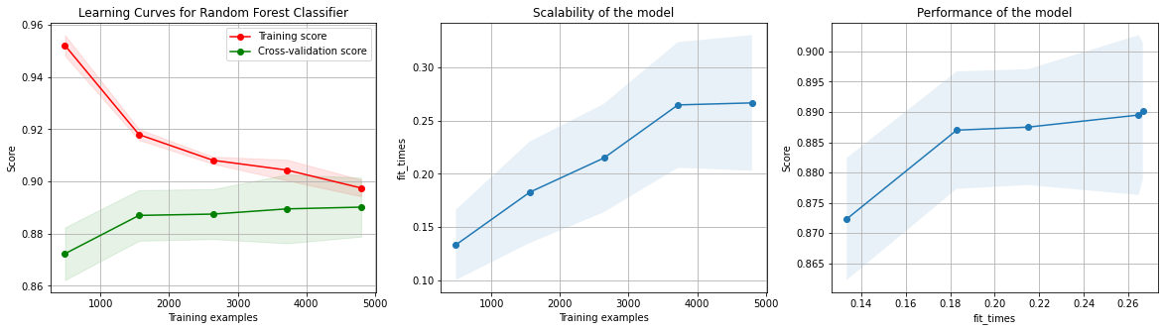
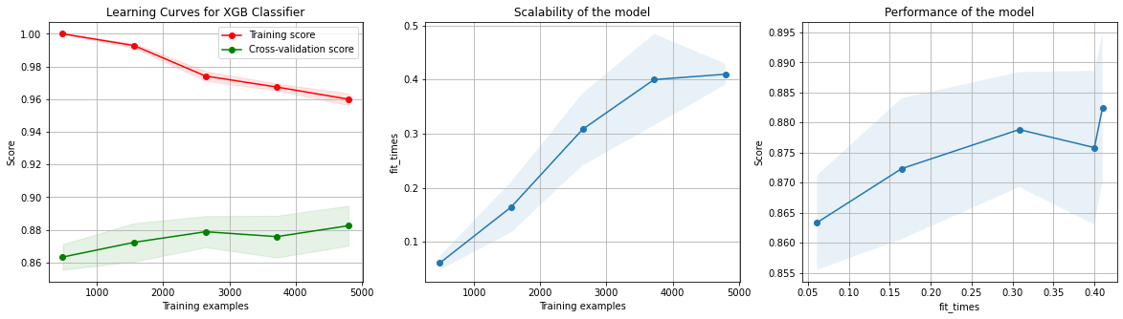
Best two candidates performance
Random forest trained on our data converges faster than XG-Boost and is slightly more accurate

Slide 17
Preliminary conclusion : the model
Features have been engineered to be treated by a ML algorithm
Random Forest Classifier is the best performing model among those tested

Slide 18

Business Q&A
How does the model respond to business questions?

Slide 19
Business questions
What are the most important personal data for the resident response prediction ?
Do age and income correlate to response ?
How do the most important categorical features correlate to response ?

Slide 20
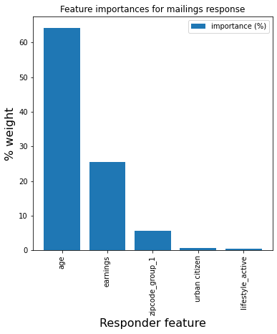
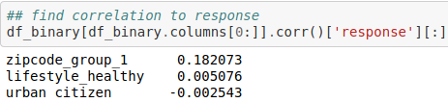
Important predictors
Major
- resident age
- resident income
- lives in the residential area designed by zipcodes ranging from 10000 to 19999
Minor
- lives in a rural area
- has a healthy lifestyle
correlated
anti-correlated

Slide 21
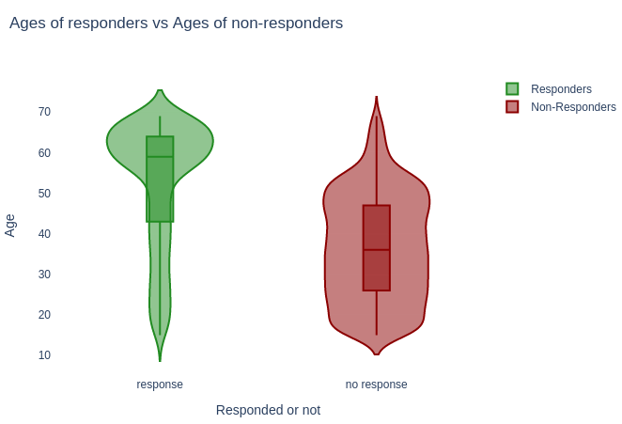
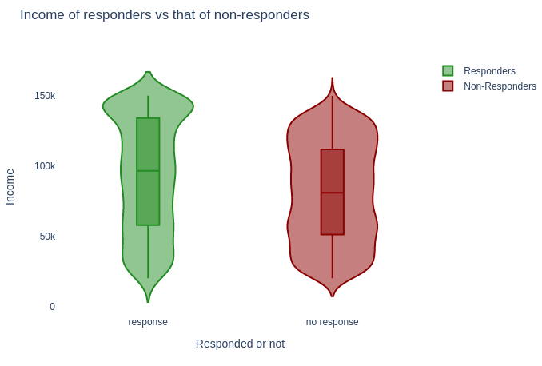
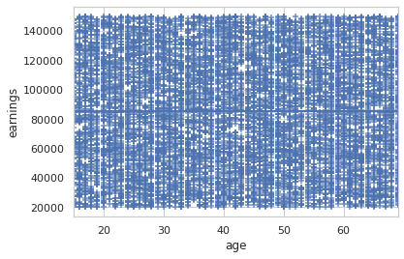
Most reactive groups - age and income
Most responses from older residents (60-70) with high income (150k)
Those two predictors have no correlation

Slide 22
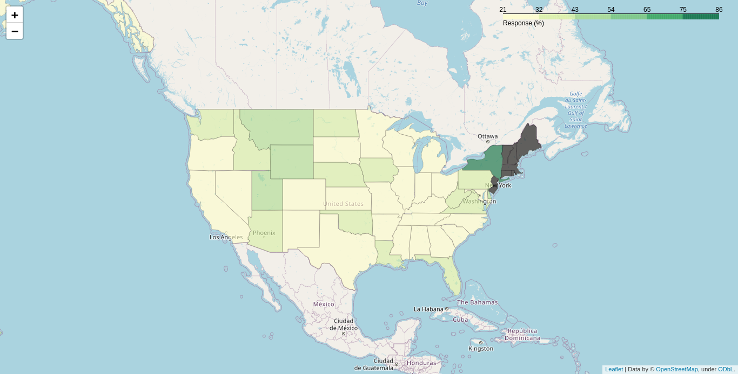
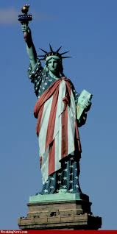
Most reactive groups - geodata
Zip codes predict that best response come from a specific geographical area
Based on zip code values, if the residential area was U.S., most active responders would be in the state of New York

Slide 23
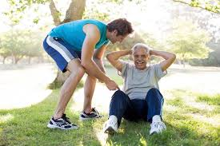
Conclusions
The Random Forest Classifier predicts the response with 90 % accuracy and 84 % recall
The ideal resident with highest response probability should be :
- 60-70 years old
- earning 150k / year
- living in the rural area of a specific region/state
- have an active lifestyle

