Slide 1
From First Enquiry to Treated Patient. Tracked.
THE PATIENT FLOW SYSTEM FOR PRIVATE CLINICS
Done for you. Number agreed in writing.
Or we work free until we deliver
Med spa | Hair | Skin | IVF | Dental | Wellness
Notes:
LIVE CALL, 0:00-1:00. Open with permission and a plan: 'Thanks for the time. I'll keep this to about 20 minutes. First I want to show you something I did on your clinic, then how we fix it, then you tell me if it makes sense.' Ask them to say in one line what they run and how new patients find them today. Write down their answer. You will use it on slide 6.

Slide 2

Who We Are
Growth partner for private clinics
8+ years running paid ads
$2M+ ad spend managed (₹20Cr+)
Nitesh Jaiswal, Founder
Ads, instant reply, booking and tracking under one roof
Notes:
1:00-1:30. Keep it to 30 seconds: 'I've spent 8 years running paid ads, with over $2M in spend managed. For clinics we run the ads, the instant reply, the booking and the tracking.' Then move on. Don't add the '30,000+ appointments' line until you've confirmed what it covers.

Slide 3
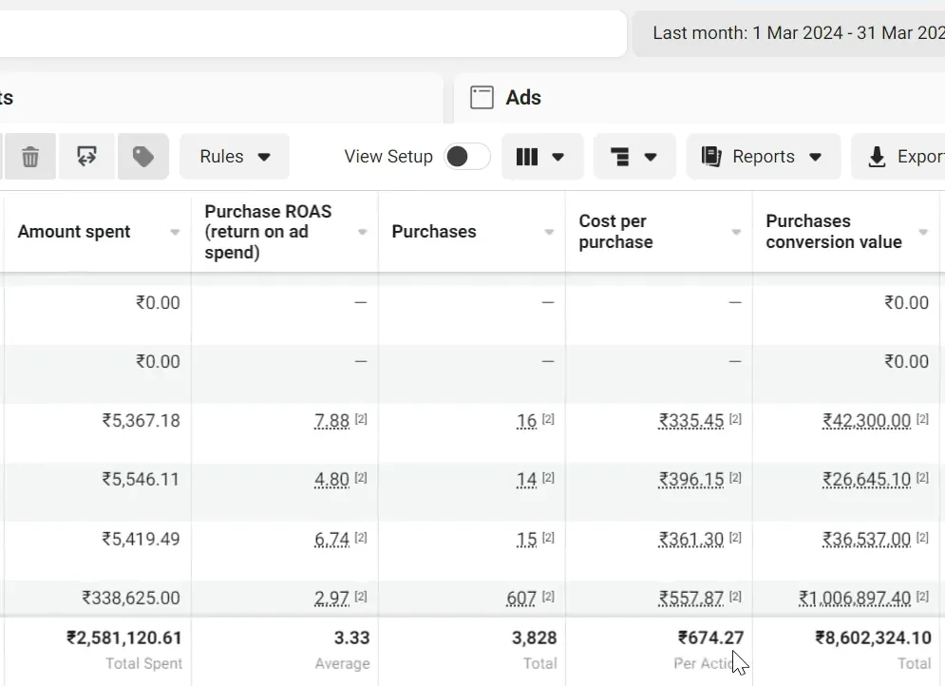
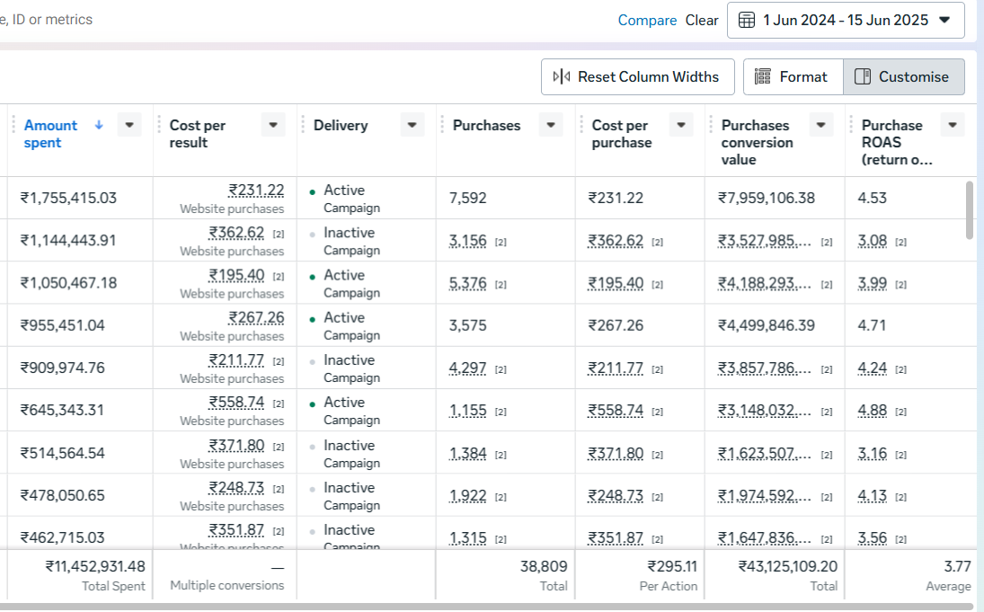
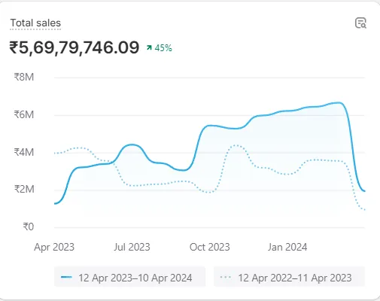
Our ad results, in other industries
₹86L in a month
₹4.31 Cr
₹5.69 Cr in 12 months
Meta purchase value at 3.33 ROAS. Fashion brand, Mar 2024
Meta purchase value at 3.77 ROAS on ₹1.14 Cr spend. D2C brand, Jun 2024 to Jun 2025
Shopify total sales, up 45%. Fashion brand
Real fashion and D2C results, brand names withheld. Clinic results will come from your own weekly report.
Notes:
1:30-2:30. Be upfront: 'These are fashion and D2C brands, not clinics. I'm showing them because it's the same ad engine we'll use for you. We haven't run this for a clinic yet, and I'd rather say that than pretend.' Then: 'What you'll see in your own account is the same kind of report.'
CAPTIONS match what the screenshots show. Be ready for: 'Which brands?' Answer: 'Names are private. Happy to share more when we're working together.' Only add client names after you have their written OK.

Slide 4
We tested your clinic on a Sunday night
TEMPLATE: FILL BEFORE THE CALL
Message sent
9:47 PM Sunday
Paste your screenshot of the enquiry and the reply here
First reply
__ : __
Time they waited
__ hours
While they waited, that patient was messaging the next clinic.
Notes:
2:30-4:00. THIS IS YOUR STRONGEST SLIDE. Do this before every call:
1. Message the clinic through its website form, WhatsApp or Instagram, posing as a patient asking about a treatment. Do it at night or on a weekend if you can.
2. Screenshot the enquiry and the first reply, with times.
3. Fill the three boxes. If they have not replied yet, write 'No reply yet' and the hours waited.
4. Delete the yellow TEMPLATE badge and this note before presenting.
Say: 'Before this call I sent your clinic a message the way a new patient would. This is what happened.' Then stop talking and let them read it.
RULES: Use only your own message. Never use real patient data. Be honest and polite. If their reply was fast, say so and congratulate them, then move to Track and Show up, where most clinics still leak. If you can't run the test, delete this slide.

Slide 5



Which clinic are you?
Relying on referrals and word of mouth
Advertising, but it's not converting
Paying an agency for leads
Busy one month, quiet the next. Growth depends on who happens to recommend you.
Slow replies, leads go cold, no-shows, and enquiries that never become appointments.
You get leads and a cost-per-lead report. Nobody tracks who booked, came in or paid.
WHERE WE START
WHERE WE START
WHERE WE START
Attract: steady new enquiries, plus past patients and reviews working for you
Reply and Show up: fix the leak before you spend more
Track: every lead followed to a treated patient and revenue
Notes:
4:00-6:00. DISCOVERY. Ask: 'Which of these sounds most like you?' Many clinics are two at once.
Follow-ups:
- Referral clinic: 'How many new patients did you get last month, and how many came from referrals?'
- Already advertising: 'What do you spend a month, and how fast do you reply to new enquiries?'
- Agency clinic: 'Can your agency tell you how many new patients the ads brought in last month?'
Write their numbers down for slide 11.

Slide 6
Most agencies stop at the lead. We don't
MOST AGENCIES
PATIENT FLOW SYSTEM
Where the job ends
A lead or a click
An attended, treated patient
New enquiry
Left to your staff, hours later
Instant reply in minutes, day and night
No-shows
Your problem
Reminders, deposits, refilled slots
Your report
Reach and cost per lead
Lead to booked to attended to treated to revenue
Your agency's job ends at the lead. Ours ends at your chair.
Notes:
6:00-7:30. Say 'most agencies' or 'many agencies', never a competitor's name. Their own words from the last slide set this up: 'You told me your agency reports cost per lead. Nobody tracks what happens after. That's the gap we fill.'

Slide 7





The Patient Flow System
01
02
03
04
05
Attract
Qualify
Reply
Show up
Track
Google and Meta ads, past-patient win-back and review requests
A booking page and form questions that filter out tyre-kickers
Instant text and call-back in minutes. Your staff get an alert
Reminders, optional deposit, cancelled slots refilled
Every lead followed to attended, treated and revenue
FIXES: UNEVEN REFERRAL FLOW
FIXES: POOR-QUALITY LEADS
FIXES: LEADS GOING COLD
FIXES: NO-SHOWS
FIXES: NO ONE COUNTING PATIENTS
We build it, run it and fix it. You get a weekly report across all five stages.
Start: Lead Leak Audit in 5 business days. First campaigns live in 14.
Notes:
7:30-10:00. Walk the five stages, but spend your time where THEY said they leak:
- Referral clinic: Attract, then Reply.
- Already advertising: Reply and Show up. 'Before you spend another rupee on ads, let's fix the leak.'
- Paying an agency: Track.
Next two slides show what each stage looks like in practice.
CLAIM CHECKS: past-patient win-back and review requests are the Win-Back and Review Booster bonuses on your site. Tracking to revenue needs the clinic to share what each treatment is worth. Confirm that is in scope.

Slide 8
What your patients and team see
SAMPLE SCREENS
Your Clinic | Sun 9:47 PM
This week: new-patient appointments
Hi, I saw your ad. Anything free this week?
Mon
Tue
Wed
Thu
Fri
Hi! Yes. Thursday 4:30 PM or Friday 11:00 AM. Which works better?
New patient
Open
New patient
Open
New patient
Open
New patient
New patient
New patient
Open
Friday 11 works!
Booked. We'll send a reminder the day before.
New patient
Open
New patient
New patient
New patient
Replied in under 1 minute
Reminder sent to 8 patients for tomorrow
Illustrations of the system. Names and times are examples, not client data.
Notes:
10:00-12:00. DEMO MOMENT. Say: 'This is the Reply and Show up stages. On the left, a lead messages at 9:47 on a Sunday and gets an answer in under a minute with real times offered. On the right, your calendar fills, and reminders go out so people show up.'
Ask: 'What happens in your clinic today when someone messages at that time?'
BETTER THAN A MOCK: if you have a real demo set up (a test number, a test calendar), switch to it and show it live, or play a 60-second screen recording. Tell them it's a demo clinic, not a client.

Slide 9
Your weekly report, lead to revenue
SAMPLE REPORT
240
96
72
41
₹8.2L
Leads
Booked
Attended
Treated
Revenue
Source | Leads | Attended | Treated
Google Search | 110 | 34 | 18
Meta ads | 100 | 26 | 14
Past patients | 30 | 12 | 9
Sample layout with example numbers. Not client results.
Notes:
12:00-14:00. THE TRACK STAGE. Say: 'This is what lands in your inbox every week. Not reach, not cost per lead. How many leads came in, how many booked, how many came, how many were treated, and where each came from.'
Ask: 'If you saw this every Monday, what would you do differently?'
Point at the table: 'This is how you find out which source is actually paying for itself.'
REVENUE NEEDS THE CLINIC'S DATA: they have to share treatment value from their booking or billing system. Say so, so it isn't a surprise later.
All numbers here are sample. They add up: 240 leads, 96 booked, 72 attended, 41 treated.

Slide 10
Your first 90 days
1
2
3
4
5
Day 5
Day 7
Day 14
Day 30
Day 90
Lead Leak Audit
Replies go live
Ads go live
Your number
Guarantee check
A clear list of where patients leak out today
Every enquiry answered in minutes
Campaigns and your booking page running
Agreed in writing, from real data
Number hit, or we work free until it is
You see something real at every step.
Notes:
14:00-15:30. Make it concrete: 'If we start on [date], the audit lands by [date], replies are live by [date], ads go live by [date], and we sit down on [day 30] to agree your number.' Only promise these dates if your team can hit them. Check capacity before the call.

Slide 11
What one more patient is worth
FILL LIVE WITH THE CLINIC
×
=
Extra attended patients a month
Value of a new patient
Extra revenue every month
____
₹ ______
₹ ______
Compare it with what you put in
Your ad spend ₹ ______ + Our fee ₹ ______
Use the clinic's own numbers from the worksheet. We don't guess for you.
Notes:
15:30-18:00. Fill this in LIVE with their numbers from slide 5. Example flow: 'You said a new patient is worth about [X] over the first year. If we bring [Y] extra attended patients a month, that's [X x Y] a month. Against [ad spend + our fee]. Does that make sense?' Then be quiet.
Never invent their numbers. If they don't know the value of a patient, ask for their average first-visit spend and the number of return visits.
Delete the yellow badge before presenting, or keep it as a cue for yourself and hide it.

Slide 12
Our Guarantee and Fee
If we miss your number by day 90, we work free until we deliver it
How you pay
Ad spend: paid by you directly to Google and Meta
Our fee: set for your clinic and quoted before you start
First 90 days, then month to month
Number of attended appointments agreed in writing at day 30
Counted from your booking system, not ad platform clicks
One clinic per area
Notes:
18:00-20:00. Say it exactly: 'We agree your number of attended appointments in writing at day 30. If we haven't delivered it by day 90, we keep managing your campaigns at no charge until we do.' Do NOT say 'or you don't pay' or 'money back': the terms say we keep working free, not a refund.
STATE YOUR FEE OUT LOUD HERE. If you have a fixed fee, type it into the 'Our fee' line before the call. After you say the number, stop talking.
If they push on price, trade for something real (a longer term, a faster start). Don't cut the fee for nothing.

Slide 13
Let's fill your calendar
1
Agree your ad budget and our fee
Dreamline Labs
2
Sign the agreement and share ad, booking and lead access
connect@dreamlinelabs.com
+91 7977193104
3
Lead Leak Audit lands within 5 business days
Mumbai, India
We take one clinic per area. Let's check yours.
Notes:
THE CLOSE. Say: 'Based on what you told me, [their biggest leak] is costing you [their number]. Does it make sense to start?' Then be quiet.
If yes: send the agreement the same day and book the audit kickoff.
If not yet: book a dated follow-up before you hang up. Ask 'What would you need to see to feel sure?' Never end with 'let me know'.
SCARCITY: 'One clinic per area' is true for your model. Check whether their area is free BEFORE the call, and only say it's available if it is. Don't invent a start-date deadline.

Slide 14
Backup: questions clinics ask
We tried agencies before.
Do you have clinic case studies?
Tell us what went wrong. Then we show how reply speed, tracking and the guarantee handle it.
Not yet, and we won't invent any. This is our first programme for clinics. You see every number in your own weekly report.
What does it cost?
Are the ads allowed?
Ad spend goes directly to Google and Meta. Our fee is set for your clinic and quoted before you start.
Every ad is checked against Meta's health and cosmetic ad rules before launch. We go through what applies to your treatments first.
Notes:
BACKUP. Go here only if asked.
- 'We tried agencies': ask what they didn't like, then link it to reply speed, tracking or the guarantee.
- Case studies: use the honest line. Pair it with slide 3 and the secret-shopper test.
- Cost: give the number from the fee slide.
- Ads allowed: don't promise beyond platform-rule checks. For IVF and fertility, advertising rules are stricter and differ by country. Check with the clinic and your own advisers before you promise anything about specific treatment claims.

Slide 15
Med Spa Clinic, Mumbai (demo)
DEMO DATA
CASE STUDY 01
72
attended new-patient appointments a month, up from 22
4h → 2 min
58% → 81%
₹2,400
First reply
Show-up rate
Cost per attended appt
Notes:
HIDDEN TEMPLATE. This slide is not shown in the slideshow. It is a layout for your FIRST REAL clinic case study. Every number is made-up demo data.
TO USE: right-click the slide in the thumbnail panel and un-hide it, move it after slide 3, then:
1. Change the title to the real clinic (or 'Anonymous Med Spa, Mumbai').
2. Right-click the chart > Edit Data and enter the real monthly attended appointments.
3. Update the big number, the 'up from' number and the three chips.
4. Delete the DEMO DATA badge and '(demo)' labels.
5. Get the clinic's written OK. Never show patient names or data.
Count only appointments marked attended in the clinic's booking system, same as the guarantee.

