Slide 1
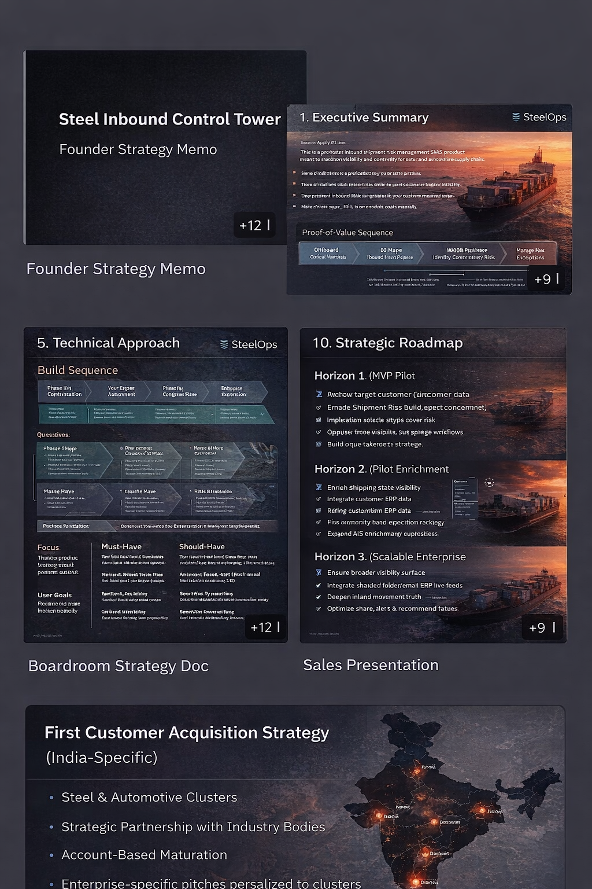
SteelOps
Steel Inbound
Control Tower
Boardroom-ready strategy, product narrative, pilot roadmap, and India-first customer acquisition story
Steel-specific, not generic
Pilot-ready
India-first
What the buyer understands in one look:
Why steel inbound risk is different from generic procurement
How data flows from Excel, ERP, emails and vessel updates into one truth
What the dashboard shows and how teams act on exceptions
How to land the first pilot with large Indian producers and eastern-belt plants
Client presentation
Notes:
[Sources] Background visual: AI-generated internal concept image, no external asset. Claims context from: Tata Steel Integrated Report FY2024-25 (digitalisation and supply-chain optimisation), Reuters 2026 report on draft National Steel Policy 2025, JSW Steel corporate presentation (bulk raw material supply-chain digitalization), AM/NS India press releases on expansion.

Slide 2
Why this matters now
India’s steel sector is expanding while raw-material security and operating coordination remain management-level concerns.
India steel capacity target
Coking coal dependence
Tata supply-chain scale
Expansion momentum
400 MT
~90%
105 MT
15 MT
Draft policy target by 2035-36
Draft policy points to import dependence reduction need
Raw materials, finished goods, scrap and by-products moved across India operations
AM/NS Hazira target by end-2026
Why a control tower wins now
First-wave target fit
Capacity growth creates more nominations, movements, berth events and inland dispatches.
Target
Why now
Best wedge
Operational complexity compounds even when procurement systems already exist.
Tata Steel
Complex network + digital maturity
One corridor / one exception class
JSW Steel
Raw-material security + digital bulk raw material programs
Demurrage + stock-cover confidence
Large producers already talk publicly about digitalisation, logistics and raw-material security.
AM/NS India
Expansion momentum + scale-up discipline
Hazira inbound command center
You are selling deeper operational control, not the idea that the problem exists.
East-belt producers
Regional proximity + visible logistics pain
Single-plant pilot using uploads first
Integrated plants lose money when delays translate into stock-cover risk too late.
One prevented disruption or demurrage event can justify pilot spend.
Steel-specific inbound control tower for raw-material continuity risk
Notes:
[Sources] Claims: Reuters, April 9 2026, draft National Steel Policy 2025 (capacity target 400 MT; coking coal dependence reduction) turn1view4. Tata Steel Integrated Report FY2024-25 pages 5 and 42 (digitalisation, supply-chain optimisation, ~105 MT movement) turn1view1 lines 115-120 and 4311-4320. JSW Steel corporate presentation May 2023 (bulk raw material supply chain digitalization; integrated control tower) turn2search3. AM/NS India public updates on Hazira expansion momentum to 15 MT by end-2026 from prior research results turn0search7/12/17.

Slide 3
The operating problem today
Most companies already have data — they do not have one operating truth.
How the process runs now
What the buyer wants instead
ERP / SAP
Today
SteelOps
POs, receipts, inventory snapshots
What goes wrong
Multiple trackers by function
One tenant-scoped command center
Vessel arrival and plant availability get treated as the same thing
PO visibility
Material-state visibility
Excel trackers
Reactive calls
Auto-opened exceptions + ownership
Shipment sheets, ETA trackers, stock calculations
Delay information shows up in different teams at different times
Purchased tonnes
Available-to-consume truth
Low trust in updates
Confidence + freshness shown openly
Stock cover is recalculated manually, often after the risk has moved
WhatsApp / calls
CHA updates, transporter messages, port exceptions
Ownership during exceptions is implicit, not logged
Daily review meetings
Manual reconciliation and fire-fighting
Steel-specific inbound control tower for raw-material continuity risk
Notes:
[Sources] No external factual claim beyond general product framing; narrative derived from internal blueprint and user-provided operating model.

Slide 4
What the product is
A steel-specific inbound decision layer beside ERP, not a generic procurement suite.
Core promise
What it is / what it is not
Turn fragmented shipment, port, inland, stock and quality signals into one operating rhythm for procurement, logistics, planning and plant teams.
What it is
What it is not
Decision layer for inbound raw materials
ERP replacement
Operational truth across movement + stock + quality
Just a vessel tracker
Live inbound truth
Shipment, port and inland visibility tied to plant/material context
Workflow system for exceptions
Static BI dashboard
Predictive continuity-risk lens
Generic source-to-pay platform
Days-of-cover risk
Available-to-consume logic, not just purchased tonnes
Exception ownership
Network overview
Shipment visibility
Cases, comments, owners, status and closure trail
Sponsor-level risk snapshot
Timeline, ETA and state contribution
Management visibility
One sponsor view for critical risks and protected value
Stock-cover engine
Exception room
Days-of-cover, breach date, confidence
Owner, status, comments, next step
Steel-specific inbound control tower for raw-material continuity risk
Notes:
[Sources] Product definition derived from user-provided blueprint and internal product scoping; no external assets or non-trivial public claims.

Slide 5
How the system works
The MVP is designed to start manual, then become progressively passive.
1
1. Ingest
2
2. Normalize
3
3. Derive state
CSV/XLSX uploads first; later email, AIS and ERP feeds
Resolve plant, material, shipment and threshold entities by tenant
On water, at port, discharging, inland, delivered
4
4. Calculate risk
5
5. Open exceptions
6
6. Drive action
Days of cover, breach date, status, confidence
Trigger cases for critical stock, ETA delay, stale updates
Assign owner, add notes, close the loop in one workflow
Onboarding truth: start with three files (shipments, stock snapshots, thresholds) → prove risk visibility in days → then layer in automation.
Steel-specific inbound control tower for raw-material continuity risk
Notes:
[Sources] System flow is internal product architecture derived from user-provided blueprint and implemented build sequence; no external claims.

Slide 6
What data the system uses
The product works with imperfect, staged inputs instead of waiting for a perfect digital estate.
Day-1 onboarding data
Automation roadmap
Input
Used for
MVP mode
Phase A
Manual uploads
Shipment tracker
Shipment master, ETA, quantity, route
Upload / XLSX
Fastest path to first insight during pilot
Stock snapshot
Available stock + daily consumption
Upload / CSV
Threshold file
Warning / critical days of cover
Upload / CSV
Phase B
Shared mailbox / folder
Port events
At port / discharging states
Optional manual
Reduce friction without ERP projects
Inland movements
Truck / rail progress to plant
Optional manual
Phase C
Vessel enrichment
Optional ETA lift for ocean leg
Phase D
ERP / TMS connectors
Scale once trust and ROI are proven
Key design principle
Never ask users to maintain data they already maintain somewhere else. Absorb the signal; only ask for exception-level input.
Steel-specific inbound control tower for raw-material continuity risk
Notes:
[Sources] Data approach derived from implemented MVP design and user-provided blueprint; no external claims.

Slide 7
Dashboard view 1 — Command center
This is the first screen an operations leader or sponsor should understand in under one minute.
Inbound Control Tower
Demo tenant
Live
Overview
Plants tracked
Critical risks
Warnings
Open exceptions
4
2
3
7
Shipments
Stock cover
At-risk materials board
Top active exception
Plant
Material
Current stock
Inbound
Days
Status
Dolvi coking coal cover likely to breach in 4.3 days after ETA moved by +2.1 days.
Exceptions
Dolvi
Coking coal
120k
75k
4.3
Critical
Hazira
Limestone
90k
25k
7.8
Warning
Owner: unassigned
High
Inland
Jamshedpur
PCI coal
110k
40k
9.5
Safe
Bokaro region
Scrap mix
--
15k
--
Insufficient
Data freshness
Admin
Shipment tracker: 08:12
Stock snapshot: 07:45
Thresholds: 2 days ago
Confidence: medium
Illustrative product screen — command center view
Notes:
[Sources] Illustrative internal product screenshot built for presentation; no external asset. Dashboard values are mock data for demonstration only.

Slide 8
Dashboard view 2 — Shipments and workflow
One movement change should translate into one action record.
Shipment visibility
Exception room
Shipment
Plant
State
ETA
Band
Critical | Stock-cover breach risk
Unassigned
!
SHP-001
Dolvi
On water
23 Apr
Low
Dolvi / Coking coal
SHP-004
Hazira
At port
21 Apr
Med
Trigger source: stock-cover engine + ETA delay
Recommended next step: review alternate inbound or approve corrective logistics action
SHP-007
Jamshedpur
In transit
20 Apr
High
Shipment detail — SHP-001
Time
Actor
Update
08:14
System
Exception opened after cover fell below threshold
08:20
Planner
Needs review against substitute blend options
Loaded
On water
At port
Inland
Plant
08:31
Logistics
Port queue issue; ETA shifted +2.1 days
Planned ETA: 20 Apr
Current ETA: 23 Apr
Confidence: medium
Latest source: shipment tracker upload
Contribution band: low
Not counted as fully available to plant yet
Action controls
Assign owner
In progress
Add note
Resolve
Illustrative product screens — shipment visibility and workflow views
Notes:
[Sources] Illustrative internal product screenshots built for presentation; no external assets.

Slide 9
Pilot design, implementation and value proof
The first sale should be a narrow pilot with measurable operating outcomes.
10–14 week pilot shape
Pilot KPI pack
Weeks 1–2
Scope one plant, one or two materials, map trackers and owners
Days-of-cover warning accuracy
Critical exceptions caught before impact
Manual follow-up reduction
Weeks 3–5
Upload ingestion, thresholds, initial stock-cover and shipment views
Demurrage / expedite visibility
Weeks 6–8
Shadow-mode operating reviews and signal calibration
What the buyer is buying
Weeks 9–14
Live usage, exception handling, quantified value readout
Today
After pilot
Fire drills
Earlier warning
Parallel trackers
Shared truth
Implicit ownership
Named owner + case trail
Late escalation
Structured action
Steel-specific inbound control tower for raw-material continuity risk
Notes:
[Sources] Pilot structure and KPI framing derive from user-provided blueprint and prior internal build plan; no external factual claim.

Slide 10
First customer acquisition strategy — India specific
Land where route complexity, continuity risk and sponsor visibility are all high.
Account priority
How to win the first meetings
Wave
Target
Wedge
1
Lead with one disruption story, not a product demo.
1
JSW / Tata / AMNS
One plant corridor + stock-cover + exceptions
2
East-belt integrated / regional
Local pilot, faster founder-led motion
2
Ask for the last serious inbound issue and reconstruct where the first signal appeared.
3
Secondary steel groups
Lighter SKU after proof points
3
Offer a 10–14 week pilot with uploads first and no ERP dependency.
Ranchi / Jharkhand advantage
Use eastern-belt proximity to sell discovery depth, not small-company positioning: Jamshedpur / Bokaro / regional steel and mining ecosystems make operating pain tangible.
4
Anchor success on stock-cover confidence, exception speed and sponsor visibility.
5
Use one logo / proof point to move into adjacent integrated producers and eastern-belt plants.
Initial commercial framing
Enterprise pilot fee + implementation; annual subscription expands by plant / network scope, not seats alone.
Steel-specific inbound control tower for raw-material continuity risk
Notes:
[Sources] Public company context from Tata Steel FY2024-25 integrated report turn1view1, JSW Steel digital bulk raw material supply-chain references turn2search3/9, AM/NS India expansion context from press releases turn1view3. Regional context also informed by Bokaro/Jharkhand public references from prior research turn0search8/23.

