Slide 1
PRODUCT TOUR
Opsfolio Suite
GRC Engineering · Continuous Assurance · AI-Native Governance
A live walkthrough of the platform that converts compliance frameworks into executable, continuously-verified controls.
Netspective Communications LLC
opsfolio.com · Confidential · May 2026

Slide 2
Today's Tour
01
02
03
The Problem
Paradigm Shift
The Ecosystem
Why traditional GRC fails modern infrastructure
Operational Truth™ and Compliance as Code
Fleetfolio + Qualityfolio feeding Opsfolio Suite
04
05
06
Product Tour
Architecture
CaaS & Close
Live walkthrough of every major module
Multi-tenant, multi-framework, AI-native
Delivery model, guarantee, and next steps
opsfolio.com · Confidential

Slide 3
THE PROBLEM
Compliance Is
Broken By Design
Every GRC tool in the market — Vanta, Drata, ServiceNow, RSA Archer — shares the same architecture: compliance is a documentation state assembled at intervals. The auditor samples from a collection of screenshots. The organization hopes nothing changed.
GAP
SNAP
AI
Point-in-Time Gaps
Screenshot Harvests
AI Agents Are Invisible
Controls pass at 2:00 AM. Fail at 2:01 AM. Nobody knows until the next scheduled scan — 23 hours and 59 minutes later.
Quarterly fire drills: collect screenshots, chase teammates for evidence, pray the auditor doesn't ask what happened between check-ins.
AI agents generate consequential actions at machine speed. No manual collection process produces contemporaneous evidence.
opsfolio.com · Confidential

Slide 4
PARADIGM SHIFT
Operational Truth™
Compliance as a computational invariant — not a documentation state.
∀ cᵢ ∈ C, ∀ t : φᵢ(Eₜ) ∨ gᵢ(t)
For every control and at every moment in time: either the control is satisfied, or a gap signal is actively asserted.
✓
✗
?
Control Satisfied
Control Failed
Control Not Observed
φᵢ(Eₜ) = true
Telemetry confirms the control is active and effective right now.
φᵢ(Eₜ) = false
Gap signal gᵢ(t) is asserted. Deviation is known, tracked, and managed.
No telemetry coverage.
Surfaces as a coverage gap — never silently assumed compliant.
★ State 3 is Opsfolio-exclusive: uninstrumented controls surface as coverage gaps, never silently pass. · opsfolio.com

Slide 5
THE ECOSYSTEM
One Platform. Two Data Engines.
Fleetfolio and Qualityfolio feed real-time operational evidence directly into Opsfolio Suite.
Fleetfolio
Opsfolio Suite
Qualityfolio
SQL-Native EDR + Fleet Management
GRC Engineering Platform
Test Management as Code (TMaC)
osquery · Steampipe · cnquery · SNMP agents
Continuous device posture: encryption, firewall, patches
Expected vs. Observed asset reconciliation
Shadow IT and unauthorized admin detection
Sovereign SQLite evidence store (surveilr)
Controls Library
Evidence Warehouse
Audit Center
Risk Management
System Security Plans
AI Governance
Asset Intelligence
Quality Intelligence
Markdown + YAML test artifacts in Git
strategy → suite → plan → cycle → case → evidence
Immutable SQL evidence via surveilr
QA · SRE · Security & Compliance unified
SOC 2, HIPAA, FDA 21 CFR Part 11, GxP
→ Asset Intelligence + Evidence Warehouse
→ Quality Intelligence + Evidence Warehouse
opsfolio.com · Confidential

Slide 6
PRODUCT TOUR
Opsfolio Suite at a Glance
Four sidebar sections. One unified GRC Engineering workspace.
Governance
Security
Compliance
AI Assistant
Controls Library
Policies Library
Evidence Warehouse
Risks Library
System Security Plans
Threat Management
Incident Management
Observability
Asset Intelligence
Quality Intelligence
Vendors & Supply Chain
Audit Center
SLOs & SLAs
Progress & POAMs
Outcomes
Legal & Insurance
Team Management
CaaS Copilot
AI-powered control guidance
Evidence gap analysis
Audit preparation assistance
opsfolio.com · Confidential

Slide 7
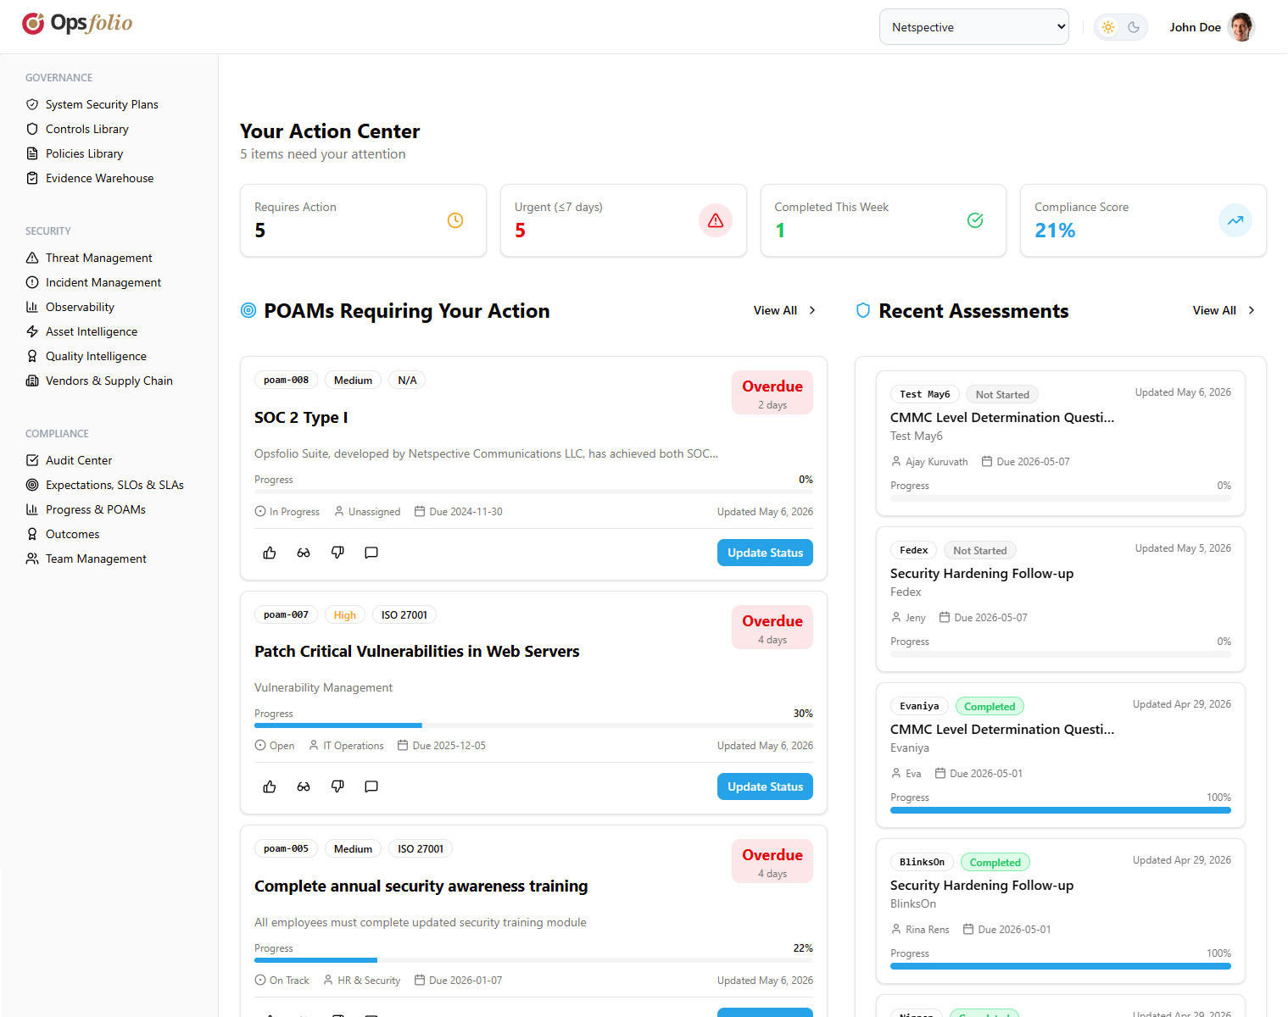
GOVERNANCE
Action Center
https://suite.opsfolio.com/
Role-specific, action-oriented dashboard
Five role views: CISO, CCO, Analyst, Consultant, Auditor
Live POAM cards: priority, status, progress bar, days remaining
Inline actions: update status, review & approve, acknowledge
Quick stats: Requires Action · Urgent · Completed · Compliance Score
Recent Accomplishments tab with impact levels
5
POAM
100%
Role Views
Action Cards
Audit-Ready
opsfolio.com · Confidential

Slide 8
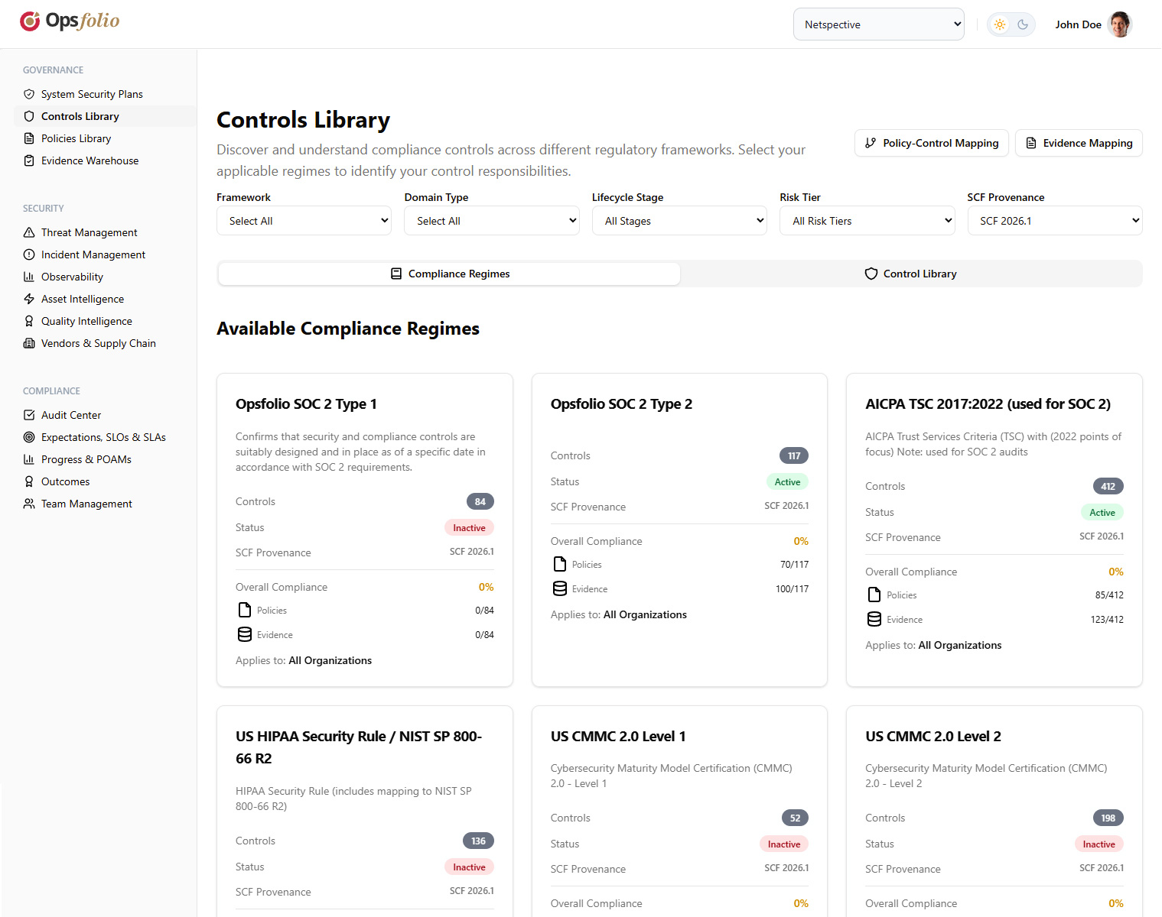
GOVERNANCE
Controls Library
https://suite.opsfolio.com/controls
Every framework. Every control. Executable.
10 compliance regimes: SOC 2, ISO 27001, NIST CSF, PCI DSS, HIPAA, GDPR, FedRAMP, SOX
4 AI-specific frameworks: ISO/IEC 42001, NIST AI RMF, EU AI Act, ISO/IEC 23894
Controls expressed as executable predicates, not documents
Per-control: policies mapped, evidence linked, compliance %
Export to CSV · Configure monitoring alerts per regime
10+
4
Code
Frameworks
AI Regimes
Controls as
opsfolio.com · Confidential

Slide 9
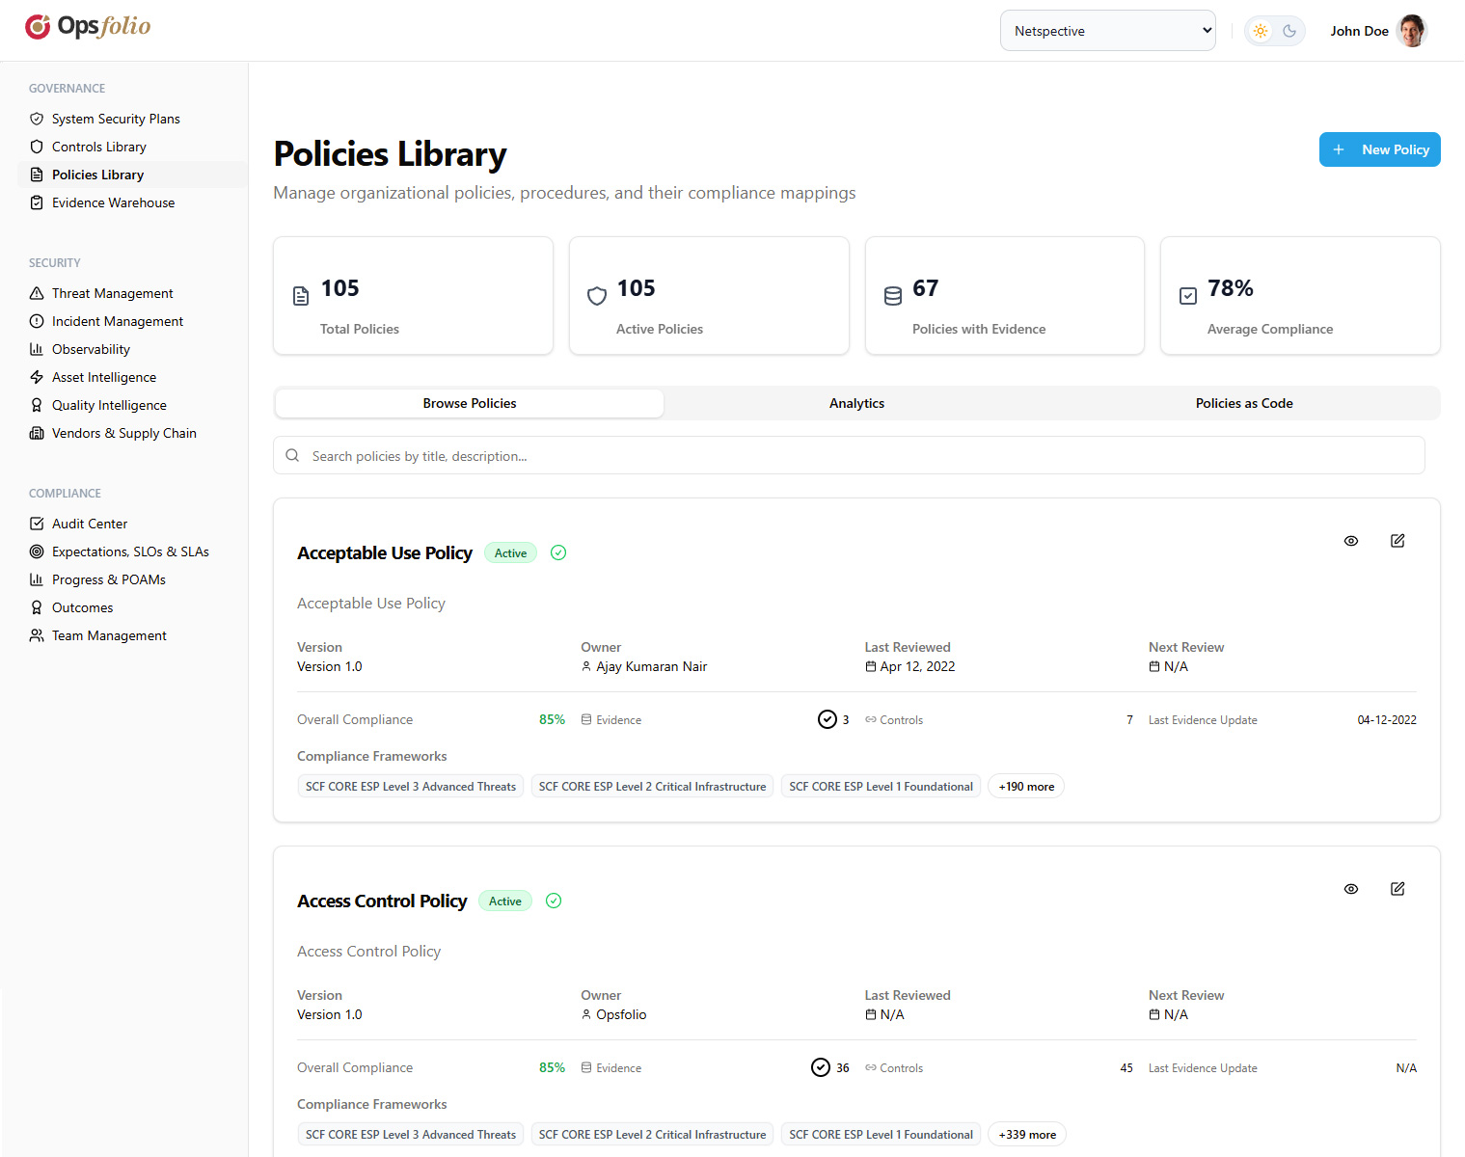
GOVERNANCE
Policies Library
https://suite.opsfolio.com/policies
Policy-as-Code with AI governance built in
Version-controlled policies with approval status tracking
Framework mapping: one policy → multiple compliance frameworks
Executable policies: schema validation, automated enforcement
AI-specific metadata: risk tier, lifecycle stage, linked models
Policy Author, Mapping, and Integration sub-pages
v2+
Multi
AI
Versioned
Framework Map
Native Governance
opsfolio.com · Confidential

Slide 10
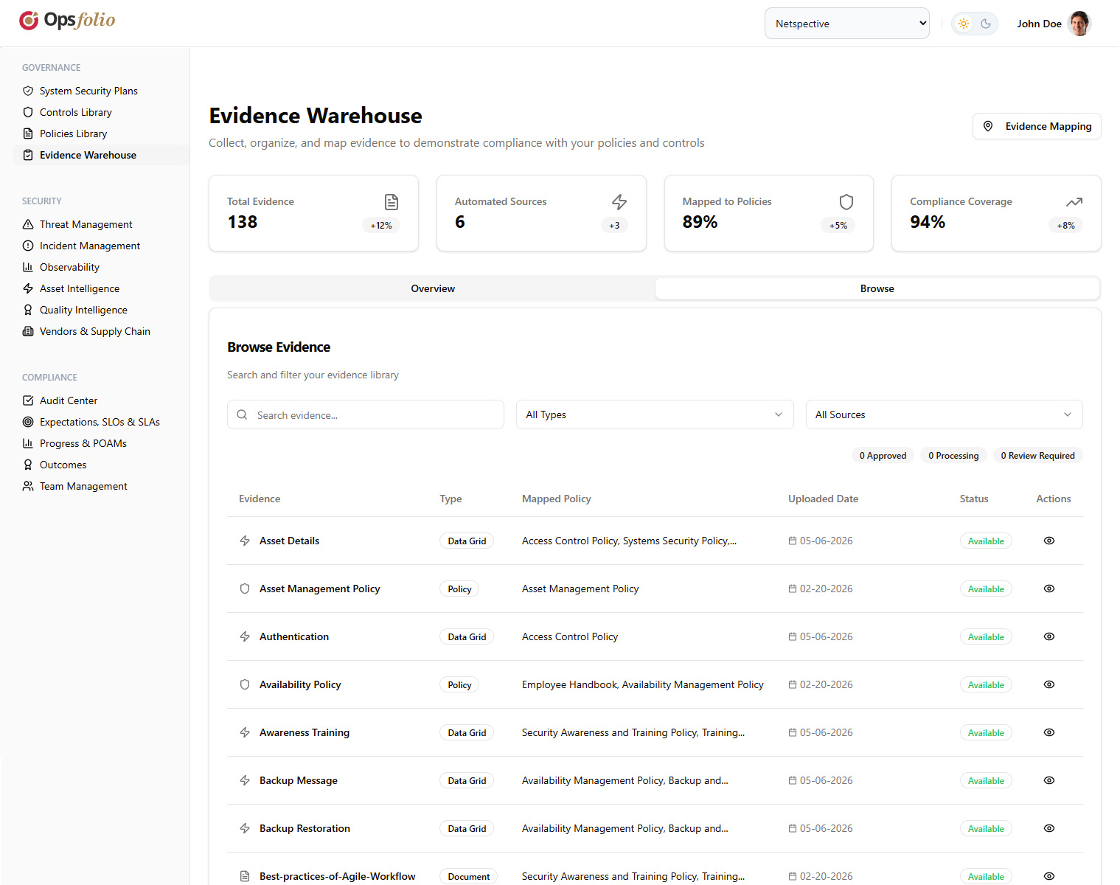
GOVERNANCE
Evidence Warehouse
https://suite.opsfolio.com/evidence-warehouse
Evidence generated, not collected
2,847 evidence items; 15 automated sources; 94% compliance coverage
5 tabs: Overview · Browse · Integrations · Upload · Mapping
Sources: AWS Integration, HR System, Nessus, manual upload
Evidence maps to policies AND controls simultaneously
One telemetry record satisfies SOC 2 + CMMC + HIPAA simultaneously
2.8K+
94%
15
Evidence Items
Coverage
Auto Sources
opsfolio.com · Confidential

Slide 11
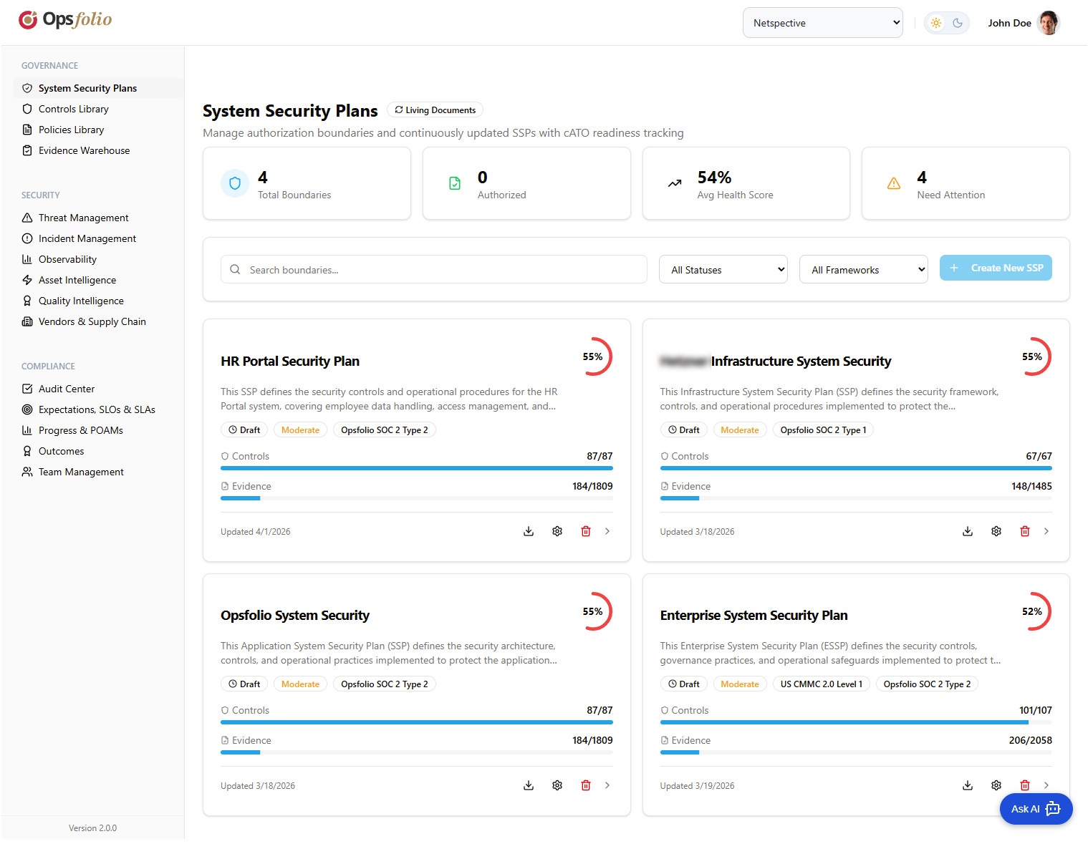
GOVERNANCE
Risks & System
Security Plans
https://suite.opsfolio.com/ssp
From risk register to cATO readiness
Risk Register: scoring, treatment, POAM linkage, audit risks
Privacy Risk Assessment and audit-specific risk tracking
SSP creation with authorization boundary definition
Continuous ATO (cATO) readiness dashboard — real-time
OSCAL export for FedRAMP and federal compliance
cATO
OSCAL
Live
Ready
Export
SSP Updates
opsfolio.com · Confidential

Slide 12
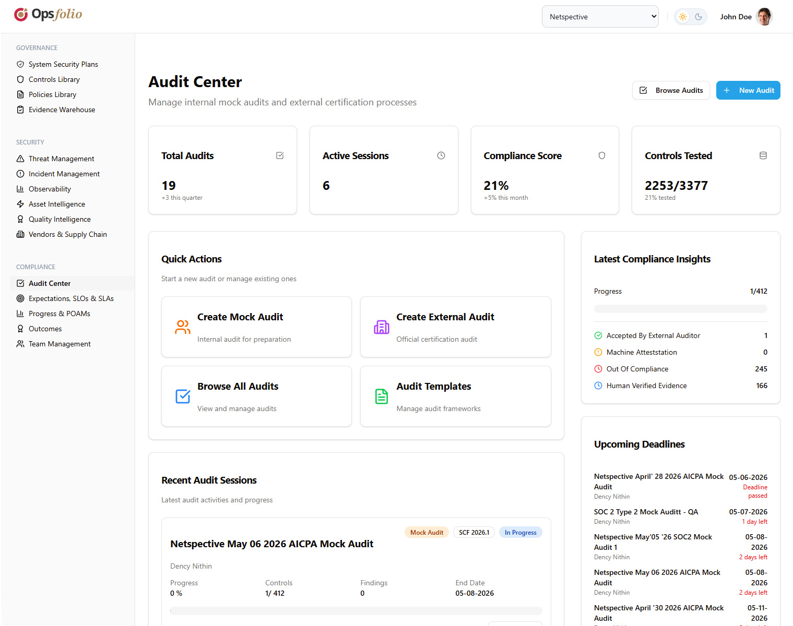
COMPLIANCE
Audit Center
https://suite.opsfolio.com/audit-center
Audit readiness as a query, not a project
24 audits tracked; 6 active sessions (2 mock, 4 external)
Types: Internal · External · Mock · Pre-Assessment
89% compliance score (+5% this month); 142/180 controls tested
Per-audit tabs: Overview · Controls · Findings · Evidence · Team · Timeline
"Continue Audit" navigates to next pending control automatically
89%
24
Hours
Compliance Score
Active Audits
Audit Prep (not weeks)
opsfolio.com · Confidential

Slide 13
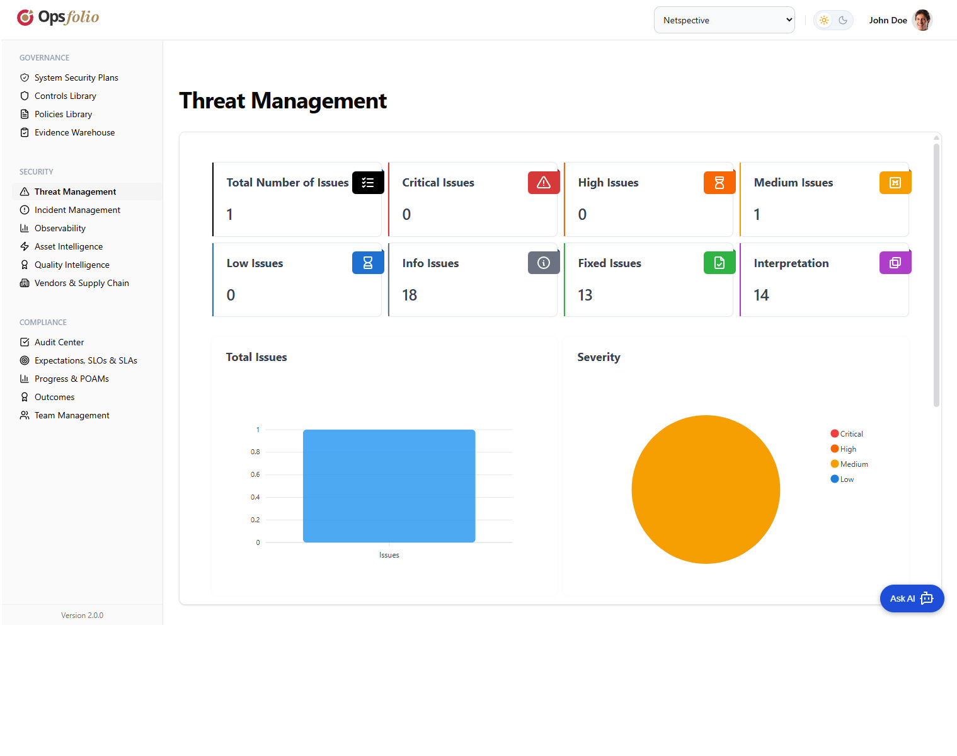
SECURITY
Threat Management
https://suite.opsfolio.com/threat-management
Proactive threat intelligence meets compliance evidence
Real-time threat detection and customizable response playbooks
Vulnerability Scanning and Penetration Testing sub-modules
Automated threat intelligence feeds with risk scoring
Incident correlation and SIEM integration
Every detection generates audit-grade evidence automatically
Real-Time
SIEM
Auto
Detection
Integration
Evidence
opsfolio.com · Confidential

Slide 14
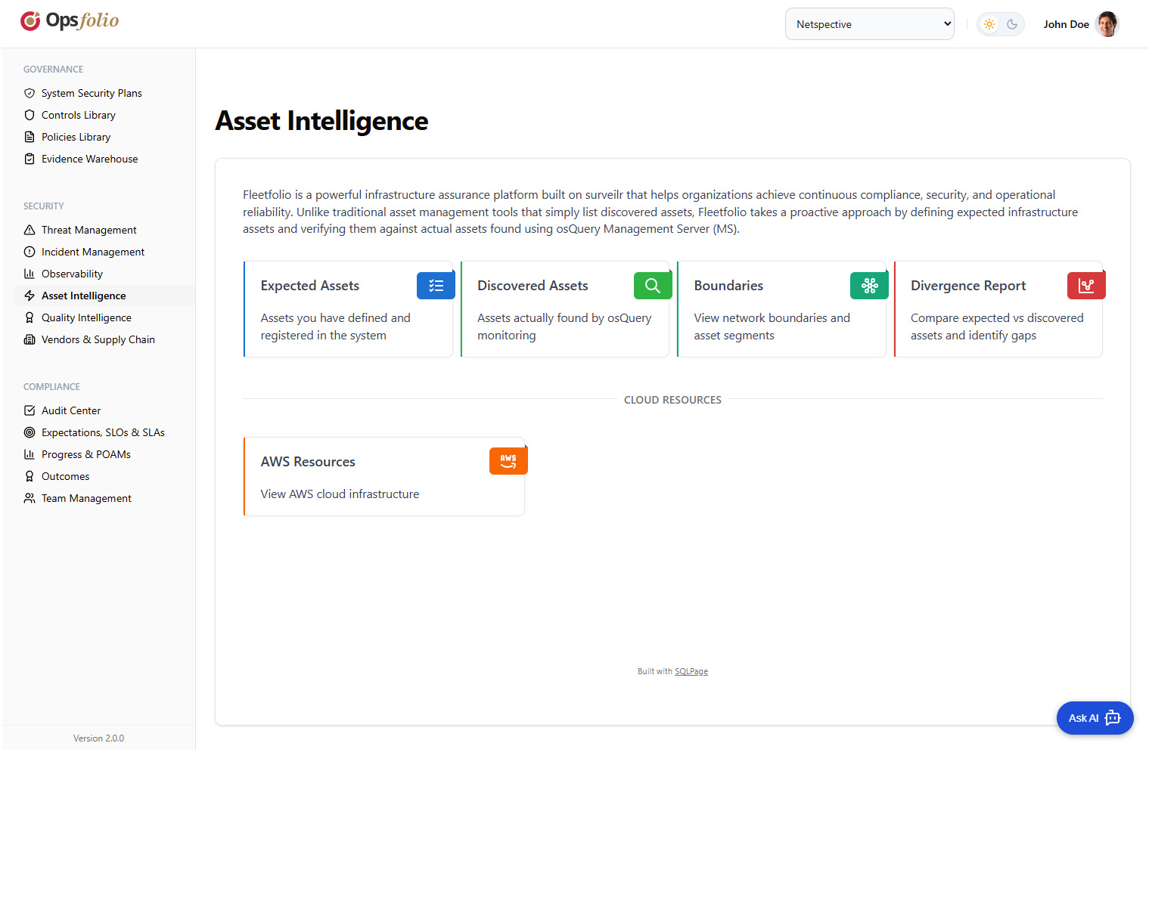
SECURITY
Asset Intelligence
https://suite.opsfolio.com/asset-intelligence
Powered by Fleetfolio · SQL-native EDR
1,997 assets: 247 servers · 1,432 workstations · 89 cloud · 156 apps
Fleetfolio agents feed live posture: encryption, firewall, patches
Expected vs. Observed reconciliation: MATCHED / MISSING / UNEXPECTED
Shadow IT and unauthorized admin detection via SQL queries
Asset Threats: 23 detected · 18 resolved · 2 critical
1,997
Live
SQL
Assets Tracked
Posture State
Query Engine
opsfolio.com · Confidential

Slide 15
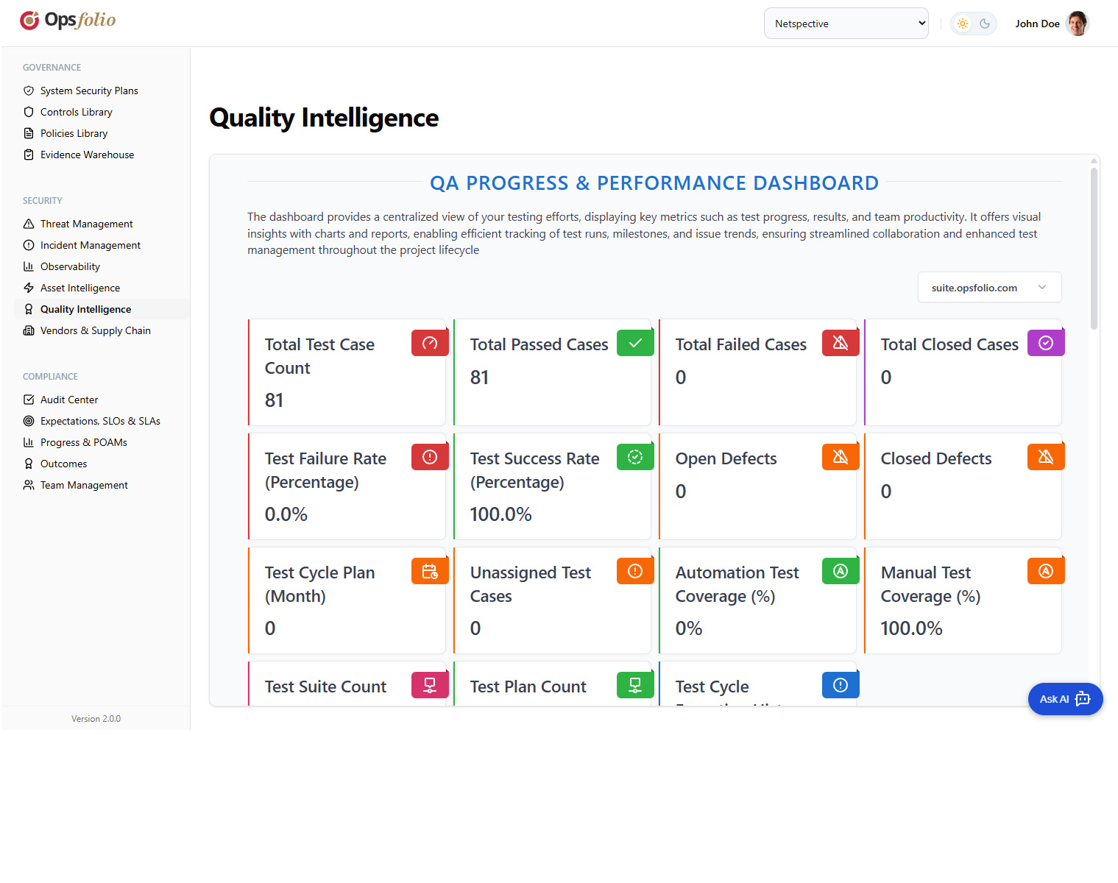
SECURITY
Quality Intelligence
https://suite.opsfolio.com/quality-intelligence
Powered by Qualityfolio · Test Management as Code
Test Management: 87% progress; Requirements Traceability: 92%
Qualityfolio artifacts: Markdown + YAML + Git → surveilr SQL evidence
strategy → suite → plan → cycle → case → evidence hierarchy
CAPA Management and Risk Analysis / FMEA modules
Evidence flows directly into the Opsfolio Evidence Warehouse
TMaC
92%
Git
Test Mgmt as Code
Req. Traceability
Version Controlled
opsfolio.com · Confidential

Slide 16
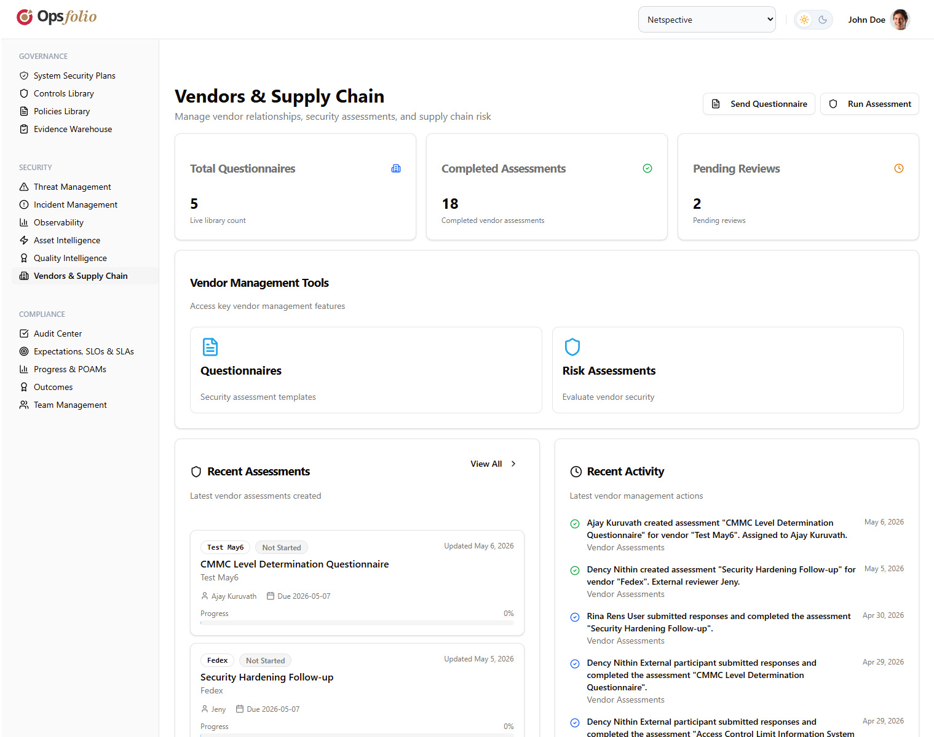
SECURITY
Vendors & Supply Chain
https://suite.opsfolio.com/vendors
Third-party risk that doesn't stop at the questionnaire
147 vendors tracked (+12%); 8 high-risk; 23 pending reviews
Risk distribution: Critical 2% · High 5% · Medium 31% · Low 62%
Modules: Inventory · Questionnaires · Assessments · Monitoring
12 expiring contracts within 30 days — proactive alerting
Continuous vendor monitoring — not annual snapshot reviews
147
8
Continuous
Vendors
High Risk
Monitoring
opsfolio.com · Confidential

Slide 17
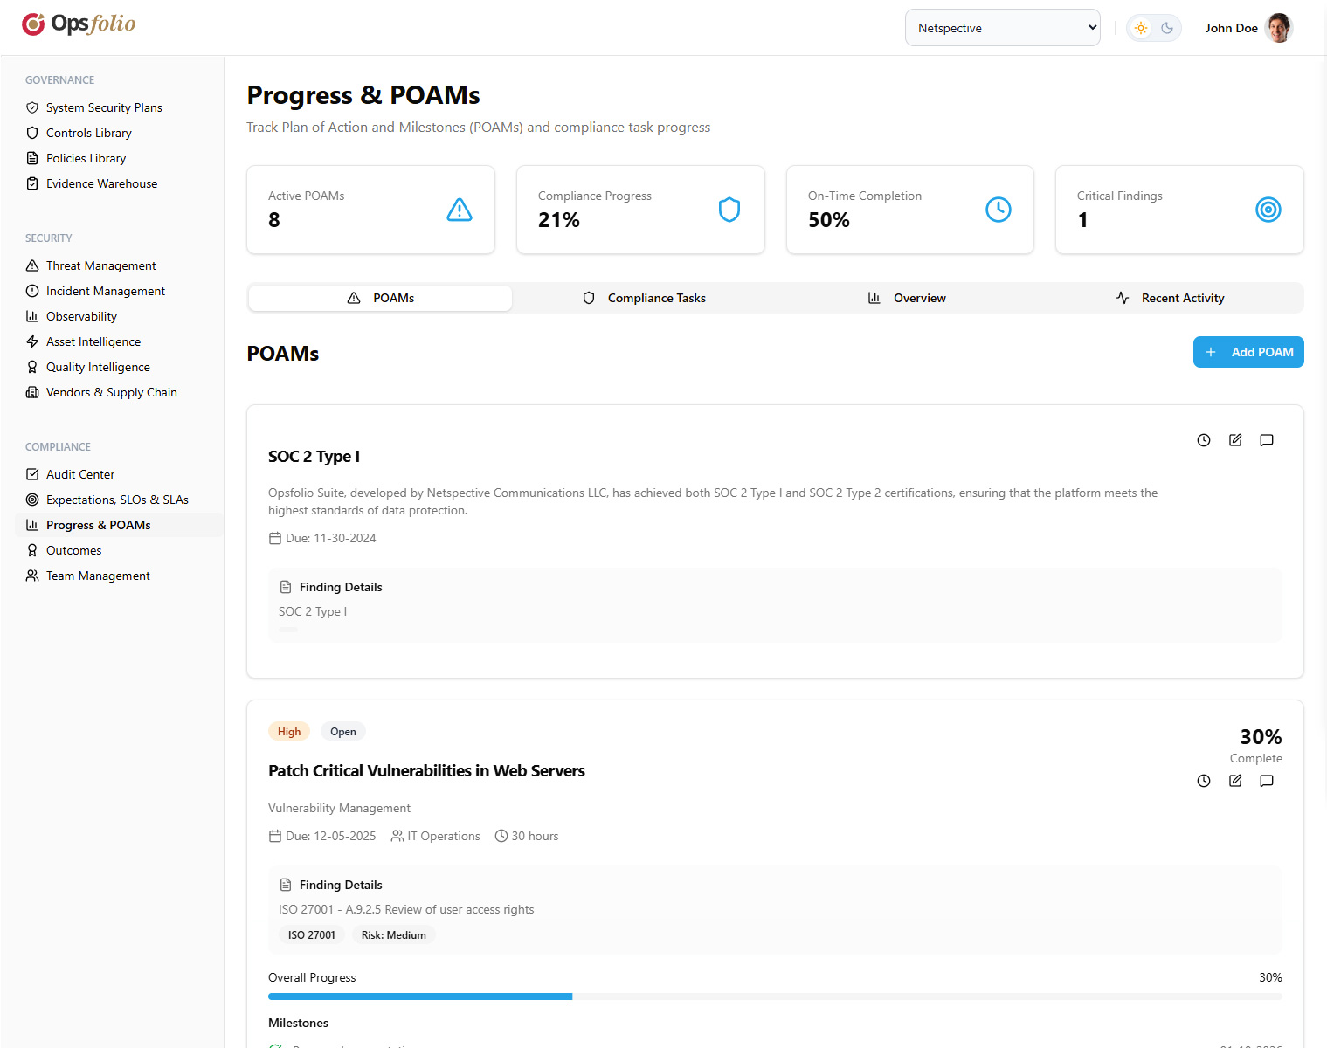
COMPLIANCE
Progress & POAMs
https://suite.opsfolio.com/progress-poams
Remediation you can track, prove, and query
POAM structure: ID, finding reference, priority, status, assignee
Milestones with individual completion status and due dates
Progress slider 0–100% with real-time dashboard updates
Linked to Risks, Audit Findings, and Asset-level POAMs
SLO/SLA tracking with outcome reporting
POAM
Live
Linked
Fully Tracked
Progress Updates
To Audits + Assets
opsfolio.com · Confidential

Slide 18
AI GOVERNANCE
Built for the AI-Native Enterprise
The only GRC architecture designed to govern non-human actors natively.
MGMT
RISK
REG
GUID
ISO/IEC 42001
NIST AI RMF
EU AI Act
ISO/IEC 23894
AI Management System Standard
AI Risk Management Framework
European AI Regulation
AI Risk Management Guidance
Why This Matters
AI agents do not have HR profiles — they cannot respond to compliance questionnaires.
They generate consequential actions at machine speed — no manual collection cadence can keep up.
Opsfolio's Operational Truth™ model — requiring all system behavior to produce verifiable operational evidence — is the only GRC architecture natively suited to AI agent governance.
This is not a roadmap item. It is an architectural consequence of the evidence-from-telemetry model.
opsfolio.com · Confidential

Slide 19
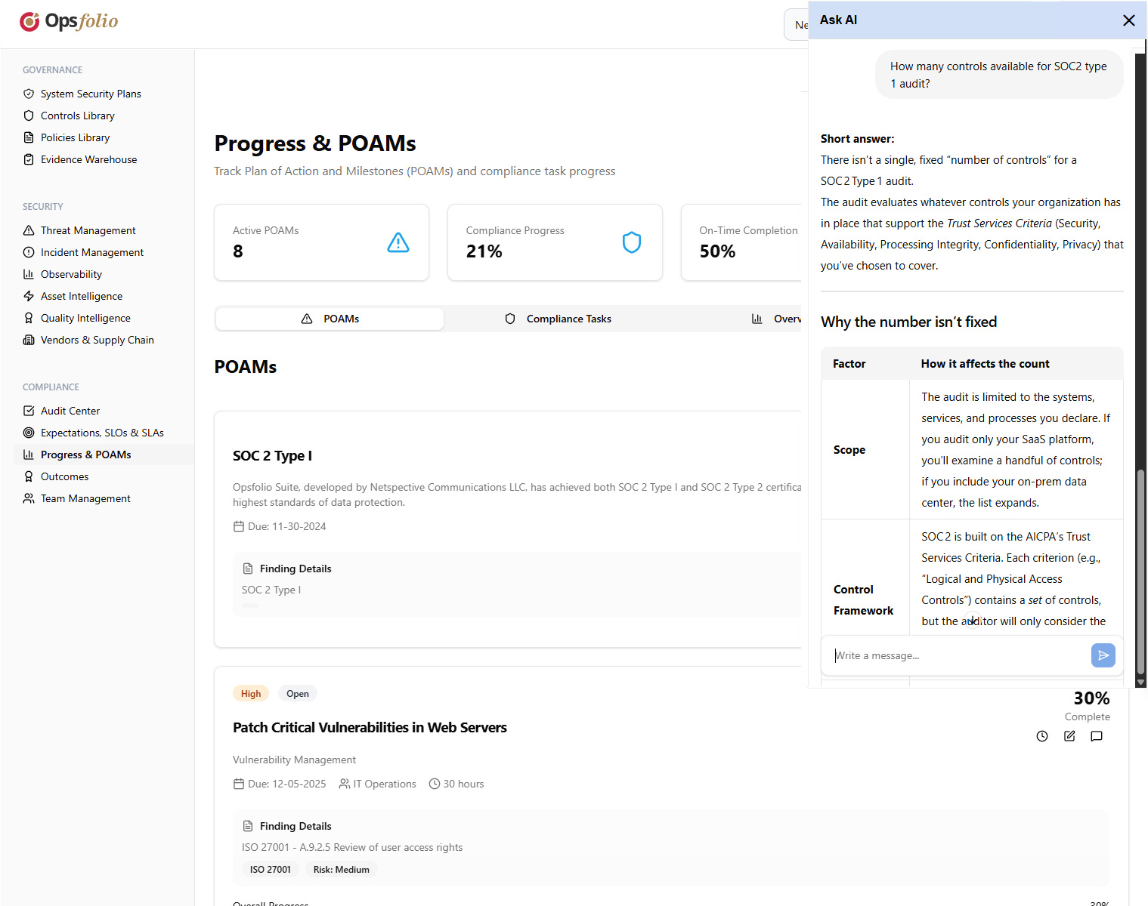
AI ASSISTANT
CaaS AI Assistant
opsfolio.suite/copilot
Compliance intelligence on demand
Compliance-as-a-Service copilot embedded in the platform
Interprets control requirements in plain language
Identifies evidence gaps and suggests remediation paths
Audit preparation: summarizes posture, flags risks
Context-aware: knows your frameworks, controls, and current posture
opsfolio.com · Confidential

Slide 20
ARCHITECTURE
Multi-Framework Coverage
One evidence record satisfies SOC 2 + CMMC + HIPAA simultaneously.
SOC 2 Type II
ISO 27001
NIST CSF
PCI DSS
Trust
Security
Framework
Payment
HIPAA
GDPR
FedRAMP
SOX
Healthcare
Privacy
Federal
Financial
CMMC
ISO/IEC 42001
NIST AI RMF
EU AI Act
Defense
AI
AI
AI/Legal
+ ISO 22301 · CCM · CCPA · ISO/IEC 23894 · Additional on request
opsfolio.com · Confidential

Slide 21
ARCHITECTURE
Multi-Tenant Architecture
Isolated workspaces per organization. Role-based access. Product-led growth activation.
Acme Corp
TechStart Inc
Global Systems
Access: Full
Access: Restricted
Access: Restricted
Workspaces:
Workspaces:
Workspaces:
Main Operations
R&D Division
Security Team
Product Development
N. America
Europe
Asia Pacific
Role-Based Access Control
Admin
Compliance Manager
Auditor
Team Member
Viewer
Full access · user management
Frameworks · controls · assessments
Assess controls · upload evidence
Complete tasks · upload evidence
Read-only dashboards
opsfolio.com · Confidential

Slide 22
ARCHITECTURE
Integration Ecosystem
Every integration lands as normalized, queryable SQL evidence.
Endpoint & Fleet
Cloud Platforms
Security Tools
Quality & Dev
Identity & HR
osquery
cnquery
Steampipe
SNMP polling
SSH / WMI
AWS (CloudTrail, Config)
Azure Monitor
GCP Cloud Logging
Kubernetes APIs
Nessus
Trivy
OpenVAS
SIEM platforms
Pen-test output
GitHub / GitLab CI
Jenkins
qualityfolio CLI
Jira / ticketing
OSCAL export
Active Directory
Okta / IdP
HR Systems
CMDB connectors
opsfolio.com · Confidential

Slide 23
DELIVERY
Compliance as a Service (CaaS)
Software + operating discipline, delivered together — not a license you have to staff.
What CaaS Delivers
1
Deploy
Primary cloud + identity + CI/CD pipeline. Three integrations cover 60–70% of SOC 2 technical surface.
Netspective engineers deploy and configure the platform for your stack
Standard control domains ship as pre-built predicate templates (40 SOC 2 controls = 40 templates, not 40 custom builds)
Ongoing compliance engineering: drift detection, gap remediation, control updates
Auditor education included: 3–5 reference auditors per framework who accept telemetry evidence
Compliance posture dashboard live from day one — not at end of implementation
2
Verify
Compliance posture goes live. First evidence generated. Audit Center opens.
3
Expand
Add frameworks, integrations, and AI governance modules as needs grow.
4
Audit
Evidence package generated by query. Audit prep: hours, not weeks.
opsfolio.com · Confidential

Slide 24
Our Guarantee
“We guarantee your audit outcome. If you follow our process and don’t pass, we keep working — at our cost — until you do.”
98%
Months
0
∞
Audit Pass Rate
Not Years to Audit-Ready
Audit Prep Sprints
Evidence on Demand
opsfolio.com · Confidential

Slide 25
Ready to See
Operational Truth™?
Opsfolio Suite · Fleetfolio · Qualityfolio
1
2
3
Contact Us
Web:
opsfolio.com
Proof-of-Concept
Framework Selection
First Audit Package
Email:
sales@opsfolio.com
We deploy against your primary cloud provider and identity provider. Live compliance posture in days.
Choose your first compliance framework. SOC 2 or CMMC are common starting points for new customers.
Within 90 days, your first audit package is generated by query. No sprint. No scramble. No screenshots.
Fleet:
fleetfolio.dev
QA:
qualityfolio.dev
Schedule a Live Demo
opsfolio.com · Confidential · Netspective Communications LLC · May 2026

