Slide 1
PRODUCT TOUR
Qualityfolio
Quality You Can Prove.
Test Management as Code (TMaC) — test artifacts authored in Markdown, versioned in Git, executed via CLI or CI, and stored as immutable, queryable SQL evidence in surveilr.
qualityfolio.dev · Confidential · May 2026
Netspective Communications LLC

Slide 2
Today’s Tour
01
02
03
Test Debt Is Audit Debt
TMaC Architecture
The Ecosystem
Why traditional QA fails compliance
Markdown + Git + SQL = provable quality
Qualityfolio + Opsfolio Suite + Fleetfolio
04
05
06
Feature Tour
SQL Evidence
Deploy & Close
Strategy, cycles, evidence, traceability
Every test is a query. Every result is evidence.
Integrations, deployment, and next steps
qualityfolio.dev · Confidential

Slide 3
THE PROBLEM
Test Debt Is Audit Debt
Organizations that pass functional tests still fail audits — because they cannot prove what happened.
Why QA Evidence Fails Audits
The Result
Test Cases in Spreadsheets
Test-ready.
Excel and TestRail data is non-versioned, manually edited, and changes without trace. No Git history.
Audit-blind.
Evidence Assembled After the Fact
Auditors arrive and teams scramble to screenshot and export. Evidence is assembled, not generated.
Tests pass in CI. Evidence vanishes. Auditors arrive to find screenshots taken yesterday, requirements traced manually to spreadsheets, and no provable record of what the system actually did.
No Requirement Traceability
Cannot prove which test covers which control. Frameworks demand traceability; TMS tools rarely deliver it.
Flaky Tests Silently Pass
A test that passes 80% of the time looks compliant at audit time but is a governance risk every day.
qualityfolio.dev · Confidential

Slide 4
THE APPROACH
TMaC: Test Management as Code
Traditional TMS: evidence is collected after the fact. Qualityfolio: evidence is the byproduct of execution.
Traditional TMS (TestRail, Xray, qTest)
Qualityfolio (TMaC)
Test cases stored in proprietary DB — no Git, no version history
Evidence uploaded manually by QA engineers after test runs
Requirement links maintained by hand — break silently on change
Compliance reporting requires dedicated export/assembly cycles
AI cannot read or generate test cases in proprietary formats
Vendor lock-in — evidence inaccessible when contract ends
Offline or air-gapped deployment usually unsupported
Markdown + YAML authoring — plain text, Git-versioned with full PR review workflow
Evidence is the execution byproduct — captured automatically on every run
FII (Foreign Integration Identifiers) link cases to controls at authoring time
SQL query against surveilr generates compliance package in minutes
AI can read, generate, and review Markdown test cases natively
Open standards — Markdown + SQLite; evidence survives any vendor change
Full offline / air-gapped support for FDA-regulated lab environments
qualityfolio.dev/why · Full comparison: TestRail, Xray, Zephyr, qTest

Slide 5
ECOSYSTEM
Qualityfolio in the Opsfolio Ecosystem
Test evidence flows directly into Opsfolio Suite’s Evidence Warehouse, where it auto-maps to compliance controls.
Qualityfolio
Opsfolio Suite
Fleetfolio
Test Management as Code (TMaC)
GRC Engineering Platform
SQL-Native EDR
Strategies, suites, plans, cycles authored in Markdown + Git
Automated + manual execution with full provenance capture
Evidence stored as immutable SQL in surveilr
FII links test cases to SOC 2, HIPAA, FDA 21 CFR, ISO controls
AI-assisted test case generation from requirements
Offline / air-gapped support for validated lab environments
Evidence Warehouse
Endpoint posture feeds Qualityfolio asset context
Fleet TEM findings trigger security test cycles
Shared surveilr DB — one SQL schema for both
Fleet evidence + test evidence in one audit package
Test execution records auto-mapped to compliance controls
Quality Intelligence
Pass/fail trends and coverage gaps surface as compliance signals
Audit Center
Qualityfolio evidence populates SOC 2, HIPAA, FDA audit packages
Controls Library
Test results validate executable control predicates in real time
Risk & Threat
Flaky tests and test failures surface as operational risk signals
fleetfolio.dev
qualityfolio.dev · Confidential

Slide 6
CORE CONCEPT
Operational Truth™ in Testing
Quality is only provable when declared intent (Expected Tests) and runtime reality (Observed Results) are continuously aligned.
COMPLIANT
GAP SIGNAL
GOVERNANCE FAIL
Tests + Evidence Align
Tests Lack Evidence
Evidence Without Tests
Operational Truth™ achieved
Assurance is incomplete
Governance is broken
Test cases executed with captured results. Cryptographic provenance. Auditor-defensible. The control is proven, not claimed.
Test cases exist but no execution evidence was captured. Intent without proof. Surfaces as an OT™ gap signal — never silently assumed compliant.
Execution records exist with no corresponding test case. Untrusted evidence. A compliance liability — cannot be traced to approved intent.
In Opsfolio Suite: GAP and GOVERNANCE FAIL states surface as Operational Truth™ gap signals — uninstrumented controls are never silently assumed compliant.
qualityfolio.dev · Confidential

Slide 7
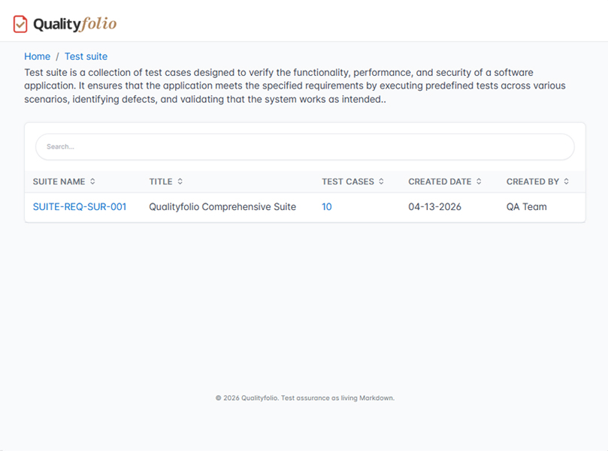
STRATEGY
https://demo.qualityfolio.dev/suites
Test Strategy
& Suite Management
Define what must be tested — in Git, not spreadsheets.
Strategies authored in Markdown with YAML metadata — version-controlled, PR-reviewed
Suite hierarchy: Strategy → Suite → Plan → Cycle → Case → Evidence
Requirements attached at plan level via FII — one requirement governs many cases
Status fields (Active / Deprecated / Draft) tracked in YAML, queryable in SQL
Multi-team support: separate projects share strategy artifacts via Git references
Git
YAML
SQL
Version Control
Machine-Readable
Queryable Hierarchy
qualityfolio.dev · Confidential

Slide 8
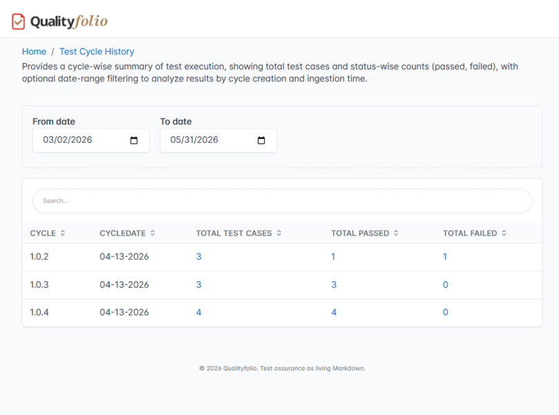
CYCLES
https://demo.qualityfolio.dev/cyclehistory
Test Cycle
Execution
Every run is a timestamped, immutable evidence record.
Cycles are timeboxed execution batches — each cycle produces a distinct evidence set
Manual, automated (CLI), and CI/CD execution paths — same evidence schema for all
Each case result stored as JSON with start/end timestamps and step-level details
Cycle approval workflow: created_by + approved_by captured in YAML at execution time
Re-run history preserved — every cycle’s results are independently queryable in SQL
TCY
Auto
Hash
Cycle IDs
CI/CD Native
Proof of State
qualityfolio.dev · Confidential

Slide 9
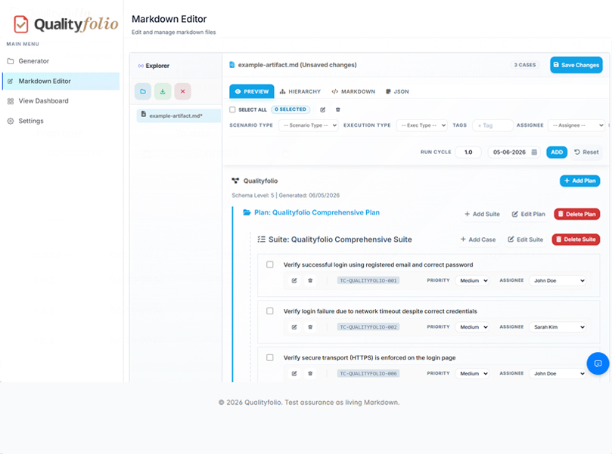
AUTHORING
https://demo.qualityfolio.dev/cases
Test Case
Authoring
Plain Markdown. Git PR workflow. AI-assisted generation.
Cases authored as TC-XXXX.case.md with YAML: priority, type, scenario_type
Body sections: Description, Pre-Conditions, Test Steps, Expected Result
Compliance metadata inline: requirement_ids, regulatory_context, risk_level
AI generates validation protocols from requirements: “Generate FDA cases from this URS”
Cases reusable across cycles — reference by case ID; no duplication or drift
MD
AI
FII
Open Format
Case Generation
Control Links
qualityfolio.dev · Confidential

Slide 10
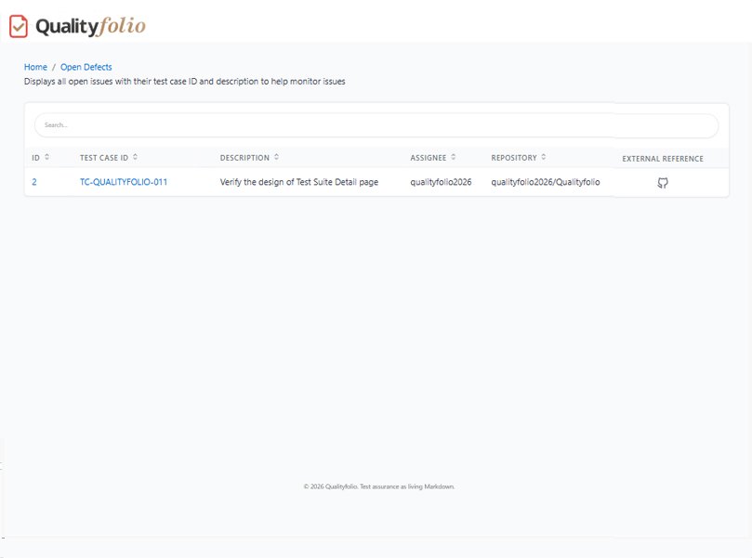
EVIDENCE
https://demo.qualityfolio.dev/evidence
Evidence Capture
& Dashboard
Live pass/fail/bug metrics. No manual evidence assembly.
Results auto-ingest via surveilr on every CI/CD run or manual execution
Dashboard: total cases executed, pass/fail rates, active bugs, execution trends
Evidence hash: SHA-256 + Git commit SHA + executor identity = cryptographic provenance
Bug evidence declared at point of failure — BUG-XXXX.md linked to the failing run
Dashboard auto-updates on ingest — auditors see live coverage state, not last export
Live
SHA
Zero
Dashboard
Evidence Hash
Manual Steps
qualityfolio.dev · Confidential

Slide 11
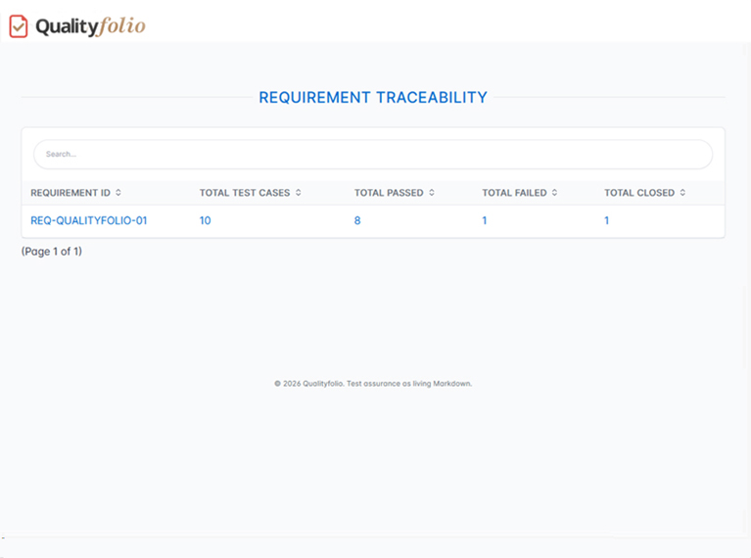
TRACEABILITY
https://demo.qualityfolio.dev/traceability
Requirement
Traceability
Every test mapped to a control. Every control provably covered.
FII (Foreign Integration Identifiers) link cases to framework controls at authoring time
One test case satisfies multiple frameworks: SOC 2 + HIPAA + ISO in one record
Coverage matrix queryable via SQL: which controls have passing evidence right now?
Gap detection: controls with no executed test cases surface as coverage gaps in real time
Traceability flows to Opsfolio Suite — evidence auto-tagged at ingest; no re-mapping
N:M
SQL
Live
Case:Control Map
Coverage Query
Gap Detection
qualityfolio.dev · Confidential

Slide 12
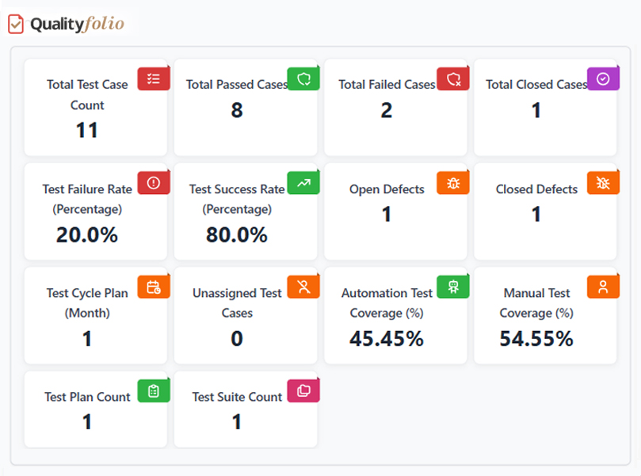
BUGS
https://demo.qualityfolio.dev/bugs
Bug Tracking
& Defect Lifecycle
Defects as code. Linked to evidence. Never orphaned.
Bugs declared at point of failure as BUG-XXXX.md — directly linked to the failing run
YAML metadata: severity, priority, assigned, status — all queryable in SQL
Lifecycle states: OPEN → IN PROGRESS → RESOLVED → REJECTED — tracked in Git history
Flaky test detection: pass-rate queries identify cases with >5% failure variance
Jira / ServiceNow auto-ticket integration — bug creates ticket at detection time
Git
SQL
Auto
Bug History
Flaky Detect
Jira Tickets
qualityfolio.dev · Confidential

Slide 13
SQL EVIDENCE
Every Test Is a Query.
Every Result Is Evidence.
Standard SQL — testable, version-controllable, auditor-defensible.
SOC 2: Access control tests Q3 2025
FDA: Computer system validation report
Flaky tests: assurance risk detection
SELECT ose.exec_nature AS test,
ose.exec_status AS status,
os.orch_started_at AS run_time
FROM orchestration_session_exec ose
JOIN orchestration_session os
ON ose.orchestration_session_id
= os.orchestration_session_id
WHERE ose.exec_nature
LIKE '%access-control%'
AND os.orch_started_at
BETWEEN '2025-07-01'
AND '2025-09-30'
ORDER BY os.orch_started_at DESC;
SELECT
json_extract(
ose.diagnostics_json,
'$.test_id') AS test_id,
json_extract(
ose.diagnostics_json,
'$.validation_category')
AS category,
ose.exec_status,
json_extract(
ose.diagnostics_json,
'$.requirement_ids') AS reqs
FROM orchestration_session_exec ose
WHERE json_extract(
ose.diagnostics_json,
'$.validation_category')
= 'computer_system_validation';
SELECT
ose.exec_nature AS test,
COUNT(*) AS runs,
SUM(CASE WHEN
ose.exec_status='PASSED'
THEN 1 ELSE 0 END)
AS passes,
ROUND(100.0 * passes
/ COUNT(*), 2)
AS pass_rate
FROM orchestration_session_exec
GROUP BY ose.exec_nature
HAVING COUNT(*) > 5
AND pass_rate < 95
ORDER BY pass_rate ASC;
Maps to: SOC 2 CC6.1 · CC6.2 · CC7.1
FDA 21 CFR Part 11 · GxP validation
Full audit trail — who, when, before/after
All queries run against surveilr — append-only SQLite. Same query = QA evidence + audit evidence.

Slide 14
COMPLIANCE
Built-In Compliance Mapping
Every test case maps to a control. Audit packages are a SQL query, not a sprint.
SOC 2 Type I & II
FDA 21 CFR Part 11
HIPAA
CC6.1,CC6.2,CC7.1,CC8.1
Part 11.10(a–k),Part 11.50
§164.312(a)(1),§164.312(c)(1)
ISO 27001
GxP / CSV
CMMC Level 2+
A.9.4.1,A.10.1.1,A.12.6.1
IQ,OQ,PQ,DQ protocols
AC.1.001,CM.2.061,SI.1.210
How This Reaches Opsfolio Suite
Qualityfolio test execution records are ingested into the Opsfolio Suite Evidence Warehouse automatically.
Each evidence record is tagged with framework controls at ingest time — SOC 2, HIPAA, FDA in one record.
The Opsfolio Audit Center queries Qualityfolio evidence to populate audit packages on demand. No manual assembly.
Coverage gaps surface as Operational Truth™ gap signals — uninstrumented controls are never assumed compliant.
qualityfolio.dev · Confidential

Slide 15
DEPLOYMENT
Run Where Your Evidence Needs to Live
Evidence sovereignty: your evidence, your infrastructure, your audit chain.
GIT
LOCAL
AIRGAP
CICD
Git-Hosted
/ GitOps
Local
/ Self-Hosted
Air-Gapped
/ Validated Lab
CI/CD
/ Cloud-Native
Test artifacts live in your own Git repo. CI/CD ingests evidence into surveilr automatically. Audit trail = your commit history.
Run surveilr on any machine. Evidence stored in local SQLite. No internet required. Auditors access the db directly via SQL.
Maximum control for FDA-regulated, GxP, or classified environments. Manual transfer. Offline operation. Sync when permitted.
Jenkins, GitHub Actions, GitLab CI. surveilr ingest runs as a pipeline step. Evidence generated automatically on every PR merge.
Your repo, your CI
Full commit-level history
GitHub/GitLab/Bitbucket
GitOps-compatible
No internet required
SQLite evidence store
Your infrastructure
Full SQL access
No external network
Manual evidence sync
FDA 21 CFR Part 11
GxP validated mode
Jenkins / GH Actions
PR-triggered evidence
Slack / Jira alerts
Central surveilr DB
Cloud SaaS option coming soon · qualityfolio.dev/deployment

Slide 16
Our Guarantee
“We guarantee your audit outcome. If you follow our process and don’t pass, we keep working — at our cost — until you do.”
98%
Months
SQL
CaaS
Audit Pass Rate
To Audit-Ready
Evidence on Demand
Delivery Model
Compliance as a Service (CaaS) Delivery
Netspective deploys Qualityfolio against your test infrastructure, CI/CD pipelines, and compliance framework. Pre-built strategy templates cover 60–70% of SOC 2 and FDA testing surface from day one. We deliver compliance engineering capability — not just a license.
qualityfolio.dev · opsfolio.com · Netspective Communications LLC · May 2026

Slide 17
Ready to Prove
Your Quality?
Qualityfolio · Opsfolio Suite · Fleetfolio
1
2
3
Contact Us
Author Your First Test
Execute a Cycle
Generate an Audit Package
QA:
qualityfolio.dev
Run qf init --template=soc2 and author your first test case in Markdown. Evidence starts flowing on your next CI run.
Execute a test cycle against your staging environment. Every result is a timestamped, immutable evidence record in surveilr.
Within 30 days: query surveilr to produce your first SOC 2 or FDA evidence package. No sprint. No screenshots.
Suite:
opsfolio.com
Fleet:
fleetfolio.dev
Email:
sales@opsfolio.com
Schedule a Live Demo
qualityfolio.dev · Confidential · Netspective Communications LLC · May 2026

