Slide 1
OPSFOLIO ECOSYSTEM
Developer Experience Tour
surveilr · Spry · Fleetfolio · Qualityfolio · Opsfolio Suite
Independent tools. Composable platform. Evidence by default.
surveilr
Spry
Fleetfolio
Qualityfolio
Opsfolio

Slide 2


THE OPSFOLIO ECOSYSTEM
Five products. Two infrastructure layers. One composable platform.
INFRASTRUCTURE LAYER
surveilr
Spry
Resource Surveillance & Integration Engine
RSSD · SQL Pages · Patterns · Single Binary
↔
Markdown-as-Code · SQL Curator · DAG Orchestrator
BI as Code · Evidence Warehouses · Runbooks
APPLICATION LAYER — BUILT ON SURVEILR + SPRY
Fleetfolio
Qualityfolio
Opsfolio Suite
SQL-native EDR
Fleet Security
TMaC · Test Evidence
QA & Compliance
GRC Engineering
Operational Truth™
Each product can be used independently OR composed into the Opsfolio Suite

Slide 3



THE INFRASTRUCTURE LAYER
Why surveilr and Spry underpin everything
surveilr = Evidence Engine
Spry = Orchestration Layer
Together = Composable Platform
Single static binary — no cluster, no runtime
Executable Markdown → DAG of SQL/Bash/TS tasks
Spry orchestrates surveilr ingestion pipelines
Ingests any resource → portable SQLite RSSD
Type-safe SQL libraries with [PI] + {attrs}
surveilr stores evidence that Spry notebooks reference
Every detection, event, test result → immutable SQL row
Builds SQLPage web apps from a single .md file
Fleetfolio & Qualityfolio are surveilr Patterns + Spry views
Built-in SQL Pages web server
Evidence Warehouses — code + output in one artifact
Opsfolio Suite layers GRC policy on both
AI-ready Operational Truth™ Warehouses
BI as Code — dashboards version-controlled in Git
Each tool retains full independent DX

Slide 4




SURVEILR · WHAT IS IT
surveilr
Resource Surveillance & Integration Engine for Operational Truth™
Your resources. Your truth. Your control.
One Binary
RSSD
SQL Native
AI-Ready
Evidence-First
Static. No cluster.
Runs anywhere.
Portable SQLite
Operational Truth Warehouse
Standard SQL is
the only interface
Deterministic substrate
for AI Workforce™
Immutable, timestamped
by default
Oracle/PG/MySQL
Files + IMAP
REST APIs
HL7/FHIR/X.12
Capturable Execs
RSSD → Operational Truth™ Warehouse
SQL · JDBC/ODBC · MCPs · AI Skills · SQL Pages

Slide 5
SURVEILR · INSTALL & FIRST RUN
Zero to Operational Truth™ in 3 commands
$ Install surveilr
$ First run
# macOS — Homebrew
brew tap surveilr/tap && brew install surveilr
# Linux — global install (Could use brew as well)
wget https://github.com/surveilr/packages/releases/latest/download/surveilr_jammy.deb
sudo dpkg -i surveilr_jammy.deb
# Manual — download + move binary
wget https://github.com/surveilr/packages/releases/\
download/latest/surveilr_x86_64-linux.tar.gz
tar -xzf surveilr_*.tar.gz && sudo mv surveilr /usr/local/bin/
surveilr --version
# 1. Ingest files from the current directory
surveilr ingest files
# 2. Load a domain Pattern (e.g. Osquery)
deno run -A https://github.com/surveilr/patterns/blob/main/osquery-ms/queries.sql.ts | surveilr shell
# 3. Launch the built-in SQL Pages web UI
surveilr web-ui \
-d "resource-surveillance.sqlite.db" \
--port 3010 --host localhost
# Open → http://127.0.0.1:3010
$ Upgrade
✓ One binary — no daemon, no cluster, no JVM
✓ Runs on Linux · macOS · Windows · Raspberry Pi · Air-gap
✓ Data stays local — sovereign by default
# Always stay current
surveilr upgrade --yes
surveilr --version

Slide 6
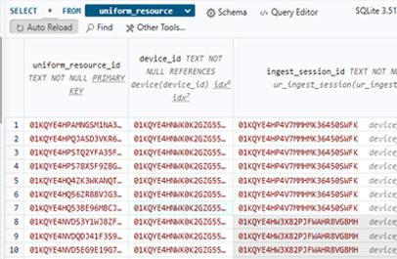
SURVEILR · UNIVERSAL SCHEMA & RSSD
Every resource lands in one normalized SQLite database
resource-surveillance.sqlite.db — core schema
-- Core ingestion tables (simplified)
CREATE TABLE uniform_resource (
uniform_resource_id TEXT PRIMARY KEY,
device_id TEXT NOT NULL,
ingest_session_id TEXT NOT NULL,
uri TEXT NOT NULL, -- source path/URL
content BLOB, -- raw content
nature TEXT, -- file type / mime
size_bytes INTEGER,
last_modified_at TIMESTAMPTZ,
content_digest TEXT, -- SHA-256 hash
created_at TIMESTAMPTZ DEFAULT CURRENT_TIMESTAMP
);
CREATE TABLE uniform_resource_csv ( -- type-specialized view
uniform_resource_id TEXT PRIMARY KEY REFERENCES uniform_resource,
header_names_csv_row TEXT, -- detected columns
parsed_data JSONB -- structured rows
);
surveilr RSSD opened in SQLite editor— uniform_resource table
Portable
ACID + WAL
Point-in-Time
Sync-Ready
Copy one .db file
to share an entire warehouse
Safe concurrent reads,
no data loss on crash
Query data as it existed
at any moment T
Replicate to Postgres,
Oracle, MySQL at scale

Slide 7
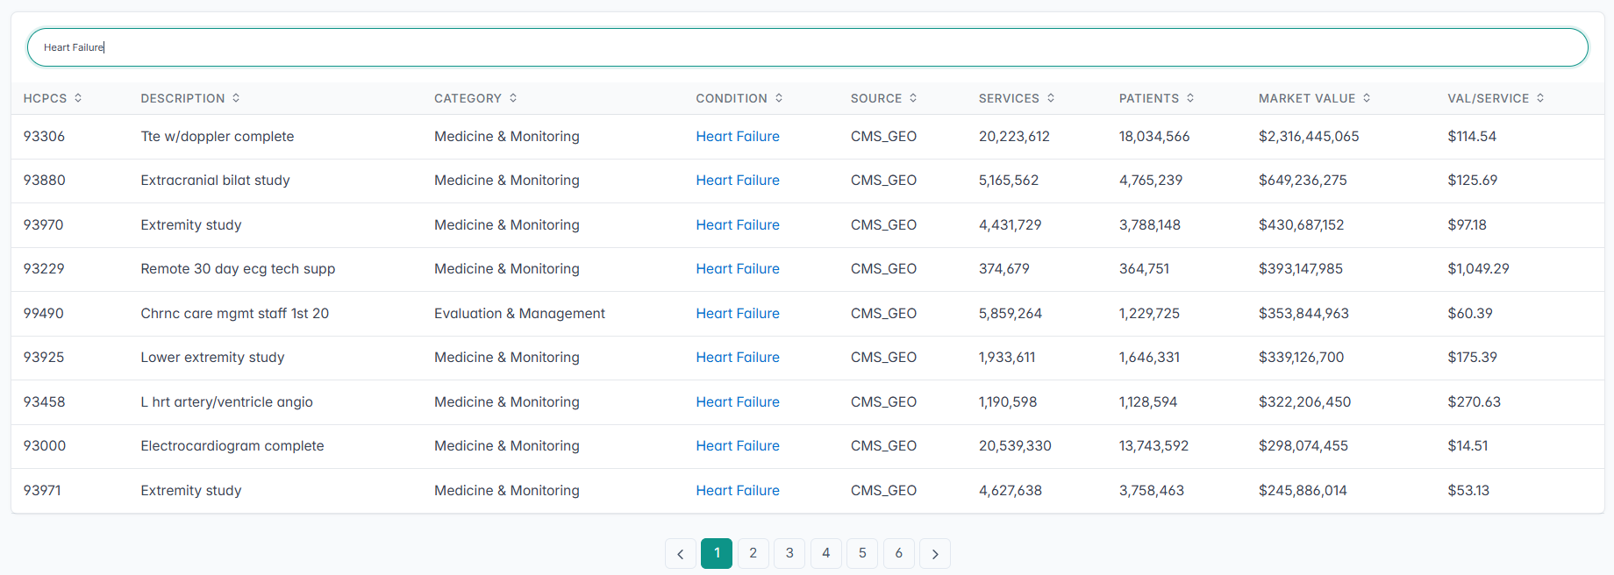
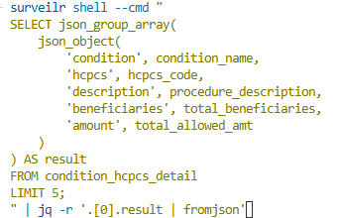
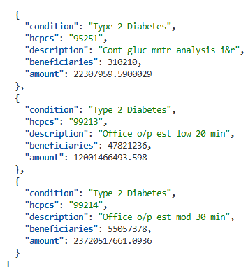
SURVEILR · QUERYING OPERATIONAL TRUTH™
SQL is the only interface you need to know
Observability — stop searching logs, start querying
-- Contextual Unified Activity Records: all checkout failures
-- for premium users in the last hour with feature flag X
SELECT request_id, user_id, error_code, duration_ms, feature_flags
FROM activity_record
WHERE service = 'checkout'
AND status_code >= 400
AND subscription = 'premium'
AND time > datetime('now', '-1 hour')
ORDER BY duration_ms DESC;
surveilr SQL Pages dashboard — query results rendered as interactive table with filters
Security posture — live SQL against fleet state
-- Fleet posture: unencrypted devices
SELECT hostname, os_version, last_seen
FROM device_posture
WHERE disk_encrypted = FALSE
AND last_seen > datetime('now', '-7 days');
Cross-system — joins across any ingested source
-- Cross-source correlation: deploys vs incidents
SELECT d.deploy_id, d.deployed_at, i.incident_title,
i.opened_at, julianday(i.opened_at) - julianday(d.deployed_at) AS lag_days
FROM deploys d
JOIN incidents i ON i.opened_at > d.deployed_at
ORDER BY lag_days ASC;
surveilr CLI — surveilr shell --cmd 'SELECT ...' returning JSON output

Slide 8



SURVEILR · DOMAIN PATTERNS
Pre-packaged SQL solutions for specific domains
Each Pattern = stateless.sql (views) + stateful.sql (caches) + package.sql.ts (assembler). Install with one command.
Observability
Business Intelligence
Data Quality
DevOps & SRE
Contextual Unified Activity Records. Replace text logs with SQL-queryable structured records.
Turn RSSD into a BI substrate. Connect Metabase, Superset, Power BI via ODBC/JDBC.
SQL-defined quality checks, freshness tests, and exception reporting against ingested resources.
Capture deploys, incidents, on-call signals, and pipeline events into one queryable RSSD.
Financial Auditing
Healthcare Compliance
Message Queue
Security Monitoring
Aggregate transactional evidence for SOX-style audits with tamper-evident provenance.
HIPAA-aligned, HL7/FHIR-aware ingestion and evidence collection for regulated environments.
Durable SQL-native MQ with SQS-compatible facade. Queue history = audit evidence.
osquery-based endpoint config evidence, correlated for continuous security posture management.
deno run -A https://github.com/surveilr/patterns/blob/main/osquery-ms/queries.sql.ts | surveilr shell

Slide 9
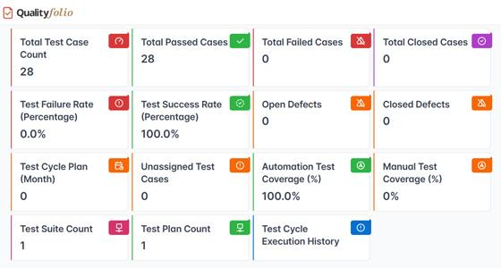
SURVEILR · BUILT-IN SQL PAGES WEB SERVER
Write SQL. Get a web app. No Node, no PHP, no Python stack.
SQL → rendered web table, no HTML needed
-- Every SELECT statement is a rendered UI component
SELECT 'table' AS component,
'Test Results' AS title;
SELECT test_case_id,
exec_status AS status,
exec_nature AS test_name,
orch_started_at AS run_date
FROM orchestration_session_exec
WHERE exec_status = 'FAILED'
ORDER BY orch_started_at DESC;
$ Start web UI
# Launch in one command
surveilr web-ui \
-d resource-surveillance.sqlite.db \
--port 3010 \
--host localhost
# Open browser → http://127.0.0.1:3010
Dashboards
Evidence Portals
Admin Consoles
Compliance UIs
Internal Tools

Slide 10

SURVEILR · INDEPENDENT USE vs. OPSFOLIO SUITE
Full developer experience. Your choice of scope.
surveilr — Standalone
surveilr inside Opsfolio Suite
Data pipeline tool (ELT from any source → RSSD)
Powers the Evidence Warehouse — all Opsfolio controls store evidence here
Local-first observability (Contextual Unified Activity Records)
Fleetfolio reads fleet telemetry from surveilr RSSDs
SQL-native message queue without Kafka/RabbitMQ
Qualityfolio orchestration sessions stored in surveilr tables
AI/RAG backend — structured Operational Truth as LLM context
Opsfolio GRC policy layer queries surveilr for control satisfaction
Portable evidence store for security tools (osquery, Trivy)
Continuous audit posture = live SQL across surveilr evidence
One-command web dashboards via SQL Pages
Framework-agnostic: SOC 2, CMMC, HIPAA, ISO 27001 from one RSSD
surveilr is always the same binary — no "Suite edition" vs "Community edition" distinction

Slide 11
SPRY · WHAT IS IT
Spry
SQL Curator & Markdown-as-a-Programmable-Medium
Use Markdown to code, build, and orchestrate intelligence.
BI as Code
Executable Runbooks
SQL Libraries
Dashboards, queries, metrics in Markdown.
Version and review like code.
Ops procedures as Markdown.
Every step is a runnable cell.
Reusable type-safe SQL fragments
with [PI] + {attrs} binding.
SQL Migrations
AI Context Eng.
Evidence Warehouses
Pure SQL + CTEs. Idempotent.
No migration framework required.
Author prompts, embeddings, RAG
pipelines as Markdown cells.
Audit-ready notebooks: code
+ outputs for SOC2/HIPAA proof.

Slide 12
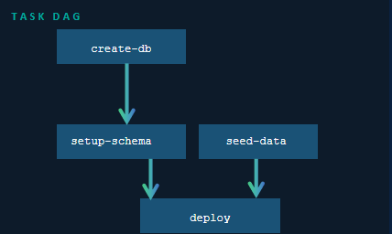
SPRY · EXECUTABLE MARKDOWN & TASK DAG
Every fenced code block is a runnable cell. Dependencies wire a DAG.
Spryfile.md — named tasks + deps + SQL routes
# Spryfile.md — a complete application in one Markdown file
## setup
```bash create-db --descr "Create database file"
rm -f app.db && sqlite3 app.db "VACUUM;"
```
```bash setup-schema --dep create-db --descr "Apply schema"
sqlite3 app.db < schema.sql
```
```bash seed-data --dep setup-schema --descr "Load seed rows"
sqlite3 app.db < seed.sql
```
```bash deploy --dep setup-schema --dep seed-data
echo “Deployment completed” ```
## Routes
```sql index.sql { route: '/' }
SELECT 'hero' AS component,
'My App' AS title,
'Built with Spry' AS description;
```
```sql users.sql { route: '/users', cache: 60 }
SELECT 'table' AS component;
SELECT id, name, email FROM users;
```
Key directives
--descr "..."
Human description of the task
--dep <name>
Dependency on another named task
{ route: '/' }
SQL cell becomes a SQLPage URL route
{ cache: 60 }
Cache route response for N seconds

Slide 13
SPRY · CLI & QUICK START
Bootstrap to running app in seconds
$ 1. Install Spry
Spry CLI reference — spry <command>
# macOS / Linux — Homebrew (recommended)
brew install programmablemd/packages/spry
# Initialize a new Spry project
spry sp init
# Verify installation
spry --version
run
Execute ALL tasks in dependency order
task <name>
Run one task + its prerequisites
spc --fs <dir>
Compile Spryfile → SQLPage filesystem
spc --watch
Live reload on Markdown changes (dev)
$ 2. Develop & run
# Generate SQLPage filesystem + watch for changes
spry sp spc \
--fs dev-src.auto \
--conf sqlpage/sqlpage.json \
--watch
# In another terminal — execute all tasks (DAG)
spry rb run
# Run a specific task + its deps
spry rb task deploy
spc --conf <file>
Specify SQLPage config (dev vs prod)
--dialect sqlite|postgres
Choose database at init time
--target-dir <path>
Set project directory at bootstrap
📸 Screenshot placeholder: Spry CLI — spry rb run output showing task DAG execution with ✓ / ✗ per cell

Slide 14
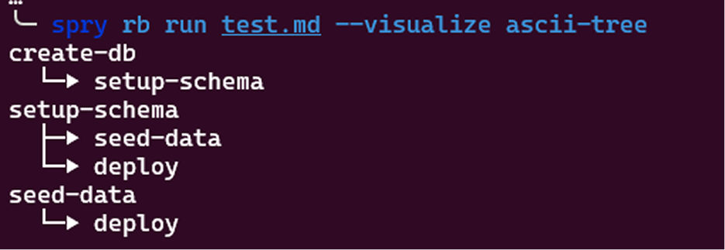
SPRY · CLI & QUICK START
close

Slide 15
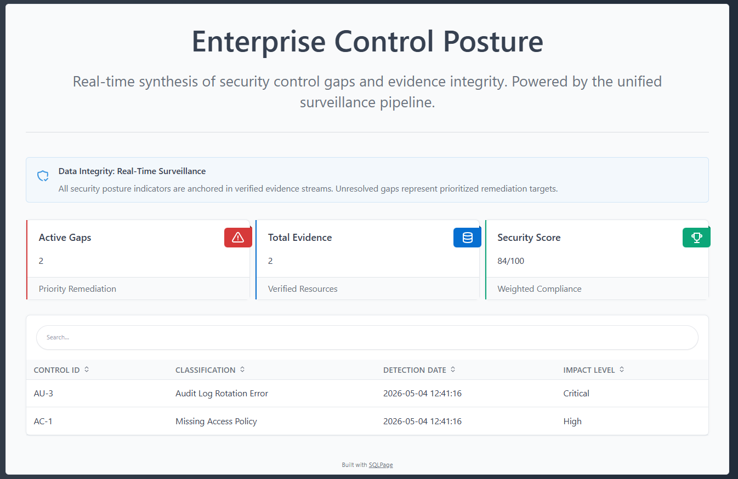
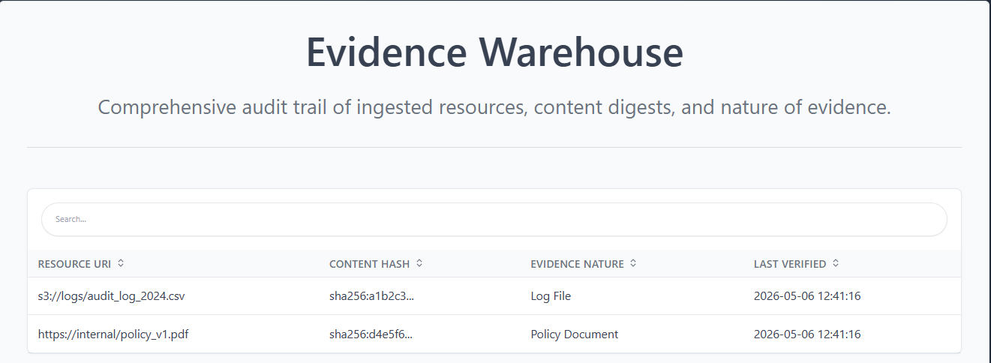
SPRY · SQLPAGE ROUTES & EVIDENCE WAREHOUSES
SQL cells become web routes. Notebooks become audit artifacts.
Spryfile.md — SQL cells wired to URL routes
```sql dashboard.sql { route: '/admin/dashboard', cache: 300 }
-- Named *.sql cell → SQLPage URL at /admin/dashboard
SELECT 'hero' AS component,
'Control Posture' AS title;
SELECT 'table' AS component,
'Active Gaps' AS title;
SELECT control_id, gap_type, detected_at, severity
FROM control_gaps
WHERE resolved_at IS NULL
ORDER BY severity DESC;
```
```sql evidence.sql { route: '/evidence' }
SELECT 'table' AS component, 'Evidence Log' AS title;
SELECT uri, content_digest, last_modified_at, nature
FROM uniform_resource
WHERE last_modified_at > datetime('now', '-30 days');
```
Evidence Warehouse — executable quality checks as SQL cells (Soda.io alternative)
# Evidence Warehouse — Data Quality as Code
# Each check is a SQL cell that fails loudly on violation
```sql check-null-evidence --descr "No orphaned evidence"
SELECT CASE
WHEN COUNT(*) > 0 THEN error('Orphaned evidence records found: ' || COUNT(*))
ELSE 'PASS: all evidence linked to controls'
END
FROM uniform_resource ur
LEFT JOIN control_evidence ce ON ce.resource_id = ur.uniform_resource_id
WHERE ce.control_id IS NULL;
```

Slide 16
SPRY · INDEPENDENT USE vs. OPSFOLIO SUITE
A complete developer tool on its own.
Use Case
Spry Standalone
Inside Opsfolio Suite
Data engineering pipelines
Mix SQL/Bash/TS in one Markdown. --dep wires DAG. Replaces dbt + Makefile.
Spry pipelines ingest + transform data that lands in surveilr RSSDs for Opsfolio controls.
Internal dashboards
Write SQL cells named *.sql. and spry sp spc serves them as a web app instantly.
Spry authors the SQLPage views used by Fleetfolio and Qualityfolio dashboards.
Runbooks / SRE
Executable Markdown procedures with real Bash cells. Single source of truth for ops.
Opsfolio uses Spry runbooks to encode and execute control testing procedures.
Data Quality checks
SQL cells as executable tests. Fail loudly. Re-run on every push. No YAML.
Control predicate checks (φᵢ(Eₜ)) are authored and run as Spry SQL cells.
AI context pipelines
Version prompts, embeddings, retrieval as cells. Reproducible RAG with full traceability.
Opsfolio AI Workforce™ agents are orchestrated by Spry for evidence collection tasks.
Spry has no dependency on surveilr. All features work standalone with any SQLite or PostgreSQL database.

Slide 17
FLEETFOLIO · SQL-NATIVE EDR BUILT ON SURVEILR
Fleetfolio
Device state you can query. Evidence you can prove.
HOW FLEETFOLIO USES SURVEILR
osquery agents
Steampipe
cnquery
SNMP polling
Cloud APIs (AWS/Azure/GCP)
Vuln scanners
surveilr RSSD → Fleetfolio SQL Views + SQL Pages
Detection & Response
Asset Reconciliation
Posture & Policies
SQL-native rules. Detection = evidence. Timestamped + auditable.
Expected vs Observed: MATCHED / MISSING / UNEXPECTED / RELOCATED
disk_encrypted, firewall, OS version. Drift alerts with before/after snapshots.
Threat Exposure Mgmt
Cloud Cost Discovery
Compliance Mapping
Pen test orchestration. CVE correlation. POA&M generation.
Idle/oversized/zombie resources flagged. Savings in dollar amounts.
SOC2, CMMC, FedRAMP, HIPAA, ISO 27001, NIST 800-53 out of box.

Slide 18
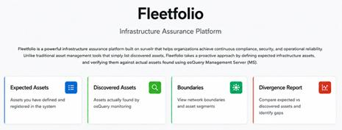
FLEETFOLIO · SQL-NATIVE DETECTION & ASSET RECONCILIATION
Detection rules are SQL. Evidence is SQL. Reconciliation is SQL.
Detection — Policy as SQL query
Asset Reconciliation — Expected vs Observed
-- Policy: all laptops MUST have disk encryption
-- Detection fires as a row in device_posture_violations
SELECT hostname, disk_encrypted, os_version, last_seen
FROM device_posture dp
JOIN device_inventory di ON dp.device_id = di.device_id
WHERE di.device_type = 'laptop'
AND dp.disk_encrypted = FALSE;
-- Asset reconciliation: Expected vs Observed
-- Status: MATCHED | MISSING | UNEXPECTED | RELOCATED
SELECT COALESCE(e.asset_tag, d.serial_number) AS asset_id,
e.expected_location, d.observed_location,
CASE
WHEN e.asset_tag IS NULL THEN 'UNEXPECTED'
WHEN d.serial_number IS NULL THEN 'MISSING'
WHEN e.expected_location != d.observed_location THEN 'RELOCATED'
ELSE 'MATCHED'
END AS reconciliation_status,
d.last_seen
FROM expected_assets e
FULL OUTER JOIN device_inventory d ON e.asset_tag = d.asset_tag
WHERE e.asset_tag IS NULL
OR d.serial_number IS NULL
OR e.expected_location != d.observed_location;
Drift Detection — before/after evidence snapshots
-- Drift detection: devices that WERE encrypted, now aren't
SELECT hostname, changed_at,
old_value AS was_encrypted,
new_value AS now_encrypted,
evidence_before, evidence_after
FROM device_posture_changes
WHERE field = 'disk_encrypted'
AND old_value = TRUE
AND new_value = FALSE
ORDER BY changed_at DESC;
-- Each row has before/after evidence snapshots + audit trail
Evidence — complete incident package from one SQL query
-- Full incident evidence package (for any detection ID)
SELECT detection_id, detection_rule, detected_at,
hostname, evidence_snapshot, remediation_status,
remediation_completed_at, audit_chain
FROM detection_events d
WHERE detection_id = 'DET-2024-0847';
📸 Fleetfolio SQL Pages — posture drift timeline: disk_encrypted TRUE → FALSE events over 30 days

Slide 19
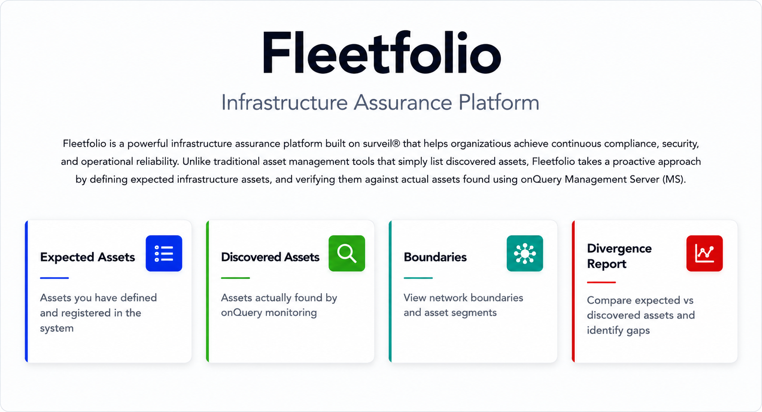
FLEETFOLIO · SQL-NATIVE DETECTION & ASSET RECONCILIATION
close

Slide 20
QUALITYFOLIO · TEST MANAGEMENT AS CODE ON SURVEILR
Qualityfolio
Evidence-Driven Quality Telemetry — Test Management as Code (TMaC)
TMaC ARTIFACT HIERARCHY
HOW QUALITYFOLIO USES SURVEILR
Project
→
Strategy
→
Suite
→
Plan
→
Cycle
→
Test Case
→
Evidence
1
Author
Markdown + YAML test cases in Git. Full PR review workflow.
2
Ingest
TC-001.case.md — Markdown test case with YAML frontmatter
surveilr ingest files — Markdown artifacts land in RSSD.
---
test_case_id: "TC-001"
title: "Verify MFA enforcement for PHI-bearing endpoints"
type: test_case
test_plan: TP-001
test_type: "Manual"
priority: "High"
tags: ["Security", "HIPAA", "SOC2-CC6.1"]
---
## Test Steps
1. Navigate to /api/phi-data without MFA token
2. Confirm HTTP 401 with MFA_REQUIRED error code
3. Complete MFA challenge and retry
4. Confirm HTTP 200 and access granted
## Expected Result
Access denied without MFA; granted after MFA challenge.
3
Execute
CLI/CI/manual run. Results captured as structured JSON evidence.
4
Store
orchestration_session + orchestration_session_exec tables in RSSD.
5
Query
SQL evidence available instantly. Auditor self-service via SQL Pages.
📸 Qualityfolio web UI — test cycle dashboard with pass/fail charts and evidence explorer

Slide 21
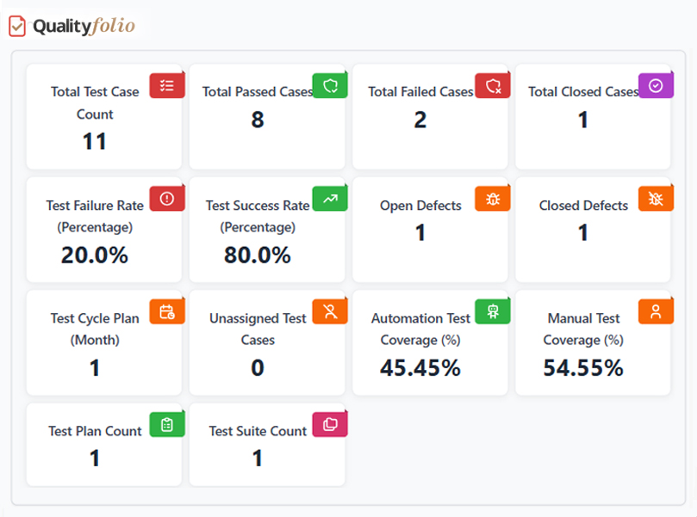
QUALITYFOLIO · TEST MANAGEMENT AS CODE ON SURVEILR
close

Slide 22
QUALITYFOLIO · SQL EVIDENCE & COMPLIANCE QUERIES
Every test result is a queryable, immutable SQL row
Evidence schema — immutable, timestamped, auditable
SOC 2 evidence query — Q3 access controls
-- surveilr orchestration tables (Qualityfolio's evidence schema)
CREATE TABLE orchestration_session (
orchestration_session_id TEXT PRIMARY KEY,
device_id TEXT NOT NULL,
orchestration_nature_id TEXT NOT NULL,
version TEXT NOT NULL,
orch_started_at TIMESTAMPTZ NOT NULL,
orch_finished_at TIMESTAMPTZ,
diagnostics_json JSONB
);
CREATE TABLE orchestration_session_exec (
orchestration_session_exec_id TEXT PRIMARY KEY,
orchestration_session_id TEXT REFERENCES orchestration_session,
exec_nature TEXT NOT NULL, -- test name
exec_status TEXT NOT NULL, -- PASSED | FAILED
exec_code TEXT NOT NULL, -- test body
output_text TEXT, -- captured output
narrative_md TEXT -- evidence narrative
);
-- SOC 2: all access control tests in Q3 2025
SELECT ose.exec_nature AS test_name,
ose.exec_status AS status,
os.orch_started_at AS execution_time,
ose.narrative_md AS evidence_summary
FROM orchestration_session_exec ose
JOIN orchestration_session os
ON ose.orchestration_session_id = os.orchestration_session_id
WHERE ose.exec_nature LIKE '%access-control%'
AND os.orch_started_at BETWEEN '2025-07-01' AND '2025-09-30'
ORDER BY os.orch_started_at DESC;
Flaky test detection — assurance risk
-- Flaky tests — assurance risk report
SELECT ose.exec_nature AS test_name,
COUNT(*) AS total_runs,
SUM(CASE WHEN ose.exec_status='PASSED' THEN 1 ELSE 0 END) AS passes,
ROUND(100.0 * SUM(CASE WHEN ose.exec_status='PASSED'
THEN 1 ELSE 0 END) / COUNT(*), 2) AS pass_rate
FROM orchestration_session_exec ose
GROUP BY ose.exec_nature
HAVING COUNT(*) > 5 AND pass_rate < 95
ORDER BY pass_rate ASC;
$ Install & run
# Install surveilr, run Qualityfolio, launch UI
spry rb run qualityfolio.md
spry sp spc --fs dev-src.auto --destroy-first --conf sqlpage/sqlpage.json --md qualityfolio.md
EOH_INSTANCE=1 PORT=9227 surveilr web-ui -d ./resource-surveillance.sqlite.db --port 9227 --host 0.0.0.0
📸 Qualityfolio — SOC 2 evidence package view: test name, status, timestamp, evidence hash per row

Slide 23
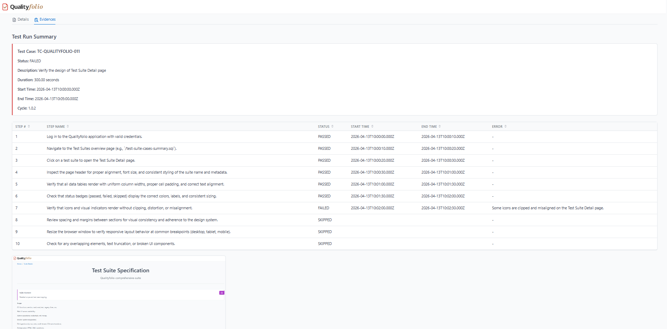
QUALITYFOLIO · SQL EVIDENCE & COMPLIANCE QUERIES
close

Slide 24
THE OPSFOLIO SUITE — GRC ENGINEERING PLATFORM
Compliance is not a document state. It is a computational invariant.
OPERATIONAL TRUTH™ INVARIANT
∀ cᵢ ∈ C, ∀ t : φᵢ(Eₜ) ∨ gᵢ(t)
For all controls and all times — control is satisfied OR a gap signal is asserted. No unknown state.
surveilr
Spry
Fleetfolio
Qualityfolio
Eₜ — Evidence State
φᵢ — Control Predicates
Fleet Surface
Quality Surface
Ingests telemetry from all systems. Every RSSD row is a timestamped, immutable observed evidence point.
SQL cells express the expected control conditions. They're versioned, reviewed, and continuously evaluated.
Contributes device state, posture, and security telemetry as Eₜ evidence for infrastructure controls.
Contributes test execution records and assurance evidence as Eₜ for software and process controls.
Three control states: ✓ Satisfied ✗ Failed (gap asserted) ⚠ Not Observed (coverage gap)

Slide 25


CHOOSE YOUR DEVELOPER PATH
Every tool works independently. Compose as you grow.
Path 1 — surveilr Standalone
Path 2 — Spry Standalone
Path 3 — Fleetfolio / Qualityfolio
Path 4 — Full Opsfolio Suite
1
brew install surveilr
1
brew install programmablemd/packages/spry
1
Install surveilr
1
Deploy surveilr + Spry pipelines
2
surveilr ingest files
2
Author Spryfile.md
2
surveilr shell qualityfolio/package.sql
2
Install Fleetfolio + Qualityfolio patterns
3
surveilr shell pattern.sql
3
spry rb run
3
surveilr ingest files
3
Define controls as Spry SQL cells
4
surveilr web-ui --port 3010
4
spry sp spc --watch
4
surveilr web-ui + open UI
4
Query Operational Truth™ at any moment
Best for: data engineers, SRE, observability, compliance evidence
Best for: SQL pipelines, dashboards, runbooks, BI as Code
Best for: security teams, QA engineers, compliance officers
Best for: GRC engineering, continuous audit posture, AI Workforce™

Slide 26
GET STARTED TODAY
Independent tools. Composable platform. Evidence by default.
surveilr
brew tap surveilr/tap && brew install surveilr
surveilr.com · docs.opsfolio.com/surveilr
Spry
brew install programmablemd/packages/spry
sprymd.org · docs.opsfolio.com/spry
Fleetfolio
sudo docker pull fleetfolio/fleetfolio && sudo docker run --rm -it --env-file .env -v $(pwd)/.env:/opt/eaa/.env -v $(pwd)/results:/opt/eaa/sessions/ fleetfolio/fleetfolio
sudo docker pull fleetfolio/threat-exposure && sudo docker run --rm -it -p 9228:9228 -v "$PWD:/data" fleetfolio/threat-exposure
fleetfolio.dev · docs.opsfolio.com/spry/fleetfolio/introduction
spry rb run qualityfolio.md
spry sp spc --fs dev-src.auto --destroy-first --conf sqlpage/sqlpage.json --md qualityfolio.md
EOH_INSTANCE=1 PORT=9227 surveilr web-ui -d ./resource-surveillance.sqlite.db --port 9227 --host 0.0.0.0
Qualityfolio
qualityfolio.dev · next.qualityfolio.dev
Opsfolio Suite · opsfolio.com · Compliance-as-a-Service — software + operating discipline delivered together

