Slide 1
PRODUCT TOUR
Fleetfolio
Device State You Can Query. Evidence You Can Prove.
SQL-native endpoint detection, continuous posture management, and audit-grade evidence — built for security leaders who need to prove control effectiveness, not just claim it.
Netspective Communications LLC
fleetfolio.dev · Confidential · May 2026

Slide 2
Today's Tour
01
02
03
Compliant Insecurity
The Architecture
The Ecosystem
Why passing audits doesn't mean you're secure
SQL-native EDR and the evidence-first difference
Fleetfolio + Opsfolio Suite + Qualityfolio
04
05
06
Feature Tour
SQL Evidence
Deploy & Close
Detection, posture, reconciliation, TEM, cloud costs
Every detection is a query. Every query is evidence.
Integration, deployment models, and next steps
fleetfolio.dev · Confidential

Slide 3
THE PROBLEM
Compliant Insecurity
Most organizations pass their annual audit — and still get breached.
Why It Happens
The Result
Evidence Decay
Audit-ready.
Screenshots and exports are stale the moment they're captured. Auditors sample a past state.
Breach-prone.
Audit-Time Heroics
Teams scramble to assemble evidence when the auditor arrives. Controls exist on paper only.
Controls are documented but not continuously verified. Detection tools fire alerts that vanish. Evidence is assembled, not generated. The gap between the audit and the breach grows invisible.
Policy-Reality Gap
Documented controls don't reflect operational enforcement. No one knows what's actually running.
Tool Fragmentation
osquery, MDM, CMDB, monitoring — each a silo. None speaks compliance. AI can't JOIN them.
fleetfolio.dev · Confidential

Slide 4
THE APPROACH
SQL-Native EDR: A Different Architecture
Traditional EDR detects threats. Fleetfolio detects threats AND proves what happened.
Traditional EDR
Fleetfolio
Alerts fire — then vanish into a SIEM queue
Evidence is a screenshot or export, assembled later
Detection rules are proprietary, opaque, untestable
Compliance reports generated manually from alert data
No native understanding of audit requirements
Every detection is ephemeral — no audit chain
AI can't query alerts that live in a proprietary log format
Every detection rule is a SQL query — version-controlled, testable
Every alert is a timestamped, immutable evidence artifact
Detection = evidence: one query serves SOC 2 AND security ops
Compliance mapping built into every rule at authoring time
Audit packages generated by querying evidence, not assembling PDFs
Full audit chain: who, when, before/after, cryptographic hash
AI can SELECT from device_posture, device_inventory right now
fleetfolio.dev/compare · Full comparison: CrowdStrike, SentinelOne, Carbon Black, FleetDM

Slide 5
ECOSYSTEM
Fleetfolio in the Opsfolio Ecosystem
Fleet telemetry flows directly into Opsfolio Suite's Evidence Warehouse and Asset Intelligence.
Fleetfolio
Opsfolio Suite
Qualityfolio
SQL-Native EDR + Fleet Management
GRC Engineering Platform
Test Management
as Code (TMaC)
Endpoint posture: encryption, firewall, patches
Asset reconciliation: MATCHED / MISSING / UNEXPECTED
Vulnerability findings from Nessus, Trivy, OpenVAS
Cloud resource inventory (AWS, Azure, GCP)
Pen test findings via Threat Exposure Management
Network device telemetry via SNMP
Asset Intelligence
Live fleet posture feeds directly into asset inventory
Git-versioned test artifacts
Immutable SQL evidence (surveilr)
Feeds Quality Intelligence in Opsfolio
Maps to SOC 2, HIPAA, FDA 21 CFR
Evidence Warehouse
Fleet telemetry becomes compliance evidence, auto-mapped to controls
Audit Center
Fleetfolio evidence populates SOC 2, CMMC, FedRAMP audit packages
Threat Management
TEM findings flow into the threat and incident modules
Controls Library
Fleet posture checks map to executable control predicates
qualityfolio.dev
fleetfolio.dev · Confidential

Slide 6
CORE CONCEPT
Expected vs. Observed
Every asset has what you think exists — and what agents actually find. Fleetfolio reconciles them continuously.
Expected Assets
Observed Assets
Reconciliation
Design-Time Intent
Runtime Reality
Operational Truth™ via SQL
What your organization believes should exist. Defined in the asset registry: servers, workstations, cloud instances, network devices.
What agents actually discover on the network right now. Continuous check-ins via osquery, SNMP, cloud APIs — timestamped, immutable.
FULL OUTER JOIN produces four states: MATCHED (governance working) · MISSING (reliability or security failure) · UNEXPECTED (shadow IT or compromise) · RELOCATED (location drift).
Source: CMDB / asset registry
Source: surveilr evidence store
SELECT hostname, status FROM asset_comparison_report
In Opsfolio Suite: every MATCHED asset feeds Asset Intelligence in real time. Every UNEXPECTED asset triggers a gap signal in the Operational Truth™ invariant.
fleetfolio.dev · Confidential

Slide 7
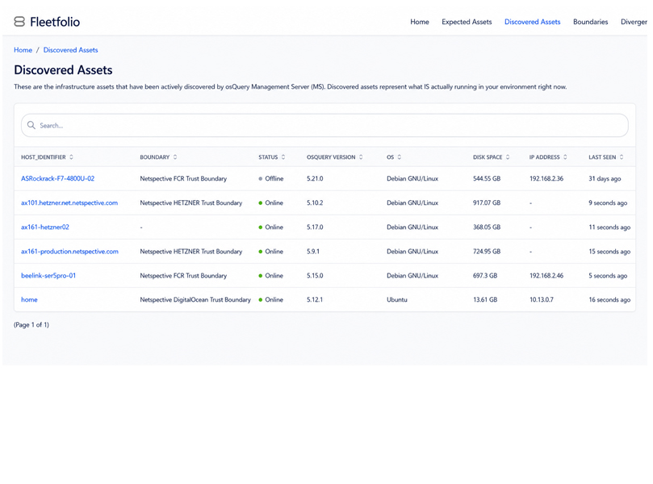
DETECTION
Endpoint Detection
& Response
fleetfolio.dev/product/detection
Every detection rule is SQL. Every alert is evidence.
SQL-native detection: rules are version-controlled queries, not opaque signatures
Configuration drift detection: disk encryption, firewall, patch level
Unauthorized local admin detection via SQL query against local_admins table
Vulnerable software: CVE correlation against installed package versions
Incident evidence collection with full provenance: who, when, before/after
SQL
Auto
Live
Detection Engine
Evidence Chain
Alert → Evidence
fleetfolio.dev · Confidential

Slide 8
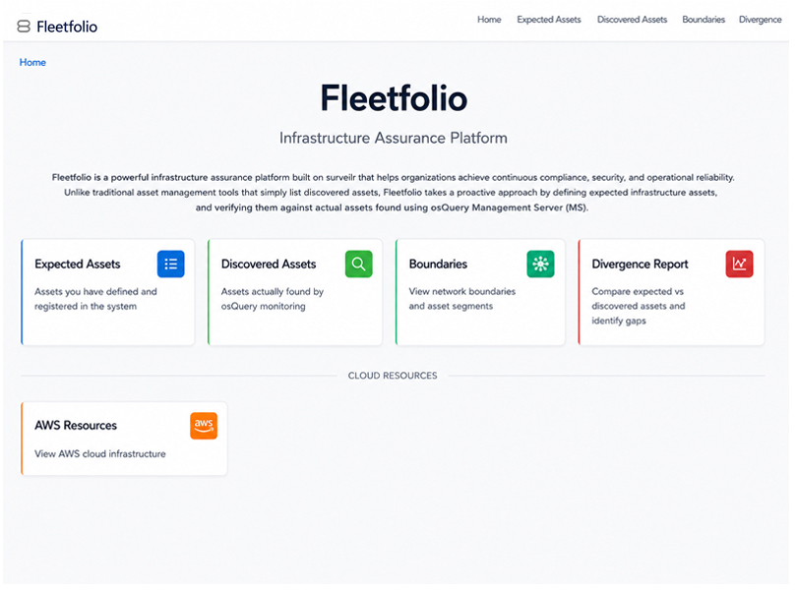
DISCOVERY
Fleet Asset
Discovery
fleetfolio.dev/product/asset-reconciliation
Inventory fresh within minutes. Shadow IT detected automatically.
Agent-based and agentless: SNMP, SSH, WMI, cloud APIs — all devices, all surfaces
Continuous check-ins with last_seen timestamps — no quarterly exports
FULL OUTER JOIN reconciliation: MATCHED / MISSING / UNEXPECTED / RELOCATED
Shadow IT: unknown devices detected and flagged as unauthorized attack surface
Owner assignment, tagging, criticality, boundary mapping — all queryable in SQL
Live
4
SQL
Asset State
Recon. States
One JOIN
fleetfolio.dev · Confidential

Slide 9
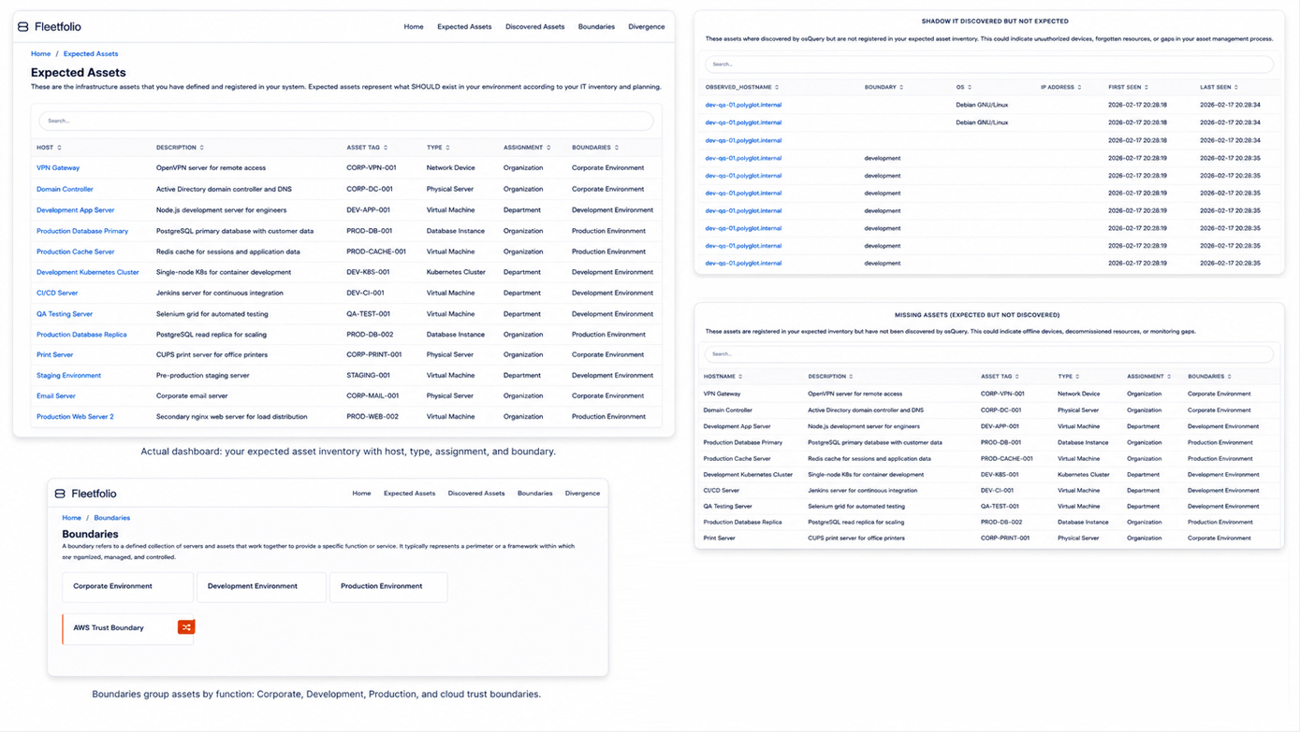
fleetfolio.dev · Confidential

Slide 10
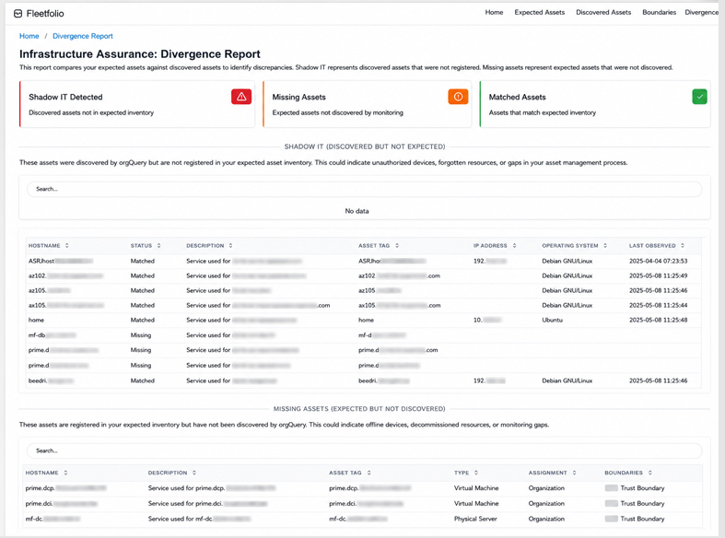
POSTURE
Security Posture
& Config Management
fleetfolio.dev/product/posture
Policy-as-SQL: version-controlled, testable, drift-detecting.
Disk encryption, firewall status, OS version, patch level — all boolean SQL fields
Drift detection: devices that were compliant and are now not — with timestamps and audit trail
Before/after evidence snapshots for every posture change
Compliance control mapping built into each policy query (ISO 27001, SOC 2, NIST)
Alert on regression: when a device drops below baseline, a gap signal is immediately asserted
Drift
Hash
Live
Auto-Detected
Proof of State
Posture Baseline
fleetfolio.dev · Confidential

Slide 11
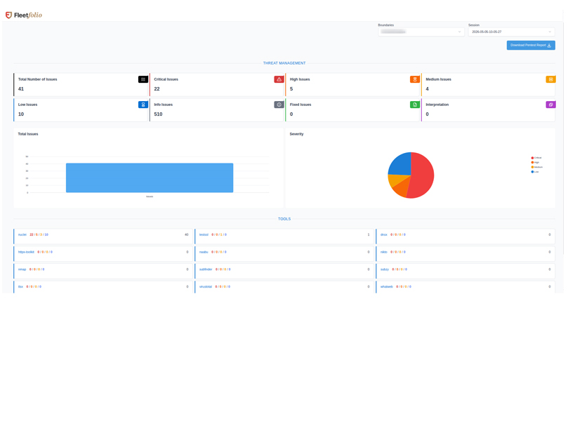
TEM
Threat Exposure
Management
fleetfolio.dev/product/tem
Pen test findings structured as evidence, not PDFs.
Ingests Nessus, Trivy, OpenVAS, and manual pentest output — normalized to SQL
Real-time TEM dashboard: live findings, not stale reports. No more waiting for PDFs
CVSS/EPSS-based prioritization — focus remediation on actual risk, not noise
Lifecycle tracking: Open → In Progress → Remediated → Validated → Closed
Auto-generates POA&M items mapped to SOC 2, ISO, CMMC, HIPAA, FedRAMP
Auto
Live
5-Stage
POA&M Generation
Finding Dashboard
Remediation Flow
fleetfolio.dev · Confidential

Slide 12
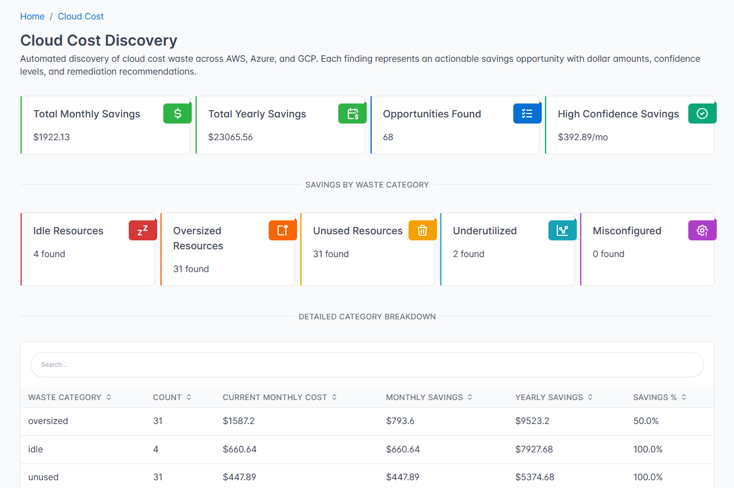
CLOUD COSTS
Cloud Cost
Visibility
fleetfolio.dev/product/cloud-costs
Waste is a governance gap. Fleetfolio proves it with dollar amounts.
Scans AWS, Azure, GCP — orphaned resources, oversized instances, idle services
Maps every waste category to a governance gap and compliance control
Savings quantified: monthly and annual projections, per resource
Connects cost waste to configuration drift — governance failures cost money
Three-command setup: set credentials, run surveilr ingest, query savings
3
SQL
$$$
Cloud Providers
Savings Query
Quantified Waste
fleetfolio.dev · Confidential

Slide 13
SQL EVIDENCE
Every Detection Is a Query.
Every Query Is Evidence.
Standard SQL — testable, version-controllable, audit-defensible.
Posture: Detect unencrypted laptops
Drift: Encryption disabled since last check
Shadow IT: Unknown devices on the network
SELECT hostname, disk_encrypted, last_checked
FROM device_posture dp
JOIN device_inventory di ON dp.device_id = di.device_id
WHERE di.device_type = 'laptop' AND disk_encrypted = FALSE;
SELECT hostname, changed_at, old_value AS was_encrypted,
new_value AS now_encrypted, evidence_before, evidence_after
FROM device_posture_changes
WHERE field = 'disk_encrypted' AND old_value = TRUE
AND new_value = FALSE ORDER BY changed_at DESC;
SELECT o.host_identifier, o.ip_address, o.first_seen,
o.last_seen, o.operating_system
FROM shadow_it_hosts o
WHERE o.first_seen >= date('now', '-7 days')
ORDER BY o.first_seen DESC;
Maps to: SOC 2 CC6.1 · ISO A.10.1 · NIST SC-28
Full audit trail — who, when, before/after snapshots
Evidence artifact: unauthorized attack surface
All queries run against surveilr — append-only SQLite. Same query = security ops + audit evidence.

Slide 14
COMPLIANCE
Built-In Compliance Mapping
Every detection rule maps to a control. Audit packages are a SQL query, not a sprint.
SOC 2 Type I & II
FedRAMP Low/Mod/High
HIPAA
CC6.1, CC6.2, CC7.1, CC8.1
AC-2, CM-6, CM-7, SI-2, SC-28
§164.312(a)(1), §164.312(c)(1)
NIST 800-53
CMMC Level 2+
ISO 27001
AC-2, CM-8, SI-3, SI-7, RA-5
AC.1.001, CM.2.061, SI.1.210
A.8.1, A.9.4, A.10.1, A.12.6
How This Reaches Opsfolio Suite
Fleetfolio posture checks and TEM findings are ingested into the Opsfolio Suite Evidence Warehouse automatically.
Each piece of evidence is tagged with framework controls at ingest time — SOC 2, CMMC, FedRAMP in one record.
The Opsfolio Audit Center queries Fleetfolio evidence to populate audit packages on demand. No manual assembly.
Coverage gaps surface as Operational Truth™ gap signals — uninstrumented controls are never silently assumed compliant.
fleetfolio.dev · Confidential

Slide 15
DEPLOYMENT
Sovereign by Design
Your data never leaves your control. Deploy where your security policy requires.
ONPREM
VPC
AIRGAP
EDGE
On-Premises
/ Self-Hosted
Private Cloud
/ VPC
Air-Gapped
/ Sovereign
Edge /
Remote Sites
Full control. No internet required. surveilr runs on your own hardware. Data never leaves the building. Ideal for regulated environments.
Deploy in your AWS, Azure, or GCP private network. Cloud elasticity with your security controls intact.
Maximum security for classified or restricted environments. Manual data transfer. Offline operation. Sync when connected.
Lightweight agents at branch offices, factory floors, or remote sites. Local ingestion, synchronized to central surveilr on reconnect.
No internet required
Your infrastructure
Maximum control
CMMC / FedRAMP compliant
Cloud elasticity
Network isolation
Your cloud account
Multi-region capable
No external network
Manual transfer
Offline operation
Sync when permitted
Lightweight agents
Intermittent connectivity
Local evidence store
Central aggregation
Cloud SaaS option coming soon · fleetfolio.dev/deployment

Slide 16
INTEGRATIONS
Bring Your Existing Tools
All connectors land as normalized SQL tables in surveilr. One schema. All sources.
Endpoints
Network
Cloud
Vuln. Scanners
Workflow & Ticketing
osquery
cnquery
Steampipe
WMI (Windows)
SSH probes
SNMP polling + traps
Syslog ingestion
JSONL feeds
Network switch APIs
AWS (CloudTrail, Config)
Azure Monitor
GCP Logging
Kubernetes APIs
Nessus
Trivy
OpenVAS
Pen-test output (JSON/XML/CSV)
Jira (auto-ticket findings)
ServiceNow
Slack / Teams alerts
OSCAL export
All integrations land in surveilr · fleetfolio.dev/integrations

Slide 17
Our Guarantee
“We guarantee your audit outcome. If you follow our process and don’t pass, we keep working — at our cost — until you do.”
98%
Months
SQL
CaaS
Audit Pass Rate
To Audit-Ready
Evidence on Demand
Delivery Model
Compliance as a Service (CaaS) Delivery
Netspective deploys Fleetfolio against your primary cloud provider, identity provider, and endpoints. Standard control templates cover 60–70% of SOC 2 technical surface from day one. We deliver compliance engineering capability — not just a license.
fleetfolio.dev · opsfolio.com · Netspective Communications LLC · May 2026

Slide 18
Ready to Query
Your Fleet?
Fleetfolio · Opsfolio Suite · Qualityfolio
1
2
3
Contact Us
Fleet:
fleetfolio.dev
Connect Your Fleet
Run Your First Query
Audit Package
Suite:
opsfolio.com
Deploy osquery agents and point Steampipe at your cloud. Fleet posture goes live in hours, not weeks.
SELECT * FROM device_posture WHERE disk_encrypted = FALSE. See your actual exposure in seconds.
Within 90 days: generate your first SOC 2 or CMMC audit package by query. No sprint. No screenshots.
Email:
sales@opsfolio.com
QA:
qualityfolio.dev
Schedule a Live Demo
fleetfolio.dev · Confidential · Netspective Communications LLC · May 2026

