Slide 1
Getting Started with Lakehouses in Microsoft Fabric
Module 4

Slide 2
What is a lakehouse in Microsoft Fabric?
A lakehouse is a data architecture for storing and analyzing both structured and unstructured data in the same location
The structure is flexibile and scalable, allowing organizations to handle large volumes of data
Lakehouses integrate with data management and analytics tools for data engineering and analytics
Notes:
Microsoft Fabric Lakehouse is a data architecture platform for storing, managing, and analyzing structured and unstructured data in a single location. It's a flexible and scalable solution that allows organizations to handle large volumes of data using various tools and frameworks to process and analyze that data. It integrates with other data management and analytics tools to provide a comprehensive solution for data engineering and analytics.

Slide 3
Delta Lake Tables—the core of the Lakehosue
Fabric supports multiple table formations including managed, unmanaged, and regular non-Delta Hive tables.
However, the core of Fabric is the Delta Lake storage format commonly used in Apache Spark
Delta Lake is an open-source storage layer which adds relational database semantics to Spark-based data lake tables
Tables in Microsoft Fabric lakehouses are Delta tables, which is signified by the triangular Delta (▴) icon on tables in the lakehouse user interface.
Notes:
The benefits of using Delta tables include:
Relational tables that support querying and data modification. With Apache Spark, you can store data in Delta tables that support CRUD (create, read, update, and delete) operations. In other words, you can select, insert, update, and delete rows of data in the same way you would in a relational database system.
Support for ACID transactions. Relational databases are designed to support transactional data modifications that provide atomicity (transactions complete as a single unit of work), consistency (transactions leave the database in a consistent state), isolation (in-process transactions can't interfere with one another), and durability (when a transaction completes, the changes it made are persisted). Delta Lake brings this same transactional support to Spark by implementing a transaction log and enforcing serializable isolation for concurrent operations.
Data versioning and time travel. Because all transactions are logged in the transaction log, you can track multiple versions of each table row and even use the time travel feature to retrieve a previous version of a row in a query.
Support for batch and streaming data. While most relational databases include tables that store static data, Spark includes native support for streaming data through the Spark Structured Streaming API. Delta Lake tables can be used as both sinks (destinations) and sources for streaming data.
Standard formats and interoperability. The underlying data for Delta tables is stored in Parquet format, which is commonly used in data lake ingestion pipelines. Additionally, you can use the SQL Endpoint for the Microsoft Fabric lakehouse to query Delta tables in SQL.

Slide 4
Fabric Lakehouse SQL Endpoing
In Fabric, there is a serving layer, which generates a SQL endpoint and a default dataset during creation.
This allows the user to work directly on top of the Delta tables in the data lake to provide an easy experience from ingestion to reporting

Slide 5

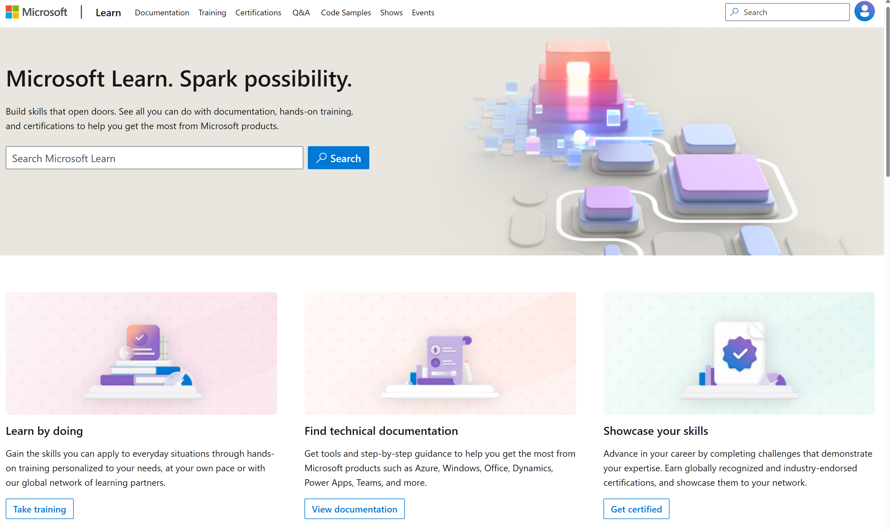
Microsoft Learn Demo
Microsoft Learn: Build skills that open doors in your career

Slide 6
Readiness and Enablement Links
The Microsoft Federal Team is here to help you accelerate customers' digital transformation. Microsoft Federal has tailored to make your organizations skilling journey successful. From the Business Decision Maker to the technical community and end-users, Microsoft provides customers with access to endless skilling resources. Below you will find links to these resources:
Get training tailored to your organization's needs: Find learning paths for specific roles in your organization, plus course recommendations based on technology, skill level, and solution area: Training | Learning Portal (microsoft.com)
Events Calendar - US Partner Community Blog – Microsoft
In addition to the above, the Microsoft Federal Team can address the needs of your non-technical community of your learners through:
Skilling Hours - Readiness and Enablement: Skilling our Federal Customers and Partners (office.com)
Microsoft Learning Portal: A closer look at Azure through training modules and gamified learning
Microsoft Learning Portal
Additional Learning Resources:
Get started with Azure – Introduction | Microsoft Azure
Microsoft Learn (path-based)
Exam-based: Select filters: Azure, D365, M365, Power Platform, and more
Microsoft Virtual Training Days – Virtual Instructor Led
Microsoft Technology Center - Work through your Account Manager
Home - Microsoft Tech Community
Microsoft Reactor | Microsoft Developer – Virtual Instructor Led

