Slide 1
Optimize and Troubleshoot Data Processing
Module 12

Slide 2
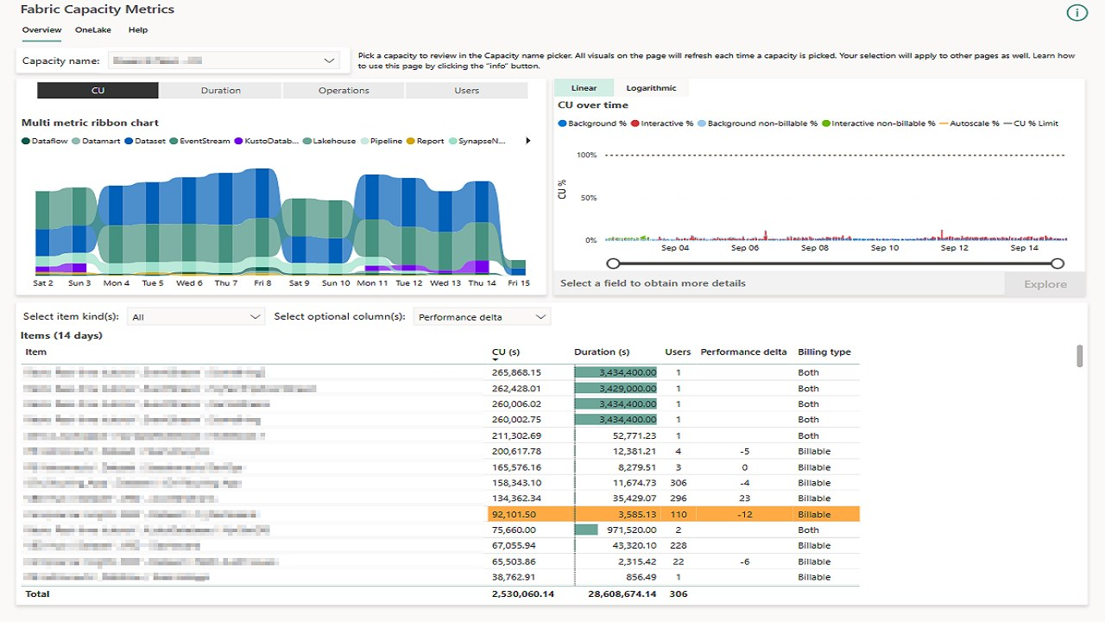
Capacity Metrics App
Notes:
The Microsoft Fabric Capacity Metrics app is designed to provide monitoring capabilities for Microsoft Fabric capacities. Monitoring your capacities is essential for making informed decisions on how to best use your capacity resources. For example, the app can help identify when to scale up your capacity or when to turn on autoscale.
You can install the app from AppSource.
The multi-metric ribbon chart can help you identify if a certain type of workload is consuming all of your CUs. The items list can help you identify if there are performance issues or resource constraints due to a specific item, such as a notebook or semantic model.

Slide 3
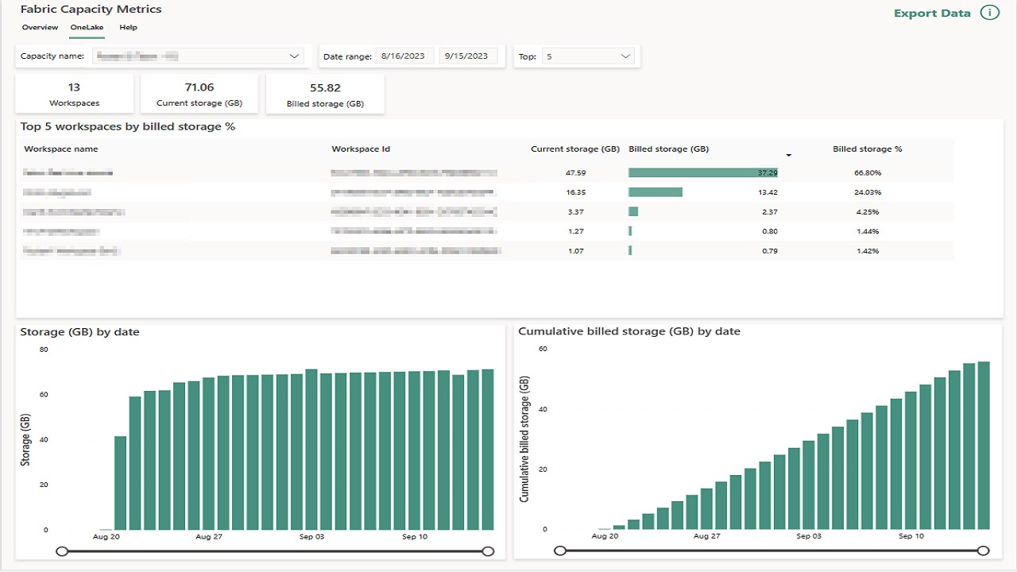
Capacity Metrics - OneLake
Notes:
On the OneLake page, you can find workspaces that are taking the largest amount of storage. You can also see the trends in your storage by date.

Slide 4
Data Warehouse Performance Tips
Use DMVs (dynamic management views) to monitor query execution
Update statistics after data loads
Group insert statements into batches
Minimize transaction sizes
Create primary keys, foreign keys, and unique constraints
Use a star schema design
Use the smallest data type that supports your data
Notes:
When optimizing T-SQL executed in a data warehouse, you can use existing dynamic management views (DMVs) to monitor connection, session, and request status in Microsoft Fabric. DMVs can help you find the user executing a long-running query.
The Warehouse uses a query engine to create an execution plan for a given SQL query. When you submit a query, the query optimizer tries to enumerate all possible plans and choose the most efficient candidate. To determine which plan would require the least overhead, the engine needs to be able to evaluate the amount of work or rows that might be processed by each operator. Then, based on each plan's cost, it chooses the one with the least amount of estimated work. Statistics are objects that contain relevant information about your data, to allow the query optimizer to estimate these costs. Currently, auto-update of statistics is not supported. You will need to manually update statistics after each data load or data update to assure that the best query plan can be built.
If you need to load thousands or millions of rows throughout the day, it's likely that singleton INSERTS aren't optimal.
INSERT, UPDATE, and DELETE statements run in a transaction. When they fail, they must be rolled back. To reduce the potential for a long rollback, minimize transaction sizes whenever possible. Minimizing transaction sizes can be done by dividing INSERT, UPDATE, and DELETE statements into parts.
Having primary key, foreign key and/or unique constraints may help the Query Optimizer to generate an execution plan for a query. These constraints can only be UNENFORCED in Warehouse so care must be taken to ensure referential integrity is not violated.
Star schemas minimizes JOINS at query time, reduces the number of rows read and facilitates aggregations and grouping processing.
When defining your tables, use the smallest data type that supports your data as doing so will improve query performance. This recommendation is important for CHAR and VARCHAR columns. If the longest value in a column is 25 characters, then define your column as VARCHAR(25). Avoid defining all character columns with a large default length.
Use integer-based data types if possible. SORT, JOIN, and GROUP BY operations complete faster on integers than on character data.

Slide 5
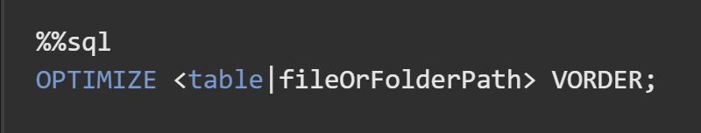
Spark Optimization Tips
Optimized write (small files problem)
Low-shuffle merge
Understand V-Order
Notes:
Delta Lake can improve the speed of read queries from a table by coalescing small files into larger ones by using the OPTIMIZE command on a Delta table
Delta Lake MERGE command allows users to update a delta table with advanced conditions. It can update data from a source table, view or DataFrame into a target table by using MERGE command. However, the current algorithm in the open source distribution of Delta Lake isn't fully optimized for handling unmodified rows. The Microsoft Spark Delta team implemented a custom Low Shuffle Merge optimization, unmodified rows are excluded from an expensive shuffling operation that is needed for updating matched rows.
The implementation is controlled by the spark.microsoft.delta.merge.lowShuffle.enabled configuration, enabled by default in the runtime. If you disable this setting, have a good reason.
V-Order is a write time optimization to the parquet file format that enables lightning-fast reads under the Microsoft Fabric compute engines, such as Power BI, SQL, Spark and others. V-Order works by applying special sorting, row group distribution, dictionary encoding and compression on parquet files, thus requiring less network, disk, and CPU resources in compute engines to read it, providing cost efficiency and performance. V-Order sorting has a 15% impact on average write times but provides up to 50% more compression. V-Order is applied at the parquet file level. Delta tables and its features, such as Z-Order, compaction, vacuum, time travel, etc. are orthogonal to V-Order, as such, are compatible and may be used together for extra benefits.
V-Order is enabled by default in Microsoft Fabric and in Apache Spark it's controlled by a configuration at the session level or on write operations.

Slide 6
Data Factory Pipelines
Copy activity
Intelligent throughput optimization
Degree of copy parallelism
Enable staging
Incremental loads where possible
Parallelize with ForEach
Notes:
Specify to optimize the throughput. You can choose from: • Auto • Standard • Balanced • Maximum When you choose Auto, the optimal setting is dynamically applied based on your source-destination pair and data pattern. You can also customize your throughput, and custom value can be 2-256 while higher value implies more gains.
Specify the degree of parallelism that data loading would use. If you notice that either the data store or the capacity is overwhelmed with the load, decrease the parallelCopies value to relieve the load.
Specify whether to copy data via an interim staging store (ADLS). Enable staging only for the beneficial scenarios. To improve performance, you can use staged copy to compress the data on-premises so that it takes less time to move data to the staging data store in the cloud. Then you can decompress the data in the staging store before you load into the destination data store.

Slide 7
Power BI Semantic Models
Disable auto date/time
Avoid many:many relationships
Push custom columns as far up in the process as possible
Remove unnecessary rows and columns in imported semantic models
Avoid converting blanks to values
Avoid overly complex RLS filters
Use Boolean expressions as filter arguments
Use DAX COUNTROWS() instead of COUNT()
Use variables to improve formulas
Notes:
Disabling auto date/time can reduce the size of imported semantic model as that feature creates a date table for each date or date/time field in the semantic model.
Many to many relationships can cause query performance issues. They can be resolved by implementing bridge tables in many cases.
Rather than using a DAX custom column in an imported semantic model, you could implement the same logic in the source warehouse or lakehouse
Often tables have columns that are analytically irrelevant like audit columns in data warehouse tables. These columns should be removed from tables when importing into Power BI semantic models or data flows.
It's recommended that your measures return BLANK when a meaningful value cannot be returned.
This design approach is efficient, allowing Power BI to render reports faster. Also, returning BLANK is better because report visuals—by default—eliminate groupings when summarizations are BLANK.
When row-level security filters are implemented, the DAX query from the report must be executed with these filters applied every time. A simple filter may not have a noticeable impact on query performance. But a very complex filter might cause queries to slow down noticeably.
It's recommended you pass filter arguments as Boolean expressions, whenever possible. It's because Import model tables are in-memory column stores. They are explicitly optimized to efficiently filter columns in this way.
Use COUNTROWS over Count when applicable because: It's more efficient, and so it will perform better.
It doesn't consider BLANKs contained in any column of the table.
The intention of formula is clearer, to the point of being self-describing.

Slide 8
Summary
Use the Capacity Metrics App to understand CUs (capacity units) and storage used
Optimize each data processing tool according to best practices

Slide 9

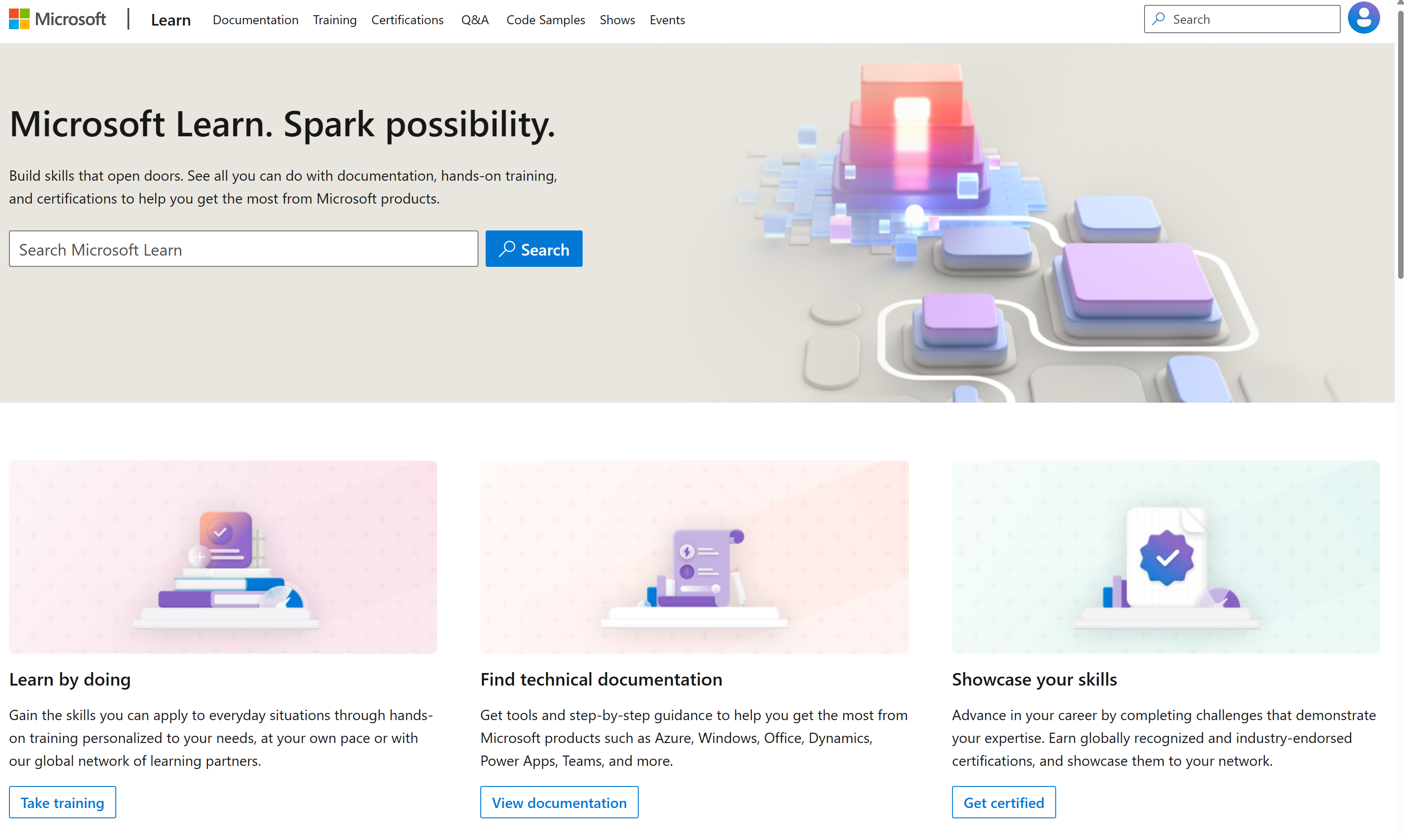
Microsoft Learn Demo
Microsoft Learn: Build skills that open doors in your career

Slide 10
Readiness and Enablement Links
The Microsoft Federal Team is here to help you accelerate customers' digital transformation. Microsoft Federal has tailored to make your organizations skilling journey successful. From the Business Decision Maker to the technical community and end-users, Microsoft provides customers with access to endless skilling resources. Below you will find links to these resources:
Get training tailored to your organization's needs: Find learning paths for specific roles in your organization, plus course recommendations based on technology, skill level, and solution area: Training | Learning Portal (microsoft.com)
Events Calendar - US Partner Community Blog – Microsoft
In addition to the above, the Microsoft Federal Team can address the needs of your non-technical community of your learners through:
Skilling Hours - Readiness and Enablement: Skilling our Federal Customers and Partners (office.com)
Microsoft Learning Portal: A closer look at Azure through training modules and gamified learning
Microsoft Learning Portal
Additional Learning Resources:
Get started with Azure – Introduction | Microsoft Azure
Microsoft Learn (path-based)
Exam-based: Select filters: Azure, D365, M365, Power Platform, and more
Microsoft Virtual Training Days – Virtual Instructor Led
Microsoft Technology Center - Work through your Account Manager
Home - Microsoft Tech Community
Microsoft Reactor | Microsoft Developer – Virtual Instructor Led

