Slide 1
Use Data Factory pipelines in Microsoft Fabric
Module 7

Slide 2
Data Pipelines
Orchestrate overall process by sequencing activities
Commonly used for ETL (extract, transform, and load) processes
Can load data to/from OneLake, a lakehouse, or warehouse
Run on demand or on a schedule
Similar to the standalone Azure Data Factory service in Azure
Notes:
The Data Factory experience in Microsoft Fabric provides data integration combining Power Query with the scale of Azure Data Factory to move and transform data.
Data pipelines define a sequence of activities that orchestrate an overall process, usually by extracting data from one or more sources and loading it into a destination; often transforming it along the way. Pipelines are commonly used to automate extract, transform, and load (ETL) processes that ingest transactional data from operational data stores into an analytical data store, such as a lakehouse or data warehouse.
If you're already familiar with Azure Data Factory, then data pipelines in Microsoft Fabric will be immediately familiar. They use the same architecture of connected activities to define a process that can include multiple kinds of data processing tasks and control flow logic. You can run pipelines interactively in the Microsoft Fabric user interface, or schedule them to run automatically.

Slide 3
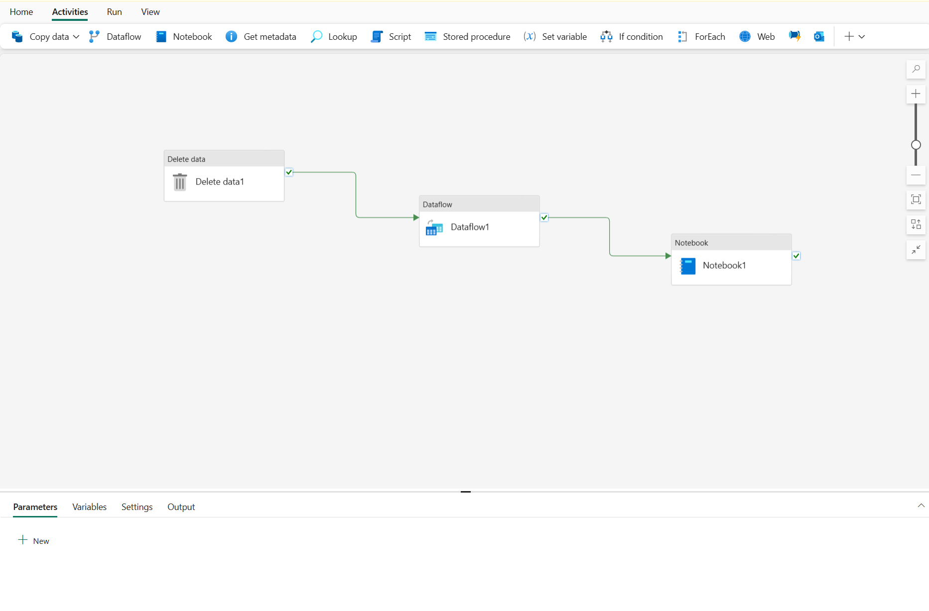
Pipeline Concepts
Activities
Control Flow
Data Transformation
Parameters
Pipeline Runs
Notes:
Activities are the executable tasks in a pipeline. You can define a flow of activities by connecting them in a sequence. The outcome of a particular activity (success, failure, or completion) can be used to direct the flow to the next activity in the sequence.
Pipelines can be parameterized, enabling you to provide specific values to be used each time a pipeline is run. For example, you might want to use a pipeline to save ingested data in a folder, but have the flexibility to specify a folder name each time the pipeline is run.
Using parameters increases the reusability of your pipelines, enabling you to create flexible data ingestion and transformation processes.
Each time a pipeline is executed, a data pipeline run is initiated. Runs can be initiated on-demand in the Fabric user interface or scheduled to start at a specific frequency. Use the unique run ID to review run details to confirm they completed successfully and investigate the specific settings used for each execution.

Slide 4
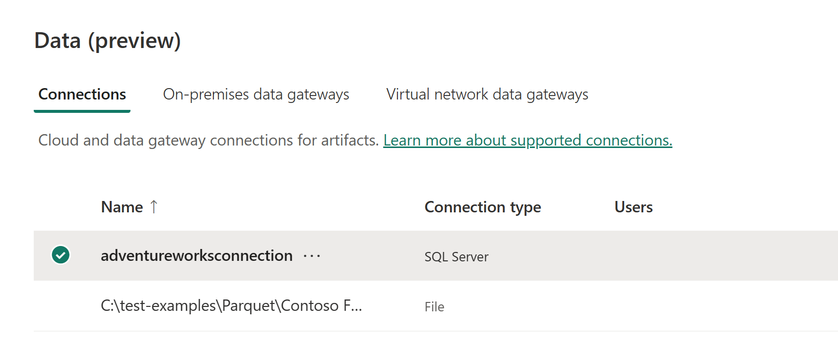
Connections
When you create a connection to an external data source in a data pipeline activity, the connection is added to the Connections list found under Settings.
Notes:
Connections to data sources outside of Fabric are catalogued in the Connections list under Settings. You can access them here to edit and manage them.
This differs from Azure Data Factory, where you would deal with Linked Services.

Slide 5
Activities
Control Flow
Invoke Pipeline
For Each
If
Lookup
Set Variable
Web Activity
Get Metadata
Data Transformation
Copy Data
Dataflow Gen2
Delete Data
Fabric Notebook
Stored Procedure
SQL Script
Notes:
Control Flow There are two broad categories of activity in a pipeline.
Data transformation activities - activities that encapsulate data transfer operations, including simple Copy Data activities that extract data from a source and load it to a destination, and more complex Data Flow activities that encapsulate dataflows (Gen2) that apply transformations to the data as it is transferred. Other data transformation activities include Notebook activities to run a Spark notebook, Stored procedure activities to run SQL code, Delete data activities to delete existing data, and others.
Control flow activities - activities that you can use to implement loops, conditional branching, or manage variable and parameter values. The wide range of control flow activities enables you to implement complex pipeline logic to orchestrate data ingestion and transformation flow.
Control flow activities are executed by the data factory engine. Some data transformation tasks are executed by the data factory engine (copy data and delete data), but others use external compute. For example stored procedure and SQL Script activities use the compute from the database or warehouse where the SQL should run.

Slide 6
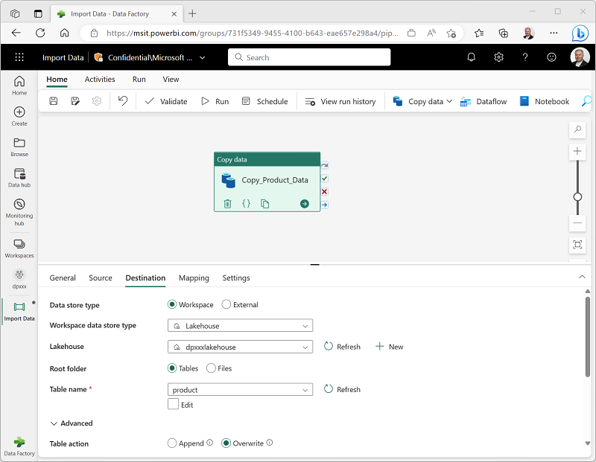
Copy Activity
One of the most commonly use activities
Copy data from source to destination without transformations

Slide 7
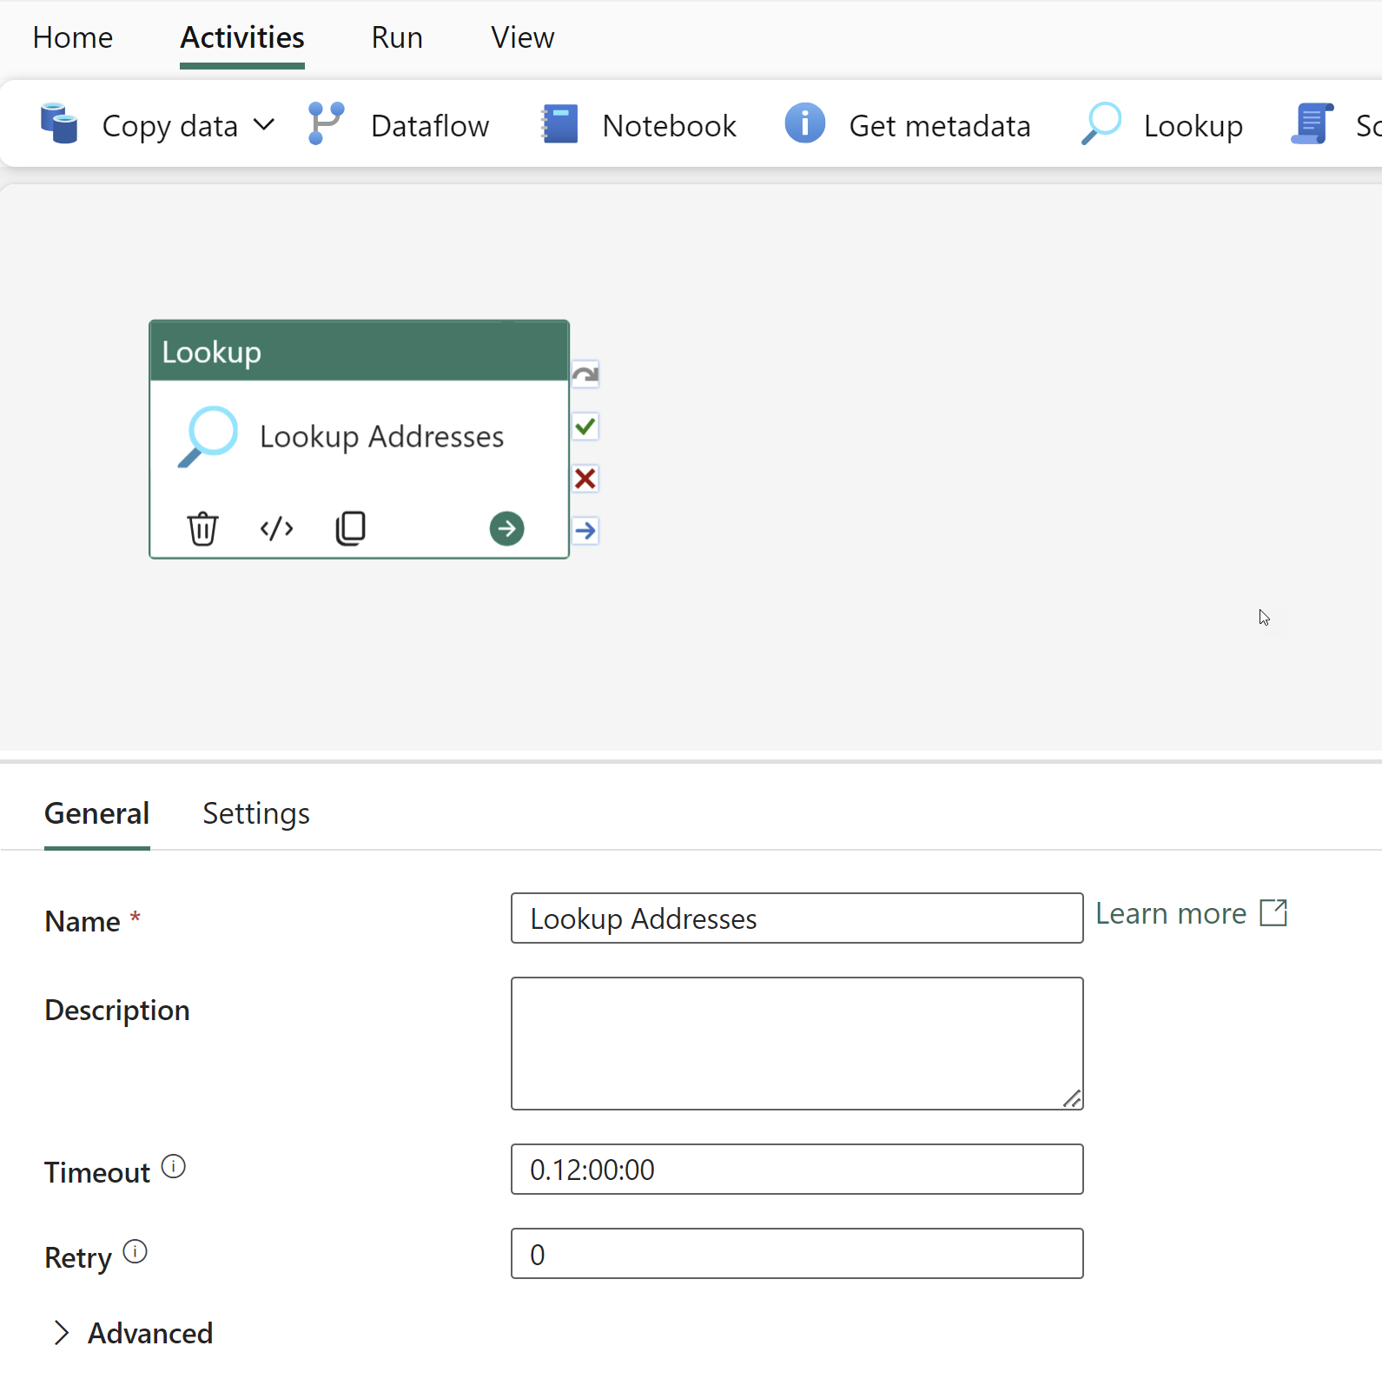
Lookup Activity
Retrieve a dataset
Use it to dynamically determine which objects to operate on in a subsequent activity
Look up records in a database or files in OneLake
Single or multi-row output
Notes:
The Fabric Lookup activity can retrieve a dataset from any of the data sources supported by Microsoft Fabric. You can use it to dynamically determine which objects to operate on in a subsequent activity, instead of hard coding the object name. Some object examples are files and tables.
Lookup activity reads and returns the content of a configuration file or table. It also returns the result of executing a query or stored procedure. The output can be a singleton value or an array of attributes, which can be consumed in a subsequent copy, transformation, or control flow activities like ForEach activity.
The Lookup activity can return up to 5000 rows; if the result set contains more records, the first 5000 rows are returned. The Lookup activity output supports up to 4 MB in size; activity fails if the size exceeds the limit. The longest duration for Lookup activity before timeout is 24 hours.

Slide 8
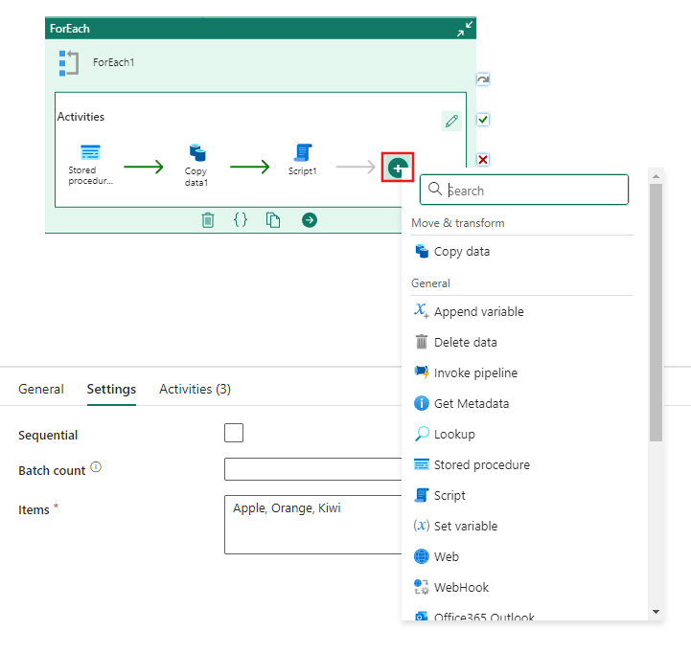
ForEach Activity
Iterate over a collection and execute specified activities
Add multiple activities inside the ForEach activity
Choose sequential or parallel execution
Notes:
The ForEach Activity defines a repeating control flow in a Microsoft Fabric pipeline. This activity is used to iterate over a collection and executes specified activities in a loop. The loop implementation of this activity is similar to a ForEach looping structure in programming languages.
In the Settings tab you can specify whether processing of the items in the batch should be Sequential (or otherwise in parallel). You can also specify a maximum number of items to process at the same time with Batch count.
The items can be a static list, like what’s shown in the screenshot, or it can be the items retrieved in a ForEach or SQL Script activity.

Slide 9
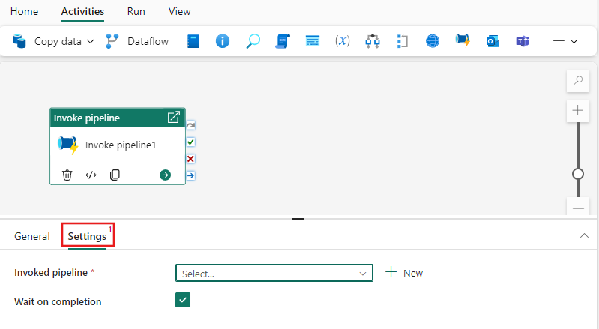
Invoke Pipeline Activity
Execute another Fabric pipeline
Used to orchestrate the execution of one or more pipelines from within a single pipeline
Choose whether to continue once the pipeline run is started or completed
Notes:
The Fabric Invoke pipeline activity can execute another Microsoft Fabric pipeline. You can use it to orchestrate the execution of one or multiple pipelines from within a single pipeline.
You can use the dependencies between activities to execute one pipeline only after another succeeds or fails. Additional control flow activities can be used with the Invoke Pipeline Activity. Using the If activity, you can specify other conditions under which a pipeline should execute or be skipped.
You can choose to wait on completion, or continue directly, in which case the invoked pipeline executes in parallel with activities following it within the parent pipeline's execution flow.
Activities inside the ForEach loop can reference @item in parameters and other expressions.

Slide 10
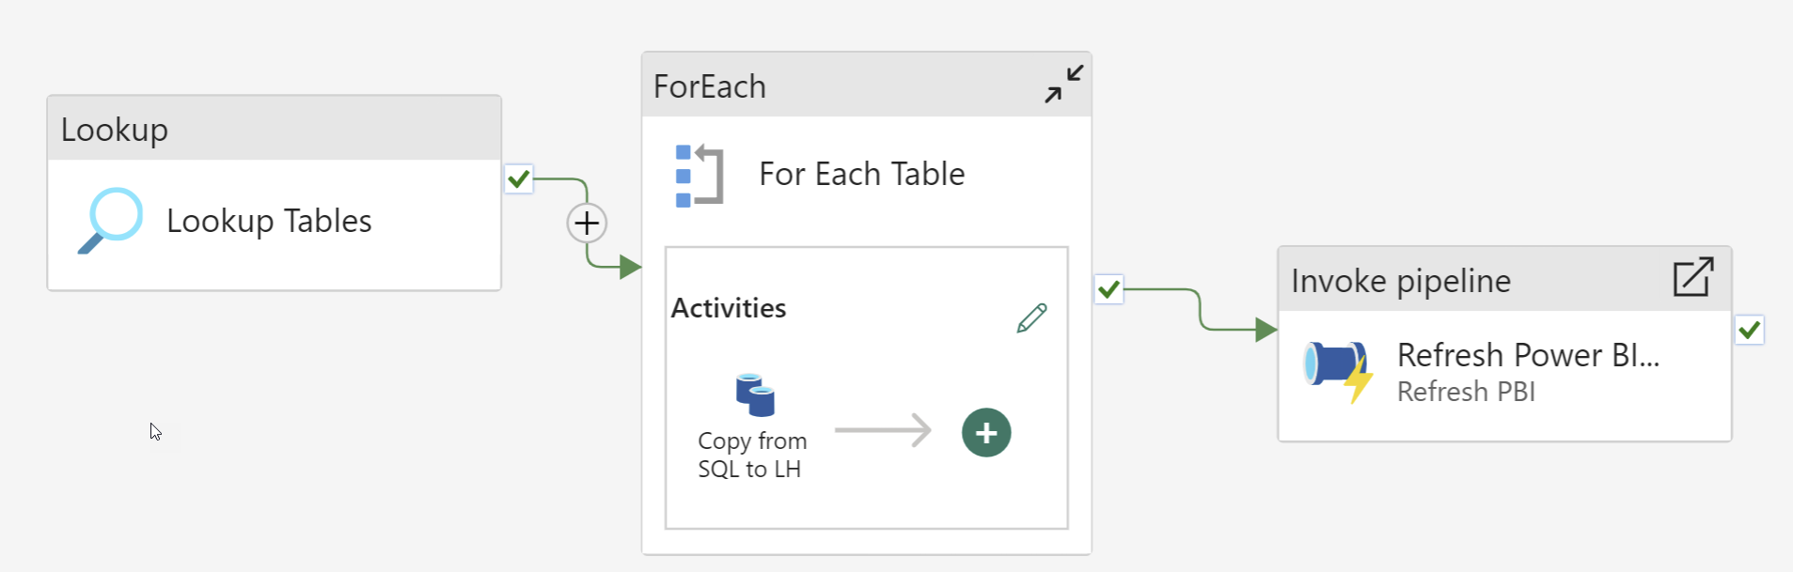
Use Activities Together
Notes:
In this example, we have used the Lookup, ForEach, Copy data, and invoke pipeline activities.
First, we look up a list of all the tables in a schema in an Azure SQL DB.
For each table, we copy data from the table to a lakehouse.
Once the tables are copied, we refresh a Power BI semantic model that contains some of the tables.

Slide 11
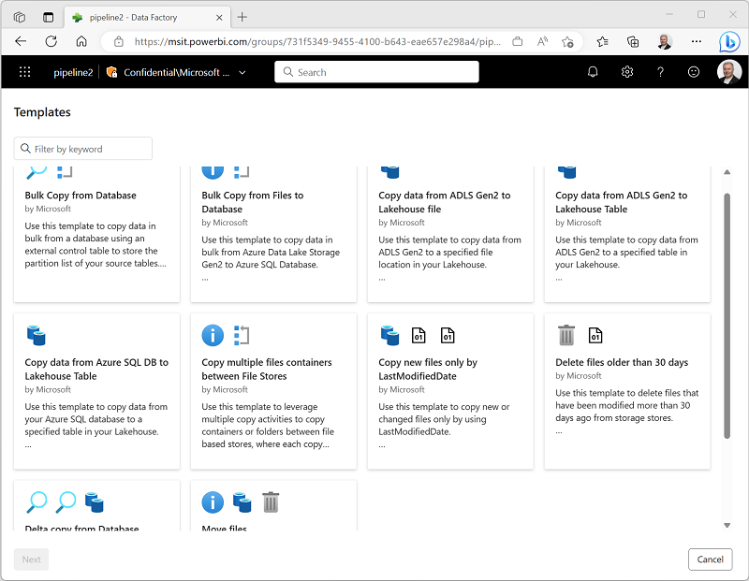
Pipeline Templates
Predefined templates for common data processing scenarios
Choose as a starting place and customize
Notes:
You can define pipelines from any combination of activities you choose, enabling to create custom data ingestion and transformation processes to meet your specific needs. However, there are many common pipeline scenarios for which Microsoft Fabric includes predefined pipeline templates that you can use and customize as required.
To use a template, create a new pipeline and then select Choose a Task to Start. This will open the menu of templates for you to choose from.
Examples of templates include:
Bulk copy from database
Copy data from Azure SQL DB to Lakehouse table
Copy new files only by LastModifiedDate
Delete files older than 30 days

Slide 12
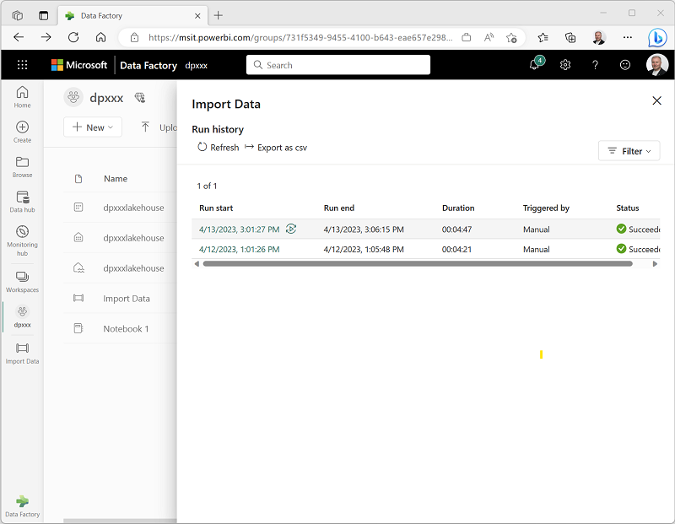
Monitor Pipelines
View the run history for a pipeline in the Fabric UI
Notes:
To monitor your data pipeline runs, hover over your pipeline in your workspace. Doing so will bring up three dots to the right of your pipeline name. Select the three dots to find a list of options. Then select View run history. This action opens a fly-out on the right side of your screen with all your recent runs and run statuses. Select one of your pipeline runs to view detailed information. You’ll be able to view what your pipeline looks like and view more properties like Run ID or errors if your pipeline run failed.
To view performance details, hover over an activity row and select the glasses icon. Performance details will pop up. If your data pipeline failed, view the error message by hovering over the activity row and select the message icon under Status. This selection will bring up error details, such as the error code and message.

Slide 13
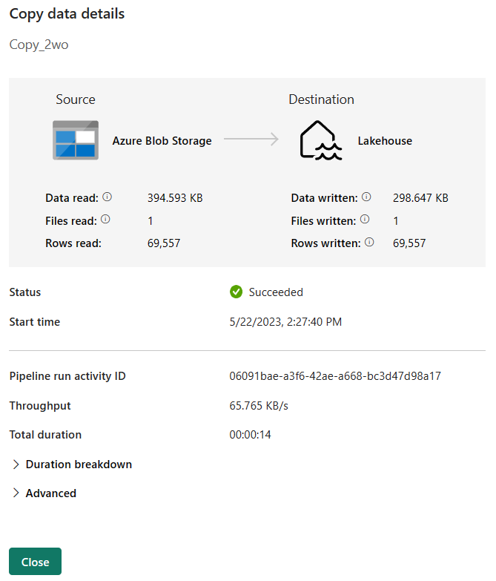
Copy Activity Run Details
Notes:
The Copy activity has additional details that you can view to understand performance. You can see, the amount of data read and written, the number of files read and written, the number of rows read and written. You’ll also see the status and start time of the activity.
Toward the bottom of the copy data details you’ll find the throughput and total duration. Expanding the duration breakdown can show the time split between queueing and data transfer.

Slide 14
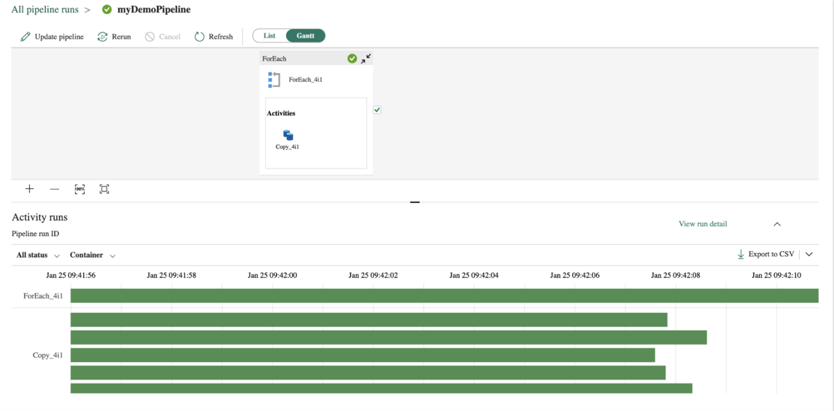
Gantt View
Notes:
A Gantt chart is a view that lets you see the run history over a time range. If you switch to a Gantt view, all pipeline runs will be grouped by name, displayed as bars relative to how long the run took. The length of the bar relates to the duration of the pipeline. You can select the bar to view more details.
This is helpful when performance tuning or looking for long-running activities.

Slide 15
Summary
Data pipelines orchestrate ETL processes using a GUI.
Pipelines contain activities such as Copy data, ForEach, and Invoke Pipeline.
Activities can be chained together using dependencies.
Templates are available to speed up development of common data processing tasks.
Pipelines and activities can be monitored inside Fabric.

Slide 16

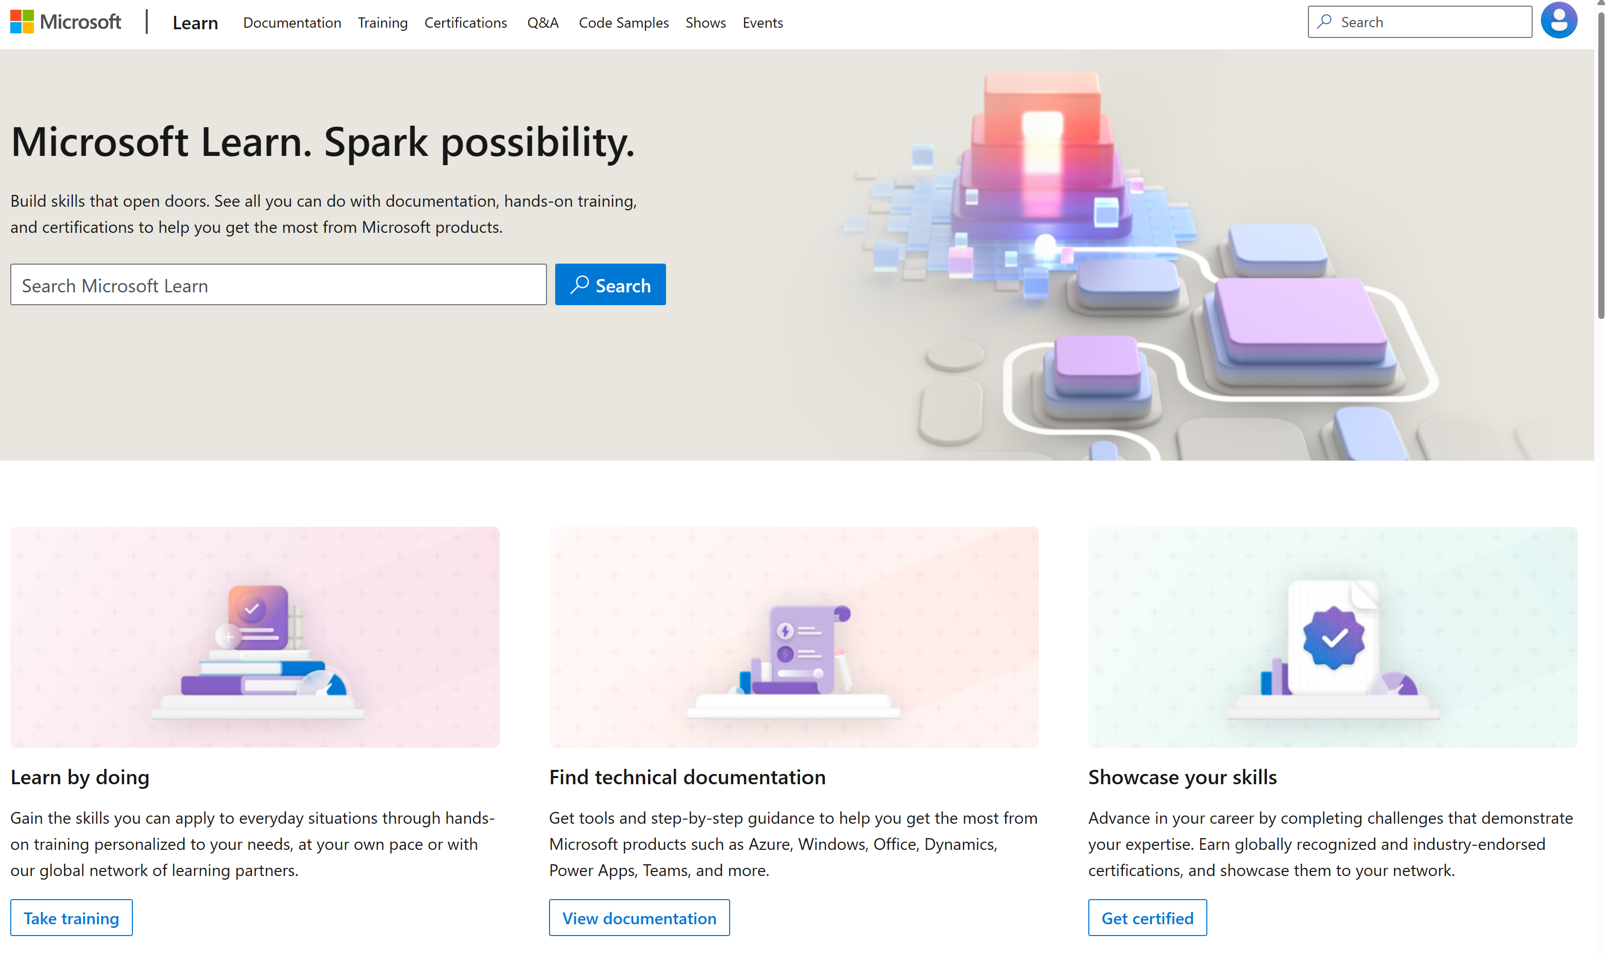
Microsoft Learn Demo
Microsoft Learn: Build skills that open doors in your career

Slide 17
Readiness and Enablement Links
The Microsoft Federal Team is here to help you accelerate customers' digital transformation. Microsoft Federal has tailored to make your organizations skilling journey successful. From the Business Decision Maker to the technical community and end-users, Microsoft provides customers with access to endless skilling resources. Below you will find links to these resources:
Get training tailored to your organization's needs: Find learning paths for specific roles in your organization, plus course recommendations based on technology, skill level, and solution area: Training | Learning Portal (microsoft.com)
Events Calendar - US Partner Community Blog – Microsoft
In addition to the above, the Microsoft Federal Team can address the needs of your non-technical community of your learners through:
Skilling Hours - Readiness and Enablement: Skilling our Federal Customers and Partners (office.com)
Microsoft Learning Portal: A closer look at Azure through training modules and gamified learning
Microsoft Learning Portal
Additional Learning Resources:
Get started with Azure – Introduction | Microsoft Azure
Microsoft Learn (path-based)
Exam-based: Select filters: Azure, D365, M365, Power Platform, and more
Microsoft Virtual Training Days – Virtual Instructor Led
Microsoft Technology Center - Work through your Account Manager
Home - Microsoft Tech Community
Microsoft Reactor | Microsoft Developer – Virtual Instructor Led

