Slide 1
Understanding Dimensional Models
Module 10

Slide 2
Data Models
Describe entities, their attributes, and relationships
3 Levels: physical, logical, conceptual
Product
Product ID
Product Name
Product Category
Sales
Product ID
Store ID
Quantity
Cost
Sales Amount
Store
Store ID
Store Name
Store State Province
1
*
1
*
Notes:
In order to shape our data appropriately for analytics, we need to have a basic understanding of data models.
Data models describe entities, their attributes, and the relationships between entities. In the example shown here, Product, Sales, and Store are entities. Store ID, Store Name, and Store State Province are attributes of the Store entity.
And we can see relationships between the Store entity and the Sales entity based upon the Store ID.
Data models can describe 3 different levels. A conceptual model is very high level, perhaps including only entities and relationships. A logical model might add attributes and keys. A physical model defines table names, column names, and data types. It describes how data is physically arranged and typed in a database.
Another way to look at it is: conceptual models define WHAT the model contains. Logical models define how the system should be implemented regardless of technology. The physical model describes how the model will be implemented specifically in a lakehouse, warehouse, or Power BI.
We’re going to focus on logical and physical models in this section.

Slide 3
Types of Data Models
Normalized relational model (3NF)
“Denormalized” dimensional model
Flat/denormalized single table
Notes:
Lakehouses and Power BI data models are very flexible in terms of the types of data models they allow. Common types of data models include a normalized relational model. This is what you might find when pulling data directly from a transactional system.
Another option is a more denormalized dimensional model consisting of facts and dimensions.
On the other end of the spectrum is the single flattened table.

Slide 4
Understanding Dimensional Models
A denormalized relational model
Made up of tables with attributes
Relationships defined by keys and foreign keys
Organized for understandability and ease of reporting rather than update
Queried and maintained by SQL or special purpose management tools
Notes:
The purpose of dimensional modeling is to enable business intelligence (BI) reporting, query, and analysis. The key concepts in dimensional modeling are facts, dimensions, and attributes. There are different types of facts (additive, semi additive, and nonadditive), depending on whether they can be added together over time. Dimensions can have different hierarchies, and have attributes that define the who, what, where, and why of the dimensional model. The grain, or level of granularity, is another key concept with dimensional modeling because it determines the level of detail. Facts, dimensions, and attributes can be organized in several ways (star, snowflake, multidimensional, and multifact star), called schemas. The choice of schema depends on variables such as the type of reporting that the model needs to facilitate and the type of BI tool being used. Building a dimensional model includes additional puzzle pieces such as calendar and time dimensions; and more complicated pieces such as conforming, degenerative, and role-playing dimensions; and consolidated fact tables.

Slide 5
Dimensional models
Facts: measurements, events
Dimensions: entities, context, slices
Dimension
Fact
Dimension
Product
Product ID
Product Name
Product Category
Sales
Product ID
Store ID
Quantity
Cost
Sales Amount
Store
Store ID
Store Name
Store State Province
1
*
1
*
Notes:
Let’s look at dimensional models more closely.
Dimensional models are made up of facts and dimensions.
Facts contain measurements and events. We usually aggregate values from fact tables when analyzing data.
Dimension tables contain entities that provide context and allow us to slice facts into meaningful pieces.
In this example, Sales is a fact table. It contains measures such as Sales Amount that we might want to sum.
Store and Product are dimensions. We might want to slice Sales Amount by Product Category or filter Sales Amount by a particular Store Name.

Slide 6
Dimension Tables
Contain text and descriptive information to help describe facts
Part of a one to many relationship with facts via the surrogate key
Has a surrogate key uniquely identifies each row
Has an alternate/business key to identify each instance of an entity in the source system
Notes:
Dimension tables contain descriptive information about the data in the fact tables. Dimension tables typically have a small number of rows and are used to provide context for the data in the fact tables. For example, a dimension table might contain information about the customers who placed sales orders.
In addition to attribute columns, a dimension table contains a unique key column that uniquely identifies each row in the table. In fact, it's common for a dimension table to include two key columns:
A surrogate key is a unique identifier for each row in the dimension table. It's often an integer value that is automatically generated by the database management system when a new row is inserted into the table.
An alternate key is often a natural or business key that identifies a specific instance of an entity in the transactional source system - such as a product code or a customer ID.
You need both surrogate and alternate keys in a data warehouse, because they serve different purposes. Surrogate keys are specific to the data warehouse and help to maintain consistency and accuracy in the data. Alternate keys on the other hand are specific to the source system and help to maintain traceability between the data warehouse and the source system.

Slide 7
Fact Tables
Contains two or more foreign keys
Tend to have very large record
Useful facts tend to be numeric and additive
Notes:
Fact tables contain the numerical data that you want to analyze. Fact tables typically have a large number of rows and are the primary source of data for analysis. For example, a fact table might contain the total amount paid for sales orders that occurred on a specific date or at a particular store.

Slide 8
Surrogate Keys
Anonymous integers that represent a unique row in a dimension table
Used to build relationships in a dimensional model
Product ID | Product Name | Product Category
1 | Product ABC | Category 1
2 | Product XYZ | Category 1
3 | Product DEF | Category 2
Product
Product ID
Product Name
Product Category
Sales
Product ID
Store ID
Quantity
Cost
Sales Amount
1
*
Product ID | Store ID | … | Sales Amount
1 | 4 | … | 108.80
2 | 1 | … | 19.99
1 | 2 | … | 54.40
3 | 2 | … | 75.00
Notes:
We relate facts and dimensions via surrogate keys in the dimension table. Surrogate keys are often meaningless integers that are added to dimension tables to represent a unique row.
The dimension table surrogate key is used as a foreign key in the fact table to reference the dimension.
In this example, we can see that Sales is related to Product by the Product ID column. We are implying here that is the surrogate key. If there are natural keys in your model that come from the source system, those are not usually the best to use for relationships, especially if they are not integers. We want to build relationships between tables based upon a single column.
When we look at the values in the table, Product ID 1 represents one row in the dimension. Product ID 1 may be found in multiple rows in the fact table. This is called a 1 to many relationship

Slide 9
Star vs Snowflake Schema
Star
Product
Product ID
Product Name
Product Category
Sales
Product ID
StoreID
Quantity
SalesAmount
Store
Store ID
Store Name
Store State Province
1
*
1
*
Snowflake
Product Category
Product Category ID
Product Category
Product
Product ID
Product Name
Product Category ID
Sales
Product ID
StoreID
Quantity
SalesAmount
Store
Store ID
Store Name
Geography ID
Geography
Geography ID
State Province
Country
1
1
*
1
1
*
*
*
Notes:
Both star schemas and snowflake schemas are considered dimensional models.
Let’s look at how they are different.
We have a sales fact table related to a store dimension and product dimension. We can see that the dimension tables are on the 1 side of the 1 to many relationship.
And here is a snowflake schema. We have our same sales fact. But the dimensions are more normalized. Rather than repeating the text value for product category in the product dimension, we put an ID value in the product dimension and make a new product category dimension, with each product category only listed once.
We have the same situation with geography. In the star schema, the state/province was in the store dimension. In the snowflake, there is a geography table, and the geography ID is in the Store table.

Slide 10

Compare Star and Snowflake
Both: Contain facts and dimensions
Star: Every dimension is directly related to a fact
Snowflake: Dimensions maybe be related directly to a fact or to another dimension
Dim
Dim
Dim
Dim
Dim
Dim
Dim
Dim
Dim
Dim
Fact
Dim
Dim
Fact
Dim
Dim
Notes:
Both star schemas and snowflake schemas contain facts and dimensions.
The main difference is that in a star schema, dimensions are only directly related to facts.
In a snowflake schema, dimension may be related to a fact, or they might be related to another dimension. So I may have to go from Product category through product to relate to the sales fact.
The dimensions branching off of other dimensions makes the model look more like a snowflake, hence the name.

Slide 11
Date table
Facilitates slicing by month/quarter/year/etc.
Required for time intelligence calculations
A single date table can play multiple roles
Date Dimension
Date | Month Nbr | Month | Quarter Nbr | Quarter | Year | Fiscal Year | Fiscal Month | Fiscal Quarter
1-Jan-2019 | 1 | January | 1 | Q1 | 2019 | 2020 | 4 | 2
Sales Fact
Order Date | Ship Date | Product ID | Store ID | Quantity | Sales Amount
1-Jan-2019 | 3-Jan-2019 | 1 | 2 | 4 | 101.92
Notes:
Let’s dig in more to dimensional models.
A commonly found dimension in most data models is a date dimension. It is common to have one centralized date table to be used with multiple dates in the data model.
It usually has one row per day for the date range of the data being analyzed. And rather than calculating the month, quarter, or year on the fly in each query, we can store that on the date table and quickly look it up. We can also store fiscal calendars on the date table. This may be shifted months where a fiscal year stars in July or October. Or it could be something like a 4-4-5 or 4-5-4 schedule.
Here is a date dimension with some commonly found columns. We’ve got month name and number, quarter name and number, calendar year, and fiscal year attributes.
We can relate that date column in the date dimension to our sales fact.
Let’s start by related Date to Order Date
But there is also a Ship Date in the sales fact. We can relate that column to the date dimension as well.
When we reuse the date dimension for multiple purposes, that is called a role-playing dimension.

Slide 12
Level of Granularity
Level of detail of a table, what makes the row unique
Example: Sales Fact granularity may be Order ID and item
Example: Budgets set at the department – month level
Order ID | Order Date | Ship Date | Product ID | Store ID | Quantity | Sales Amount
12345 | 1-Jan-2019 | 3-Jan-2019 | 1 | 2 | 4 | 101.92
No other row in the table will have these two values
Notes:
Another important concept in dimensional modeling is level of granularity.
This is just the level of detail defined by the data modeler. It’s what makes each row in a table unique.
For example, we have a sales fact table with Order ID, Order Date, Ship Date, Product ID, Store ID, and our measures. We may decide that the level of granularity may be Order ID and product ID.
This would mean that no other row would have the same set of Order ID and Product ID values.
Another fact table may have relationships to some of the same dimension tables, but may have a different granularity. For instance, many budgets are set at the department and month level, rather than at the day level.

Slide 13
Relationship Cardinality
One to many (1:*)
One to one (1:1)
Many to many (*:*)
Most common, default type
Available in composite models in Power BI
Product
Product ID
Product Name
Product Category
Sales
Product ID
StoreID
Quantity
SalesAmount
Store
Store ID
Store Name
Store State Province
1
*
*
1
Notes:
If we create our relationship from sales to product, there will be many sales of each product.
One to many is the same thing, but with the tables in reverse order. For each product row, there can be multiple rows in sales.
This is the most common cardinality for relationships, and it is also the default in Power BI. This is partially because of our use of star schemas. They are inherently 1:many from relationship to fact.
Another cardinality option is 1:1. This should be used sparingly because we would typically combine those attributes into one table. But there are legitimate uses for it, and it is sometimes used to add a security table in Power BI to the model for use with row-level security.
If you are building composite models in Power BI, there is also a many-to-many option. It removes the requirement to have unique values in one of the tables in the relationship. This relationship type can be used to create relationships between tables that have different levels of granularity. For instance, sales at the day level and budget at the month level. Or demographics at the state level but customers at the city level. There are a few data modeling and performance implications when using a many to many relationship in a composite model, so they should be used sparingly. There are alternatives that can be created with DAX that will likely perform better. The alternative to a many:many relationship is a bridge table.

Slide 14
Bridge Tables
Resolve many:many relationships between facts and dimensions by adding a table
Common way to model multi-valued attributes
Customer
Customer ID
Customer Name
Customer Number
Account-Customer Bridge
Account ID
Customer ID
Account
Account ID
Account Name
Account Number
Bank Transactions
Account ID
Transaction Date
Transaction Amount
1
*
1
*
1
*
Notes:
Dimensional designs often need to accommodate multivalued dimensions. Patients can have multiple diagnoses. Students can have multiple majors. Employees can have multiple skills. Bank accounts can have multiple customers. A bridge table adds an additional table to a data model to replace the many:many with 1:many relationships.
In this example of accounts and customers, there may be multiple customers associated with each account. And Each customer may have multiple accounts. Our transactions fact is tied to the account, but we may need to look at transactions by customer.
So we add a bridge table with one row per combination of account and customer.
Bridge tables can sit between fact and dimension tables, or alternatively, between a dimension table and its multivalued attributes

Slide 15
Power BI Likes Star Schemas
Dimension tables support filtering and grouping
Fact tables support summarization
Surrogate keys fit the requirement of building relationships on a single column
Star schema simplifies DAX calculations
Notes:
Power BI works well with star schemas, and that should be our goal for data models, except in special circumstances.
This is because dimension attributes make great slicers and filters in Power BI. And fact tables work well for summarizing data, counting, summing, or averaging columns.
Power BI requires that we build relationships based upon a single column in each table, and surrogate keys work well for that.
Star schemas also simplify DAX calculations. This get more complex when you have a denormalized table or a snowflake.

Slide 16
Build the Star Schema Further Up in the BI Stack
In the data warehouse
In the Gold layer lakehouse
The Power BI default semantic model will inherit the dimensional model
Lakehouse Star Schema
Default Semantic Model Star Schema
Warehouse Star Schema
Default Semantic Model Star Schema
Notes:
When you create a Lakehouse, a default Power BI semantic model is created with the SQL Endpoint.
The default semantic model is queried via the SQL Endpoint and updated via changes to the Lakehouse. You can also query the default semantic model via cross-database queries from a Warehouse. By default, all tables and views in the Warehouse are automatically added to the default Power BI semantic model.
The default Power BI semantic model inherits all relationships between entities defined in the model view and infers them as Power BI semantic model relationships, when objects are enabled for BI. Inheriting the warehouse's business logic allows a warehouse developer or BI analyst to decrease the time to value towards building a useful semantic model and metrics layer for analytical business intelligence (BI) reports

Slide 17
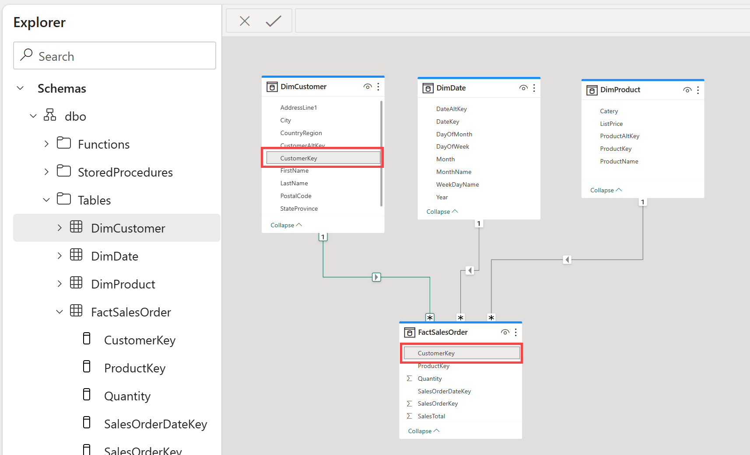
Model View
Notes:
A data model defines the relationships between the different tables in the semantic model in Fabric, the rules for how data is aggregated and summarized, and the calculations or measures that are used to derive insights from the data. These relationships and measures are included in the semantic model, which is then used to create reports in Power BI.
You can easily switch between the Data, Query, and Model view Fabric using the menu in the bottom left corner of the screen. The Data view shows the tables in the semantic model, the Query view shows the SQL queries that are used to create the semantic model, and the Model view shows the data model.
If you can’t define all of your relationships in a warehouse, you can use the Model View in Power BI to create them in your customized semantic model. After defining relationships in your semantic model, you can then define measures and create visuals with Power BI.

Slide 18
Summary
Dimensional models contain facts and dimensions.
Facts aggregate measures and events.
Dimensions contain entities and their descriptive attributes.
In a star schema, a dimension is related directly to one or more fact tables.
Relationships between tables allow us to slice or aggregate a fact by a dimension.
Power BI works best with a star schema.
If you have control over the underlying lakehouse or warehouse, the star schema should be built there.

Slide 19

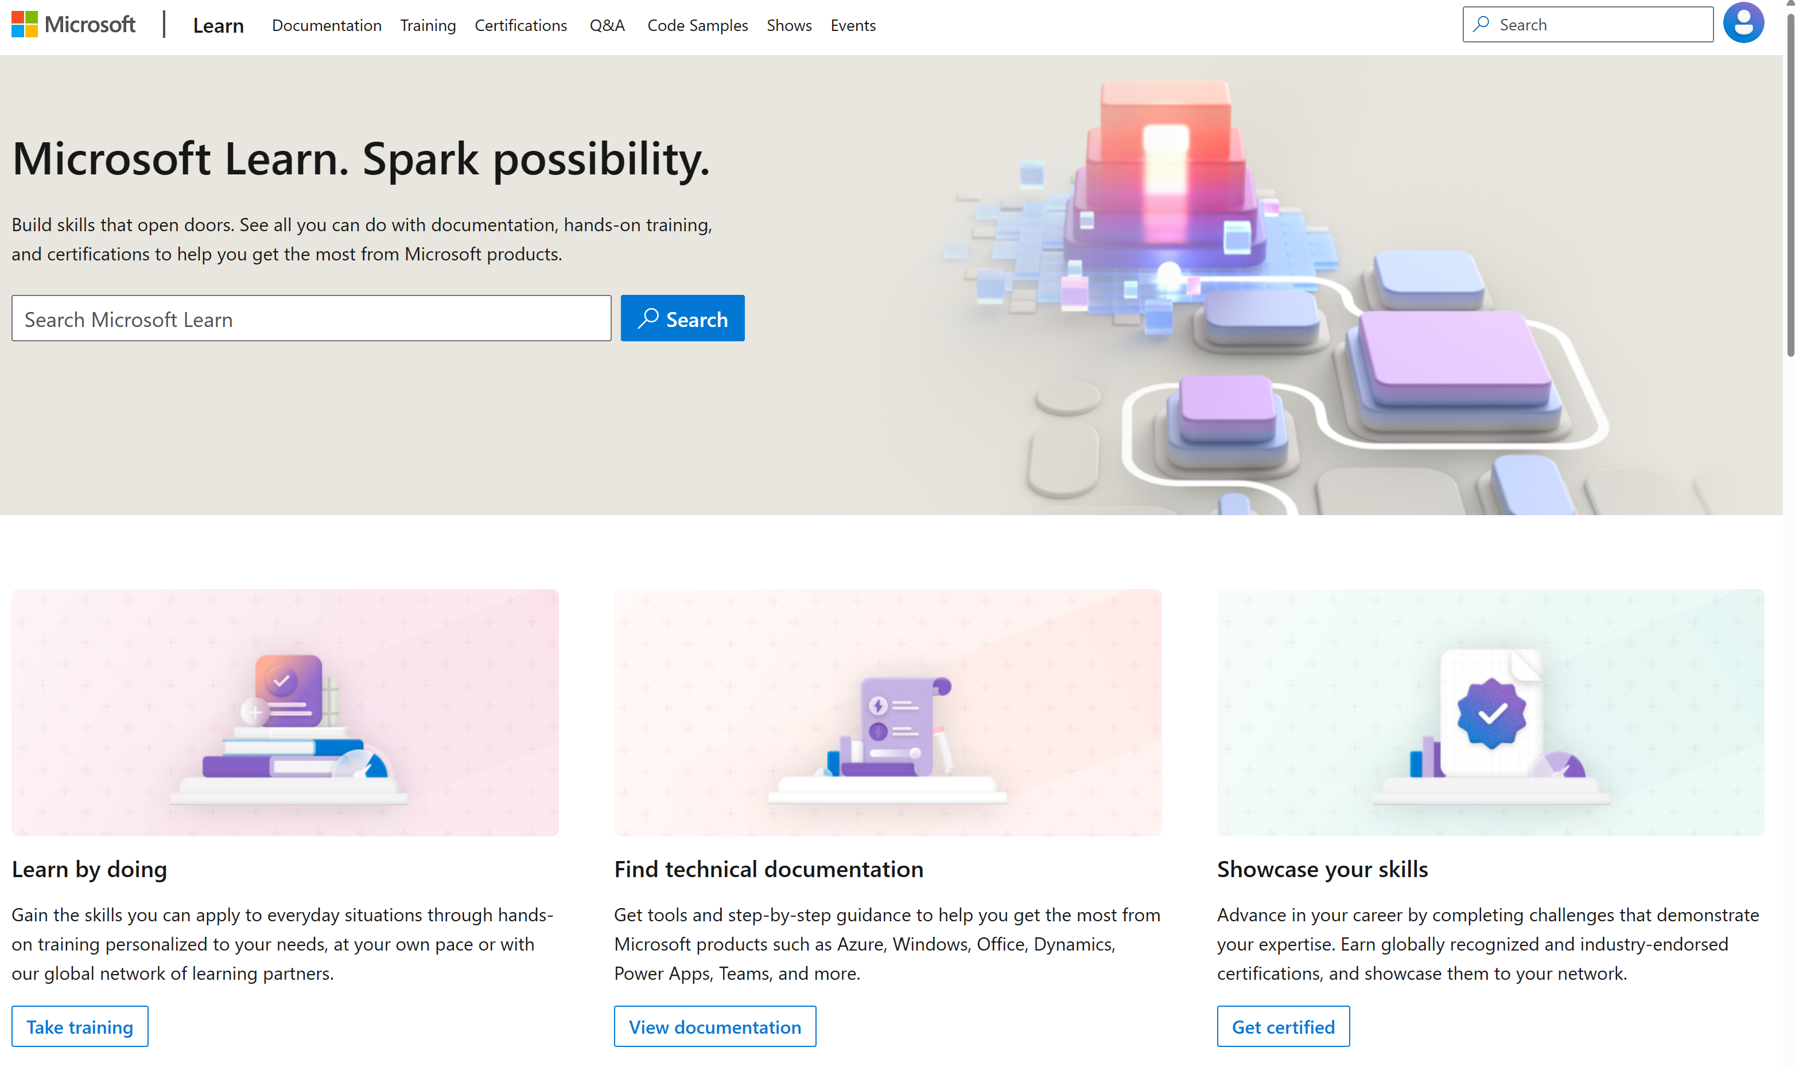
Microsoft Learn Demo
Microsoft Learn: Build skills that open doors in your career

Slide 20
Readiness and Enablement Links
The Microsoft Federal Team is here to help you accelerate customers' digital transformation. Microsoft Federal has tailored to make your organizations skilling journey successful. From the Business Decision Maker to the technical community and end-users, Microsoft provides customers with access to endless skilling resources. Below you will find links to these resources:
Get training tailored to your organization's needs: Find learning paths for specific roles in your organization, plus course recommendations based on technology, skill level, and solution area: Training | Learning Portal (microsoft.com)
Events Calendar - US Partner Community Blog – Microsoft
In addition to the above, the Microsoft Federal Team can address the needs of your non-technical community of your learners through:
Skilling Hours - Readiness and Enablement: Skilling our Federal Customers and Partners (office.com)
Microsoft Learning Portal: A closer look at Azure through training modules and gamified learning
Microsoft Learning Portal
Additional Learning Resources:
Get started with Azure – Introduction | Microsoft Azure
Microsoft Learn (path-based)
Exam-based: Select filters: Azure, D365, M365, Power Platform, and more
Microsoft Virtual Training Days – Virtual Instructor Led
Microsoft Technology Center - Work through your Account Manager
Home - Microsoft Tech Community
Microsoft Reactor | Microsoft Developer – Virtual Instructor Led

