Slide 1
Getting Started with Lakehouses in Microsoft Fabric
Module 4

Slide 2
What is a Lakehouse?
A lakehouse is a data architecture for storing and analyzing both structured and unstructured data in the same location
The structure is flexible and scalable, allowing organizations to handle large volumes of data
Lakehouses integrate with data management, data engineering, and analytics tools
Notes:
Lakehouses are a data architecture platform for storing, managing, and analyzing structured and unstructured data in a single location. It's a flexible and scalable solution that allows organizations to handle large volumes of data using various tools and frameworks to process and analyze that data. It integrates with other data management and analytics tools to provide a comprehensive solution for data engineering and analytics.
A Lakehouse presents as a database and is built on top of a data lake using Delta format tables. Lakehouses combine the SQL-based analytical capabilities of a relational data warehouse and the flexibility and scalability of a data lake. Lakehouses store all data formats and can be used with various analytics tools and programming languages. As cloud-based solutions, lakehouses can scale automatically and provide high availability and disaster recovery.

Slide 3
Lakehouse Technical Concepts
A few key components enable lakehouse technology:
Metadata layers for data lakes
Query engines optimized for SQL execution against data lakes
Optimized access for data science and machine learning tools
Lakehouses can support ACID transactions
Decoupled storage and compute
Notes:
The lakehouse architecture is defined as “a data management system based on low-cost and directly-accessible storage that also provides traditional analytical DBMS management and performance features such as ACID transactions, data versioning, auditing, indexing, caching, and query optimization.”
Let’s go into more detail on the key features of a data lakehouse and problems this concept solves.
Lakehouses merge data lake storage flexibility with data warehouse analytics. Microsoft Fabric offers a lakehouse solution for comprehensive analytics on a single SaaS platform.
ACID transaction support. ACID stands for atomicity, consistency, isolation, and durability — key properties that define a transaction and ensure data consistency and reliability. Such transactions have long been available only in data warehouses, but the lakehouse presents the capability to apply them to data lakes too. This solves the issue with low data quality of the latter when many data pipelines involve concurrent data reads and write

Slide 4
Lakehouse Benefits
Lakehouses use Spark and SQL engines to process large-scale data and support machine learning or predictive modeling analytics.
Lakehouse data is organized in a schema-on-read format, which means you define the schema as needed rather than having a predefined schema.
Lakehouses support ACID (Atomicity, Consistency, Isolation, Durability) transactions through Delta Lake formatted tables for data consistency and integrity.
Lakehouses are a single location for data engineers, data scientists, and data analysts to access and use data.
Notes:
Some benefits of a lakehouse include:
Lakehouses use Spark and SQL engines to process large-scale data and support machine learning or predictive modeling analytics.
Lakehouse data is organized in a schema-on-read format, which means you define the schema as needed rather than having a predefined schema.
Lakehouses support ACID (Atomicity, Consistency, Isolation, Durability) transactions through Delta Lake formatted tables for data consistency and integrity.
Lakehouses are a single location for data engineers, data scientists, and data analysts to access and use data.
A Lakehouse is a great option if you want a scalable analytics solution that maintains data consistency. It's important to evaluate your specific requirements to determine which solution is the best fit.

Slide 5
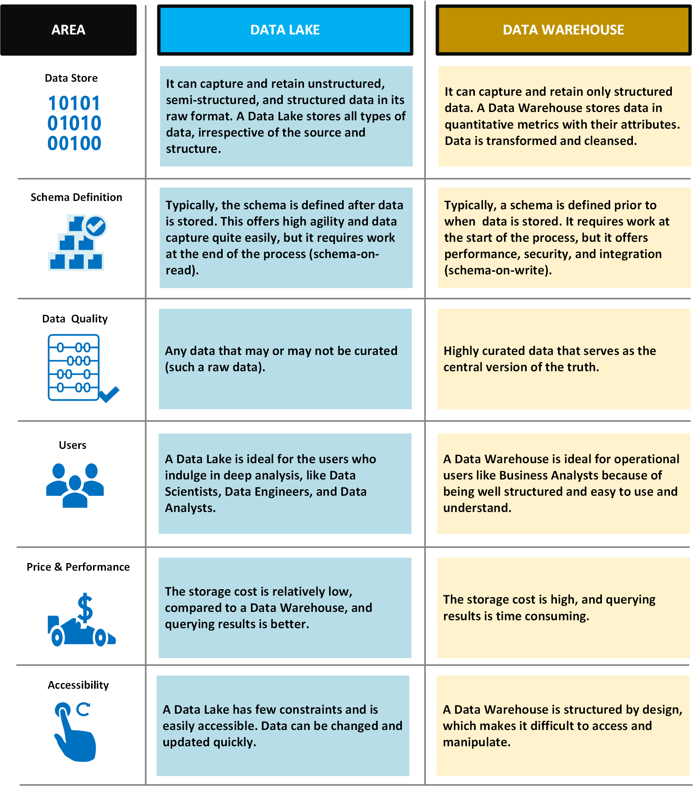
Data Lake vs Data Warehouse
Notes:
Typical uses for a data lake include data exploration, data analytics, and machine learning.
A data lake can also act as the data source for a data warehouse. With this approach, the raw data is ingested into the data lake and then transformed into a structured queryable format. Typically this transformation uses an ELT (extract-load-transform) pipeline, where the data is ingested and transformed in place. Source data that is already relational may go directly into the data warehouse, using an ETL process, skipping the data lake.
Data lake stores are often used in event streaming or IoT scenarios, because they can persist large amounts of relational and nonrelational data without transformation or schema definition. They are built to handle high volumes of small writes at low latency, and are optimized for massive throughput.
Challenges
Lack of a schema or descriptive metadata can make the data hard to consume or query.
Lack of semantic consistency across the data can make it challenging to perform analysis on the data, unless users are highly skilled at data analytics.
It can be hard to guarantee the quality of the data going into the data lake.
Without proper governance, access control and privacy issues can be problems. What information is going into the data lake, who can access that data, and for what uses?
A data lake may not be the best way to integrate data that is already relational.
By itself, a data lake does not provide integrated or holistic views across the organization.
A data lake may become a dumping ground for data that is never actually analyzed or mined for insights.

Slide 6
Data Lake vs Data Lakehouse
 | Data lake | Data Lakehouse
Type | Structured, semi-structured, unstructured | Structured, semi-structured, unstructured
Engine | Relational, non-relational | Relational, non-relational
Schema | Schema on read | Schema on read, schema on write
Format | Raw, unfiltered, processed, curated | Raw, unfiltered, processed, curated, delta format files
Sources | Big data, IoT, social media, streaming data | Big data, IoT, social media, streaming data, application, business, transactional data, batch reporting
Scalability | Easy to scale at a low cost | Easy to scale at a low cost
Users | Data scientists, data engineers | Business analysts, data engineers, data scientists
Use cases | Machine learning, predictive analytics, AI | Core reporting, BI, machine learning, predictive analytics, AI
Notes:
Data lake vs. data lakehouse
Now you know the difference between a data lake vs. a data warehouse. But what's the difference between a data lake and a data lakehouse? And is it necessary to have both?
Despite its many advantages, a traditional data lake is not without its drawbacks. Because data lakes can accommodate all types of data from all kinds of sources, issues related to quality control, data corruption, and improper partitioning can occur. A poorly managed data lake not only tarnishes data integrity, but it can also lead to bottlenecks, slow performance, and security risks.
That's where the data lakehouse comes into play. A data lakehouse is an open standards-based storage solution that is multifaceted in nature. It can address the needs of data scientists and engineers who conduct deep data analysis and processing, as well as the needs of traditional data warehouse professionals who curate and publish data for business intelligence and reporting purposes. The beauty of the lakehouse is that each workload can seamlessly operate on top of the data lake without having to duplicate the data into another structurally predefined database. This ensures that everyone is working on the most up-to-date data, while also reducing redundancies.
Data lakehouses address the challenges of traditional data lakes by adding a Delta Lake storage layer directly on top of the cloud data lake. The storage layer provides a flexible analytic architecture that can handle ACID (atomicity, consistency, isolation, and durability) transactions for data reliability, streaming integrations, and advanced features like data versioning and schema enforcement. This allows for a range of analytic activity over the lake, all without compromising core data consistency. While the necessity of a lakehouse depends on how complex your needs are, its flexibility and range make it an optimal solution for many enterprise orgs.

Slide 7
What is a Fabric Lakehouse?
Combines the SQL-based analytical capabilities of a relational data warehouse and the flexibility and scalability of a data lake
Built on top of OneLake using Delta format tables
Query with SQL
Interact with multiple tools
Default Semantic Model
SQL Endpoint
Metadata data for tables, views, etc.
Data in OneLake
Notes:
Each lakehouse produces three named items in the Fabric-enabled workspace:
Lakehouse is the lakehouse storage and metadata, where you interact with files, folders, and table data.
Semantic Model (default) is an automatically created data model based on the tables in the lakehouse. Power BI reports can be built from the Semantic Model.
SQL Endpoint is a read-only SQL endpoint through which you can connect and query data with Transact-SQL.
After creating a lakehouse, you can load data - in any common format - from various sources; including local files, databases, or APIs. After you've ingested the data into the Lakehouse, you can use Notebooks or Dataflows (Gen2) to explore and transform it.
Data Factory Pipelines can be used to orchestrate Spark, Dataflow, and other activities; enabling you to implement complex data transformation processes.
After transforming your data, you can query it using SQL, use it to train machine learning models, perform real-time analytics, or develop reports in Power BI.
You can also apply data governance policies to your Lakehouse, such as data classification and access control.

Slide 8
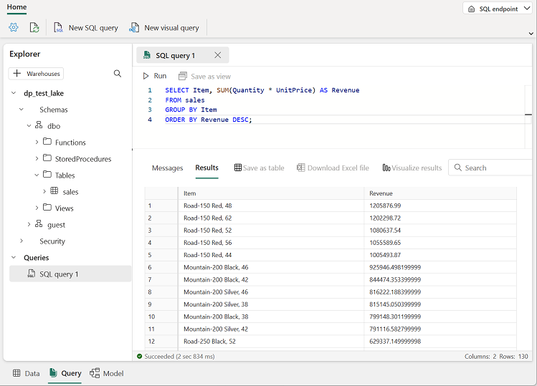
Fabric Lakehouse SQL Endpoint
SQL-based experience for lakehouse delta tables
Analyze data in delta tables using T-SQL language
Save functions, generate views, and apply SQL security
Read-only, no ability to modify data directly
Notes:
Microsoft Fabric provides a SQL-based experience for lakehouse delta tables. This SQL-based experience is called the SQL Endpoint. You can analyze data in delta tables using T-SQL language, save functions, generate views, and apply SQL security. To access SQL Endpoint, you select a corresponding item in the workspace view or switch to SQL endpoint mode in Lakehouse Explorer.
Creating a lakehouse creates a SQL endpoint, which points to the lakehouse delta table storage. Once you create a delta table in the Lakehouse, it's immediately available for querying using the SQL endpoint.
SQL endpoint operates in read-only mode over lakehouse delta tables. You can only read data from delta tables using SQL endpoint. They can save functions, views, and set SQL object-level security. To modify data in lakehouse delta tables, you have to switch to lakehouse mode and use Apache Spark.
Note that only the tables in Delta format are available in the SQL endpoint. Parquet, CSV, and other formats can't be queried using the SQL endpoint. If you don't see your table, convert it to Delta format.
You can set object-level security for accessing data using SQL endpoint. These security rules will only apply for accessing data via SQL Endpoint. To ensure data is not accessible in other ways, you must set workspace roles and permissions.

Slide 9
Creating a Fabric Warehouse
Create a lakehouse in any Premium tier workspace
Create from the Data Engineering homepage, workspace view, or Create Hub
The lakehouse creation process produces three named items:
Lakehouse
Semantic Model
SQL Endpoint
Work with the lakehouse in lakehouse or SQL endpoint mode
Notes:
You can create a lakehouse an a Premier-tier Fabric-enabled workspace. This workspace must be tied to a Fabric or trial capacity.
There are a few ways you can get started with the creation process:
Data Engineering homepage: You can easily create a lakehouse through the Lakehouse card under the New section in the homepage.
2. Workspace view: You can also create a lakehouse through the workspace view when you are on the Data Engineering experience by using the New dropdown. 3. Create Hub: An entry point to create a lakehouse is available in the Create Hub page under Data Engineering.
Each lakehouse produces three named items in the Fabric-enabled workspace:
Lakehouse is the lakehouse storage and metadata, where you interact with files, folders, and table data.
Semantic Model (default) is an automatically created data model based on the tables in the lakehouse. Power BI reports can be built from the Semantic Model.
SQL Endpoint is a read-only SQL endpoint through which you can connect and query data with Transact-SQL.
You can work with the data in the lakehouse in two modes:
Lakehouse enables you to add and interact with tables, files, and folders in the Lakehouse via the Lakehouse Explorer.
SQL Endpoint enables you to use SQL to query the tables in the lakehouse and manage its relational data model.

Slide 10
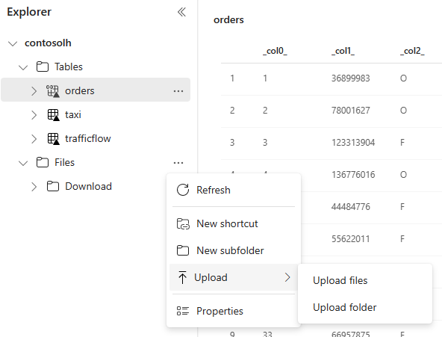
Ingest Data into a Fabric Lakehouse
Many ways to load data into a lakehouse:
File upload from local computer
Run a copy activity in pipelines
Set up a dataflow
Apache Spark libraries in notebook code
Notes:
In Microsoft Fabric, there are a few ways you can get data into a lakehouse:
File upload from local computer
Run a copy tool in pipelines
Set up a dataflow
Apache Spark libraries in notebook code
The Copy tool is a highly scalable Data Integration solution that allows you to connect to different data sources and load the data either in original format or convert it to a Delta table. Copy tool is a part of pipelines activities that you can modify in multiple ways, such as scheduling or triggering based on an event.
For users that are familiar with Power BI dataflows, the same tool is available to load data into your lakehouse. You can quickly access it from the Lakehouse explorer "Get data" option, and load data from over 200 connectors.
You can use available Spark libraries to connect to a data source directly, load data to a data frame, and then save it in a lakehouse. This method is the most open way to load data in the lakehouse that user code is fully managing. External Delta tables created with Spark code won't be visible to SQL endpoint. Use shortcuts in Table space to make external Delta tables visible for SQL endpoint.
Small files from a local machine can be easily uploaded using Lakehouse Explorer. For repeated ingested of small to medium files or specific data connectors, use data flows. Large files are best loaded with a copy activity in a pipeline. Complex transformations are best performed in a notebook.

Slide 11
The Fabric Lakehouse Explorer
Provides a unified graphical representation of the whole Lakehouse for users to navigate, access, and update their data.
The Table Section shows the managed area of your lake, which is typically organized and governed to facilitate efficient data processing and analysis
The Unidentified Area displays any folders or files in the managed area with no associated tables in SyMS.
The File Section represents the unidentified area of your lake. It can be seen as a "landing zone" for raw data that is ingested from various sources and requires additional processing before it can be used for analysis.
Notes:
he Lakehouse explorer page is the main Lakehouse interaction page; you can use it to load data into your Lakehouse, browse through the data, preview them, and many other things. The page is divided into three sections: the Lakehouse explorer, the main view, and the ribbon.
The Lakehouse explorer provides a unified graphical representation of the whole Lakehouse for users to navigate, access, and update their data.
The Table Section is a UI representation of the managed area of your lake which is typically organized and governed to facilitate efficient data processing and analysis. All tables, whether automatically or explicitly created and registered in the metastore, are displayed here. You can preview table data, view the table schema, access underlying files of selected table, and perform various other actions.
The Unidentified Area is a part of the managed area of your lake which displays any folders or files in the managed area with no associated tables in SyMS. For example, if a user were to drop an unsupported folder/file in the managed area, e.g.: a directory full of pictures or audio, this would not get picked up by our auto-detection process and hence not have an associated table. In this case, this folder would be found in this unidentified area. The main purpose of this new section is to promote either deleting these files from the managed area or moving them to the file section for further processing.
The File Section is the UI representation of the unidentified area of your lake, it can be seen as a "landing zone" for raw data that is ingested from various sources and requires additional processing before it can be used for analysis. You can navigate through directories, preview files, load a file into a table and perform various other actions.
The main view area of the Lakehouse page is the space where most of the data interaction occurs. The view changes depending on what you select. Since the object explorer only displays a folder level hierarchy of the lake, the main view area is what you use to navigate your files, preview files, and various other tasks.

Slide 12
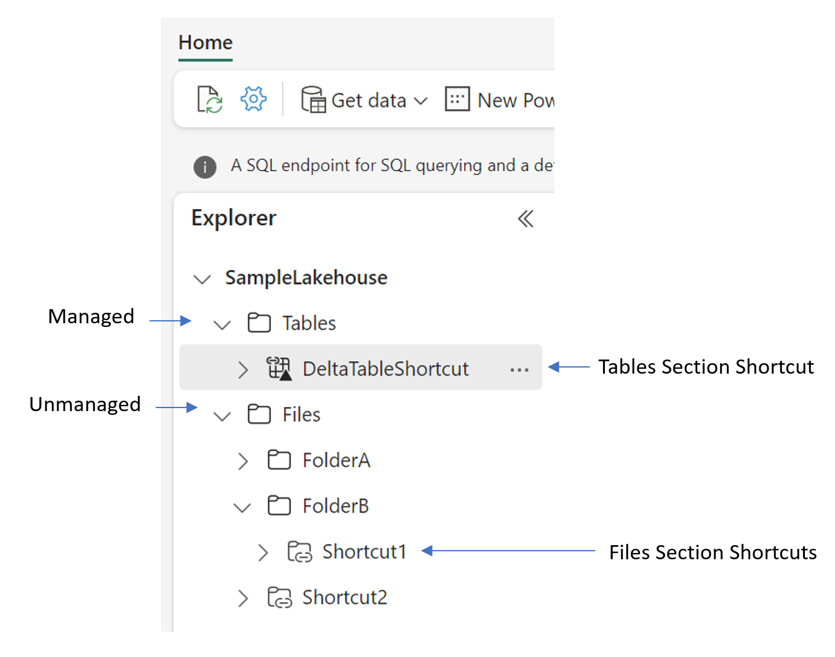
Shortcuts
Create shortcuts at the top level of the Tables folder or any level of the files folder
Access table shortcuts as if they were a “local” table in the lakehouse:
SELECT TOP (100) * FROM [MyLakehouse].[dbo].[MyShortcut]
Notes:
In Module 1, we discussed that shortcuts are embedded references within OneLake that point to other files' store locations without moving the original data. The embedded reference makes it appear as though the files and folders are stored locally but in reality; they exist in another storage location.
To create a shortcut, open Lakehouse Explorer and select where to place the shortcut under Tables or Files. Creating a shortcut to Delta formatted table under Tables in Lakehouse Explorer will automatically register it as a table, enabling data access through Spark, SQL endpoint, and default semantic model. Spark can access shortcuts in Files for data science projects or for transformation into structured data.
Shortcuts to Microsoft Fabric internal sources will use the calling user identity. External shortcuts will use connectivity details, including security details specified when the shortcut is created.
You can read shortcuts in the Tables section of a lakehouse through the SQL endpoint for the lakehouse. You can access the SQL endpoint through the mode selector of the lakehouse or through SQL Server Management Studio (SSMS).

Slide 13
Fabric Lakehouse Security
Workspace roles:
Users with Admin, Member, and Contributor roles can perform all CRUD operations on all data
Users with Viewer role can only read data stored in Tables using SQL endpoint
Permissions:
ReadData permission on SQL endpoint to access data without SQL policy.
ReadAll permission on the lakehouse to access all data using Apache Spark.
Build permission on the default semantic model to allow building Power BI reports on top of the semantic model.
Lakehouse sharing by default grants users Read permission on shared lakehouse, associated SQL endpoint, and default semantic model.
Notes:
Workspace roles define what user can do with Microsoft Fabric items. Roles can be assigned to individuals or security groups from workspace view. In a lakehouse the users with Admin, Member, and Contributor roles can perform all CRUD operations on all data. A user with Viewer role can only read data stored in Tables using SQL endpoint.
Lakehouse sharing by default grants users Read permission on shared lakehouse, associated SQL endpoint, and default semantic model. In addition to default permission, the users can receive:
ReadData permission on SQL endpoint to access data without SQL policy.
ReadAll permission on the lakehouse to access all data using Apache Spark.
Build permission on the default semantic model to allow building Power BI reports on top of the semantic model.
By sharing, users grant other users or a group of users access to a lakehouse without giving access to the workspace and the rest of its items. Shared lakehouse can be found through Data Hub or the Shared with Me section in Microsoft Fabrics.
When someone shares a lakehouse, they also grant access to the SQL endpoint and associated default semantic model.

Slide 14

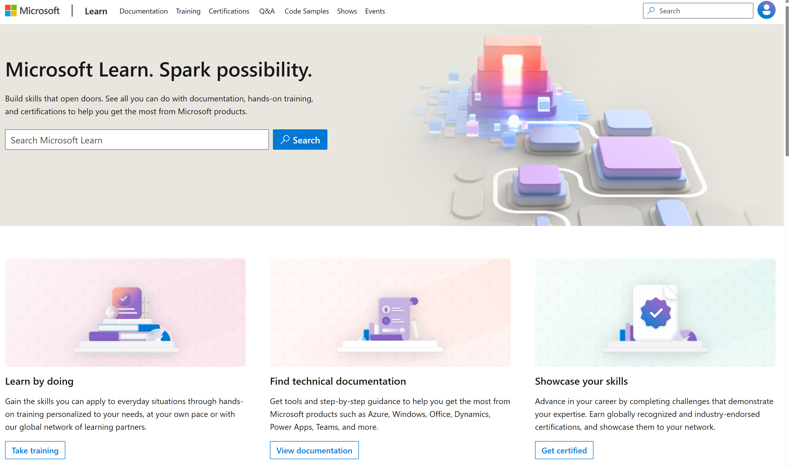
Microsoft Learn Demo
Microsoft Learn: Build skills that open doors in your career

Slide 15
Readiness and Enablement Links
The Microsoft Federal Team is here to help you accelerate customers' digital transformation. Microsoft Federal has tailored to make your organizations skilling journey successful. From the Business Decision Maker to the technical community and end-users, Microsoft provides customers with access to endless skilling resources. Below you will find links to these resources:
Get training tailored to your organization's needs: Find learning paths for specific roles in your organization, plus course recommendations based on technology, skill level, and solution area: Training | Learning Portal (microsoft.com)
Events Calendar - US Partner Community Blog – Microsoft
In addition to the above, the Microsoft Federal Team can address the needs of your non-technical community of your learners through:
Skilling Hours - Readiness and Enablement: Skilling our Federal Customers and Partners (office.com)
Microsoft Learning Portal: A closer look at Azure through training modules and gamified learning
Microsoft Learning Portal
Additional Learning Resources:
Get started with Azure – Introduction | Microsoft Azure
Microsoft Learn (path-based)
Exam-based: Select filters: Azure, D365, M365, Power Platform, and more
Microsoft Virtual Training Days – Virtual Instructor Led
Microsoft Technology Center - Work through your Account Manager
Home - Microsoft Tech Community
Microsoft Reactor | Microsoft Developer – Virtual Instructor Led

