Slide 1
Design and Implement a Partition Strategy
Module 3

Slide 2
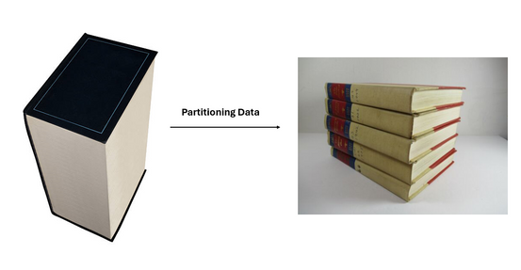
The Importance of Partitioning
While Fabric is a software as a service platform, design choices can still influence performance
As data volumes increase, partitioning is an important concept in Spark, Data Warehouse, Real-Time, and Lakehouse scenarios
Notes:
Data partitioning is a data management technique used to divide a large dataset into smaller, more manageable subsets called partitions or shards. Each partition contains a portion of the data, and these partitions can be stored and processed independently. The primary goal of data partitioning is to improve performance, scalability, and manageability in large-scale data systems. Imagine having a vast encyclopedia, and your task is to find a specific page containing a particular word. Instead of searching through the entire encyclopedia, you opt to navigate directly to the relevant section that might contain the desired information. This approach allows you to narrow down your search scope and quickly find the page you need. This concept of narrowing down the search space by dividing data into manageable sections is precisely what partitioning entails.

Slide 3
Partitioning Concepts

Slide 4
Why Partition Data?
Improve scalability
Improve performance
Provide operational flexibility
Improve security
Notes:
Why partition data?
Improve scalability. When you scale up a single database system, it will eventually reach a physical hardware limit. If you divide data across multiple partitions, each hosted on a separate server, you can scale out the system almost indefinitely.
Improve performance. Data access operations on each partition take place over a smaller volume of data. Correctly done, partitioning can make your system more efficient. Operations that affect more than one partition can run in parallel.
Improve security. In some cases, you can separate sensitive and nonsensitive data into different partitions and apply different security controls to the sensitive data.
Provide operational flexibility. Partitioning offers many opportunities for fine-tuning operations, maximizing administrative efficiency, and minimizing cost. For example, you can define different strategies for management, monitoring, backup and restore, and other administrative tasks based on the importance of the data in each partition.
Match the data store to the pattern of use. Partitioning allows each partition to be deployed on a different type of data store, based on cost and the built-in features that data store offers. For example, large binary data can be stored in blob storage, while more structured data can be held in a document database.
Improve availability. Separating data across multiple servers avoids a single point of failure. If one instance fails, only the data in that partition is unavailable. Operations on other partitions can continue. For managed PaaS data stores, this consideration is less relevant, because these services are designed with built-in redundancy.

Slide 5
Designing Partitions
Horizontal partitioning (often called sharding). In this strategy, each partition is a separate data store, but all partitions have the same schema.
Vertical partitioning. In this strategy, each partition holds a subset of the fields for items in the data store.
Functional partitioning. In this strategy, data is aggregated according to how it is used by each bounded context in the system.
Notes:
There are three typical strategies for partitioning data:
Horizontal partitioning (often called sharding). In this strategy, each partition is a separate data store, but all partitions have the same schema. Each partition is known as a shard and holds a specific subset of the data, such as all the orders for a specific set of customers.
Vertical partitioning. In this strategy, each partition holds a subset of the fields for items in the data store. The fields are divided according to their pattern of use. For example, frequently accessed fields might be placed in one vertical partition and less frequently accessed fields in another.
Functional partitioning. In this strategy, data is aggregated according to how it is used by each bounded context in the system. For example, an e-commerce system might store invoice data in one partition and product inventory data in another.
These strategies can be combined, and we recommend that you consider them all when you design a partitioning scheme. For example, you might divide data into shards and then use vertical partitioning to further subdivide the data in each shard.

Slide 6
Partitioning Patterns
Competing Consumers Pattern
Compute Resource Consolidation Pattern
Compute Partitioning
Leader Election Pattern
Sharding Pattern
Index Pattern
Data Partitioning
Materialized View Pattern
CQRS
Event Sourcing
Data Consistency

Slide 7



Partitioning Concepts
Sharding logic:
Route requests for tenant 1 to shard …
…
Route request for tenant 44 to shard A
…
Route requests for tenant 227 to shard C
…
Route request for tenant N to shard …
Application instance
Application instance
Query: Find information for tenant 55
Query: Find information for tenant 27
. . .
Partition A
Partition B
Partition C
Partition N
Notes:
You can partition anywhere you are storing data (for documents), graphs, or tables. Containers are logical resources and can span one or more physical partitions or servers. The number of partitions is based on the storage size and throughput provisioned for a container or storage
If you are already familiar with the sharding pattern, the idea of dynamic partitioning is not very different.

Slide 8
Partitioning Data (spillover)
Start with 1 partition, fill it, then move to next
headroom {
(fill factor)
Notes:
When a partition begins to fill up and run out of resources, it is time to spill-over or re-distribute data to another partition. This may occur when an outlying tenant is consuming more storage and/or throughput than expected, or the application is simply outgrowing the existing partitions. You will want to monitor and pick an appropriate threshold (e.g. 80% of storage consumed), based on the rate that which resources are consumed, to act upon to prevent the possibility of application failure. This is one of the most rudimentary partitioning patterns.

Slide 9
Partitioning Data (range)
Keep current data hot, Warm historical data, Scale-down older data, Purge / Archive
X
}
current
period
Notes:
Assign a continuous range of keys (from some minimum to some maximum) to each partition. Within each partition, we can keep keys in sorted order(SSTables and LSM-Trees). This helps in range scans. Uniform partitioning is not possible practically though, and it leads to the hot spots (partitions corresponding to the range of time)
Range partitioning is most commonly used with a date key to split the data. In some cases, you may choose to partition data by customer, if you expect to have similar workloads from each of your customers. The important takeaway about the range partitioning pattern is that you should have a range key that roughly splits the data evenly between partitions so you avoid any potential hotspots.

Slide 10

Partitioning Data (lookup)
Home tenant / user to a specific partition. Use “master” lookup.
Cache this shard map
Tenant | Partition Id
Customer | 1
Big Customer | 2
Another | 3
to avoid making the lookup the bottleneck
Notes:
The notion of a lookup partition is commonly used for dimensions that are commonly joined to individual partitions of fact table. This design pattern helps reduce east-west data movement in distributed systems like Fabric Data Warehouse. Replicated lookup tables work well for dimension tables in a star schema. Dimension tables are typically joined to fact tables, which are distributed differently than the dimension table. Dimensions are usually of a size that makes it feasible to store and maintain multiple copies. Dimensions store descriptive data that changes slowly, such as customer name and address, and product details. The slowly changing nature of the data leads to less maintenance of the replicated table.

Slide 11
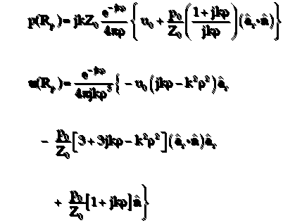
Partitioning Data (hash)
Evenly distribute across n number of partitions (algorithmic) ….
n = n + m
Notes:
Hash distribution is most commonly used when there is no natural partitioning key for data. It effectively creates a round-robin distribution pattern for data across partitions, which minimizes potential hotspots or over/underfilled partitions.

Slide 12
Partitioning Design Concepts
Minimize cross-partition data access operations
Consider replicating static reference data
Data access logic may need to be modified
Large quantities of existing data might need to be migrated, to distribute it across partitions
Consider how queries locate the correct partition
Consider periodically rebalancing shards
Notes:
Partitioning adds complexity to the design and development of your system. Consider partitioning as a fundamental part of system design even if the system initially only contains a single partition. If you address partitioning as an afterthought, it will be more challenging because you already have a live system to maintain:
Data access logic will need to be modified.
Large quantities of existing data might need to be migrated, to distribute it across partitions.
Users expect to be able to continue using the system during the migration.
In some cases, partitioning is not considered important because the initial dataset is small and can be easily handled by a single server. This might be true for some workloads, but many commercial systems need to expand as the number of users increases.
Moreover, it's not only large data stores that benefit from partitioning. For example, a small data store might be heavily accessed by hundreds of concurrent clients. Partitioning the data in this situation can help to reduce contention and improve throughput.
Consider the following points when you design a data partitioning scheme:
Minimize cross-partition data access operations. Where possible, keep data for the most common database operations together in each partition to minimize cross-partition data access operations. Querying across partitions can be more time-consuming than querying within a single partition, but optimizing partitions for one set of queries might adversely affect other sets of queries. If you must query across partitions, minimize query time by running parallel queries and aggregating the results within the application. (This approach might not be possible in some cases, such as when the result from one query is used in the next query.)
Consider replicating static reference data. If queries use relatively static reference data, such as postal code tables or product lists, consider replicating this data in all of the partitions to reduce separate lookup operations in different partitions. This approach can also reduce the likelihood of the reference data becoming a "hot" dataset, with heavy traffic from across the entire system. However, there is an additional cost associated with synchronizing any changes to the reference data.
Minimize cross-partition joins. Where possible, minimize requirements for referential integrity across vertical and functional partitions. In these schemes, the application is responsible for maintaining referential integrity across partitions. Queries that join data across multiple partitions are inefficient because the application typically needs to perform consecutive queries based on a key and then a foreign key. Instead, consider replicating or de-normalizing the relevant data. If cross-partition joins are necessary, run parallel queries over the partitions and join the data within the application.
Embrace eventual consistency. Evaluate whether strong consistency is actually a requirement. A common approach in distributed systems is to implement eventual consistency. The data in each partition is updated separately, and the application logic ensures that the updates are all completed successfully. It also handles the inconsistencies that can arise from querying data while an eventually consistent operation is running.
Consider how queries locate the correct partition. If a query must scan all partitions to locate the required data, there is a significant impact on performance, even when multiple parallel queries are running. With vertical and functional partitioning, queries can naturally specify the partition. Horizontal partitioning, on the other hand, can make locating an item difficult, because every shard has the same schema. A typical solution to maintain a map that is used to look up the shard location for specific items. This map can be implemented in the sharding logic of the application, or maintained by the data store if it supports transparent sharding.
Consider periodically rebalancing shards. With horizontal partitioning, rebalancing shards can help distribute the data evenly by size and by workload to minimize hotspots, maximize query performance, and work around physical storage limitations. However, this is a complex task that often requires the use of a custom tool or process.
Replicate partitions. If you replicate each partition, it provides additional protection against failure. If a single replica fails, queries can be directed toward a working copy.
If you reach the physical limits of a partitioning strategy, you might need to extend the scalability to a different level. For example, if partitioning is at the database level, you might need to locate or replicate partitions in multiple databases. If partitioning is already at the database level, and physical limitations are an issue, it might mean that you need to locate or replicate partitions in multiple hosting accounts.
Avoid transactions that access data in multiple partitions. Some data stores implement transactional consistency and integrity for operations that modify data, but only when the data is located in a single partition. If you need transactional support across multiple partitions, you will probably need to implement this as part of your application logic because most partitioning systems do not provide native support.

Slide 13
Rebalancing Partitions
It is important to understand what your data store does automatically in regard to partitions
Some data services, and partitioning patterns will inherently distribute data
Some data services may require periodic rebalancing
You need to ensure any rebalancing effort does not impact user data access
Notes:
As a system matures, you might have to adjust the partitioning scheme. For example, individual partitions might start getting a disproportionate volume of traffic and become hot, leading to excessive contention. Or you might have underestimated the volume of data in some partitions, causing some partitions to approach capacity limits.
Some data stores, such as Azure Cosmos DB, can automatically rebalance partitions. In other cases, rebalancing is an administrative task that consists of two stages:
Determine a new partitioning strategy.
Which partitions need to be split (or possibly combined)?
What is the new partition key?
Migrate data from the old partitioning scheme to the new set of partitions.
Depending on the data store, you might be able to migrate data between partitions while they are in use. This is called online migration. If that's not possible, you might need to make partitions unavailable while the data is relocated (offline migration).

Slide 14
Partitioning in Fabric

Slide 15
Fabric Services Using Partitioning
Fabric Data Science
Fabric Data Engineering
Fabric Data Warehouse
Fabric Real-Time Analytics
Notes:
Partitioning is a key part of fabric, and each component implements it slightly differently. In this module you have learned about the concepts around partitioning. As you move into further modules in this course, you will leanr the specifics of partitioning in each individual component and how those optimizations should happen.

Slide 16
Summary
Partitioning and dimensional modeling are two of the more important concepts you can understand for analytical workloads
Different components of Fabric implement partitioning in different ways. You will learn more specifics in each module
Implementing partitioning may require maintenance and changes to your application or data engineering jobs, but will help your overall performance

Slide 17

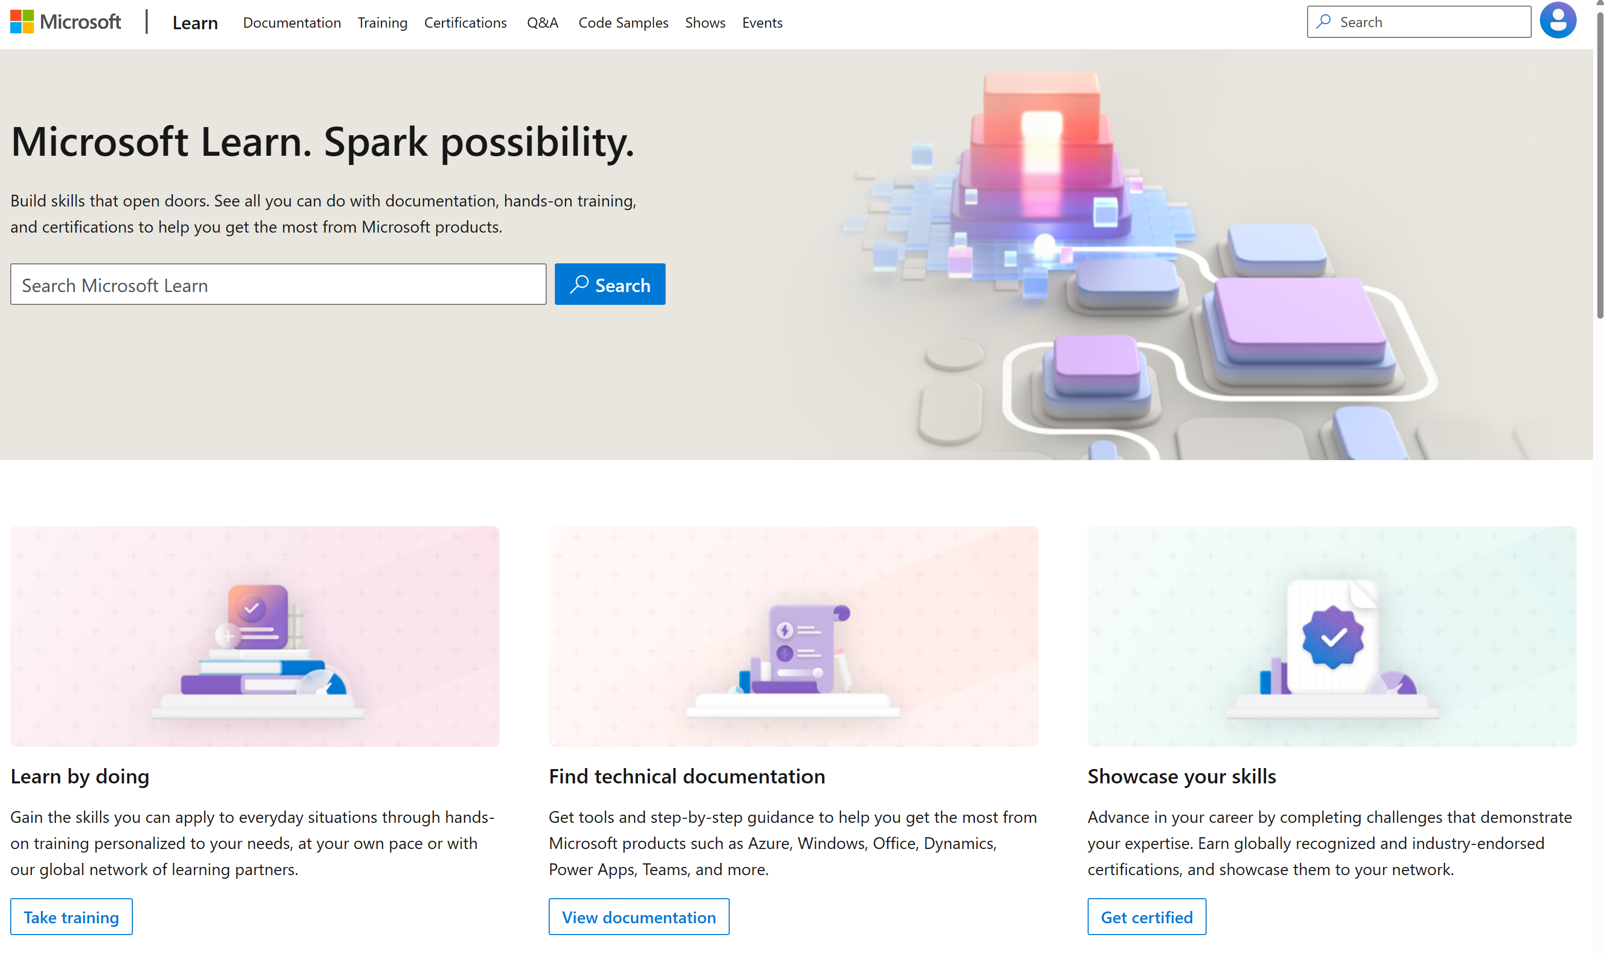
Microsoft Learn Demo
Microsoft Learn: Build skills that open doors in your career

Slide 18
Readiness and Enablement Links
The Microsoft Federal Team is here to help you accelerate customers' digital transformation. Microsoft Federal has tailored to make your organizations skilling journey successful. From the Business Decision Maker to the technical community and end-users, Microsoft provides customers with access to endless skilling resources. Below you will find links to these resources:
Get training tailored to your organization's needs: Find learning paths for specific roles in your organization, plus course recommendations based on technology, skill level, and solution area: Training | Learning Portal (microsoft.com)
Events Calendar - US Partner Community Blog – Microsoft
In addition to the above, the Microsoft Federal Team can address the needs of your non-technical community of your learners through:
Skilling Hours - Readiness and Enablement: Skilling our Federal Customers and Partners (office.com)
Microsoft Learning Portal: A closer look at Azure through training modules and gamified learning
Microsoft Learning Portal
Additional Learning Resources:
Get started with Azure – Introduction | Microsoft Azure
Microsoft Learn (path-based)
Exam-based: Select filters: Azure, D365, M365, Power Platform, and more
Microsoft Virtual Training Days – Virtual Instructor Led
Microsoft Technology Center - Work through your Account Manager
Home - Microsoft Tech Community
Microsoft Reactor | Microsoft Developer – Virtual Instructor Led

