Slide 1
Getting Started with Lakehouses in Microsoft Fabric
Module 4

Slide 2
Lakehouse Technical Concepts
A few key components enable lakehouse technology:
Metadata layers for data lakes
Query engines optimized for SQL execution against data lakes
Optimized access for data science and machine learning tools
Lakehouses can support ACID transactions
Support for a variety of open file formats
Decoupled storage and compute
Notes:
According to the aforementioned paper, the lakehouse architecture is defined as “a data management system based on low-cost and directly-accessible storage that also provides traditional analytical DBMS management and performance features such as ACID transactions, data versioning, auditing, indexing, caching, and query optimization.”
Let’s go into more detail on the key features of a data lakehouse and problems this concept solves as suggested by Databricks.
ACID transaction support. ACID stands for atomicity, consistency, isolation, and durability — key properties that define a transaction and ensure data consistency and reliability. Such transactions have long been available only in data warehouses, but the lakehouse presents the capability to apply them to data lakes too. This solves the issue with low data quality of the latter when many data pipelines involve concurrent data reads and write

Slide 3
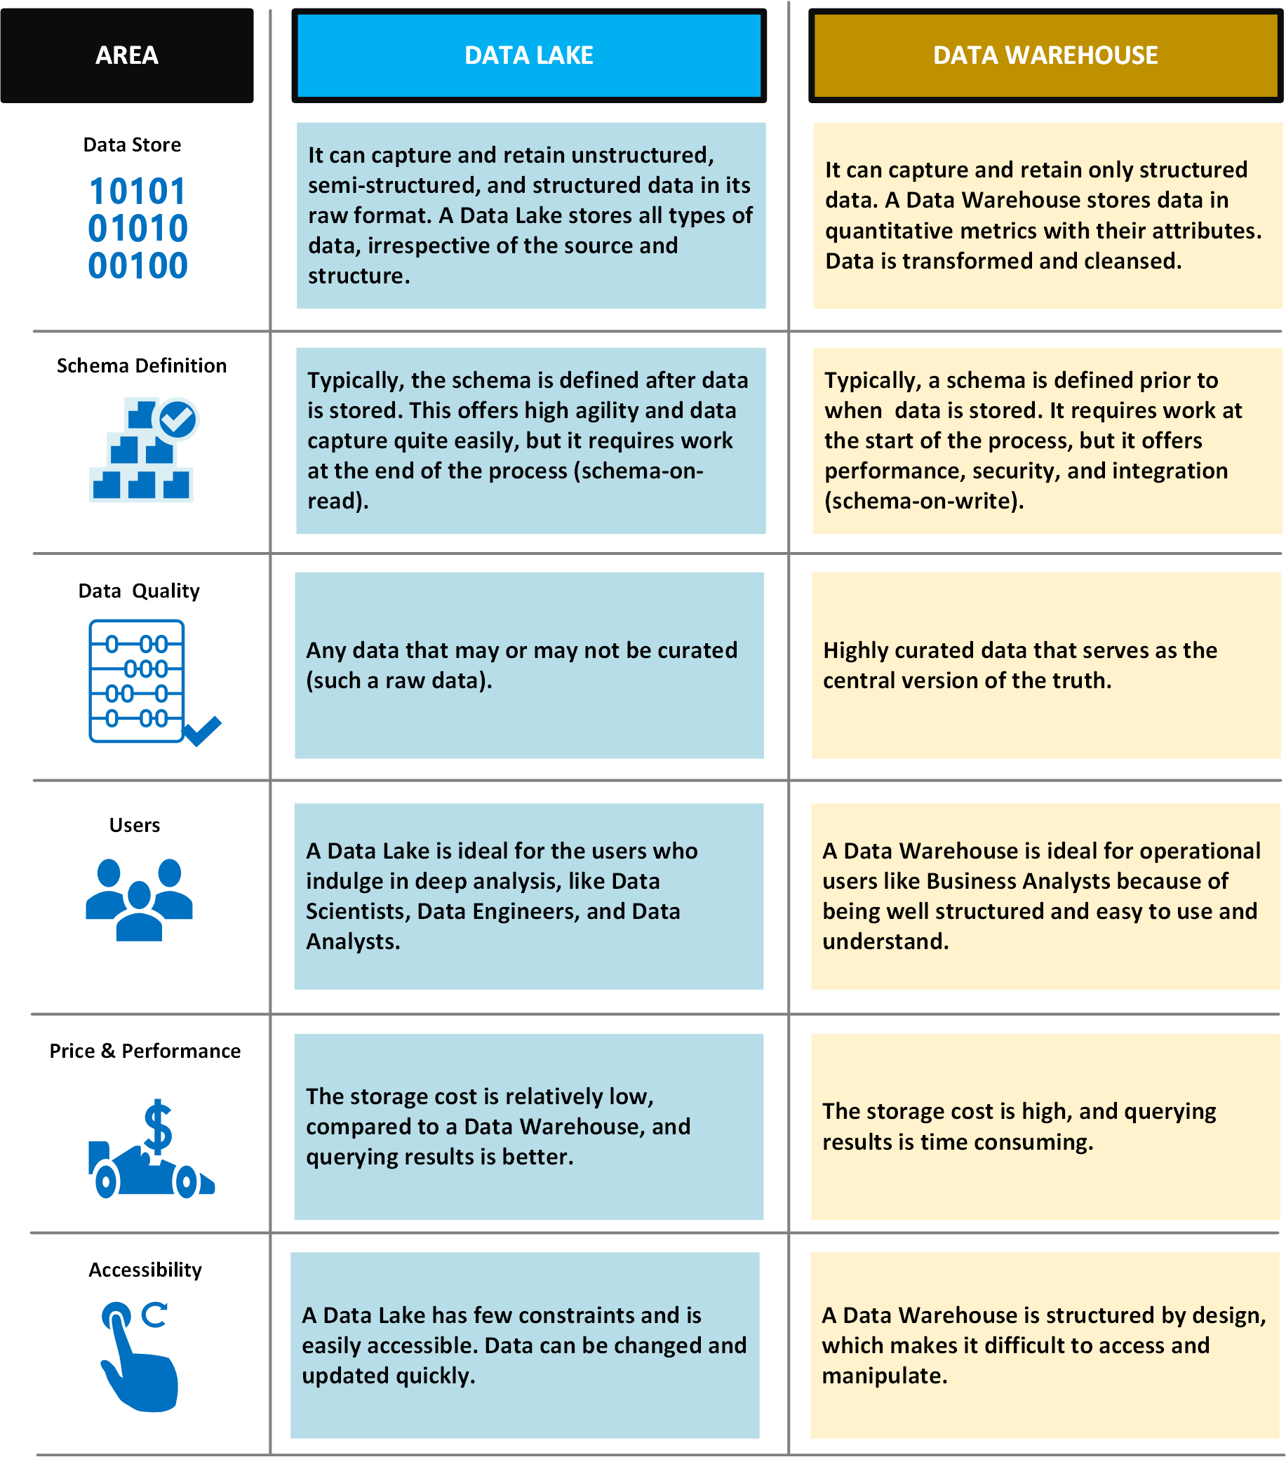
Data Lake vs Data Warehouse
Notes:
Typical uses for a data lake include data exploration, data analytics, and machine learning.
A data lake can also act as the data source for a data warehouse. With this approach, the raw data is ingested into the data lake and then transformed into a structured queryable format. Typically this transformation uses an ELT (extract-load-transform) pipeline, where the data is ingested and transformed in place. Source data that is already relational may go directly into the data warehouse, using an ETL process, skipping the data lake.
Data lake stores are often used in event streaming or IoT scenarios, because they can persist large amounts of relational and nonrelational data without transformation or schema definition. They are built to handle high volumes of small writes at low latency, and are optimized for massive throughput.
Challenges
Lack of a schema or descriptive metadata can make the data hard to consume or query.
Lack of semantic consistency across the data can make it challenging to perform analysis on the data, unless users are highly skilled at data analytics.
It can be hard to guarantee the quality of the data going into the data lake.
Without proper governance, access control and privacy issues can be problems. What information is going into the data lake, who can access that data, and for what uses?
A data lake may not be the best way to integrate data that is already relational.
By itself, a data lake does not provide integrated or holistic views across the organization.
A data lake may become a dumping ground for data that is never actually analyzed or mined for insights.

Slide 4
Data Lake vs Data Lakehouse
 | Data lake | Data Lakehouse
Type | Structured, semi-structured, unstructured | Structured, semi-structured, unstructured
Not available | Relational, non-relational | Relational, non-relational
Schema | Schema on read | Schema on read, schema on write
Format | Raw, unfiltered, processed, curated | Raw, unfiltered, processed, curated, delta format files
Sources | Big data, IoT, social media, streaming data | Big data, IoT, social media, streaming data, application, business, transactional data, batch reporting
Scalability | Easy to scale at a low cost | Easy to scale at a low cost
Users | Data scientists | Business analysts, data engineers, data scientists
Use cases | Machine learning, predictive analytics | Core reporting, BI, machine learning, predictive analytics
Notes:
Data lake vs. data lakehouse
Now you know the difference between a data lake vs. a data warehouse. But what's the difference between a data lake and a data lakehouse? And is it necessary to have both?
Despite its many advantages, a traditional data lake is not without its drawbacks. Because data lakes can accommodate all types of data from all kinds of sources, issues related to quality control, data corruption, and improper partitioning can occur. A poorly managed data lake not only tarnishes data integrity, but it can also lead to bottlenecks, slow performance, and security risks.
That's where the data lakehouse comes into play. A data lakehouse is an open standards-based storage solution that is multifaceted in nature. It can address the needs of data scientists and engineers who conduct deep data analysis and processing, as well as the needs of traditional data warehouse professionals who curate and publish data for business intelligence and reporting purposes. The beauty of the lakehouse is that each workload can seamlessly operate on top of the data lake without having to duplicate the data into another structurally predefined database. This ensures that everyone is working on the most up-to-date data, while also reducing redundancies.
Data lakehouses address the challenges of traditional data lakes by adding a Delta Lake storage layer directly on top of the cloud data lake. The storage layer provides a flexible analytic architecture that can handle ACID (atomicity, consistency, isolation, and durability) transactions for data reliability, streaming integrations, and advanced features like data versioning and schema enforcement. This allows for a range of analytic activity over the lake, all without compromising core data consistency. While the necessity of a lakehouse depends on how complex your needs are, its flexibility and range make it an optimal solution for many enterprise orgs.

Slide 5
What is a lakehouse in Microsoft Fabric?
A lakehouse is a data architecture for storing and analyzing both structured and unstructured data in the same location
The structure is flexibile and scalable, allowing organizations to handle large volumes of data
Lakehouses integrate with data management and analytics tools for data engineering and analytics
Notes:
Microsoft Fabric Lakehouse is a data architecture platform for storing, managing, and analyzing structured and unstructured data in a single location. It's a flexible and scalable solution that allows organizations to handle large volumes of data using various tools and frameworks to process and analyze that data. It integrates with other data management and analytics tools to provide a comprehensive solution for data engineering and analytics.

Slide 6
Delta Lake Tables—the core of the Lakehosue
Fabric supports multiple table formations including managed, unmanaged, and regular non-Delta Hive tables.
However, the core of Fabric is the Delta Lake storage format commonly used in Apache Spark
Delta Lake is an open-source storage layer which adds relational database semantics to Spark-based data lake tables
Tables in Microsoft Fabric lakehouses are Delta tables, which is signified by the triangular Delta (▴) icon on tables in the lakehouse user interface.
Delta tables are made up of Parquet data files and a _delta_log JSON file analogous to a transaction log for the table
Notes:
Delta tables are schema abstractions over data files that are stored in Delta format. For each table, the lakehouse stores a folder containing Parquet data files and a _delta_Log folder in which transaction details are logged in JSON format.
The benefits of using Delta tables include:
Relational tables that support querying and data modification. With Apache Spark, you can store data in Delta tables that support CRUD (create, read, update, and delete) operations. In other words, you can select, insert, update, and delete rows of data in the same way you would in a relational database system.
Support for ACID transactions. Relational databases are designed to support transactional data modifications that provide atomicity (transactions complete as a single unit of work), consistency (transactions leave the database in a consistent state), isolation (in-process transactions can't interfere with one another), and durability (when a transaction completes, the changes it made are persisted). Delta Lake brings this same transactional support to Spark by implementing a transaction log and enforcing serializable isolation for concurrent operations.
Data versioning and time travel. Because all transactions are logged in the transaction log, you can track multiple versions of each table row and even use the time travel feature to retrieve a previous version of a row in a query.
Support for batch and streaming data. While most relational databases include tables that store static data, Spark includes native support for streaming data through the Spark Structured Streaming API. Delta Lake tables can be used as both sinks (destinations) and sources for streaming data.
Standard formats and interoperability. The underlying data for Delta tables is stored in Parquet format, which is commonly used in data lake ingestion pipelines. Additionally, you can use the SQL Endpoint for the Microsoft Fabric lakehouse to query Delta tables in SQL.

Slide 7

Fabric Lakehouse SQL Endpoint
In Fabric, there is a serving layer, which generates a SQL endpoint and a default dataset during creation.
This allows the user to work directly on top of the Delta tables in the data lake to provide an easy experience from ingestion to reporting
Only tables that are stored in the Delta format can be accessed via the SQL endpoint
Notes:
Lakehouse SQL endpoint
The Lakehouse creates a serving layer by automatically generating a SQL endpoint and a default dataset during creation. This new see-through functionality allows user to work directly on top of the Delta tables in the lake to provide a frictionless and performant experience all the way from data ingestion to reporting.
An important distinction between default warehouse is that it's a read-only experience and doesn't support the full T-SQL surface area of a transactional data warehouse. Note that only the tables in Delta format are available in the SQL endpoint. Parquet, CSV, and other formats can't be queried using the SQL endpoint. If you don't see your table, convert it to Delta format.

Slide 8

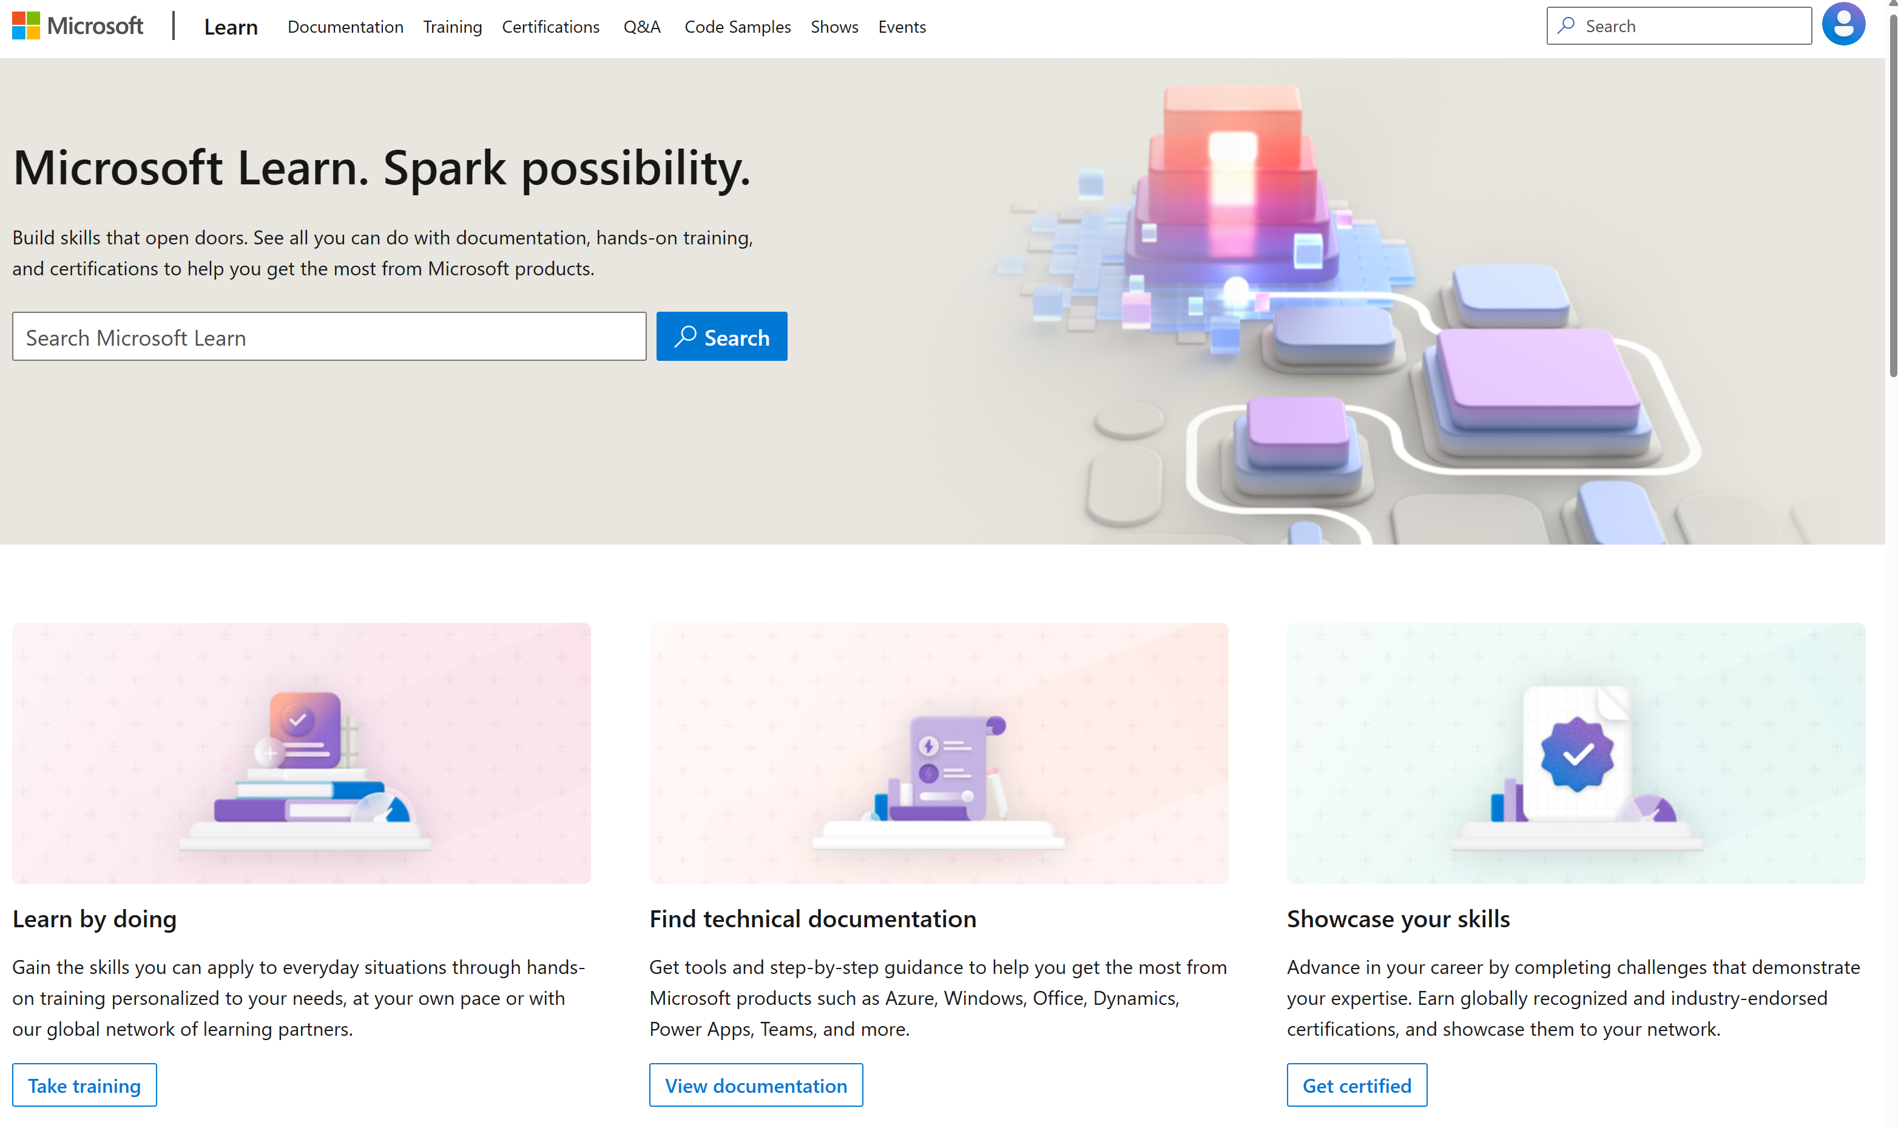
Microsoft Learn Demo
Microsoft Learn: Build skills that open doors in your career

Slide 9
Readiness and Enablement Links
The Microsoft Federal Team is here to help you accelerate customers' digital transformation. Microsoft Federal has tailored to make your organizations skilling journey successful. From the Business Decision Maker to the technical community and end-users, Microsoft provides customers with access to endless skilling resources. Below you will find links to these resources:
Get training tailored to your organization's needs: Find learning paths for specific roles in your organization, plus course recommendations based on technology, skill level, and solution area: Training | Learning Portal (microsoft.com)
Events Calendar - US Partner Community Blog – Microsoft
In addition to the above, the Microsoft Federal Team can address the needs of your non-technical community of your learners through:
Skilling Hours - Readiness and Enablement: Skilling our Federal Customers and Partners (office.com)
Microsoft Learning Portal: A closer look at Azure through training modules and gamified learning
Microsoft Learning Portal
Additional Learning Resources:
Get started with Azure – Introduction | Microsoft Azure
Microsoft Learn (path-based)
Exam-based: Select filters: Azure, D365, M365, Power Platform, and more
Microsoft Virtual Training Days – Virtual Instructor Led
Microsoft Technology Center - Work through your Account Manager
Home - Microsoft Tech Community
Microsoft Reactor | Microsoft Developer – Virtual Instructor Led

