Slide 1
Create models and build Power BI reports in Fabric
Module 11

Slide 2
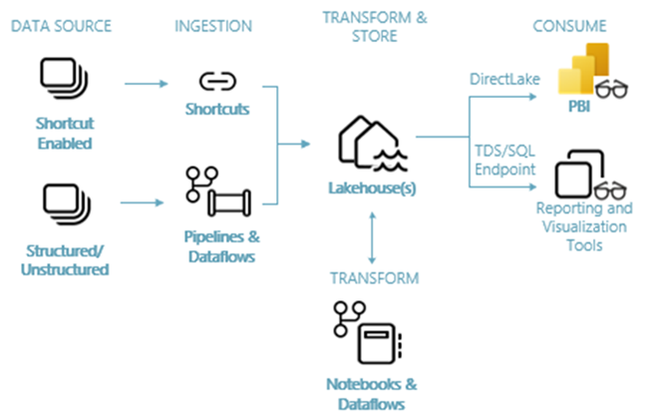
Power BI in Fabric
Notes:
Once you have ingested, transformed, and stored your data in a serving layer, you will want to analyze and report on that data. This is where Power BI comes in. Power BI is natively integrated in the whole Fabric experience. Your Power BI items live in a Fabric workspace alongside your lakehouse, warehouse, pipelines, and dataflows.
In Microsoft Fabric, Power BI datasets are a semantic model with metrics; a logical description of an analytical domain, with business friendly terminology and representation, to enable deeper analysis. Once you have a dataset, you can create a report that uses the dataset.
If you have used Power BI in the past, the experience in Fabric will be very similar with some additional features available only in Fabric.

Slide 3





Power BI Components
Default Dataset
Interactive report
Scorecard
Custom Dataset
Interactive report
Dashboard
Interactive report
Paginated report
Notes:
There are many types of items available in the Power BI experience. We’ve discussed that Power BI datasets are semantic models with metrics.
A Power BI report, also referred to as an interactive report, is one or more pages of visualizations such as line charts, maps, and treemaps. All of the visualizations in a report come from a single dataset. Reports can be created from scratch by you and your colleagues, and can be shared with you directly, in a workspace, or as part of an app.
A dashboard is a canvas that contains tiles and widgets. Each tile pinned from a report or from Q&A displays a single visualization that was created from a dataset and pinned to the dashboard. Entire report pages can also be pinned to a dashboard as a single tile. Dashboards are used to provide an at-a-glance view for decision makers with navigation into reports to get more details.
Scorecards in Power BI let customers curate their metrics and track them against key business objectives in a single view. These metrics may be manually entered or connected to a datapoint in a Power BI report.
Paginated reports provide you with the ability to produce highly formatted, print-ready layouts. So, paginated reports are ideal for operational reports, like sales invoices. Paginated reports are built on the technology that creates SQL Server Reporting Services reports.
Of the items listed here, datasets and Power BI reports are the item types used most often.

Slide 4
Power BI Datasets

Slide 5
Power BI Datasets
Semantic models that provide:
Hierarchies, descriptions, relationships
Measures to standardize metrics for repeatable analysis
Catalog and search capabilities in the Data Hub
Custom permissions for workload isolation and security
A data source for Power BI reports
A data source for Excel and third-party tools
Notes:
A data model defines the relationships between the different tables in the dataset, the rules for how data is aggregated and summarized, and the calculations or measures that are used to derive insights from the data. These relationships and measures are included in the dataset, which is then used to create reports in Power BI.
Once you publish/save the dataset, it becomes searchable in the Data Hub and is added to a Micrsoft Purview data catalog.
There are several ways to grant permissions to read, write, build reports on, and share a dataset. We’ll discuss those in more detail in this module.
A Power BI report must be connected to one (and only one) dataset. Other tools from Microsoft and third parties can also connect to a published dataset.

Slide 6
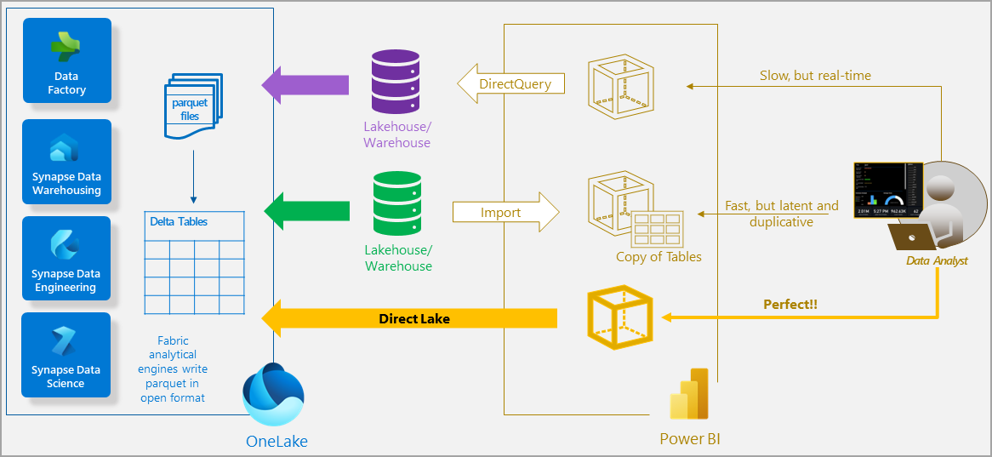
Storage Modes
Notes:
In, Fabric there are 3 main storage modes for a dataset.
Previously, Power BI had DirectQuery and Import.
In DirectQuery mode, the Power BI engine queries the data at the source, which can be slow but avoids having to copy the data. Any changes at the data source are immediately reflected in the query results.
With import mode, performance can be better because the data is cached and optimized for business-intelligence queries without having to query the data source for each DAX query submitted by a report. However, the Power BI engine must first copy the data into the dataset during refresh. Any changes at the source are only picked up with the next dataset refresh.
Direct Lake mode is a groundbreaking new dataset capability for analyzing very large data volumes in Power BI. Direct Lake is based on loading parquet-formatted files directly from a data lake without having to query a Lakehouse endpoint, and without having to import or duplicate data into a Power BI dataset. Unlike DirectQuery, there is no translation to other query languages or query execution on other database systems, yielding performance similar to import mode. Because there's no explicit import process, it's possible to pick up any changes at the data source as they occur, combining the advantages of both DirectQuery and import modes while avoiding their disadvantages.

Slide 7
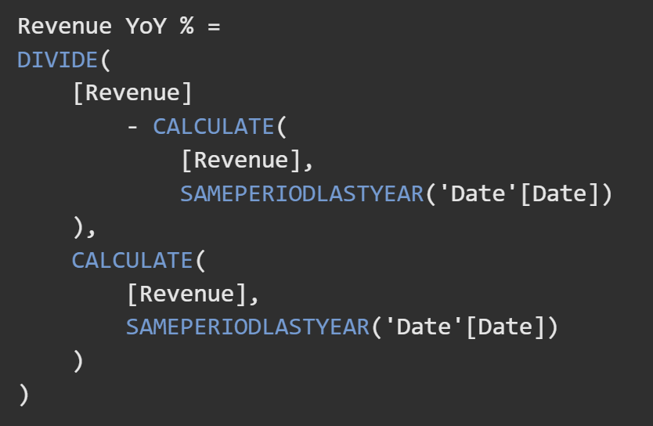
Measures
Created using DAX (Data Analysis eXpression) language
Summarize data in a dataset to return a single value
Evaluated at query time, results not stored in the model
May reference tables, columns, other measures in the dataset
Notes:
No matter the storage mode used, all data models in Power BI contain measures. The simplest measures are simple aggregations such as summing a single column. Commonly, we need to perform calculations over time, perhaps to compare this year’s revenue to last year. Or to calculate a daily average temperature from hourly readings.
This is the purpose of measures in a Power BI model. Measures are calculated at query time, rather than being stored in a model. So they are best used (with some exceptions) for aggregations over rows rather than row-level calculations. Row-level calculations could be pushed further up the stack and performed in a data lake or warehouse.
While the result of a measure is a single scalar value, the intermediate steps of a measure can reference other objects in the model including tables, columns, and other measures.
An important concept in DAX is context. You will often see the CALCULATE function used to change the context in which a calculation is performed. In the example shown here, calculate is used to change the time period from the selected date to the same period in the prior year.

Slide 8
Default Datasets
Queried via the SQL Endpoint for a lakehouse
Updated via changes to the lakehouse/warehouse
All tables and views in a warehouse are automatically added
Inherits all relationships between entities defined in the model view of a warehouse
Created and managed in a web browser
Can be customized to add/remove tables and relationships and to add measures
Notes:
As discussed previously, a default dataset is generated for lakehouses and warehouses.
When you create a Lakehouse, a default Power BI dataset is created with the SQL Endpoint. The default dataset is represented with the (default) suffix. The default dataset is queried via the SQL Endpoint and updated via changes to the Lakehouse. You can also query the default dataset via cross-database queries from a Warehouse.
By default, all tables and views in the Warehouse are automatically added to the default Power BI dataset. Users can also manually select tables or views from the Warehouse they want included in the model for more flexibility. Objects that are in the default Power BI dataset are created as a layout in the model view. While all constraints are translated to relationships, currently in Power BI, only one relationship can be active at a time, whereas multiple primary and foreign key constraints can be defined for warehouse entities. Automatic translation of constraints to relationships in the default Power BI dataset is only applicable for tables in the Warehouse in Microsoft Fabric, not currently supported in the SQL Endpoint.
While custom datasets can be created and modified in Power BI desktop, the default dataset must be managed using a web browser.

Slide 9
Default vs New Dataset
Default:
Automatically generated
Modify only in a web browser
Uses Direct Lake for lakehouse sources, kept in sync for you
Cannot be deleted
New/Custom
User created
Modify in a web browser, Power BI Desktop, or third-party tools
Uses the storage mode of your choice
Can be deleted
Notes:
Let’s compare the default dataset to a custom dataset that you create.
With the default dataset, the dataset is created automatically for you, and the aforementioned business logic gets inherited from the parent lakehouse or Warehouse respectively, jump-starting the downstream analytics experience for business intelligence and analysis with an item in Microsoft Fabric that is managed, optimized, and kept in sync with no user intervention.
With lakehouse, sources that keeping in sync comes from Direct Lake. We’ll talk more about Direct Lake next, but the most important thing to understand is that it performs well and doesn’t require dataset refreshes.
The default dataset may meet reporting needs when the data model is relatively simple. Sometimes we need more than this.
When you need to combine data from your lakehouse with other sources that can’t be referenced by a shortcut, you need to make a new dataset. If you prefer a more pro-dev experience using Power BI Desktop or 3rd party tools such as Tabular Editor, you will want to make a new dataset. If you need to change the storage mode of your dataset away from Direct Lake, you’ll need to create a new dataset.

Slide 10
Direct Lake
Power BI dataset reads directly from parquet files in OneLake without copying data
Must be created in the web experience
Contain tables and views from a single Lakehouse (shortcuts included)
Cannot be mixed with other storage modes in the same dataset
Does not support calculated columns and calculated tables
Support read and write via the XMLA endpoint
Queries that exceed dataset size limit fall back to DirectQuery mode
Does not support Row-Level Security
Notes:
We’ve established that Direct Lake mode eliminates the import requirement by loading the data directly from OneLake and does not need to translate queries to other languages. While Direct Lake is an exciting new feature, it’s important to evaluate whether it fits your use case. You must use the web experience to create a Direct Lake dataset. There can be only one data source, which is your lakehouse. And you cannot mix Direct Lake with other modes.
You can’t create calculated tables and columns in a Direct Lake dataset, but that is largely ok because you can create those tables and columns directly in your lakehouse and then read them in Power BI.
While Direct Lake datasets do support XMLA read and write, Direct Lake datasets created or modified by using XMLA-based tools cannot be opened in the Web modelling feature.
One important thing to note is that there is a dataset size limit for Direct Lake. If the limit is exceeded, queries executed by a report/client against the Direct Lake dataset will fall back to Direct Query mode. This can greatly impact query speed.
Another thing to note, that is likely a temporary limitation, is that RLS is not supported in Direct Lake datasets.

Slide 11
Creating New Datasets
Can be done in Power BI Desktop or web experience
Must use web for Direct Lake
Choose storage mode for each table when not Direct Lake (import, direct query)
Power Query for imported models
Calculated tables and columns for imported non-Direct Lake models
DAX measures for all models
Notes:
In general, you can create datasets using Power BI Desktop or the web. The web is the newer and more limited experience, but it is also the only way to create Direct Lake datasets.
When you aren’t working in Direct Lake, you can choose a mode for each table, depending on the source. When you have an imported dataset, you can use Power Query to get and transform data. Then you can use DAX to create calculated tables and columns.
And for all model types, you can use DAX to create measures.
Once you have created and published your dataset, you can use it to create reports.

Slide 12
Reports

Slide 13
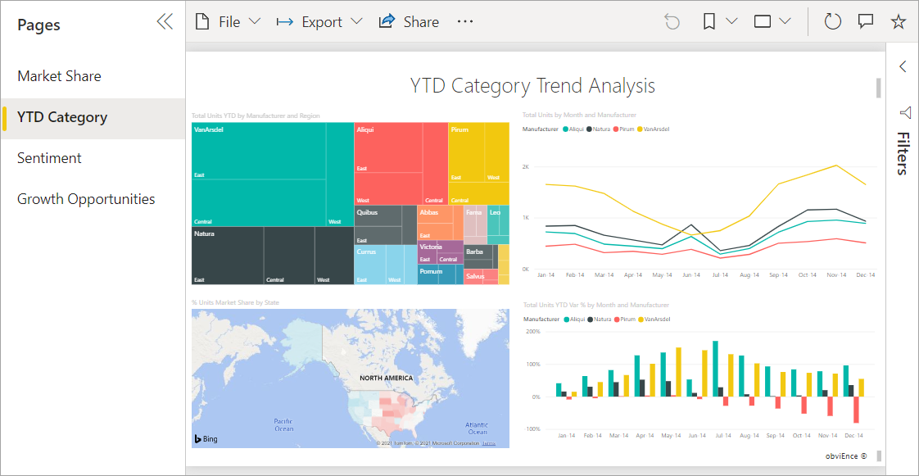
Power BI Reports
Connected to a single dataset
One or more pages
One or more visuals
Interactive and customizable
Mobile layouts
Update as underlying data changes
Create in Power BI Desktop or Service
Notes:
A Power BI report is a multi-perspective view into a dataset, with visuals that represent findings and insights from that dataset. A report can have a single visual or many pages full of visuals.
It could be one page or many pages. A page could contain one visual or a dozen or more visuals.
Power BI reports generally offer interactivity and customization. They also offer mobile-friendly report layouts that can be created separately from the main desktop layout.
When the dataset updates, the report shows the updated data.
Reports can be created in Power BI Desktop or the service using a web browser.

Slide 14
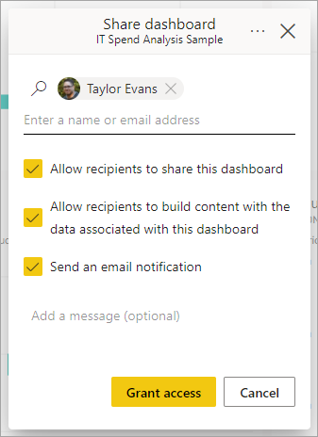
Distributing Power BI Reports
Options for sharing reports with other users:
Workspace roles
Power BI App
Share directly
Embed in secure portal
Embed in public portal
Embed in PowerPoint

Slide 15
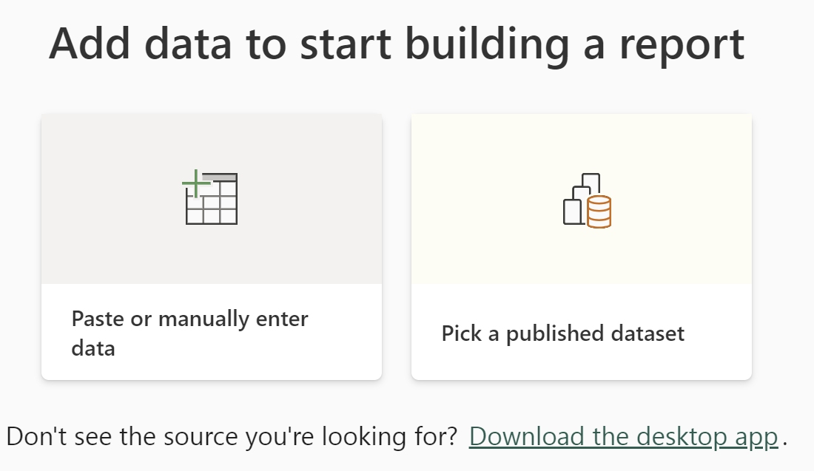
Create a Report from an Existing Dataset
Use Power BI Desktop or Web experience
Choose a dataset from the list of existing datasets
Start a blank report or use web to auto-create a report
Datasets can exist in another workspace
Makes datasets more reusable
Reduces duplication of logic across datasets
Notes:
When creating a Power BI report, you can decide whether to create a new dataset as the source for the report or to use an existing dataset.
You can publish the dataset first, and then connect to it to create a report. You can create multiple reports using the same dataset - this makes it a “shared dataset”. Having shared datasets reduces the need to duplicate logic across multiple datasets. The dataset you use for a report does not have to exist in the same workspace as the report.
If you are using the web experience, you can have Power BI auto-generate a report for you. But the usefulness of that report may vary. You can always start with a blank report and build it yourself.

Slide 16
Secure Your Power BI Report and Dataset
Workspace Roles
Dataset permissions
Row-level security
Object-level security
Notes:
There are multiple ways that a use could gain access to a report or dataset.
They could be granted access via a workspace role.
Or they could not be a member of a workspace role but have direct access to a particular dataset.
Within the dataset, you can secure data so that users only see their own data by using row-level security. Row-level security (RLS) with Power BI can be used to restrict data access for given users. Filters restrict data access at the row level, and you can define filters within roles.
Be aware that in the Power BI service, users with access to a workspace have access to datasets in that workspace. RLS only restricts data access for users with Viewer permissions. It doesn't apply to Admins, Members, or Contributors.
You configure row-level security roles and filters in Power BI Desktop.
Object-level security (OLS) enables model authors to secure specific tables or columns from report viewers. For example, a column that includes personal data can be restricted so that only certain viewers can see and interact with it. In addition, you can also restrict object names and metadata. Like RLS, OLS is also defined within model roles. Currently, you can't create OLS definitions natively in Power BI Desktop. To create roles on Power BI Desktop datasets, use external tools such as Tabular Editor.

Slide 17
Dataset Permissions from Workspace Roles
 | Admin | Member | Contributor | Viewer
Read | X | X | X | X
Build | X | X | X
Reshare | X | X
Write | X | X | X
Notes:
As mentioned earlier, being a workspace role member automatically grants you certain permissions to a dataset in that workspace. A workspace viewer can read the dataset, meaning they can see the data in a report and Q&A question.
A contributor can build a report using the dataset and modify the dataset.
A member can do everything a contributor can do, plus reshare the dataset to give read access to other users.

Slide 18
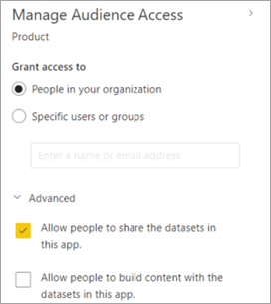
Ways to Grant Dataset Permissions
Manage dataset permissions page
Sharing link
App recipient
Rest APIs
Notes:
Outside of workspace roles, there are other ways to gain access to a dataset.
You can grant dataset permissions directly from the manage dataset permissions page.
When you share a report, you can grant build and reshare permissions to the dataset in addition to read.
When you publish a Power BI app, you can also specify whether to grant recipients build and reshare permissions. This is shown on this slide.
And you can programmatically grant access via the Power BI APIs.

Slide 19
Summary
Two important Power BI items are the dataset and report.
Tables in a dataset can have imported, Direct Query, or Direct Lake storage mode
All datasets have measures, while some have calculated columns and tables
You can use the default dataset created for your lakehouse or warehouse, or create your own custom dataset
Power BI reports connect to only one dataset
It’s important to secure your dataset, paying attention to both role membership and direct permissions

Slide 20

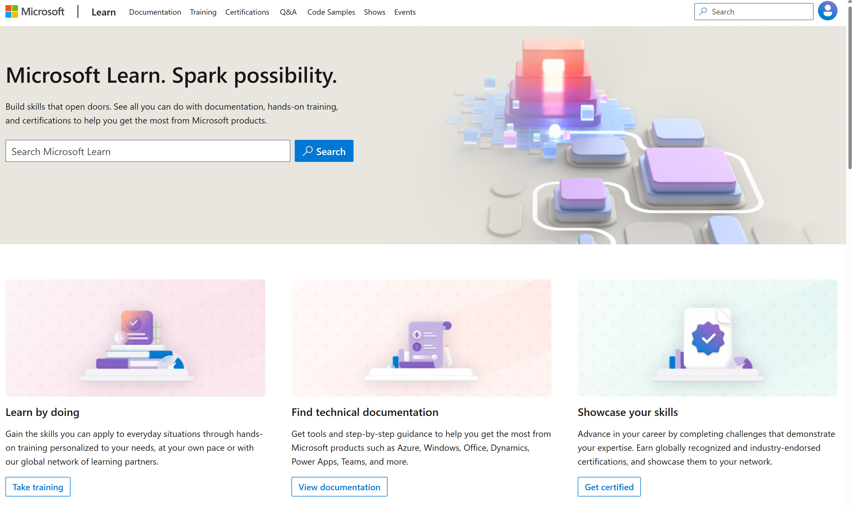
Microsoft Learn Demo
Microsoft Learn: Build skills that open doors in your career

Slide 21
Readiness and Enablement Links
The Microsoft Federal Team is here to help you accelerate customers' digital transformation. Microsoft Federal has tailored to make your organizations skilling journey successful. From the Business Decision Maker to the technical community and end-users, Microsoft provides customers with access to endless skilling resources. Below you will find links to these resources:
Get training tailored to your organization's needs: Find learning paths for specific roles in your organization, plus course recommendations based on technology, skill level, and solution area: Training | Learning Portal (microsoft.com)
Events Calendar - US Partner Community Blog – Microsoft
In addition to the above, the Microsoft Federal Team can address the needs of your non-technical community of your learners through:
Skilling Hours - Readiness and Enablement: Skilling our Federal Customers and Partners (office.com)
Microsoft Learning Portal: A closer look at Azure through training modules and gamified learning
Microsoft Learning Portal
Additional Learning Resources:
Get started with Azure – Introduction | Microsoft Azure
Microsoft Learn (path-based)
Exam-based: Select filters: Azure, D365, M365, Power Platform, and more
Microsoft Virtual Training Days – Virtual Instructor Led
Microsoft Technology Center - Work through your Account Manager
Home - Microsoft Tech Community
Microsoft Reactor | Microsoft Developer – Virtual Instructor Led

