Slide 1
Get started with Real-Time Analytics in Microsoft Fabric
Module 13

Slide 2
Real-Time Analytics in Fabric
Uses KQL database
Optimized for time-series and streaming data
Supports structured, unstructured, and semi-structured data
Notes:
Real-Time Analytics is a fully managed big data analytics platform optimized for streaming, and time-series data. It utilizes a query language and engine with exceptional performance for searching structured, semi-structured, and unstructured data. Real-Time Analytics is fully integrated with the entire suite of Fabric products, for both data loading, data transformation, and advanced visualization scenarios.
Fabric uses a KQL Database, the same technology that is behind Azure Data Explorer, to support real-time analytics. It is optimized to provide fast queries on large amounts of heterogenous, quick-moving data.

Slide 3
Real-Time Analytics Capabilities
Ingest data from any source, in any data format.
Run analytical queries directly on raw data without the need to build complex data models or create scripting to transform the data.
Import data with by-default streaming that provides high performance and low latency
Scale to an unlimited amount of data
Integrate seamlessly with other workloads and items in Microsoft Fabric
Notes:
Real-time analytics is unique from batch data warehousing. It can do the following:
Capture, transform, and route real-time events to various destinations, including custom apps.
Easily ingest or load data from any source, in any data format.
Run analytical queries directly on raw data without the need to build complex data models or create scripting to transform the data.
Import data with by-default streaming that provides high performance, low latency, high freshness data analysis.
Imported data undergoes default partitioning - both time and hash-based partitioning, and by-default indexing.
Work with versatile data structures including query structured, semi-structured, or free text.
Query raw data without transformation, with high performance, incredibly low response time, while using a wide variety of available operators.
Scale to an unlimited amount of data, from gigabytes to petabytes, with unlimited scale on concurrent queries and concurrent users.
Integrate seamlessly with other experiences and items in Microsoft Fabric.

Slide 4
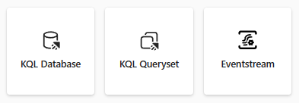
Real-Time Analytics core components
KQL Database
KQL Queryset
Eventstream
Notes:
A KQL database is a Kusto database and an upper-level entity that hosts a collection of tables, stored functions, materialized views, shortcuts, and datastreams.
Use the KQL Queryset to run queries, and view and manipulate query results on data from your Data Explorer database. The KQL Queryset allows you to save queries for future use, or export and share queries with others. In addition, the KQL Queryset uses the Kusto Query language for query creation, and also supports some SQL functions.
The Eventstream feature allows you to integrate streaming data from multiple source types, which include Event hubs, custom apps, and sample data. Once you've established your source(s), you can then send the streaming data to multiple destinations including a Lakehouse, KQL Database, or a custom app.

Slide 5
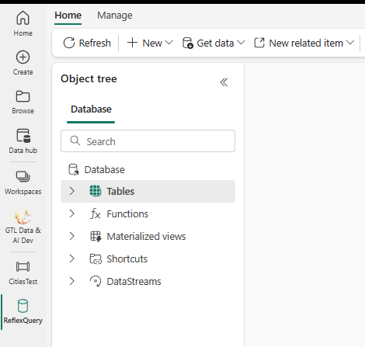
KQL Database Objects
Notes:
A table is a schema entity that contains a set of columns and rows of data. A table has a well-defined schema (an ordered list of column name and data type pairs). You can use the .create table command to create a new table, the .show table command to show the table schema, and the .ingest command to ingest data into a table.
A function is a schema entity that encapsulates a subquery expression that can be invoked from within other KQL queries. A stored function has a name, an optional list of parameters, and a body that contains the subquery expression. You can use the .create function command to create a new stored function, and the .show functions command to show the stored functions in a database.
A materialized view is a schema entity that stores precomputed results of a query for faster retrieval. A materialized view has a name, an optional list of parameters, and a body that contains the query expression. You can use the .create materialized-view command to create a new materialized view, and the .show materialized-views command to show the materialized views in a database.
A datastream is a representation of all of the attached KQL eventstreams connected to the KQL database

Slide 6
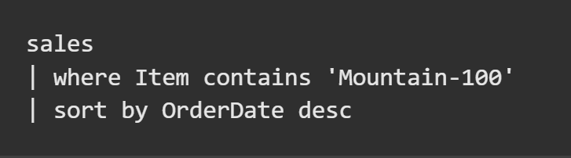
Kusto Query Language
Declarative query language for searching large-scale log data efficiently and quickly
Allows you to filter, aggregate, and present your data
Notes:
To query data from a table in a KQL database, you can use the Kusto Query Language (KQL), which is used to write queries in Azure Data Explorer, Azure Monitor Log Analytics, Azure Sentinel, and Azure Fabric. KQL is a read-only request to process data and return results. KQL queries are made of one or more query statements.
A query statement consists of a table name followed by one or more operators that take, filter, transform, aggregate, or join data. For example:
KQL queries are created using relational operators to filter and transform data using a syntax similar to SQL. However, KQL syntax includes extensions that enable advanced text and pattern matching, statistical analysis, time-series projections, geo-spatial, and machine learning algorithms.
The example query selects data from a sales table, applies a where clause, and sort the data by OrderDate descending before returning results.

Slide 7
When to use Real-Time Analytics in Fabric
High data freshness required
Required query latency is seconds
Search or access data in different formats
Data has a time component that can benefit from the time series-optimized database structure
Need to create ad-hoc queries on any field or row without prior optimization
Notes:
Not every situation calls for real-time analytics, but these capabilities can be very useful when:
Your required time from data ingestion to query is very low
You need analytics queries to run quickly on large amounts of data
You need to search data that arrives in different formats
You have time-series data
An example use case would be the following: You work at a global retail chain. You need to collect and store data from a variety of different sources, such as manufacturers, shippers, suppliers, and in a variety of formats, such as structured, semi-structured, and unstructured data. All this actionable data is captured in a KQL database, providing a scalable data solution for your growing data that can hold billions of records that can be retained for years on end for you to query and compare with the streaming data. Not only can you use a KQL queryset to perform time series analysis, but you can also create Power BI reports visualizing geospatial analytics of land and maritime routes, quickly detect anomalies, and collaborate with project managers on dashboards to make better business decisions.

Slide 8
Integration with Other Fabric Items
Load data from OneLake into KQL database
Visualize real-time data in Power BI
Analyze real-time data in Spark notebooks
Use KQL database as a source for a dataflow
Copy or lookup data in a pipeline
Notes:
While you can use Real-time analytics without integrating it with other Fabric services, it works well with other fabric items.
You can land streaming data in OneLake and load it into your KQL database.
You can visualize your real-time data in Power BI.
You can analyze real-time data in a Spark notebook.
And you can use the KQL database as a data source for pipelines and dataflows

Slide 9
Summary
Real-time analytics supports fast moving, heterogenous data
The core components are a KQL Database, a KQL Queryset, and an Eventstream
Kusto Query language allows you to filter, aggregate, and present your data
Many integration points with other Fabric services

Slide 10

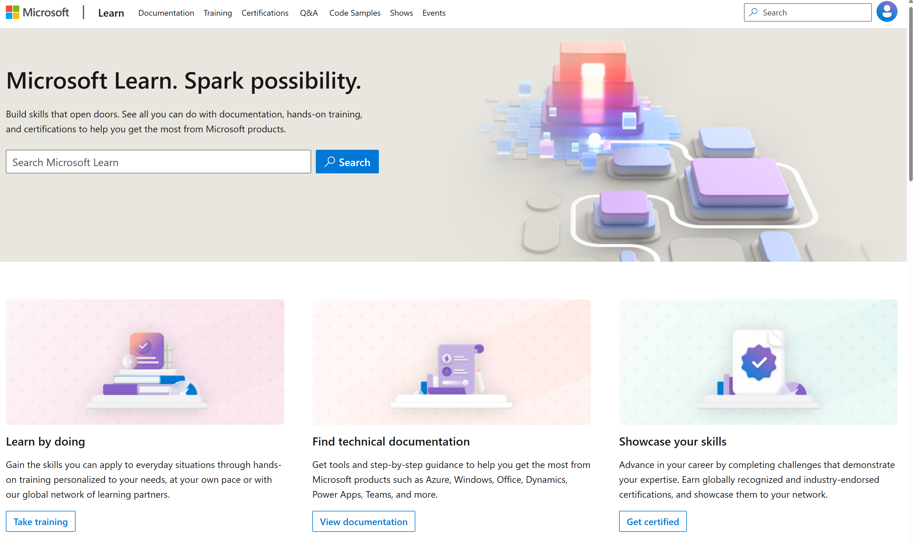
Microsoft Learn Demo
Microsoft Learn: Build skills that open doors in your career

Slide 11
Readiness and Enablement Links
The Microsoft Federal Team is here to help you accelerate customers' digital transformation. Microsoft Federal has tailored to make your organizations skilling journey successful. From the Business Decision Maker to the technical community and end-users, Microsoft provides customers with access to endless skilling resources. Below you will find links to these resources:
Get training tailored to your organization's needs: Find learning paths for specific roles in your organization, plus course recommendations based on technology, skill level, and solution area: Training | Learning Portal (microsoft.com)
Events Calendar - US Partner Community Blog – Microsoft
In addition to the above, the Microsoft Federal Team can address the needs of your non-technical community of your learners through:
Skilling Hours - Readiness and Enablement: Skilling our Federal Customers and Partners (office.com)
Microsoft Learning Portal: A closer look at Azure through training modules and gamified learning
Microsoft Learning Portal
Additional Learning Resources:
Get started with Azure – Introduction | Microsoft Azure
Microsoft Learn (path-based)
Exam-based: Select filters: Azure, D365, M365, Power Platform, and more
Microsoft Virtual Training Days – Virtual Instructor Led
Microsoft Technology Center - Work through your Account Manager
Home - Microsoft Tech Community
Microsoft Reactor | Microsoft Developer – Virtual Instructor Led

